Slide 1
CEOS WGISS #46 Data Interoperability and Use WGCV-1: Data formats and interoperability
Kristi Kline
Oct 25, 2018

Slide 2
WGCV-1 Task
Task Objective | Deliverables | Projected Completion Date | Background Information | Working Group (IG)
WGCV-1: Data Formats and Interoperability in the frame of FDA | Perform analysis of quality/uncertainty parameters for Analysis Ready data (ARD). | Q2 2018 | Work to define a set of quality/uncertainty parameters to be included within ARD and determine an initial method to incorporate these along with their provenance into the data stream, including education of the data community on how to provide provenance information. Coordinate with relevant working groups and stakeholders within CEOS. | WGCV with the support of WGISS

Slide 3
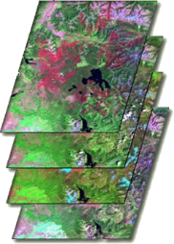
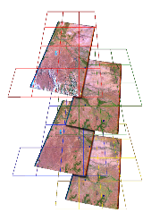
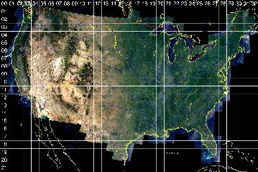
What is Analysis Ready Data (ARD)?
Data processed to a level that enables direct use in applications
Allows geospatial, multi-spectral, and multi-temporal manipulations for the purposes of data reduction, analysis, and interpretation
Consistent radiometric processing scaled to surface reflectance and surface temperature
Consistent geometry including spatial coverage and cartographic projection – e.g., pixels align through time
Metadata of sufficient detail on data provenance, geographic extent, scaling coefficients, and data type
Initial ARD production is focused on the TM through OLI record (1982 – present) for the U.S., but to eventually back through MSS (1972) and global scale

Slide 4
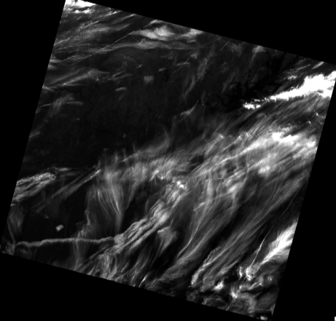
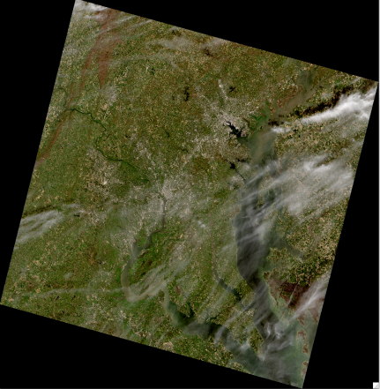
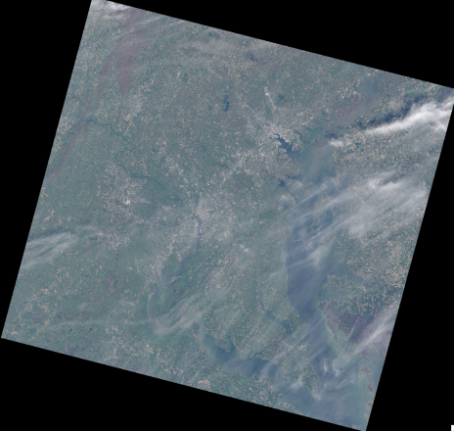
Example of Landsat scene-based products
Top of Atmosphere
Reflectance (“Level 1”)
Surface Reflectance (“Level 2”)
185km
Cloud metadata
Landsat 8, path 15, row 33 (WRS2)

Slide 5
Natural orbital drift of scene-based products
185km
swath

Slide 6
Analysis Ready Data
Facilitates time-series analysis

Slide 7
ARD Quality Assurance (QA) data to automate filtering

Slide 8
Time-series analysis
→ “Continuous” change detection & classification (CCDC)
T2
T1
Mixed Forest
Low Density Residential
Pixel Intensity
Measure delta to determine change
Fit trend models to understand change continuously.
1984
1988
1992
1996
2000
2004
2008
2012
Time
Graph adapted from C. Holden, Boston University
Zhu, Z. and C.E. Woodcock. 2014. Continuous change detection and classification of land cover using all available Landsat data. Remote Sensing of Environment 144:152–171.

Slide 9
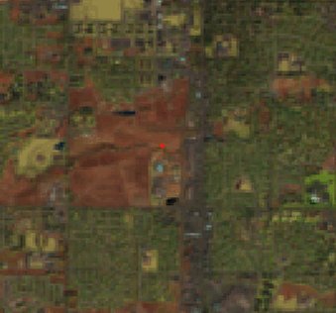
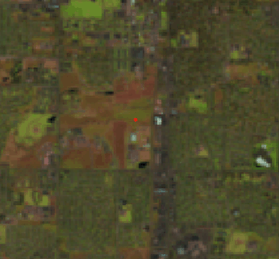
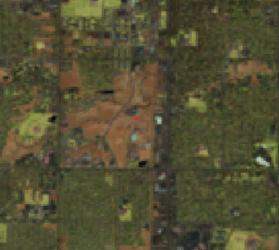
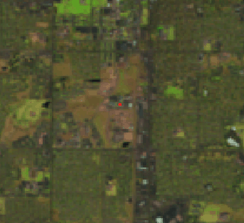
CCDC revealing different kinds of change over time
Cropland
Hay/Pasture
In conversion
Developed
A pixel history of a location in
Fort Collins, Colorado
Mid-IR band
Ft. Collins USGS
Reflectance (scale factor 0.0001)
Class 1
Class 2
Class 3
Class 4
1984 1986 1988 1990 1992 1994 1996 1998 2000 2002 2004 2006 2008 2010 2012
Date
Zhu, Z. and C.E. Woodcock. 2014. Continuous change detection and classification of land cover using all available Landsat data. Remote Sensing of Environment 144:152–171.
Notes:
This is happening in all bands simultaneously
CCDC first works through the entire history of the pixel to define annual cyclical trajectories and flag changes.
The coefficients that describe the mathematical trajectories in between change flags are fed to the Random Forest classifier to determine cover-class labels.

Slide 10
Data Science and the 80/20 rule
Data
Prep
Users spend 80% of their time finding, cleaning, and reorganizing huge amounts of data, and only 20% of their time on actual data analysis that informs decision making.
Analysis
“80% activities” include*:
Analysis Ready Data
Tracking data provenance, from data generation through data preparation
Validating data
Coping with sampling biases and heterogeneity
Working with different data formats and structures
Developing algorithms that exploit parallel and distributed architectures
Ensuring data integrity
Ensuring data security
Enabling data discovery and integration
Enabling data sharing
*Source: Frontiers in Massive Data Analysis, 2013, National Academies of Sciences.

Slide 11
Types of Metadata
Descriptive metadata | For finding or understanding a resource
Administrative Data Technical metadata Preservation metadata Rights metadata | For decoding and rendering files Long-term management of files Intellectual property rights attached to content
Structural metadata | Relationships of parts of resources to one another
Markup languages | Integrates metadata and flags for other structural or semantic features within content
From Understanding Metadata: What is Metadata, and What is it For? By Jenn Riley. Accessed 10/2/2018: https://groups.niso.org/apps/group_public/download.php/17446/Understanding%20Metadata.pdf

Slide 12
Tiers of Metadata
Metadata can be created at a variety of levels. Landsat metadata can be grouped into three main tiers:
Collection-level metadata (preservation)
Granule-level metadata (technical/descriptive)
Pixel-level metadata (technical/descriptive)
Landsat Collection 2 Changes
Minor changes for Level-1 product metadata
Normalize Level-2 product metadata to be similar to Level-1 product metadata
Provenance
Collections define processing system and overall dataset parameters
Metadata will identify input data where necessary
SHA-512
?? How much info in each product metadata file versus collection ??

Slide 13
SpatioTemporal Asset Catalog (STAC)
From the website:
“The SpatioTemporal Asset Catalog (STAC) specification aims to standardize the way geospatial assets are exposed online and queried. A 'spatiotemporal asset' is any file that represents information about the earth captured in a certain space and time. The initial focus is primarily remotely-sensed imagery (from satellites, but also planes, drones, balloons, etc), but the core is designed to be extensible to SAR, full motion video, point clouds, hyperspectral, LiDAR and derived data like NDVI, Digital Elevation Models, mosaics, etc.”
Source: https://github.com/radiantearth/stac-spec/blob/master/README.md

Slide 14
SpatioTemporal Asset Catalog (STAC)
Collaborative effort with the private sector to make metadata more uniform and accessible across multiple platforms
Transforms metadata into a JSON format, which is cloud friendly
Fields are grouped to help identify universal fields against sensor specific
Collection-level fields start with c:
Universal Earth Observation fields start with eo:
Landsat-specific fields start with landsat:
Other standard fields, such as s3path and datetime, are not prefaced with anything
Other adopters include:
Spacenet
CBERS
ISERV
Planet Disaster Data
DigitalGlobe
NASA EOSDIS Common Metadata Repository API (Element84)

Slide 15
SpatioTemporal Asset Catalog (STAC)
Sample metadata:
{
"c:description": "Landsat-8 Analysis Ready Data (ARD)",
"c:id": "landsat-8-l2",
"c:name": "Landsat-8 ARD",
"datetime": "2014-07-24T18:45:57.219Z",
"eo:cloud_cover": 0,
"eo:gsd": 15,
"eo:instrument": "OLI_TIRS",
"eo:off_nadir": 0,
"eo:platform": "landsat-8",
"eo:sun_azimuth": 126.32495884,
"eo:sun_elevation": 63.77280901,
"id": "LC08_L2SP_044034_20140724_20171210_01_A1",
"landsat:path": 44,
"landsat:row": 34,
"provider": "USGS",
"s3path": "L08/2014/044/034/LC08_L2SP_044034_20140724_20171210_01_A1",
}

Slide 16
Cloud Optimized Geotiff

Slide 17
QUESTIONS?

