Slide 1
WGCV-03 CEOS Data Cube and…for Cal/Val
Committee on Earth Observation Satellites
WGISS 46 2018
Dr Robert Woodcock

Slide 2
WGCV-3
WGCV-3: CEOS Data Cubes and CEOS Test Sites Data Access in support to WGCV Activities
Robert Woodcock, Medhavy Thankappan (and GA +CSIRO DEA Cal/Val team)
Greg Stensaas, Michael Morahan
Objective is to provide an improved user access to the LPV supersite data sets coupled with analytics tools to provide improved results for the users.
Open Data Cube on Demand + Jupyter Notebook for Cal/Val = Ready-to-run

Slide 3
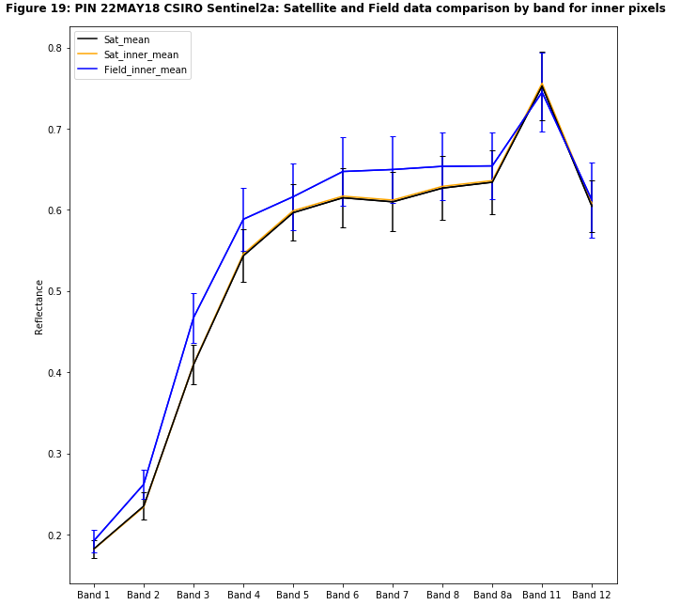
Cal/Val Workflow
Satellite Data
BRDF
Spectrum comparison
BRDF
Convolve to satellite sensor
Averaging
Field Data

Slide 4
Cal/Val Notebook DEA (GA)

Slide 5
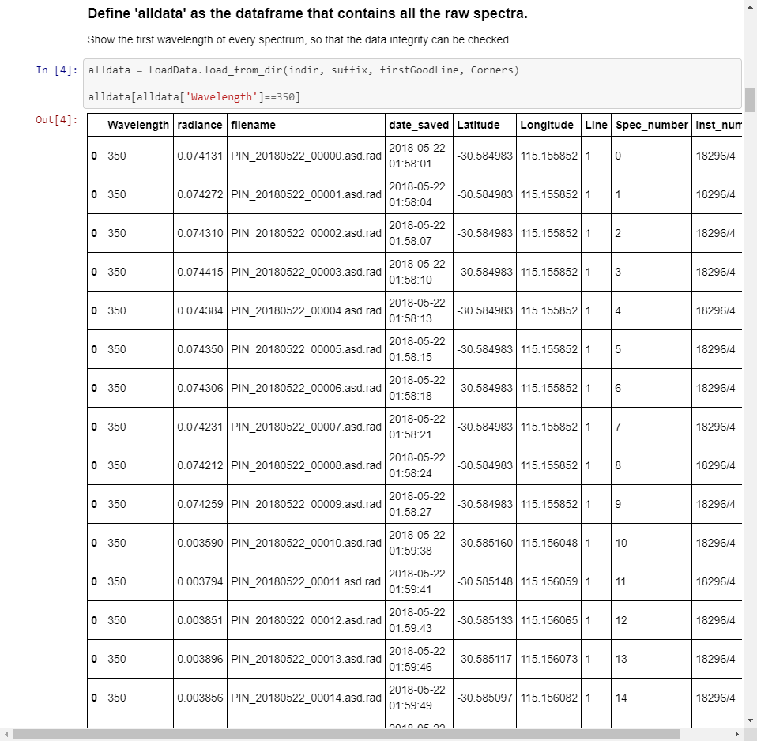
Cal/Val Notebook DEA (GA)

Slide 6
Cal/Val Notebook DEA (GA)

Slide 7
Cal/Val Notebook DEA (GA)

Slide 8
Cal/Val Notebook DEA (GA)

Slide 9
Cal/Val Notebook DEA (GA)

Slide 16
DC on Demand
A demo…maybe
Courtesy of ODC contributors: CSIRO, GA, FrontierSI, USGS, …

Slide 17
Next steps
Join the dots
Appear to have all the puzzle pieces but
ARD-on-Demand and field data equivalent – service composition is a problem
Field data-on-Demand - ??? If you already know how please give me your contact details.
Need to elevate notebook to CEOS level – CEOS/WGISS Information Systems.

