Slide 1

FDA-08 FDA Whitepaper
Update
Committee on Earth Observation Satellites
WGISS 46 2018
Dr Robert Woodcock

Slide 2
FDA-08
Establish a common description of Future Data Architecture functional blocks and identify interfaces and interoperability approaches.
The WHAT of FDA, not just the WHY
  Less on How…though How is being worked on independently everywhere
"The challenge is in providing the right settings so the potential can translate to reality both for individual CEOS members through to global initiatives.“
  FDA Interim Report

Slide 3
FDA Why to FDA What
FDA-08 Confluence site active since August 2018
  6 registered contributors
  2 active
    To register/contribute contact Robert.Woodcock@csiro.au
First step:
  A brave soul volunteered an initial draft
    It provided A view into the FDA ecosystem
  Whilst simple the single view was could not communicate all necessary information
Conclusion: Use multiple views per the Reference Model for Open Distributed Processing (RM-ODP)

Slide 4
Viewpoints
The RM-ODP framework factors an architecture description into the following five complementary viewpoints:
  Enterprise Viewpoint: (Why)
    defining the purpose, scope and policies of the system
  Information Viewpoint: (What)
    describing the semantics of information and information processing within the system
  Computational Viewpoint: (What)
    a decomposition of the system into computational interfaces
  Engineering Viewpoint: (What)
    describing the system infrastructure and mechanisms supporting distribution
  Technology Viewpoint: (How)
    a focus on technology choices to realise the system

Slide 5
Table of Contents
Introduction
Enterprise Viewpoint
  Purpose
  Scope
  Policies
  Roles and Functions
Information Viewpoint
  Information Standards
  Geospatial Information Standards
  Dataset Metadata
  Discovery Metadata
  EO Analytics Metadata
  Geography Markup Language
  Earth Observation Information Standards

Slide 6
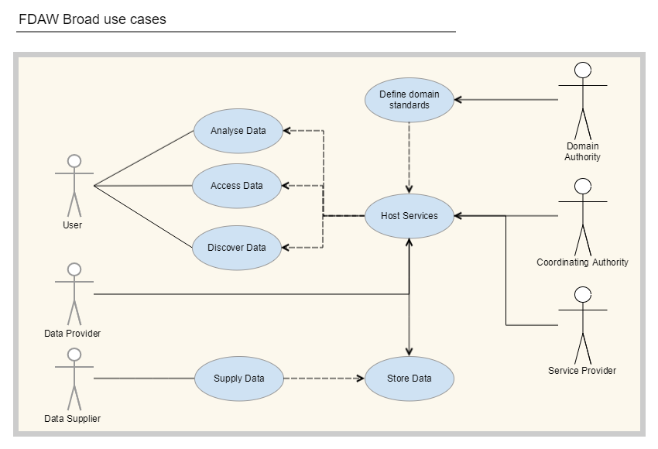
Enterprise Viewpoint: Actors
Notes:
CEOS
Provide the right setting for the authorities
Provide the right setting to empower the other Actors to contribute/consume at scale
This is what the FDAW should communicate
Data Provider
Provides EO or other information services to CEOS community and users. The Data Provider remains the custodian of the data.
USGS, ESA
Data Supplier
Supplies EO data or other information resources to Data Provider
Data Distributor
Provides an alternate, non-custodial, storage location and distribution service.
AWS Public Datasets, Google Earth Engine
Service Provider
Publishes a service. There are a wide range of service types including discovery, data access, calibration, validation, analysis, archiving, provenance.
Domain authority
Provides community endorsed information models or vocabularies for adoption within the CEOS community
WGISS, LSI-VC, WGCV
Coordinating authority
Provides essential coordination and integration services for the broader community
WGISS
User
Discovers and accesses information and analytics through the FDAW services
May include machine users, such as decision support and monitoring systems

Slide 7
Table of Contents
Computational Viewpoint
  Analytical Services
    EO Analytics Services
      Service Categories
      Service Interface Standards
    EO Analysis Ready Data Processing Service
  Data Access Services
    Web Coverage Services
    File Download Service
    Web Features Service
  Data Portrayal Services
    Types of Visualization
    Service Interface Standards
      Map-related Standards
Computational Viewpoint
  Data Generation Services
    Data Acquisition
  Discovery Services
    Catalogue Service for the Web
    WGISS Connected Data Assets
    Support Services
    Provenance Service
    Vocabulary Services
      Earth Observation parameters and observables Registry
    Monitoring Sites and networks Registry
    Authentication, Authorisation and Accounting Services
  Service Orchestration
    Synchronous vs. Asynchronous Services
Notes:
Could we do with a features registry – to help with AI classification? Could be crowd-sourced, not warrantied, its just works alongside what WGISS does?

Slide 8
Table of Contents
Engineering Viewpoint
Technology Viewpoint
Appendix A - FDA Interim Report Architectural Principles
  Discovery and Access
  Usage
  Integration
  Infrastructure

Slide 9
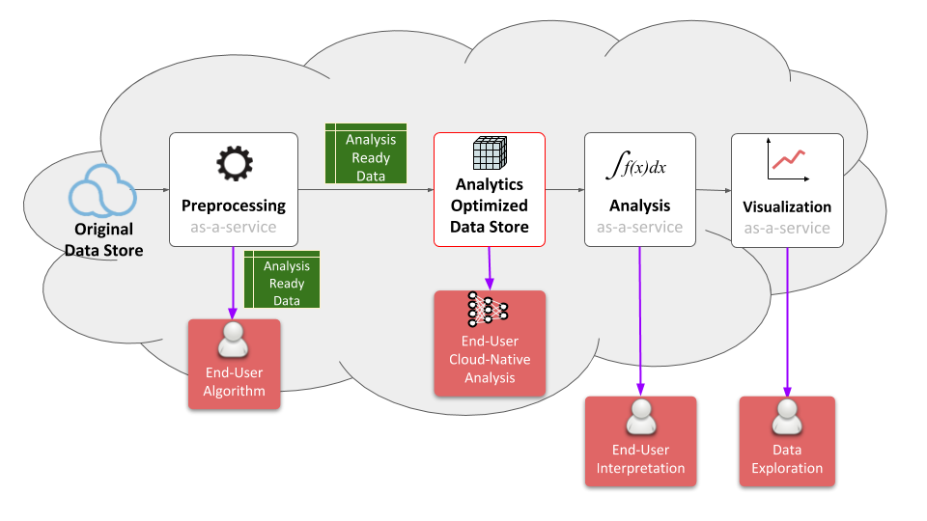
FDA enabled…
Cached

Slide 10
Finishing FDA-08
“War and Peace” or a Fact sheet
  Can FDA-08 focus only on what is changing and current gaps?
Contributors – its low
  Not necessarily a problem now, but fails if it stays small
  Elevating outputs from Agency activities to the CEOS community level, WGISS Information systems – how? timeliness?

