Slide 1
WGISS/GEOSS
2018
Dr. Tendani Lavhengwa
Data Systems Manager
South African National Space Agency
Imraan Saloojee
South African National Space Agency
Karabo Mithi
Data Systems Administrator
South African National Space Agency
Willard Mapurisa
Research & Applications Development
South African National Space Agency

Slide 2
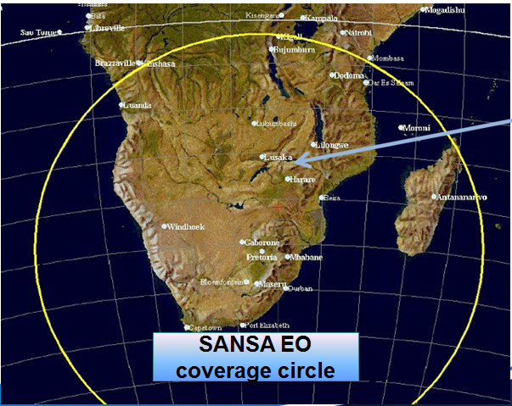
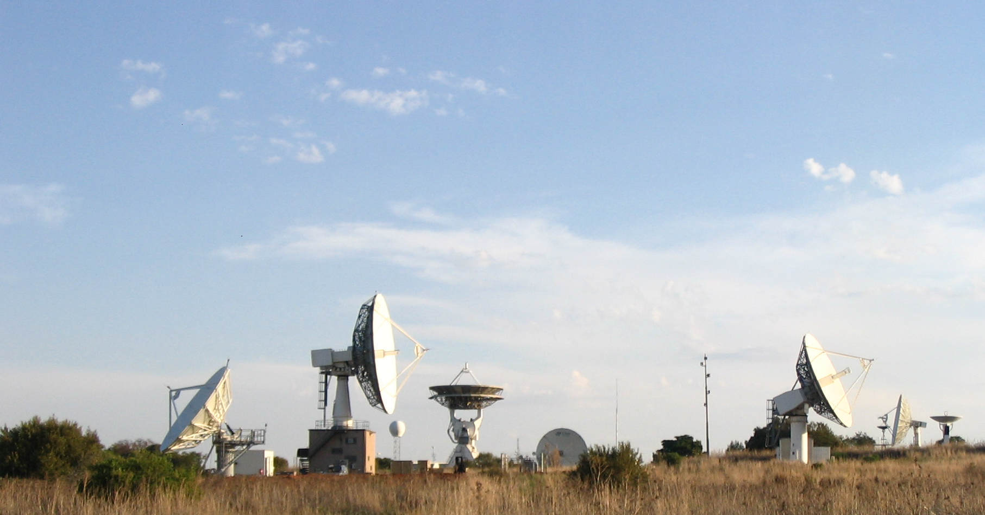
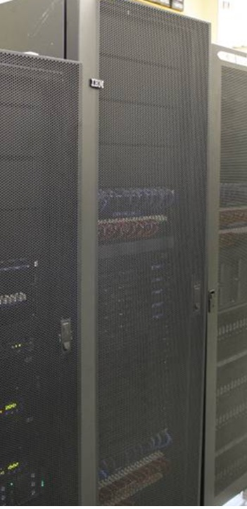

Physical infrastructure, location & processing
Ground receiving station HBK, Tshwane, Gauteng

Slide 3
Systems Overview
Processing servers installed and operational
Internal
TS5
DRS
ACS
Tapes
Lustre environment
External
FTP – DMZ
Website - Catalogue
Interaction with service providers
Current operations
Data extractions
Migration
Other ad-hoc activities
Maintenance
Data delivery
PCI Processing Server
ENVI Processing Server
Filesystem Server
Commvault Archive Agent
Commvault Application Hosting Server
Commvault Media Agent Hosting Server
Lustre MetaData Server
Lustre Management Server
Lustre Object Storage Server
MISR Processing Server
NPP Receiving Server
ProPack Processing Server
CHPC Remote Processing Server

Slide 4
Our Observations
**Current reception
Landsat 7
Landsat 8
Spot 6 & 7
Modis (TERRA & AQUA)
NPP
CBERS-04 -P5
CBERS-04 -P10
CBERS-04 -MUX
CBERS-04 -WFI
**Large historic archive
Landsat5
Spot1
Spot2
Spot4
Spot5
CBERS-02B
SumbandilaSAT
MISR
**Planned:
A mirror site for: Sentinel

Slide 5
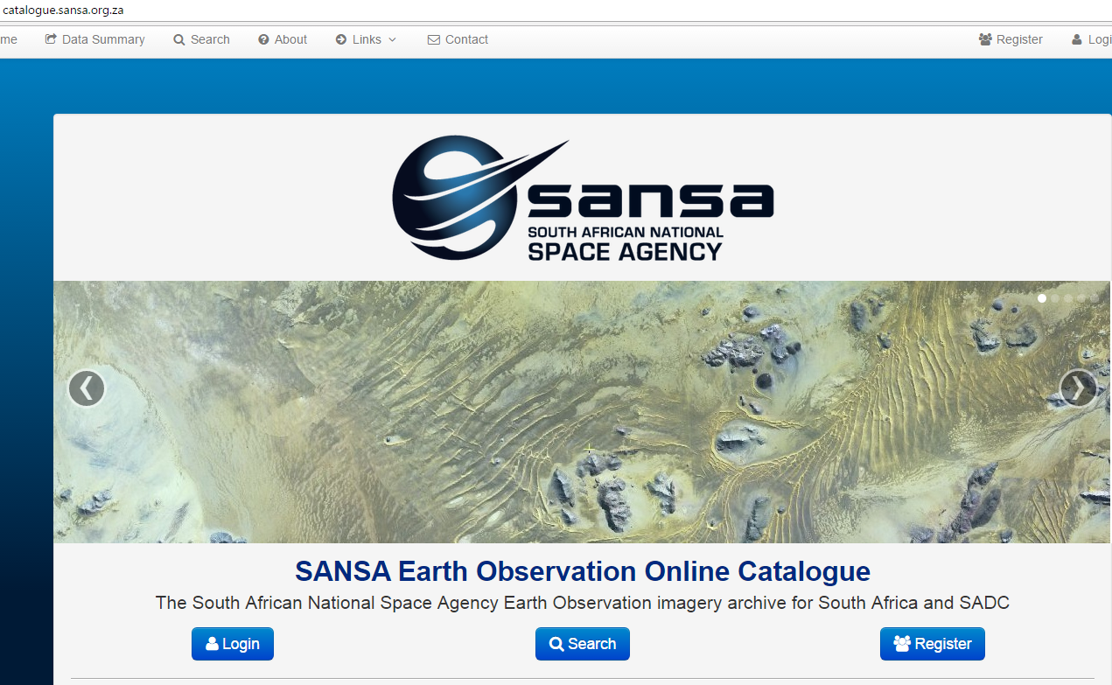
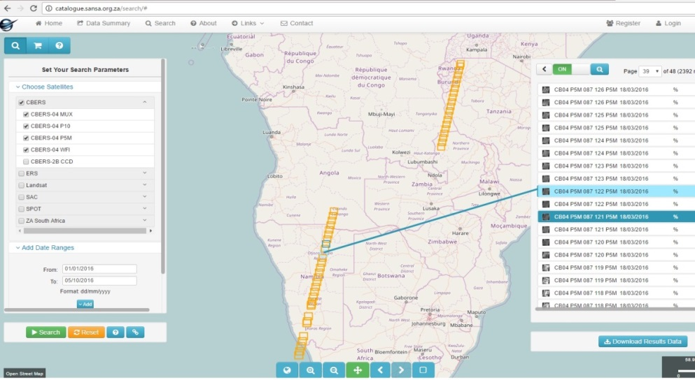
Searching & Ordering through the Online Catalogue
-raw data
-processed data (multiple levels)
-national products
-other products and services custom developed
value added products
Types of deliveries

Slide 6
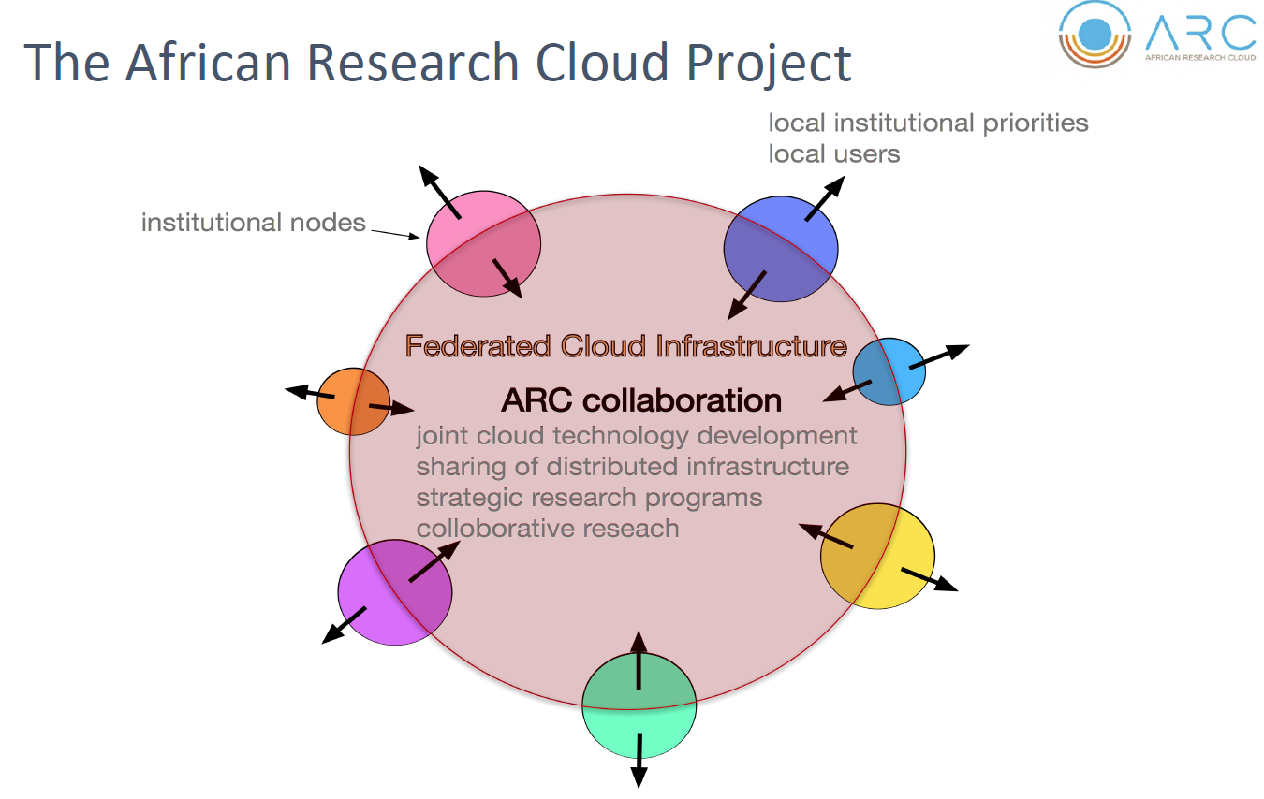
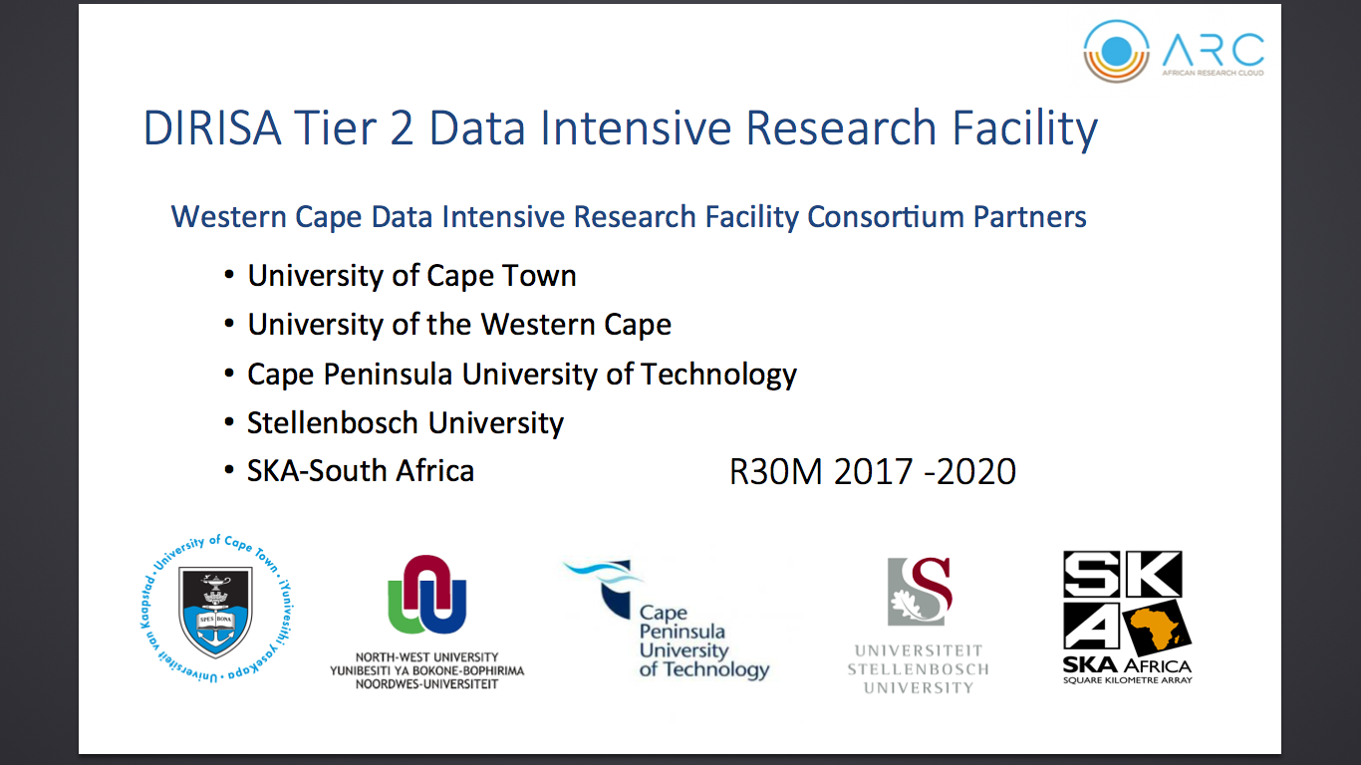

Slide 7
SANSA storage growth for Earth Observation Data
Blue: Projected Operational yearly growth at 200TB
This in not to cater for new sensors and can be revised based on user needs.
Red: Caters for changes in supported datasets
Cloud opportunities will enable the scaling to be easier

Slide 8
African Research Cloud (ARC)- SANSA contribution
EODC
SAEOSS Portal
Earth Observation Data Centre (EODC)
EO-ARC-node
ARC - Cloud
Earth Observation Data Centre (EODC)
SAEOSS Portal
ARC - Cloud

Slide 9
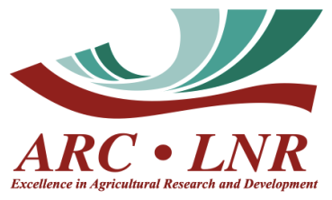

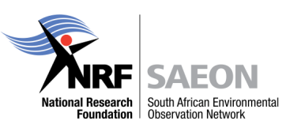



South African Earth Observations in the ADIRC / ARC
Data Source | Host | Participants
Landsat Data Cube | DIRISA / SANSA | ARC
 |  | SANSA
 |  | CSIR
 |  | SAEON
Agriculture Data Cube | SAEON / ARC | ARC and partners
Terra/ Aqua Modis Data Cube | Meraka | Meraka
 |  | ARC
 |  | SAEON
Global Change Data Cube (including biophysical parameters, carbon stocks and flows, climate, soil, and other EO image/ vector derived layers, time series observations) |  | SARVA
 | SAEON | ETFEON
 |  | SMON
 |  | BEA
 |  | SASDI
 |  | SANBI
Climate Change Projections: NetCDF/ HDF-5 |  | SAWS
 | ARC | ARC
 | SAWS | CSIR
 |  | CSAG
 |  | SAEON
Adopted as a Pilot thematic area in ADIRC, October 2016
  Prototype of geospatial platform in ARC to focus on Food Security and Agriculture (support AfriGAM)
  Data Cube approach
EO in ARC Workshop on 19 May 2017
  Overview of South African EO Institutions: capabilities and contributions
  Partnership and governance model
  Technical development roadmap
  Definition of strategic demonstration projects e.g. food security

Slide 10
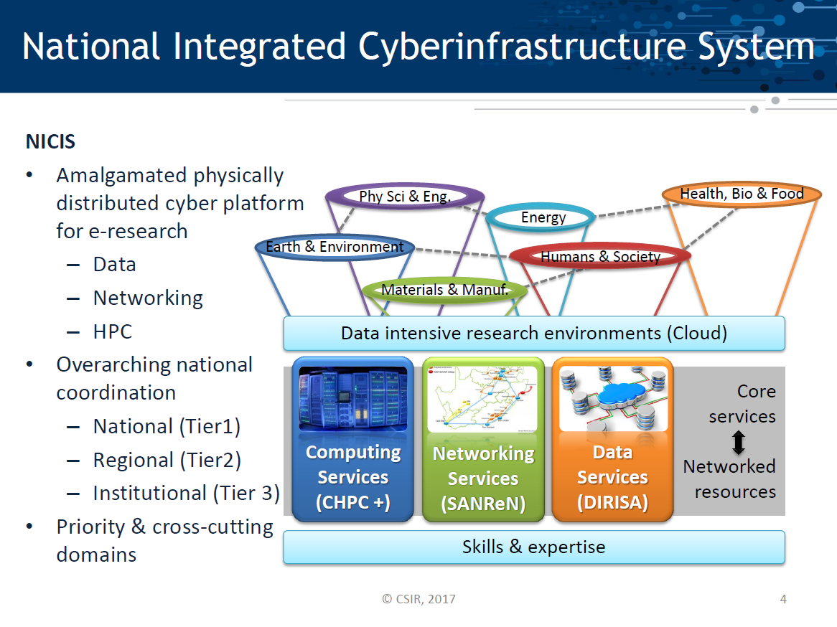

Slide 11
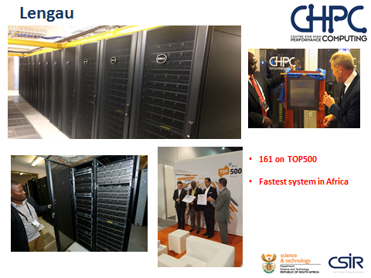
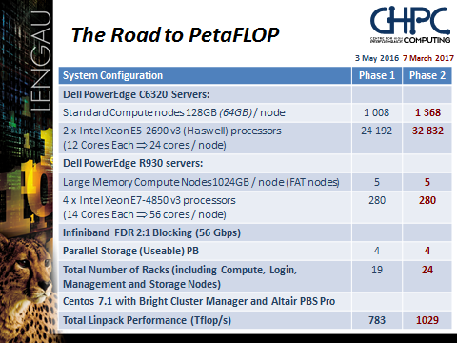

Slide 12
Emerging E&EO Research Data Infrastructure
ORCID, DataCite, …
Services
External Systems
Services/ Components/APIs
Data Providers
Linked Open Data
Global Registries
Open Data Platform
Shared Metadata
Data Hosting
Services
Components
Portals
Gateways
Guidance
Physical Infrastructure
Brokers and Harvesters
SARVA
GEOSS DAB,
ICSU WDS,
…
Earth and
Environmental Sciences
BioEnergy Atlas
Global Infrastructures
SAEOSS
Community or Thematic Portals
ICSU Portals
SAEON Portals
Gateways
ILTER/
GEO BON/
Carbon Atlas
NRF/ DIRISA
Other
Disciplines
Products
SASDI
SAEIS
SARIR
SPECIES
SANEIM
SASSCAL

Slide 13

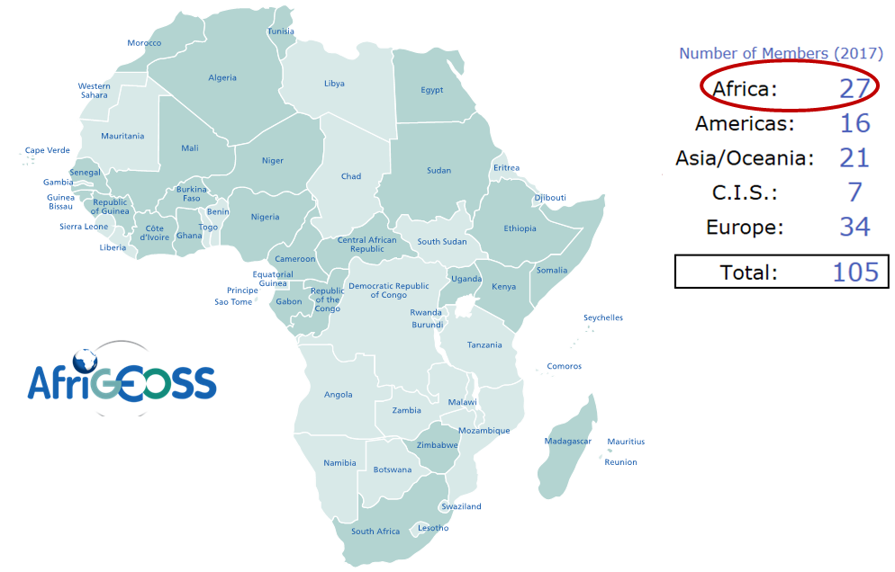

The role of Regional and National GEOSS:- AfriGEOSS/ …
Member countries

Slide 14
The role of Regional and National GEOSS:- AfriGEOSS/ …
2nd AfriGEOSS Symposium: 13th June 2017, Sunyani, Ghana
Key outcomes related to data…
Infrastructure for Accessing and Processing EO Data
Capacity Development

Slide 15

The role of Regional and National GEOSS:- AfriGEOSS/ …
African Research Cloud Project
Adopted as a Pilot thematic area in ADIRC, October 2016
Prototype of geospatial platform in ARC to focus on Food Security and Agriculture (support AfriGAM)
Data Cube approach
EO in ARC Workshop on 19 May 2017
South African EO Institutions: capabilities into Africa
Partnership and governance model
Technical development roadmap
Definition of strategic demonstration projects e.g. food security

Slide 16
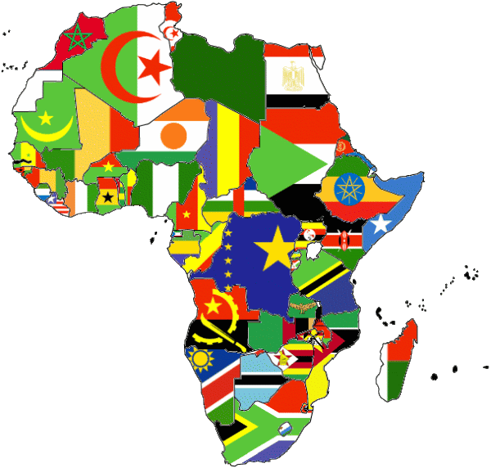
The role of Regional and National GEOSS:- AfriGEOSS/ …
African Research Cloud Project – evolution into Africa
HPC-?
Astro HPC
EO HPC Node(s)
HPC-?
HPC-?
HPC-?
Bio Info HPC
GMES & Africa
SERVIR
WASCAL
SASCAL
UNGGIM – Africa
AfriGEOSS
African Space Programme

Slide 17
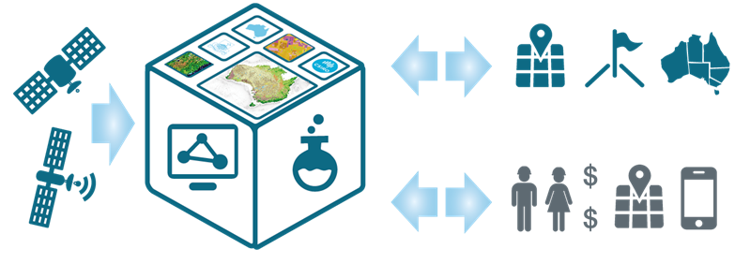
The role of Regional and National GEOSS:- AfriGEOSS/ …
Data Cube for Earth Observation
Also receiving attentions
with activities under investigation at different institutions

Slide 18
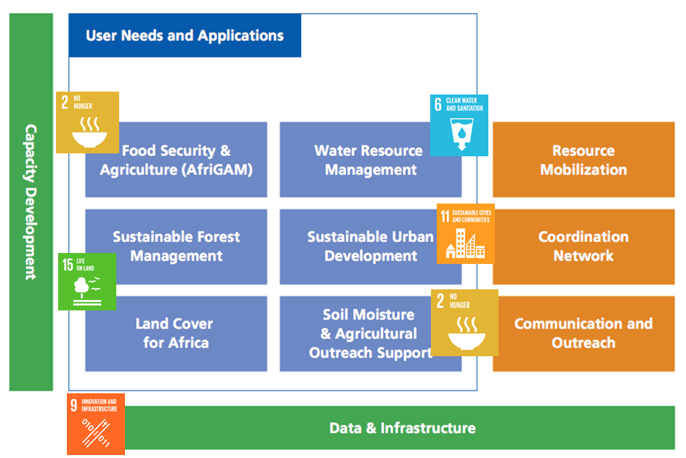
The role of Regional and National GEOSS:- AfriGEOSS/ …
Action Areas on SDG's

Slide 19

Thank you!

