Slide 1
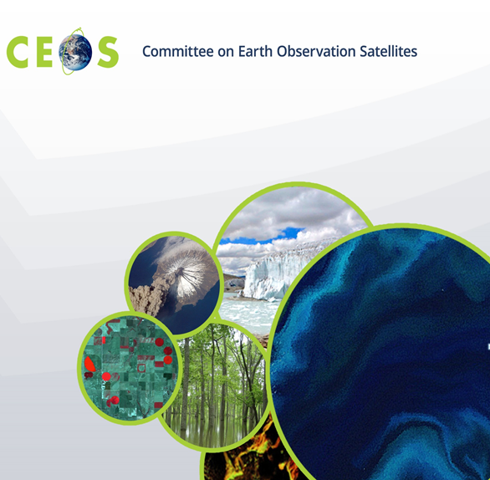

Joost Van Bemmelen
Stefano Nativi
Mattia Santoro
Guido Colangeli
The GEOSS Platform

Slide 2
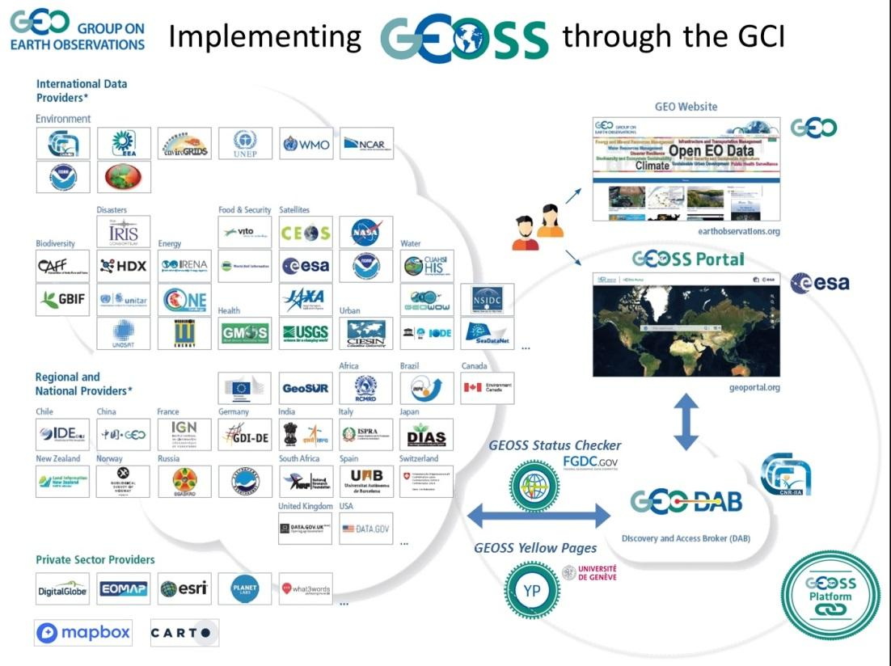
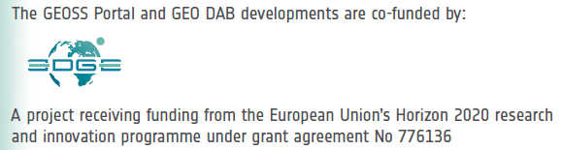
The Global Earth Observation System of Systems

Slide 3

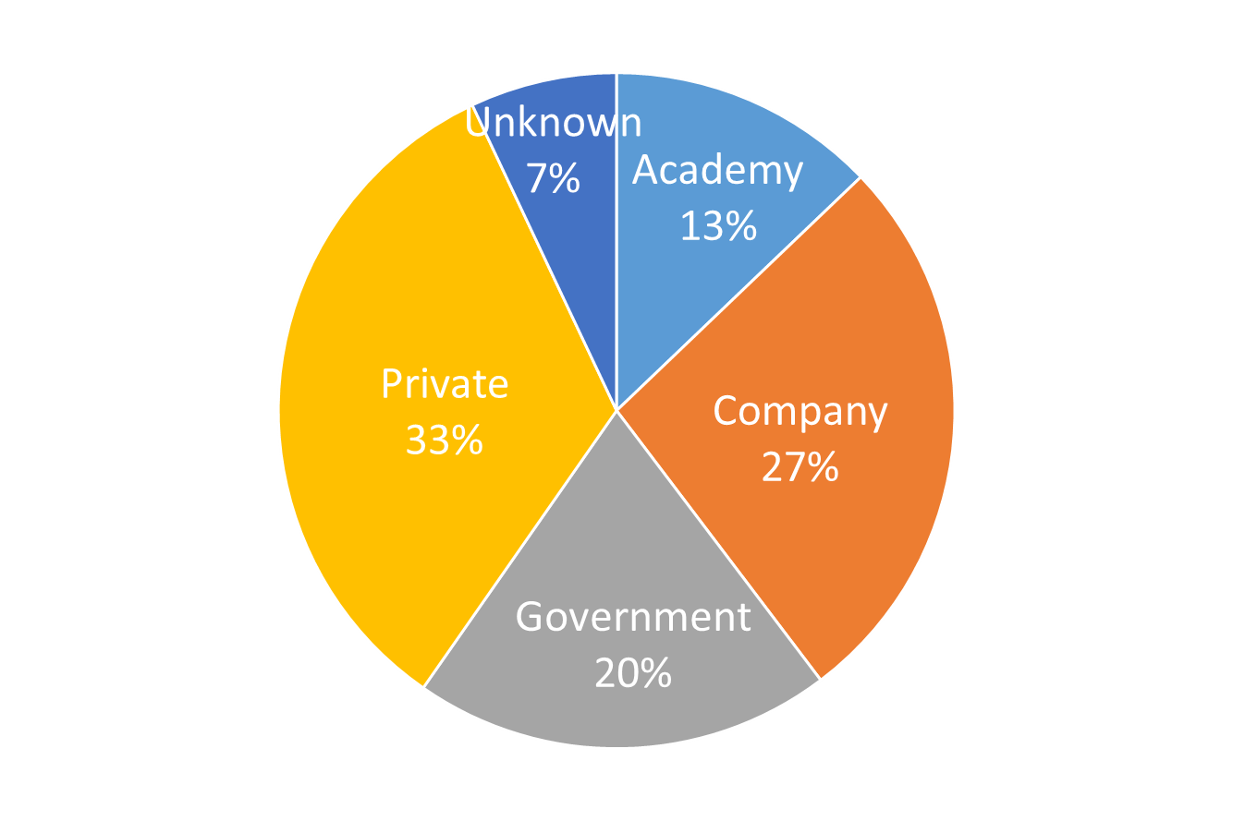
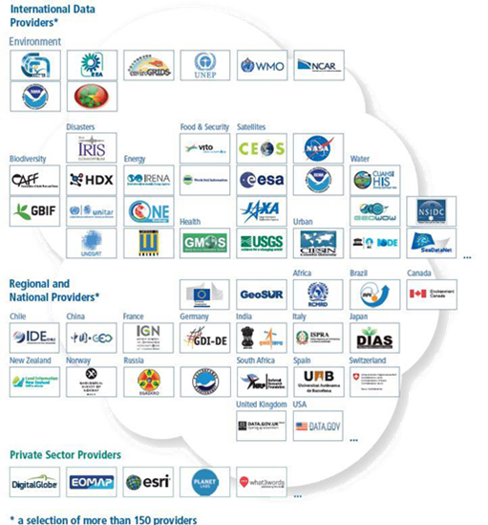

Current resources in GEOSS
Users
GEOSS presently links more than 183 open data catalogs and information systems, comprising over 414 million data and information resources.
GEOSS, in the last two years, served about 15 thousand unique users finalizing about 150 thousand searches
~ 15 thousand unique IP
~ 150 thousand searches
> 183 Data
Providers
> 45 million
Datasets
> 400 million Granules
GEOSS Platform including APIs
35 Languages

Slide 4



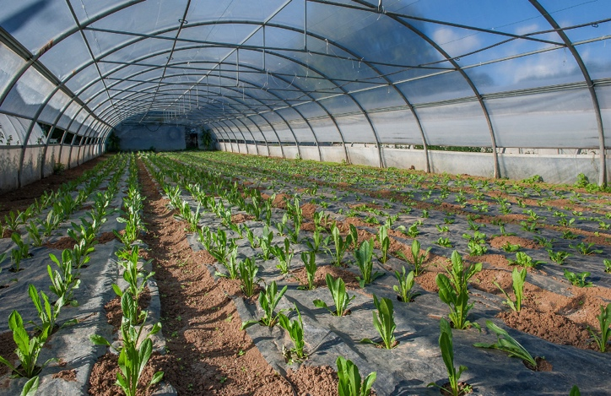
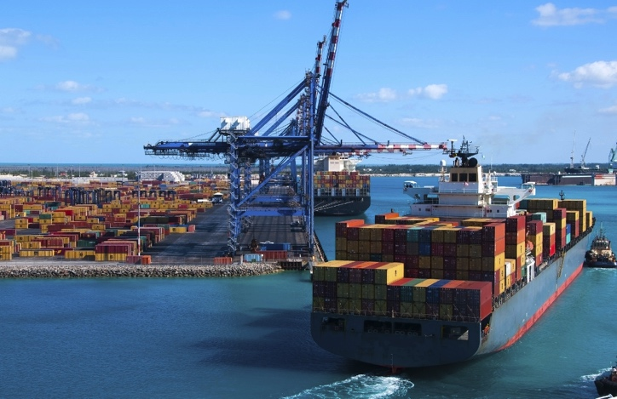


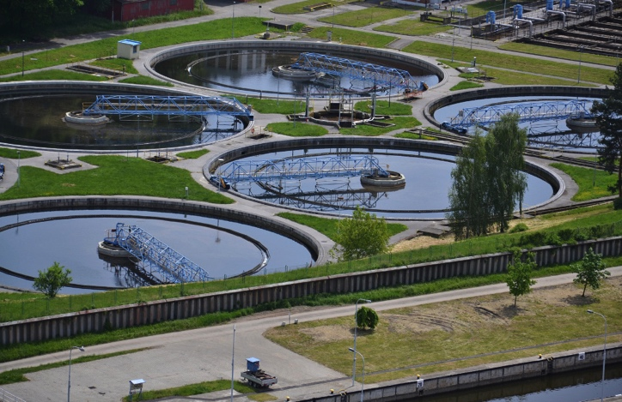

Weather
Societal Benefit
Areas
Notes:
High-level overview

Slide 5


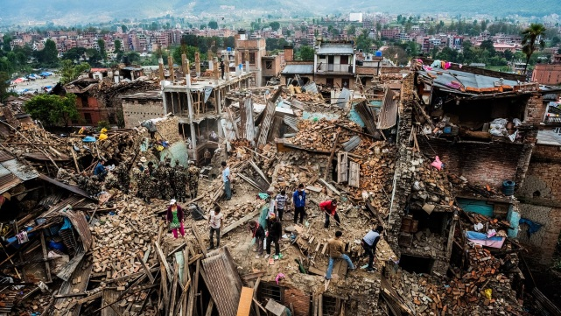
GEOSS Platform supporting Global Policies
Sustainable Development
Climate Action
Disaster Risk Reduction
UN SDGs
Paris Agreement
Sendai Framework
Supporting Resilient Infrastructure
Measuring Status
& Progress
Monitoring & Understanding
Notes:
High-level overview

Slide 6








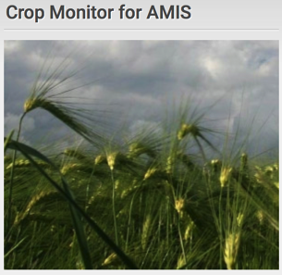

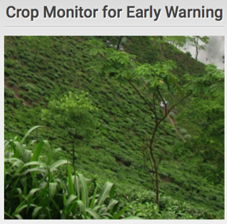
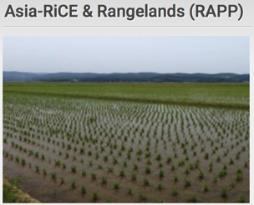

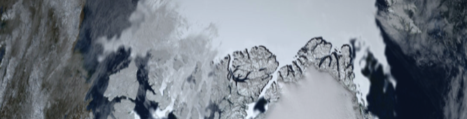

Initiatives
Biodiversity
Observation
Network
The Global Observation System for Mercury
Geohazard Supersites
and Natural
Laboratory Initiative
Notes:
How does GEO Respond to the requirements, e.g. via implementation of Initiatives/Flagships/…

Slide 7
GEOSS as a Knowledge Hub to enable the Analytics revolution in EO
Supporting elicitation of Knowledge via enriched metadata based on user involvement
Connecting with Scientific Knowledge Bodies to serve Policy-Specific needs
Access to Knowledge

Slide 8
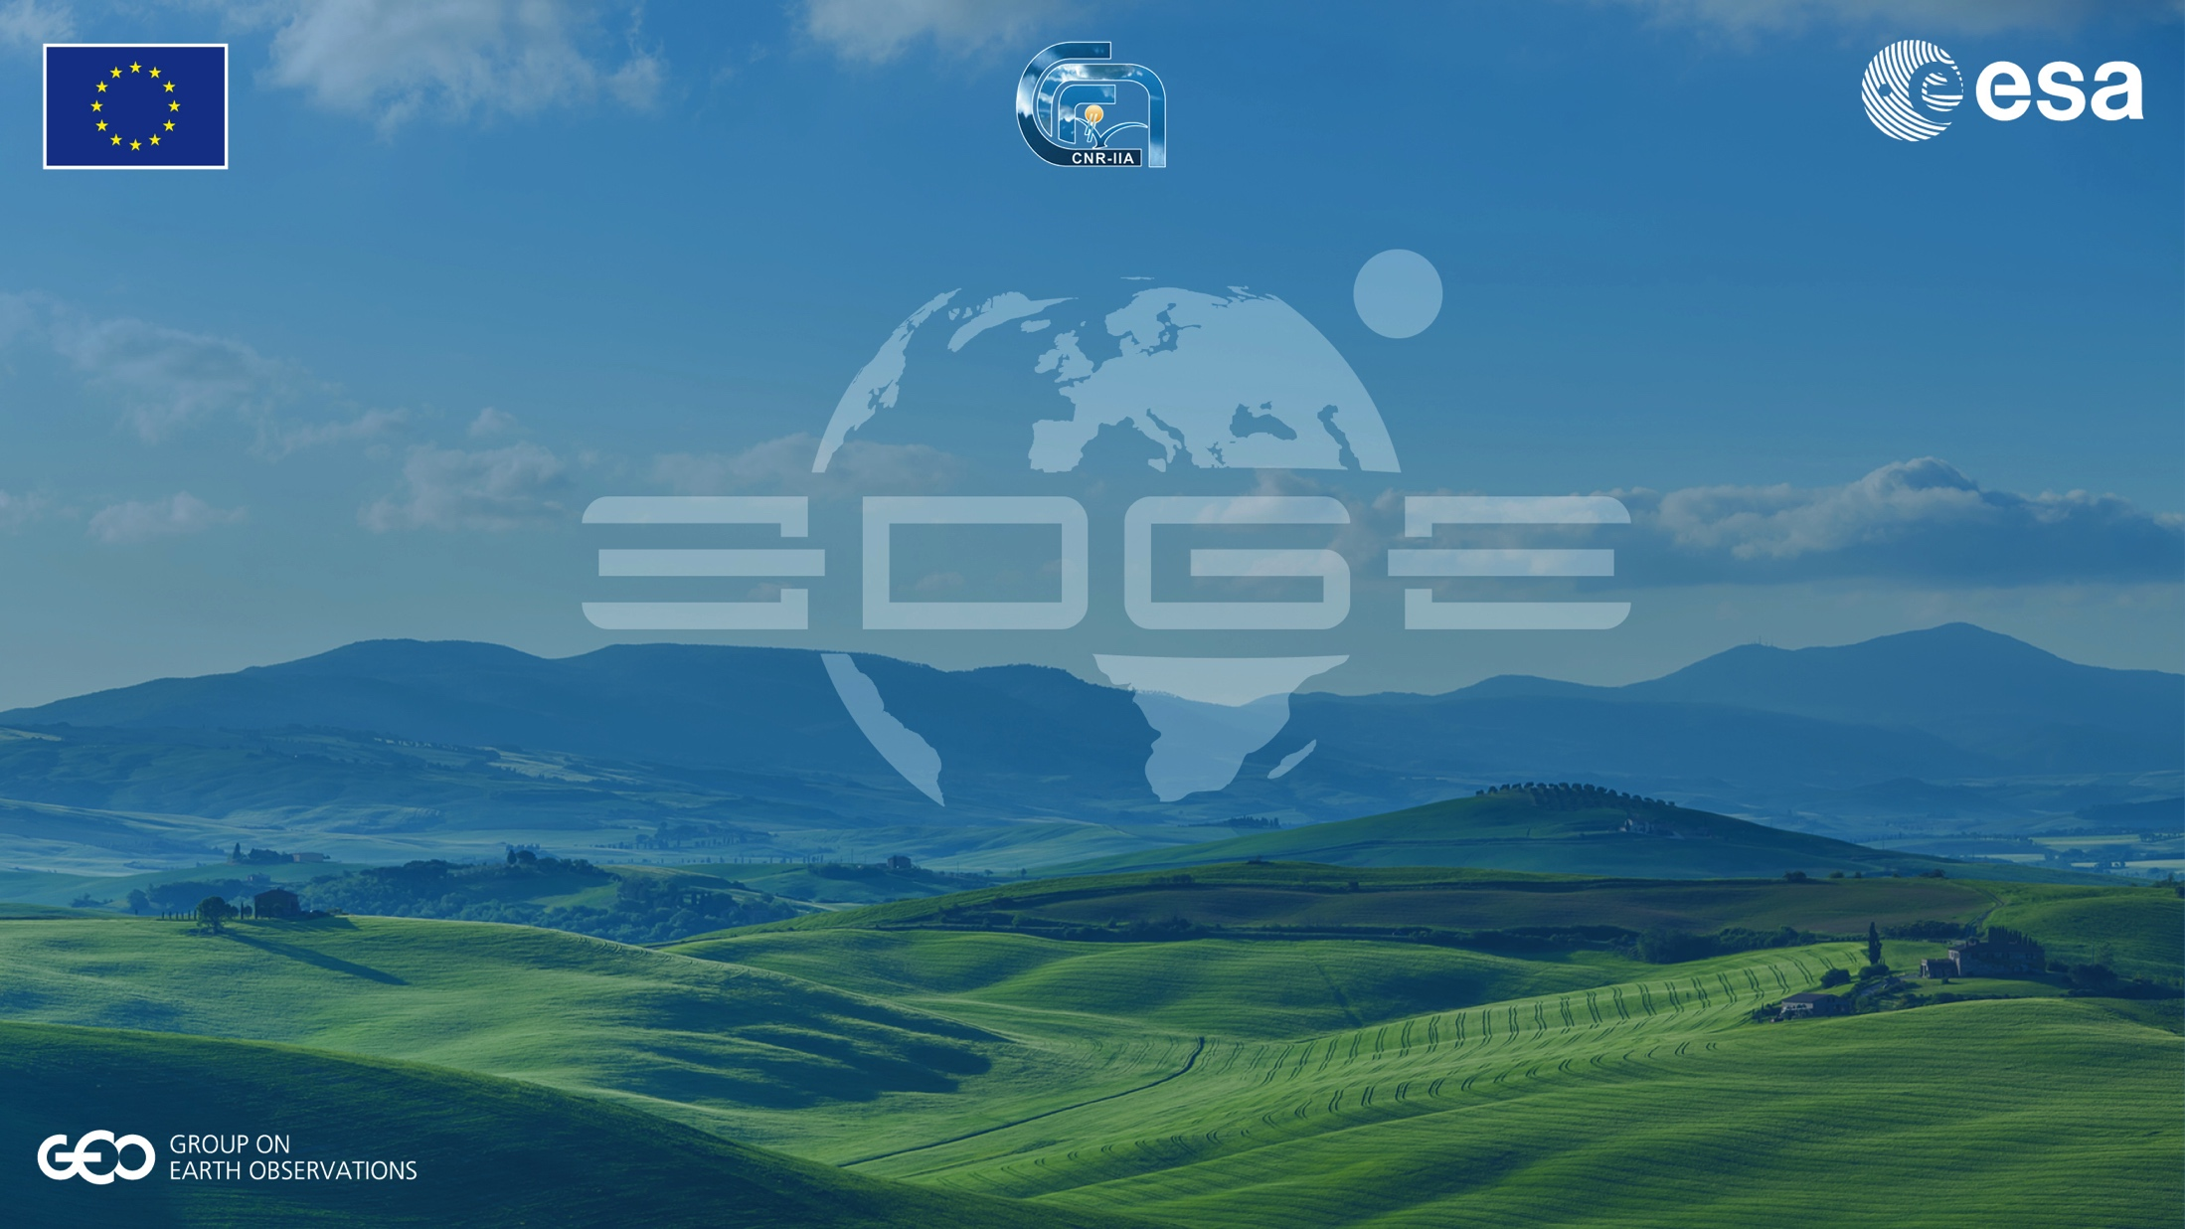
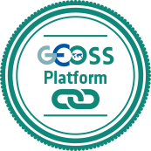
The GEOSS Platform
User Feedback
Ecosystem
User
Feedback
Explicit
Instant Feedback
Implicit
Usage
Statistics
Bug
Enhancement
Questionnaire
Feedback Form
GEO Like
Interface
Resources
Interface Content
Usage Analysis
Development
Team
Data
Resource
Providers
Usage Analysis
Answer adaptation

Slide 9
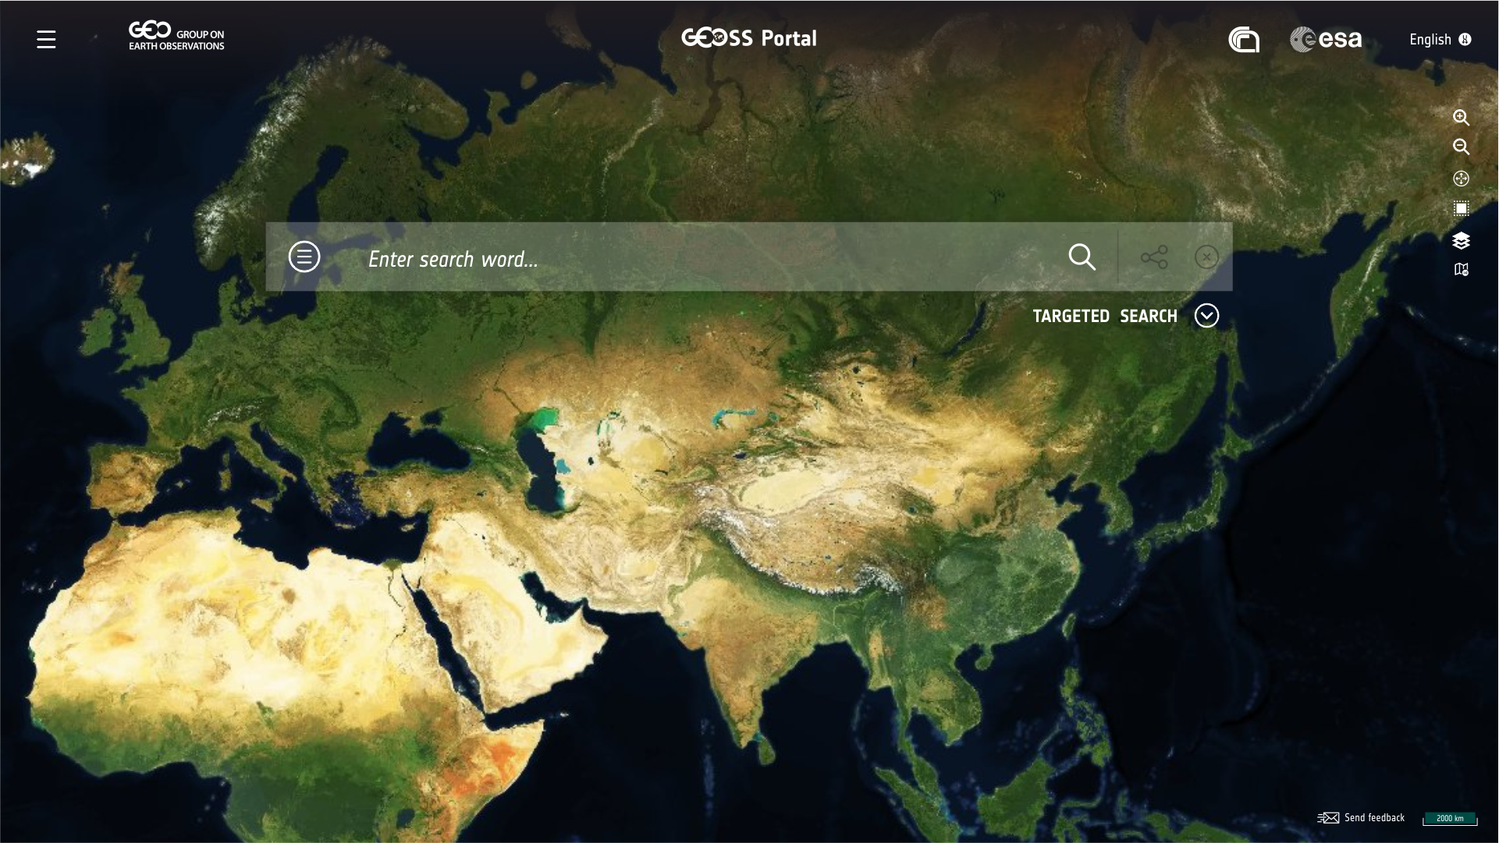

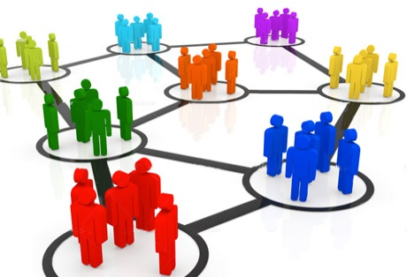
Interface keywords ≠ Resources keywords
A user is looking for information
by using natural words
Transformation
Need to analyse the behaviour of the users to adapt both
the user interface and
the data scope
Ontologies
Role for Knowledge Providers:
Communities & Domain Experts
Web sources
Targeted search
Visualisation
Widgetization
Use Combinations
Service user
(Semi) products
Products Methods
Customised GEOSS Views
Service toolbox for visualisation
Language Support
Services

Slide 10
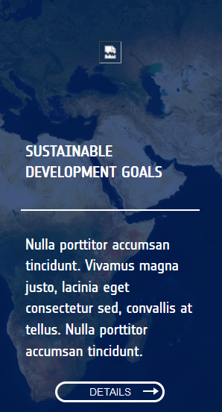
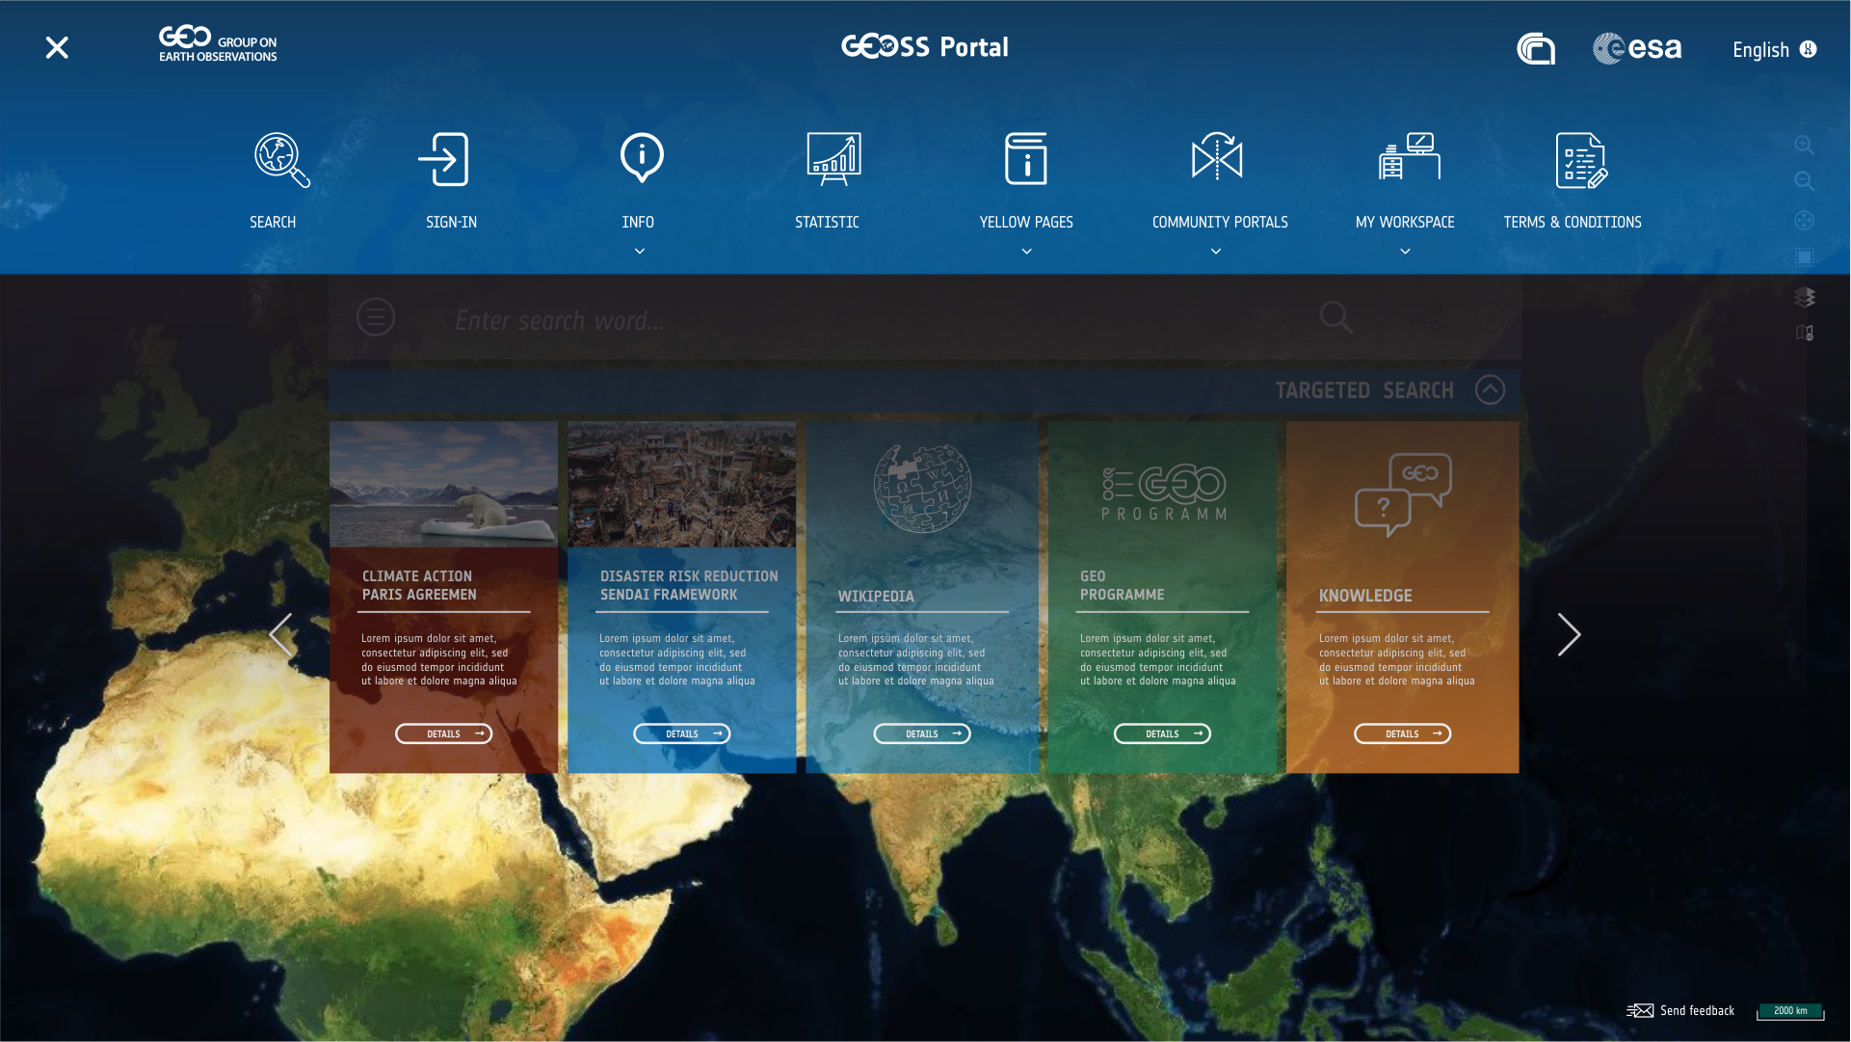
Providing an access point for sharing
Scientific knowledge bodies: Targeted search

Slide 11
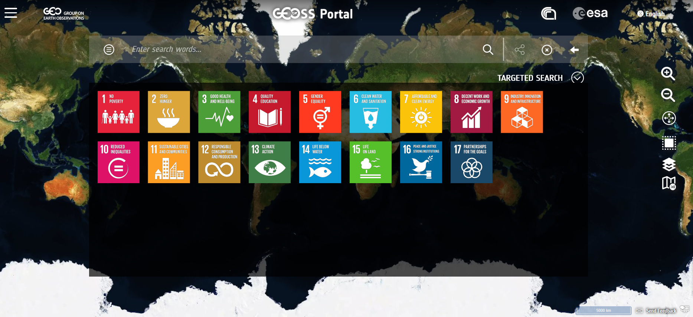
Targeted search: SDG

Slide 12
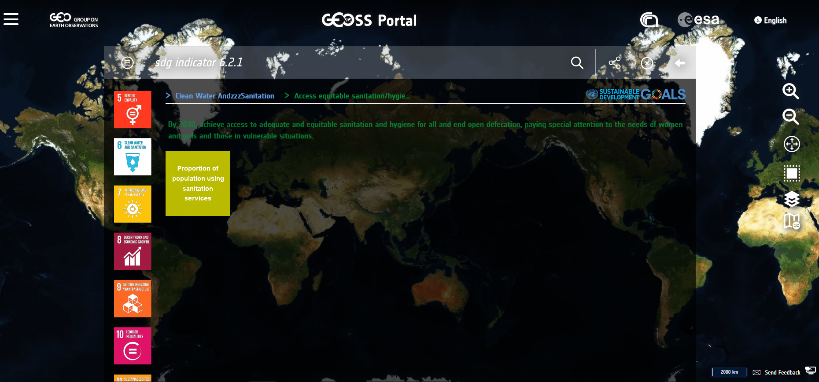
Targeted search: SDG

Slide 13
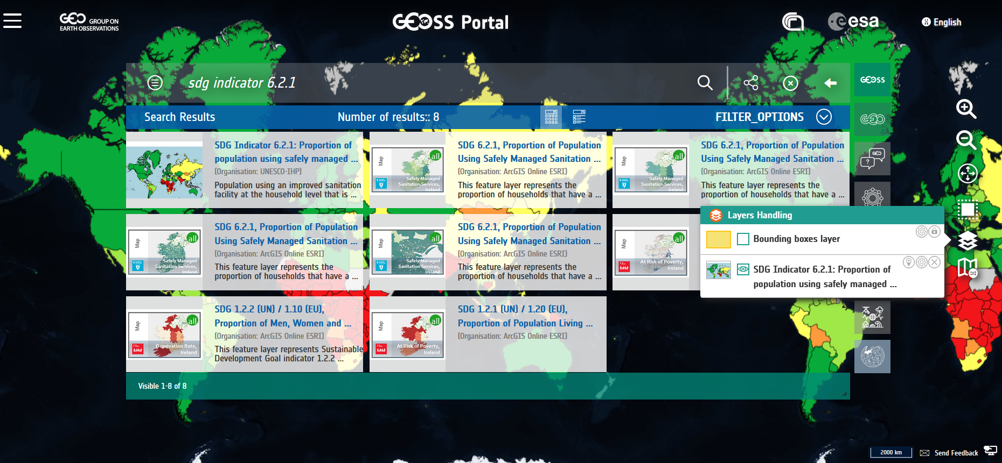
Targeted search: SDG

Slide 14
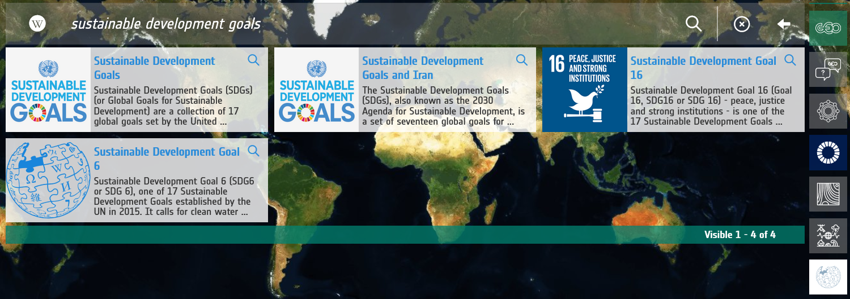
Targeted search: Wikipedia
Wikipedia

Slide 15
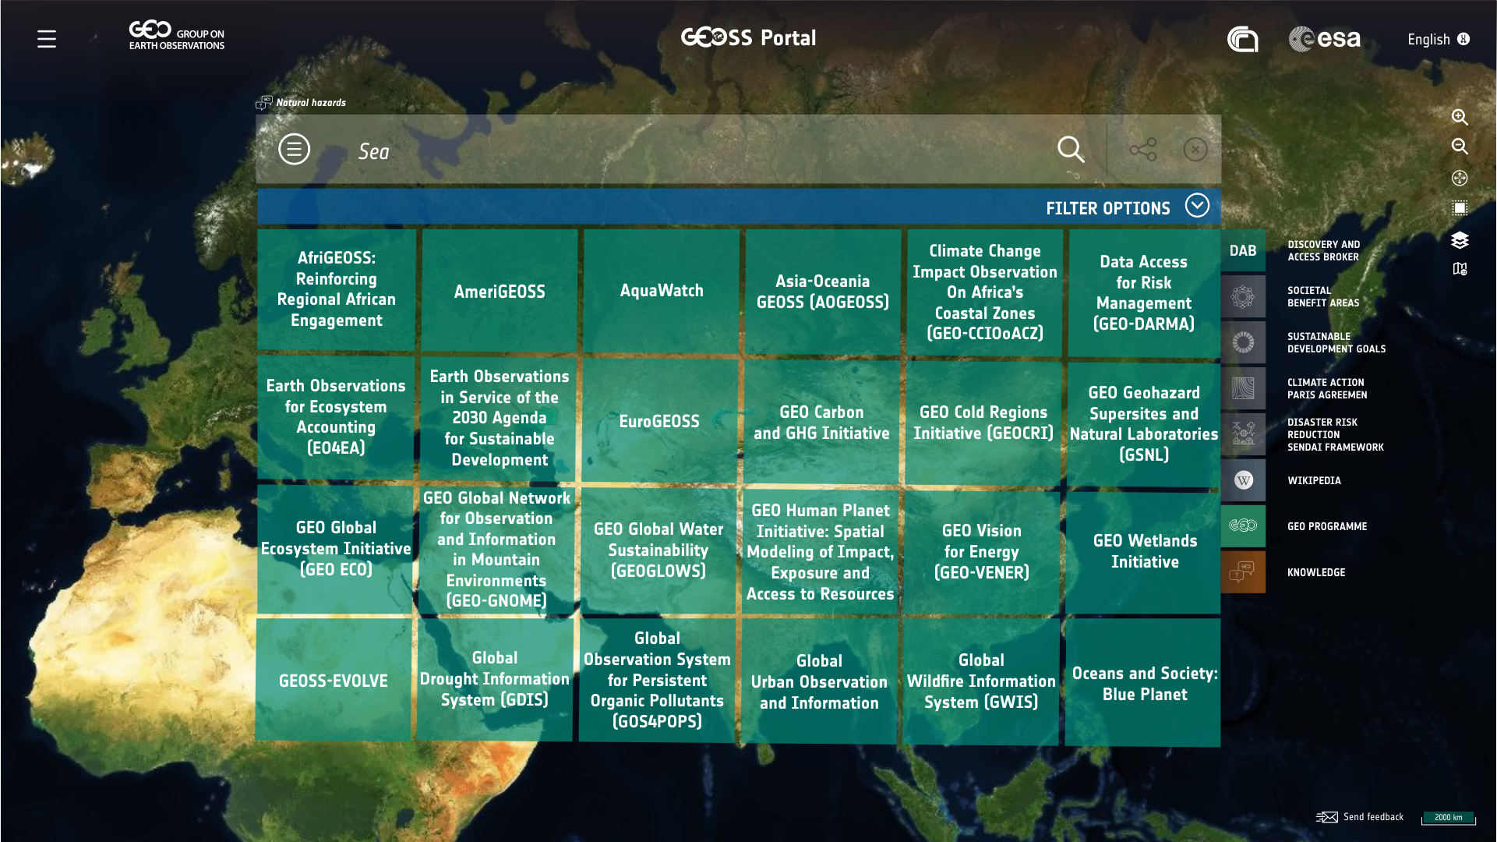

Targeted search: GEO Programmes
Wikipedia

Slide 16
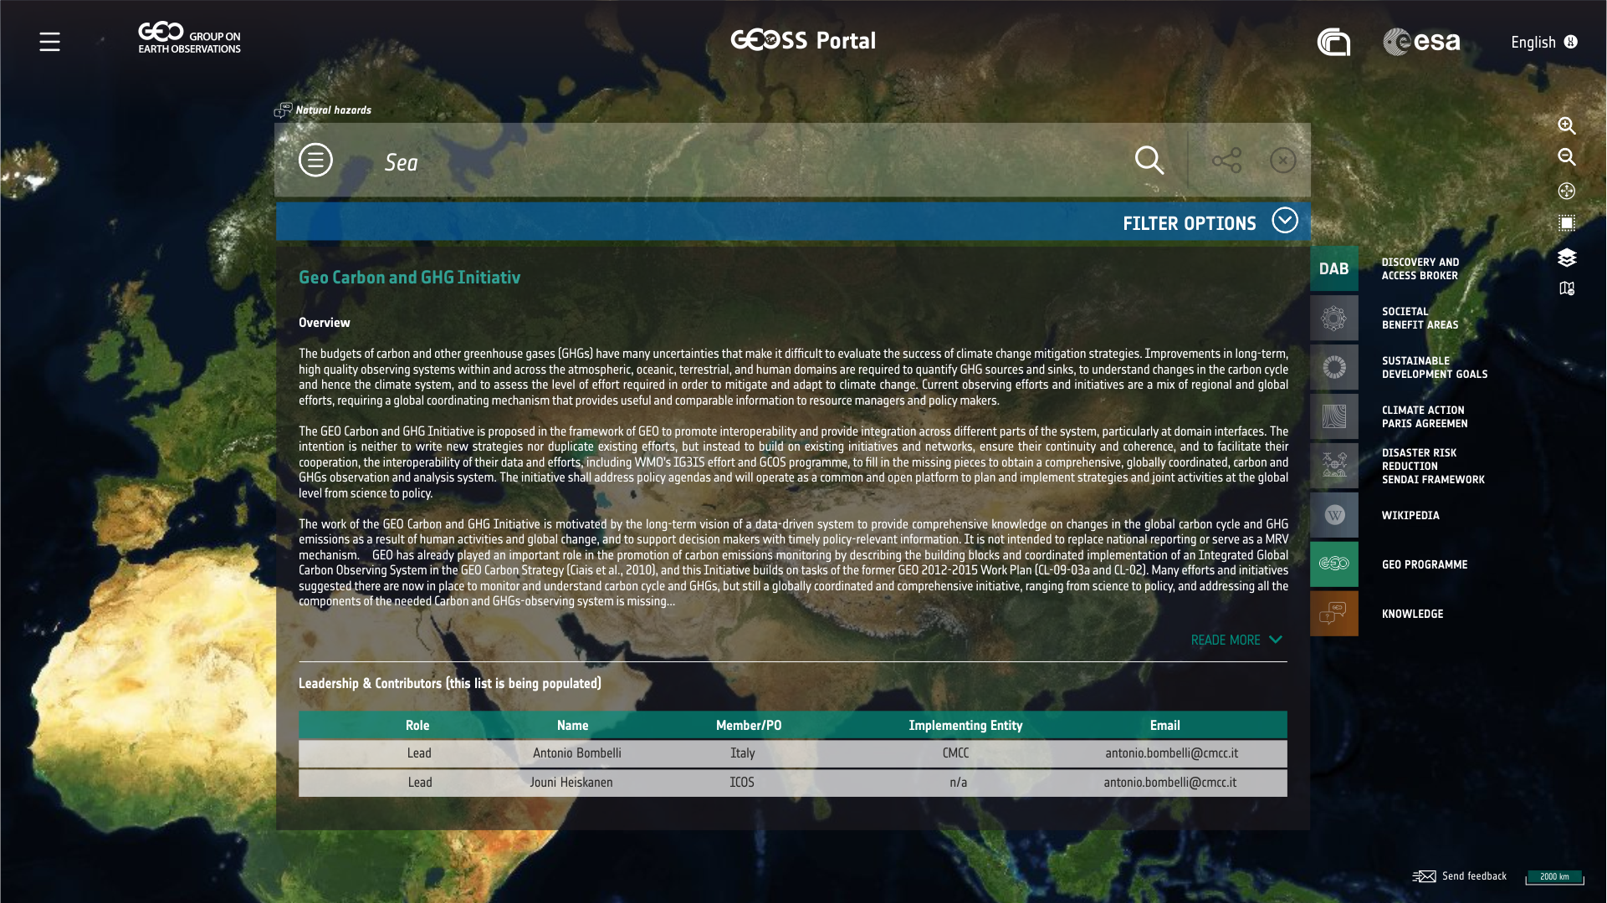
Wikipedia

Slide 17
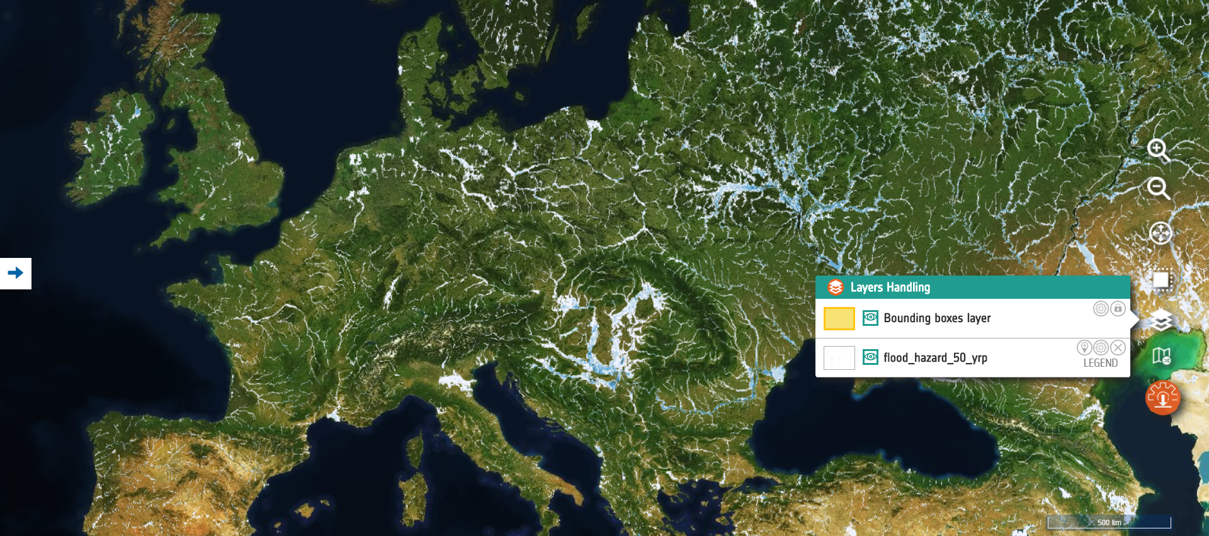
Supporting Data Transformation
The GEOSS platform allows visualising data/information/knowledge layers (existing and generated on-the-fly) via its Portal.
Users can benefit from (customisable) services offered by the GEOSS platform in case resources expose suitable interfaces (WCS)
These services include re-projection, sub-setting, reformatting
and are provided on-the-fly by the GEOSS platform.
Notes:
DAB can on the fly change the projection and perform sub-setting in case data is accessible via web-services (WCS in this case)
DAB can as well apply transformations in terms of output format.

Slide 18
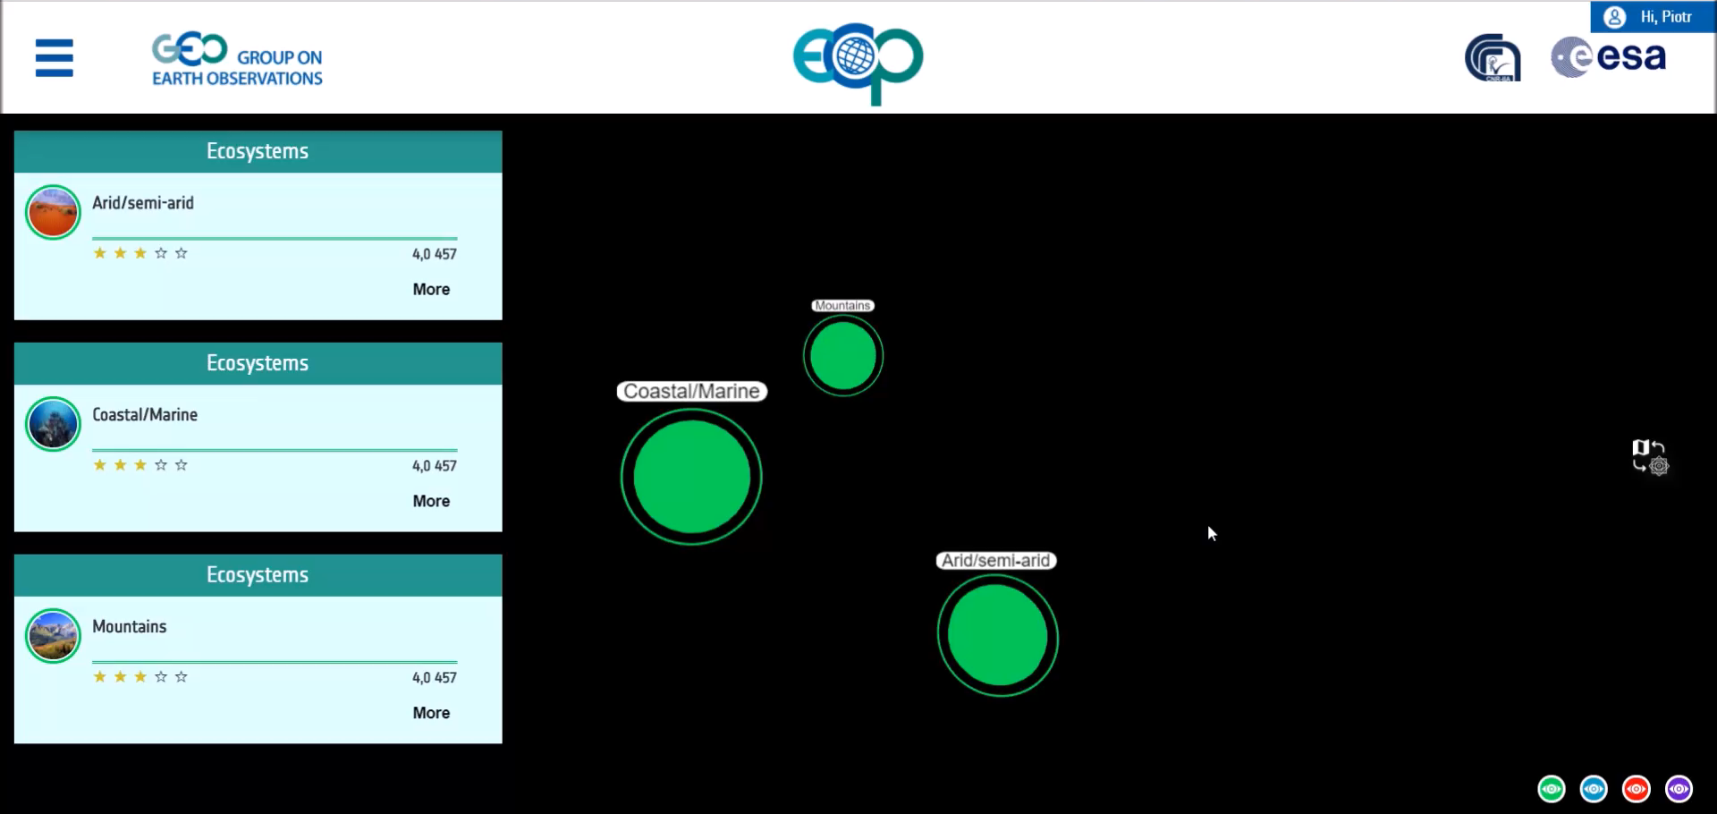
Knowledge Producer example
The ECOPotential Project
This example shows how the GEOSS platform can be customised to provide processing services for extracting knowledge from information, selecting an Ecosystem, Protected Area, Scenario and finally a Process or Workflow. Users are then guided in executing the Workflow benefiting from information accessible via the GEOSS Platform that is transformed into knowledge.
See https://www.youtube.com/watch?v=m8lFGaDabo4&t=56s for a demonstration.

Slide 19


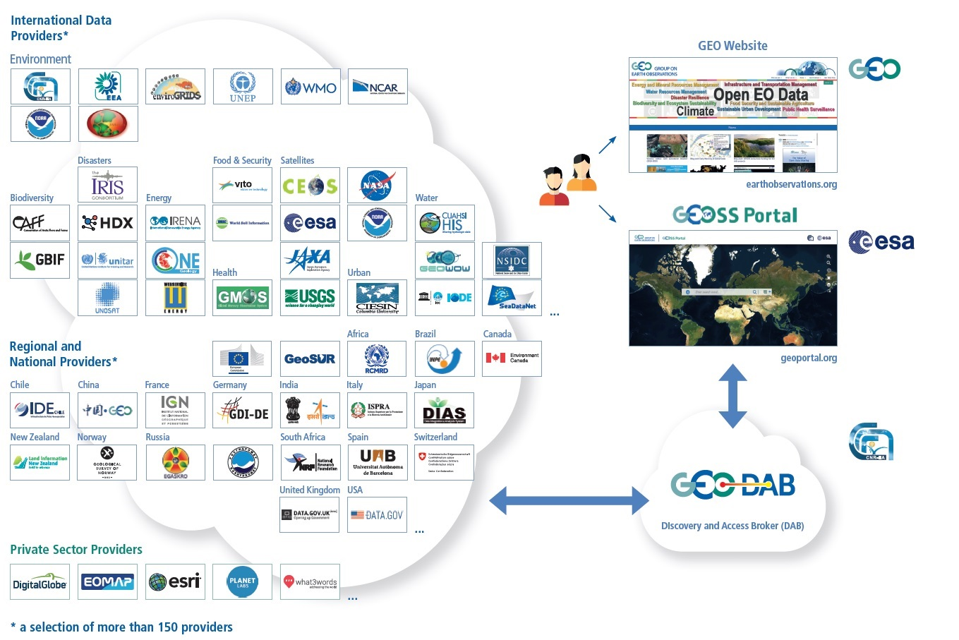


Moving towards a User-Centric
I need data for my community…
… We would like to address user needs at regional and local level
I want to use
My search parameters
My language
Selected GEOSS data-sources (and no others…)
GEOSS and my data sources (combine)
Functionality of interest to me…
My graphical user interface / portal …

Slide 20


Moving towards a User-Centric
I need data for my community…
… We would like to address user needs at regional and local level
Collaborate
Customise
Reuse
I want to use
My search parameters
My language
Selected GEOSS data-sources (and no others…)
GEOSS and my data sources (combine)
Functionality of interest to me…
My graphical user interface / portal …
Communities often use their own Data and Portals and have their own specificities
GEOSS shall respond to Users’ needs
A new concept in supporting User Communities has been developed
Tailored – user-centric approach

Slide 21





Moving towards a User-Centric
GEOSS View
GEOSS Widget
GEOSS Mirror
GEOSS
API
To orient the whole GEOSS resources to the specialised themes the community is interested in
To reuse and embed in your own Portal some GEOSS key functionalities and GEOSS Portal look and feel
To reuse the GEOSS Portal as a whole, tailored to resources, themes and functionalities of the Community
High level open Application Program Interface to directly dialogue with the GEO DAB
Reuse
GEOSS Like
Customise
To feedback, rate, comment, share resources
Collaborate

Slide 22
The GEOSS View
GEOSS View
GEOSS Widget
GEOSS Mirror
GEOSS API
To orient the whole GEOSS resources to the specialised themes the community is interested in
To reuse and embed in your own Portal some GEOSS key functionalities and GEOSS Portal look and feel
To reuse the GEOSS Portal as a whole, tailored to resources, themes and functionalities of the Community
High level open Application Program Interface to directly dialogue with the GEO DAB
  Subset of the whole GEOSS resources defined by applying a set of clauses:
            Discovery clauses (e.g. spatial envelope, keywords, sources, etc.)
        Access clauses (e.g. data format, access protocol, CRS, etc.)
GEOSS Like
To feedback, rate, comment, share resources

Slide 23
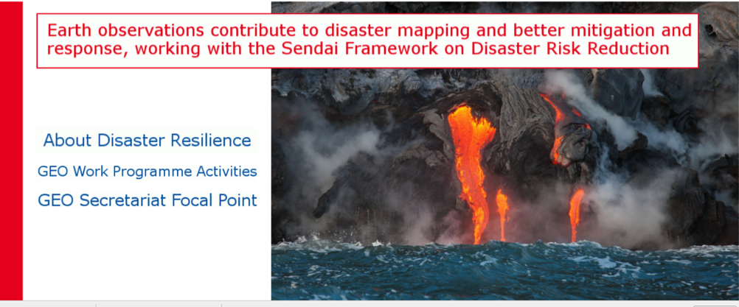
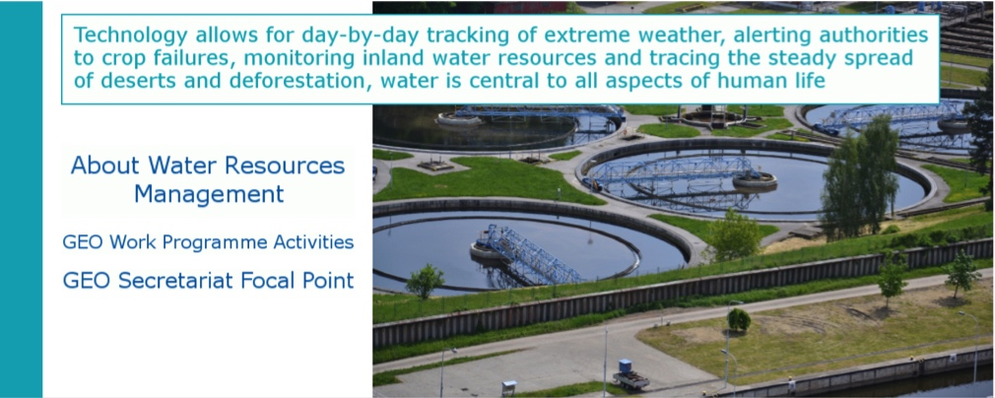
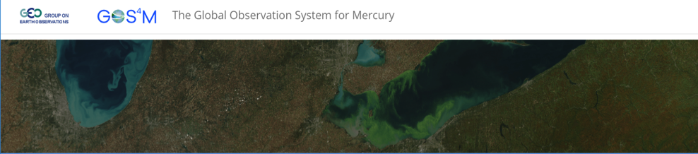
Examples of GEOSS Views
GEOSS View
GEOSS Widget
GEOSS Mirror
GEOSS API
To orient the whole GEOSS resources to the specialised themes the community is interested in
To reuse and embed in your own Portal some GEOSS key functionalities and GEOSS Portal look and feel
To reuse the GEOSS Portal as a whole, tailored to resources, themes and functionalities of the Community
High level open Application Program Interface to directly dialogue with the GEO DAB
Disaster
GEOSS Like
To feedback, rate, comment, share resources
Water
Communities
Views
GLOBAL OBSERVATION SYSTEM FOR MERCURY (GOS4M)

Slide 24
The GEOSS Widget
GEOSS View
GEOSS Widget
GEOSS Mirror
GEOSS API
To orient the whole GEOSS resources to the specialised themes the community is interested in
To reuse and embed in your own Portal some GEOSS key functionalities and GEOSS Portal look and feel
To reuse the GEOSS Portal as a whole, tailored to resources, themes and functionalities of the Community
High level open Application Program Interface to directly dialogue with the GEO DAB
The GEOSS Widget is addressed to Communities that:
    Own a website with a map on it;
    Wish to discover GEOSS Resources, too;
    Do not want to implement a GEOSS Search from scratch
GEOSS Like
To feedback, rate, comment, share resources
    Provides essential features of GEOSS;
    Lightweight application;
    Free;
    Easily configurable.

Slide 25
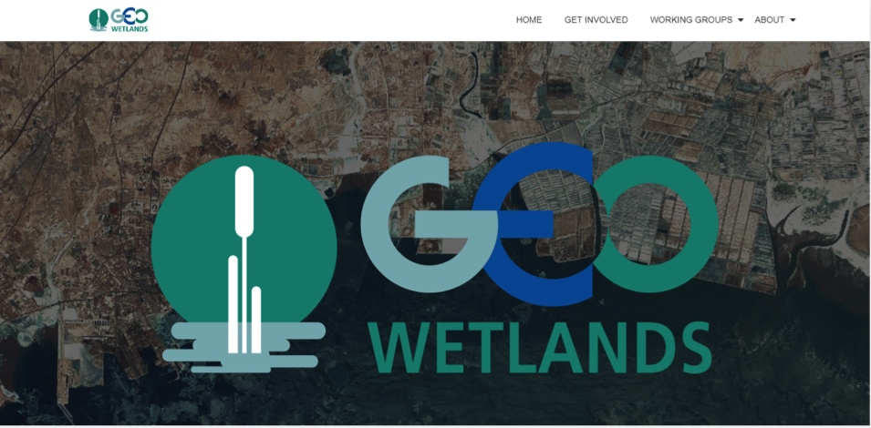
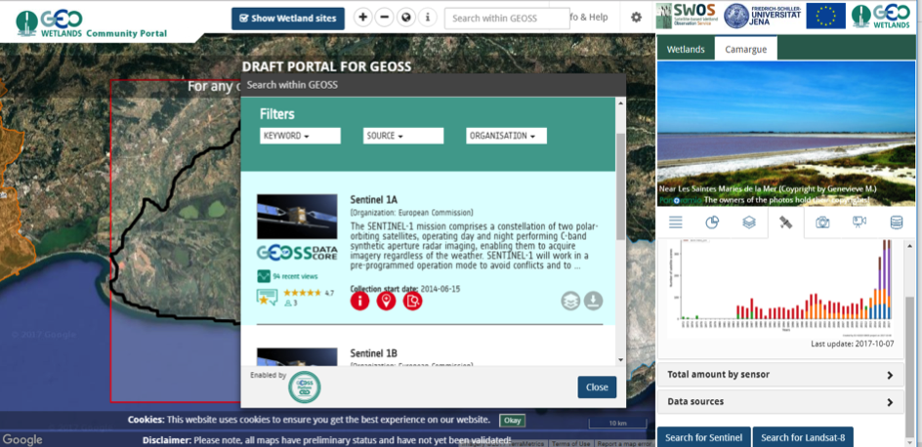
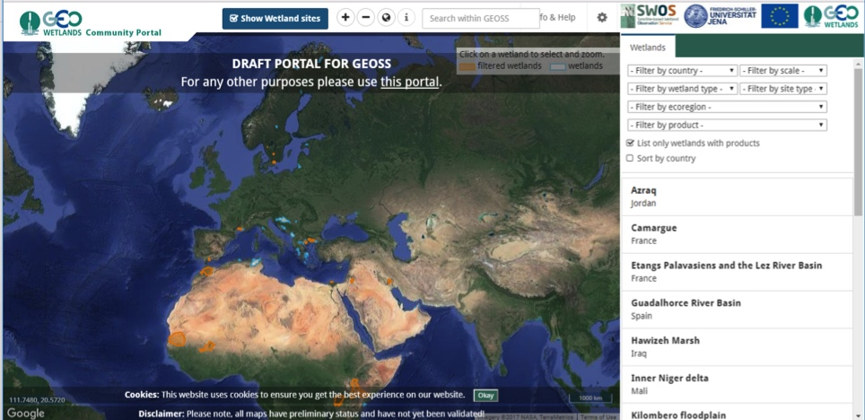
Examples of GEOSS Widget Use
GEOSS View
GEOSS Widget
GEOSS Mirror
GEOSS API
To orient the whole GEOSS resources to the specialised themes the community is interested in
To reuse and embed in your own Portal some GEOSS key functionalities and GEOSS Portal look and feel
To reuse the GEOSS Portal as a whole, tailored to resources, themes and functionalities of the Community
High level open Application Program Interface to directly dialogue with the GEO DAB
GEOSS Like
To feedback, rate, comment, share resources
GEO Wetlands Community Portal

Slide 26
The GEOSS Mirror
GEOSS View
GEOSS Widget
GEOSS Mirror
GEOSS API
To orient the whole GEOSS resources to the specialised themes the community is interested in
To reuse and embed in your own Portal some GEOSS key functionalities and GEOSS Portal look and feel
To reuse the GEOSS Portal as a whole, tailored to resources, themes and functionalities of the Community
High level open Application Program Interface to directly dialogue with the GEO DAB
The GEOSS Mirror is addressed to Communities that:
    Do not have their own Portal;
    Want to expose their own data as a subset of GEOSS Resources with their own branding
GEOSS Like
To feedback, rate, comment, share resources
Mirror Sites:
    Are configurable GEOSS Portal Instances with partly configurable layout;
    Access a subset of the overall GEOSS Resources via the GEOSS Views;
    Run on the GEOSS Portal infrastructure

Slide 27







Examples of GEOSS Mirror Use
GEOSS View
GEOSS Widget
GEOSS Mirror
GEOSS API
To orient the whole GEOSS resources to the specialised themes the community is interested in
To reuse and embed in your own Portal some GEOSS key functionalities and GEOSS Portal look and feel
To reuse the GEOSS Portal as a whole, tailored to resources, themes and functionalities of the Community
High level open Application Program Interface to directly dialogue with the GEO DAB
GEOSS Like
To feedback, rate, comment, share resources

Slide 28
The GEOSS API
GEOSS View
GEOSS Widget
GEOSS Mirror
GEOSS API
To orient the whole GEOSS resources to the specialised themes the community is interested in
To reuse and embed in your own Portal some GEOSS key functionalities and GEOSS Portal look and feel
To reuse the GEOSS Portal as a whole, tailored to resources, themes and functionalities of the Community
High level open Application Program Interface to directly dialogue with the GEO DAB
Different APIs for serving diverse Application development users
GEOSS Like
 | Geospatial Expert | Web Dev. Expert
Standard Web Services (OGC Web Services, OAI-PMH, CKAN, etc.) | X
OpenSearch (Extended) | X
GEO DAB API JS |  | X
GEO DAB API REST |  | X
To feedback, rate, comment, share resources
  A set of standard Web service interfaces:
    e.g. OGC service interfaces, CKAN, OAI-PMH, FTP, etc.
  A set of APIs for software developers:
    Client side APIs:
      (high-level) JavaScript library
      … .
    Server side APIs:
      - REST/JSON APIs
      - OpenSearch APIs

Slide 29
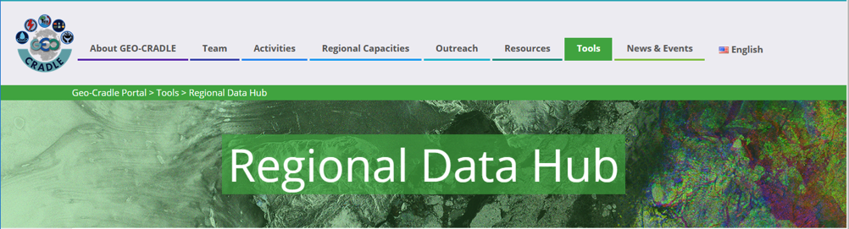
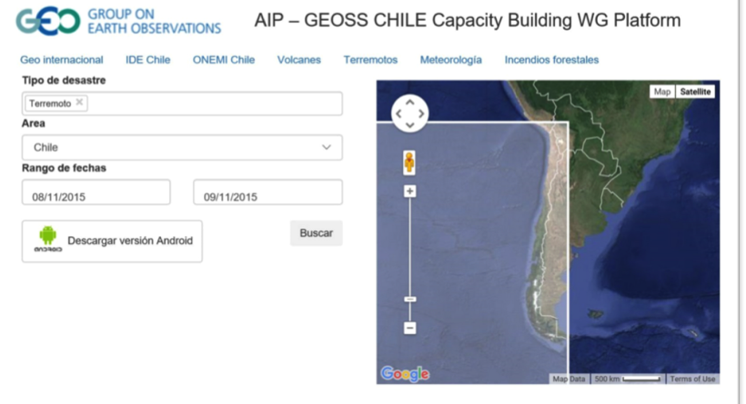
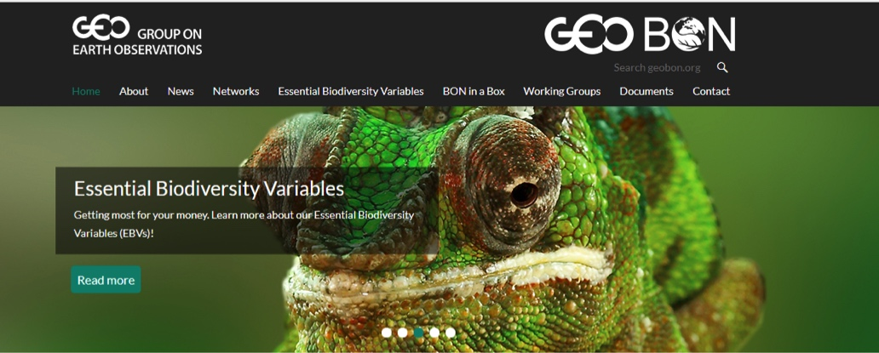
Examples of GEOSS API Use
GEOSS View
GEOSS Widget
GEOSS Mirror
GEOSS API
To orient the whole GEOSS resources to the specialised themes the community is interested in
To reuse and embed in your own Portal some GEOSS key functionalities and GEOSS Portal look and feel
To reuse the GEOSS Portal as a whole, tailored to resources, themes and functionalities of the Community
High level open Application Program Interface to directly dialogue with the GEO DAB
GEO CRADLE
GEOSS Like
GEOSS CHILE
To feedback, rate, comment, share resources

Slide 30
Moving towards a User-Centric
GEOSS View
GEOSS Widget
GEOSS Mirror
GEOSS API
To orient the whole GEOSS resources to the specialised themes the community is interested in
To reuse and embed in your own Portal some GEOSS key functionalities and GEOSS Portal look and feel
To reuse the GEOSS Portal as a whole, tailored to resources, themes and functionalities of the Community
High level open Application Program Interface to directly dialogue with the GEO DAB
Reuse
GEOSS Like
Customise
To feedback, rate, comment, share resources
Collaborate
Reuse
Depending on
Community
Needs

Slide 31



A User Centric Approach
→Build around three pillars
GEOSS Mirror
GEOSS
Status Checker
GEOSS View
GEOSS Like
Reuse
Collaborate
Customise
GEOSS Yellow
Pages
GEOSS Widget
GEOSS API
Thank you

Slide 32

Project Overview – Project data
Project co-funded by: EC DG-RTD
Project Officer: Michel Schouppe/M. van Meerloo
Project Coordinator: Joost van Bemmelen – ESA
Subcontractors: CNR-IIA and Eversis
Funding: 1.5 Meur
Duration: 1 October 2017 – 30 September 2019
EDGE is a response to: Horizon 2020 Work Programme 2016 – 2017 - 12. Climate action, environment, resource efficiency and raw materials - Other actions - call European contribution to the GEOSS Web Portal enhancement (Global Earth Observation System of Systems)

