Slide 1

Future Data Access and Analysis Architectures
Committee on Earth Observation Satellites
GEOS-WGISS Workshop
WGISS 46 2018
Dr Robert Woodcock

Slide 2

Objective
Identify areas where GEOS and WGISS could practically work together
  →Joint action plan
Interactive presentation
  Ask questions
  Interrupt
  Provide perspectives
  Seek clarification
  …or its death by PowerPoint!
As the day proceeds collect potential actions
This Photo by Unknown Author is licensed under CC BY-NC

Slide 3
Why CEOS FDA?
What drives? What matters?
  Substantial expectation of growth in the EO based digital economy across Industry and Government
  A step change in EO satellite capability over the next 5 years leading to new applications
  EO analytics platforms
    Data+compute+tools
  Cloud hosted
    scalable analysis
  Third-party application development
    Common Dev Interfaces (APIs)
    Data Cubes (not just files)
  Timely availability
  Ready to Analyse, not just access
  Multi-sensor integration
  Pixel level data discovery and access (refined search)
Notes:
When CSIRO proposed FDA…
The changing business expectations and the three V’s combine to put pressure on the entire EO value chain.
+ Global initiatives using EO data are reporting issues in bring multiple agency data together for analysis (they can find it thanks to WGISS interoperability, but download preparation and analysis are barriers.
+ Industry innovation has high technical barriers – many are not skilled in data preparation and calibration, but are in downstream analysis and application
(then cover off on the specifics on the slide which has the reported issues and expectations)

Slide 4

User Experience
Aquawatch
Swiss Data Cube
Big Data hosts
  AWS on Earth
  Digital Globe GBDX
  …
This Photo by Unknown Author is licensed under CC BY-SA
Notes:
How long to deploy DC, TEP.. To suitable compute environment (PC, HPC, Cloud)?
Index data?
Prepare data?
Access and/or ingest data?

Slide 5

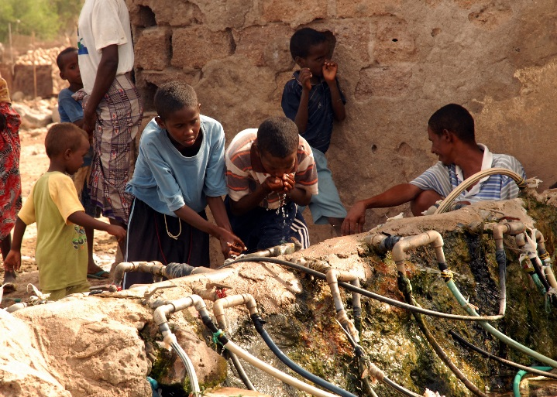



AquaWatch Mission
The mission of AquaWatch is to:
Improve the coordination, delivery and utilization of water quality information for the benefit of society

Slide 6
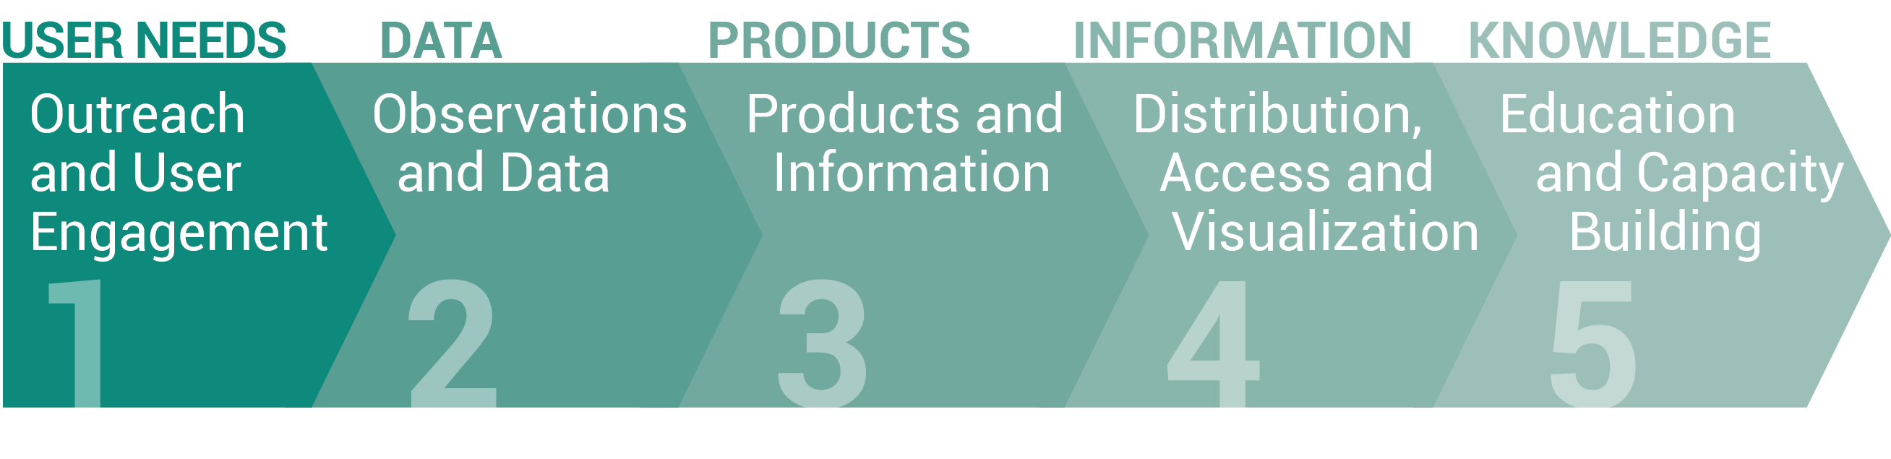
AquaWatch Working Groups
AquaWatch has have five Working Groups (WGs). The function of the WGs is to support timely and successful project implementation and task execution, and provide necessary scientific, technical and other support as required for projects and activities.

Slide 7
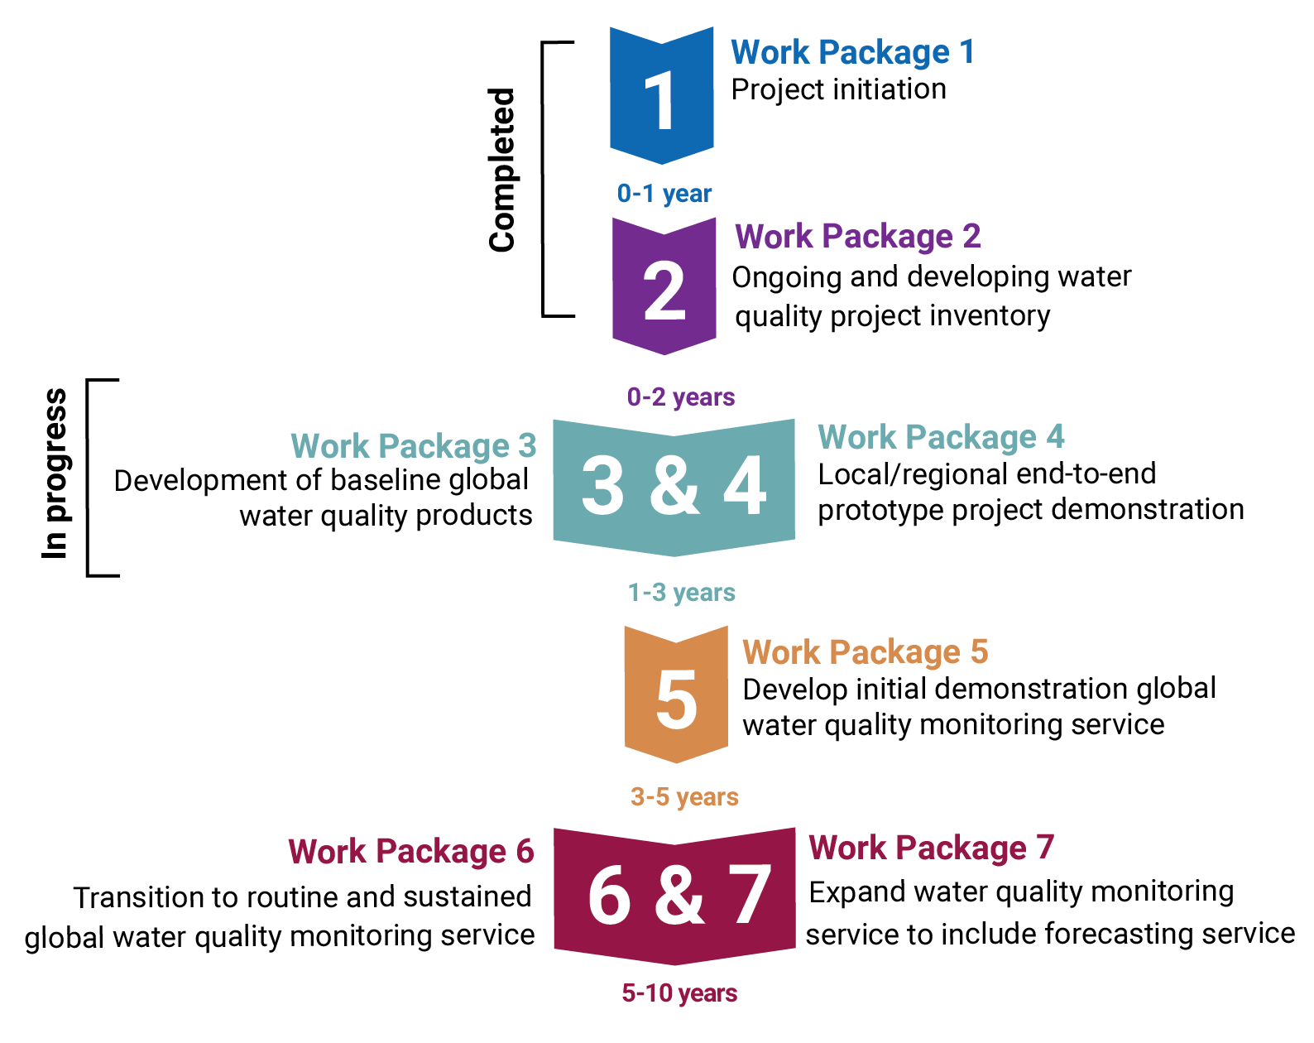
Current Activities
Water Quality Information Service Work Packages

Slide 8
Aquawatch challenge
Easy
  Regional end-to-end project demonstration
  Global end-to-end project demonstration
  With a range of assumptions and appropriate budget
Hard
  Identified 6 different Water Quality products and applications in the space of 5 minutes
    Varying scientific rigour: limited validation and no error estimates
    Source data may or may not be the same
    Atmospheric correction may or may not be the same
    Water quality algorithm may or may not be the same
    …and in time they change!
Notes:
Provenance matters
The choice of algorithms matters – and who determines this is a governance issue – regional sovereign choice or Global agreed choice or Monitoring organisation choice (regardless of sovereignty)

Slide 9
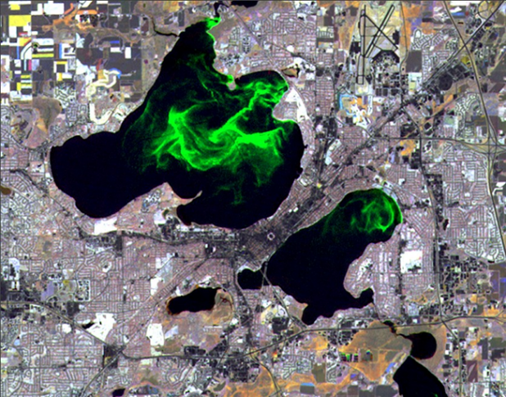

Aquawatch real use-case
The real question isn’t “can you build a water quality product?” it is:
  Where and when on the planet does a water quality issue exist? (e.g. Algal Blooms)
Lakes Mendota & Monona -University of Wisconsin SSEC image
This Photo by Unknown Author is licensed under CC BY-SA
Notes:
With sufficient budget it is likely this question can be realistic answered in today’s compute environments!

Slide 10
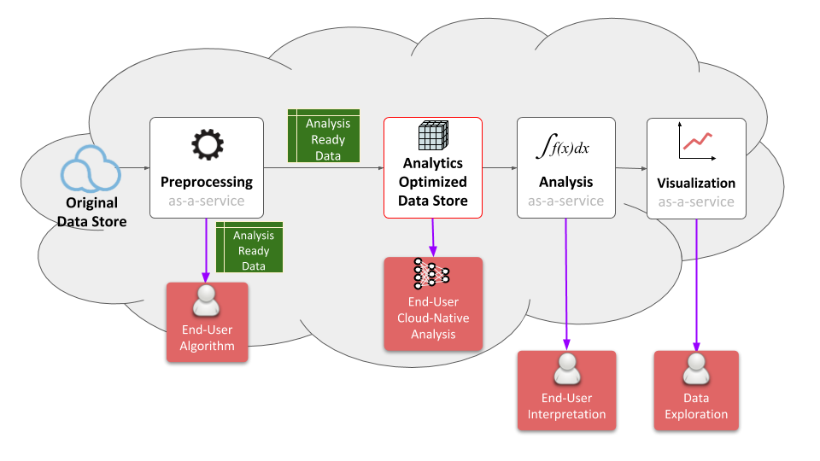
A lot more stuff matters
User choice – who “controls” what?
Provenance
Economics
Governance
New Actors
Chris Lynnes, NASA – FDA whitepaper (draft)

Slide 11
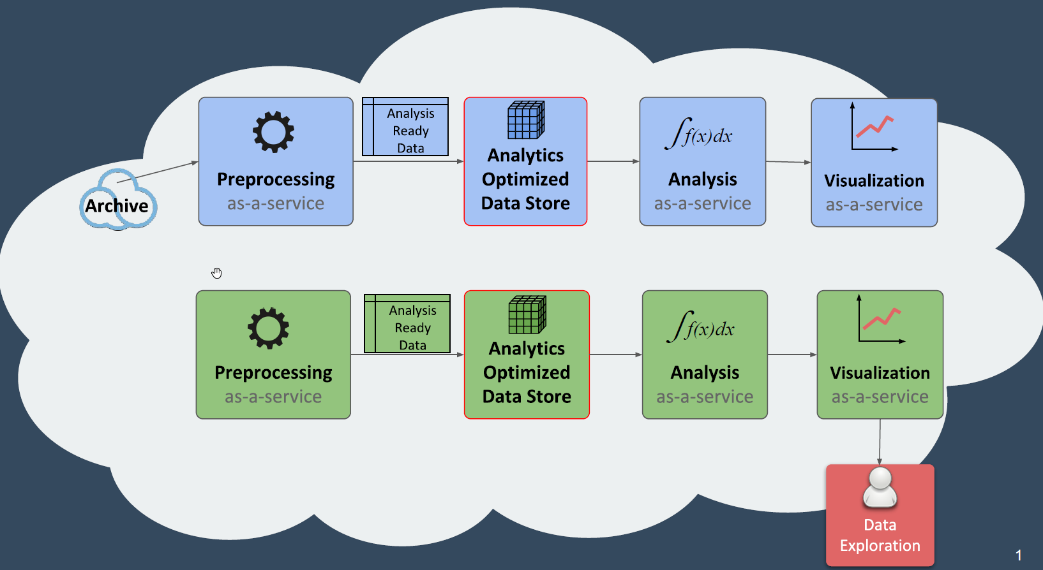
Composing Services

Slide 12
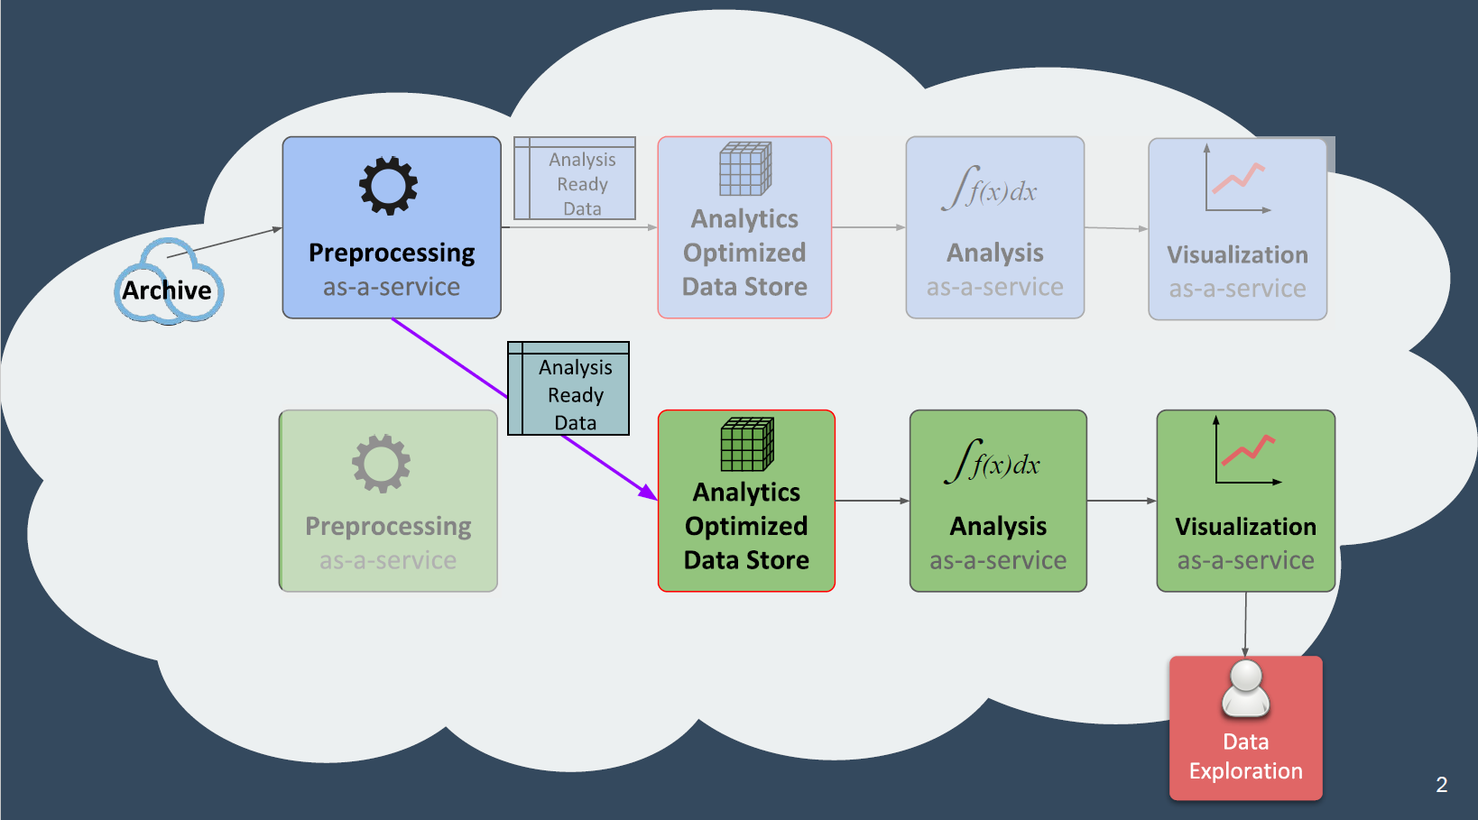
Composing Services

Slide 13
Future Data Architectures
Principles
“Analysis for the masses” – Before, After
Interaction | Discovery and Download (files) User provides compute | In-place analysis of ready-to-use data User application, data and compute combine from different parties on-demand
Integration | Single sensor discovery Integration a user problem | Comparable observations Global multi-sensor analysis routine
Interoperability | Discovery of files Emphasis on access | Refined discovery of pixels Emphasis on usability for analysis
Interfaces | Independent application development over data Agency stores and distributes data | APIs, Virtual Labs enabled by standards Use of third parties for storage, distribution and analysis
Notes:
This slide shows the architectural principles that change.
Discussion will be mostly providing an brief explanation of each component – most likely only emphasising a few as there will likely not be time for all.

Slide 14
What to talk about?
Scaling to global analysis is technologically plausible
Scaling of Actors is challenging
  Changing user expectations
  Governance impacts
  Economic impacts
  Provenance impacts
  New participant impacts
  Discovery and access impacts
Mesh Model, GEOSS Evolve Discussion Paper

Slide 15
Swiss Data Cube
Reconciling differences, even for the same data:
  There are several options available to access Landsat imagery:
    Web interfaces (Earth Explorer, Glovis)
    USGS API
    Google Earth Engine
    AWS bucket
  Formats, compression type, data chunking
  Metadata forms: MTL, XML, …
ARD generation
Big Data hosts
Gregory Giuliani, Bruno Chatenoux, Andrea De Bono, Denisa Rodila, Jean-
Philippe Richard, Karin Allenbach, Hy Dao & Pascal Peduzzi (2017) Building an Earth Observations
Data Cube: lessons learned from the Swiss Data Cube (SDC) on generating Analysis Ready Data
(ARD), Big Earth Data, 1:1-2, 100-117, DOI: 10.1080/20964471.2017.1398903
Notes:
There are several options available to access Landsat imagery. It is possible to order images
directly on web interfaces like EarthExplorer or Glovis. Another option is to use the USGS
Application Programming Interface (API) to programmatically retrieve Landsat scenes.
Alternatively, GEE and AWS are accessible either directly via HTTP protocol, or via gsutil
(https://cloud.google.com/storage/docs/gsutil), which is a Python application that gives
access to Google Cloud Storage from command lines.
The way providers distribute scenes varies as well. USGS and GEE are providing a single
zipped file with all the bands, but they are using different compression formats (respectively
tar.gz and tar.bz). AWS allows a direct access to each band in a geotiff format with the com
Press deflate option (meaning they can be used directly).
an issue has emerged using multiple data providers. Indeed, USGS provides metadata in an XML-encoded fil
whereas GEE and AWS are providing metadata in text Metadata files (MTL.txt). Therefore,
we modified the data preparation script in order to handle both XML and MTL files and
generate the correct files used in the ingestion process.

Slide 16
Swiss Data Cube
ARD products are not commonly generated by data providers
current delivery mechanisms are not efficient
→ requires finding a procedure to routinely generate ARD ensuring that all observations are consistent and comparable
must be automated as much as possible (e.g. discover, download, and preprocessing)
able to discover and access data from different repositories (e.g. ESPA, Sentinels Data Hub)
handle different sensors (e.g. Landsat MSS, TM, ETM, OLI; Sentinel 1 SAR; Sentinel 2 MSI), and should be interoperable (e.g. to enhance reusability).
Gregory Giuliani, Bruno Chatenoux, Andrea De Bono, Denisa Rodila, Jean-
Philippe Richard, Karin Allenbach, Hy Dao & Pascal Peduzzi (2017) Building an Earth Observations
Data Cube: lessons learned from the Swiss Data Cube (SDC) on generating Analysis Ready Data
(ARD), Big Earth Data, 1:1-2, 100-117, DOI: 10.1080/20964471.2017.1398903

Slide 17
Interoperability and Use
FDA Themes supported via WGISS
CEOS Analysis Ready Data (ARD)
  Develop and provision CARD4L-compliant optical and/or SAR products
  Examine ARD for ocean and atmosphere domains
Interoperable Free and Open Tools
  Continue supporting the CEOS Data Cube (CDC) initiative
  Demonstrate new technologies through ongoing support of ‘pilot projects’ and consideration of alternate candidate architectures
Data, Processing, and Architecture Interface Standards
  Develop standards for pixel-level data discovery, access, and common analytical processing requests (e.g., cloud free mosaics of ARD) exploiting EO satellite data among various CEOS exploitation platforms
Analytical Processing Capabilities
  Prototype portable web-based analytical processing APIs/Web Services that work across CEOS exploitation platforms in full computing environments for time series and other analysis
User Metrics
  Develop a data use metrics framework through which agencies can contribute to how EO data is being used, rather than just downloaded data quantities
Block A: Analysis Ready Data, CARD4L and interoperable products
Block B: Agency roles in stimulating EO “use-environments”

Slide 18

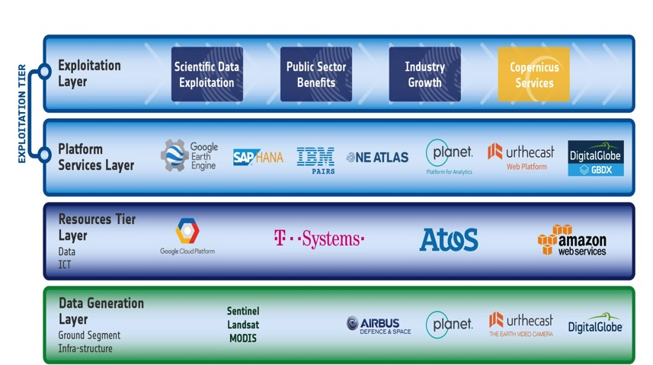
FDA Common Description
White Paper
  FDA-8: Establish a common description of Future Data Architecture functional blocks and identify interfaces and interoperability approaches (support FDA AHT)
Multiple viewpoints into the evolving FDA landscape:
  Enterprise, Information, Computation, Engineering, Technology
Building on WGISS Discovery and Access Infrastructure with a system wide view
Emphasis on what is changing: Analysis, Cloud, consumer EO
Notes:
WGISS is supporting the FDA ad-hoc team in the drafting of a white paper on to establish a common description of Future Data Architecture functional blocks and interfaces
There is large consensus that a common architectural model and terminology will:
facilitate interagency dialog
enable identification of interfaces
enable work on standardisation once interfaces identified
So we are working on a unified pretty diagram based on 5 viewpoints to convey all the necessary knowledge.
Building on WGISS Discovery and Access Infrastructure with a system wide view
Emphasis on what is changing: Analysis, Cloud, consumer EO
Technology and Engineering viewpoints link directly to the open source software and FDA inventory activities.

Slide 19
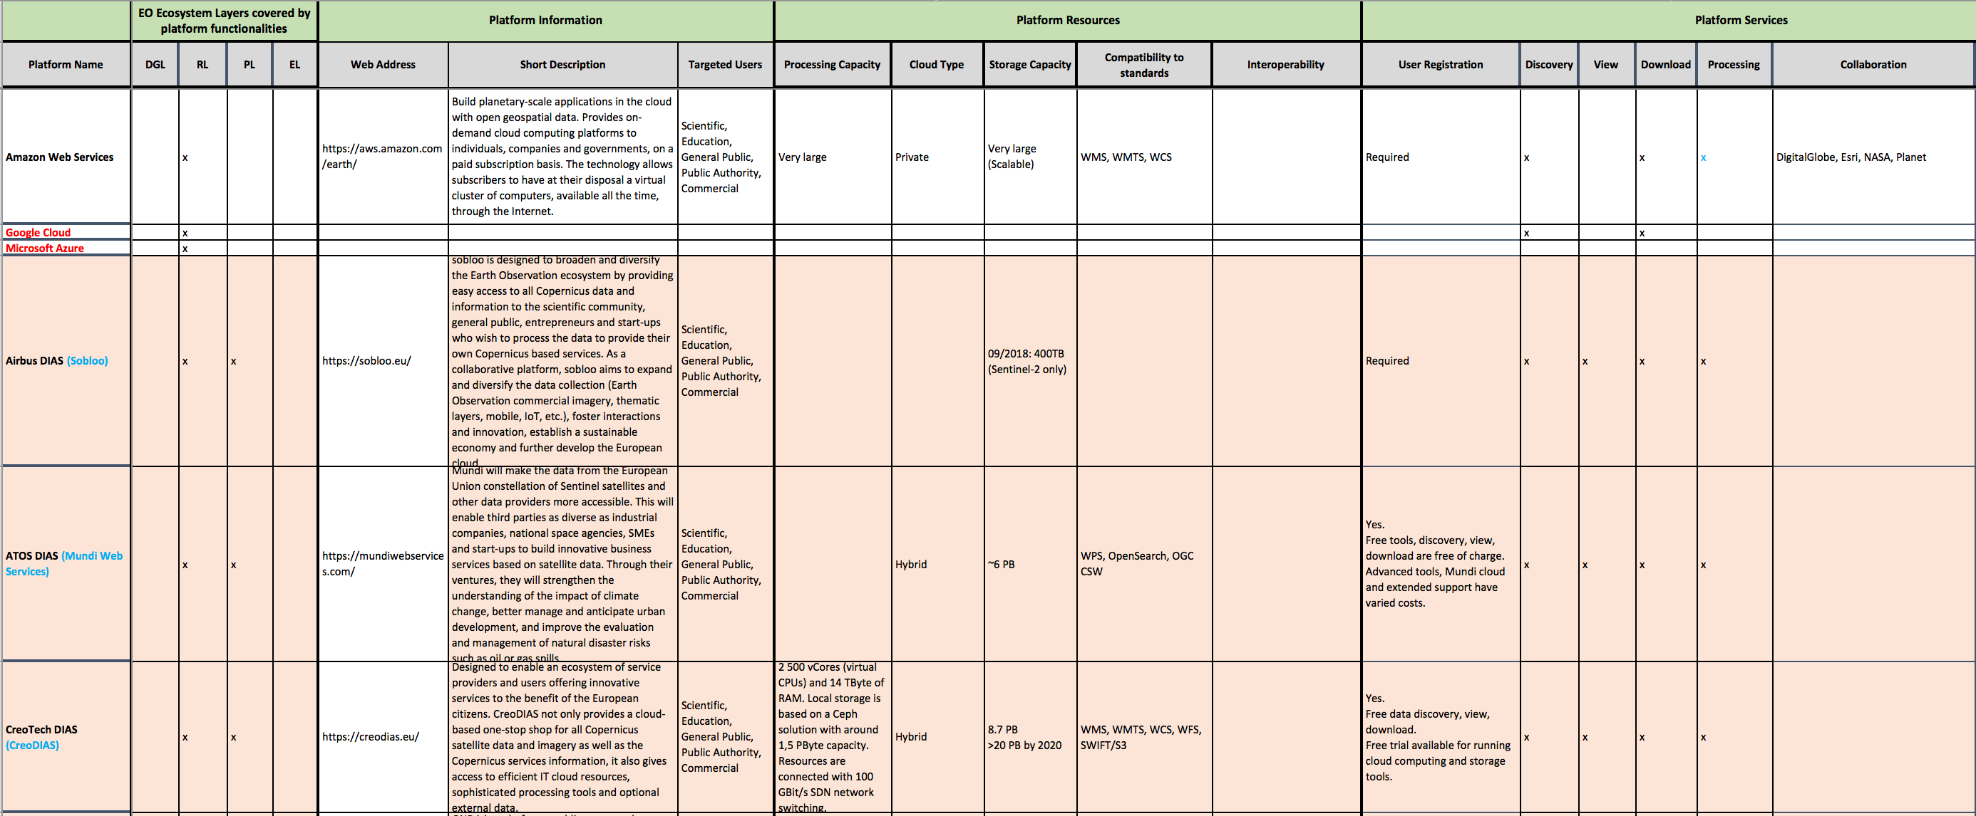
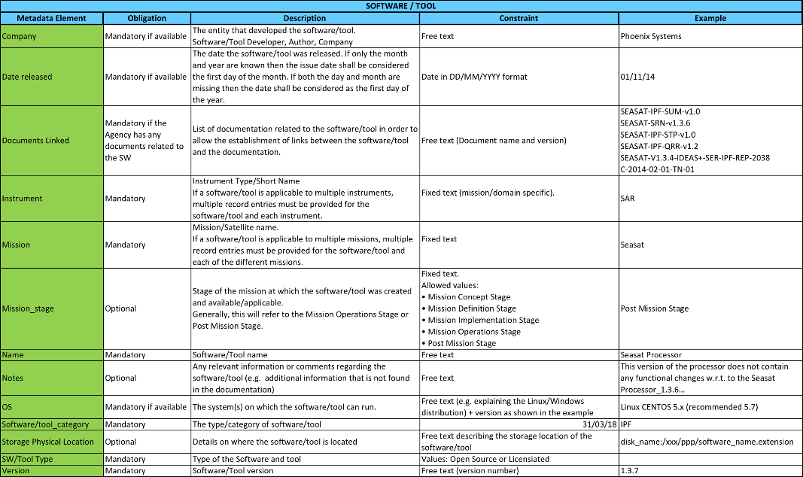
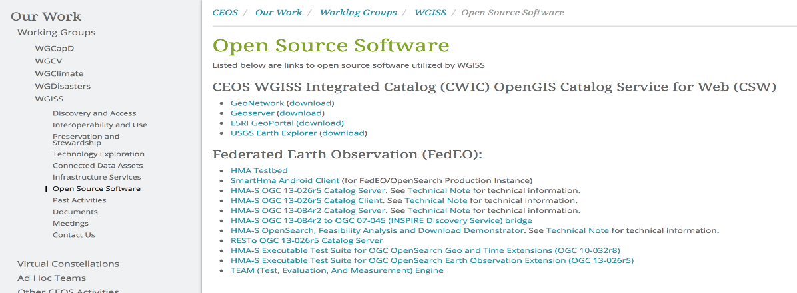
Inventories: 1) FDA Elements; 2) Open Source SW and Tools
  FDA-9: Inventory and characterize existing FDAs operated by both public and private entities
Template defined in coordination with FDA-AHT
Inventory being filled-up with information collected from different sources
  FDA-10: Inventory of CEOS agencies (Open Source) Software and Tools and implement a mechanism for discovery and access
Template defined
Inventory being filled-up with information collected from WGISS members
Notes:
Consensus that an inventory of “EO use environments” is a useful exercise that will provide insight into the EO ecosystem

Slide 20
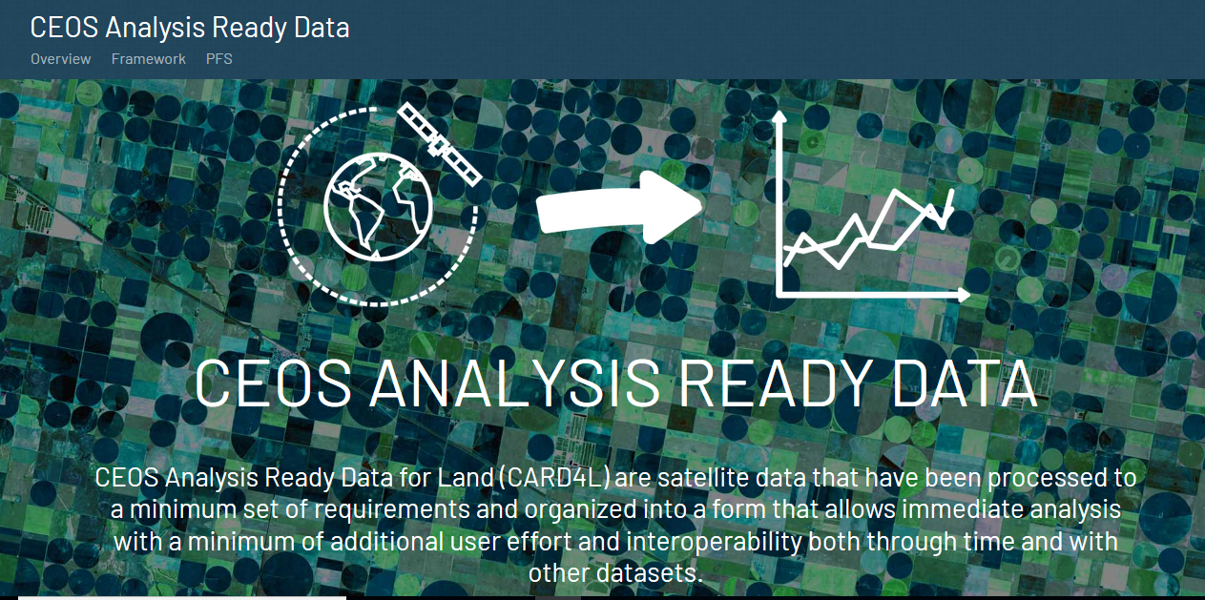
CARD4L
http://ceos.org/ard/

Slide 21
WGISS and WGCV
WGCV – Ongoing around four different topics:
  Data Formats and Interoperability in the framework of FDA
  Quality Indicators in Discovery Metadata
  CEOS Data Cubes and CEOS Test Sites Data Access in support of WGCV Activities
  Standardization and Best Practices

Slide 22
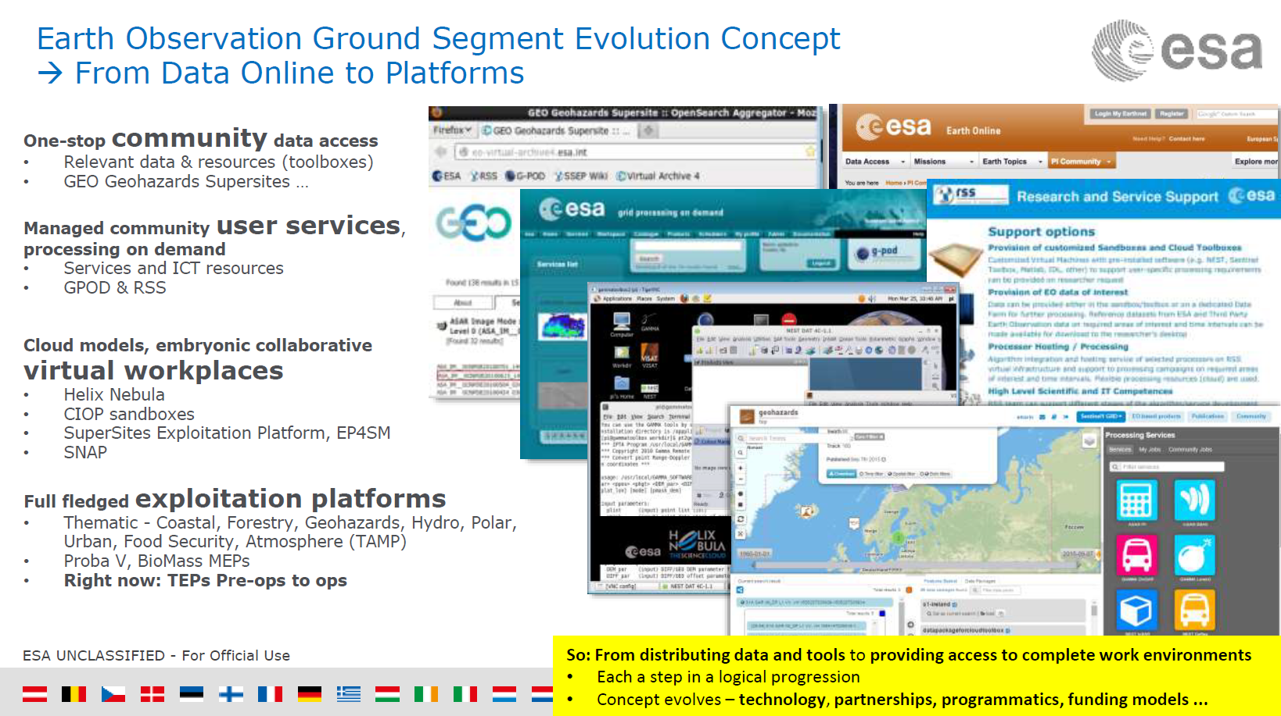
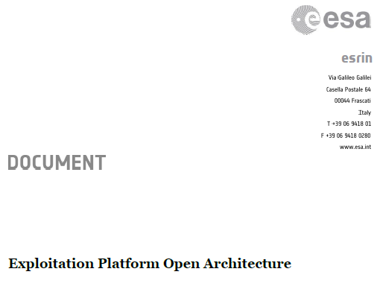
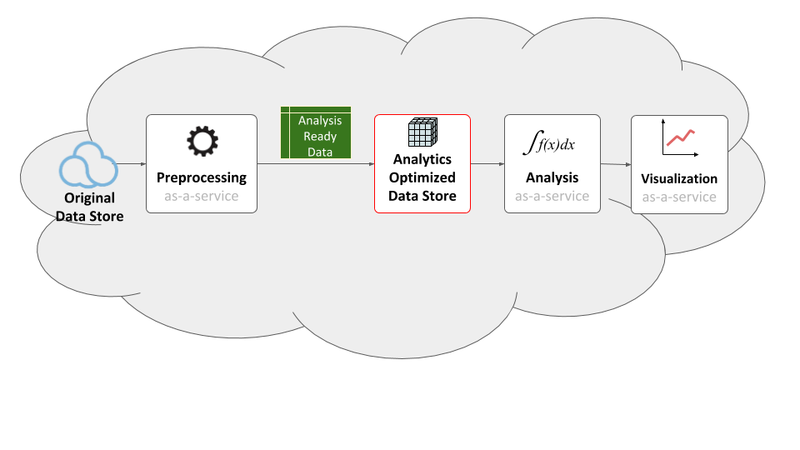
How: Similar. But…
Swiss Data Cube
Chris Lynnes, NASA
Notes:
Governance and actor scale is arguably with in the bounds of an “organisation”.
GEO, UN SDG, needs scalability without the expotential rise of over head in communication.
This means some modules inside an application need to be accessible to support independent third party actors scaling.

Slide 23
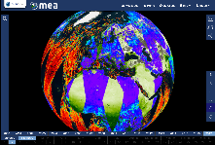






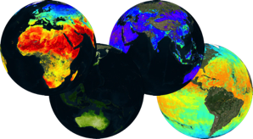
A big thing…innovation rate
Elevating Agency FDA components to WGISS CEOS Information Systems? (ESA TPM…)
Web based GUI
(including third-party applications)
Jupyter Notebook
CLI / REST API
Visualization layer
Standardised data access interfaces allow connecting a wide range of user interfaces
Datacube Engine/API VMs
The deployment of DAS in front of each data source enables effective access services
Data layer
Data remain at their own location (multiple data centers) with the original data format
Mission-specific data
Thematic data
Other geospatial data
Notes:
Rate of technology change vs rate of CEOS (WGISS) change?
Clearly, extraordinary EO analytics scales can be achieved for multiple domains and applications across multiple CEOS data sets – at what cost? Can CEOS make it cheaper and faster

Slide 24

What does help look like?
A joint response…
  Do no harm
  Empower all
  Drive down effort and time
  Remove undifferentiated heavy lifting at the CEOS end
This Photo by Unknown Author is licensed under CC BY-NC-ND

Slide 25
Data Analytics
Data Analytics was identified early in the FDA process as a neglected theme in terms of CEOS coordination. Improved data analysis is also seen as a key driver to increase the usability and use of Earth Observation data, in particular by user communities, which have not been acquainted with EO.
a) It is important to get a more complete picture of the range and the state-of-the-art of EO data analytics in the CEOS context. Specific communities, such as the Artificial Intelligence (AI) community are already formulating specific requirements toward EO data and product providers.
b) It is important to agree on a systematic process and supporting mechanisms to integrate Data Analytics as a highly relevant FDA theme in the CEOS environment.
→ Recommendation: task relevant CEOS groups to discuss/agree on the best perimeter and mechanisms to be applied to the Data Analytics theme.

Slide 26
Discovery expands
Collections and Granules: CEOS WGISS IDN, CWIC FedEO, Open Search
  A few options but manageable
  Can we build out from something that is working in CEOS?
What about?
  Replicas (caches) on Big Data hosts
  Algorithms and applications
  Provenance and Repeatability
  Versioning
  Insitu data and validation tools and references
And, joins?
  This algorithm on that compute that also has this data
  SAR and Optical with these wavelengths over a region in this time period
And with baked in analysis?
  X% cloud free over my area of interest (not a % of a scene)
  With “water”, “urban area”, “bare earth”, “ships”…
And languages, vocabularies
  …

Slide 27
Scalable community
Coordination of FDA interoperability
  How much knowledge can be assumed? OGC, Cloud architectures
  …can we focus on what CEOS community must coordinate or do we need to deal with details?
    These choices directly impact FDA-08 whitepaper content
  Modularity levels for CEOS agency services and data – where are the correct boundaries?
  Self assessment tool->Peer Review by WGISS->Support/guidance – like LSI-VC Card4L approach?
GOES-WGISS FDA?
  Core infrastructure services for Community Authority role?
  Propogating knowledge – instant gratification tooling?

Slide 28
Do you agree?
Analysis Ready Data (ARD) is no longer a desire of global users, but is now becoming a requirement and an expectation
CEOS needs to make it easier for global users to get ARD
Notes:
It seems to me the simplified world view is insufficient to the task at hand.

Slide 29
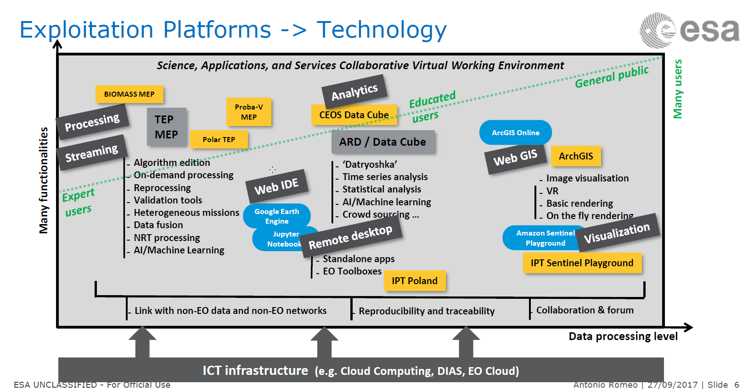
User spectrum

Slide 30
GEOSS Satellite Earth Observation Resources
This cross-cutting task aims to ensure the long-term availability of the sustained, coordinated, comprehensive satellite Earth observation data that is a critical component of GEOSS and a key enabler of current and future GEO Community Activities, Initiatives, and Flagships.
Specify, develop, launch, operate and coordinate space missions to provide new observations, sustain critical time-series, and fill or minimize spatial or temporal gaps in the satellite observations required to support sustained production of fundamental variable sets as defined through the GEO requirements and analysis processes.
Promote the development and implementation of technologies and the uptake of best practices to enhance space data access in support of the evolution of the GEOSS, particularly focusing on enhanced access to space data via the GCI.
Support broader GEO efforts to promote EO by providing evidence of the unique, and complementary, value of satellite data to successful delivery of major regional and global initiatives.
Coordinate increased interoperability among space data infrastructures and develop integrated global and regional space datasets that support validated and prioritized requirements identified through GEO processes
Identify and coordinate the necessary actions for the protection of the radiofrequency bands necessary to ensure proper operation of EO instruments.

Slide 31
GEO/CEOS alignment (2/3)
Activities | Lead | GEO EO4SDG (with support of GEO initiatives) | CEOS ADH SDGs (with support of other CEOS bodies)
Capacity building | GEO | Coordinate the capacity building efforts with custodian Agencies and other GEO initiatives including the GEO WG-CB GEO also developed a number of privileged contacts with pilot countries | Support provided on an ad-hoc basis (with CEOS WGCapD) Conduct capacity building activities in coordination with EO4SDG (with WGCapD, other CEOS WGs) ?
EO enabling infrastructures for SDGs (platforms and toolboxes) | CEOS | Support CEOS on deploying Open Data Cube in countries | CEOS SEO through AHT SDG (Open Data Cube) Develop examples of data cube outputs to address key sustainability needs & SDG indicators Not prescriptive – Open to all relevant tools and platforms
Satellite Analysis Read Data (ARD) for the SDGs | CEOS | Express ARD needs from SDG community | CEOS FDA/VC-LSI through AHT SDG (ARD analysis) But CEOS FDA planned to be phased out after CEOS 32 Plenary
EO long term data continuity (For SDG indicators baseline and regular future reporting) | CEOS | Express EO data needs from SDG community | analysis of the satellite data availability (legacy data and long term continuity) for each of the SDG indicators

Slide 32
GEO/CEOS alignment (3/3)
Activities | Lead | GEO EO4SDG (with support of GEO initiatives) | CEOS ADH SDGs (with support of other CEOS bodies)
EO Data products validation / standardization / certification | CEOS | Express validation/standardisation needs from SDG community | CEOS WGCV through AHT SDG
EO Promotion and Outreach in the SDG community | GEO | Manage the EO4SDG Portal and communication material | support provided on ad-hoc basis But important that CEOS appears in the communication
EO4SDG Awards to be announced at the GEO Plenary & rolled out in January 2019 timeframe | GEO | EO4SDG will conduct annual awards for exemplary uses of EO to support the SDGs and their respective targets and indicators | Serve in the Evaluation Panel and Award Selection Committee
(long term objective) Develop EO4SDG Portal into a SDG interactive knowledge resource | GEO & CEOS | EO4SDG Portal: evolution into a SDG EO knowledge Hub,: Official Metadata & Guideline on how EO is integrated in SDG metrics (per indicator). Best practices, lessons learned, valuation and impact assessment, inventory of tools and platforms available (per indicator) Access to on-line platforms for calculating EO metrics | CEOS can contribute to the building of the EO knowledge Hub for SDGs and lead the development of on-line platforms. to be integrated in the GEO EO4SDG portal: open-source tools for calculating EO metrics for all relevant SDGs [in collaboration with other CEOS WGs / AHTs, i.e., CEOS SEO, other]

