Slide 1

FDA Topics Going Forward…???
Committee on Earth Observation Satellites
WGISS 46 2018
Dr Robert Woodcock

Slide 2
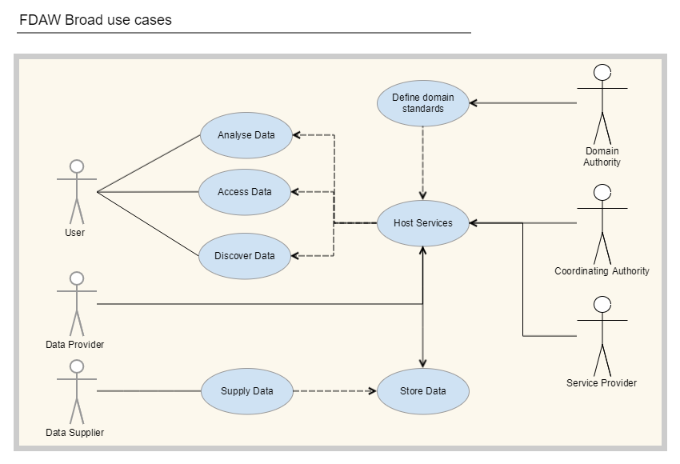
Role of WGISS in FDA
(Chair report)
CEOS
Information
System
Notes:
Data Provider
Provides EO or other information services to CEOS community and users. The Data Provider remains the custodian of the data.
USGS, ESA
Data Supplier
Supplies EO data or other information resources to Data Provider
Data Distributor
Provides an alternate, non-custodial, storage location and distribution service.
AWS Public Datasets, Google Earth Engine
Service Provider
Publishes a service. There are a wide range of service types including discovery, data access, calibration, validation, analysis, archiving, provenance.
Domain authority
Provides community endorsed information models or vocabularies for adoption within the CEOS community
WGISS, LSI-VC, WGCV
Coordinating authority
Provides essential coordination and integration services for the broader community
WGISS
User
Discovers and accesses information and analytics through the FDAW services
May include machine users, such as decision support and monitoring systems

Slide 3
A few things…
User experience – how? (WGISS Chair report)
  Work with WGCapD – better access to broad users through training materials and feedback?
  Instant gratification – working code/tools?
Maturity assessment (WMO)
  An FDA Self-assessment tool?
Do we need an IGSN/DOI/… equivalent for CEOS to track provenance and use of data regardless of replication (EVER-EST)?
  What else would WGISS need to do to support these types of systems?
Metrics system API (Measuring EO data usage)
  Do we need a CEOS API for the metrics data gathering and contribution? – “all to hard to do in one step”
  Metrics collection in Cloud?
  Impact metrics – DOIs and a h-index for Data? Does CEOS (FDA) create the necessary ecosystem for a Journal/end user to create impact metrics CEOS can use?

Slide 4
A few more things…
Robustness of the CEOS information systems - failover in a distributed system (CEOS SEO – Cove tool)
  At least a monitoring tool should be in place to show CEOS Information Systems status?
  A cache of the metadata for performance and failover?
Automating Governance (Connected Data Assets…)
  Service/data source/metatdata out of date, notifying managers, etc – robots to help run our world?
  Scaling discovery annotation for non-ceos user-communities
    Can CEOS services support/not prevent this?

Slide 5
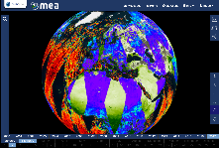






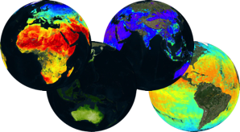
A big thing…innovation rate
Elevating Agency FDA components to WGISS CEOS Information Systems? (ESA TPM…)
Web based GUI
(including third-party applications)
Jupyter Notebook
CLI / REST API
Visualization layer
Standardised data access interfaces allow connecting a wide range of user interfaces
Datacube Engine/API VMs
The deployment of DAS in front of each data source enables effective access services
Data layer
Data remain at their own location (multiple data centers) with the original data format
Mission-specific data
Thematic data
Other geospatial data
Notes:
Rate of technology change vs rate of CEOS (WGISS) change?
Clearly, extraordinary EO analytics scales can be achieved for multiple domains and applications across multiple CEOS data sets – at what cost? Can CEOS make it cheaper and faster

Slide 6
A bigger thing…?
Understanding implications in
  Governance
  Economics

Slide 7
CEOS VAST Chair initiative
(Chair report)
Forest and Rice monitoring application using FDA in Mekong Delta
  A good FDA use-case?
    Less encumbered by established systems and “group-think”
  Direct WGISS link in implementation via CSIRO and CEOS SEO
WGISS assist in coordinating FDA actions for the specific work outcome
  Coordinate some of our FDA implementation efforts to improve WGISS Information Systems for
    Provenance
    Discovery – algorithms and data (and joins)
    Dynamic ARD pipelines
    SAR/Optical and Data Cube training (WGISS+WGCapD)

