Slide 1
Single Sign-On (SSO) Authentication
Marco Leonardi
23/10/2018

Slide 2
Summary
ESA Earth Observation Single Sign On
ESA Pathfinder activities
ESA Plans for standard and interoperable authentication solutions
DATA-14 White paper on Single Sign On Authentication

Slide 3
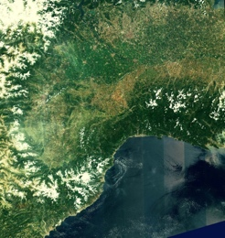
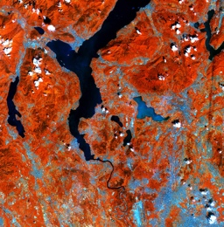
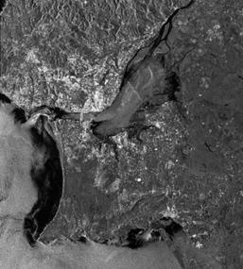
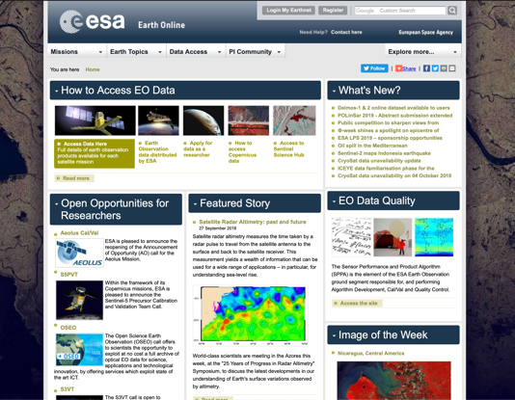
ESA Earth Observation Single Sign On (1)
Heterogeneous users communities
Protected
ESA EO Resources
ESA EOSSO Self-Registration Service
ESA EO Services
Attributes
Authorisation
(ABAC)
Authentication
ESA EO Users Community

Slide 4
ESA Earth Observation Single Sign On (2)
What’s behind the “Single sign-on”?
SAML2
Ad-hoc solutions for legacy services
(i.e. ftp)
Central
Repository
Centralised Access Policies Based on Attributes

Slide 5
ESA Pathfinder activities – Achievements in 2018
Successfull Cloud services access pilot:
Scope of the pilot was to:
experiment cloud-based Identity and Access Management mechanisms for EO Applications by using different authentication/authorisation technologies like SAML, OAuth, OpenID Connect
Integrate such AAI with the most representative cloud services management software like Ceph and Keystone
Successfull ESA Earth Observation federation pilot:
This pilot implements a working SAML federation between different ESA EO departements by also supporting social media login capabilities (i.e. Facebook and Google)
Successfull federation pilot between space organizations:
This pilot implements working SAML federations between different organizations like ESA, DLR and EUMETSAT (services and identity providers)

Slide 6
ESA Plan for standard and interoperable authentication solutions
ESA is performing an evolution in its user and identity management infrastructure aiming at standardising architectures and processes in line with the results of the most recent initiatives in this field like in example the AARC Blueprint Architecture
The new ESA Earth Observation Identity and Access Management Infrastructure (EO-IAM) will allow user access to satellite data and to the Exploitation Platforms’ services by supporting standard digital identities federations (and interfederations like eduGAIN)
The new ESA EO-IAM will be able to make the federated user identification an enabler for the Exploitation Platforms in the context of the Network of EO Resources

Slide 7
DATA-14 White paper on Single Sign On Authentication
The aim of the new white paper will be to promote the best practices for the (federated) single sign on authentication
International working groups and research organizations are working on this topic since many years with the objective of creating a shared approach to the identity and access management needs
«Interoperability» is one of the main drivers and «federation» is one of the most promising solutions
Interoperable federations for single sign on authentication need to share best prectices and standard architectures
International space organizations and scientific communities active in the field of the Earth Observation can cooperate in order to improve the way the EO Data resources can be accessed by the users

Slide 8
Marco Leonardi
EO Software Engineer
Phone: +39 06 941 88644
Email: marco.leonardi1@esa.int
QUESTIONS?

