Slide 1
AI4EO
A presentation to CEOS WGISS-46
From the ESRIN Φ-lab, 23 October 2018
Sveinung Loekken, ESA
Directorate of Earth Observation Programmes
Future Systems Department, Φ-Lab Explore
Notes:
Who could explain the third law of thermodynamics?

Slide 2
We are now at a cross road of opportunities, where on the one hand AI is becoming one of the most transformative technologies of the 21st century, while European EO capability and the overall observing system is delivering a unique and comprehensive picture of the planet, generating massive, open data sets
Making the most of this window of opportunity is the challenge, and an urgent one
Notes:
A workshop in March 2018 ESRIN with leaders in the European R&D community
And a following industry workshop in May

Slide 3
Prez in a slide
Revolutionary changes in sensing and ICT create opportunities and challenges for Earth Observation
AI is transforming industries. Will it transform EO?
We’re late !
Require fundamental and applied R&I; reference and analysis ready data; infrastructure; ecosystem; training; …
Must act now in order to boost competitiveness, as well as the uptake and impact of EO data
Notes:
We’ve spent 8-10 Billion on Copernicus observing system
A crossroads of revolutionary opportunities

Slide 4
Revolution
Notes:
We’ve spent 8-10 Billion on Copernicus observing system
A crossroads of revolutionary opportunities

Slide 5
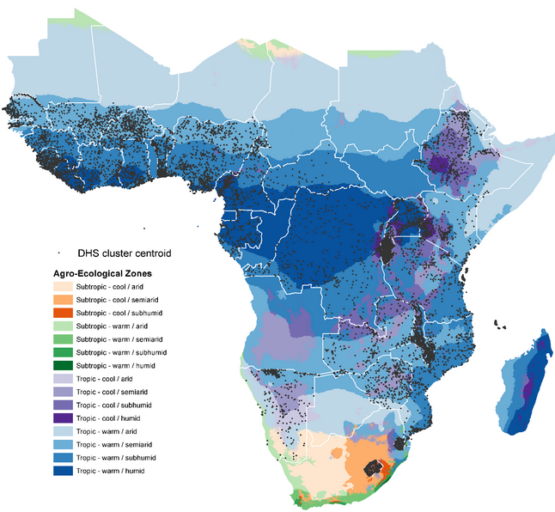
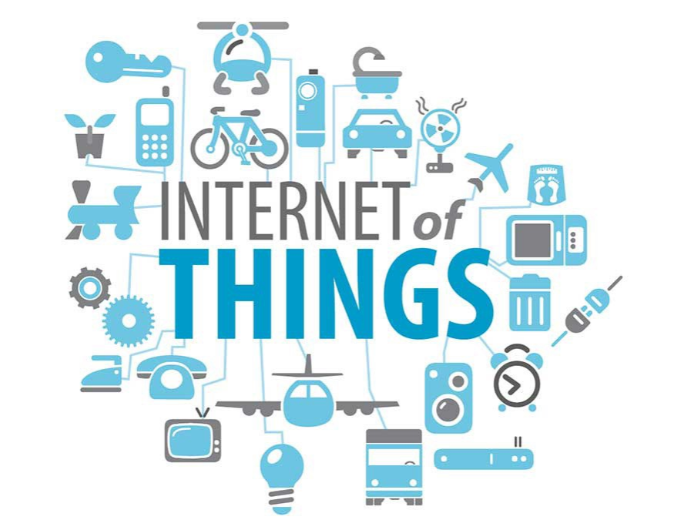
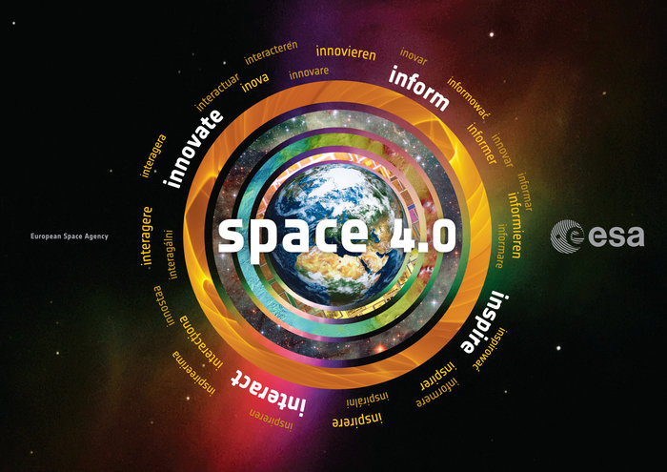
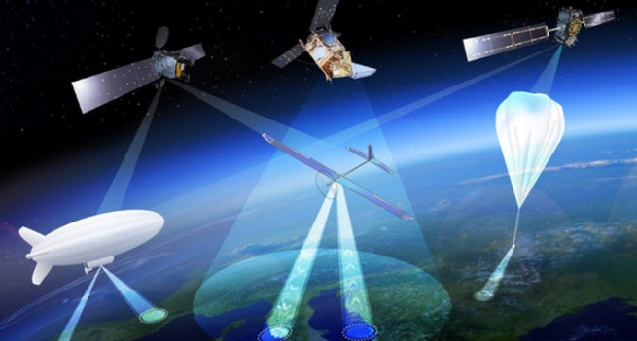
The sensing revolution
Notes:
1. We are in the presence a revolutionary increase in observational capability – a veritable sensing revolution:
European primacy: Copernicus, ESA Earth Explorers, the Meteorology missions, and European national missions provide the best operational, sustained space-based earth-observing system in the world
New Space players, like Ice Eye, Cosine, EarthI, Planet, and others launch cheaper, smaller, and less precise earth observation missions
So space-based EO has matured: EO is Operational and Sustained; Commoditized and Commercial; and Europe holds the primacy
In addition, platforms like HAPs and even drones make complementary observations on a different scale of geography and phenomenon, and
the Internet of things is made up of a billions of sensors, made for different purposes, but also providing a host of data on the earth
IN addition comes the enormous quantities of social media and socioeconomic data and derived information – geolovated or not
This ‘Intelligent Network of Sensors’ provide a view of the planet, of unprecedented scale(s) and precision …
We need the capability to translate this into value

Slide 6
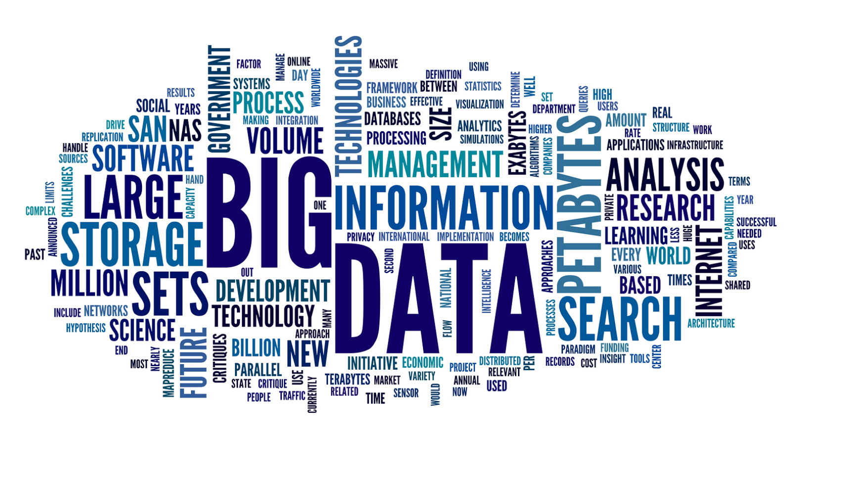
The (Big) data revolution
Notes:
But what is the value of data? The value of the data itself is nothing, Big Data in itself is actually a liability.
The output of the sensing revolution is BIG EO DATA
Big Data works on the principle that the more you know about anything or any situation, the more reliably you can gain new insights and make predictions about what will happen in the future. By comparing more data points, relationships will begin to emerge that were previously hidden, and these relationships will enable us to learn, and inform our decisions
The Value of big data comes only when we do something to it to extract insights. We need value extraction that matches the richness of the observing system
--------------------------
Big data starts with the exponential explosion in the amount of data we have generated since the dawn of the digital age. This is largely due to the rise of computers, the Internet and technology capable of capturing information from the real, physical world we live in, and converting it to digital data.
Right now this data is used to:
Cure disease and prevent cancer – Data-driven medicine
Feed the hungry – Agriculture is being revolutionized by data which can be used to maximize crop yields, minimize the amount of pollutants
Explore distant planets – we collect and analyzes millions of data points to model every eventuality to land sensors on the surface of Mars
Monitor, predict, and react to changes in the earth’s climate
Predict and respond to natural and man-made disasters
Prevent crime – Police forces are increasingly adopting data-driven strategies based on their own intelligence and public data sets in order to deploy resources more efficiently and act as a deterrent where one is needed.
Make our everyday lives easier and more convenient – Shopping online, crowdsourcing a ride or a place to stay on holiday, choosing the best time to book flights
Today, Big Data gives us unprecedented insights and opportunities, but it also raises concerns and questions that must be addressed:
Data privacy – The Big Data we now generate contains a lot of information about our personal lives,
Data security – Even if we decide we are happy for someone to have our data for a particular purpose, can we trust them to keep it safe?
Data discrimination – When everything is known, will it become acceptable to discriminate against people based on data we have on their lives?

Slide 7
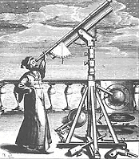
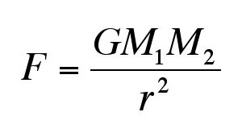
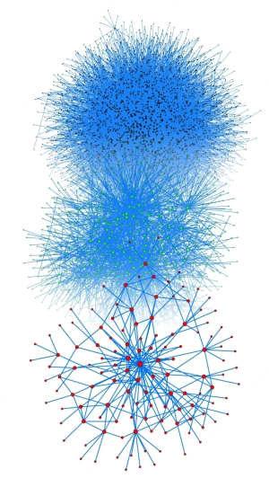
The 4th Paradigm of Scientific Discovery
Experimental
Theoretical
Computational
Data Intensive
Last Millennia
Last Centuries
Last Decades
Now & Future
Observation and Description of Natural Phenomena
Observational astronomy
Newton’s laws, Maxwell’s equations
Simulation of Complex Phenomena
Climate models
Unify theory, experiment & simulation with multidisciplinary data & distributed communities
Notes:
The way we do science is changing
Increasingly, scientific breakthroughs will be powered by advanced computing capabilities that help researchers manipulate and explore massive datasets.
Jim Gray, a Technical Fellow and visionary at Microsoft's eScience group, who was lost at sea in 2007, defined the Fourth Paradigm of scientific exploration
Experimental: Babylonian star catalogues from 1200, the Copernican rebvolution (observations of lunar motions on 9 March 1497)
Theoretical: Exemplified by Newton’s law of universal gravitation; or Maxwells equations forming the theoretical foundation for classical electromagnetism
Computational: Exemplified by physical mathematical models that allow for understanding and predicting phenomena
Data intensive: enabled by new technologies for gathering, manipulating, analysing and displaying data.

Slide 8
The ICT revolution
Changes in the technologies, tools, operations concepts, and business models addressing Big Data
Cloud and Fog computing (XaaS); Platforms / user to the data; Open source frameworks and tools; Distributed value chains; Distributed ledgers; IoT; IDEs; Analysis ready data …
&
Advanced data analytics: AI, ML, DL
Massive increase in data handling and analytical capability
Notes:
How do make sense of it all, how to extract value from the data?

Slide 9
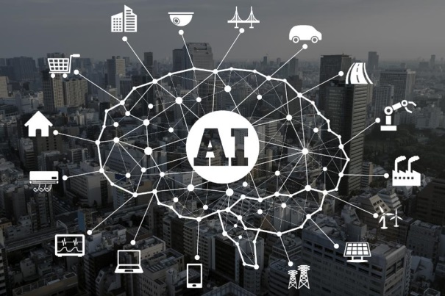
The AI revolution
The raise of AI and the DL revolution
From AI-winters to everyday use: 2010 + and imagenet; HPC and Cloud; data and algorithms- deep Neural networks
“The new ‘electricity’ fuelling the 4th Industrial revolution”
AI is Transforming industries; e.g. self-driving cars
Will the same transformative effect take place in Space, and in EO?
Notes:
Not a rethorical question – the basics are different – human scale phenomena and object recognition 0 cats and dogs in JPEGS

Slide 10
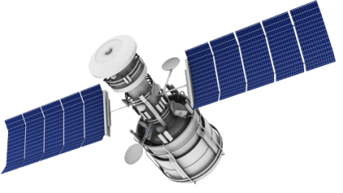
The Jurassic data value chain
Curation,
Preparation, Storage, Dissemination
Exploitation
Acquisition
You are here
Notes:
A simple data value chain, applied to EO, but generally true for all kinds of data
We now have the best observing system in the world. Are at exploitation. Does not mean that the observing system is complete
EO data has very high first copy cost, very low marginal cost
The traditional value chjain cannot cope with

Slide 11
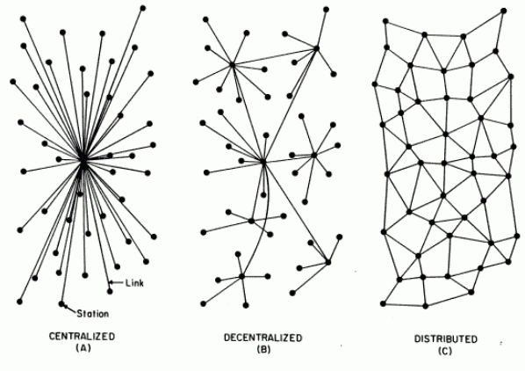
Towards a new data value chain
Operational
Sustained
Commoditized
Commercial
Multi-source
Heterogeneous
Distributed
Automated
Advanced analytics – AI and models
Notes:
How do make sense of it all, how to extract value from the data?

Slide 12
Challenge and Opportunity
Notes:
We’ve spent 8-10 Billion on Copernicus observing system
A crossroads of revolutionary opportunities

Slide 13
Challenges
Making sense of the vast and diverse amount of EO (and other) data
Physically-based and indirect measurement of geophysical parameters estimated from remotely sensed physical quantities across the whole electromagnetic spectrum
Observe (and reason about) phenomena from human to global scales
Very high dimensional data – hampers direct application of DL models
Integration of physical principles into statistical algorithms of AI
Diversity of data - multispectral optical, radar, etc
Volume of data – how to go from petabytes to ‘a few good numbers’?
Complexity of data - capturing dynamic features of a highly non-linear coupled Earth System; not cats and dogs in images
… and then we mix in other sources …

Slide 14
Challenges (II)
Time – hello future EO!
Programmatics – common objectives, use of resources
Community – Research, industry, AI and EO, ICT
Competition – EO vs. social media and self driving cars
Data – Analysis ready, Reference
Basics - Infrastructure, tools, frameworks, open source
Notes:
Programmatics – a common agenda that allows for the support of evoltion in the fields
Community – collaborate, now driven mostly by ICT industry , bridge between industry and research
Competition – difficult top attract ai talent
Training data and analysis ready data
Infrastructire

Slide 15
Opportunity
‘AI for Good’ – EO value for society, science, business, jobs, …
Target: exploitation in line with the observing system
We are now at a cross roads of opportunities, where on the one hand AI is becoming one of the most transformative technologies of the 21st century, while on the other hand European EO capability is delivering a totally unique and comprehensive picture of the planet, thereby generating big open data sets to be explored by AI
Revolutionary increase in the uptake and impact of EO data

Slide 16
Agenda
Notes:
We’ve spent 8-10 Billion on Copernicus observing system
A crossroads of revolutionary opportunities

Slide 17
Community recommendations
Exploratory activities
Fundamental research AI4EO (including Exploratory / Proof of Concept studies), XAI, EO-specific fundamental problems
Demonstration activities - portfolio of use cases in partnership with industry, real problems/grand challenges
Challenges activities - a suite of AI challenges, addressing data scientists and innovators
Capacity building activities
Open data sets, reference training data, analysis ready data
Expertise and training
Tools and infrastructure
Ecosystem building activities
An ecosystem of of AI4EO actors under a single banner, including the research community, the private sector, Startup and investor ecosystem, addressing the challenges of AI4EO
Notes:
Fundamental
Challenges: Development of a suite of AI challenges, addressing data scientist and innovators, using innovation platform like Kaggle [kaggle.com], Kelvins [kelvins.esa.int], or other crowdsourcing tools
Ecosystem- The idea here is to build an interdisciplinary ecosystem of European AI4EO actors under a single banner, bringing together research, industry, institutions, and users, and based on the major challenges of AI4EO. Actions aim to foster bi-directional bridging among communities, formulate common objectives, stimulate synergies, conduct common activities, initiatives, and programmes and develop, attract, and retain expertise.

Slide 18
Timely need for a European initiative
Enable rapid transfer of AI knowledge, techniques and expertise from data scientists to the world of EO research (in both directions) and business applications
Foster new partnerships with non-space and ICT players
Develop and rapidly prototype innovative AI-based EO solutions by providing the necessary digital infrastructure, data and tools
Empower the new generation of researchers, data entrepreneurs, and digital startups with AI4EO capability
Harness the involvement of citizens through crowdsourcing, by integrating this data stream into innovative solutions
Deliver economic impact and create jobs in Europe by creating AI-powered EO solutions addressing real industry challenges

Slide 19
Conclusions
Unique and timely opportunity now to play a major enabling role in the scientific and societal AI revolution that is underway by enabling AI4EO at a large European scale
Revolutionary changes in sensing, AI, ICT, and related technologies create new and huge opportunities and challenges for EO data exploitation
AI is “The new ‘electricity’ fuelling the 4th Industrial revolution”, and the key that will unlock the untapped potential of EO data streams
Competition is fierce and Europe is lagging
Urgent, concerted and targeted action required to ensure (also) European competitiveness

Slide 20
Thanks!
Sveinung.Loekken@esa.int
www.esa.int

