Slide 1
ESA Pilot Datacube for TPMs/HMs/EEs
Andrea Della Vecchia, Mirko Albani, Damiano Guerrucci (ESA)
Simone Mantovani (MEEO)
23/10/2018

Slide 2
Introduction
Collaborative Environment
Example of current Collaborative Environments
Thematic Exploitation Platform
Mission Exploitation Platform
Joint ESA-NASA Multi-Mission Analysis Platform
ESA Collaborative Environment

Slide 3
Introduction
Collaborative Environment
Example of current Collaborative Environments
Thematic Exploitation Platform
Mission Exploitation Platform
Joint ESA-NASA Multi-Mission Analysis Platform
ESA Collaborative Environment

Slide 4
Collaborative Environment
EO collaborative environment is a virtual working environment providing access to EO data and analysis tools, processors, information and Communication Technology resources required to work with them, through one coherent interface.
A collaborative environment aims to change the paradigm from
“data to user“ to “user to data”

Slide 5
Introduction
Collaborative Environment
Example of current Collaborative Environments
Thematic Exploitation Platform
Mission Exploitation Platform
Joint ESA-NASA Multi-Mission Analysis Platform
ESA Collaborative Environment

Slide 6
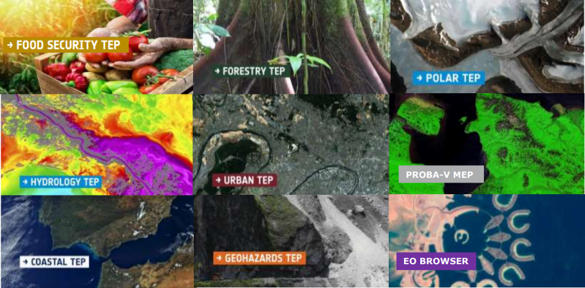
Thematic Exploitation Platform - TEP
https://tep.eo.esa.int/
In this context ESA has started in 2014 the EO Exploitation Platforms (EPs) initiative, a set of R&D activities that in the first phase (up to 2017) aims to create an ecosystem of interconnected Thematic Exploitation Platforms (TEPs) on European footing, addressing:
Coastal
Forestry
Hydrology
Geohazards
Polar
Urban themes
Food Security (under definition)
TEP presentation at CEOS WGISS#44

Slide 7
PV Mission Exploitation Platform – MEP
The PROBA-V Mission Exploitation Platform (PV-MEP) is an ESA pathfinder project aiming to:
Build and operational Exploitation Platform
Give full access to PROBA-V data repository (@VITO PDF)
Integrate, correlative data and derived products addressing the wider vegetation user community with the final aim to ease and foster the use of PROBA-V data.

Slide 8

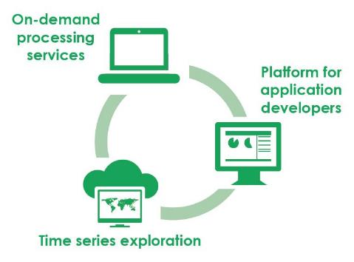
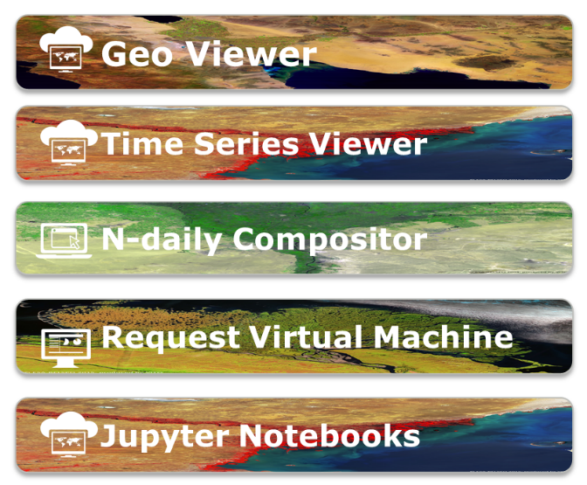
Proba-V MEP – Tools
https://proba-v-mep.esa.int/
(*) only operations & EC funded – limited to viewers
(**) http://viewer.globalland.vgt.vito.be/viewer/
http://viewer.globalland.vgt.vito.be/tsviewer/
Copernicus Global Land (*) (**)
SPOT-VEGETATION
Proba-V

Slide 9






Joint ESA-NASA
Multi-Mission Analysis Platform (MAP)

Slide 10

Joint Biomass-NISAR-GEDI MAP
Transparent access to the content of both platforms
ESA NASA MEP
NASA Mission
Data
NASA Mission
Tools&Visu
ESA-NASA
Missions
Community
ESA Mission
Data
ESA Mission
Tools&Visu
NASA Mission
Processing
resources
ESA Mission
Processing
resources
Up to date data and algorithms
Cohesive community

Slide 11
Joint ESA-NASA MAP Objectives
To provide to the users a common virtual working environment
Federation of two (or more) platforms to allow to both US and European users a transparent access to the content of both platforms, CEOS WGISS guidelines shall be considered
To allow end-users to access up-to-date data and algorithms for biomass estimation and to increase the cohesion of the P/L-band SAR and biosphere communities
The capabilities envisioned for the MAP will enable for the first time efficient and tailorable intercomparison, cross-calibration, and fusion of data from these missions for a broad class of scientists and other users (notably with respective ground segments and cal/val activities)

Slide 12
Introduction
Collaborative Environment
Example of current Collaborative Environments
Thematic Exploitation Platform
Mission Exploitation Platform
Joint ESA-NASA Multi-Mission Analysis Platform
ESA Collaborative Environment

Slide 13
ESA Collaborative Environment
To provide the ESA PDGS with a set of interoperable and federated services permitting the users to:
Access to missions/platforms information supported by a common ontology
Discovery and, if possible, direct download of EO data:
  Copernicus Missions (e.g., Sentinels)
  Third Party Missions - TPMs (e.g. SPOT, Landsat …)
  Heritage Missions - HMs (e.g., ERS-1/2, ENVISAT instruments …)
  Earth Explorer – EEs (e.g., SMOS, Cryosat, SWARM, …)
  International repositories (e.g., NASA CMR, CEOS IDN)
Discovery and access to basic services (e.g., datacube):
  Browse/visualization tools and time series extraction
  EO data extraction, resampling and reprojection
Hosted Processing for authorised users/communities (e.g., CAL/VAL)

Slide 14
M2M Interfaces
EO Data Visualization and pre-analysis clients
Catalogue Clients
Remote Desktop Access
  - CAL-VAL Activities
  - Access Point for Application Platforms
International EO Gateway Information Page:
- CEOS IDN
Specific Mission Portal:
  - SWARM
  - SMOS
  - Cryosat
  - External
ESA PDGS Data Cube
Query
Data Access
Information Page:
- ESA EO Gateway
Multi Mission Portal
– ESA eoli
Population
Distribution Facility
Thesauri Service
Data/Service Catalogue
Hosted Processing
Online Data Storage
VM – CAL/VAL Processors
Web Service Interface (e.g., OADS, ftp, http)
VM – Browse Images Generation
VM – DataCube Engine/API
TPMs
EO-SIP
HMs
EO-SIP
EEs
EO-SIP
Core Services close to the data

Slide 15
M2M Interfaces
EO Data Visualization and pre-analysis clients
Catalogue Clients
Remote Desktop Access
  - CAL-VAL Activities
  - Access Point for Application Platforms
International EO Gateway Information Page:
- CEOS IDN
Specific Mission Portal:
  - SWARM
  - SMOS
  - Cryosat
  - External
ESA PDGS Data Cube
Query
Data Access
Information Page:
- ESA EO Gateway
Multi Mission Portal
– ESA eoli
Population
Distribution Facility
Thesauri Service
ESA Catalogue
TTO by Q1 2019
Data/Service Catalogue
Hosted Processing
Online Data Storage
VM – CAL/VAL Processors
Web Service Interface (e.g., OADS, ftp, http)
VM – Browse Images Generation
VM – DataCube Engine/API
TPMs
EO-SIP
HMs
EO-SIP
EEs
EO-SIP
Core Services close to the data

Slide 16
M2M Interfaces
EO Data Visualization and pre-analysis clients
Catalogue Clients
Remote Desktop Access
  - CAL-VAL Activities
  - Access Point for Application Platforms
International EO Gateway Information Page:
- CEOS IDN
Specific Mission Portal:
  - SWARM
  - SMOS
  - Cryosat
  - External
ESA PDGS Data Cube
Query
Data Access
Information Page:
- ESA EO Gateway
Multi Mission Portal
– ESA eoli
Population
Prototyping phase
by Dec ‘18
Distribution Facility
Thesauri Service
Data/Service Catalogue
Hosted Processing
Online Data Storage
VM – CAL/VAL Processors
Web Service Interface (e.g., OADS, ftp, http)
VM – Browse Images Generation
VM – DataCube Engine/API
TPMs
EO-SIP
HMs
EO-SIP
EEs
EO-SIP
Core Services close to the data

Slide 17

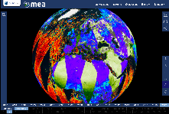


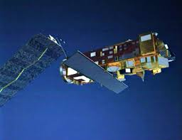
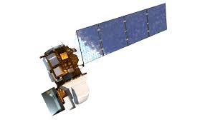
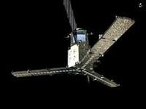
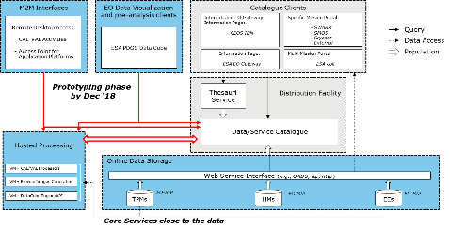
Web based GUI
(including third-party applications)
Jupyter Notebook
CLI / REST API
EO Data Visualization and pre-analysis clients
M2M Interfaces
Visualization layer
Standardised data access interfaces allow connecting a wide range of user interfaces
Hosted Processing
Datacube Engine/API VMs
The deployment of DAS in front of each data source enables effective access services
Online Data Storage
ESA
Third Party Missions
ESA
Heritage Missions
ESA
Earth Explorer
Data layer
Data remain at their own location (multiple data centers) with the original data format

Slide 18
TPMs online data storage @ESA
Mission | Product (~ 0.6 PB) | Collection Description | Data format | Online data storage https://tpm-ds.eo.esa.int/collections/ | Hosted processing
Landsat-5 | Level 1 (L1G, L1Gt, GEO_1P, GTC_1P) (Storage: 355 TB) | TOI: 04/1984 – 11/2011 (link) | EO-SIP (ZIP): - single band TIF | @ESA | @ESA (WCS link; GUI link)
Landsat- 7 | Level 1 (TC_1P) (Storage: 64 TB) | TOI:07/1999 – 12/2003 (link) | EO-SIP (ZIP): - single band TIF | @ESA | @ESA (WCS link; GUI link)
Tropforest | Multiple (Storage: 8TB) | TOI: 07/2006 – 04/2011 (link) | EO-SIP (ZIP): - ZIP - CEOS format | @ESA | @ESA (under registration)
SPOT-1-5_ESA | Level 1 Level 2 (Storage: 6TB) | TOI: 04/1986 – 11/2015 (link) | EO-SIP (ZIP): - ZIP - CEOS format | @ESA | @ESA (to be registered)
IKONOS-2 | Level 1 (Storage: 1TB) | TOI: 12/2000 – 12/2008 (link) | EO-SIP (ZIP): - ZIP - TIFF | @ESA | @ESA (to be registered)
OceanSat2 | Level 0 Level 1 Level 2 (Storage: 126TB) | TOI: 10/2015 – 07/2018 (link) | EO-SIP (ZIP): - ZIP - HDF | @ESA | HDF inside a ZIP currently not supported
Seasat | Level 1 (Storage: 1TB) | TOI: 07/1978 – 10/1978 (link) | EO-SIP (ZIP): - TAR - CEOS format | @ESA | @ESA (to be registered)

Slide 19
HMs online data storage (L0 @ESA → L1+ @LocalInventory)
Mission | Product (~ 1.6 PB) | Collection Description | Data format | Online data storage https://esar-ds.eo.esa.int/oads/access/collection | Hosted processing
ENVISAT | ASAR collectiona (Storage L1 ~600TB) ASA_GM1_1P, ASA_IMM_1P, ASA_WSM_1P, ASA_IMS_1P, ASA_IMP_1P, ASA_APS_1P, ASA_APP_1P, ASA_WSS_1P | TOI:2002 – 2012 (link) (link) (link) (link) (link) (link) (link) (link) | Level 1: ENVISAT (N1) | Level 0 @ ESA Level 1 @MEEO | @MEEO (to be registered) (under registration) (to be registered) (to be registered) (to be registered) (to be registered) (to be registered) (to be registered) (to be registered)
ERS | SAR collectiona (Storage L1 ~1PB) SAR_IMS_1P, SAR_IMP_1P | TOI: 07/1991 – 07/2011 (link) (link) | Level 1: ERS (E1) | Level 0 @ ESA Level 1 @MEEO | @MEEO (to be registered)

Slide 20
EEs online data storage
Mission | Product (~ 1.5 TB) | Collection Description | Data format | Online data storage https://smos-diss.eo.esa.int/oads/access | Hosted processing
SMOS | Collection (Storage L2 ~1.5TB) MIR_SMUDP2 MIR_OSUDP2 | TOI:2010 – (link) | DBL / GeoTIFF | Level 2 @ ESA Level 2 @MEEO | @MEEO (GUI link) (GUI link)
SMOS | MIR_BWSF1C MIR_BWSD1C MIR_BWLF1C MIR_BWLD1C | (link) | DBL / GeoTIFF | Level 1 @ ESA | @MEEO (to be registered)
SMOS | MIR_SCSF1C MIR_SCSD1C MIR_SCLF1C MIR_SCLD1C | (link) | DBL / GeoTIFF | Level 1 @ ESA | @MEEO (to be registered)
SMOS | MIR_SC_F1B MIR_SC_D1B | (link) | DBL / GeoTIFF | Level 1 @ ESA | @MEEO (to be registered)

Slide 21

The users:
connect to the GUI (https://eodatacube.eu/mea3/)
  select the collection(s)
  define AOI/TOI
connect to the central jupyter hub
  use/edit/create notebooks to manage the full data cycle (discover, access, process, visualize)
Open his/her own terminal
  use API / CLI to code and send the access / processing query
The GUI:
connects to datacube @ESA
sends the access / processing query to the DAS component
The DAS:
retrieves the data from the online storage
sends back the GUI
Notes:
To update the screenshot with ESA correct one. Keeping the current animation

Slide 22
The users:
connect to the GUI (https://eodatacube.eu/mea3/)
  select the collection(s)
  define AOI/TOI
connect to the central jupyter hub
  use/edit/create notebooks to manage the full data cycle (discover, access, process, visualize)
Open his/her own terminal
  use API / CLI to code and send the access / processing query
The jupyter hub provides:
notebooks with examples of access / processing query to the DAS component @ESA
interactive interface for live coding to discover, access, process, visualize the datacube(s)

Slide 23
F E D E R A T I O N

Slide 24



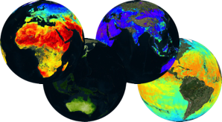
Web based GUI
(including third-party applications)
Jupyter Notebook
CLI / REST API
Visualization layer
Standardised data access interfaces allow connecting a wide range of user interfaces
Datacube Engine/API VMs
The deployment of DAS in front of each data source enables effective access services
Data layer
Data remain at their own location (multiple data centers) with the original data format
Mission-specific data
Thematic data
Other geospatial data

Slide 25
Federated Infrastructure
Available Collections (~ overall storage +5PB)
High Resolution optical satellite data (Level 1)
Sentinel 2 (10m, global, since 2015)
Landsat 8 (30m, Europe, since 2013)
Land Products (Level 2+)
Vegetation Indexes (250m - 10m, 2000)
Land Surface Temperature (1Km, 2000)
Soil Moisture (100Km - 10km, 1978)
Land Cover type (1km, 2000)
Atmospheric Products (Level 2+ Numerical Model)
Air Temperature (12.5 - 1km, 1979)
Precipitation (100km - 4.5km, 1979)
Aerosol Optical Thickness (1km, 2000)
Ocean products (Level 2+ Numerical Model)
Sea Surface TEMPERATURE (5km, Global, 2017)
OCEAN Salinity (10Km, Global, 2010)
Chlorophyll data (5km, Europe, 2010 – 2013)
Sea Surface Height (12km, Europe, 1993 – 2017)
Sea Surface Velocity (12km, Europe, 1993 – 2017)
ESA TPMs/ HMs/ EEs
Landsat 4/7 (30m, Europe, since 1984)
SPOT (1986 – 2015)
ERS-1/-2 (1991 – 2011, on demand)
ENVISAT (2002 – 2012, on demand)
SMOS (10km, since 2010)
In BLUE external repositories

Slide 26
The users:
connect to the GUI (https://eodataservice.org/)
  select the collection(s)
  define AOI/TOI
connect to the central jupyter hub
  use/edit/create notebooks to manage the full data cycle (discover, access, process, visualize)
Open his/her own terminal
  use API / CLI to code and send the access / processing query
The GUI:
connects to the selected datacube(s)
sends the access / processing query to the DAS component
The DAS:
retrieves the data from the online storage
sends back the GUI

Slide 27
The users:
connect to the GUI (https://eodataservice.org/)
  select the collection(s)
  define AOI/TOI
connect to the central jupyter hub
  use/edit/create notebooks to manage the full data cycle (discover, access, process, visualize)
Open his/her own terminal
  use API / CLI to code and send the access / processing query
The jupyter hub provides:
notebooks with examples of access / processing query to the DAS component
interactive interface for live coding to discover, access, process, visualize the datacube(s)

Slide 28
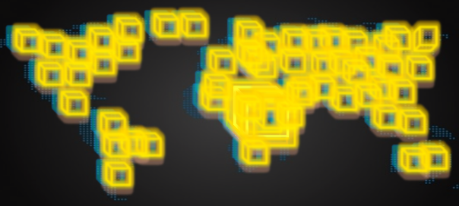
Effective Data Access
Let’s assume we want to correlate pollution and temperature over Ferrara (Italy).
We want to use time series of Land Surface Temperature (LST) and Aerosol Optical Thickness (AOT) from MODIS.
LST timeseries 3 years
Global: ~120GB
Italy: ~245MB
Ferrara: ~17KB
Data transfer rate
500x
10⁶x
AOT timeseries 3 years
Global: ~300MB
Italy: ~1MB
Ferrara: ~17KB
Data transfer rate
300x
10⁴x
Notes:
To be replaced with time series

Slide 29
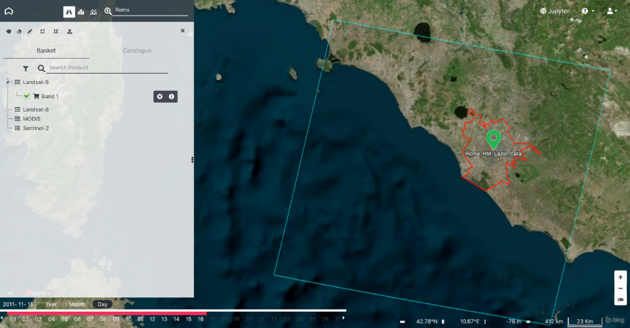
Effective Data Access
Let’s assume we want to monitor the urban area of Rome in Italy.
We want to use time series of Landsat True Color (RGB) and Vegetation Index (NDVI).
Landsat-5 (path/row = 191/31)
26 years (1985 - 2011)
~160GB (~400MB/product)
RGB timeseries 26 years
RGB full tile (blue line): ~22GB
RGB over Rome (red line): ~4GB
RGB over Rome (green marker): ~1KB
Data transfer optimization 7x - 40x - 10⁸x
NDVI timeseries 26 years
NDVI full tile (blue line): ~25GB
NDVI over Rome (red line): ~5GB
NDVI over Rome (green marker): ~2KB
Notes:
To be replaced with time series

Slide 30
CEOS CAL/VAL Test Case demo: link
(user: demo, pwd: demodemo)
Select product of interest
Select site(s) of interest
- CEOS Land Validatio Sites
Retrieve the timeseries
Next step:
- To include CEOS Radiometric Calibration Network
- Ingest ground mesearuments
- Retrieve multisource timeseries
CEOS land validation sites
Notes:
https://adam.eodataservice.org/rest/?geometries=%5b355,356%5d

Slide 31
CLI / API Interface
OpenSearch and WCS services offer standard requests for discovery and access services
Simple python utilities to obtain access token and query secure WCS endpoint (cli_examples.py) can be found here
  $ ./ meeo_sso_cli.py [-h] -u USERNAME [-p PASSWORD]
  $ ./cli_examples.py [-h] -u USERNAME [-p PASSWORD]

Slide 32
OGC OpenSearch for Internal Products Discovery
http://<endpoint>/opensearch?
&service=CSW
&version=2.0.2
&request=GetRecords
&elementsetname=full
&typenames=csw:Record
&resulttype=results
&q=<ID>
&bbox=<UL,LR>
&time=<t₁,t₂>
OGC-standardised catalogue service
OpenSearch

Slide 33
OGC WCS for Coverage Access
http://<endpoint>/wcs2?
service=WCS&Request=GetCapabilities
&version=2.0.0
http://<endpoint>/wcs2?
service=WCS&Request=DescribeCoverage
&version=2.0.0
&CoverageID=<ID>
http://<endpoint>/wcs2?
service=WCS&Request=GetCoverage
&version=2.0.0
&CoverageID=<ID>
&SubsetX=x(x₁, x₂)
&SubsetY=y(y₁,x₂)
&SubsetT=t(t₁, t₂)
&format=<#####>
&colortable=<ID>
&scale=<nn>
&size=<output raster size>
WCS
WCS
List of available datasets with some basic information
Detailed information for a specific collection (dimensions and ranges, supported output data formats, …)
WCS
Data (raster, xml)

Slide 34
OGC WCS Query Example
GetCapabilities operation
https://eodataservice.org/test/wcs?service=WCS&Request=GetCapabilities&version=2.0.0
describeCoverage operation
https://eodataservice.org/test/wcs?service=WCS&Request=DescribeCoverage&version=2.0.0&coverageID=MOD11C1_LSTDAY_4326_005
getCoverage: Time series of LST over Tokyo from 2017-01-01 00:00:00 to 2017-12-06T00:00:00 in xml format (times provided in unix time
https://eodataservice.org/test/wcs?service=WCS&Request=GetCoverage&version=2.0.0&coverageID=MOD11C1_LSTDAY_4326_005&format=application/xml&subset=Long(139.5104,139.5104)&subset=Lat(35.6900,35.6900)&subset=t(1483228800,201512518400)
getCoverage: Same as above, but times provided in ANSI format https://eodataservice.org/test/wcs?service=WCS&Request=GetCoverage&version=2.0.0&coverageID=MOD11C1_LSTDAY_4326_005&format=application/xml&subset=Long(139.5104,139.5104)&subset=Lat(35.6900,35.6900)&subset=unix(2017-01-01T00:00:00,2017-12-06T00:00:00)

Slide 35
OGC WCS Query Example
getCoverage: Global Sea Surface Salinity image for the day 2017-06-01 in png format, colored full size
https://eodataservice.org/test/wcs?service=WCS&Request=GetCoverage&version=2.0.0&coverageID=OceanSalinity_4326_01&subset=t(1496275200,%201496361599)&format=%20image/png&colortable=NCV_rainbow2
getCoverage: Same as above but scaled (small 300px thumbnail)
https://eodataservice.org/test/wcs?service=WCS&Request=GetCoverage&version=2.0.0&coverageID=OceanSalinity_4326_01&subset=t(1496275200,%201496361599)&format=%20image/png&colortable=NCV_rainbow2&size=300
getCoverage: landsat NDVI subset for the day 2017-12-04 09:58:54 in geoTiff format
https://eodataservice.org/test/wcs?service=WCS&Request=GetCoverage&version=2.0.0&coverageID=LC8_NDVI_32632_30&subset=N(4900000,4910000)&subset=E(600000,610000)&subset=t(1512381534,1512381534)&format=image/tiff
Getcoverage: Sentinel 2A with ANSI time and scale factor=0.1 – full image
http://185.52.194.236/wcs?service=WCS&Request=GetCoverage&version=2.0.0&subset=unix(2018-01-29T00:00:00,2018-01-29T23:00:00)&mgrs_tile=T30TVK&format=image/png&scale=0.1&CoverageId=S2A_MSIL1C_vRGB

Slide 36
Next Step – 2019
TTO ESA Catalogue Q1 2019
TTO ESA TPM/HM/EE Datacube Q2 2019
Q4 ’18
Most of ESA TPM/HM/EE collections available
Preliminary support of CEOS WGCV and ESA Cal/Val use cases
Web UI available from ESA EO Landing Page
Q2 ’19
Software refactoring to boost performance and manage concurrent users
Internal OpenSearch interface aligned with CEOS OS BP 1.2
All ESA TPM/HM/EE collections available
Full support to ESA Cal/Val initiatives (CEOS WGCV support need to be formalized)
Content synchronization with ESA Catalogue and FedEO
Q4 ‘19
CEOS WGISS(/WGCV) international cooperation
Evolution about interoperability (e.g., connection with several Open Data Cube instances)

