Slide 1
CEOS OpenSearch Conformance Test Document
CEOS WGISS Meeting #46
A. Della Vecchia, M. Albani (ESA)
Yves Coene (Spacebel)
23/10/2018

Slide 2
Agenda
CEOS WGISS Working Groups (WGs) & Objectives
Achievements
Pending Activities
Synergy with OGC initiatives
Conclusions & next steps

Slide 3
Agenda
CEOS WGISS Working Groups (WGs) & Objectives
Achievements
Pending Activities
Synergy with OGC initiatives
Conclusions & next steps

Slide 4
Working Groups (WGs)
CEOS WGISS OpenSearch II Project, started with WGISS#40, led by:
ESA Andrea Della Vecchia
Spacebel Yves Coene
On the basis of the WGISS-40 meeting conclusions (WGISS-40 MoM), the following targets have been defined:
Consolidation and finalization of CEOS OpenSearch Best Practice document
Updating of the CEOS Developer Guide document in accordance with the BP finalisation
Start discussion about CEOS OpenSearch Conformance Tests document
CEOS WGISS Connected Data Assets System Level Team, led by Yonsook Enloe, was created after the WGISS#42 in September 2016 (Action WGISS-42-09). It aims to analyse the CEOS Data Assets, identify interoperability issues, propose solutions and feed CEOS standardisation initiatives in synergies with OGC activities. Monthly telco performed since 24 October 2016.

Slide 5
Objectives
To set up and make available a fully standardised and interoperable CEOS (but not limited to) connected data assets, following items need to be addressed:
Make available CEOS OpenSearch endpoints: IDN, CWIC and FedEO
  IDN https://cmr.earthdata.nasa.gov/opensearch/collections/descriptor_document_facets.xml?clientId=cswOpenSearchDoc
  CWIC http://cwic.wgiss.ceos.org/opensearch/datasets/osdd.xml?clientId=cwicClient
  FeDEO http://fedeo.esa.int/opensearch/description.xml
Agree and define CEOS OpenSearch Guidelines, including:
  CEOS OpenSearch Best Practice, version 1.2, issued on 13/06/2017
  CEOS OpenSearch Developer Guide, version 2.0D3, issued on 14/11/2016
  CEOS OpenSearch Conformance Test Plan, version 1.0, issued on 28/08/2018
Deliver CEOS conformance Test SW to quantify:
  CEOS OpenSearch endpoints compliancy with CEOS Guideline
  Interoperability among CEOS OpenSearch endpoints
Points II and III could be reiterated considering new CEOS WGISS requirements and taking care of OGC standardization initiatives

Slide 6
Agenda
CEOS WGISS Working Groups (WGs) & Objectives
Achievements
Pending Activities
Synergy with OGC initiatives
Conclusions & next steps

Slide 7
CEOS OS / SLT Working Group Objectives
To set up and make available a fully standardised and interoperable CEOS (but not limited to) connected data assets, following items need to be addressed:
Make available CEOS OpenSearch endpoints: IDN, CWIC and FedEO
  IDN https://cmr.earthdata.nasa.gov/opensearch/collections/descriptor_document_facets.xml?clientId=cswOpenSearchDoc
  CWIC http://cwic.wgiss.ceos.org/opensearch/datasets/osdd.xml?clientId=cwicClient
  FeDEO http://fedeo.esa.int/opensearch/description.xml
Agree and define CEOS OpenSearch Guidelines, including:
  CEOS OpenSearch Best Practice, version 1.2, issued on 13/06/2017
  CEOS OpenSearch Developer Guide, version 2.0D3, issued on 14/11/2016
  CEOS OpenSearch Conformance Test Plan, version 1.0, issued on 28/08/2018
Deliver CEOS conformance Test SW to quantify:
  CEOS OpenSearch endpoints compliancy with CEOS Guideline
  Interoperability among CEOS OpenSearch endpoints
Points II and III could be reiterated considering new CEOS WGISS requirements and taking care of OGC standardization initiatives

Slide 8
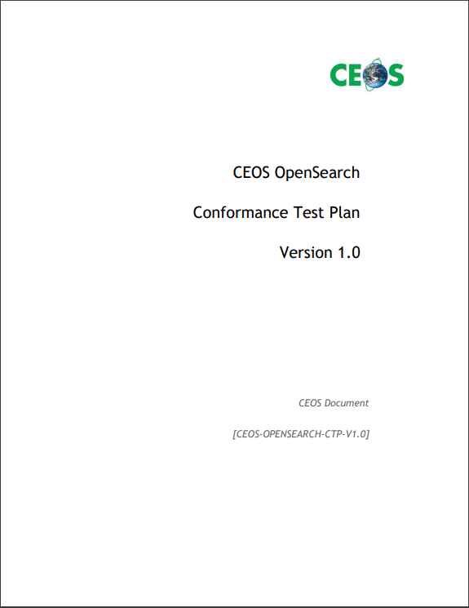

Approach
CEOS Conformance Test Plan Document
Organised as European Cooperation for Space Standardization (ECSS) Software Validation Specification (SVS)
  Test Designs
  Test Cases

Slide 9
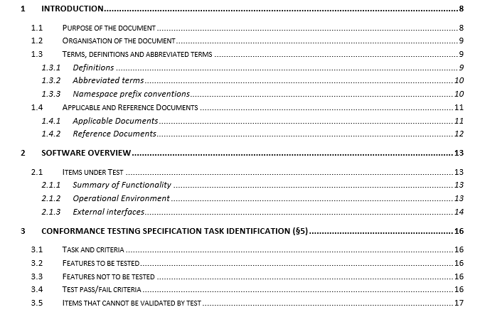
Proposed ToC

Slide 10
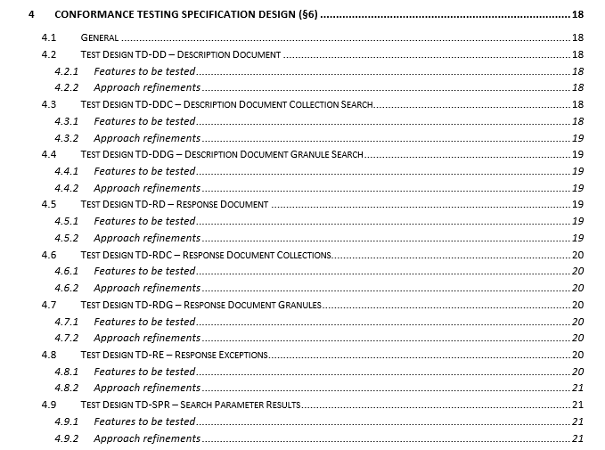
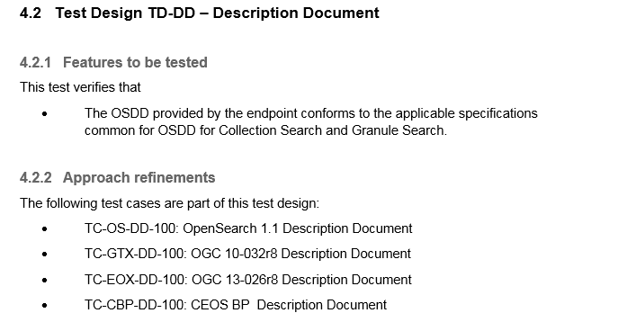
Test Design

Slide 11
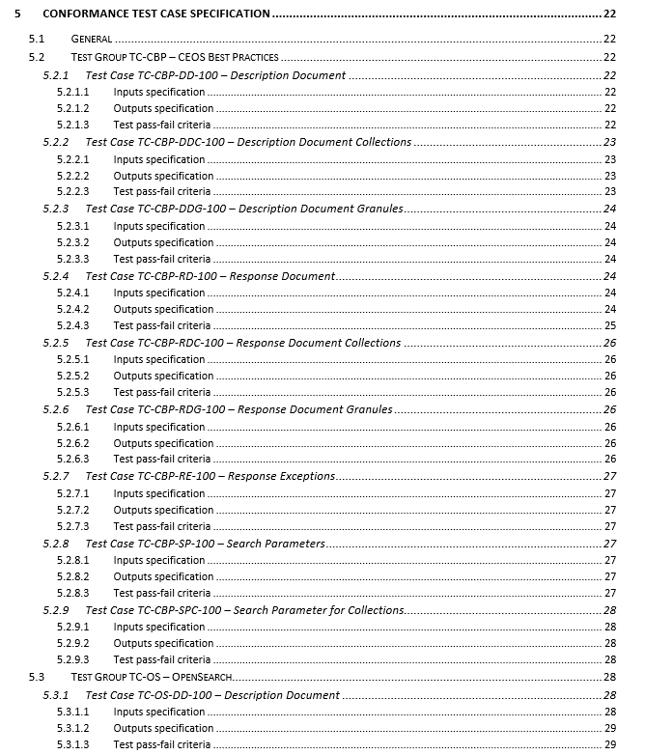
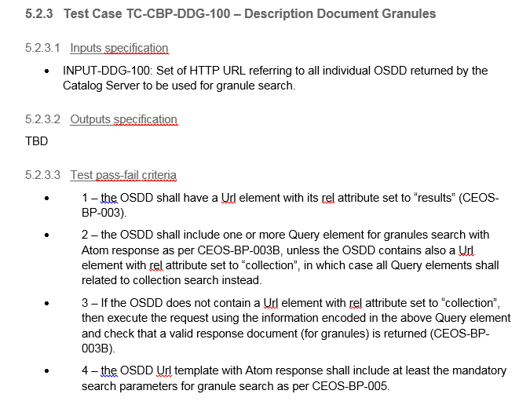
Test Cases

Slide 12
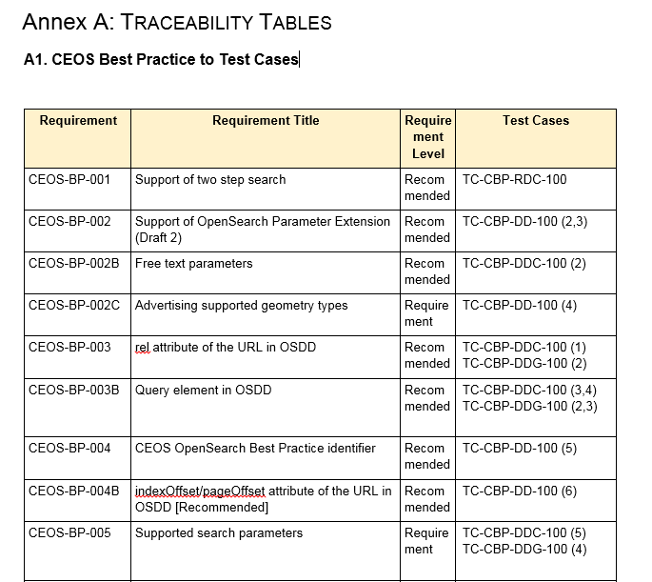
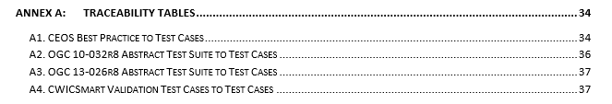
Traceability

Slide 13

Roadmap
Candidate
Final Release
Final Release
Draft
RIDs
Draft
Ver 1.0 D4
4th June ‘18
Ver 1.0 D4-RIDs
22nd June`18
Ver 1.0 D5
1st Aug`18
Ver 1.0 D5-RIDs
9th Aug `18
Ver 1.0
28th Aug`18
System Level Team
I Review
ESA/SPB new issue
Ad-hoc Telco if needed
System Level Team
II Review
ESA/SPB to finalize

Slide 14
Collected RIDs
30/03/2018 – First draft release for internal SLT review
15/06/2018 – Calin Duma – 55 RIDs – CEOS-OPENSEARCH-SVS-V1.0D4_cvd_comments
4 RIDs – To be further discussed (CDV40 / CDV44 / CDV50 / CDV51)
4 RIDs – Clarification wrt OpenSearch-UI (former CWIC Smart Validation Tool )
20/06/2018 – CWIC Team – 2 RIDs – Email
23/06/2018 – Eugene Genong Yu – 3 RIDs – Email
23/06/2018 – Michael Morahan – 6 RIDs – CEOS-OPENSEARCH-SVS-V1.0D4_MPM
09/08/2018 – SLT closed all the open issues
28/08/2018 – Issues Release 1.0

Slide 15
Agenda
CEOS WGISS Working Groups (WGs) & Objectives
Achievements
Pending Activities
Synergy with OGC initiatives
Conclusions & next steps

Slide 16
CEOS OS / SLT Working Group Objectives
To set up and make available a fully standardised and interoperable CEOS (but not limited to) connected data assets, following items need to be addressed:
Make available CEOS OpenSearch endpoints: IDN, CWIC and FedEO
  IDN https://cmr.earthdata.nasa.gov/opensearch/collections/descriptor_document_facets.xml?clientId=cswOpenSearchDoc
  CWIC http://cwic.wgiss.ceos.org/opensearch/datasets/osdd.xml?clientId=cwicClient
  FeDEO http://fedeo.esa.int/opensearch/description.xml
Agree and define CEOS OpenSearch Guidelines, including:
  CEOS OpenSearch Best Practice, version 1.2, issued on 13/06/2017
  CEOS OpenSearch Developer Guide, version 2.0D3, issued on 14/11/2016
  CEOS OpenSearch Conformance Test Plan, version 1.0, issued on 28/08/2018
Deliver CEOS conformance Test SW to quantify:
  CEOS OpenSearch endpoints compliancy with CEOS Guideline
  Interoperability among CEOS OpenSearch endpoints
Points II and III could be reiterated considering new CEOS WGISS requirements and taking care of OGC standardization initiatives

Slide 17
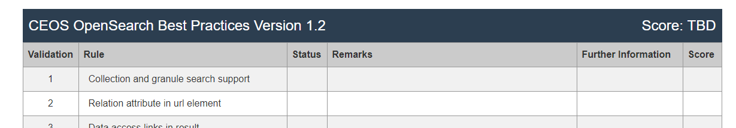
Conformance Procedures - Open Issues
Deliver CEOS Conformance Test SW
  CEOS Conformance Test Software will permit to validate and score external OpenSearch endpoints vs CEOS guideline. This CEOS tool shall be on CEOS OpenSearch Conformance Test Plan guidelines.
  Within WGISS SLT working group the following as been discussed and preliminary agreed:
    NASA to keep OpenSearch-UI (former CwicSmart) On-line Validation tool updated with future CEOS OS BP changes (SLT MoM 01/03/2017) – Done
    NASA does have plans to make all their software, including OpenSearch-UI (former CwicSmart) On-line Validation tool , open source. Until that happens, the Validation is a publically accessible service (SLT MoM 01/03/2017) – Done
    ESA available to support NASA to enhance and test OpenSearch-UI Validation tool, to produce a CEOS tool usable by all agencies (SLT MoM 01/03/2017). This also implies the application of an open source license for this Conformance Test Software (Sec. 4.2 WGISS#42 MoM)

Slide 18
Agenda
CEOS WGISS Working Groups (WGs) & Objectives
Achievements
Pending Activities
Synergy with OGC initiatives
Conclusions & next steps

Slide 19
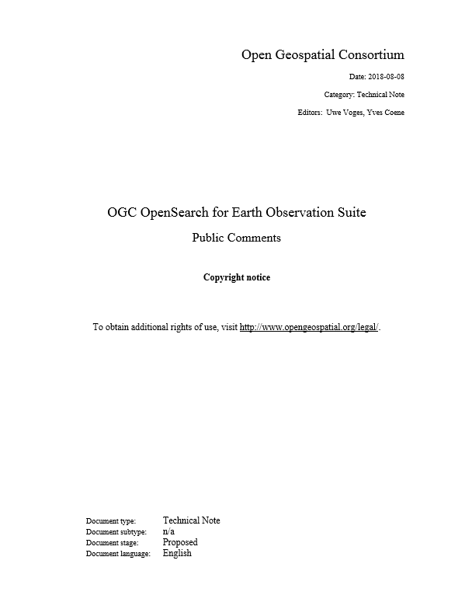
Synergy with OGC initiatives
Requested to OGC to approve that the related document package enters the so-called “public review” phase (3 weeks). Public comments period was closed in August 2018 (OGC call for public review).
Current activity (September-November 2018) is assessment of public comments that
were received:
  OGC 13-026r9: 6 comments
  OGC 17-003: 24 comments (incl. 18 from DLR – related to JSON-LD
  Linked Data encoding)
  OGC 17-047: 6 comments (incl. 4 from VITO).
  Currently, all comments received are being processed by the SWG and
  dispositions are being agreed also with authors of the comments.
Documents package resolving the comments has to be delivered next to OGC for
final TC Vote for adoption as standard.

Slide 20
Agenda
CEOS WGISS Working Groups (WGs) & Objectives
Achievements
Pending Activities
Synergy with OGC initiatives
Conclusions & next steps

Slide 21
Conclusion & Next Steps
Short terms – Q1 2019
CEOS Conformance Test SW
To share CEOS Conformance Test SW with OGC, within TeamEngine (http://opengeospatial.github.io/teamengine/)
Longer Terms – by 2019
Search-Engine-Friendly with
  schema.org (Annex C CEOS OS BP 1.2) to maximize the interaction/visibility with WWW search engine (e.g., Google Dataset Search engine)
  Using Microdata, for plain text formatting (e.g., ESA Landing Page)
Once closed the standardization cycle of OGC 13-026r9 / OGC 17-047 / OGC 17-003, these might be adopted as baseline for a new review cycle of the CEOS Best Practice/Conformance Test Document, in order to:
  Simplify significantly the CEOS guidelines (e.g., CEOS BP 1.2 is applicable in the new OGC specs)
  Manage EO data services metadata (e.g., WMS, WCS, WPS, datacube API, ordering, etc…)
  Increase gateway/catalogue performance and the level of interoperability (e.g., ranking, flexible string research, light product metadata model, etc…)
  Ease the GUI development and performance (e.g., moving toward geoJSON(LD)- encoding)

