Slide 1
JAXA data portal report
CEOS WGISS meeting 46th.
Yousuke Ikehata, Makoto Natsuisaka, Kaori Kuroiwa,
Yuji Shimomura(JAXA)

Slide 2
Recent activities.
JAXA replaced the dissemination system “G-Portal”.
To distribute global earth observation products
Web service and FTP/SFTP/GridFTP services
Free of charge except for high resolution image sensor products
Commercial use is possible
Redistribution or transfer is possible
Users are requested to indicate a proper credit
https://gportal.jaxa.jp

Slide 3
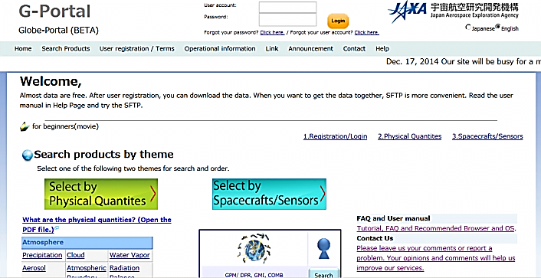
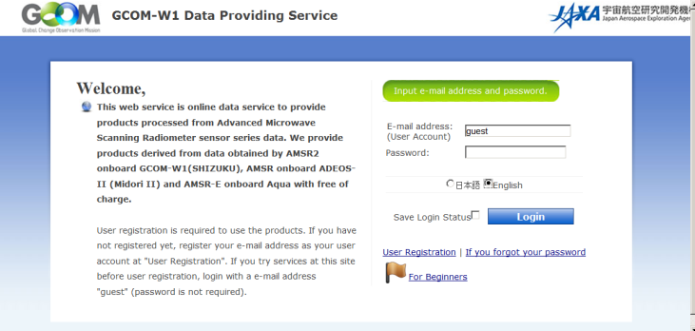
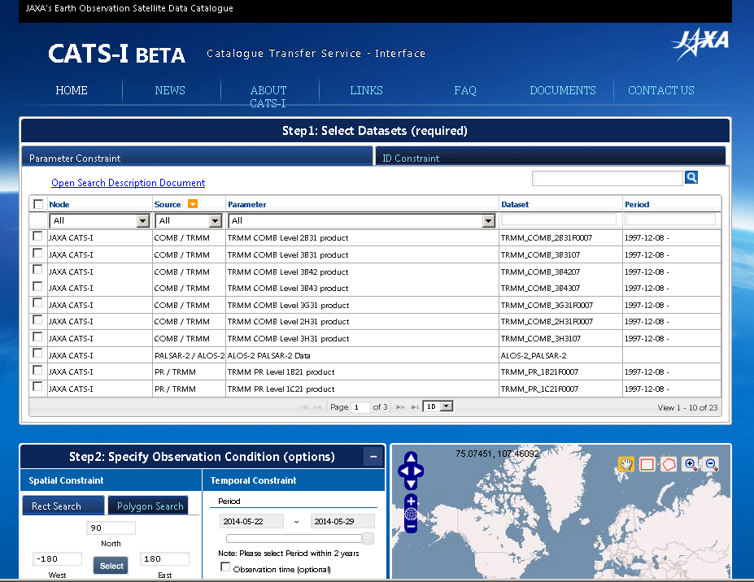
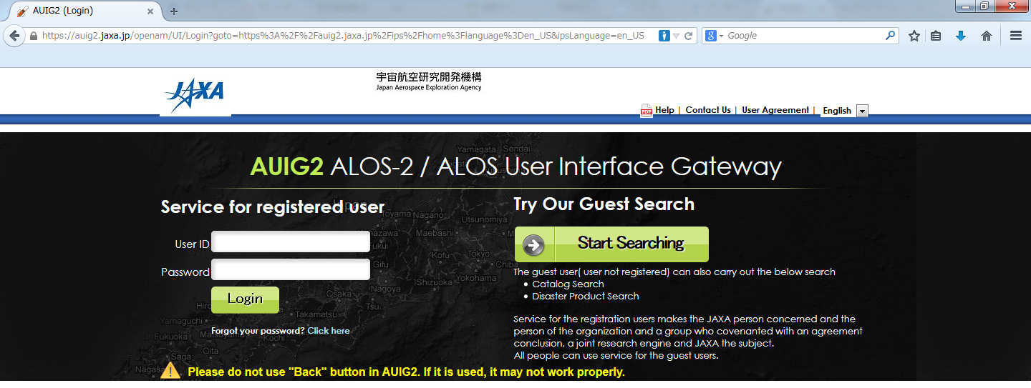
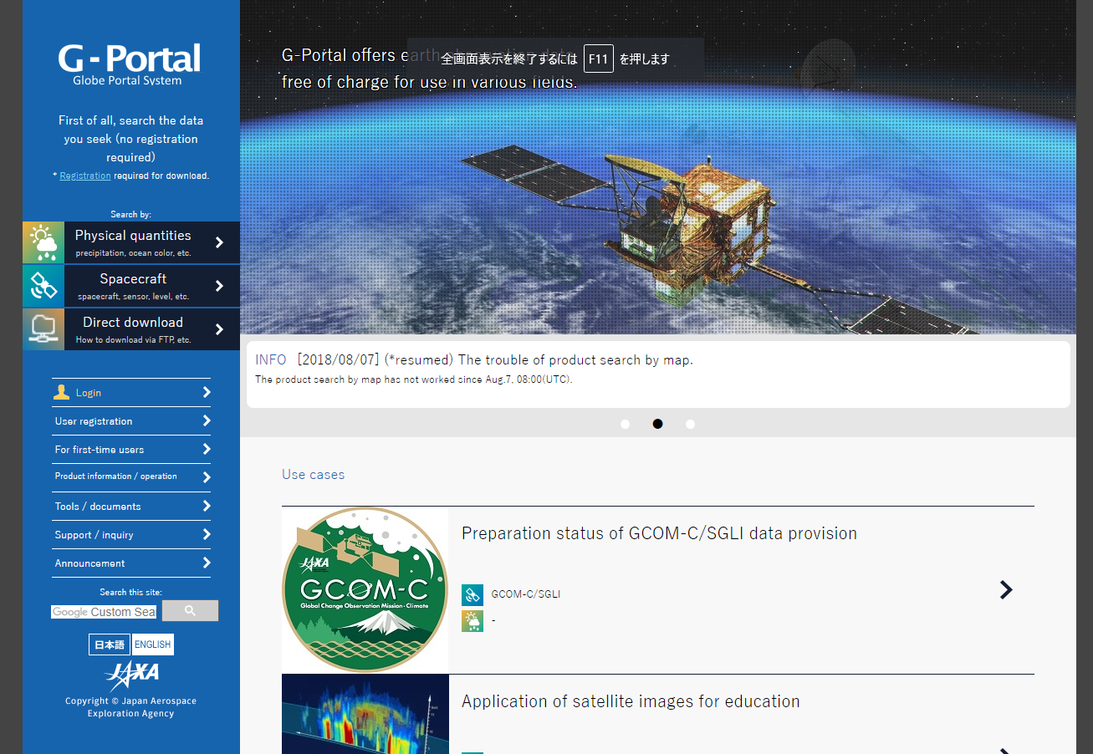
3 systems are merged into new G-Portal.
G-Portal
for catalog interoperability
(CATS-I)
https://catsi.jaxa.jp/
G-Portal
https://www.gportal.jaxa.jp/
GCOM-W Data Providing Service
https://gcom-w1.jaxa.jp/
AUIG2
https://auig2.jaxa.jp/ips/home/
New G-Portal
https://gportal.jaxa.jp/
On going

Slide 5
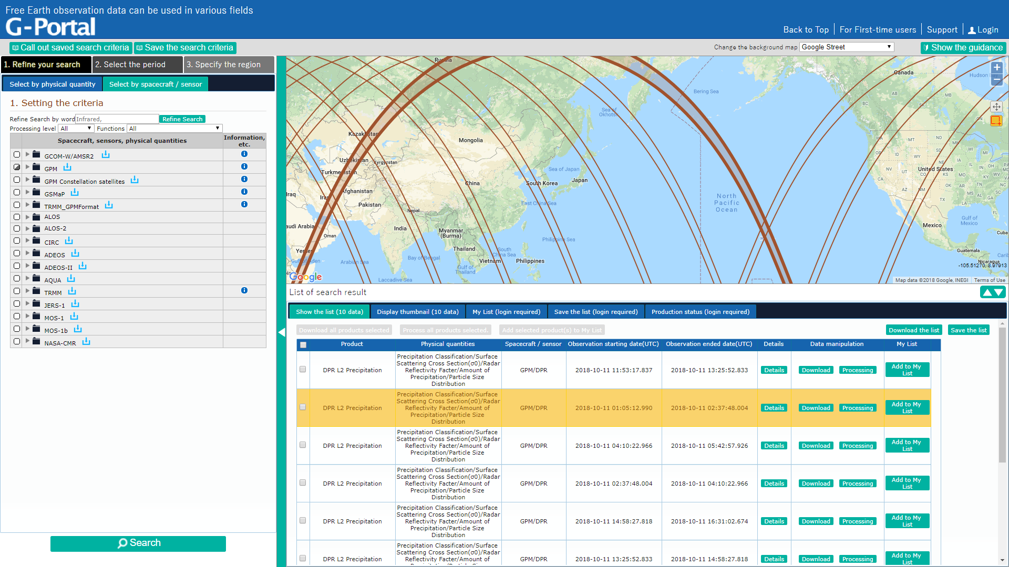

Slide 6
Overview of G-Portal
New portal integrates catalog services.
Supported response formats are shown below.
ATOM, json, ebRIM, HTML, ISO19115, DublinCore
Only provides granule level search ( not provides collection level search )
CSW
Compatible with “version 3.0.0”
OpenSearch
Compatible with “2015-06-10 version 1.0.1”
Request examples are shown below.
ATOM
https://gportal.jaxa.jp/csw/csw?service=CSW&version=3.0.0&request=GetRecords&outputFormat=application/atom%2bxml
ISO19115
https://gportal.jaxa.jp/csw/csw?service=CSW&version=3.0.0&request=GetRecords&outputFormat=application/xml&outputSchema=http://www.isotc211.org/2005/gmd

Slide 7
Features of the new system (1/3)
Processed data is expanded and immediately provided.
The previous system was basically designed as a production by order system.
User order -> process -> announce by e-mail -> download.
Only GPM, Aqua(AMSR-E), TRMM, and JERS-1 were preserved as processed products.
The new system archives processed products. All the data obtained by the following satellites processed and uploaded to the new system.
MOS-1/1b(MESSR*)
JERS-1(VNIR, SWIR, SAR)
ADEOS(AVNIR*, OCTS)
ADEOS-II(AMSR, GLI)
*MOS-1/1b and ADEOS(AVNIR) products are migrated now.

Slide 8
Features of the new system (2/3)
The usability is improved.
New or Improved features
Subset ( Area or Physical parameter)
Scene shift
Format Conversion (HDF-5, NetCDF, Ascii)
＊Above features is only available for GPM, GCOM-W and Aqua (AMSR-E) data.
MODIS catalogs are harvested from CMR@NASA to fill the gap between ADEOS-II/GLI and SGLI.

Slide 9
Features of the new system (3/3)
The data transfer performance is improved.
High performance ftp(gridftp) and simple ftp(Normal ftp) are added for direct access services.
Previous G-Portal provides only SFTP for direct access.
Internal data transfer rate became 3 times faster.
Changed the system architecture for more high scalability.
Integrates data access and catalog service
Contribute to GEOSS and CEOS portals by providing catalogs.

Slide 10
Architecture WGISS Data Assets
JAXA

Slide 11
DIF-10 Update for IDN
IDN
Collection level
DIF
DIF
JAXA
JAXA has already registered DIF-10 to IDN and will add the one on GCOM-C, the products of which will be released in Dec., 2018.

Slide 12
FedEO Update
CSW ( online interface)
Granule level
FedEO
JAXA
XML
XML
Collection level
Collection level* information were updeated by e-mail.
Granule level information is harvested by CSW.
*Send XML step by step.(GPM, TRMM, ALOS, ALOS-2 is available)

Slide 13
Direct Connection with GEOSS Portal by online
GEO/GEOSS Portal
Undergoing testing
JAXA
Collection level* information were provided by offline(e-mail).
Granule level information is harvested by CSW.
*Sent information about datasets and its IDs.

