Slide 1
WGISS-46 ACCESS Section: IDN Report
Michael Morahan
IDN Coordinator
Michael.P.Morahan@nasa.gov
CEOS WGISS-46
DLR, Oberpfaffenhofen, Germany
October 2018
This work was supported by NASA/GSFC under Raytheon Co. contract number NNG15HZ39C.
This document does not contain technology or Technical Data controlled under either the U.S. International Traffic in Arms Regulations or the U.S. Export Administration Regulations.

Slide 2
Outline
Overview of NASA’s Vision of Services (UMM-S)
Migration of IDN SERFs to UMM-S
Metadata Management Tool (MMT): Successor to DocBuilder
DocBuilder-10: Create/Update Dataset Records
Transition of DIF-9 to DIF-10
Schedule for UMM-C and GCMD/IDN Keywords
IDN‘s WGISS/WGCV Joint Session: Collaborative Actions

Slide 3
I. Overview of NASA’s Vision of Services (UMM-S)

Slide 4
What is the UMM-S? (Unified Metadata Model for Services)
What is a Service?
We need to recognize SERF legacy for services, but extend NASA web services to include
future support for access of NASA data from the cloud. These services provide a method of transforming
the data (e.g. subsetting, reprojection or reformatting, or a combination of these).
How to Discover and Utilize a Service?
In order to locate web services or portals, software or tools, we can use the GCMD client to search and return metadata for services. https://gcmd.nasa.gov/
In order to discover and transform data, we can use the EDSC client to search and return transformed data via services. https://earthdata.nasa.gov/
How to Describe a Service?
Services are described by their attributes, e.g.
Service Name: “SERVIR”
Service LongName: “Mesoamerican
Visualization and Monitoring
System (SERVIR)”
Service Type: “WEB PORTAL”
Service Version: “1.8”
Service RelatedURL:
“https://www.servirglobal.net/default.aspx”

Slide 5
UMM-S Required Fields
Field Name | Description
Name | The name of the service, software, or tool. (Example: "AIRS_L3_OPENDAP".)
LongName | The long name of the service, software, or tool. It provides a human readable name for the service. (Example: "OPENDAP (Hyrax) framework for AIRS Level 3 data products".)
Type | The type of the service, software, or tool. (Example: OPeNDAP)
Version | The edition or version of the service, software, or tool. The version should be defined in the form x, y, and z. where 'x.y.z' means 'major.minor.incremental' version numbers. Typically, 'x' and 'y' are numbers (0 through 9) and 'z' is a number (0 through 99). (Example: 1.1.1)
Description | A brief description of the service, software, or tool. For example, a description might contain information about what is the service, the purpose of the service, and the parameters (or variables) being invoked, and what are the sources of these data.
RelatedURLS | This element contains important information about the Uniform Resource Locator (URL) for the service.
ServiceKeywords | Allows for the specification of Earth Science Service keywords that are representative of the service, software, or tool being described. The controlled vocabulary for Service Keywords is maintained in the Keyword Management System (KMS). (Example: "ServiceCategory: Earth Science Services, ServiceTopic: Data Management/Data Handling, ServiceTerm: Data Search and Retrieval". )
ServiceOrganizations | The service provider, or organization, or institution responsible for developing, archiving, and/or distributing the service, software, or tool. (Example: "Role: SERVICE PROVIDER, ShortName: INPE, LongName: National Institute for Space Research, Brazil".)

Slide 6
Example: NOAA_Shoreline_GIS Service
[ {
"meta" : {
"native-id" : "NOAA_Shoreline_GIS",
"provider-id" : "SCIOPS",
"concept-type" : "service",
"concept-id" : "S1535675684-SCIOPS",
"revision-date" : "2018-07-10T19:32:05Z",
"user-id" : "tstevens",
"deleted" : false,
"revision-id" : 2,
"format" : "application/vnd.nasa.cmr.umm+json"
},
"umm" : {
"AncillaryKeywords" : [ "GIS", "Hydrologic Data", "Environmental Risk Data", "Shoreline", "Sea", "Vector", "Coast" ],
"RelatedURLs" : [ {
"Description" : "Access the NOAA Shoreline Data Explorer.",
"URLContentType" : "DistributionURL",
"Type" : "GET SERVICE",
"Subtype" : "ACCESS MAP VIEWER",
"URL" : "http://www.ngs.noaa.gov/newsys_ims/shoreline/index.cfm"
} ],
"Type" : "TOOL",
"ServiceKeywords" : [ {
"ServiceCategory" : "EARTH SCIENCE SERVICES",
"ServiceTopic" : "DATA ANALYSIS AND VISUALIZATION",
"ServiceTerm" : "GEOGRAPHIC INFORMATION SYSTEMS",
"ServiceSpecificTerm" : "WEB-BASED GEOGRAPHIC INFORMATION SYSTEMS"
}, {
"ServiceCategory" : "EARTH SCIENCE SERVICES",
"ServiceTopic" : "DATA MANAGEMENT/DATA HANDLING",
"ServiceTerm" : "DATA SEARCH AND RETRIEVAL"
}, {
"ServiceCategory" : "EARTH SCIENCE SERVICES",
"ServiceTopic" : "METADATA HANDLING",
"ServiceTerm" : "DATA DISCOVERY"
} ],
"ServiceOrganizations" : [ {
"Roles" : [ "SERVICE PROVIDER" ],
"ShortName" : "DOC/NOAA/NOS/NGS",
"LongName" : "National Geodetic Survey, National Ocean Service, NOAA, U.S. Department of Commerce",
"Service "ContactPersons" : [ {
"Roles" : [ "SERVICE PROVIDER" ],
"ContactInformation" : {
"ContactMechanisms" : [ {
"Type" : "Email",
"Value" : "ngs.infocenter@noaa.gov"
}, {
"Type" : "Fax",
"Value" : "301-713-4172"
}, {
"Type" : "Telephone",
"Value" : "301-713-3242"
} ],
"Addresses" : [ {
"StreetAddresses" : [ "National Geodetic Survey, NOAA", "Information Services Branch", "1315 East-West Highway" ],
"City" : "Silver Spring",
"StateProvince" : "MD",
"PostalCode" : "20910-3282"
} ]
},
"FirstName" : "INFORMATION SERVICES BRANCH",
"LastName" : "NATIONAL GEODETIC SURVEY"
} ],
"ContactInformation" : {
"RelatedUrls" : [ {
"URLContentType" : "DataCenterURL",
"Type" : "HOME PAGE",
"URL" : "https://www.ngs.noaa.gov/"
} ]
}
} ],
"ScienceKeywords" : [ {
"Category" : "EARTH SCIENCE",
"Topic" : "SOLID EARTH",
"Term" : "GEOMORPHIC LANDFORMS/PROCESSES",
"VariableLevel1" : "COASTAL LANDFORMS"
}, {
"Category" : "EARTH SCIENCE",
"Topic" : "TERRESTRIAL HYDROSPHERE",
"Term" : "SURFACE WATER"
}, {
"Category" : "EARTH SCIENCE",
"Topic" : "TERRESTRIAL HYDROSPHERE",
"Term" : "SURFACE WATER",
"VariableLevel1" : "SURFACE WATER FEATURES",
"VariableLevel2" : "LAKES/RESERVOIRS"
}, {
"Category" : "EARTH SCIENCE",
"Topic" : "TERRESTRIAL HYDROSPHERE",
"Term" : "SURFACE WATER",
"VariableLevel1" : "SURFACE WATER FEATURES",
"VariableLevel2" : "RIVERS/STREAMS"
} ],
"Description" : "The NOAA Shoreline Data Explorer system is an online management and sharing system of shoreline data that cartographically depicting the dynamic interface between land and water at the time of survey. The tool provides high-resolution digital shoreline from multi-temporal surveys of our nation's coastline. It provides the following capabilities:\r\n\r\n-View available shoreline project boundaries\r\n-View vector shoreline data\r\n-View and download FGDC compliant metadata\r\n-Make printable maps\r\n-Download vector shoreline shapefiles",
"Version" : "NOT PROVIDED",
"UseConstraints" : "The data contained on this site should NOT TO BE USED FOR NAVIGATION.",
"Name" : "NOAA_Shoreline_GIS",
"ContactPersons" : [ {
"Roles" : [ "AUTHOR" ],
"ContactInformation" : {
"ContactMechanisms" : [ {
"Type" : "Email",
"Value" : "Tyler.B.Stevens@nasa.gov"
}, {
"Type" : "Telephone",
"Value" : "301-851-8113"
} ],
"Addresses" : [ {
"StreetAddresses" : [ "5700 Rivertech Court" ],
"City" : "Riverdale",
"StateProvince" : "MD",
"Country" : "USA",
"PostalCode" : "20737"
} ]
},
"FirstName" : "TYLER",
"MiddleName" : "B.",
"LastName" : "STEVENS"
} ],
"LongName" : "NOAA Shoreline Data Explorer"
}
} ]
}

Slide 7
CMR SEARCH API
Service records can be search using the CMR SEARCH API
Search for all
curl ‘https://cmr.earthdata.nasa.gov/search/services’
Search by Keyword
curl ‘https://cmr.earthdata.nasa.gov/search/services?keyword=OpenDAP&pretty=true’
Search for specific service
curl ‘https://cmr.earthdata.nasa.gov/search/services.umm_json?name=AIRX3STD.006&pretty=true’
CMR SEARCH API Documentation: https://cmr.earthdata.nasa.gov/search/site/docs/search/api.html#searching-for-services
Notes:
Add Search query

Slide 8
Latest Capabilities and Features
RelatedURLs increased cardinality to 1 to N
Options class expanded to include supported Input and Output projections, Input and Output formats.
ServiceQuality class added
Platforms and Instruments classes added
Addition of OperationMetadata class to support a wide variety of server-side operations (e.g. GetCapabilities, GetMap, GetCoverage)
UMM-S schema 1.2 https://git.earthdata.nasa.gov/projects/EMFD/repos/unified-metadata-model/browse/service/v1.2
UMM-S document: https://wiki.earthdata.nasa.gov/download/attachments/49448405/UMM-S_V1.2_20180530.docx

Slide 9
II. Migration of IDN SERFs to UMM-S

Slide 10
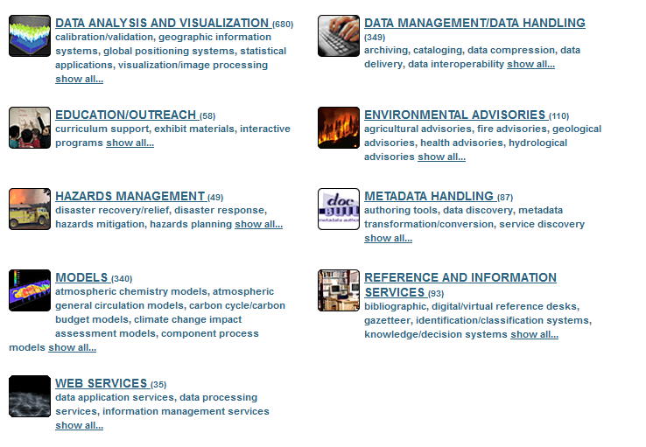
What is the SERF? (Service Entry Resource Format)
Metadata standard used to describe Earth science tools, software, and models (e.g. EDSC, Giovanni, Panoply, USGS Model Viewer)
Supports the discovery and access of these tools, software, and models
Originated (in year 2000) as a prototype within NASA’s Earth Science Technology Office (ESTO) and supported by NASA and the Committee on Earth Observation Satellites (CEOS)
Data Service Types

Slide 11
Why Migrate to UMM-S in CMR?
Use the Expanded Model and Infrastructure To Make Services More Useful
Extended service capabilities (service invocation, subsetting, reprojection, time aggregation, etc...)
Link Services With Applicable Data Sets
Allows for service capabilities and specific tools to be accessible to/from their applicable data sets, which renders the services discoverable, available, and useful to users that might not already be aware of them
Search Across a Common Repository for Services
Centralized catalogue of all services, tools, software, models across U.S. and international agencies that work with Earth science data

Slide 12
What’s Being Migrated?
All Viable SERFs in GCMD/IDN
SCIOPS/IDN provider records
EOSDIS provider records
Should I Stay or Should I Go
Does the service describe a tool or software?
Is the service still viable/supported?
Is the service being deprecated
Do the links still work?
Is the service from a commercial provider?
Are the other attributes still accurate?

Slide 13
Migration Schedule: Fall 2018
The IDN staff will email IDN Providers with their list of SERF records.
The Providers are to review the SERF records.
Determine to migrate or deprecate the records.
Work with IDN staff to cleanup/migrate or deprecate/archive SERF records
The IDN staff will ingest viable UMM-S records into CMR.
The CMR Metadata Quality Team will be assisting with the migration of the service records. Please reach out to IDN User services (gsfc-gcmduso@mail.nasa.gov) and/or myself (Michael.P.Morahan@nasa.gov) .

Slide 14
III. Metadata Management Tool (MMT): Successor to DocBuilder

Slide 15
Metadata Management Tool (MMT): Coming Attraction (2019)
Login using same ID and password as docBUILDER
Submit new/updated data and services descriptions to the IDN for review and ingest by the CMR Metadata Team.
Assess quality of metadata using inline validation.
Export metadata in DIF-10, NASA MENDs ISO, ATOM formats.
View metadata using HTML “Pretty View” permanent link.
Features my change pending design review.

Slide 16
Metadata Management Tool (MMT): Data Flow Diagram
Metadata Quality Coordinator
2. Send draft
1. Create draft record
Draft
3. Edit draft
5. Edit record
4. Publish record
CMR
Revisions
(up to 10)
(Optional) Revert to
previous revision

Slide 17
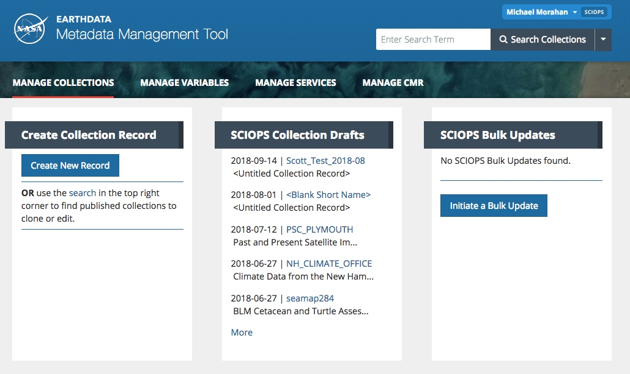
Metadata Management Tool (MMT): Manage Collections
User and Provider
Search in CMR
Open drafts
Create new draft

Slide 18
Metadata Management Tool (MMT): Draft Collection
Short Name_Version
Long Name
Publish CMR record
Delete Draft
Progress Panel
Preview Panel
Spatial Preview

Slide 19
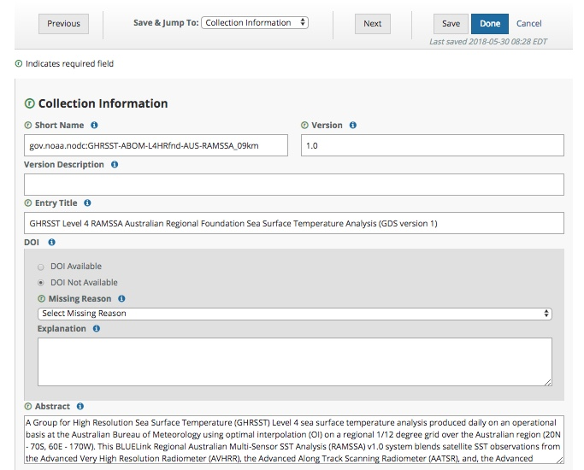
Metadata Management Tool (MMT): Editing Fields
Change form
Required section
Required field
Information
Select value from
drop-down

Slide 20
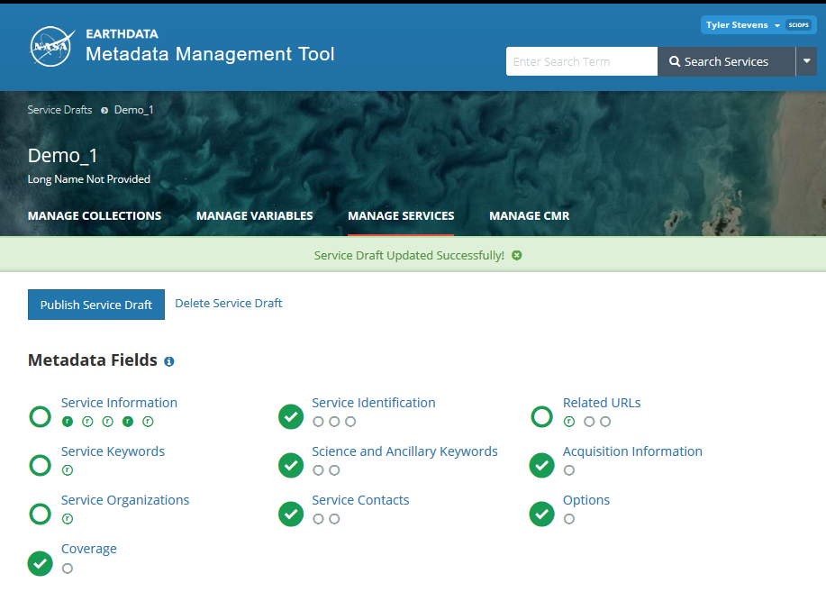
Metadata Management Tool (MMT)
MMT allows users to manage and curate UMM-S metadata records in the Common Metadata Repository (CMR).
Manage Services Page
Edit Service Record Page

Slide 21
IV. DocBuilder-10: Create/Update Dataset Records

Slide 22
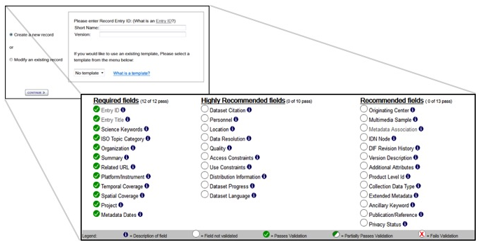
Create/Update Dataset Records
DocBuilder-10 is a web-based metadata authoring tool that allows metadata authors to add (or modify) dataset descriptions (DIFs) records for the IDN. https://idn.ceos.org/DocumentBuilder/Home.do?Portal=ceos_idn

Slide 23
V. Transition of DIF-9 to DIF-10

Slide 24
DIF-9 to DIF-10 Transition Schedule
(2017-2018)
Sent Provider DIF-9 to DIF-10 QA/Triage Reports.
May 1, 2018
Start migrating existing non-NASA DIF-9 records to DIF-10.
2019 (First quarter)
Plan to have all metadata records transition.
Providers need to submit new metadata in DIF-10 or any format compatible with NASA’s Common Metadata Repository (CMR).
Compatible formats: DIF-10, NASA ISO (MENDs), and UMM-JSON.
docBUILDER supports DIF-10 format.

Slide 25
Transitioned Status
Provider | # of records | # of records transition | # of records not transition | Completion Precentage | State
SCIOPS | 17282 | 10797 | 6485 | 62% | On-going
AU_AADC | 2772 | 0 | 2772 | 0% | Under Review
CNES | 20 | 20 | 0 | 100% | Completed
ESA | 112 | 20 | 92 | 18% | On-going
EUMETSAT | 62 | 0 | 0 | 0% | Under Review
INPE | 43 | 43 | 0 | 100% | Completed
ISRO | 34 | 34 | 0 | 100% | Completed
JAXA | 340 | 340 | 0 | 100% | Completed
NOAA_NCEI | 5578 | 0 | 5578 | 0% | Testing
USGS_EROS | 142 | 13 | 129 | 9% | On-going
Total | 26385 | 11267 | 15056 | 42.70%

Slide 26
VI. Schedule for UMM-C and GCMD/IDN Keywords

Slide 27
UMM-C: Proposed New Fields (2019)
average size of a downloadable file (granule)
total size of all of the downloadable collection files
More information on UMM: https://earthdata.nasa.gov/umm
Notes:
Related URL:
* Changes are based on the UMM URL type reconciliation effort with the CMR and the ARC Team.
* Impact is 683 EOSDIS provider records (GES DISC and PO DAAC) and 583 IDN records.
Water Quality/Water Chemistry:
* Changes are based on review of the keywords and to align more closely with the EPA water quality criteria and user search behavior.
* Impact is 83 EOSDIS provider records (GHRC, ORNL, PO DAAC, SEDAC) and 2,404 SCIOPS/IDN records.
* This set of keywords have not been updated since 2002.

Slide 28
Keyword Version 8.7 Proposed Topics (2019)
Cryosphere
Earth Science Services/
Web Services
If you are interested in becoming a keyword reviewer,
please contact the ESO at eso-staff@lists.nasa.gov.
Notes:
Related URL:
* Changes are based on the UMM URL type reconciliation effort with the CMR and the ARC Team.
* Impact is 683 EOSDIS provider records (GES DISC and PO DAAC) and 583 IDN records.
Water Quality/Water Chemistry:
* Changes are based on review of the keywords and to align more closely with the EPA water quality criteria and user search behavior.
* Impact is 83 EOSDIS provider records (GHRC, ORNL, PO DAAC, SEDAC) and 2,404 SCIOPS/IDN records.
* This set of keywords have not been updated since 2002.

Slide 29
VII. IDN‘s WGISS/WGCV Joint Session: Collaborative Actions

Slide 30
IDN Actions Status
Quality Indicators in Discovery Metadata
Action: WGISS (Michael) to start defining best approach for representing and including QIs for the selected test case in discovery metadata searchable by end users.
WGISS need one specific and one broader example of SST QI to start analysis. Awaiting input from WGCV
CEOS Data Cubes and CEOS Test Sites Data Access in support to WGCV Activities
Action: WGISS (Michael) to define how to get this info into the IDN for discover and possibly access by August.
Will be started after receiving initial input by WGCV, completed by end November

Slide 31
Questions/Discussion
Please Provide feedback to:
gsfc-gcmduso@mail.nasa.gov
Or
Michael.P.Morahan@nasa.gov

Slide 32
Backup SLIDES

Slide 33
UMM-S Design (v1.2)

Slide 34
UMM-S Fields
Name [R] | ConnectPoint | DataResourceSpatialExtent [R] | ParameterDescription [R] | AncillaryKeywords | SupportedOutputProjections
LongName [R] | ResourceName | DataResourceSpatialExtentType [R] | ParameterOptionality [R] | ServiceOptions | ProjectionName
Type [R] | ResourceLinkage [R] | SpatialResolution [R] | ParameterRepeatability [R] | SubsetTypes | ProjectionLatitudeOfCenter
Version [R] | ResourceDescription | SpatialResolutionUnit [R] | ScienceKeywords | VariableAggregation | ProjectionLongitudeOfCenter
Description [R] | OperationChainMetadata | DataResourceTemporalExtent [R] | ServiceContacts [R] | SupportedInputProjections | ProjectionFalseEasting
RelatedURLs [R] | OperationChainName [R] | DataResourceTemporalExtentType [R] | ContactPersons | ProjectionName | ProjectionFalseNorthing
ServiceKeywords [R] | OperationChainDescription | TemporalResolution [R] | ContactGroups | ProjectionLatitudeOfCenter | ProjectionAuthority
ServiceOrganizations [R] | CoupledResource | TemporalResolutionUnit [R] | Platforms | ProjectionLongitudeOfCenter | ProjectionUnit
OperationMetadata | ScopedName | RelativePath | Instruments | ProjectionFalseEasting | ProjectionDatumName
OperationName | DataResourceDOI | CouplingType | ServiceQuality | ProjectionFalseNorthing | InterpolationTypes
DistributedComputingPlatform | DataResource | Parameter | ServiceCitation [R] | ProjectionAuthority | SupportedInputFormats
OperationDescription | DataResourceIdentifier [R] | ParameterName [R] | AccessConstraints | ProjectionUnit | SupportedOutputFormats
InvocationName | DataResourceType [R] | ParameterDirection [R] | UseConstraints | ProjectionDatumName | MaxGranules

Slide 35
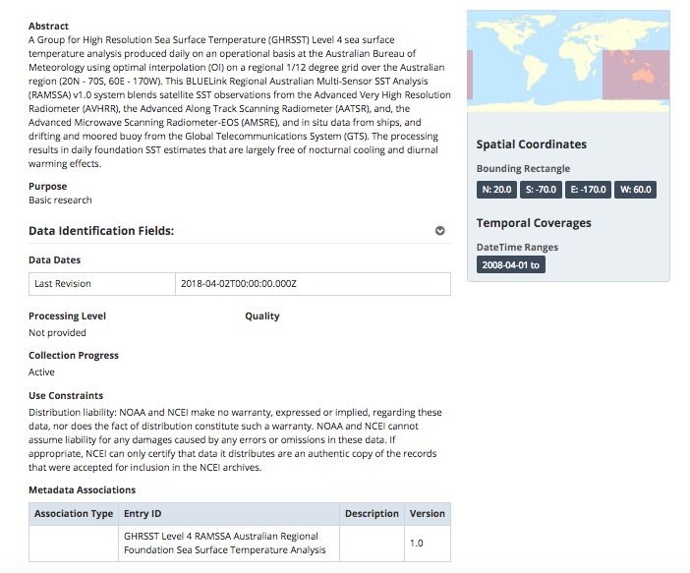
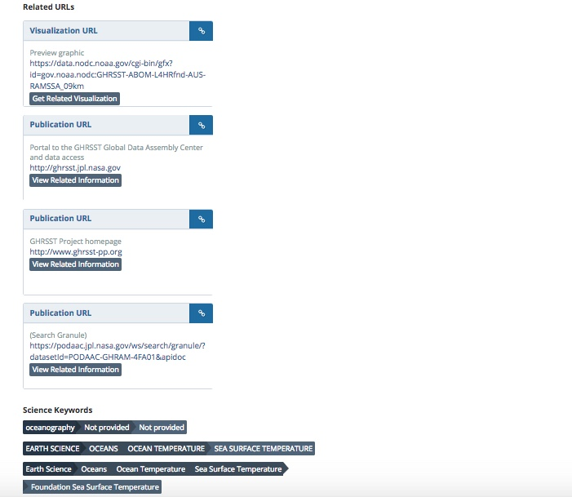
Metadata Management Tool (MMT): Preview Draft Record

Slide 36
This work was supported by NASA/GSFC under Raytheon Co. contract number NNG15HZ39C.
in partnership with

