Slide 1
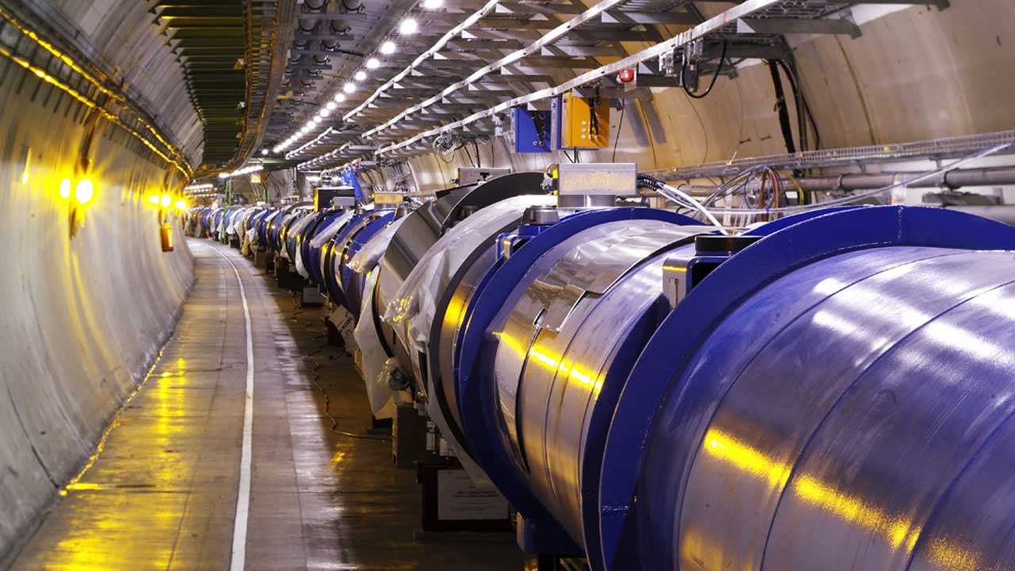

Slide 2

Data Preservation
(and more) at CERN
LEP (1989-2000), LHC(2009-40+)
International Collaboration for Data Preservation and
Long Term Analysis in High Energy Physics
CEOS WGISS-46
https://indico.cern.ch/event/763278/
Jamie.Shiers@cern.ch
30 years in 30 minutes!

Slide 3
Suggested topics…
Archive Infrastructure and technology
Monitoring tools
Archive volume, missions, coverage
Archiving flows and processes
Data format/packaging for long term archive
Management of the relevant associated knowledge
Volume and Trend
AOB

Slide 4
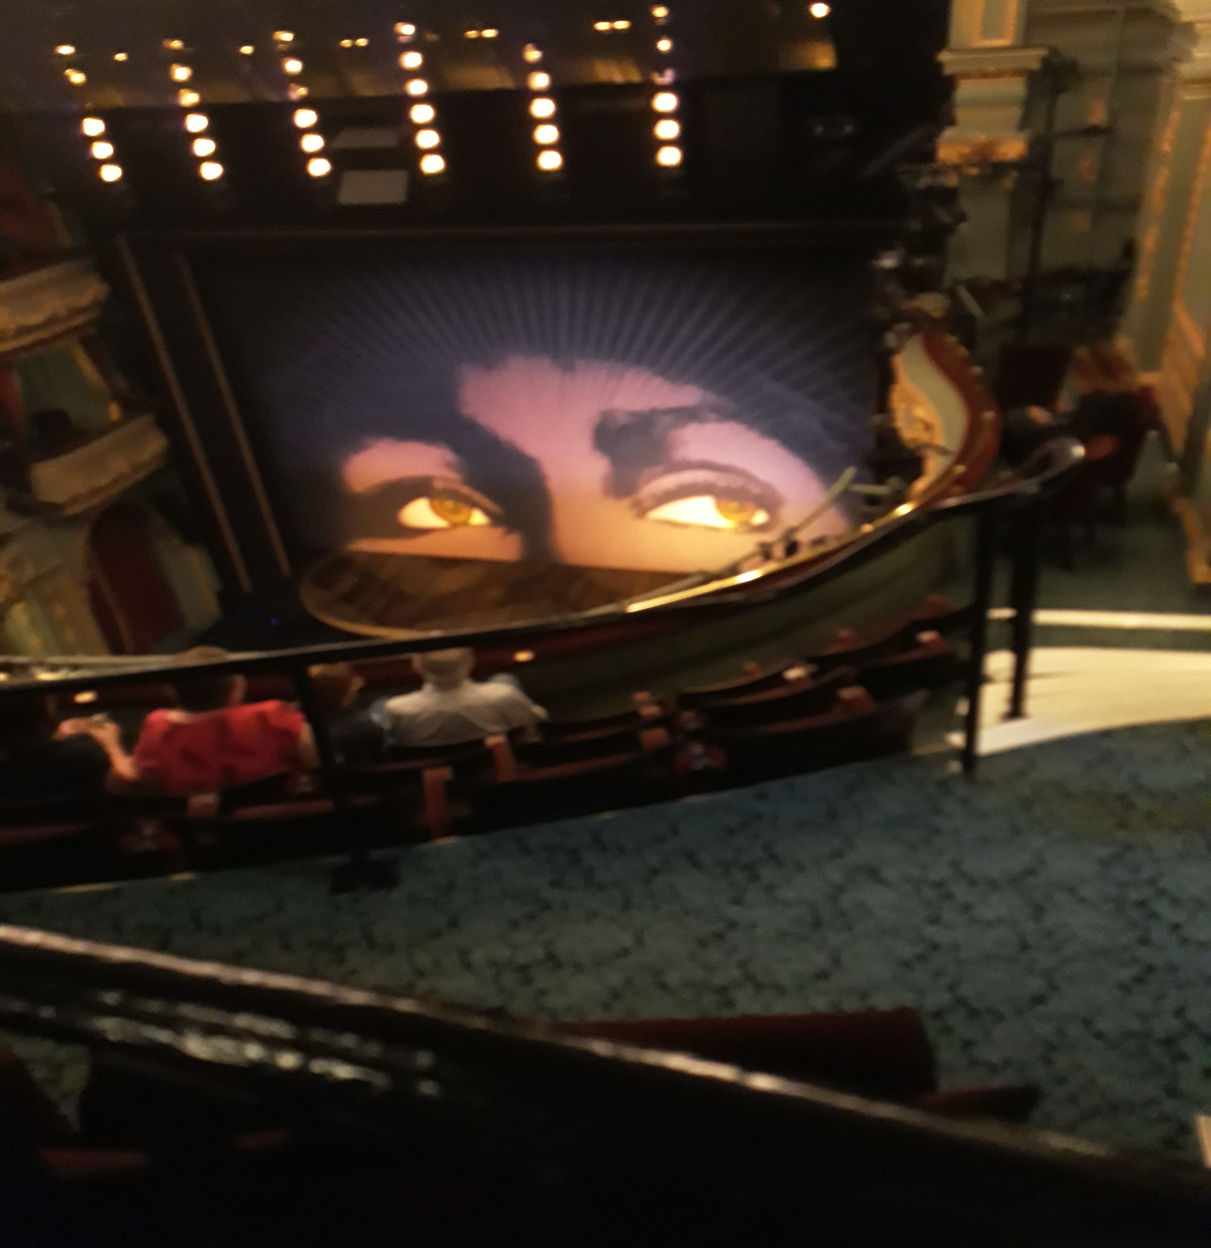


Slide 5
Overview
Current state of Long-Term (multi-decade) Data Preservation at CERN
  What data (“missions”) this covers
  The main services involved including costs
How we got here (it was not (at) all planned)
  Some key milestones & contributing factors
  Major migrations & some dead-ends
Where we expect to go in the coming years

Slide 6
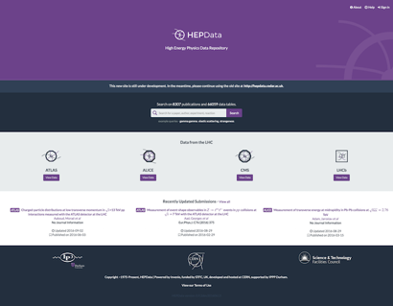
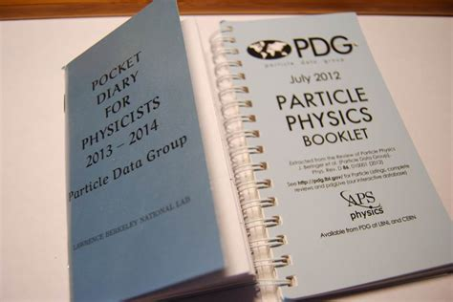
1. Current State
About a dozen active experiments at CERN
  Historically ~1000 since birth of CERN (1954)
Most attention goes to the 4 main LHC experiments: ALICE, ATLAS, CMS, LHCb
These together generate 50PB (and growing) of data per data-taking year
Current “archive” around 300PB
Raw data is stored (tape) at CERN with a copy across ~10 “Tier1” centres
Distributed OAIS? Maybe….

Slide 7
1. The Large Hadron Collider
Originally proposed in late 1970s (78 / 79)
“Real” data taking started in 2009/10
Announcement of Higgs Boson in 2012
Approximately 100 days of beam time per year with longer technical stops in the winter
And occasional “long shutdowns” – LS2 starts imminently and will last until mid-2021
Major machine (and detector) upgrades during LSx: after LS3: HL-LHC
These come with (big) increases in data rates

Slide 8
1. Open Data at the LHC
For the first time at CERN / in HEP: the LHC experiments have Open Access policies
And have released more than 1PB of data
With the necessary software + VMs + documentation
And it works – and is used!
Designated communities include “theorists”, citizen scientists & high-schools
Big questions about funding for Open Data resources: but does it ALL need to be online ALL of the time?
Also – for the first time – preservation / curation of data part of an MoU signed by Funding Agencies
Open Data also from OPERA – CERN recognised experiment

Slide 9
1. Data Preservation in the LHC Era
Key components described in the 2012/13 update of the European Strategy for Particle Physics
By 2016, these were matched by stable, production services (see iPRES paper)
In 2017, task force looking at challenges of HL-LHC (2025+) and beyond concluded inter alia that
“bit preservation with an acceptably low error rate can be considered a solved problem”.
Today, the focus has moved on (later) and another ESPP update is about to start…

Slide 10
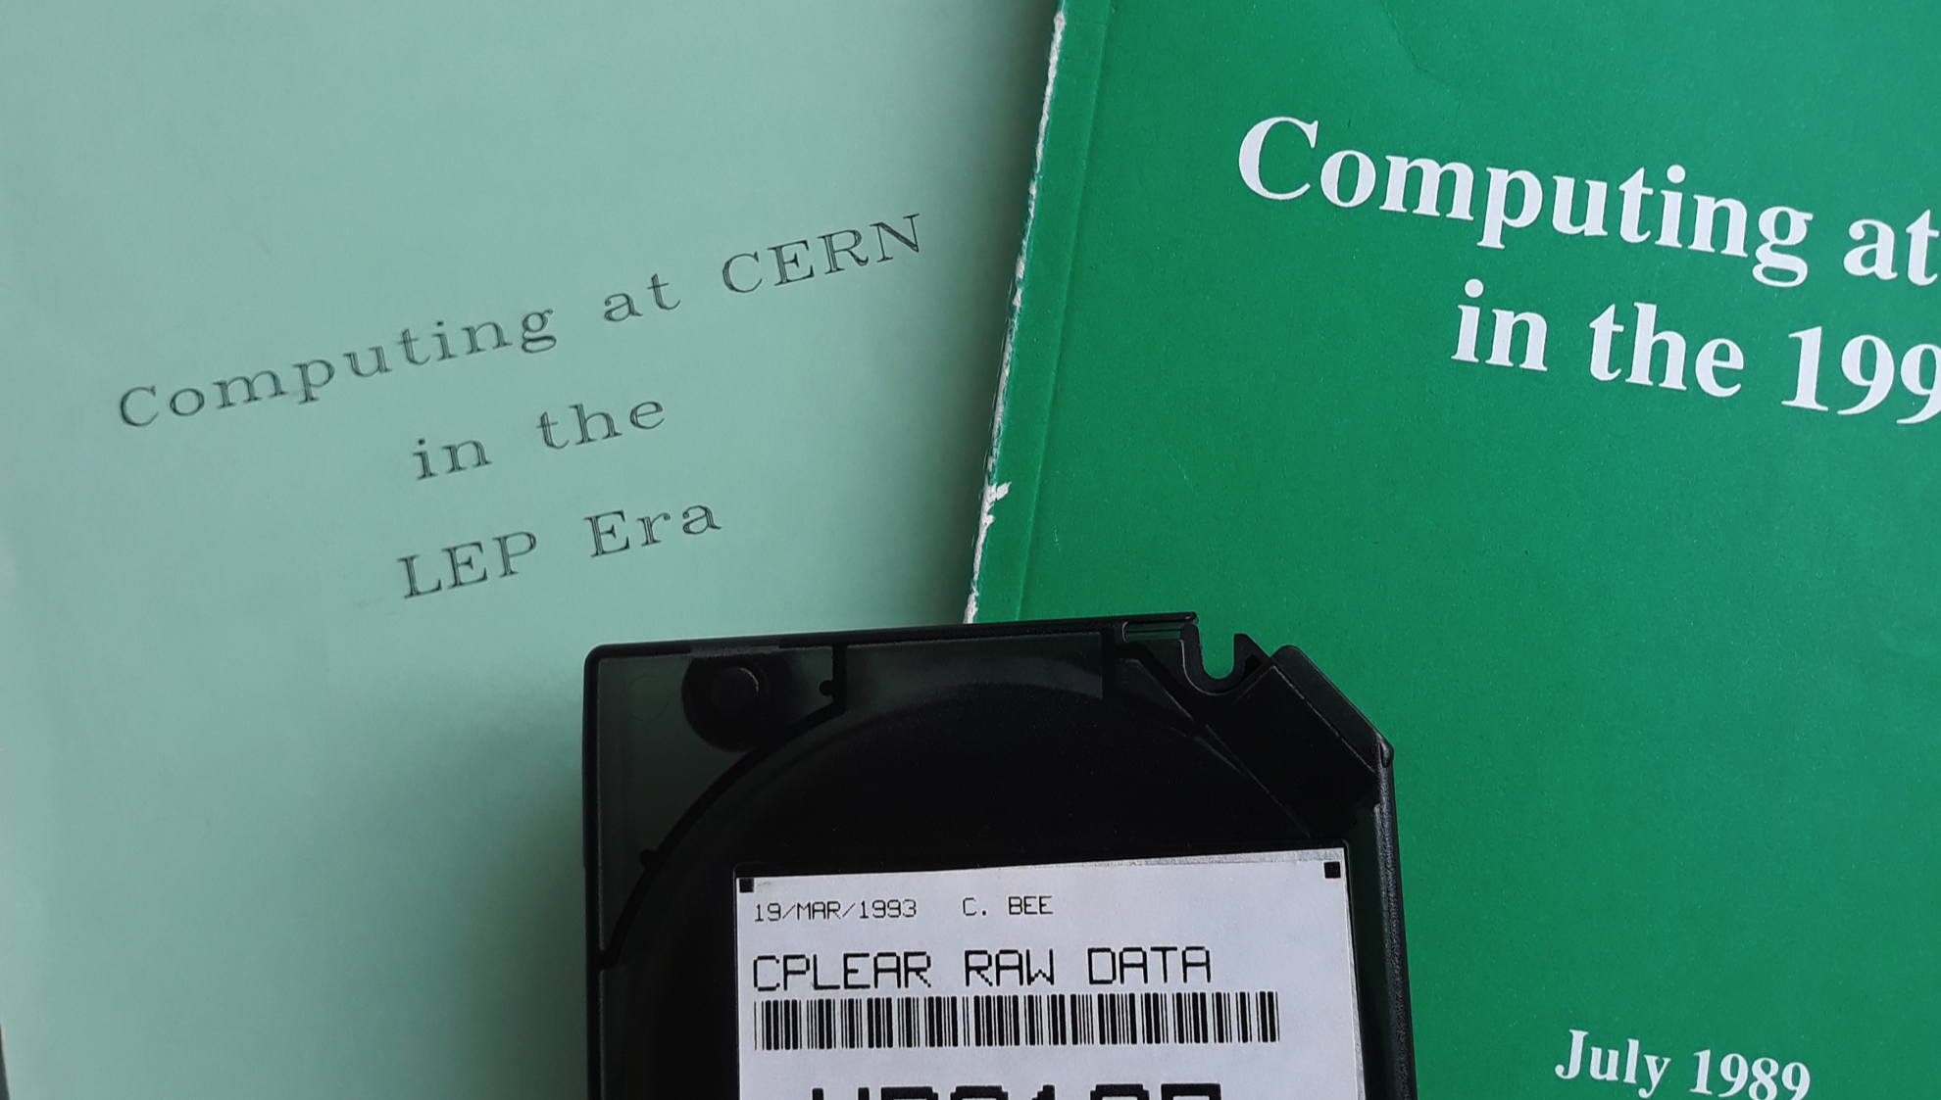
2. How did we get here?

Slide 11
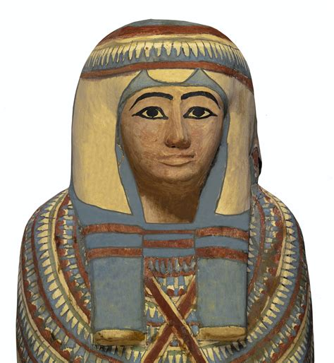
2. The LEP Era
Prior to LEP (1989-2000), experiments tended to be relatively short-lived
LEP required a degree of planning that was previously unknown (but predictions wrong…)
And it faced almost constant migrations (operating systems, computer hardware), as well as paradigms
  Mainframe – clusters – farms – grids – clouds – ?
IMHO this need for regular migration is one reason why the data is still usable today
Another is the IBM 3480 cartridge… and people…

Slide 12
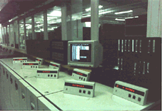
2. LEP Tape Management
Experiments bought and managed their tapes: data was referred to by VSN+FSEQ
My contribution: introduction of a platform-independent naming scheme (file catalog) + the F and A in F.A.I.R. (maybe)
//catalogue/experiment/dir1/dir2/.../dirn/filename
This started the journey to “managed storage” where now all data is in robots
Multiple copies of LEP data: 2 tape + 1 disk at CERN alone (extra copies at outside labs)
Migrating the data forward…

Slide 13
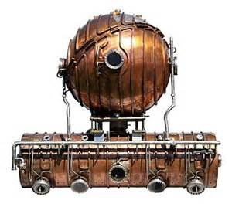
2. LEP Software
Software designed in an era of very heterogeneous computers & operating systems
*NEW* Key decisions on machine independent data formats (e.g. IEEE floating point) &
self-describing (to an extent) data
Many migrations helped weed out bugs in code and ended up with 64 bit code for Unix / Linux
Relatively(?) easy to port forward & validate
Try doing that with legacy mainframe code
Porting the software forward…

Slide 14
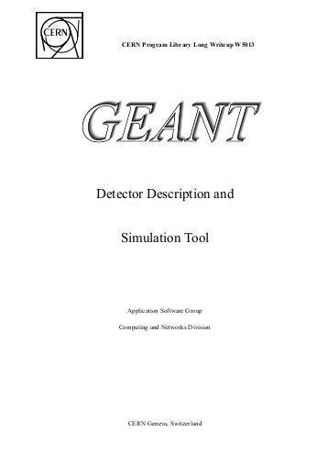
2. LEP Documentation
Major effort in mid-1990s to re-format and bring up to date CERN Program Library documentation
  LaTeX source, Postscript and HTML Output
Re-done in ~2015 to produce consistent PDF, PDF/A and HTML – and capture much missing meta-data – and store in a Digital Library
  DOIs – we did not go as far as ORCID IDs
Experts are needed to validate output!
No automatic conversion of document formats

Slide 15
2. PV2018 Proceedings
I submitted an abstract, based on “Collaborative Long-Term Data Preservation: From Hundreds of PB to Tens of EB” to PV
Somehow, the 4-page paper got “extracted” from the conference proceedings and fed into the CERN Document Server CDS
It looks like it was printed & then scanned on the lowest resolution scanner left in the world
The abstract was re-typed? OCR-ed?
DPHEP was changed to DPI-IEP, even though the HEP acronym was defined in the same sentence
“Automatic” is no substitute for intelligence

Slide 16
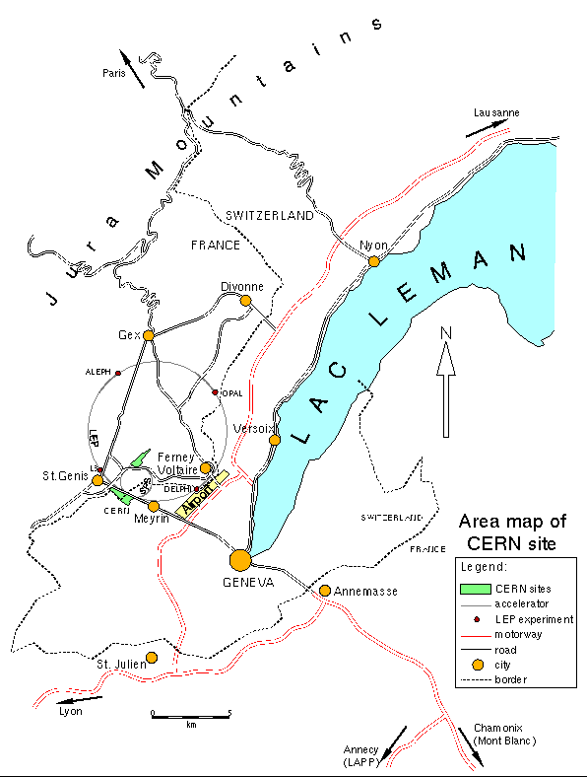
2. LEP Summary
Started with mainframes, user-managed
tapes and “unaffordable computing / storage”
Profited from RISC and then PC revolutions
Data preservation was not considered from the start – several unsuccessful attempts all doomed to failure for reasons including:
  Bit preservation “as a service” not available
  Incomplete understanding of preservation
  “Long-term” support & funding lacking
Despite this, the data from all 4 experiments is still available and that from 3 fully usable!
“Last gasp” data preservation – at the end, or even after, the end of data taking

Slide 17
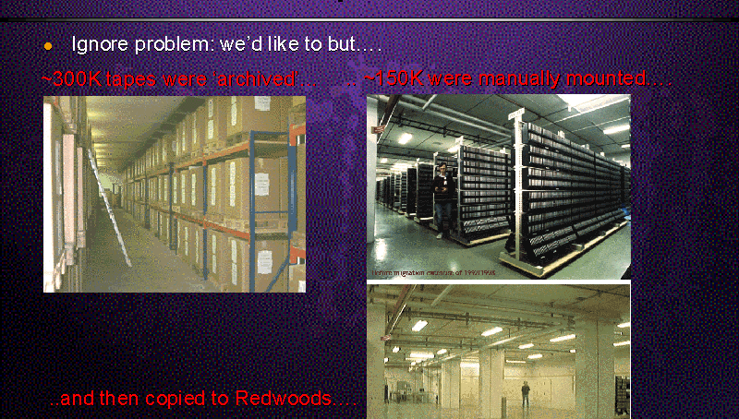
2. LEP Era: Tape Archive

Slide 18
2. Preparing for the LHC
Computing R&D projects started in the mid-90s – (others much earlier)
No explicit focus on preservation at this stage, rather on Mass Storage Systems, Data Formats and I/O systems
This included IBM’s HPSS, Objectivity/DB and a major move from Fortran to C++
C++ has remained, but both HPSS and Objectivity/DB were replaced:
Major data migrations requiring new s/w
But where are the documents and presentations from these projects?

Slide 19
2. Enter the Grid (A Y2K Bug?)
(W)LCG based on a hierarchical model of O(1) Tier0s, O(10) Tier1s and O(100) Tier2s
  Sum of resources at each level ~constant
  Service levels decrease with increasing Tier #
“Data curation” – a responsibility of the Tier0 and Tier1 centres (LCG TDR 2005)
  “A Tier-1 is responsible for the storing and general curation of archived data through the life of the experiments it supports.
  This implies the need to retain capabilities in the technology in which the data is originally recorded or to migrate the data to new storage technologies as they are adopted at that site in the future.”
This was the first time (AFAIK) data preservation was considered prior to data taking
  Although clearly not thought out in much detail, nor costed

Slide 20
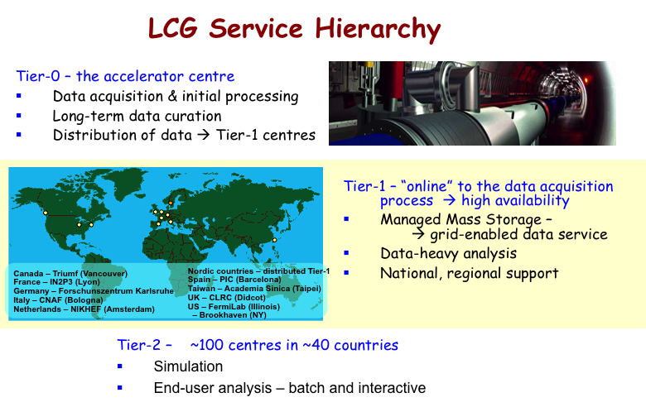

Slide 21
2. The DPHEP Blueprint
Towards the end of “the noughties” (2000 decade), a number of Collider experiments were coming to an end worldwide
Together, formed the DPHEP Study Group that produced a Blueprint document outlining the motivation for LTDP in HEP as well as major issues (funding, support)
Fed into the 2012 ESPP update and resulted in LTDP being a part of the current strategy

Slide 22


The DPHEP Blueprint
Comprehensive review of the HEP situation
Action plan proposed for the next 3 years
A cry for help:
  Urgent action is needed for LTDP in HEP
  The preservation of the full capacity to do analysis is recommended such that new scientific output is made possible using the archived data

Slide 23
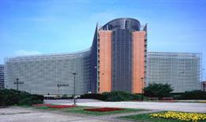
2013 ESPP on LTDP
…data preservation and distributed data-intensive computing should be maintained and further developed.
Well – at least it got a mention!
Hope to have something a bit more concrete next time! (2030 vision?)

Slide 24
2. From Study Group to Collaboration
Primary goal was to deliver solutions to the issues outlined in the Blueprint
  Preparing a 2020 Vision (shown many times)
  Understanding the Full Costs of Curation
  Agreeing HEP-wide on the core services on which LTDP depends
    “Bit preservation” (of the data) (?? TDRs ??)
    Documentation preservation (more complex than just a few PDFs)
    Preservation of software + environment in which it runs
    VERY DIFFERENT to porting s/w forward…
  Such services in production since 2015 at CERN, outside and in EOSC*
  Although I don’t believe in generic TDRs… See later…
See https://indico.cern.ch/category/4458/

Slide 25
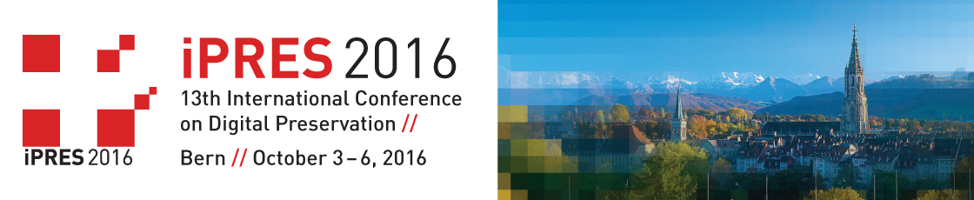
LTDP in HEP (iPRES 2016 paper)
Built on 3 preservation "pillars":
  The data itself ("bits” – state of the art bit preservation);
  Documentation (services like Zenodo, B2SHARE);
  together with the necessary
  Software + environment (CernVM / CVMFS)
Services for all 3 areas exist and are mature but change on fully independent timescales
We need flexible (not static) bridges between them
See https://cds.cern.ch/record/2195937/files/iPRES2016-CERN_July3.pdf

Slide 26


Slide 27
3. Future Directions
“Analysis preservation” and reproducibility of results are top priorities for Data Producers
Solving the Open Data funding / resource problem
Data Preservation for non-CERN experiments
Completing ISO 16363 certification seen as important for CERN, possibly also ESFRIs + ?
Tape alternatives? Concerns over size of Enterprise Tape market (we are a small player)
Use of commercial or other Cloud Backends?
PV2020 and “EIROforum” meetings

Slide 28
3. Future Directions (I)
“Analysis preservation” and reproducibility of results are top priorities for Data Producers
  This could be highly complex but experiments “agree” on what information must be captured; prototyping how to do it
  Possible RIA project (January 2019) in this area
Solving the Open Data funding / resource problem
  My proposed solution: define what resources possible and cache only recent / “featured” / requested data (NOT ALL!)
Data Preservation for non-CERN experiments
  By example: WLCG / HSF workshop at JLAB March 2019
  Ingest & preservation of 2PB BaBar data (SLAC)

Slide 29
Topic: INFRAEOSC-02-2019
Title:
Prototyping new innovative services
Challenge:
Develop an agile, fit-for-purpose and sustainable service offering accessible through the EOSC hub that can satisfy the evolving needs of the scientific community by stimulating the design and prototyping of novel innovative digital services. Innovative models of collaboration that genuinely include incentive mechanisms for a user oriented open science approach should be considered.
Scope:
Actions that target gaps in the service offering of the EOSC hub and develop innovative services that address relevant aspects of the research data cycle (from inception to publication, curation, preservation and reuse), e.g. allowing implementation of new scientific data-related developments and intelligent linking and discovering of all research artefacts.
By the end of the project the services should be leveraged to foster interdisciplinary research, serving a wider remit of research needs, as well as new users like industry and the public sector.
The services should be based on systems and technologies that have reached TRL 6 before the start of the project and will be brought to at least TRL 8 by the end of the project.
Proposals should demonstrate how the resulting services complement, enrich and could potentially be integrated into the EOSC hub.
Proposals retained for funding under this topic should take due consideration of any accessibility requirements set under the projects funded under EINFRA-12-2017 topic that may be available at the time the call will be open.
Consortia are encouraged to include SMEs
Type of Action:
RIA
Budget:
€28.5M
Submission opening:
16/10/2018
Suggested contribution requested per proposal:
Submission deadline:
29/01/2019
€5-6M

Slide 30
3. Future Directions (II)
Completing ISO 16363 certification seen as important for CERN, possibly also ESFRIs + ?
  Self-certification drafted; Stage 1 “off-site” audit performed; planning formal on-site audit
  N.B. covers all LTDP activities at CERN – not just scientific data
  Certification of some ESFRIs as part of ESCAPE project
Tape alternatives? Concerns over size of Enterprise Tape market (we are a small player)
  Possible topic for EIROForum+ TWG meetings
  CERN is following this internally, with Tier1s and big players such as Internet giants
Use of commercial or other Cloud Backends?
  H2020 PCP ARCHIVER project (January 2019) will prototype this at
  100TB – 1PB level
  Can we agree on common Use Cases and interface(s)?

Slide 31
3. Future Directions (III)
PV2020 and “EIROforum” meetings
  Have discussed holding short, focused technical meetings with EIROforum (and other) members
  Tapes and tape alternatives is a possible 1st topic
  Interest?
  PV2020 tentative dates and timeline established
  Still much to do – including discussing with Esther!

Slide 32
Summary
Sustainable data preservation is a reality at CERN: 300PB with an outlook to 10EB
Now addressing “next level” concerns, including reproducibility of results,
Open Data at multi-PB level, potential use of (commercial) cloud storage etc.
Hopefully, we can strengthen our links, arrange regular technical meetings …
And make PV2020 “Simply the Best!”

Slide 33
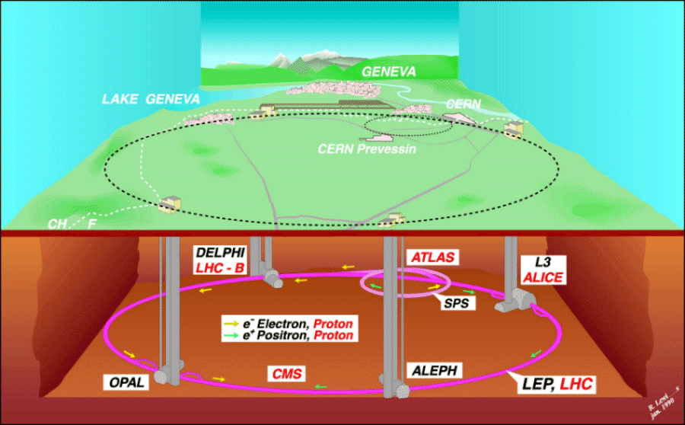
LEP Experiments: ALEPH, DELPHI, L3, OPAL (e⁺e⁻)
LHC Experiments: ALICE, ATLAS, CMS, LHCb (pp + HI)

Slide 34
Overview
2012 DPHEP “Blueprint” published & input to European Strategy of Particle Physics update
  Strategy adopted by CERN Council May 2013
2018: a new strategy update has been launched with input due December 2018
  To be adopted in (May?) 2020
What was the situation in 2012/13?
What have we achieved since then?
Outstanding issues & future directions
During this period the world about us has changed considerably (4C, FAIR DMPs, EOSC*, etc.)

Slide 35
Definitions
“Long-term” in HEP means “a few decades”
  LEP started in 1989 – data alive until 2030?
    ~100TB per experiment (ALEPH, DELPHI, L3, OPAL)
  LHC started in 2009 – upgrades until 2035+
    Also 4 main experiments (ALICE, ATLAS, CMS, LHCb)
    Already in excess of 200PB
“Collaborative” means
  Across all HEP institutes and experiments
  Together with other disciplines / institutes
  (and in particular ESFRIs and EIROForum)
  With Funding Agencies, Policy Makers,
  EOSC & other projects and also Industry

Slide 36
LEP / (HL-)LHC Timeline
Database / data management support,
CERN Program Library, Distributed Computing
DM R&D, DBs, WLCG, EGI
Major Data Migrations(!)
ESFRI roadmap as
“landmark project”
Robust, stable services over several decades
Data preservation and re-use over similar periods
“Transparent” and supported migrations

Slide 37

What does DPHEP do?
DPHEP is a Collaboration with signatures from the main HEP laboratories and some funding agencies worldwide.
It has established a "2020 vision", whereby:
  All archived data – e.g. that described in DPHEP Blueprint, including LHC data – should be easily findable and fully usable by the designated communities with clear (Open) access policies and possibilities to annotate further;
  Best practices, tools and services should be well run-in, fully documented and sustainable; built in common with other disciplines, based on standards;
  There should be a DPHEP portal, through which data / tools accessed;
  Clear targets & metrics to measure the above should be agreed between Funding Agencies, Service Providers and the Experiments.
Data Preservation in High Energy Physics

Slide 38
The DPHEP Blueprint
Comprehensive review of the HEP situation
Action plan proposed for the next 3 years
A cry for help:
  Urgent action is needed for LTDP in HEP
  The preservation of the full capacity to do analysis is recommended such that new scientific output is made possible using the archived data

Slide 39
2013 ESPP on LTDP
…data preservation and distributed data-intensive computing should be maintained and further developed.
Well – at least it got a mention!
Hope to have something a bit more concrete next time! (2030 vision?)

Slide 40
LTDP in HEP (iPRES 2016 paper)
Built on 3 "pillars":
  The data itself ("bits” – state of the art bit preservation);
  Documentation (services like Zenodo, B2SHARE);
  together with the necessary
  Software + environment (CernVM / CVMFS)
Services for all 3 areas exist and are mature but change on fully independent timescales
We need flexible (not static) bridges between them
See https://cds.cern.ch/record/2195937/files/iPRES2016-CERN_July3.pdf

Slide 41
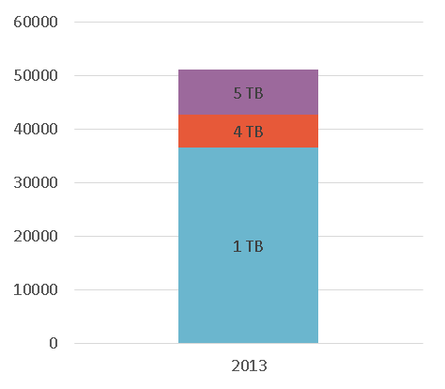
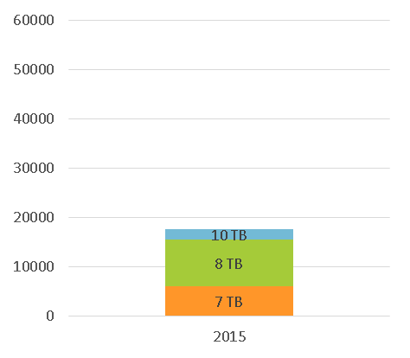
Bit Preservation: Steps Include
Regular media verification
  When tape written, filled, every 2 years…
Controlled media lifecycle
  Media kept for 2 max. 2 drive generations
Reducing tape mounts
  Reduces media wear-out & increases efficiency
Data Redundancy
  For “smaller” communities, a 2nd copy can be created: separate library in a different building (e.g. LEP – 3 copies at CERN!)
Protecting the physical link
  Between disk caches and tape servers
Protecting the environment
  Dust sensors! (Don’t let users touch tapes)
Constant improvement: reduction in bit-loss rate: 5 x 10⁻¹⁶
Not efficient for “everyone” to (re-)implement this. Outsource? (To VTDR)

Slide 42
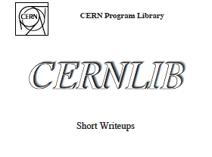
Documentation - Some Issues
Some preservation systems claim to do automatic format conversion (of documents)
IMHO this is not realistic for e.g. scientific documentation
  Maybe for basic "ASCII text”
    but see e.g. Kindle format books
  1018 and 10¹⁸ are not the same – let alone formulae for Bessel functions of the 3rd kind!
2016 re-formatting of CERNLIB docs required detailed mathematical knowledge in addition to reprocessing LaTeX into PDF!

Slide 43
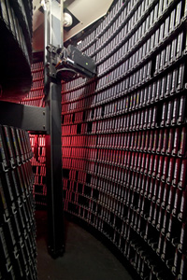
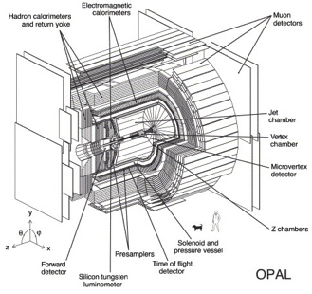
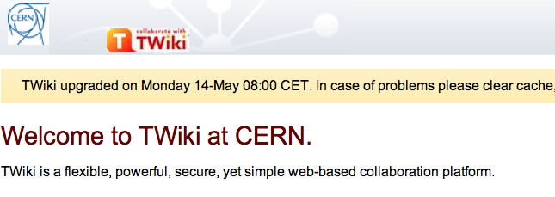
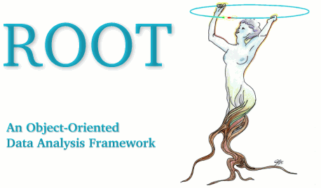
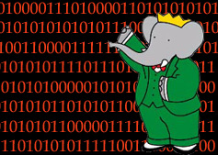

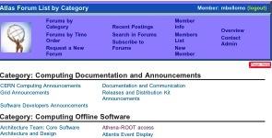
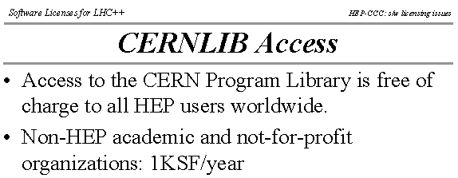


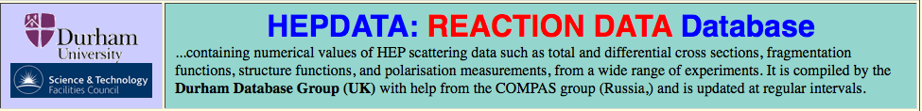

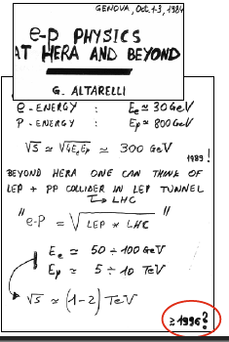
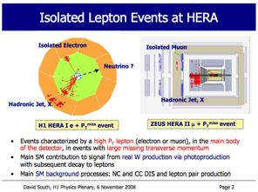
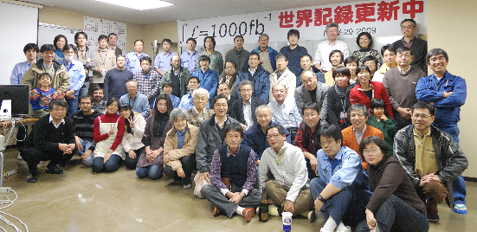


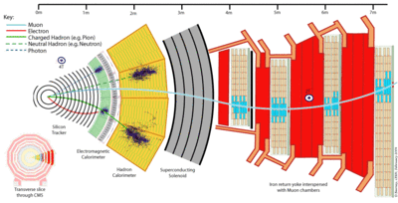
What is HEP data?
Digital information
The data themselves, volume estimates for preservation data of the
order of a few to 10 PB
(to 10 EB for LHC)
Other digital sources such as databases to also be considered
Software
Simulation, reconstruction, analysis, user, in addition to any external dependencies
Meta information
Hyper-news, messages, wikis, user forums..
Publications
Documentation
Internal publications, notes, manuals, slides
Expertise and people

Slide 44

Software Preservation
Today HEP s/w is O(10⁷) lines of code, 10s to 100s of modules and many languages!
(“Bespoke” per experiment AND analysis)
Versioning filesystems and virtualisation widely adopted in HEP: also in EGI & EOSC!
Capture and preserve software + environment for each set of preserved data
Believe we can analyse LEP data ~30 years after data taking ended! (i.e. until ~2030)
Simulation of physics processes and detectors are common apps

Slide 45
F.A.I.R. Data Management
Increasing emphasis on FAIR DMPs, including preservation, sharing, reproducibility etc.
  FAIR now includes also s/w but not yet build systems, verification procedures & environment
IMHO not yet fully understood (some claim otherwise) - we see (ir)regular changes on how we find data and what protocol(s) we use to access it
This can be a problem over periods < 1 decade
Only solution we know of: find the effort to migrate (problem for legacy projects / data)
FAIR = Findable, Accessible, Inter-operable, Re-usable

Slide 46
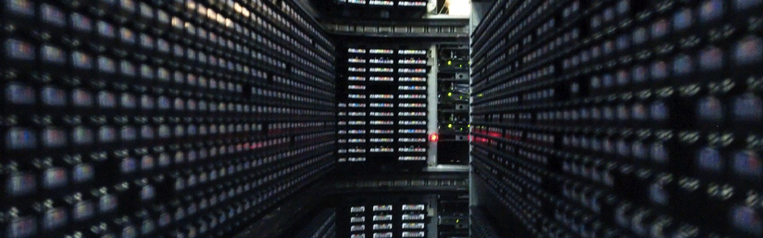
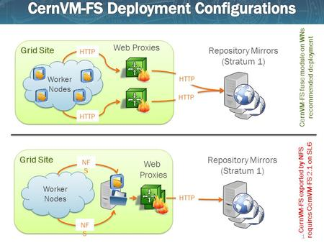

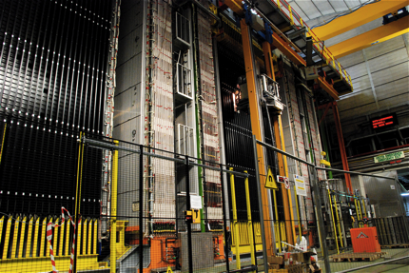
Collaboration
Through technology:
  Large Tape Users’ Group
  Invenio → Zenodo → B2SHARE (INSPIREHEP)
  CVMFS / CernVM
Through projects:
  e*, E* and H*
Through services:
  Obi-wan Zenodo
  CVMFS repository for “lost” experiments
  Possible hosting of 2PB of BaBar@SLAC data
  70 TB of OPERA data (CERN “recognised” expt)
Through workshops & conferences:
  e.g. EIROForum technical WG on LTDP
  More on Thursday… (?)

Slide 47

BaBar needs Help! BaBar in Numbers
BaBar data actively being analyzed and high impact papers published (see slide 2). Expect this to continue to at least through 2021.
SLAC management plans to stop hosting BaBar computing in February 2020 at which time the tapes with data will be ejected.
DOE support ended in 2017, now running on international common funds (OCF).
Looking for possibility of support and long term data preservation at
  CERN,
  GridKa (BaBar site for analysis and XRootD federated dataset main redirector),
  University of Victoria (BABAR site for analysis, documentation, and tools support).
BaBar lightweight VMs come with the latest software release and xrootd client included, running under the most common virtual machine players. Just add the data via the GridKa main XRootD redirector.
2PB of data on T10k-D tapes
  raw, processed, Monte Carlo
  Unique dataset at the Y(3S) resonance
  (no plan (yet?) to run at the Y(3S) @ Belle II)
Full environment enclosed in VMs (SL5,SL6)
~1TB of documentation, repositories, and dataset information (DBs, cvs, wiki, html)
  Internal documents archived on INSPIRE
574 papers, ~10 papers/year past 3 years
231 members (semi-frozen author list)
  Including PhD students in Canada, Germany, Israel, Italy, Russia, US
  Associated theorists mine data to test new ideas
~20 analyses on track, ~10 more in the pipeline
  Continue to have new analyses every year including joint BaBar -Belle analyses
Students analyze BaBar data while working on Belle II and other experiments in construction/commissioning phase

Slide 48

ISO 16363 certification of CERN
ISO 16363 follows OAIS breakdown:
    Organisational Infrastructure;
    Digital Object Management;
    Infrastructure and Security Risk Management.
Many of the elements in 3) and 5) covered by existing (and documented) CERN practices
  Some “weak” areas – being addressed – include disaster preparedness / recovery (together with EIROForum)
On-going “stage 1” external audit to high-light those areas requiring attention
  May just be a question of documentation,
  e.g. CERN is not going to change its financial practices
  (MTP etc) as a result of ISO 16363!

Slide 49
Who does it benefit?
Funding agencies, who can better judge if the money they are providing will be used according to their requirements
  e.g. FAIR DMPs which call for preservation & re-use
Data users to be able to determine the “trustworthiness” of the data (user surveys)
Producers (e.g. LHC experiments) to understand how and what a repository does to preserve their data
The data of most CERN experiments already lost!
  By number of experiments, not by volume
    CERN Greybook: 776 completed experiments, ~20 active
    “Preserved”: LEP(4), LHC(4)
    O(10) vs O(1000)

Slide 50
HEP Community White Paper
Focuses on the challenges of the next decade or so (LHC Run3, HL-LHC Run4)
  Massive increase in data rates and computational needs – way beyond technology predictions
“bit preservation with an acceptably low error rate can now be considered a solved problem”
Main areas of work now:
  Analysis capture (incl. workflows) and reproducibility
  “Open Data” at multi-PB scale and beyond
  Trying to do this in collaboration with others (e.g. RDA)
Does “Open Data” mean zero or low latency?
  People assume so – enormous implications!

Slide 51
Services are (just) services
No matter how fantastic our { TDRs, PID services, Digital Library, Software repository } etc is, they are there to support the users
Who have to do the really hard work!
  E.g. write the software, documentation, acquire and analyse the data, write the scientific papers
However, getting the degree of public recognition as at the Higgs discovery day was a target e-KPI!
Computing was thanked in the same way as the LHC & experiments

Slide 52
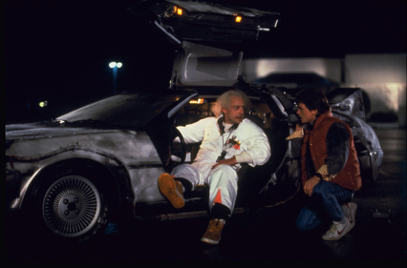
What is the future?
Some hope that it may be possible to separate long-term preservation of data at the bit level from domain-specific aspects
The former could benefit from economies of scale and specialised knowledge in running multi-PB / EB archives
The latter will continue to need expert knowledge to revalidate on a regular basis
Drive to reduce overhead through "domain protocols" for DMPs
Bottom line: be collaborative to drive down costs

Slide 53
Input to next ESPP
Certification as a “Very Trustworthy Digital Repository” – exabytes & decades & changes
Open Data – clarification(s); resources
Reproducibility & Re-use
Resilience to and handling of change(s)

Slide 54
29 years of LEP – what does it tell us?
Major migrations are unavoidable but hard to foresee!
Data is not just “bits”, but also documentation, software + environment + “knowledge”
  “Collective knowledge” particularly hard to capture
    Documentation “refreshed” after 20 years (1995) – now in Digital Library in PDF & PDF/A formats (was Postscript)
Today’s “Big Data” may become tomorrow’s “peanuts”
  100TB per LEP experiment: immensely challenging at the time; now “trivial” for both CPU and storage
  With time, hardware costs tend to zero
    O(CHF 1000) per experiment per year for archive storage
  Personnel costs tend to O(1FTE) >> CHF 1000!
    Perhaps as little now as 0.1 – 0.2 FTE per LEP experiment to keep
    data + s/w alive – (new analyses “cost extra”)
See DPHEP Workshop on “Full Costs of Curation”, January 2014:
https://indico.cern.ch/event/276820/

Slide 55
Conclusions
We are well on the way to implementing our 2020 vision using “standard” services
  VTDR & PIDs, Digital Libraries & DOIs, s/w preservation
  Services that are – or should be – offered in the EOSC*
But they are not “holistic” – “mind the gap(s)”
And they will change over time – whatever people (especially in IT) pretend!
Beware of "grey-backed gorillas"
==> Constant effort is needed – like with a bike

Slide 57
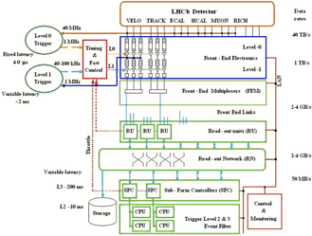
What Makes HEP Different?
We throw away most of our data before it is even recorded – “triggers”
Our detectors are relatively stable over long periods of time (years) – not “doubling every 6 or 18 months”
We make “measurements” – not “observations”
Our projects typically last for decades – we need to keep data usable during at least this length of time (but not necessarily “forever”)
We have shared “data behind publications” for more than 30 years… (HEPData)

Slide 58
ODBMS migration – overview (300TB)
A triple migration!
  Data format and software conversion from Objectivity/DB to Oracle
  Physical media migration from StorageTek 9940A to 9940B tapes
Took ~1 year to prepare; ~1 year to execute
Could never have been achieved without extensive system, database and application support!
Two experiments – many software packages and data sets
  COMPASS raw event data (300 TB)
    Data taking continued after the migration, using the new Oracle software
  HARP raw event data (30 TB), event collections and conditions data
    Data taking stopped in 2002, no need to port event writing infrastructure
  In both cases, the migration was during the “lifetime” of the experiment
  System integration tests validating read-back from the new storage

Slide 59
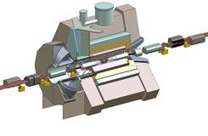
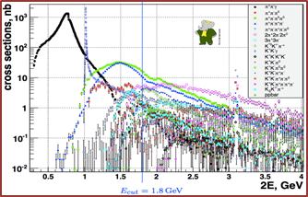
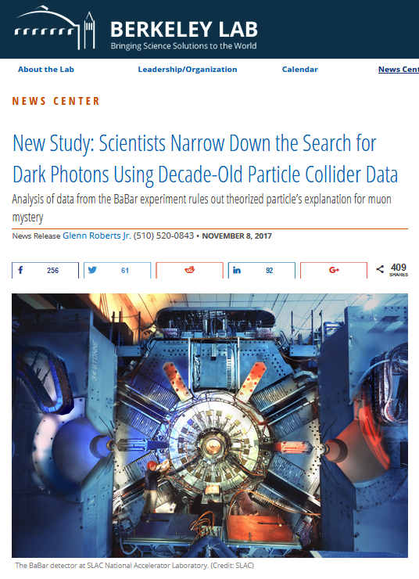
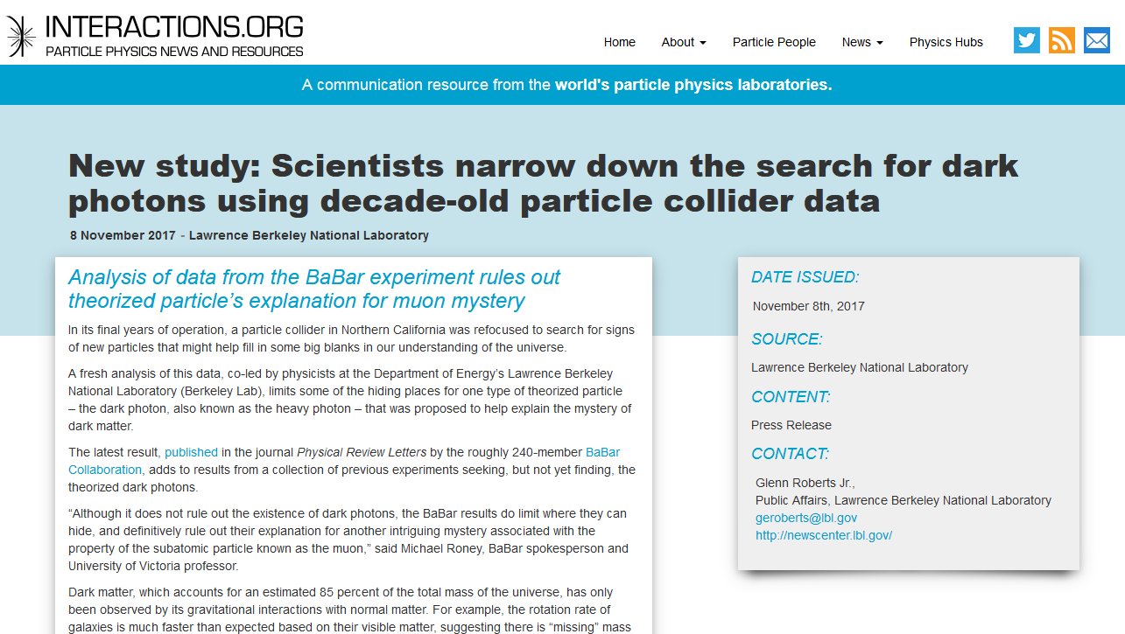
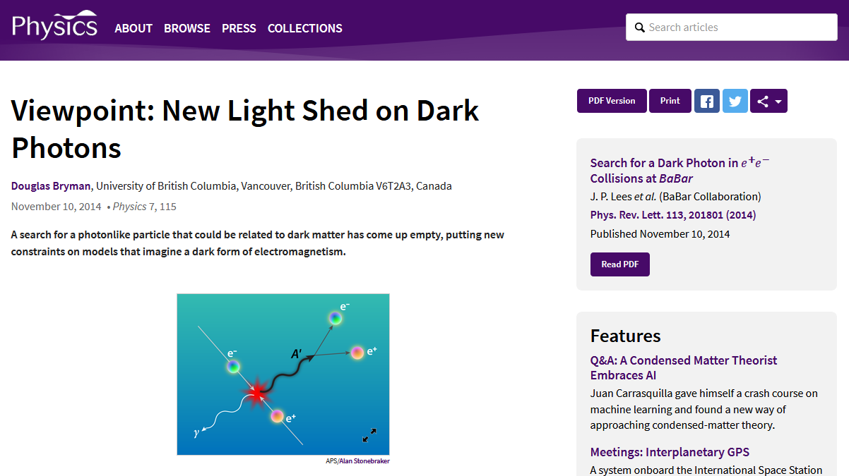
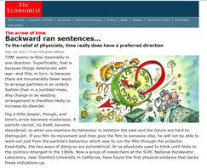
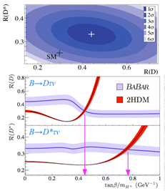
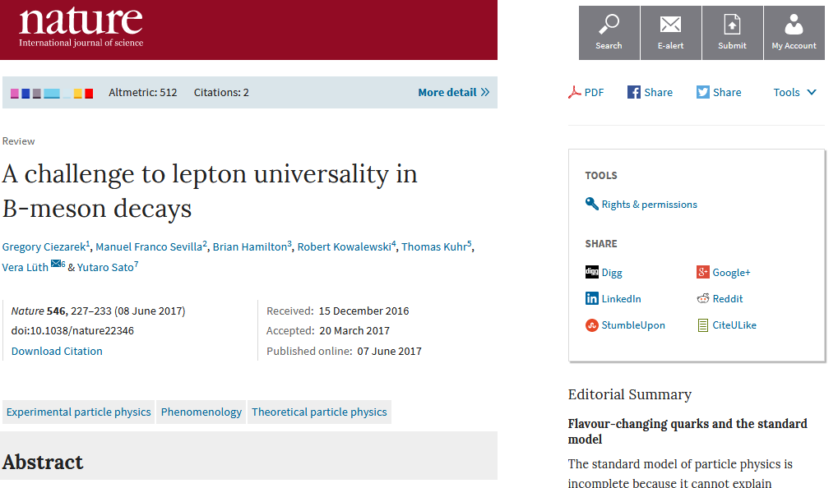
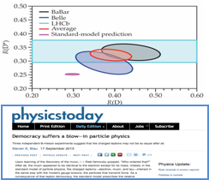
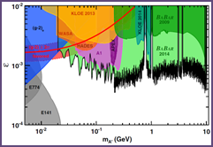
BaBar Highlights and Press Releases
November 2017
Dataset:
Y(4S): 433/fb
Y(3S): 30/fb
Y(2S): 14/fb
Off resonance: 10%
Y(1S) accessed via
Y(2S,3S) → Y(1S) π⁺π–
June 2017

