Slide 1
Working Group on Information Systems and Services (WGISS)
Committee on Earth Observation Satellites
Iolanda Maggio, ESA
WGISS#46 Meeting
Measuring Earth Observation Data Usage – Best Practices
DLR – Oberpfaffenhofen, Germany
22nd October 2018

Slide 2
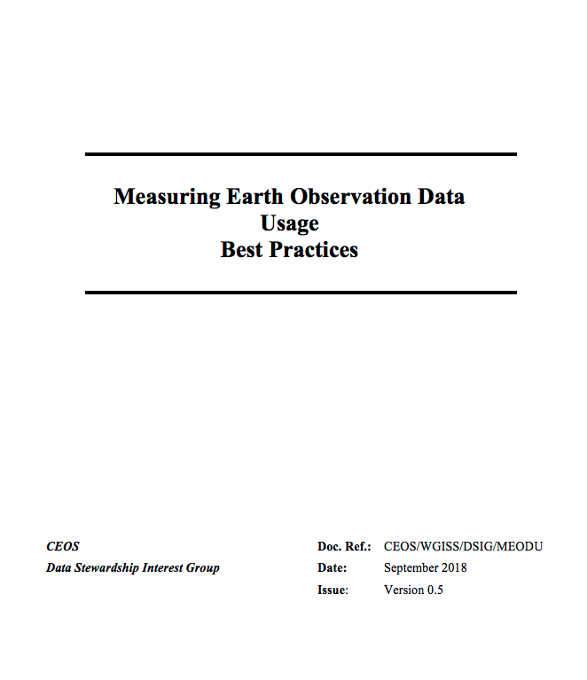
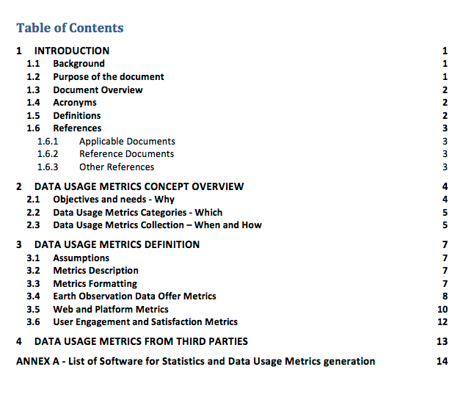
Measuring Earth Observation Data Usage - Best Practices
New title to better include all aspects around the topic

Slide 3
Measuring Earth Observation Data Usage - Best Practices: Sources
Documents and Reports
EOSDIS Report
Sentinels Annual Reporting
EUMETSAT Central Operations Report
Heritage Missions Statistics and Reporting Requirements document
Conferences Surveys
CNES PEPS Statistics
GEOSS Portal Statistics
Space Stakeholders roles
Data Owners
Common Services Manager
Missions and Dissemination Manager
WGISS representatives
Developers
Geo Providers Experts
External platforms, cloud providers and social networks
Amazon
GOOGLE Trend
Alibaba
Facebook, Twitter
Others like https://www.statista.com/

Slide 4
Why, Which, When, How, What

Slide 5
… WHY???
… From different views …
Earth Observation Data Offer viewpoint:
To improve data quality
To encourage generation of new knowledge
To better understand how data are used by users
To increase time series for existing and new scientific applications
Technologic and Platform viewpoint:
To improve the access environment (e.g. simplify web pages, reduce latency, etc.)
To monitor failures (search, download, access)
To introduce new big data technologies
To improve resource management
To improve GUI and other interfaces
To improve ranking for searching capabilities
To monitor the usage of the platform (e.g. no downloads, only searches, missing needed information, etc.)
User Engagement viewpoint:
To stimulate and attract new scientific interest
To improve citizen outreach
To simplify access processes
To monitor user behaviour
Strategic and Programmatic viewpoint:
To increase EO data usage
To embrace non-traditional users and countries
To improve and address funding

Slide 6
… WHICH??? …WHEN & HOW???
Earth Observation Data Offer Metrics
Web and Platform Metrics
User Engagement and Satisfaction Metrics
Several Usage Metrics Collection scenarios are identified
Implicit:
During the registration process: Self-registration, Registration with approval, Registration requiring evaluation
As part of the user’s actions: Downloading activities, Topics and Data search, Documentation consultation
Explicit:
After the completion of a process: Survey/Questionnaires, Feedback

Slide 7
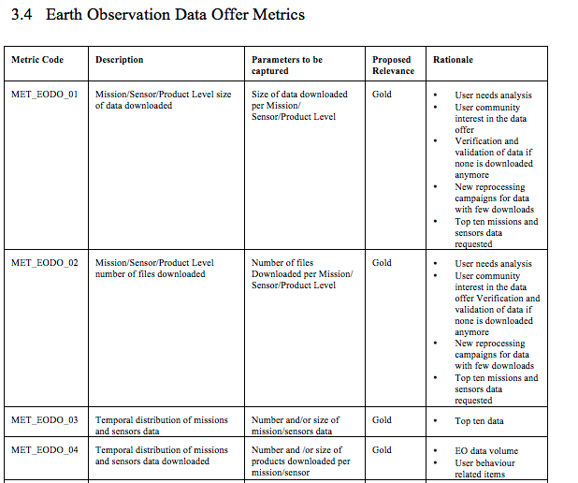
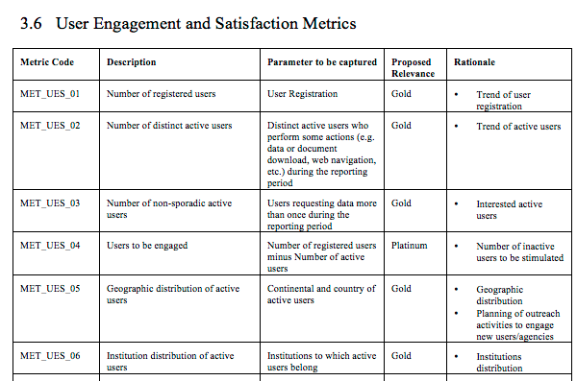
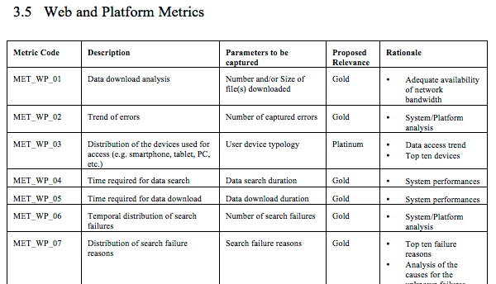
… WHAT???
Numbers:
Earth Observation Data Offer Metrics: 25 (16 Gold, 9 Platinum)
Web and Platform Metrics: 27 (16 Gold, 11 Platinum)
User Engagement and Satisfaction Metrics: 10 (5 Gold, 5 Platinum)

Slide 8
Example of Measuring Reporting

Slide 9
Measuring Earth Observation Data Usage Use Cases

Slide 10
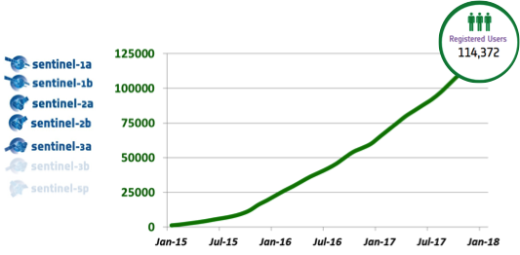
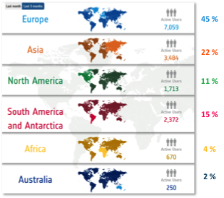
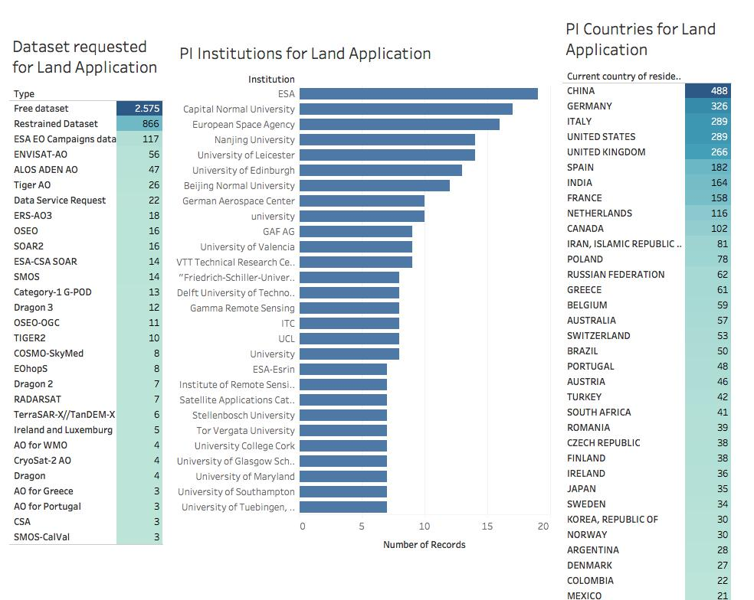
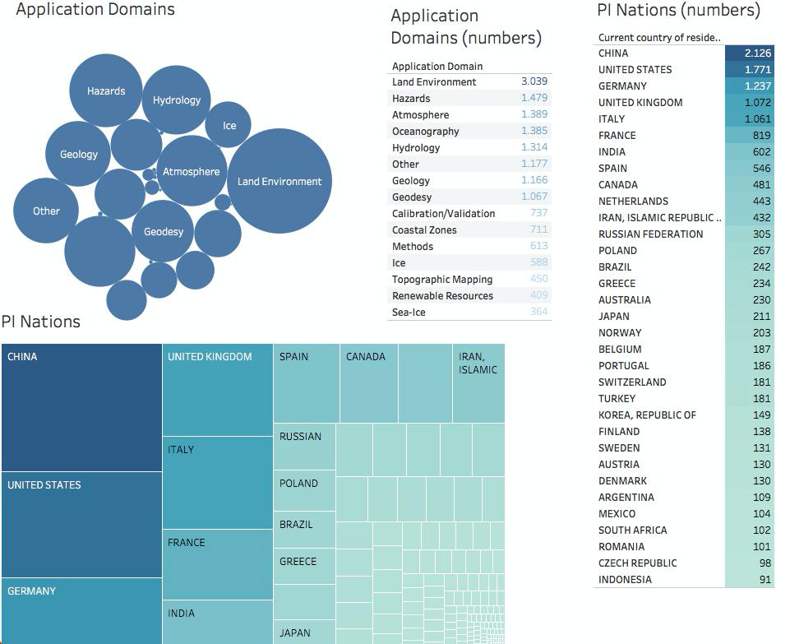
USE CASE: INTRA- Agency
Funding assignment
Sensors improvement
Time series generations
Final User needs
AFTER
BEFORE
Data Owner, Missions Manager, Operations Manager & Other
Stakeholders
Space Systems
Now he knows what he has to do!!!!!

Slide 11
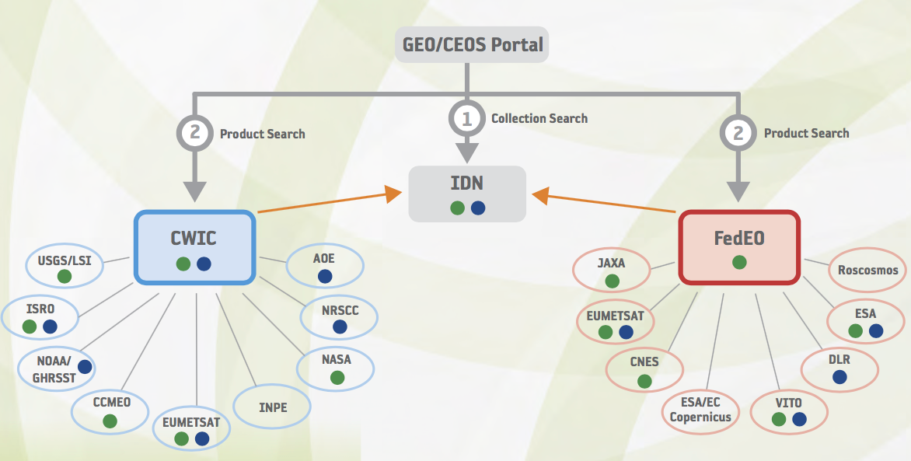
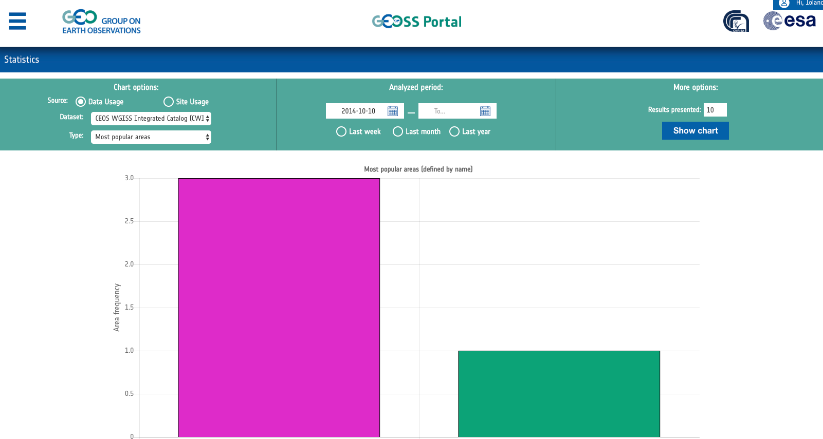
USE CASE: INTER- Agencies
Few stats already implemented in GEO/CEOS Portal
BEFORE

Slide 12
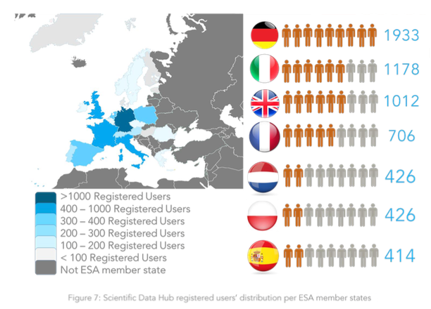
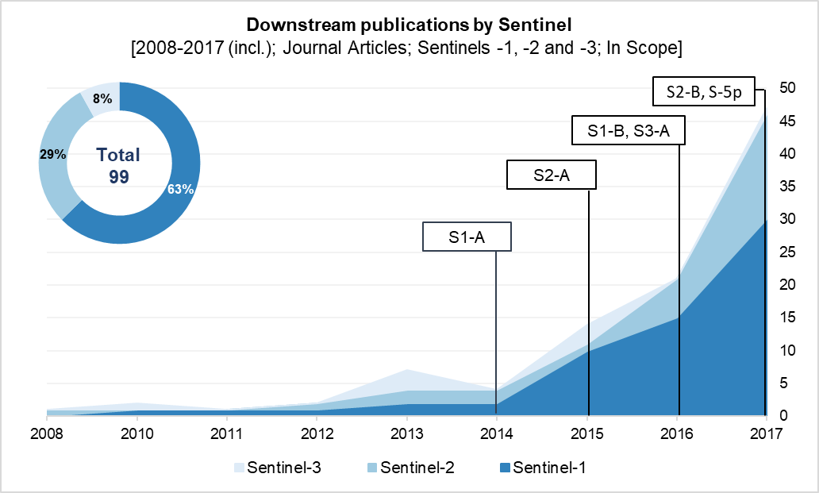
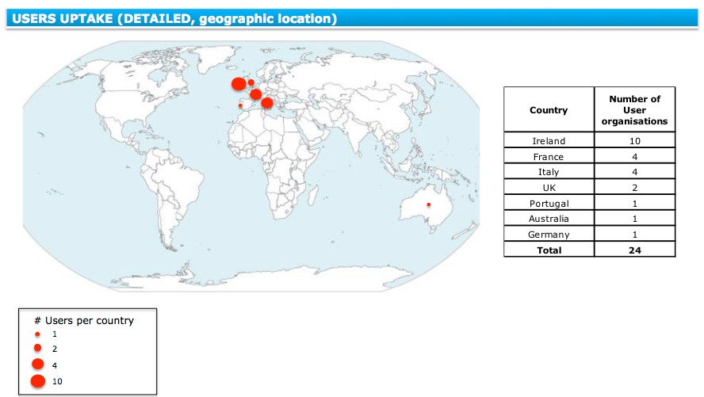
USE CASE: INTER- Agencies
AFTER

Slide 13
INTER-Agencies Collaboration
Joint Collaboration activities and projects for:
Data Format Alignment
Metadata improvement
Time series generation (e.g. FCDR)
Thematic Platforms development
Data accessibility improvement & re-designing

Slide 14
Contact:
Mirko.Albani@esa.int

