Slide 1
WGISS Working Group on Information Systems & Services
Chair report
Committee on Earth Observation Satellites
Mirko Albani - ESA
WGISS-46
DLR – Oberpfaffenhofen, Germany
22nd October 2018

Slide 2
2018 CEOS SIT Technical Workshop
11-14 September 2018 Darmstadt, Germany
Key Outcomes for WGISS during VC-WG Days
There is a need to include new FDA elements/platforms (e.g. APACHE, PANGEO, BIOMASS MAP, etc.) in the WGISS inventory and compiling some “lessons learned” from a user perspective. In addition, there is a need to address challenges of tool interoperability - WGISS
The transition of FDA Ad-Hoc team tasks should be clearly addressed through updates/additions to the CEOS groups mandates/ToR and work-plans. Need to ensure coordination. - WGISS, SEO, LSI-VC
The WGISS Technology Exploration subgroup should continue to review “future” data architectures and report back to CEOS leadership on what we should be considering for the future to enhance our data use and impact (e.g. Machine Learning, AI platforms). Look at emerging trends over the horizon and disrupting technologies - WGISS
Notes:
QUI AGGIUNGERE OUTCOMES

Slide 3
2018 CEOS SIT Technical Workshop
11-14 September 2018 Darmstadt, Germany
Key Outcomes for WGISS during VC-WG Days
There is a need to review the new “Google Datasets Search Tool” to determine how CEOS datasets are represented. - WGISS
There is a need to update the inventory of Virtual Constellations datasets and ensure discoverability/accessibility through WGISS Connected Data Assets infrastructure. - VCs/WGISS
Notes:
QUI AGGIUNGERE OUTCOMES

Slide 4
2018 CEOS SIT Technical Workshop
Actions related to WGISS
WGISS Presentation – 15 minutes slot
SITTW-2018-04: SIT Chair to propose WGISS participation in the GEO Expert Advisory Group. Due by 30 Sep 2018
GEO has formed an Expert Advisory Group (EAG) with a mandate until end 2019 and having the task to provide expert advice to the Secretariat Director on how best to design future GEOSS.
Purpose to provide relevant and timely advice wrt cutting-edge science and technology required for a results-oriented GEOSS
The principal deliverable of the EAG will be a document outlining a strategy for implementation of the vision for GEOSS.
To prepare the document to be presented to the GEO Executive Committee, the Expert Group will have three meetings, held in Geneva in connection with meetings of the GEO Programme Board.
Rob Woodcock supported by Mirko/Andy could be a suitable solution for WGISS. Can we confirm ?
Notes:
QUI AGGIUNGERE OUTCOMES

Slide 5
32nd CEOS Plenary
17-18 October 2018 – (16th of October for side sessions)
Brussels, Belgium
Notes:
QUI AGGIUNGERE OUTCOMES

Slide 6
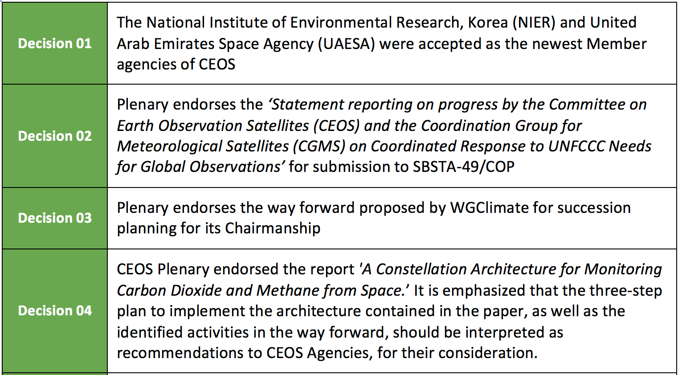
Plenary Decisions
Notes:
Da Eliminare

Slide 7
Plenary Decisions
Notes:
Da Eliminare

Slide 8
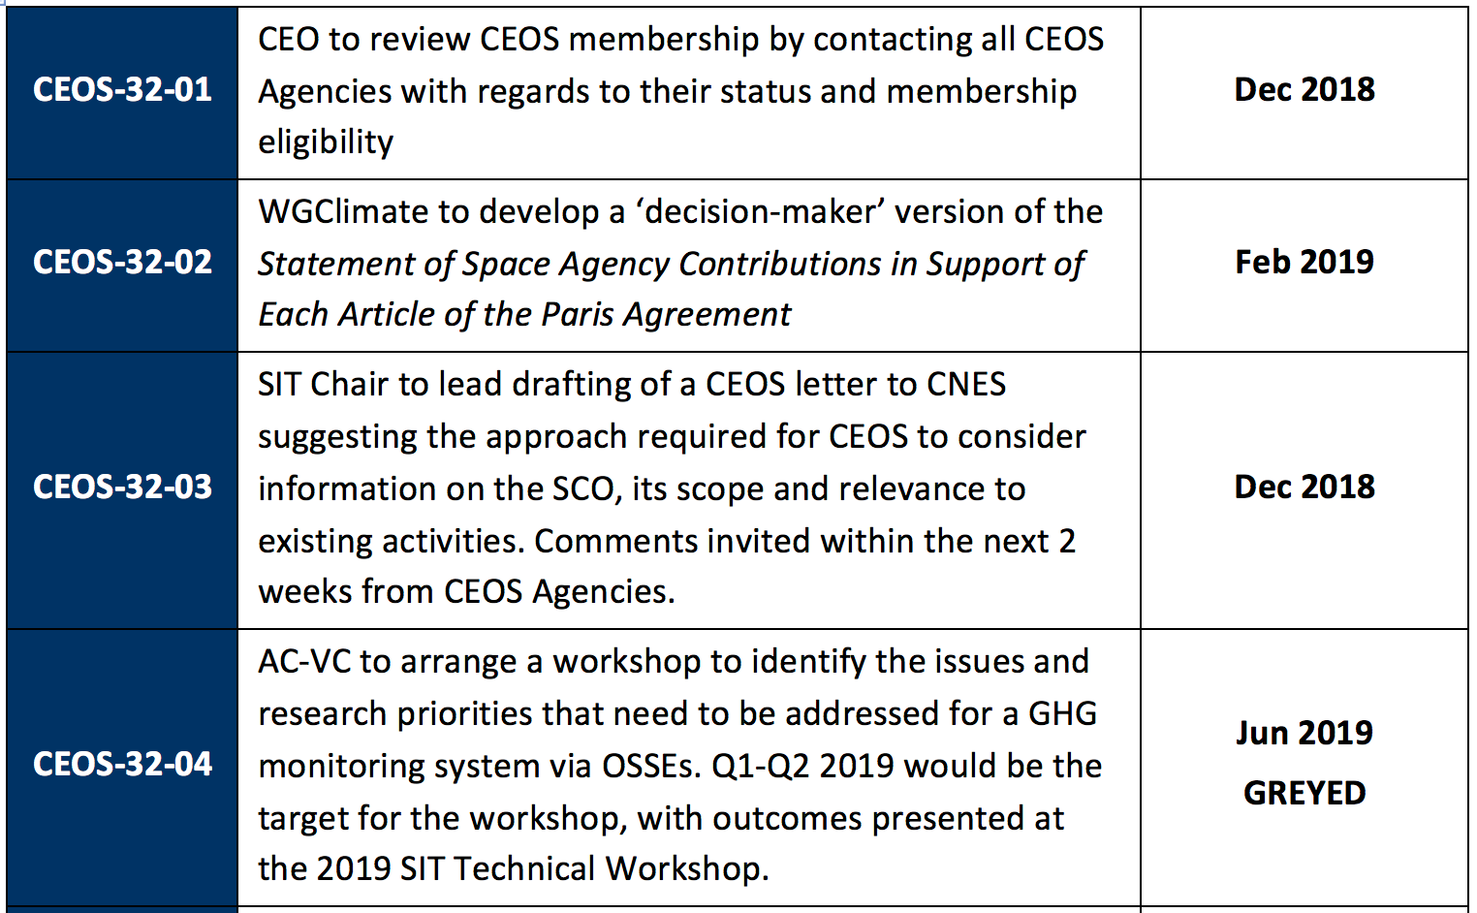
Plenary Actions
Notes:
Da Eliminare

Slide 9
Plenary Actions
Notes:
Da Eliminare

Slide 10
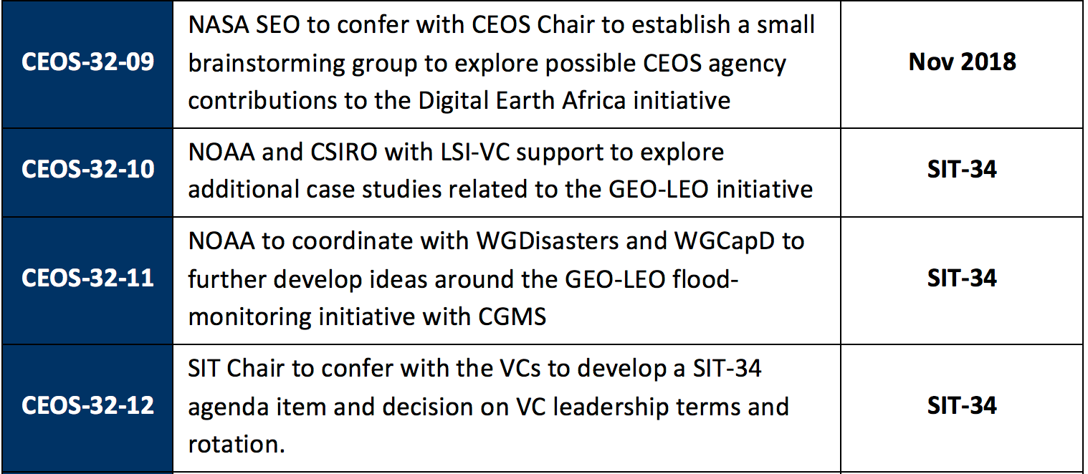
Plenary Actions
Notes:
Da Eliminare

Slide 11
Since the CEOS Plenary 2017 five themes have progressed.
Each theme can be decomposed into a set of:
practical implementations and pilot activities
improvements in their conceptual framework
standardization initiatives (mainly in WGs and VCs)
Analysis Ready Data (ARD)
Data Cubes
EO Platforms
User Metrics / Resources Inventory
EO Data Analytics

Slide 12
ARD
ARD are key to facilitate and foster EO data uptake especially by user communities, which are not comprised of EO data specialists.
Progress has been made and activities need to continue in: a) Improving the overall ARD development logic (including nomenclature) development steps and principles continue to emerge from the CEOS LSI-VC WG. b) Generating interoperable and harmonized data products - Continuous improvements are being achieved for the Landsat 8 – Sentinel 2 data products.
c) Developing ARD on-demand demonstrators in close interaction with all stakeholders. This is done with strong involvement of commercial data providers.
d) Developing the CEOS ARD 4 Land in which specifications for three product families have been completed and product assessment is ongoing.
Recommendation:
Oversight of ARD activities to the CEOS LSI-VC and close coordination with WGISS. Assure continued visibility in CEOS context. Integration of
New Space actors.

Slide 13
Data Cubes
A large variety of Data Cubes have emerged. The "CEOS Data Cube" initiative aims at utilizing CEOS Agency resources, global partnerships, satellite data, and CEOS organizational groups for further improving data access, data preparation, and data analysis for all users of satellite data. a) The CEOS Data Cube (CDC) effort is well managed and supported within the CEOS community (via the CEOS Systems Engineering Office) and also the
OpenDataCube (ODC) Partnership. The accumulated knowledge is key for the
further evolution of a harmonized data cube domain. → Session 5.5.
b) There are a number of data cube activities that can still be integrated (e.g.
European Data Cube Initiative, various industrial Data Cubes).
c) There are efforts to integrate data cubes in EO data platform environments and to provide an infrastructure (e.g. cloud) substrate → see next slides.
Recommendation:
Continue oversight of these activities by the CEOS Data Cube (CDC) coordination team. Assure continued visibility in CEOS context.

Slide 14
EO Platforms
The concept of virtual data exploitation environments (providing data, tools, processing options, etc.) based on public/commercial infrastructures (e.g. cloud resources) constitutes a broader set of initiatives with the capacity to integrate ARD and data cube components. (→Limits of data dissemination !)
Five Copernicus DIAS (Data and Information Access Services) have become operational in June 2018.
DIAS data cube instantiations and ODC open source code are available.
DIAS, ESA-NASA MAPs, etc. for future integration of data, tools, standards.
Recommendation:
WGISS: assist standardisation. Assure continued visibility in CEOS context.

Slide 15
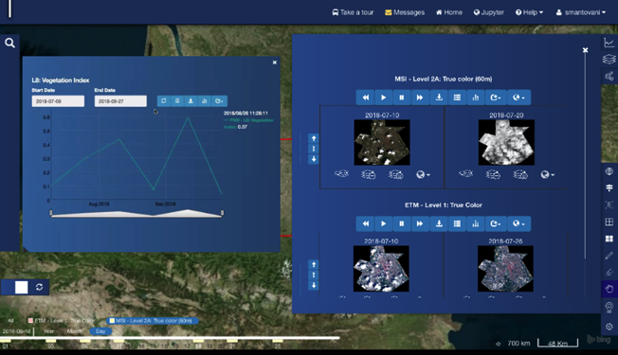
EO Platforms – Data Cube on DIAS
Implementation of Datacube Instantiation Service on DIAS
DIAS as an enabler of EO products and services
A datacube instance in 3 clicks: place, time and data collections
http://www.onda-dias.eu
http://www.creodias.eu
http://www.sobloo.eu
www.mundiwebservices.eu
http://wekeo.eu

Slide 17
User Metrics
Resources Inventory
User metrics are important in the quantitative and qualitative assessments of the attractiveness and impact of the various CEOS FDA initiatives. Together with an up-to-date inventory of EO resources available through the CEOS community: improved harmonization and programmatic planning
a) The CEOS WGISS WG has taken ownership of the User Metrics and is preparing the corresponding processes and documentation. ESA, DLR, NASA, USGS have already provided substantial information. → highly dynamic parameters (e.g. number users, types of products, available processing capacity). b) The EO Resource Inventory is closely linked to User Metrics and the CEOS WGISS WG has also taken ownership. This activity should also be harmonized with the Network of Resources activity, which are handled in conjunction with all ESA Member States in the ESA Data Coordination Body. Recommendation:
Oversight of all User Metrics and EO Resource Inventory by WGISS WG. Assure continued visibility in CEOS context.

Slide 18
Data Analytics
Data Analytics was identified early in the FDA process as a new theme in terms of CEOS coordination. Improved data analysis is also seen as a key driver to increase the usability and use of Earth Observation data, in particular by user communities, which have not been acquainted with EO.
Important to get a more complete picture of the range and the state-of-the-art of EO data analytics in the CEOS context.
Specific communities, such as the Artificial Intelligence (AI) community are already formulating specific requirements toward EO data and product providers. Recommendation:
task WGISS to identify perimeter and mechanisms to be applied to the Data Analytics. Assure continued visibility in CEOS context.

Slide 19
FDA and WGISS
Evaluate need to update Terms of Reference
Prepare updated set of actions for CEOS 2019-21 workplan to address the mandate on FDA (see FDA AHT recommendations)

Slide 20
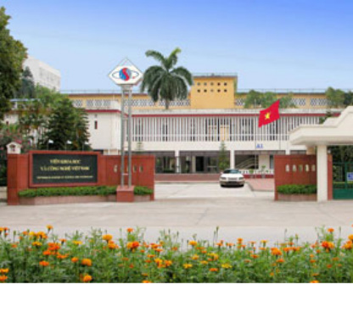
CEOS CHAIR 2019
VIETNAM ACADEMY OF SCIENCE AND TECHNOLOGY
http://www.vast.ac.vn/en/about-vast
Notes:
NON HO CONOSCENZA

Slide 21
CEOS Chair 2019
VAST/VNSC will ensure the priorities and initiatives identified by the 2018 Chair (European Commission) and current SIT Chair (NOAA) are supported and further developed through 2019:
2018 Initiative #1: Laying the foundation for an international CO2 and GHG emission monitoring system
2018 Initiative #2: Bring the benefits of Future Data Architectures to the present - identify new targets
In addition, VAST/VNSC will pursue the following application focused initiatives:
Priority #1: Carbon Observations (forested regions)
Priority #2: Observations for Agriculture (rice)

Slide 22
CEOS Chair 2019 Initiative
Seek to integrate a number of ongoing CEOS activities and data in support of the target applications for a targeted region (Mekong Delta is proposed)
Forest Monitoring
Rice Monitoring
http://ceos.org/document_management/Meetings/Plenary/32/documents/2019_CEOS_Chair_Initiatives.pdf

Slide 23
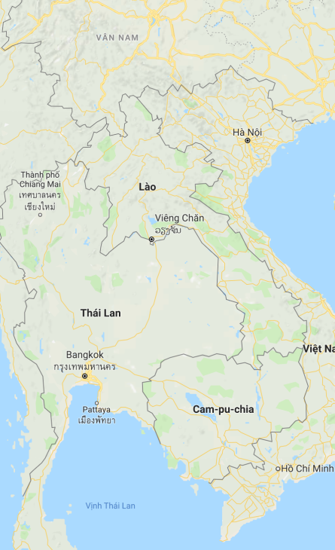
Proposed Initiative Summary
S-1 ARD
GEORice
CESBIO
ALOS ARD
CARD4L/LSI
NovaSAR ARD
ODC
Other ARD.. Landsat +
Mekong River Commission
SDCG
Forest Pilot (GFOI)
GA/CSIRO SARCube
VDC
(Vietnam DataCube)
2019 outcomes for VNSC & CEOS
Rice Pilot (GEOGLAM)
Long-term benefits
SEO
ARD pilots
SAR capacity building
CNES
AOGEOSS, Paris, SDGs
Infrastructure
Activities
Expected outcomes

Slide 24
How can WGISS contribute?
Dedicated Use Case through WGISS Carbon Portal
New Pilot activities complementing/supporting Vietnam Data Cube (VDC)
Vietnam User Oriented Training and capacity building activities (with WGCapD)
SAR Processing and SAR Applications
Others?

Slide 25
WGISS Cooperation

Slide 26
Cooperation with other groups
CEOS Carbon Team - Ongoing development of prototype Carbon Portal (CARB-15)
WGClimate - Ongoing review of ECV inventory to ensure CDRs access through WGISS Connected Data Assets Infrastructure (DATA-9)
WGDisasters – Opportunity identified: generic recovery observatory highlighted as possible cooperation area during WGDisasters meeting#10, to be further discussed.
WGCV – Ongoing around four different topics:
Data Formats and Interoperability in the framework of FDA
Quality Indicators in Discovery Metadata
CEOS Data Cubes and CEOS Test Sites Data Access in support of WGCV Activities
Standardization and Best Practices

Slide 27
Cooperation with other groups
Virtual Constellations – Opportunity identified: update the inventory of Virtual Constellations datasets and ensure discoverability/accessibility through WGISS Connected Data Assets infrastructure
WGCapD - Ongoing: WGISS Technology webinars and FDA events publicized through WGCapD, upcoming ones organised in cooperation (DATA-11 & FDA-5)
SEO - Ongoing: COVE tool harvesting metadata from WGISS Connected Data Assets Infrastructure
CGMS - Ongoing: Working Group (WG) IV Global Data Dissemination
ESIP - Ongoing: exchange of information and best practices on data stewardship
Notes:
WGISS best aligns with CGMS Working Group (WG) IV Global Data Dissemination. Many members of WGISS (e.g. NOAA, NASA EUMETSAT etc) are also members of CGMS. In the past, WGISS members have participated in WG IV to respond to CGMS action items. As an example, in response to CGMS action item # A44.03 (identify how far WGISS Interoperable standards were adopted), WGISS provided a list of CEOS agencies who have implemented CEOS Opensearch Best Practices: EUMETSAT, NASA, ESA, CNES, USGS, JAXA, ISRO (NRSC) and CCMEO.

Slide 28
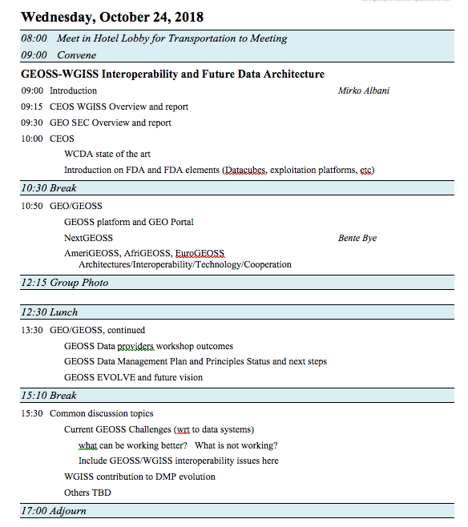
Cooperation with other groups
GEO - Ongoing:
GEOSS Platform accessing WGISS CDA infrastructure for CEOS agencies data discovery and access
WGISS contributing to GEOSS-EVOLVE initiative
Participation & support to GEOSS Data Providers
Workshops (e.g. “User Metrics” session, May 2018)
Contribution to CEOS booth at GEO Plenary
WGISS represented in NextGEOSS Advisory Board
and Working with NextGEOSS on federated
authentication technology solutions
Joint Workshop on GEOSS-WGISS
interoperability and FDA at WGISIS#43
and upcoming WGISS#46
WGISS representative will be proposed as
member of GEOSS Expert Advisory Group

Slide 29
Issues – WISP Support
The WGISS Infrastructure Services Project (WISP) provides technological support and core services for WGISS activities including teleconference and web conference support via GoToMeeting, website support, mailing list and meeting archive support.
NOAA will support WISP until April 2019 (WGISS#47)
WGISS Chair will ask SEO to support these services after April 2019 (in case no other agency actively involved in WGISS volunteers to take over WISP).
Notes:
QUESTO LO LASCIAMO

Slide 30
WGISS Vice Chair Nomination
WGISS Vice Chair Nomination for the period October 2019 – October 21
Notes:
QUESTO ANCHE

Slide 31
CEOS WORKPLAN 2019-21

Slide 32
CEOS 2019-2021 WP Development
- Proposed changes
Using the WP to improve work traceability
Better define WP deliverables
Who: CEOS entity (+ nominative), Contributing agencies (+nominative), Resource estimates
What: More detailed deliverable descriptions and breakdown into milestones (where relevant)
When: Temporal information on milestones/resources
… gradual implementation/upgrading of deliverable tracking tools.
Links from CEOS WP deliverables to GEO Work Programme elements
As the Space Arm of GEO, we need to know where our work is supporting the implementation of the GEOSS.

Slide 33
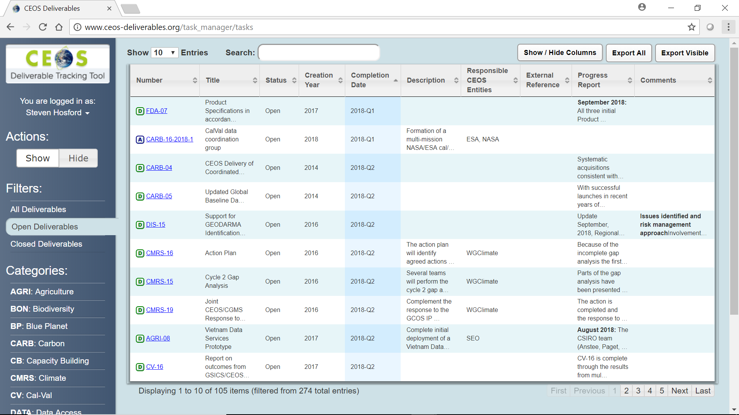
CEOS 2019-2021 WP Development
- Proposed changes
Agency-driven top-down requests
During WP development - open call to CEOS agencies to propose new CEOS deliverables
Requirement for deliverable to be carried by a CEOS entity
Need for consultation with responsible CEOS entity prior to submission to WP
Modify the ceos-deliverables.org deliverable tracking tool to record
Cumulative number of months due date has been set back for every deliverable
Nb of times due date has been set back

Slide 34
CEOS 2019-2021 Work Plan
CEO emails CEOS entities requesting updates
9th November
Deadline for updates
14th December
Work Plan V0 released
25th January
Work Plan V0 comments by
15th February
Work Plan V1 released
22nd February
5 weeks for
CEOS Entity inputs
3 weeks for
CEOS Entity feedback
UPDATE WGISS WORKPLAN AND
PREPARE WGISS CONTRIBUTION

Slide 35
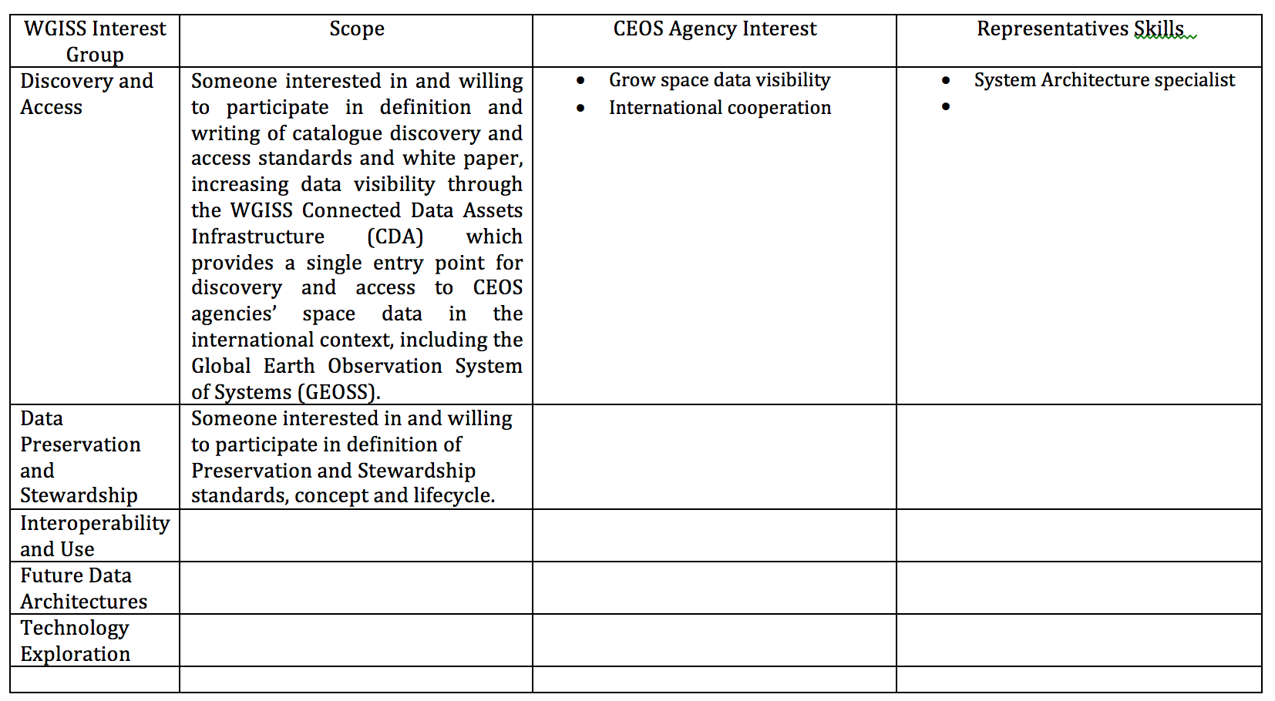
CEOS Agencies Contribution to WGISS

