Slide 1

CEOS & Work Plan
Status
Committee on Earth Observation Satellites
Steven Hosford
WGISS-46
22nd October 2018

Slide 2
Summary
News/updates
Overview of CEOS upcoming meetings
CEOS Work Plan information

Slide 3

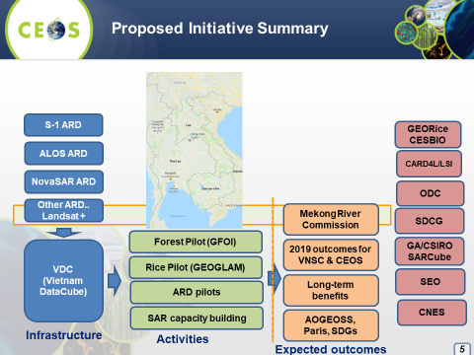
News / Updates
CEOS Chair priorities for 2019
Priority #1:
Carbon Observations (forested regions)
Priority #2:
Observations for Agriculture (rice)
  Should be a role for WGISS?
  Need to discuss with VNSC

Slide 4
News / Updates
CEOS Entity Leadership changes in 1 year
  2019 CEOS Chair – Vietnam National Space Centre
  2020 CEOS Chair – Indian Space Research Organisation (ISRO)
  2019 CEOS SIT Chair – NOAA
  2020 CEOS SIT Chair – CSIRO
  Search continues for a Deputy CEOS Executive Officer to replace current CEO from October 2019.
  WGClimate Chair to extend mandate for 1 year
  WG CalVal Chair changed last week (incoming Cindy Ong, CSIRO)
  All other CEOS WGs looking for new Vice-Chairs in Oct 2019

Slide 5
CEOS upcoming meetings
July
June
Living Planet Symposium
Milan, 13^{th –} 17th May
August
May
April
SIT Technical Workshop, 2019
Hawaii, 9th-13th Sept
September
SIT-34, Miami, USA,
2nd-4th April
March
WG/ADT meetings
CEOS 33rd Plenary, Hanoi,
14th-16th Oct
October
WGClimate-10, Marakech TBD March
WGCapD-8, Dehradun &
WGDisasters-11, Athens,
4th-8th March
WGISS, Munich, 22nd-25th Oct
November
February
GEO-XV Plenary, Kyoto, 31st-1st Nov
Freshwater from Space, Delft, 13th-15th November
December
January
LSI-VC-7, Hanoi, 14th-15th Feb
CEOS/GEO bilateral

Slide 6

CEOS Workplan 2018-2020

Slide 7
CEOS Workplan 2018-2020

Slide 8
CEOS Workplan 2018-2020

Slide 9
CEOS Work Plan timeline
CEOS Work Plan is one of CEOS’s governing documents
Based on a 3 year period
Update annually
1st request for updates
Deadline for updates
1st draft of work plan
Finalised work plan
July
June
August
May
April
September
March
October
November
February
December
January

Slide 10
CEOS 2019-2021 Work Plan
On advice from CEOS Plenary
CEO emails CEOS entities requesting updates
9th November
Deadline for updates
21st November
Work Plan V0 released
25th January
Work Plan V1 released
20th February
10 days for
CEOS Entity inputs
3 weeks for
CEOS Entity feedback

Slide 11

2019-2021 WP Development
- Proposed changes
Using the WP to improve work traceability
Better define WP deliverables
  Who: CEOS entity (+ nominative), Contributing agencies (+nominative), Resource estimates
  What: More detailed deliverable descriptions and breakdown into milestones (where relevant)
  When: Temporal information on milestones/resources
… gradual implementation/upgrading of deliverable tracking tools.
Links from CEOS WP deliverables to GEO Work Programme elements
As the Space Arm of GEO, we need to know where our work is supporting the implementation of the GEOSS.

Slide 12
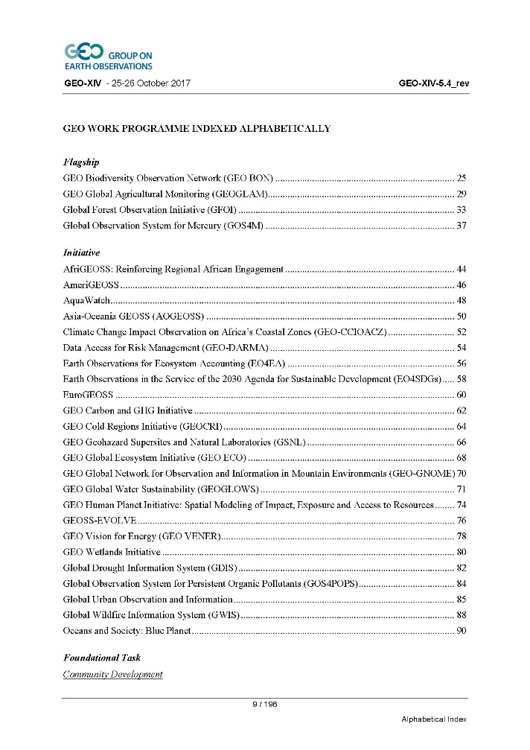
WP development process improvements
GEO Work Programme elements
Flagship (4)
Initiative (24)
Foundational Task (10)
Community Activity (36)
(figures from GEO WP 2017-2019)
References in CEOS 2019-2021 WP should be to elements in GEO WP endorsed in GEO-XV Plenary (October 2018)

Slide 13
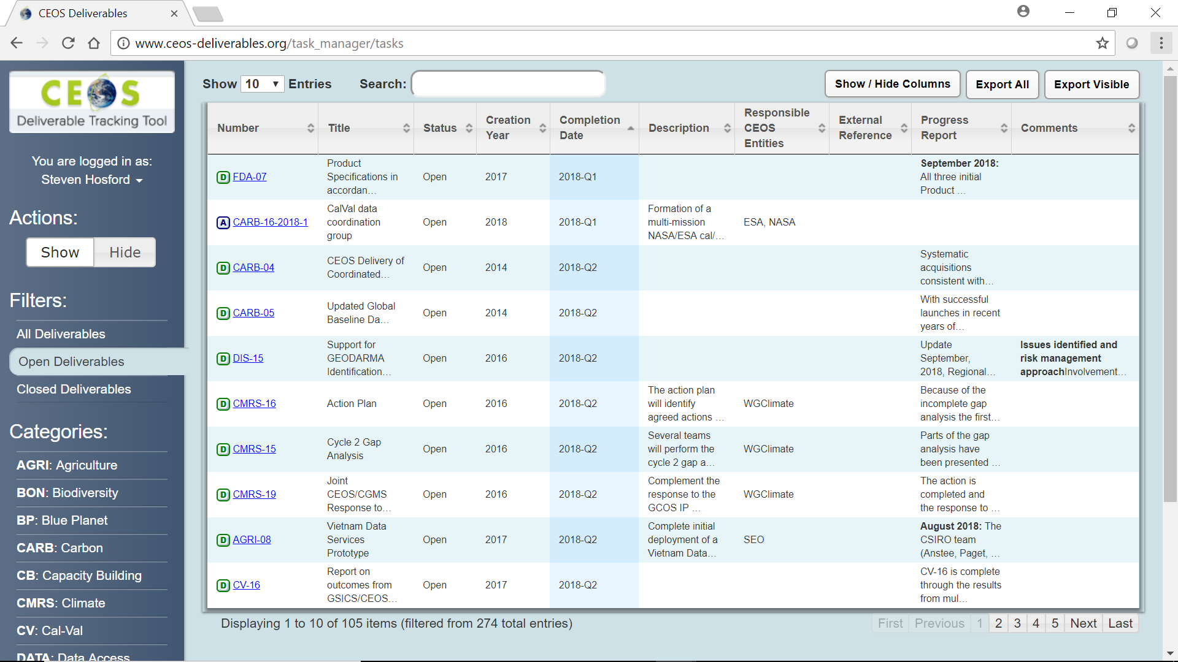
2019-2021 WP Development
- Proposed changes
Agency-driven top-down requests
During WP development - open call to CEOS agencies to propose new CEOS deliverables
  Requirement for deliverable to be carried by a CEOS entity
  Need for consultation with responsible CEOS entity prior to submission to WP
Modify the ceos-deliverables.org deliverable tracking tool to record
Cumulative number of months due date has been set back for every deliverable
Nb of times due date has been set back

Slide 14
CEOS 2019-2021 Work Plan
Messages to those of you providing CEOS Work Plan inputs:
Please plan to spend some time on your CEOS WP inputs
    9th Nov – 21st Nov
    25th Jan – 20th Feb
If your deliverable is linked to the GEO Work Programme please provide the GEO WP identifier

Slide 15
Take away messages
CEOS Leadership
CEOS Chair - VNSC, Vietnam in 2019; ISRO subsequently
CEOS SIT Chair – NOAA until October 2019; CSIRO subsequently
CEOS Work Plan
Several evolutions planned. Each WP deliverable should have
  A responsible CEOS entity and person
  More detailed description and resourcing plan (option of milestones)
  Links to GEO Work Programme
2019-2021 CEOS Work Plan, two periods for contributors:
      9th Nov – 21st Dec
      25th Jan – 20th Feb
Call for top-down agency level inputs (respecting constraints above)

