Slide 1
Next Meeting
WGISS-45 & WGCV-43
Hosted by INPE (Instituto Nacional de Pesquisas Espaciais)
São José dos Campos, Brazil
April 9-13, 2018

Slide 2
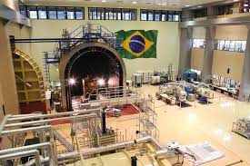
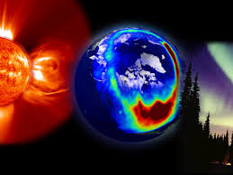
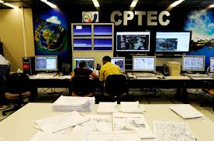
INPE is a research institute under the Ministry of Science, Technology, Innovations and Communications (MCTIC);
Its mission is to contribute through scientific research, technological development and capacity building in the fields of (1) Space Science and Atmosphere, (2) Earth Observation, (3) Weather Forecasting and Climate Studies and (4) Space Engineering and Technology, in order that Brazilian society can enjoy the benefits from the access to space;
Almost 3000 workers (own staff, scholarship workers, graduate students, trainees, visiting researches and outsourcing personnel).

Slide 3
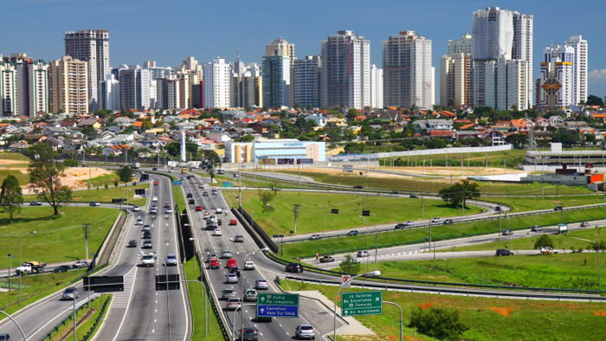
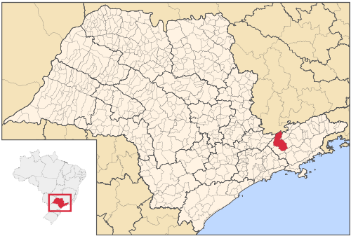
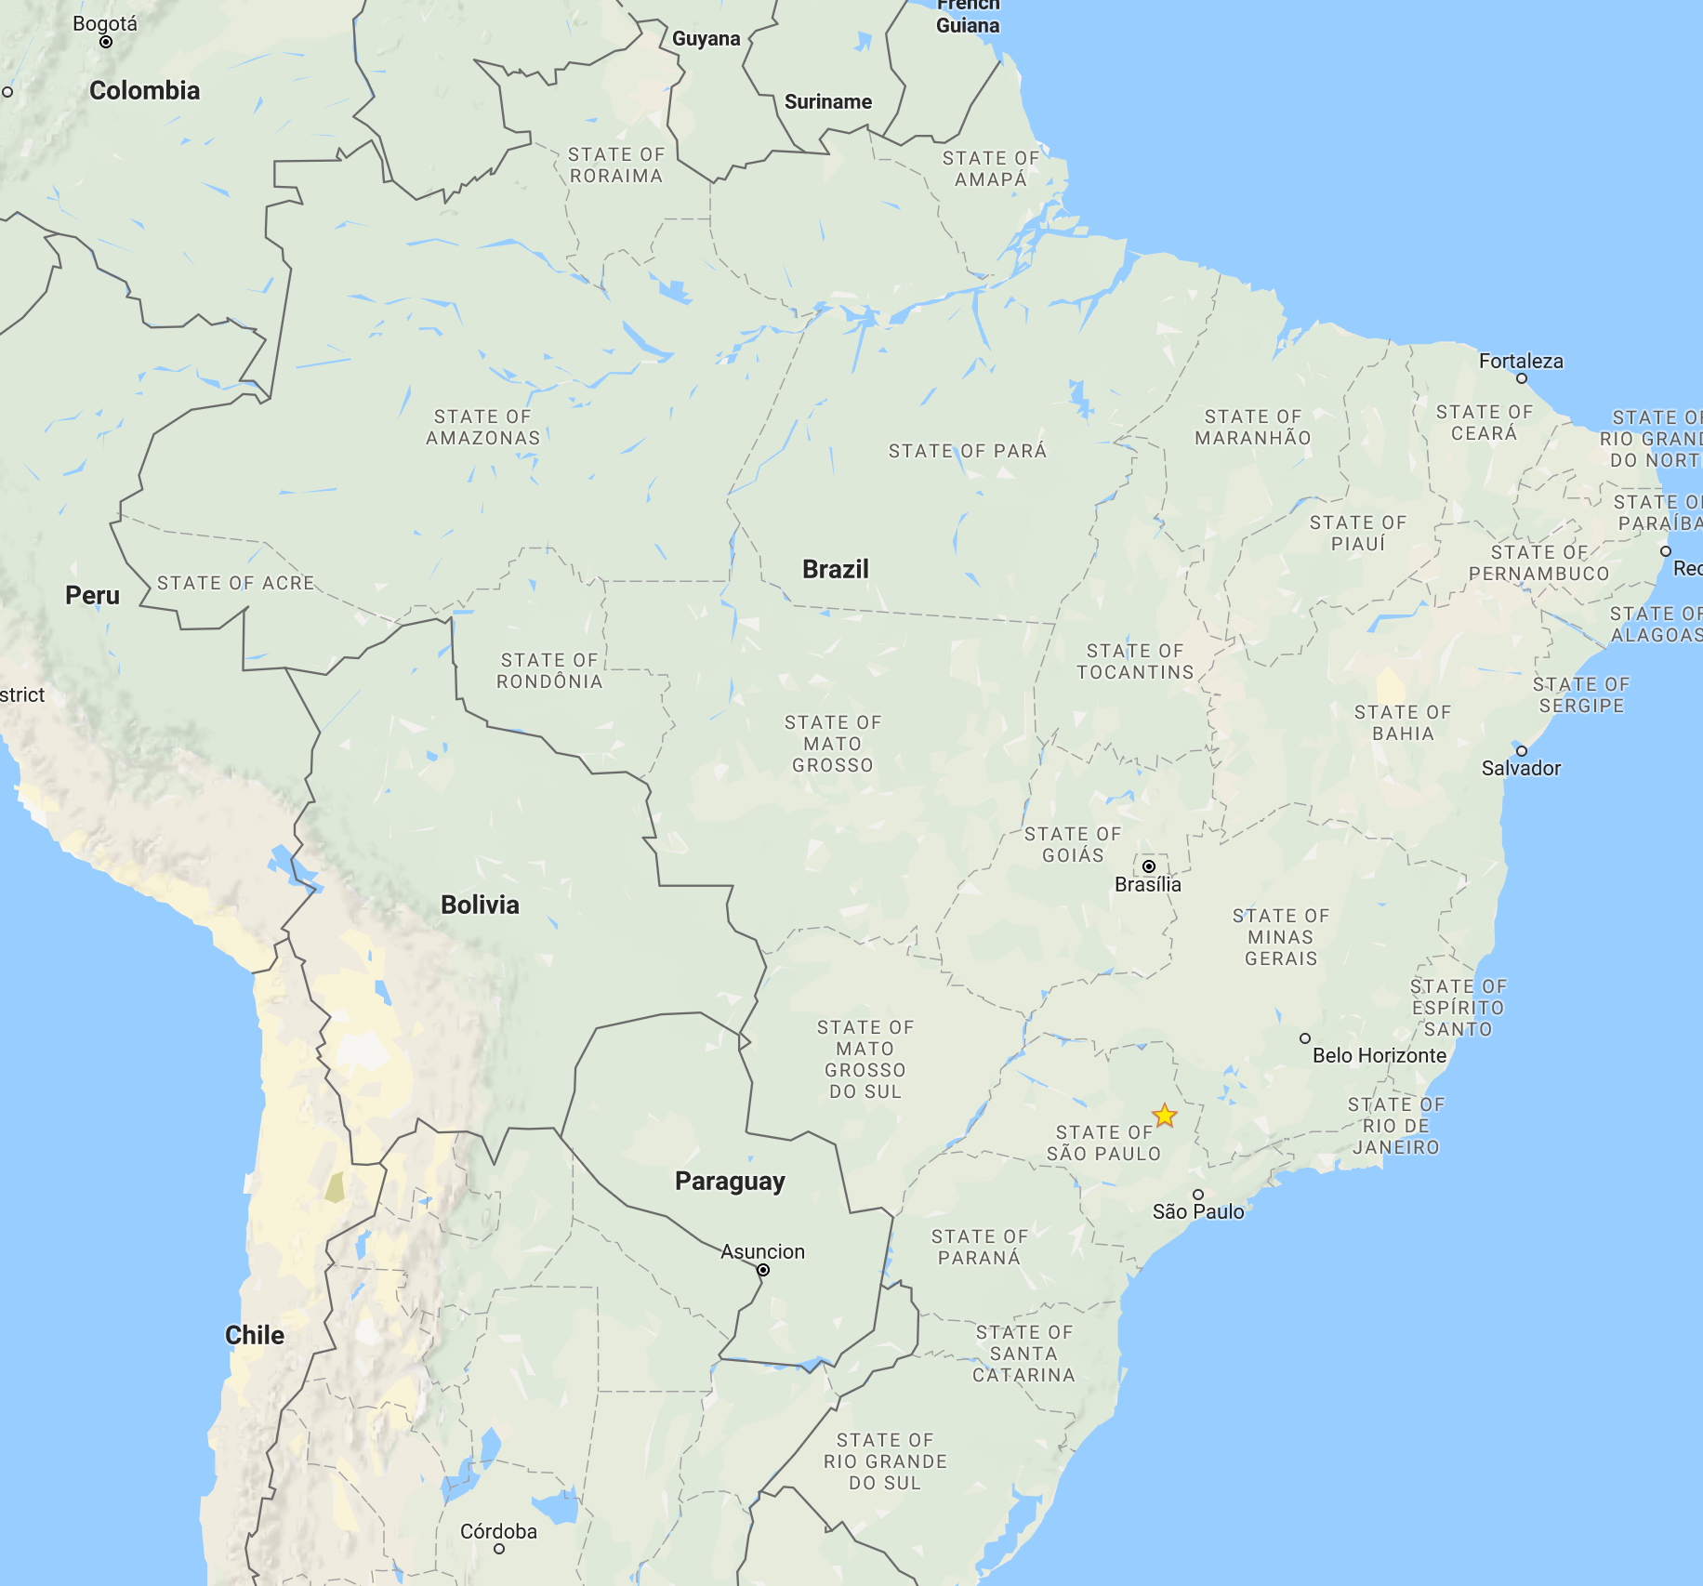
Next Meeting
INPE’s headquarters are located in
São José dos Campos (SJC), SP
(https://en.wikipedia.org/wiki/S%C3%A3o_Jos%C3%A9_dos_Campos)
Nearest airport is GRU International Airport, in São Paulo city
From GRU to SJC is a 1.5 hour drive
Accomodations special price being negotiated and will be informed soon

Slide 4
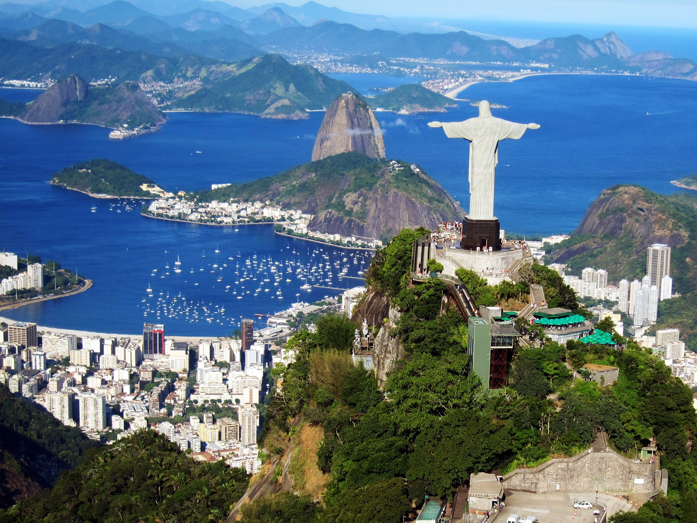
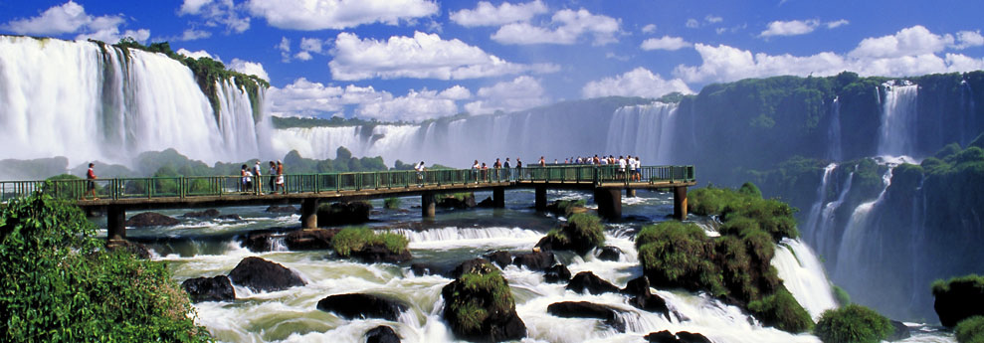
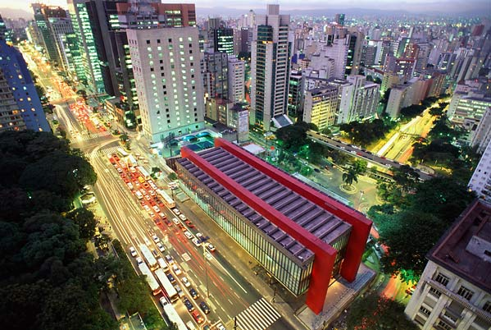
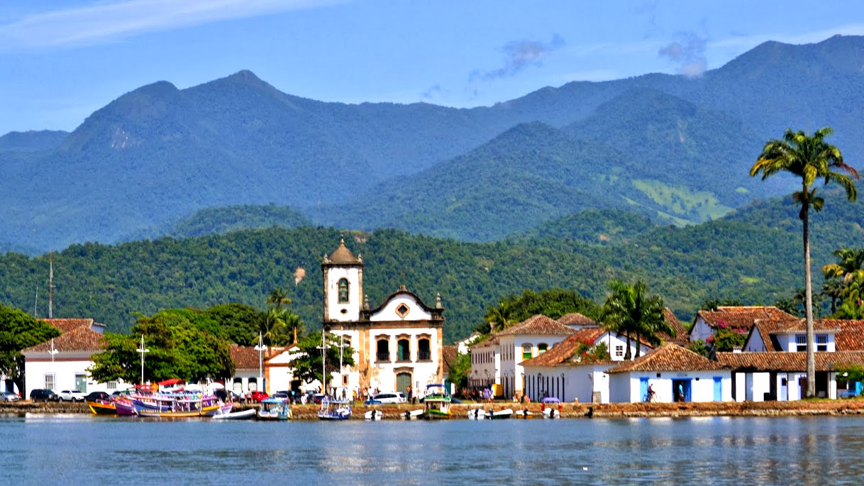
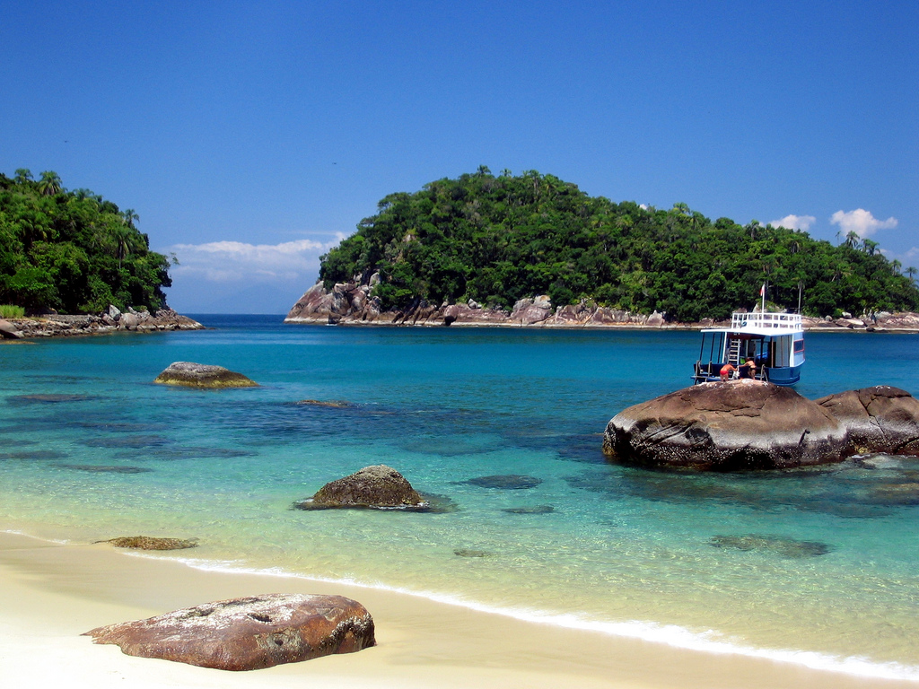
Taking the opportunity to enjoy Brazil?
Rio de Janeiro: 4 h 30 mim by car
Foz do Iguaçu: 1 h 45 mim flight from GRU
And from GRU to any other major tourism destination in Brazil
São Paulo: 1 hs 30 mim by car
Paray: 3 h by car
Ubatuba: 2 h by car

Slide 5
WGISS-45 Agenda (9-12 April)
 | Monday | Tuesday | Wednesday | Thursday | Friday
09:00 – 12:00 | WGISS Discussions | WGISS Discussions | Workshop: Introducing Copernicus DIAS for CEOS | WGISS Discussions
12:00 – 13:30 | Lunch | Lunch | Lunch | Lunch
13:30-17:30 | WGISS Discussions | Joint WGISS/WGCV Session | Workshop: Introducing Copernicus DIAS for CEOS | WGISS Discussions End of meeting
 |  | WGISS/WGCV No-host Dinner |  | INPE Facilities Tour

Slide 6
WGCV-43 Agenda (10-13 April)
 | Monday | Tuesday | Wednesday | Thursday | Friday
09:00 – 12:00 |  | WGCV Discussions | WGCV Discussions | WGCV Discussions | WGCV Discussions
12:00 – 13:30 |  | Lunch | Lunch | Lunch | Lunch
13:30-17:30 |  | Joint WGISS/WGCV Session | WGCV Discussions | WGCV Discussions | WGCV Discussions End of meeting
 |  | WGISS/WGCV No-host Dinner |  | INPE Facilities Tour

