Slide 1
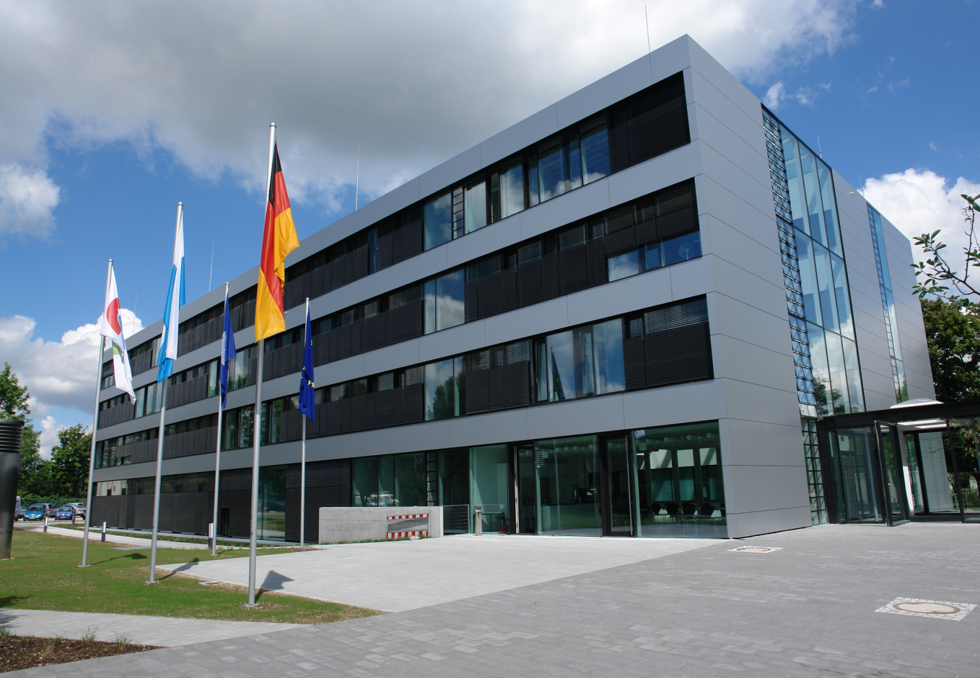
WGISS 46 - October 22nd-26th 2018
Hosted by
DLR
Oberpfaffenhofen
near Munich, Germany

Slide 2
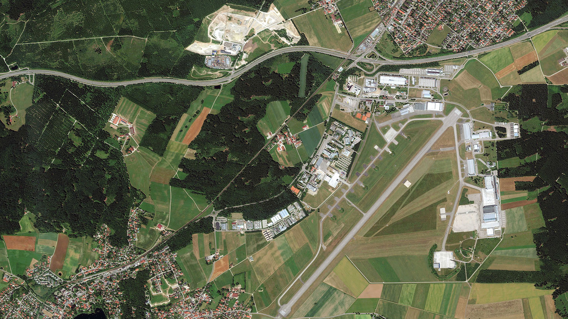
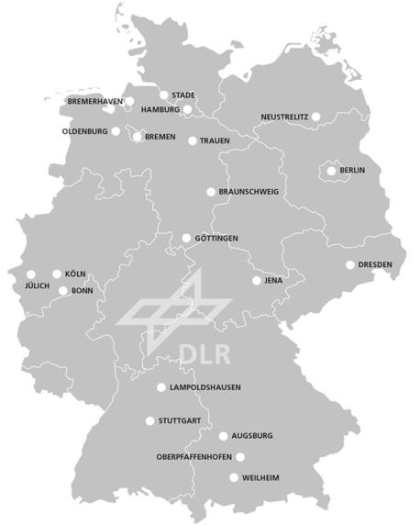
DLR-Oberpfaffenhofen
near Munich, Germany
Gilching
Munich 30 km →
← Landsberg 30 km
Wessling-Oberpfaffenhofen
DLR Earth Observation Center

Slide 3
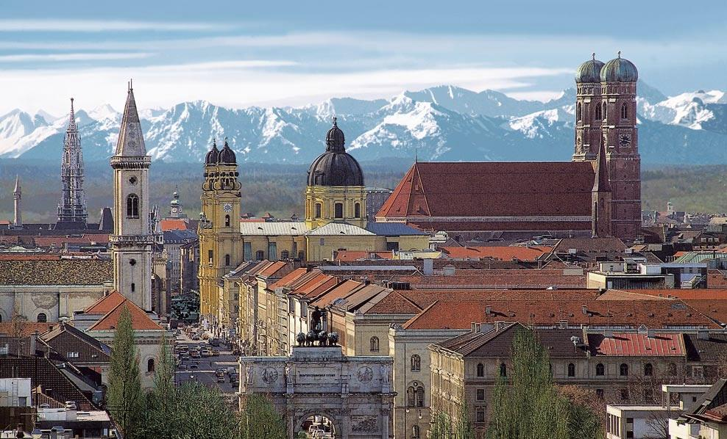
Munich

Slide 4
Additional Information
Logistics
Nearest airport: Munich Franz-Josef Strauss (MUC)
Several rooms have been blocked at a number of hotels in Herrsching am Ammersee near DLR; see separate slide for details; it is advisable to book early
The town of Herrsching can be reached from the airport via light rail (Line 8 direct); fare 11.60 EUR
DLR will provide a bus shuttle service between Herrsching and DLR in the morning and evening
Weblinks
http://www.dlr.de/dlr/en/desktopdefault.aspx/tabid-10261/320_read-214/#/gallery/701
http://www.dlr.de/dlr/en/Portaldata/1/Resources/bilder/portal/oberpfaffenhofen/DLR_OP_Standortflyer_engl2012.pdf
http://www.dlr.de/dlr/en/Portaldata/1/Resources/bilder/portal/oberpfaffenhofen/Luftbild.jpg

Slide 5
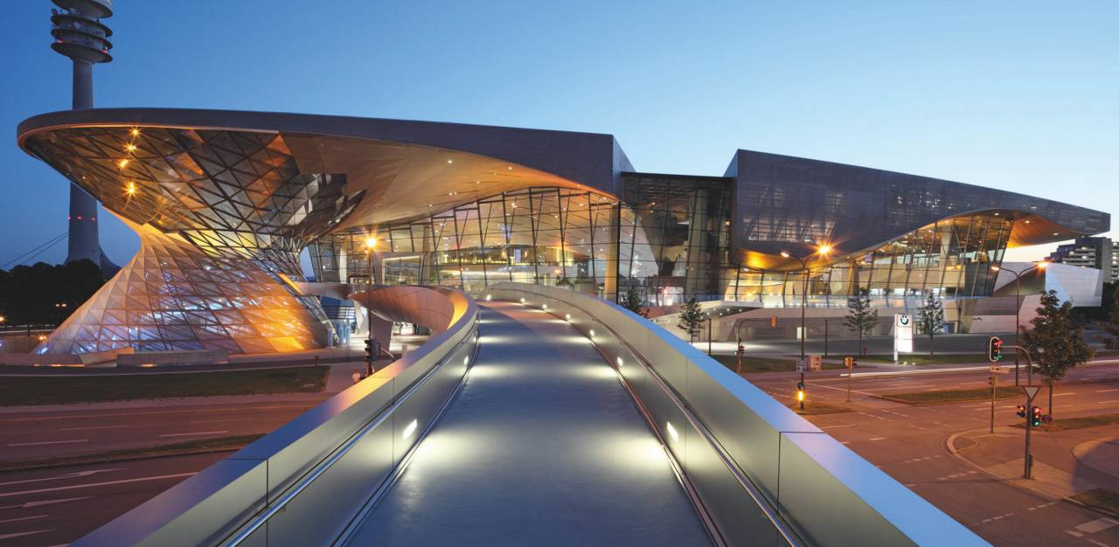
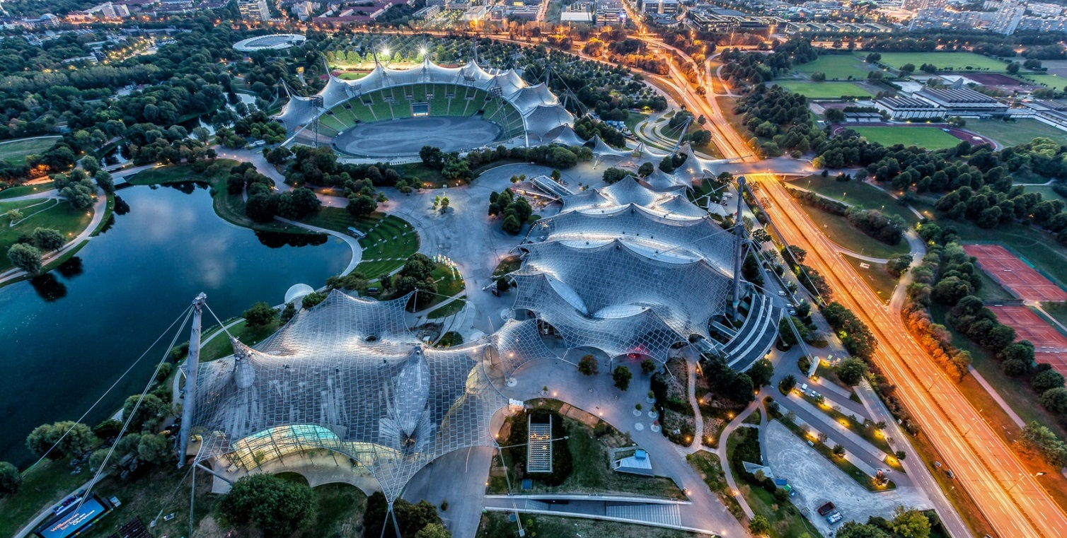
Munich BMW-Welt & Olympic Stadium

Slide 6
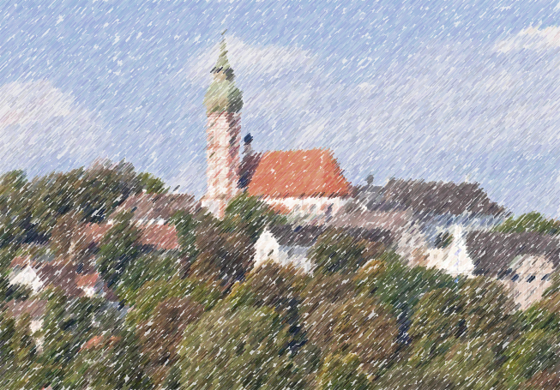
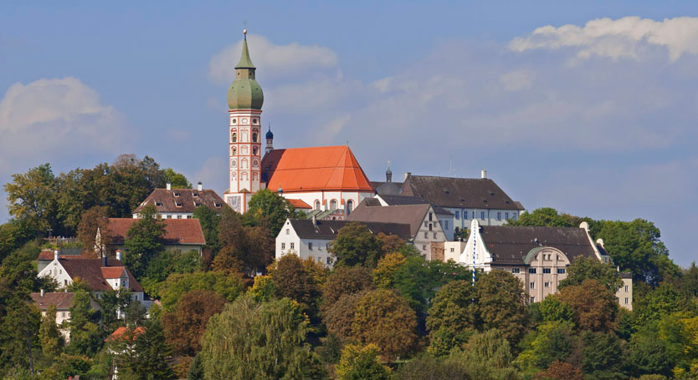
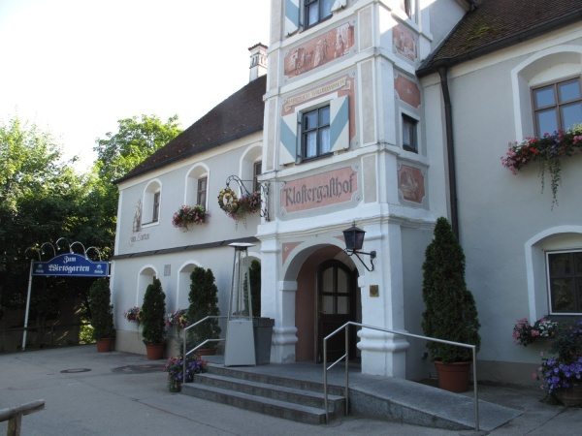
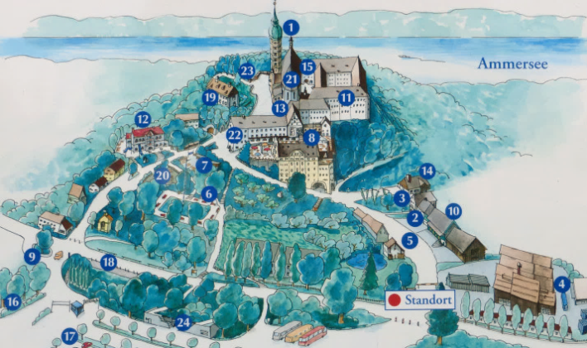
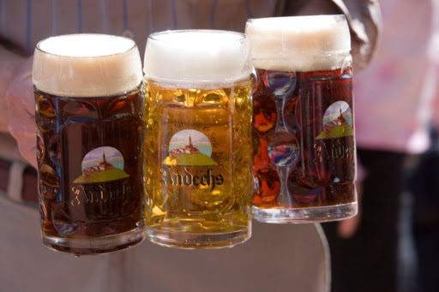
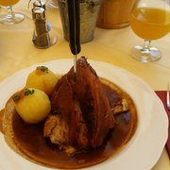
Andechs Monastery & Brewpub

Slide 7
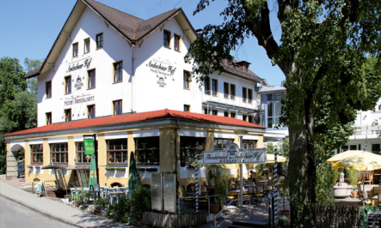
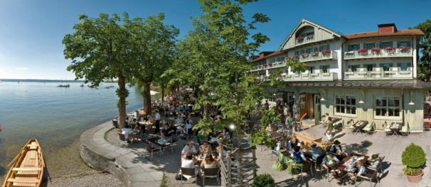
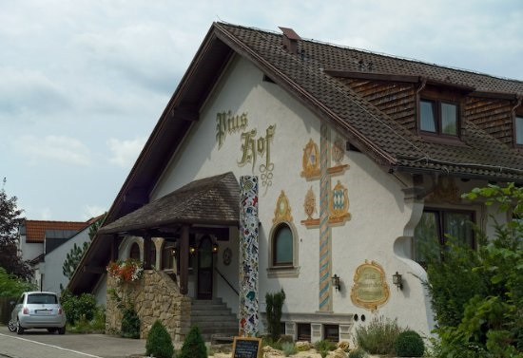
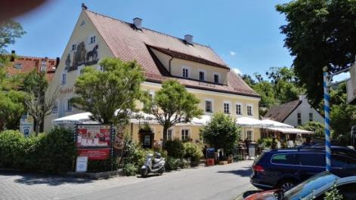
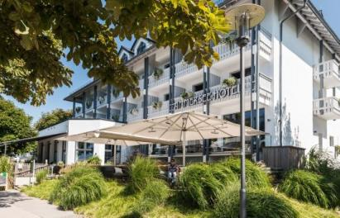
Accommodation Options
Hotel Andechser Hof
Zum Landungssteg 1, 82211 Herrsching, phone +49 8152 96810 www.andechser-hof.de
4 rooms blocked until 31st July 2018 110.00 EUR Keyword ‘CEOS-WGISS’
Hotel Seehof Herrsching
Seestraße 58, 82211 Herrsching, phone: +49 8152 9350 http://seehof-ammersee.de/en/
15 rooms blocked until 23rd July 2018 92.00 EUR Keyword ‘CEOS-WGISS
Hotel Piushof
Schönbichlstraße 18, 82211 Herrsching, phone: +49 8152 96820 http://www.piushof.de/
22 rooms blocked until 31rd July 2018 (4 rooms à 81.00, 18 rooms à 91.00 EUR) Keyword ‘CEOS-WGISS
Hotel Zur Post
https://www.post-herrsching.de/
Ammersee Hotel
https://www.ammersee-hotel.de/

