Slide 1
The NASA Earth Observing System
Data & Information System (EOSDIS)
-WGISS 45-
NASA Agency Report
Andrew Mitchell
São Paulo, Brazil
12th of April 2018
Earth Science Data & Information Systems (ESDIS) Project
Goddard Space Flight Center, Code 423
National Aeronautics and Space Administration (NASA)

Slide 2

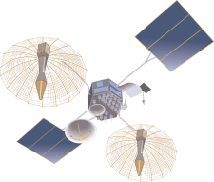
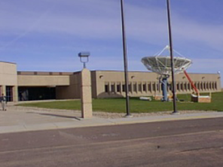
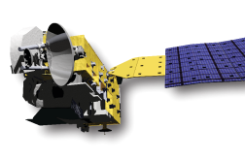
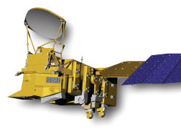
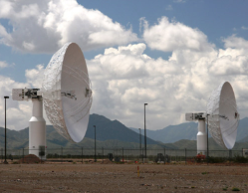
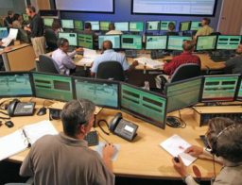
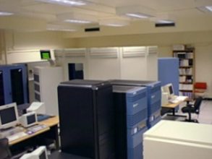
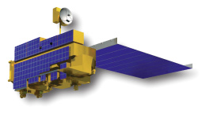
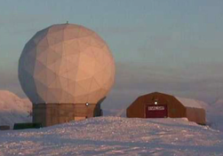
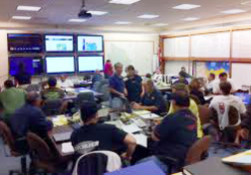
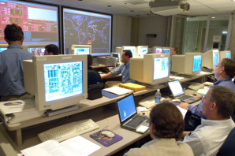
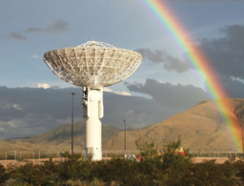
ESMO
ESDIS
Mission Operations
Science Operations
Data
Acquisition
Flight Operations,
Data Capture,
Initial Processing,
Backup Archive
Data
Transport to
Data Centers/
SIPSs
Science Data Processing,
Data Management,
Interoperable Data
Archive, and Distribution
Distribution
and
Data Access
EOSSpacecraft
Tracking and Data
Relay Satellite
(TDRS)
Research
Education
Value-Added
Providers
Internet
(Search,
Order,
Distribution)
White Sands
Complex (WSC)
EOS Data Operations
System (EDOS)
Data Processing
Interagency
Data Centers
EOSDIS
Data Centers
Earth
System Models
Direct
Broadcast
(DB)
International
Partners
EOS Polar
Ground Stations
EOS Operations
Center (EOC)
Mission Control
Instrument Teams
and Science
Investigator-led
Processing Systems
(SIPSs)
Decision Support
Systems
Network
Services
Direct Broadcast/
Direct Readout
Stations

Slide 3
Role of EOSDIS
EOSDIS provides:
  Interoperable Distributed Data Archives
  Science Data Processing
  Data Management
  On-Line Data Access Services
  Earth Science Discipline-Oriented User Services
  Network Data Transport to distributed System Elements
NASA’s Earth Science Data Policy promotes usage of data by the community
  No period of exclusive access
  Data available at no cost to all users on a non-discriminatory basis, except where agreed upon with international partners

Slide 4




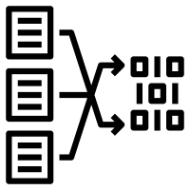




Earth Observing System Data and Information System (EOSDIS)
EOSDIS
Research
Distribute
Applications
Education
Transform*
Archive
Capture and Clean
Process
*Subset, reformat, reproject

Slide 5
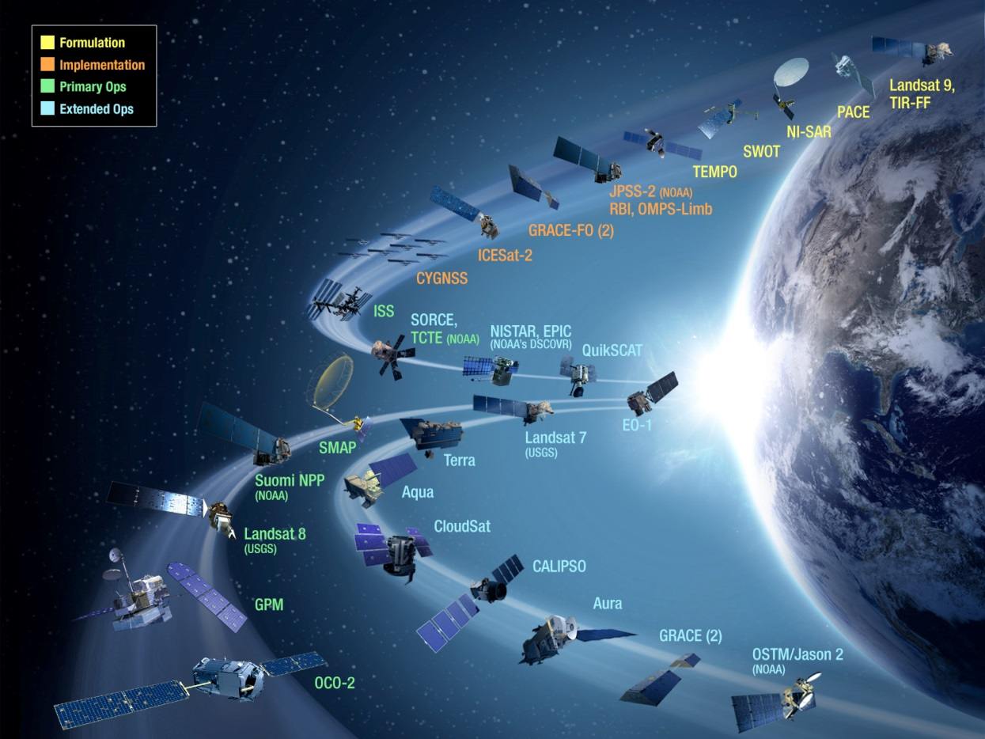
Extensive Data Collection
Started in the 1990s, EOSDIS today has 11,000+ data types (collections)
    Land
        Cover & Usage
        Surface temperature
        Soil moisture
        Surface topography
    Atmosphere
        Winds & Precipitation
        Aerosols & Clouds
        Temperature & Humidity
        Solar radiation
    Ocean
        Surface temperature
        Surface wind fields & Heat flux
        Surface topography
        Ocean color
    Cryosphere
        Sea/Land Ice & Snow Cover
    Human Dimensions
        Population & Land Use
        Human & Environmental Health
        Ecosystems

Slide 6
Data Sources
Type | Example Missions
Satellite/on-orbit Missions | Terra, Aqua, Aura, Suomi-NPP, SORCE, GPM, GRACE, CloudSat, CALIPSO, etc.
Airborne missions | IceBridge, Earth Ventures (5+ missions), UAVSAR, etc.
In Situ Measurement missions | Field campaigns on land (e.g., LBA-ECO) and in the ocean (e.g., SPURS)
Applications support | Near-real time creation and distribution of selected products for applications communities
Earth Science Research support | Research products from efforts like MEaSUREs. This also includes data from older, heritage missions (prior to EOS Program) that the DAACs rescue – e.g., Nimbus, SeaSat

Slide 7
Distributed Active Archive Centers (DAACs), collocated with centers of science discipline expertise, archive and distribute standard data products produced by Science Investigator-led Processing Systems (SIPS)
ASF DAAC
SAR Products, Sea Ice, Polar Processes
U. of Wisc.
SNPP Atmosphere
SEDAC
Human Interactions in Global Change
LPDAAC
Land Processes and Features
CDDIS
Crustal Dynamics Solid Earth
NCAR, U. of Co.
MOPITT
GSFC
SNPP, MODIS, OMI, OBPG
GES DISC
Atmos Composition & Dynamics, Global Modeling, Hydrology, Radiance
JPL
MLS, TES, SNPP Sounder
OB.DAAC
Ocean Biology and Biogeochemistry
ORNL
Biogeochemical Dynamics, EOS Land Validation
PO.DAAC
Ocean Circulation
Air-Sea Interactions
NSIDC DAAC
Cryosphere, Polar Processes
LAADS/MODAPS
Atmosphere
GHRC
Hydrological Cycle and Severe Weather
SIPS
DAAC
ASDC
Radiation Budget, Clouds, Aerosols, Tropo Composition
GHRC
AMSR-U, LIS

Slide 8
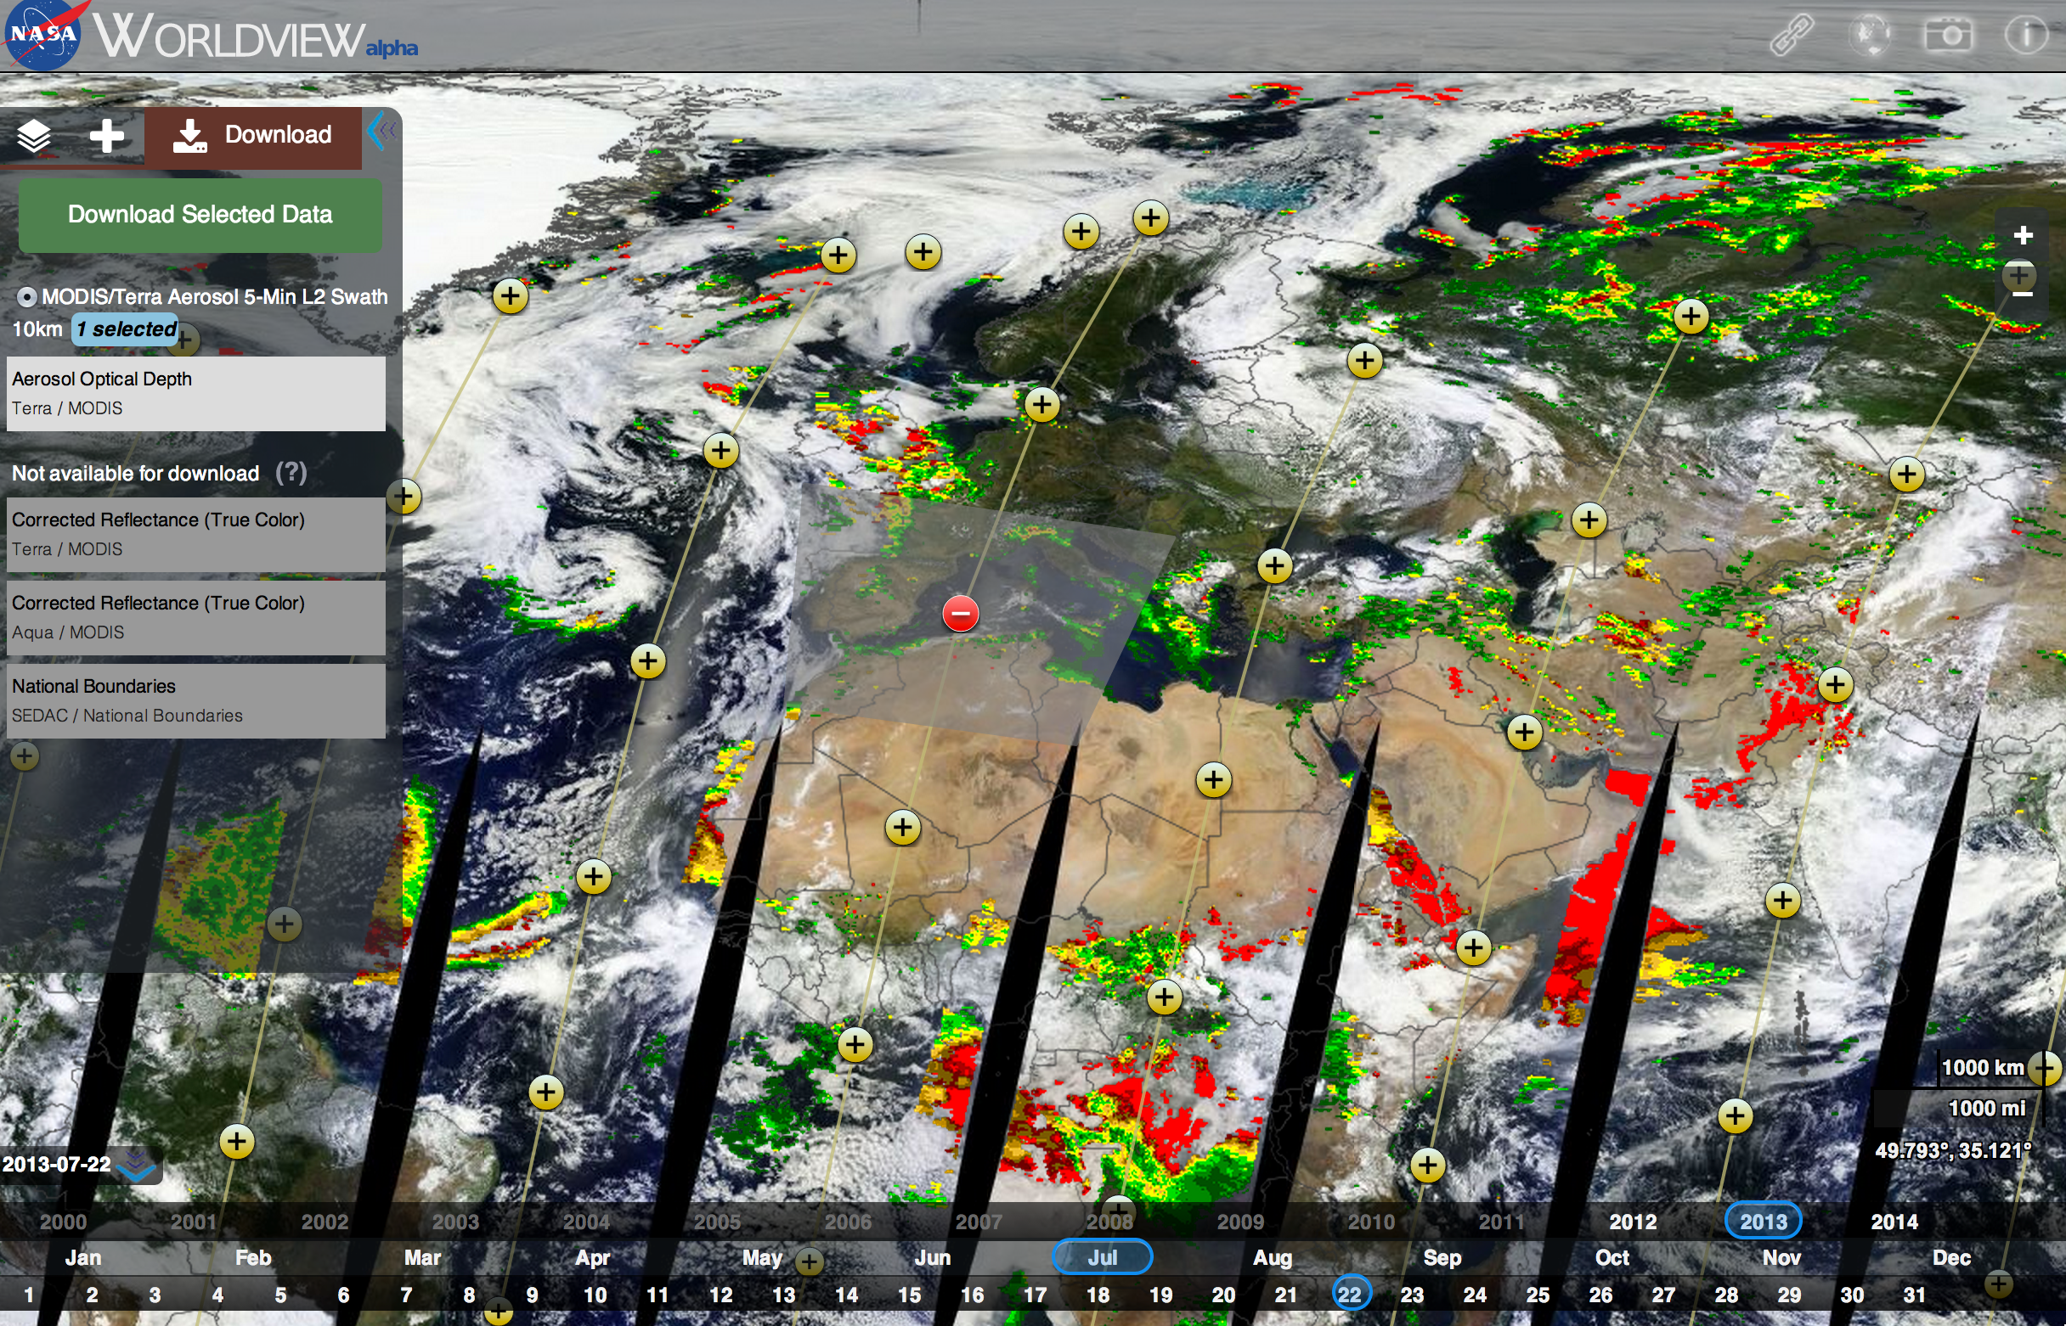
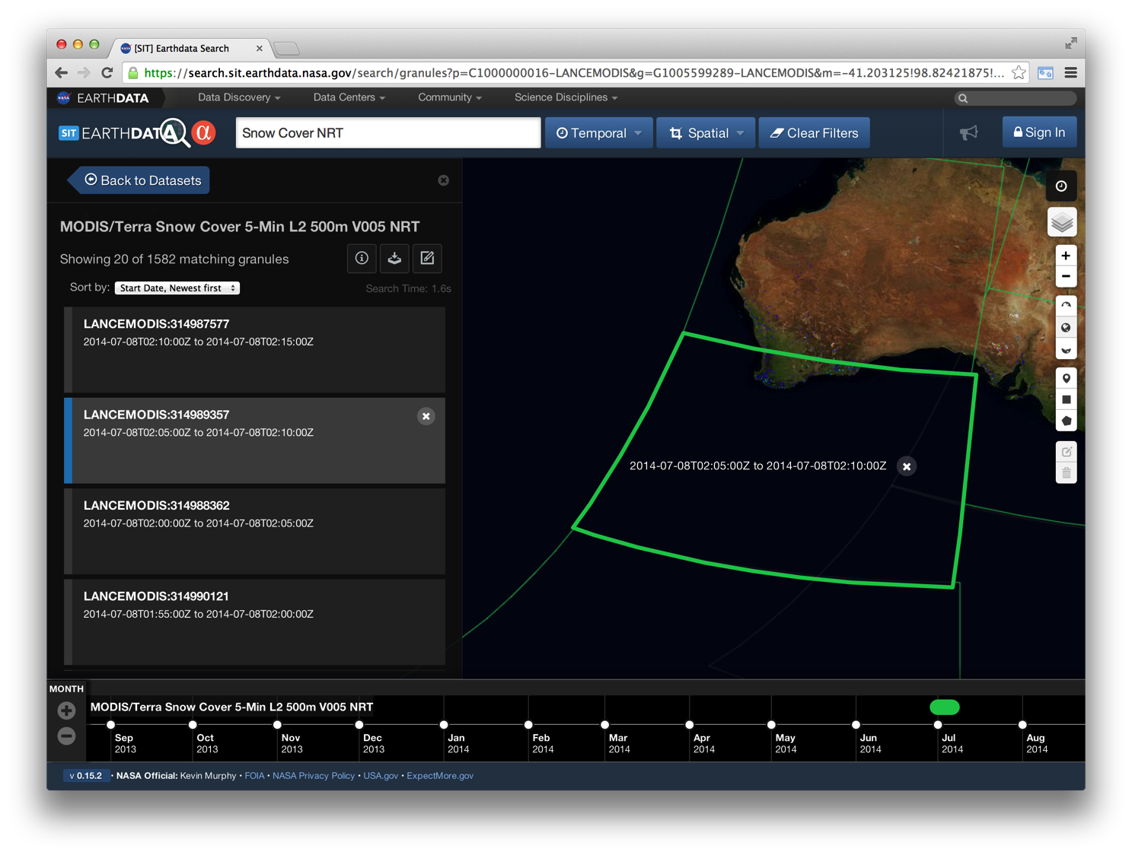
Data Access
Centralized Reusable Capabilities
Earthdata: EOSDIS website http://earthdata.nasa.gov
  Centralized, authoritative source for NASA’s Earth Science Data Systems
  Platform for interoperability among Data Centers & other assets
Metadata Services
  Searchable catalog of over 26,000 NASA and International dataset collections and granule metadata for NASA datasets
User Tools, e.g.:
  Earthdata Search Client – search and order tool
  Global Imagery Browse Services (GIBS) – full resolution imagery derived from NASA products in a standardized manner to any web-connected client (Open Sourced)
  Worldview - highly responsive interface to explore GIBS imagery and download the underlying data
User Registration System: provides a centralized mechanism for user registration and account management for all EOSDIS system elements.
Visual Search
Interactive Discovery
Notes:
CMR: A single source of unified, high-quality, and reliable Earth Science metadata
A high performance ingest and search architecture for submission and discovery of all Earth Observing System Data and Information System (EOSDIS) metadata
A metadata lifecycle that helps evolve metadata standards to ensure ‘richness’ and models new concepts proposed by stakeholders

Slide 9
Significant Progress and Accomplishments
Delivered 1.4 billion products to over 3 million users in FY17
Provided data stewardship to over 11,000 unique data products from more than 100 instruments, available to users worldwide
Provided the ability to search over 33,000 data collections in the Common Metadata Repository, with 96% of queries completing in less than 1 second.
Decommissioned the Reverb data search and discovery system, making Earthdata Search the primary means for searching and discovering NASA Earth observing data from EOSDIS.
  Scored 78 on the American Customer Satisfaction Index (ACSI) survey of 7,505 users. This was over 300 more responses than the previous year, and continued an eleven year trend of high scores for EOSDIS performance.
  Completed a 12 month commercial cloud prototype, EOSDIS Cloud Evolution (ExCEL), on August 17, 2017. Primary goal of this activity was to determine the feasibility of utilizing a commercial cloud environment for EOSDIS in the future. Successes to date:
    Began on-boarding DAAC applications to the NASA Compliant General Application Platform (NGAP) for Amazon Web Services (AWS) Cloud environment
    Began development of Cumulus, cloud optimized software for performing core DAAC functions in the cloud.

Slide 10
Significant Progress and Accomplishments
  NASA Sentinel Gateway (NSG) began successfully ingesting and transferring Sentinel-3A science data to the Ocean Biology DAAC.
  LANCE: Increased distribution by 60%, serving 123 million products in FY17, and added new products, including Terra MISR Level 2 Cloud Motion Vector
  Other new data:
    ASDC is receiving Level 1B and Level 2 products from SAGE-III ISS, and has distributed 318,000 files to 233 users
    GHRC received Beta and Provisional ISS-LIS lightning products, and distributed 1.2 million files to over 1300 users
    PO-DAAC received Level 0 through Level 3 CYGNSS data, and has distributed 286,000 files to 2,833 users.

Slide 11
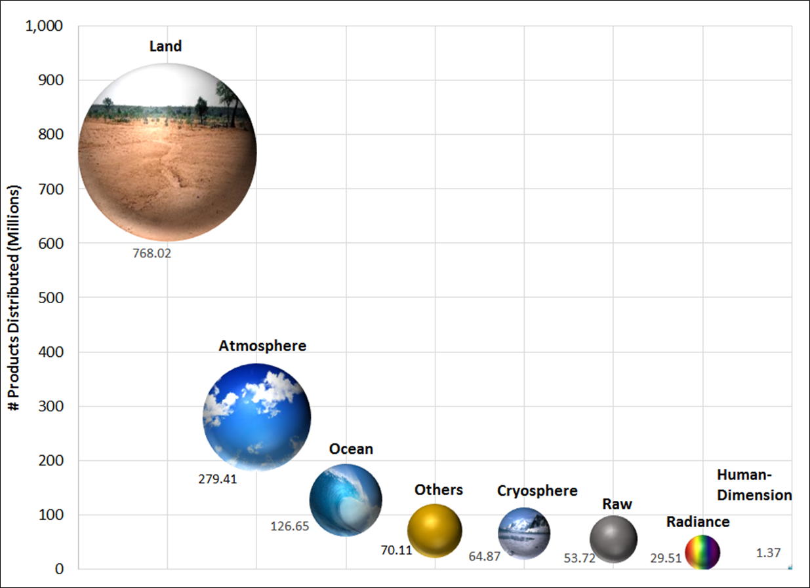
EOSDIS Yearly Total Data Volume (PB) and Number of Products (Billions) Distributed to End Users
FY2017 Number of Products Distributed by Discipline
*
* Products whose discipline was not applicable, for example, ancillary data products

Slide 12
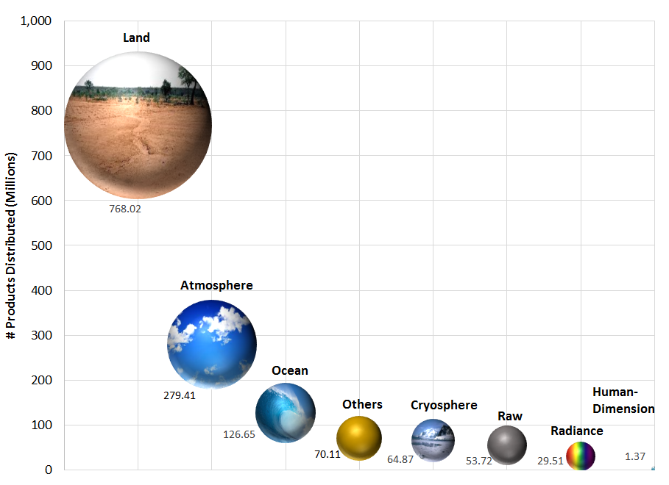
FY2017 Number of Files Distributed by Discipline
*
* Products whose discipline was not applicable, for example, ancillary data products

Slide 13
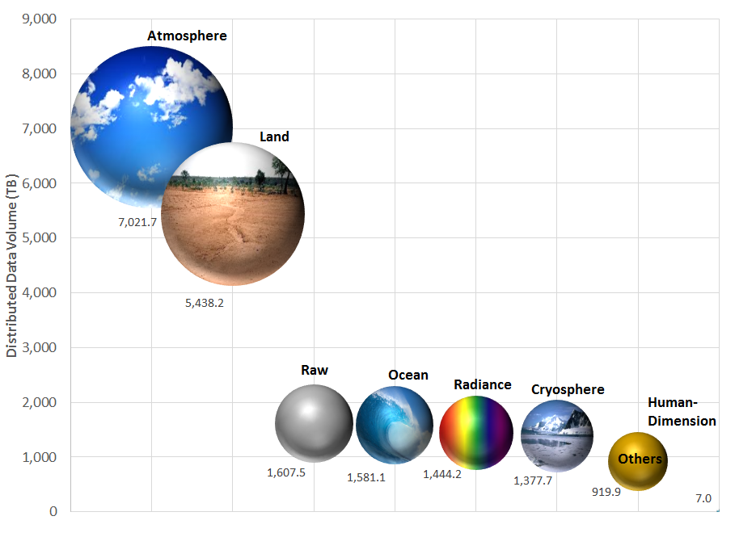
FY2017 Distributed Data Volume by Discipline

Slide 14
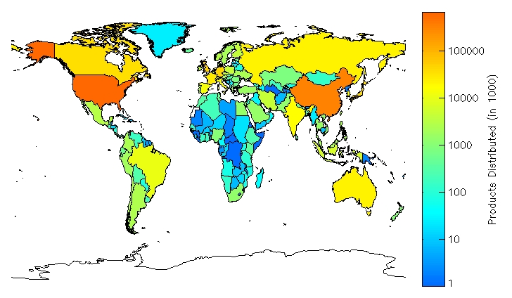
EOSDIS Global Distribution of Number of Data Products for FY2017
Top 10 Countries
United States
China
United Kingdom
Germany
Japan
Canada
France
Russia
Australia
South Korea
NASA's Earth Science data is distributed globally, the effect of an open data policy now in effect for over 17 years

Slide 15
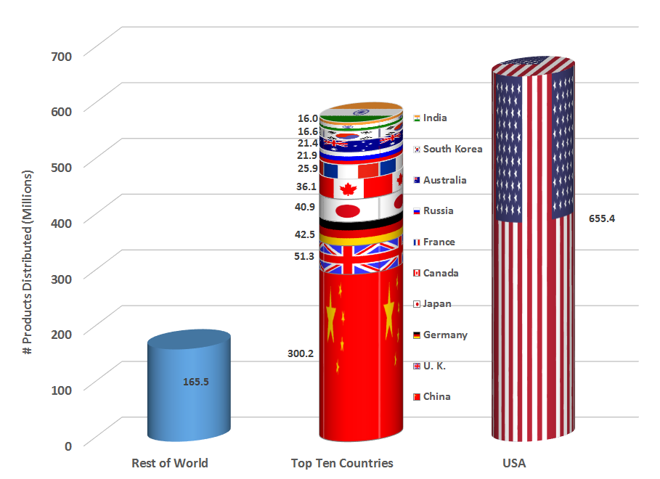
FY2017 EOSDIS Number of Data Products Distributed by Country

