Slide 1
DLR EO-Data Management - User Metrics
K. Molch, J. Senft, C. Chereji
German Aerospace Center DLR
Earth Observation Center EOC
Information Technology Division
CEOS-WGISS #45
INPE, São José dos Campos, Brasil
12 April 2018

Slide 2
Overview
User metrics reported in national Copernicus platform CODE-DE
Sources of user information
Reporting system architecture
Personal data protection
Tracking data use via persistent identifiers
Conclusions

Slide 3
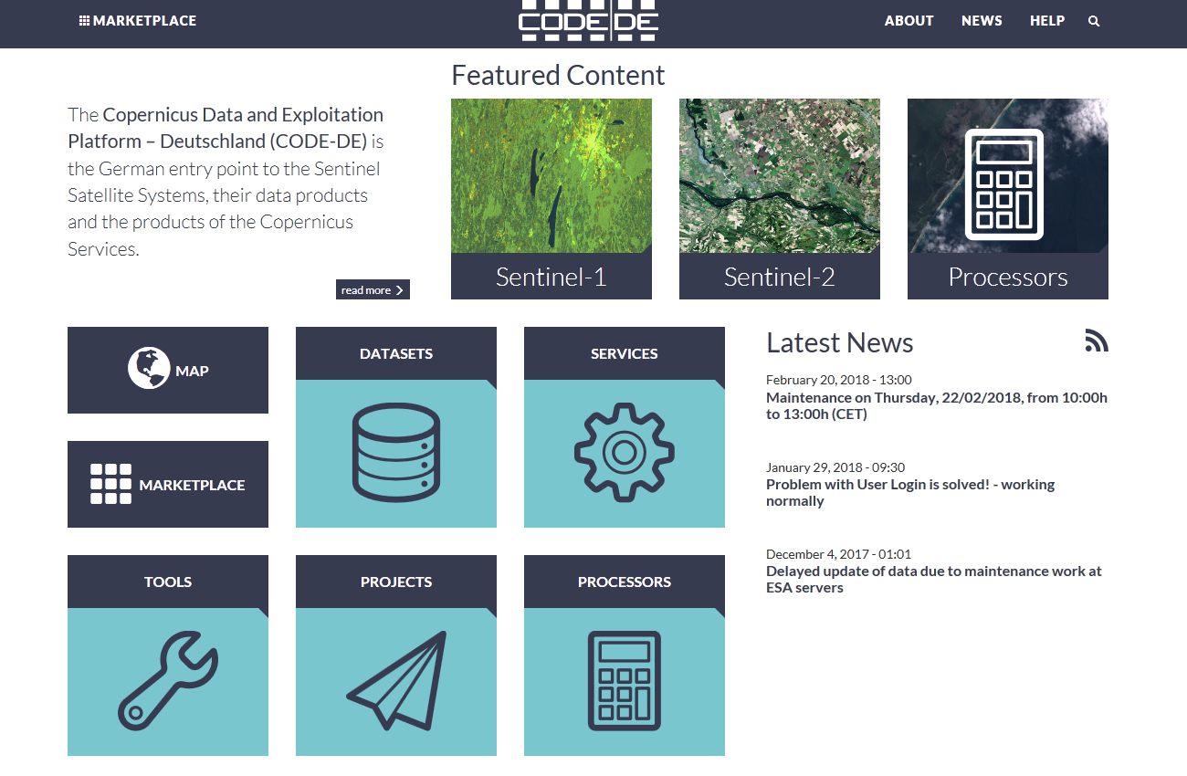
Reports generated for the Copernicus Data and Exploitation Platform Germany (CODE-DE)
Background
Project is funded nationally
Project coordination DLR-EOC
DLR-EOC is responsible for reporting work package
Reports generated for project management and funding entity
Reports
Data Download Report
User and User Activity Report
Data Availability Report
System Performance Report
Data Processing Report
Code-de.org

Slide 4
Data Download Report
Number and volume of products queried and downloaded from CODE-DE platform during the reporting period
Total global and European downloads
Downloads per day & month, month & year (depending on reporting period)
By mission and product type
By access service (WCS, direct download, DHuS, subscription)
By success of the operation (successful, partial, failed)
By country of download
‘Top 20’ – Statistics for the 20 users with the largest number of downloads during the reporting period (users are rendered anonymous)
User country of origin
User category (education, research, federal authority, …)
User field of activity (space, agriculture, forestry, …)
Number & volume of downloads
- total, per mission, per product type
Information retrieved from User Management Service
Information retrieved from Download Service

Slide 5
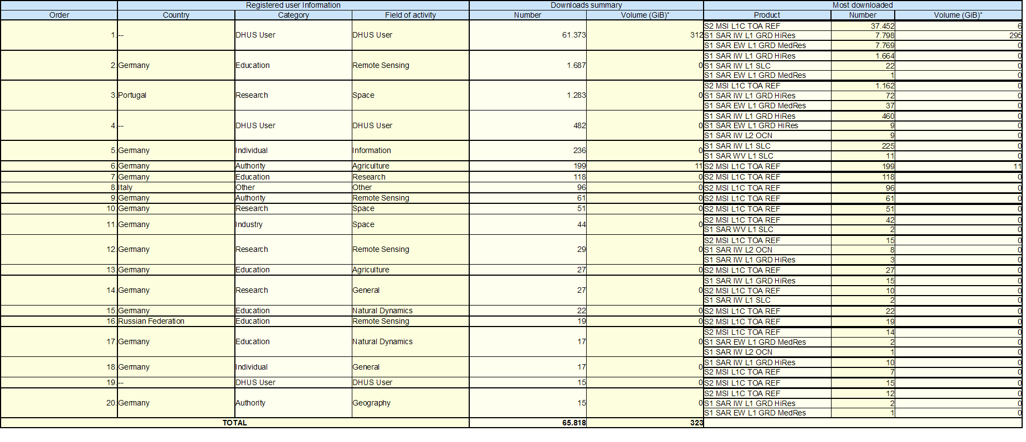
Data Download Report
Top 20 report
Report format - integrity vs. usability
Ensure information remains unchanged
Enable further processing, integration, analysis
csv, sdmx, Excel, pdf, …

Slide 6
Fields of Activity and User Categories
Fields of Activity
DLR User Management System | DLR Reporting Service | ESA User Fields
Agriculture | Agriculture | Land
Air | Air | Atmosphere
Animal Husbandry | Animal Husbandry | Land
Atmosphere | Atmosphere | Atmosphere
Biology | Biology | Climate
Building | Building | Land
Chemistry | Chemistry | Other
Climate | Climate | Climate
Disasters, Accidents, Risk | Disasters, Accidents, Risk | Emergency
Economics | Economics | Other
Energy | Energy | Climate
Environmental Policy | Environmental Policy | Climate
Fisheries | Fisheries | Marine
… | … | …
Urban Environment, Urban Stress | Urban Environment, Urban Stress | Land
Waste | Waste | Land
Water | Water | Marine
Other | Other | Other
Fields of Activity
Re-use of existing DLR UMS fields of activity
mapped to ESA user fields for customized reporting tasks
User Categories
Tailoring of ESA user domains
to meet project requirements
User Category
DLR User Management System | DLR Reporting Service | ESA User Domains
Individual | Individual | Other
Industry | Industry | Commercial
Research | Research | Research
Other | Other | Other
Education | Education | Education
Authority | Authority | Authority
Federal Authority | Federal Authority | Authority

Slide 7
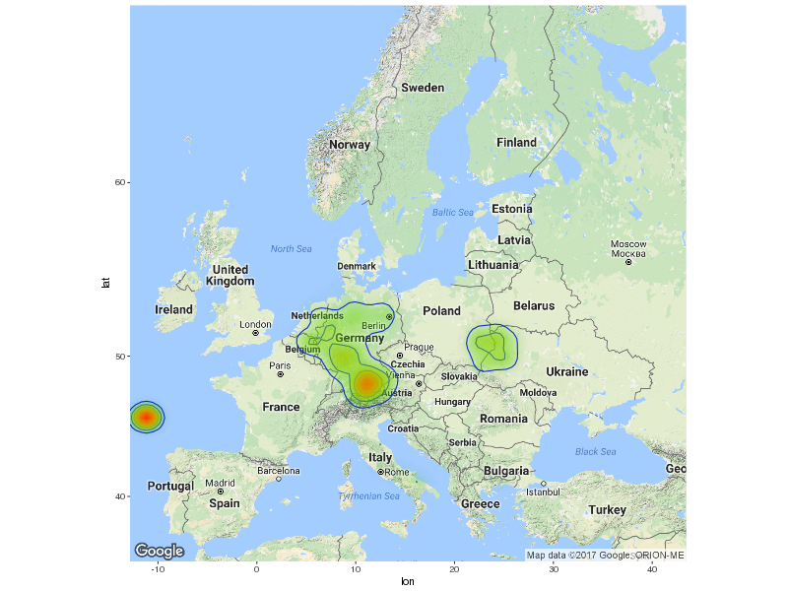
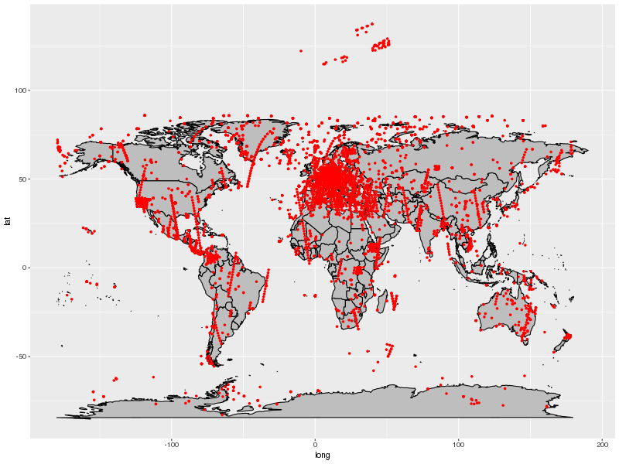
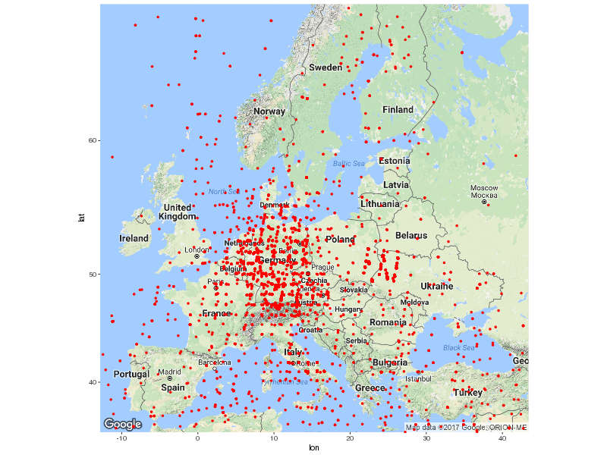
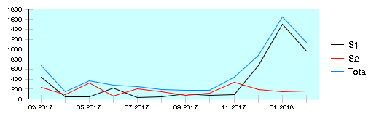
Data Download Report
Examples of graphic representation
Density of downloads
by product location
Downloads by product location
(center point of footprint of downloaded product)
Number of downloaded products per mission per month (day) over reporting period of a year (month)

Slide 8
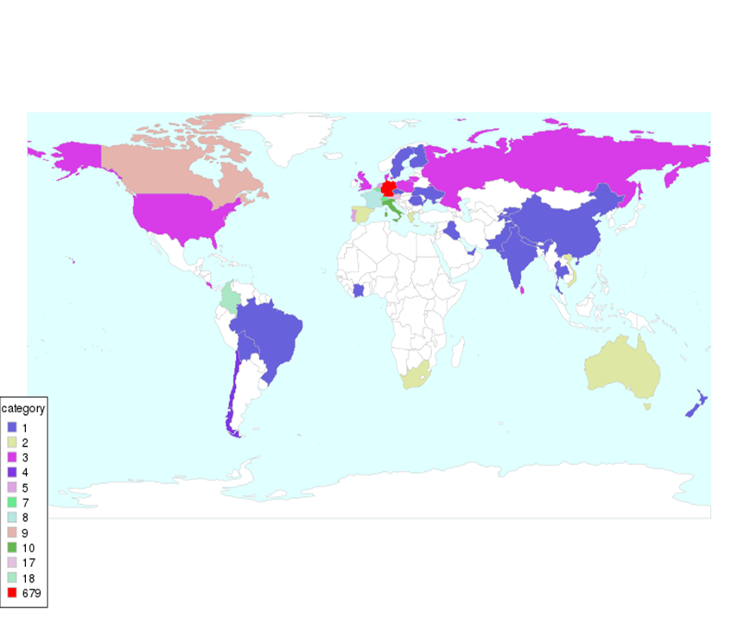
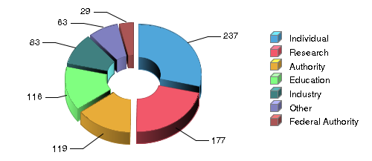
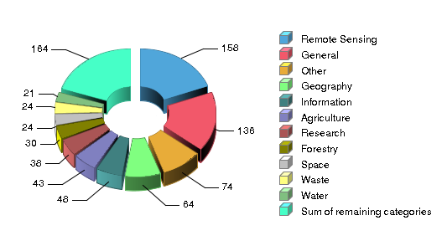
User and User Activity Report
Number of users and their activity on the CODE-DE platform based on user accounts
Total number of users and increase of users during reporting period
  By country of origin
  By user category
  By field of application
Number of changed user profiles
Number of active users - number of users by time elapsed since last login
(<1M, >1M-12M, >12M, never logged in)

Slide 9
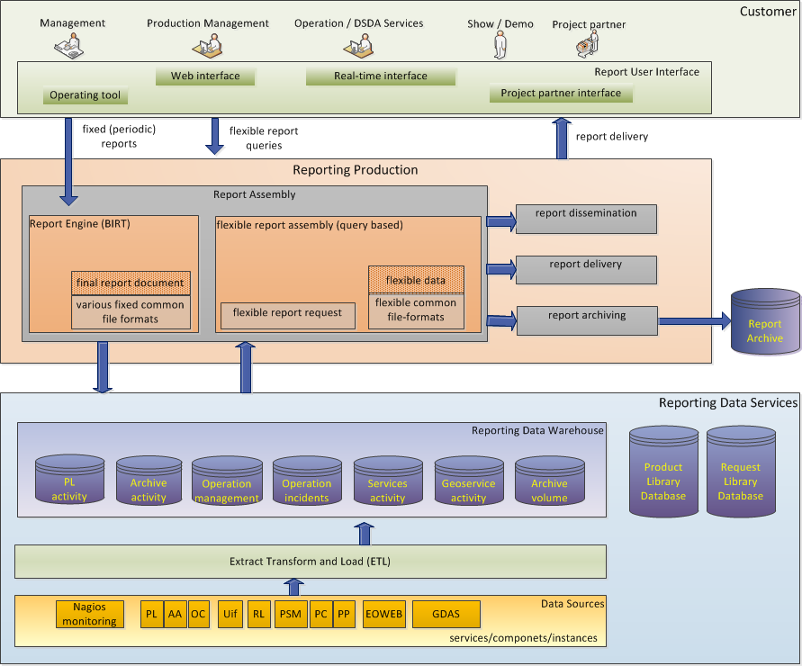
DLR Reporting System Architecture

Slide 10
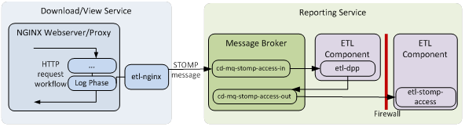
Personal Data Protection I
Rendering users anonymous for CODE-DE reporting purposes
The Reporting Service does neither store nor use user names and/or full IP addresses
Reporting Service receives information (ETL messages) from User Management Service (UMS) and Download Services
  UMS stores user names
  Download Services logs user names and full IP-addresses
  → data protection concept (what is stored, for which purpose, how, user consent, …)
Before ingesting the information, the Reporting Service …
  … clips IP-addresses → only country of download can be retrieved
  … renders user names anonymous using ’hashing’
Reporting Service stores and processes only anonymized information

Slide 11
Personal Data Protection II
Hashing user names to protect identity
User names are transformed into >60-digit alphanumeric string
example: f9f8d17aeacd88ce3802c61fa2bddc67666c354601a7a27a9d32de96896d2132
Algorithm used: SHA-256
One-way hashing → user name cannot be re-engineered
Same input always produces the same output → same user receives the same hashed string, irrespective of source of user information (User Management Service, Download Services)
→ download information (e.g. number of downloaded products) can be merged with user management information (e.g. user field of application) e.g. for Top 20 report

Slide 12
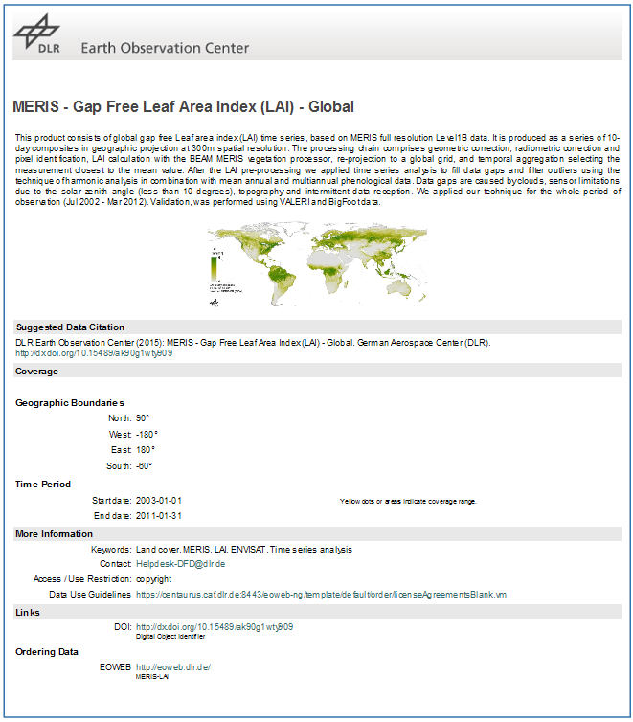
Persistent Identifiers to Track Data Use
Gradually assigning Digital Object Identifiers (DOI) to selected published DLR EO data sets
  Mostly higher level products
  Following CEOS Persistent Identifier Best Practice
Allows to track data use via related publications - effort to extract relevant user / data use information
dx.doi.org/10.15489/ak90g1wty90

Slide 13
Conclusions
User metrics tracked and reported as per project requirements
Evaluating analysis of information held in overall User Management System and available from various ordering and download services (ETL messages, logfiles)
To Do – explore analysis of ‘user satisfaction’
  Review and compile possible sources of information (helpdesk, orderdesk, …)
  Unstructured information (emails, phone calls, …)
  Surveys a possibility – not systematically done yet
  CEOS initiative welcome
  Harmonized set of metrics to track
  Harmonized user survey questions
  Technical approach for reporting to CEOS

Slide 14
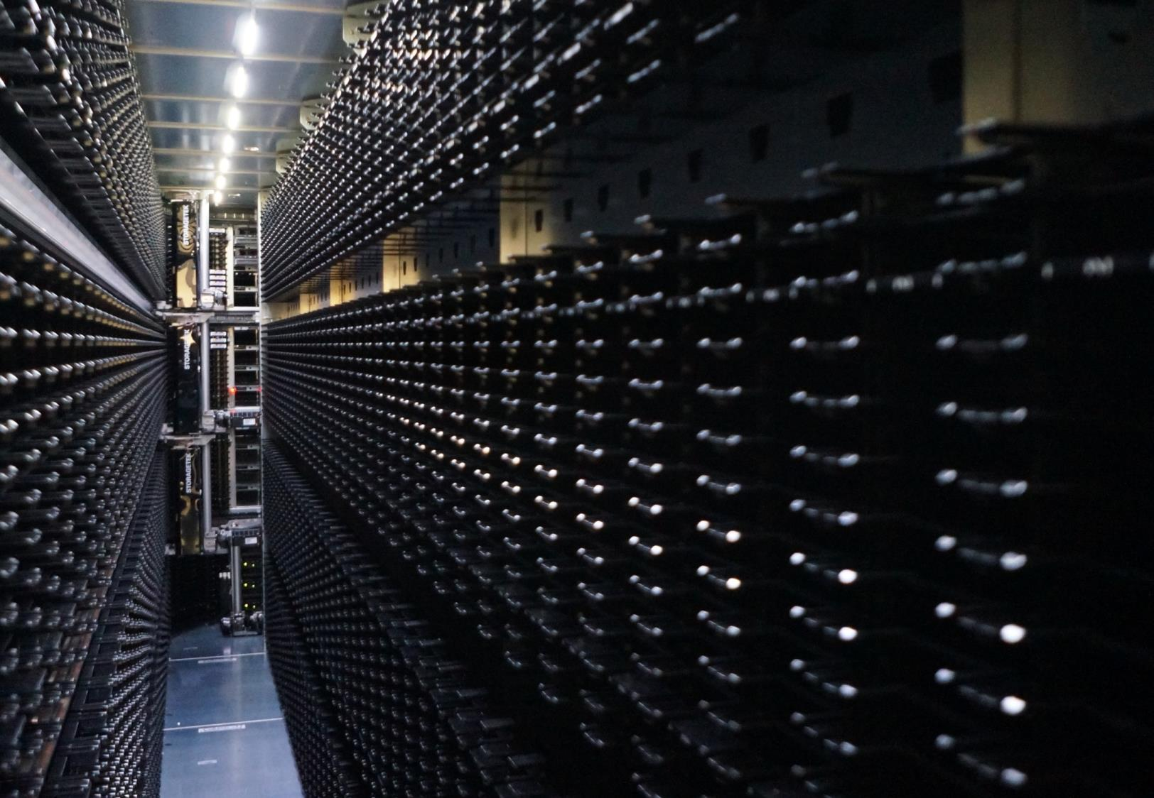
Thank you very much – Questions?
Katrin Molch
DLR Earth Observation Center
Katrin.Molch@dlr.de

