Slide 1
User Metrics Introduction
Committee on Earth Observation Satellites
Iolanda Maggio - ESA
WGISS#45
INPE, São José dos Campos (SP), Brazil
09 – 13 April 2018

Slide 2
Outline
User Metrics: CEOS needs and background
User Metrics Introduction: Why, Which, How, When, What
Points of Discussion

Slide 3
User Metrics: Background
CEOS Future Data Access & Analysis Architectures Study – Interim Study (October 2016)
Focus:
Maintain investment in EO activities being able to measure the ROI through its use and value generation.
Consider many more third parties developing applications and business, along with massive automation and consumer use of open data
Increase difficulty to collect metrics necessary for administrative reporting using things like user logins or agency portal access.
Consider to use alternate methods to gather such information whilst respecting privacy issues and remaining true to the principle of open data.
The risk to EO data becoming an anonymous contributor to major applications outcomes is high as increasing use sees it become taken for granted.
~~~~~~~~~~~~
CEOS Plenary (October 2017) Statement:
The 2018 continuation of the FDA-AHT will continue to center around five themes: CEOS Analysis Ready Data (ARD); Interoperable Free and Open Tools; Data, Processing, and Architecture Interface Standards; Analytical Processing Capabilities; and User Metrics.

Slide 4
User Metrics: Background … Continued
CEOS Work Plan 2018-2019 & WGISS Work Plan 2018-2020
User Metrics: Definition of a data use metrics framework through which agencies can contribute to a ‘sector wide’ view of how EO data is actually being used, not just how much is being downloaded. The outcome of these initiatives should be a more coordinated and coherent EO data offering, against which organisations can confidently invest their resources and leverage their distribution channels to users in an effort to realise benefits that go far beyond the traditional mono-mission approach.
FDA Action: Develop a User Metrics Best Practice.
Description: The proposed User Metrics initiative seeks to ensure planning and responsibilities are put in place for CEOS to leverage the experience being gained by individual agencies and to have an ongoing effort to collate available user metrics and to adapt the FDA strategy as these metrics are analysed beyond what is simply being downloaded. WGISS will perform a survey on existing user metrics in Earth Observation and other domains (e.g. social media) and develop a best practice for User Metrics recommended for application by CEOS agencies; these will include a user questionnaire to allow classifying the final user in terms of use of the data products and allowing generation of summary statistics on how EO data is being used and for what.

Slide 5
User Metrics: Objectives
How to increase and foster the uptake of Earth Observation Data in term of Quantity and Quality.
How to improve investment and ROI.
Produce “User Metrics Best Practices”:
Survey on existing user metrics in Earth Observation and other domains
Develop a best practice for application by CEOS agencies, containing:
Recommended metrics for user and data monitoring
Recommended “Satisfaction” Questionnaires/Survey
Recommended user and data statistics

Slide 6
User Metrics Introduction: Why, Which, How, When, What

Slide 7
User Metrics Introduction … WHY??
… From different views …
Technologic/Platform viewpoint:
To improve the access environment
To reduce lags in the access process
To improve resources management
To improve GUI and Interfaces
Investments and ROI viewpoint:
To increase EO data usage
To include not-traditional users and countries
To improve and address funding
Earth Observation Data viewpoint:
To improve the data quality
To encourage new knowledge production
User Engagement viewpoint:
To stimulate the scientific interest
To improve Citizen outreach
To simplify the access process

Slide 8
User Metrics Introduction … WHICH??
Earth Observation Data Metrics
Web/Platform Metrics
User Engagement Metrics
User Satisfaction Metrics

Slide 9
User Metrics Introduction … HOW??
User
Feedback
Explicit
Instant Feedback
Implicit
Usage
Statistics
Bug
Enhancement
Survey
Send Feedback
Form
Like
Interface
Resources
Interface Content
Feedback
to
Development
Team
Feedback
to
Data
Provider

Slide 10
User Metrics Introduction … WHEN??
Implicitly (During the registration):
Self-registration
Registration with approval
Registration requiring evaluation
…
Implicitly (During the user activities):
Downloading activities
Topic and Data Search
Documentation consultation
…
Explicitly: (After the end of the process)
Survey and questionnaire
Like
…

Slide 11
User Metrics Introduction … WHAT?? … continued
To follow, an initial excerpt of the possible metrics:
Earth Observation Data Metrics:
Use of data to create new information/knowledge
Time series requests
Data downloaded (size and numbers)
Domain/Area of interest
Location/Country
Mission/Sensors data request
Age of Datasets (versions)
Web/Platform Metrics:
Number of new registrations (new users acquisition)
Number of downloads
Average session duration
Average resolution time as regards issues that affect the users directly (keep this low to prevent rapid user disaffection)
Average number of downloaded/accessed resources per day
Percentage of accesses from mobile devices
Session duration and interval
Retention Time
Errors handling and management

Slide 12
User Metrics Introduction … WHAT?? … continued
User Engagement Metrics:
Number of active users
Number of registered users
Web referral
Cited pages
Number of scientific presentations/publications/project
Number of mentions
Social listening services might be used
User Satisfaction Metrics:
Rate of positive user feedbacks, i.e. number of positive feedbacks divided by the total number of feedbacks
Likes

Slide 13
Points of Discussion
Definition of “Active users”: A user registered could be defined “Active User”? Perhaps its better to measure actions like Download, Results of PI Project, etc.
Number of active users := users returning more than once in the reporting period?
Metrics availability - Should the metrics available to everybody? Or shall data usage figures be available to the data provider supplying the data only.
Access to metrics - should an anonymous user have access to the metrics (full/partial)?
Open data will increase difficult to collect metrics necessary for reporting using only things like user logins or agency portal access. Recommendations needed.
Ones identified metrics we should analyse tools and way to discover and calculate the metrics, measurements and statistics.
The commercial/business environment and markets could be really useful to steal suggestion and processes because this topic started in that context.

Slide 14
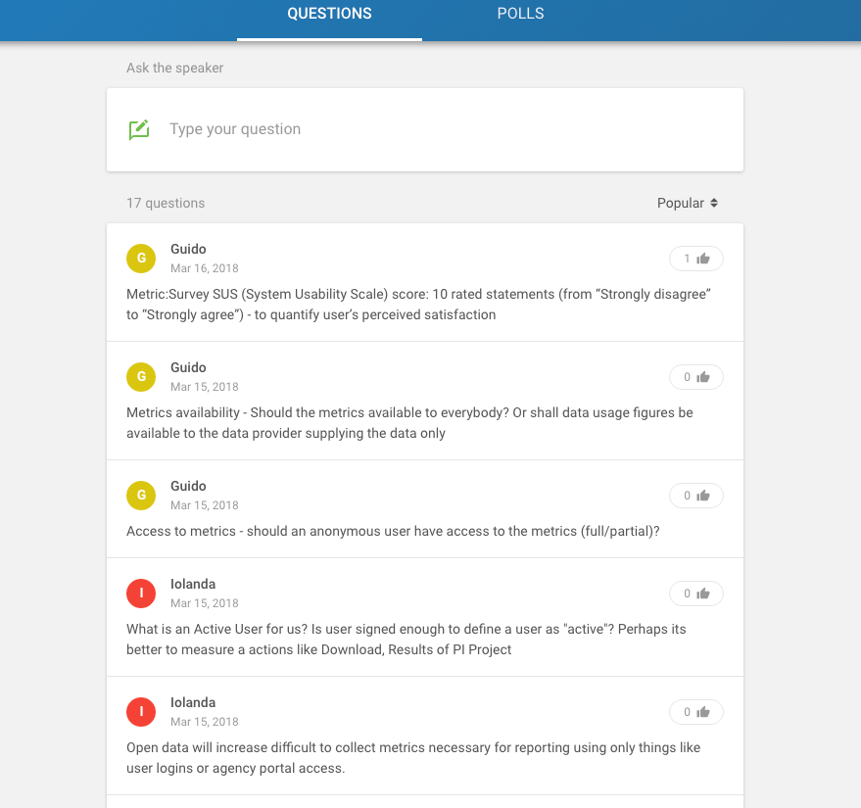
Topic Collaboration
Event Code: #UserMetrics

Slide 15
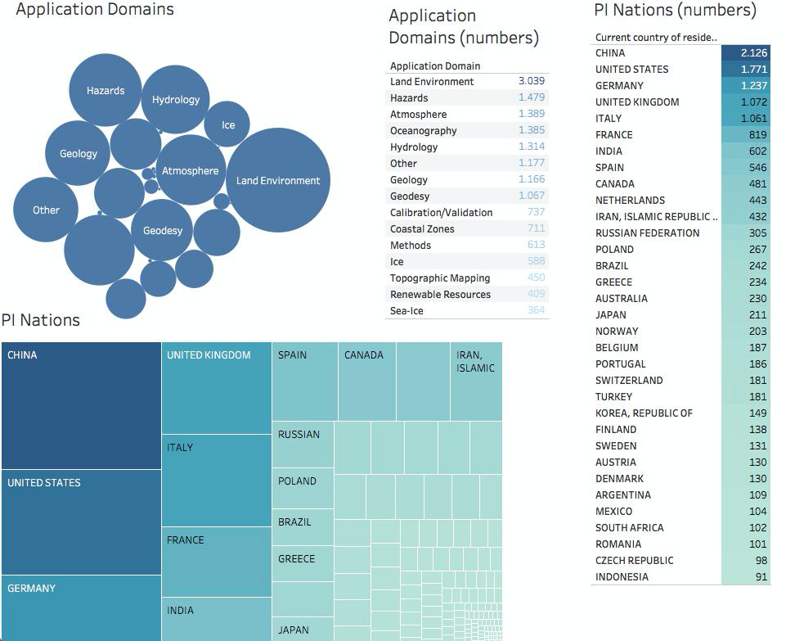
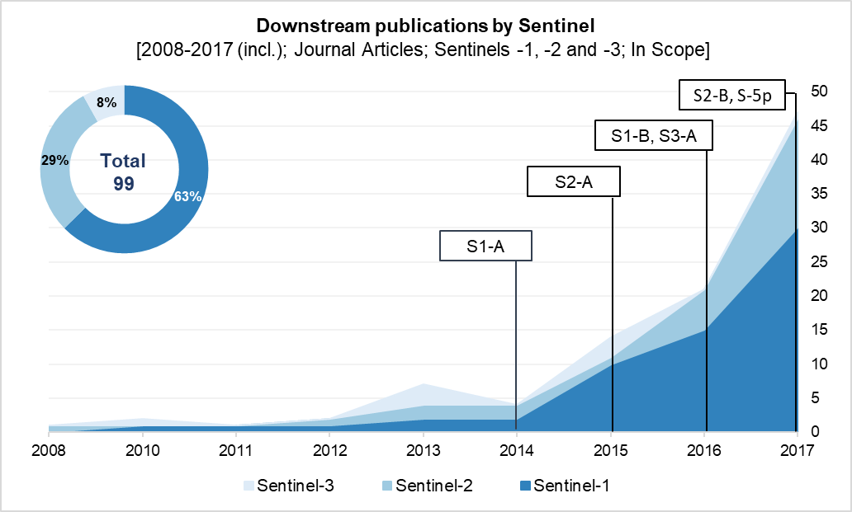
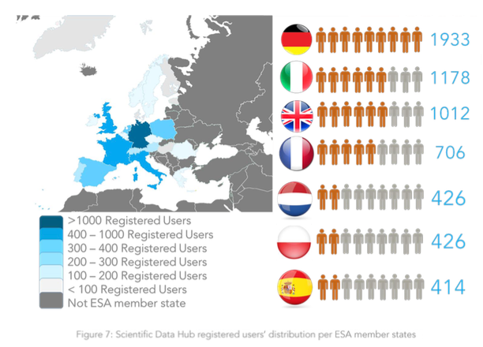
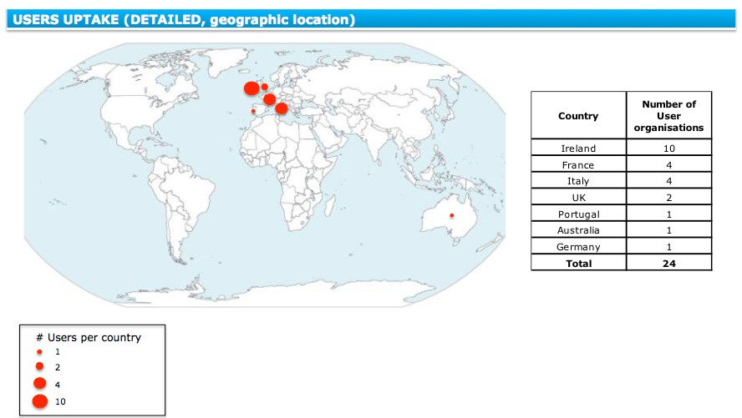
ESA User Metrics

