Slide 1


Recovery Observatory
Committee on Earth Observation Satellites
Richard Moreno
CNES
WGISS-45 – 12/03/2018

Slide 2



Recovery Observatory – the idea
Disaster (weeks)
Recovery(years)
Response
Recovery Observatory
  Space agencies already organize the emergency response after disasters (International Charter) …
  … But have little or no coordination for the post-crisis part of the disaster management cycle
A CEOS initiative (Working Group Disaster, WG currently led by CNES)
  Triggered through lessons learned by CNES from Kal-Haiti project (precursor of a Recovery Observatory) after 2010’s earthquake in Haiti

Slide 3
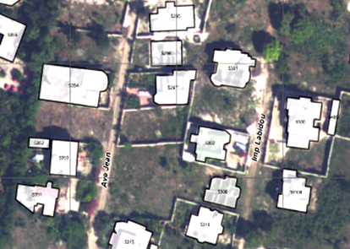
Figure 1:Jacmel buildings classification
Recovery Observatory – Objective
  Demonstrate the value of using satellite Earth Observations to support Recovery from a major disaster:
    Assessment of damages, reconstruction planning, reconstruction monitoring
  Establish institutional relationships between CEOS and stakeholders from the international recovery community.
    World Bank : Global Facility For Disaster Reduction and Recovery (GFDRR),
    United Nations : Development Programme (UNDP) Environment Programme (UNEP)
    Gouvernemental and non- gouvernemental organisations Red Cross/Red Crescent Societies (IFRC) Office for the Coordination of Humanitarian Affairs (OCHA)
  Promote innovation around high-technology
  applications to support recovery.
Jacmel buildings classification

Slide 4
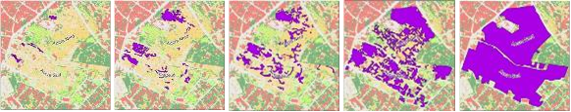
Recovery Observatory : Rationale
  Duration of a RO instance ≈ 3 years
  Plan coordinated acquisitions to support:
    Damage assessment (built areas, natural resources);
    Reconstruction planning;
    Reconstruction monitoring;
  Install a DotCloud instance (collaborative web IT workspace) to share products and user data
Monitoring of grouping of people and camps

Slide 5
Recovery Observatory : Planning
  End 2013 - Proposal from the CEOS Recovery Observatory Oversight Team (ASI, CNES, ESA, JAXA, NASA)
  13/02/2014 – proposal from WGISS to contribute to the development of the Recovery Observatory
  18/03/2014 – participation to WG disaster meeting in Paris to discuss on the project
  20/03/2014 – presentation of the project in WGISS37 (Florida) meeting
  11/07/2014 – kick-off with THALES & AKKA companies
  WGISS38 (Russia) & WGIS39 (Japan) : technical discussions with our technical support AKKA
  01/01/2015 – Delivery of the 1st version of the Recovery Observatory
  15/08/2015 – Delivery of the complete version of the Recovery Observatory

Slide 6
Recovery Observatory : WGISS
  Good example of cooperation between two CEOS working groups
    WG Disasters and WGISS
  WG Disasters has participated to the design and to the development of the Recovery Observatory
  The schedule was tight, but Recovery Observatory has been developed on time
    The planning is the one that was presented in WGISS37

Slide 7
Main features of what has been developed
Committee on Earth Observation Satellites

Slide 8
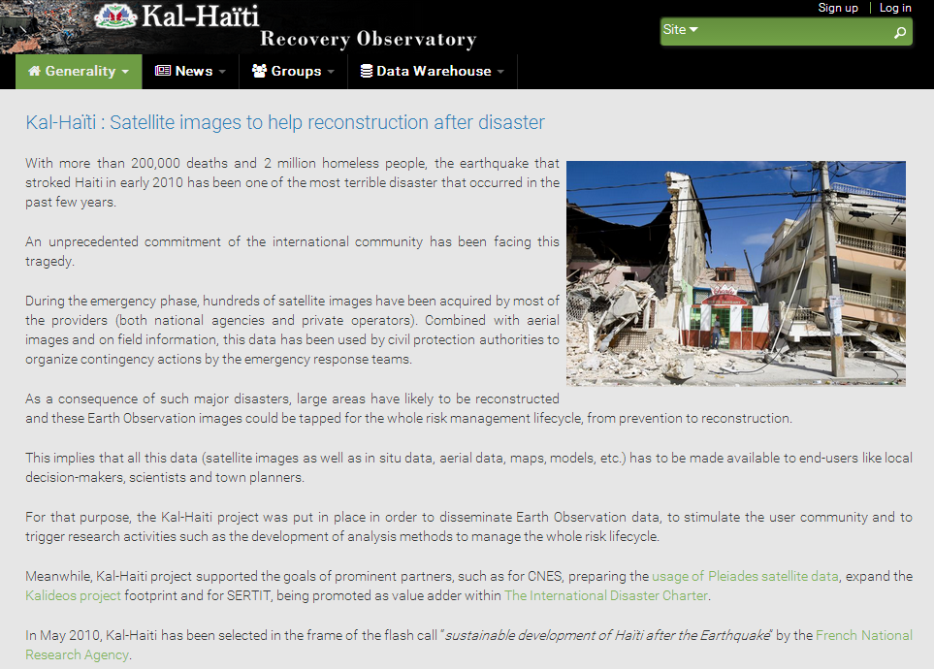
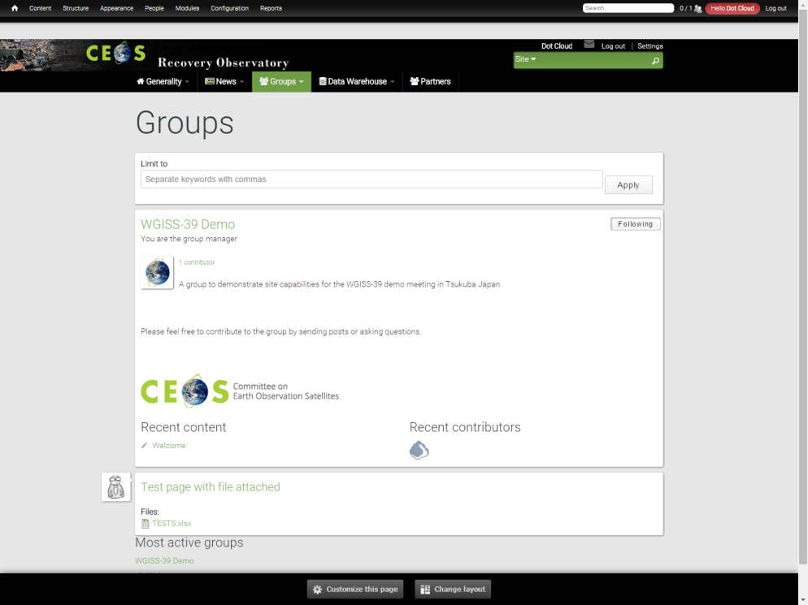
Public Web portal features
  Editorial content
    Project presentation
    General News & events
    Fed by webmaster
    License management
  Collaborative groups
    To allow users to post information & data
    within groups
    To provide security management
      Private groups
      Semi private groups
      Public groups

Slide 9
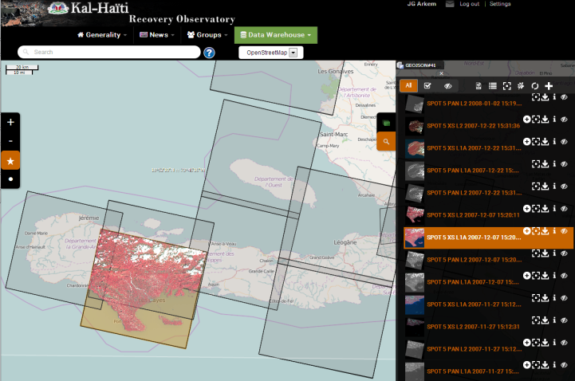
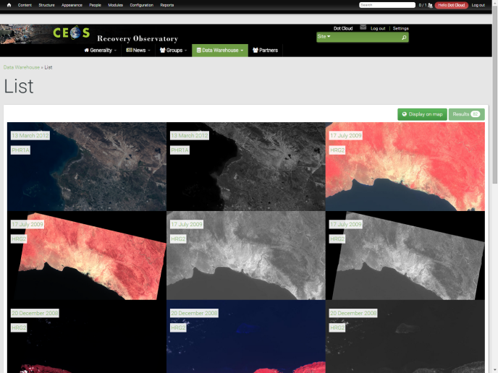
Public Web portal features
  Map with products footprints
    Full resolution products displayed on the map
    Product download
  List of available products
    List of products ordered by date of acquisition
    Product download
    Product details with metadata , quicklook
    and footprint
  Multi criteria search form

Slide 10

Mapshup

Slide 11
Recovery Observatory (RO)
Haiti Hurricane Matthew RO Status and Next Steps
Extracts of presentation to WGD #9
Brussels March 14th, 2018
Boby Piard, CNIGS
Agwilh Collet, CNES
Helene de Boissezon, CNES
Andrew Eddy, RO Secretary
Committee on Earth Observation Satellites

Slide 12
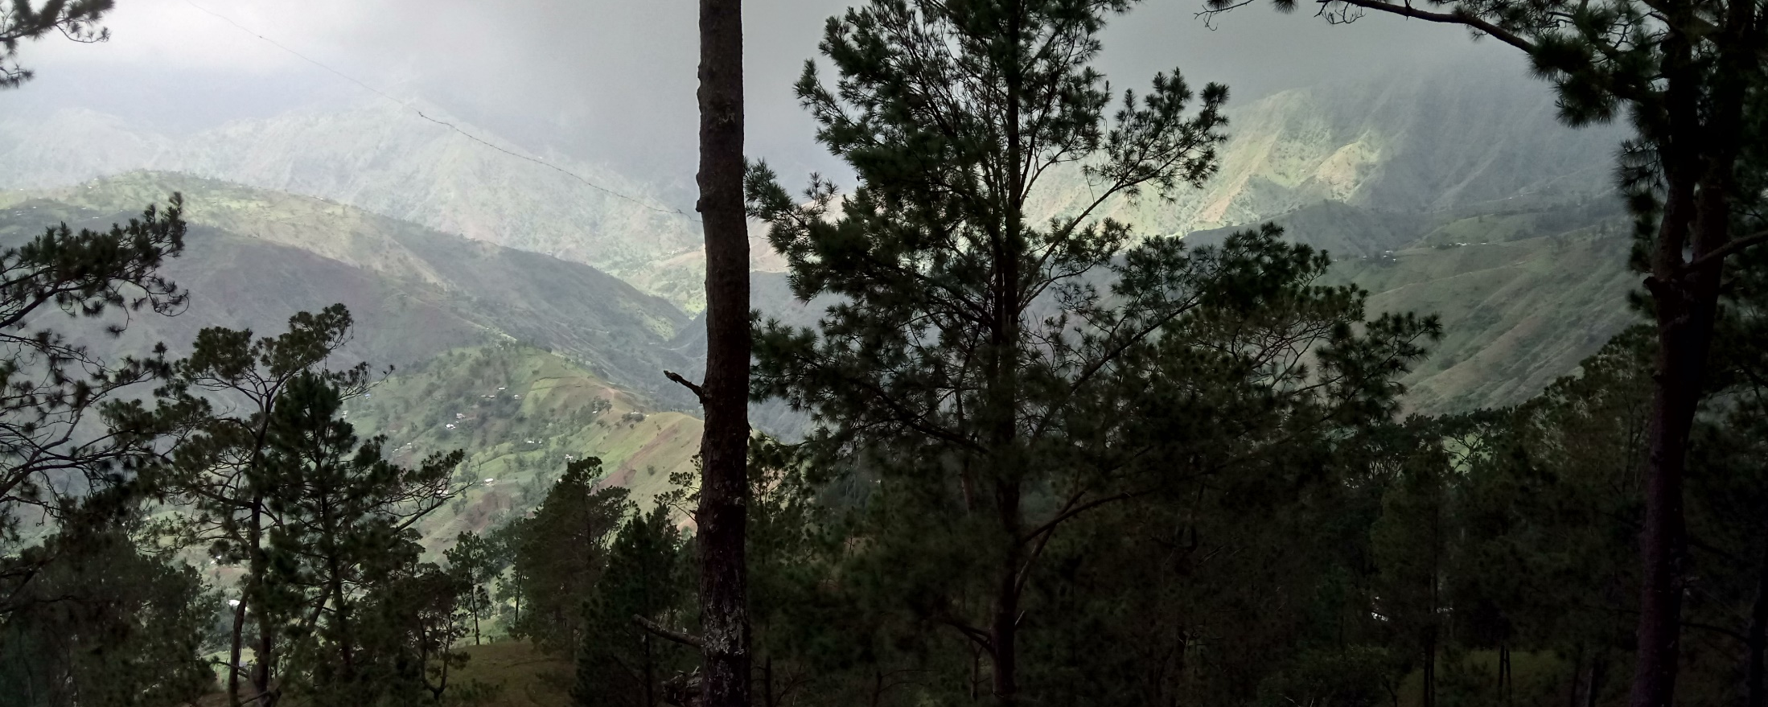
RO Status Overview
A Reminder of Haiti’s diversity
  Triggering of the RO decided by CEOS Chair in consultation with CEOS Principals, December 22, 2016, after Hurricane Matthew - October 2016
  Mission #2 to Haiti 29 May – 2 June 2017 1st RO users workshop and feedback on sample products
  Mission #3 to Haiti 5 Dec - 8 Dec 2017 technical review to work within each thematic sector and link with universities

Slide 13
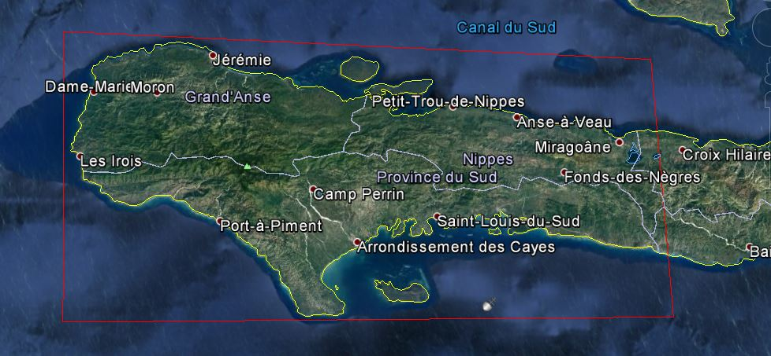
Haiti RO covers three departments: Grand’Anse, Sud, and Nippes

Slide 14
RO Timeline
Infrastructure
Early RO evaluation
Product definition, image requirements
Lessons
learned
RO Haiti Triggering
12/22/16
2015 2016 2017 2018 2019 2020
jfmamjjasond jfmamjjasond jfmamjjasond jfmamjjasond jfmamjjasond jfmamjjasond
PDNA
ROOP
Today
Hurricane Matthew
in Haïti
10/04/16
Malawi, Nepal
Demonstrators
Missions to Haiti
(2 to 3 per year)
Technical Review
5-8 Dec
1st
31 Jan – 3 Feb
1st User Workshop
29 May – 2 June
2nd User Workshop
8 – 11 May
External Mission
Generic RO discussion
WB + UNDP DC + NYC (date TBC)

Slide 15
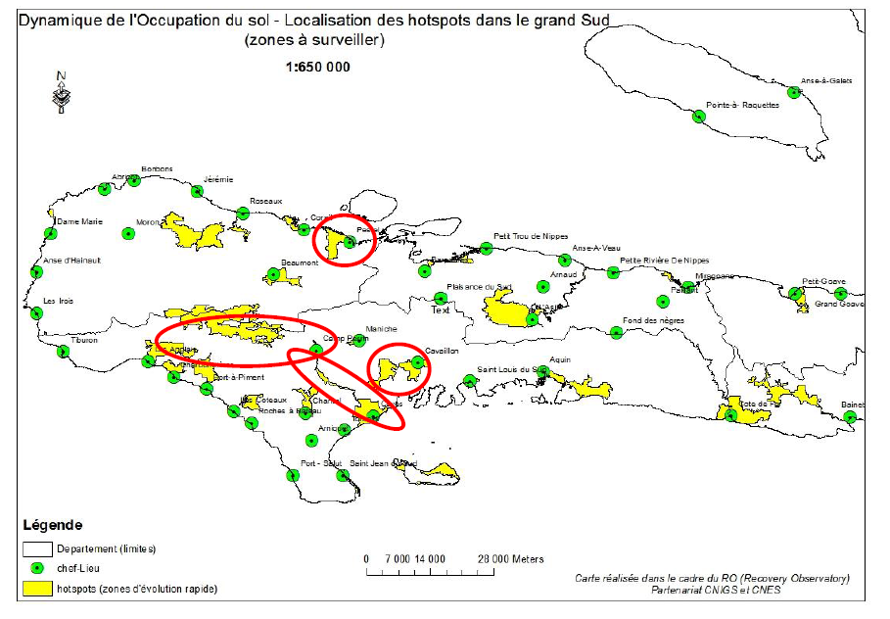
RO : Hot spot identification

Slide 16
Thematic coordinators
Produit | Key User | First Elaboration | Satellite data | Focal Point | Institution
Cartography of the building (Jérémie, Les Cayes, route d’Aquins) | CIAT/Ministry of Planning (MPCE) | Copernicus EMS; SERTIT (methodology); CNIGS (production); | Optical THR | Rose-May GUIGNARD | CIAT
 |  |  |  | Pierre Alexilien Versaille | MPCE/ CNIGS
Land Use | All (reference data) | CNIGS/CESBIO /SERTIT | Sentinel-2, HR Optical | Jacques Philemon MONDESIR | MPCE / CNIGS
Forest Evolution / Environmental Impact | Ministry of Environment (MDE) | Copernicus EMS | Sentinel-2, SPOT, Optique THR | Pierre Emmanuel PHILIPPE | MDE/ Directeur des forêts
 |  |  |  | Saint Phar JEAN | MDE/ ONEV
Agriculture | Ministry of Agriculture (MARNDR) | Copernicus EMS ; CNIGS/SERTIT | Sentinel-2, Optical HR, zoom THR | Ognel PIERRE-LOUIS | MARNDR/ DRFS
 |  |  |  | David TELCY | MPCE / CNIGS
State and monitoring of the Macaya Park | ANAP / ONEV (MDE) | Copernicus EMS ; SERTIT | Optical THR, radar THR | Sait Phar JEAN | MDE/ ONEV
State and monitoring of watersheds | ONEV (MDE) - Ministry of Agriculture (MARNDR) | CIMA Foundation | Digital terrain model 1m/20cm and Radar THR | Jean André PIERRE | MPCE/ CNIGS
 |  |  |  | Pradel FORMONVIL | MPCE/ CNIGS
 |  |  |  | Saint Phar JEAN | MDE/ ONEV
Landslide / Quarry monitoring | BME / Ministry of Public Works (MTPTC) | EOST | Optical HR/THR, Radar TerraSAR-X | Samuel GENEA | MTPTC/ BME
 |  |  |  | Eric CALAIS | ENS France
Notes:
Coordinators drawn from large range of Haitian organisations

Slide 17
Technical Meeting #1 :
Example Infrastructure in Jérémie
Infrastructure and road communication :
1st -> Jérémie
PRODUCTION SCHEME :
Data used :
  Orthophoto 2014
  Pléiades - 07/10/2016
  Pléiades - 18/10/2017
Input data :
  Building from Copernicus EMSR185 action (polygon with damage)
  Building from Open Street Map (polygon)
Methode :
The geometry of the polygons (OSM + previous site) is recaled compared to that of the orthophoto 2014, which is considered as the absolute reference.

Slide 18
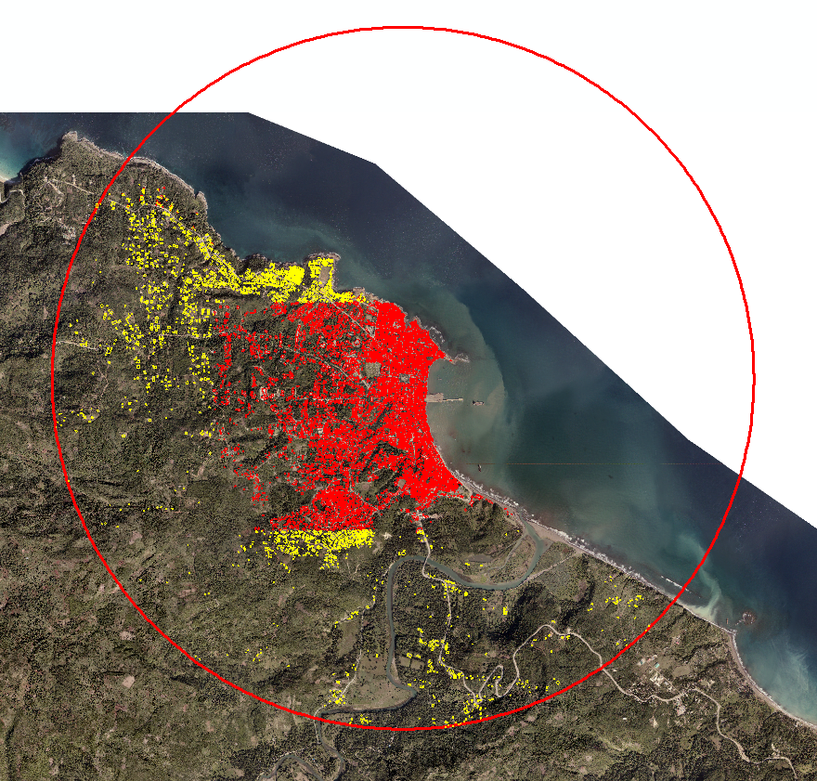
Technical Meeting #1 :
Example Infrastructure in Jérémie
Infrastructure and road communication :
1st -> Jérémie

Slide 19
Technical Meeting #1 :
Example Infrastructure in Jérémie
Infrastructure and road communication :
1st -> Jérémie
7584 buildings
2014 | 2016 | 2017 | Total
Not affected | Destroyed |  | 3219
In construction | Destroyed |  | 54
Not existing | Destroyed |  | 59
Not affected | Damaged |  | 1196
In construction | Damaged |  | 62
Not existing | Damaged |  | 49
 | Not affected | Not affected | 2037
 | Destroyed | Not affected | 2843
 | Destroyed | In construction | 111
 | Destroyed | Not existing | 303
Not affected |  | Not affected | 5719
Not affected |  | Not existing | 346
4 states :
Not affected
In Construction
Not Existing
Damaged
Destroyed

Slide 20
Technical Meeting #1 :
Example Infrastructure in Jérémie
Infrastructure and road communication :
1st -> Jérémie
Neighborhoods that have access problems

Slide 21
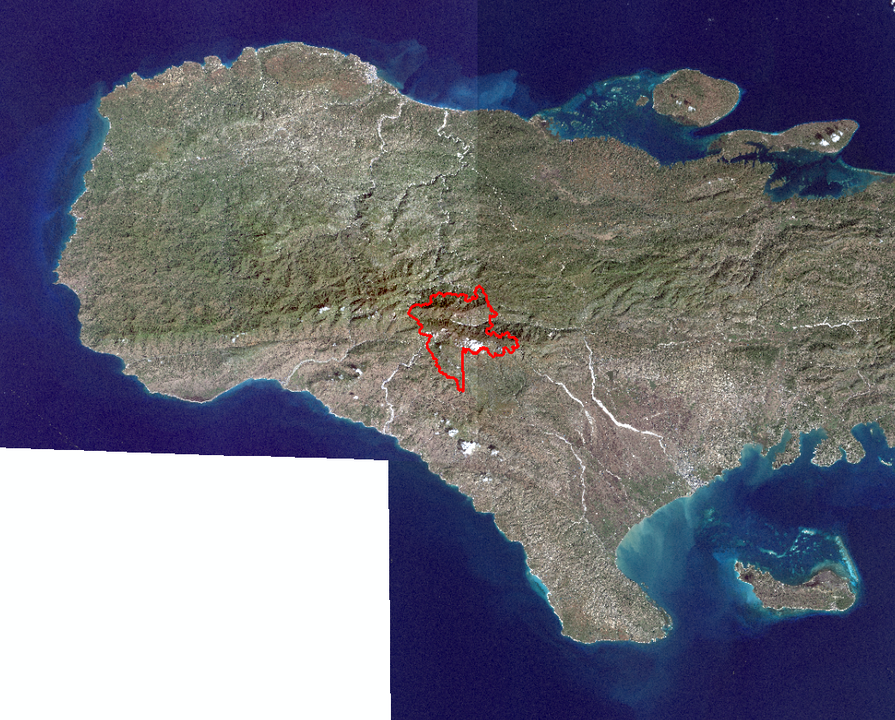
Technical Meeting #1 :
Example Vegetation monitoring / Macaya Park
Image SPOT6 of January 8, 2016
Image SPOT7 of June 25, 2016
Image SPOT7 of February14, 2017
Use fof the 4 Multi-spectrale band at 6m (R-G-B-PIR)

Slide 22
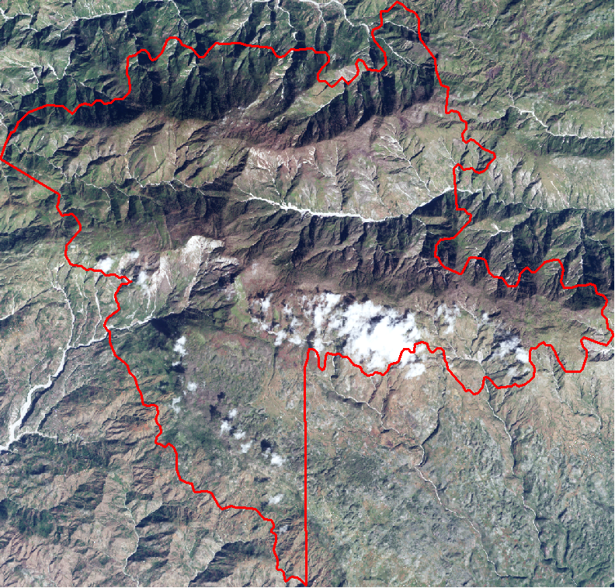
Technical Meeting #1 :
Example Vegetation monitoring / Macaya Park
Taking samples on the ortho-photo of 2014:
  Treed vegetation (31)
  Shrub vegetation (32)
  Vegetation dominated by grass (33)
  Open space without or with very little vegetation (51)
Data set for training, a second for validation

Slide 23
Technical Meeting #1 :
Example Vegetation monitoring / Macaya Park
Calculs of NDVI and Shadow Index
Indices Calculs of texture (Haralick Texture Extraction) : Entropy and Homogénéity (Inverse Different Moment)
Useful to delate cloud and the smooth classification
Random sampling in the reference database: 2000 points divided according to the proportion of each class
Crossing with the corresponding R-V-B-PIR-NDVI-SI-ENT-HOM values at the point

Slide 24
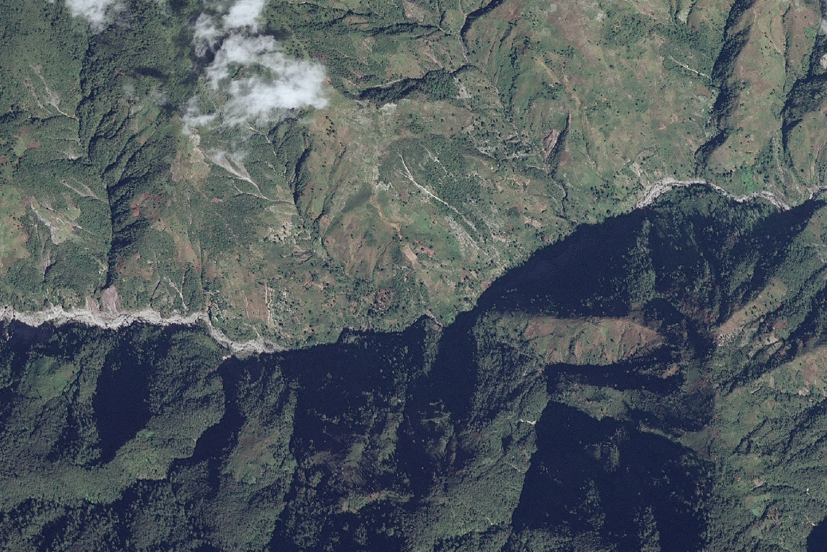
Technical Meeting #1 :
Example Vegetation monitoring / Macaya Park
January 2016

Slide 25
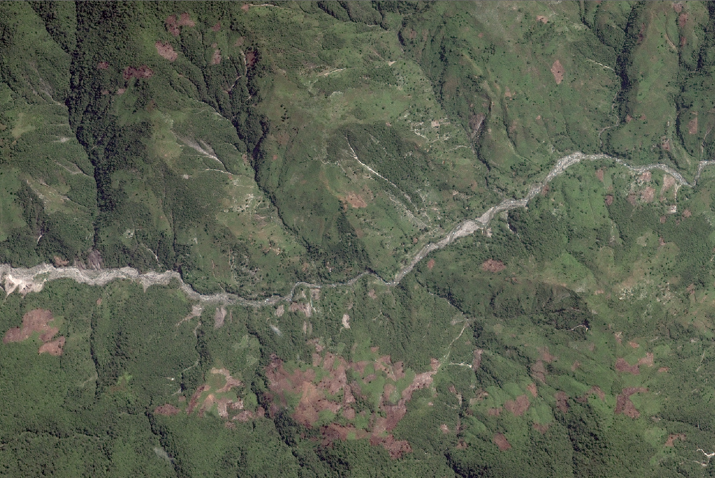
Technical Meeting #1 :
Example Vegetation monitoring / Macaya Park
June 2016

Slide 26
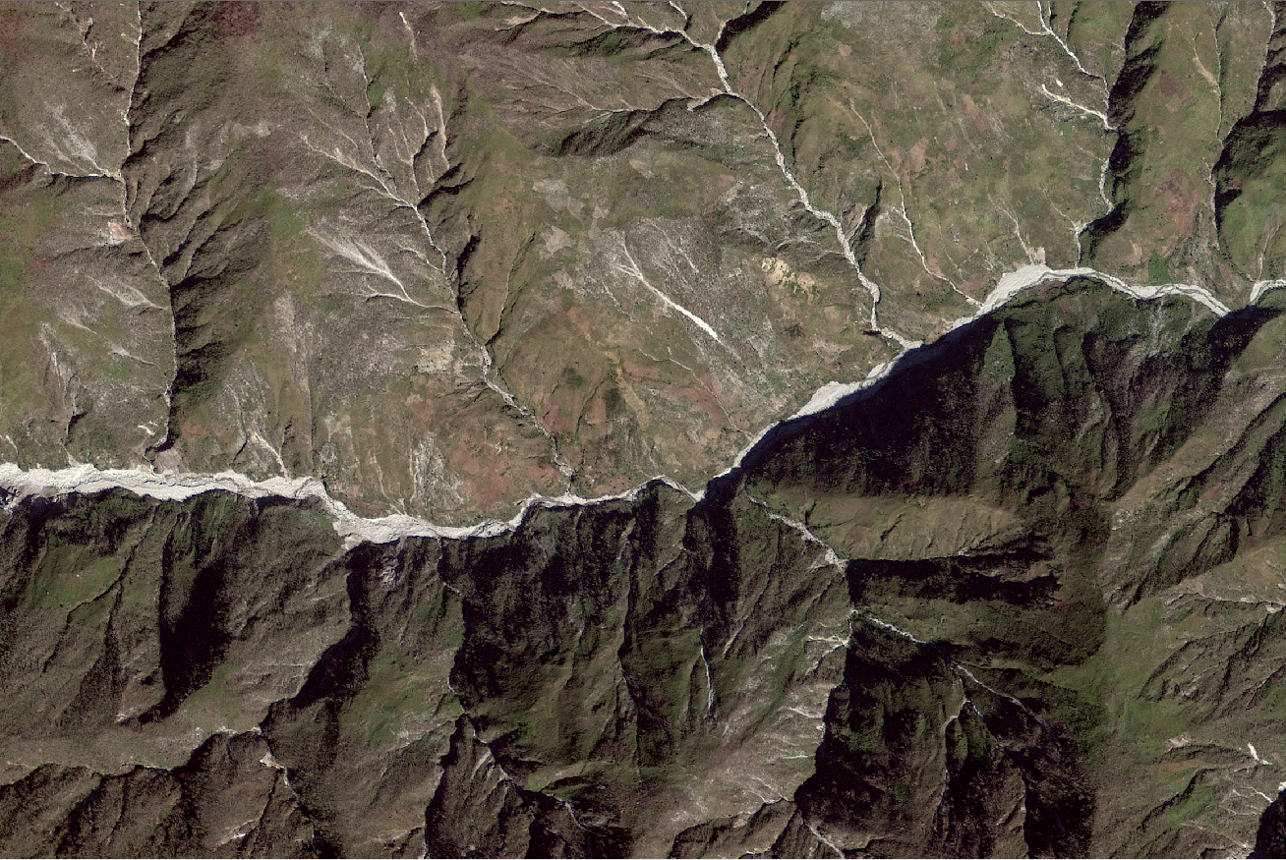
Technical Meeting #1 :
Example Vegetation monitoring / Macaya Park
February 2017

Slide 27
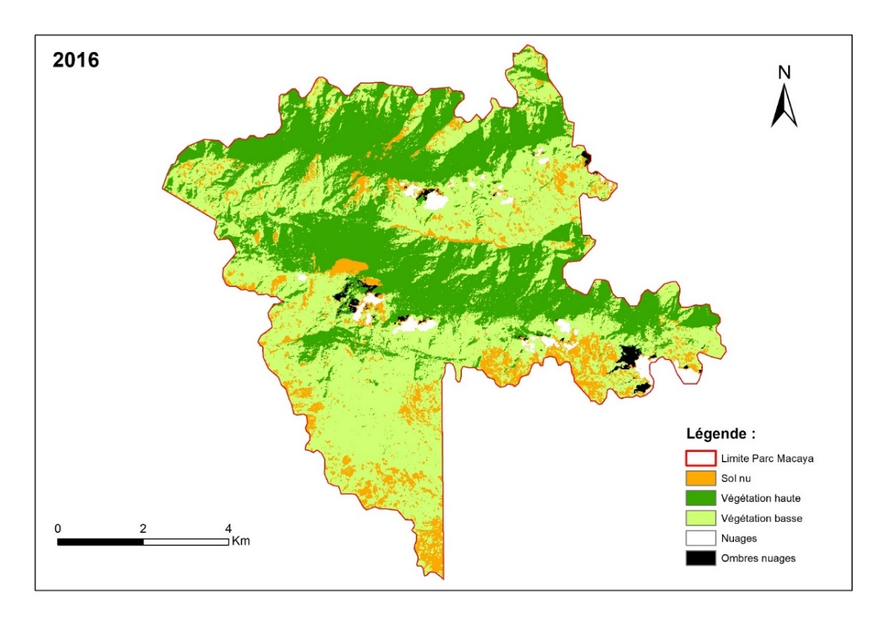
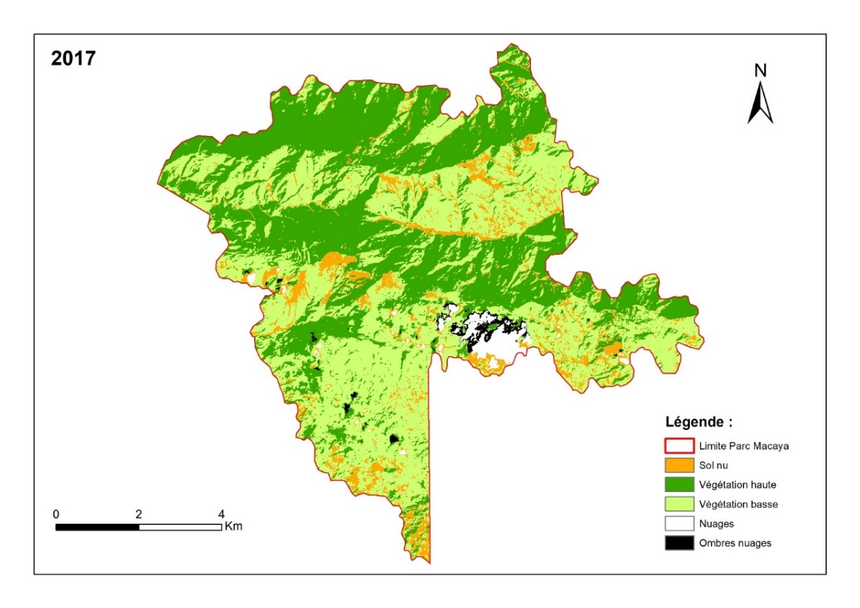
Produit exploratoire « Végétation »
Technical Meeting #1 :
Example Vegetation monitoring / Macaya Park
Preliminary Results
  Bare land : 7,34 km²
  High Vegetation : 26,71 km²
  Low Vegetation : 35,83 km²
  Other : 2,17 km²
  Bare land : 6,18 km²
  High Vegetation : 30,04 km²
  Low Vegetation : 33,73 km²
  Other : 2,11 km²
  Parc Macaya : 72,06 km²

Slide 28
Technical Meeting #1 :
Example Vegetation monitoring / Macaya Park
Preliminary Results
  No identification of plant species ... but type of vegetation (high and low)
  No cloudless images on this area (clouds on the ridges)
  Loss of information related to cloud shadow
  Need to have a very precise Digital Terrain Model to avoid a geometrical shift between images
  Confusion between bare soil and low vegetation, because dates in the dry season
  Confusion on the shaded slopes => better on summer
  No significant trend between 2016 and 2017

Slide 29

Satellite support for Risk Management in Haiti – an innovative example
The event aims to showcase the very rich experience currently underway in Haiti:
  International Charter Authorised User request;
  Hurricane Matthew RO;
  Copernicus Work in Haiti – rapid mapping and risk and recovery;
  RASOR Phase II;
  UNDP Risk Assessment Work;
  HaitiData.Org and the World Bank.
Tuesday, 15 May 09:00 – 11:00 in Capilla Room

Slide 30
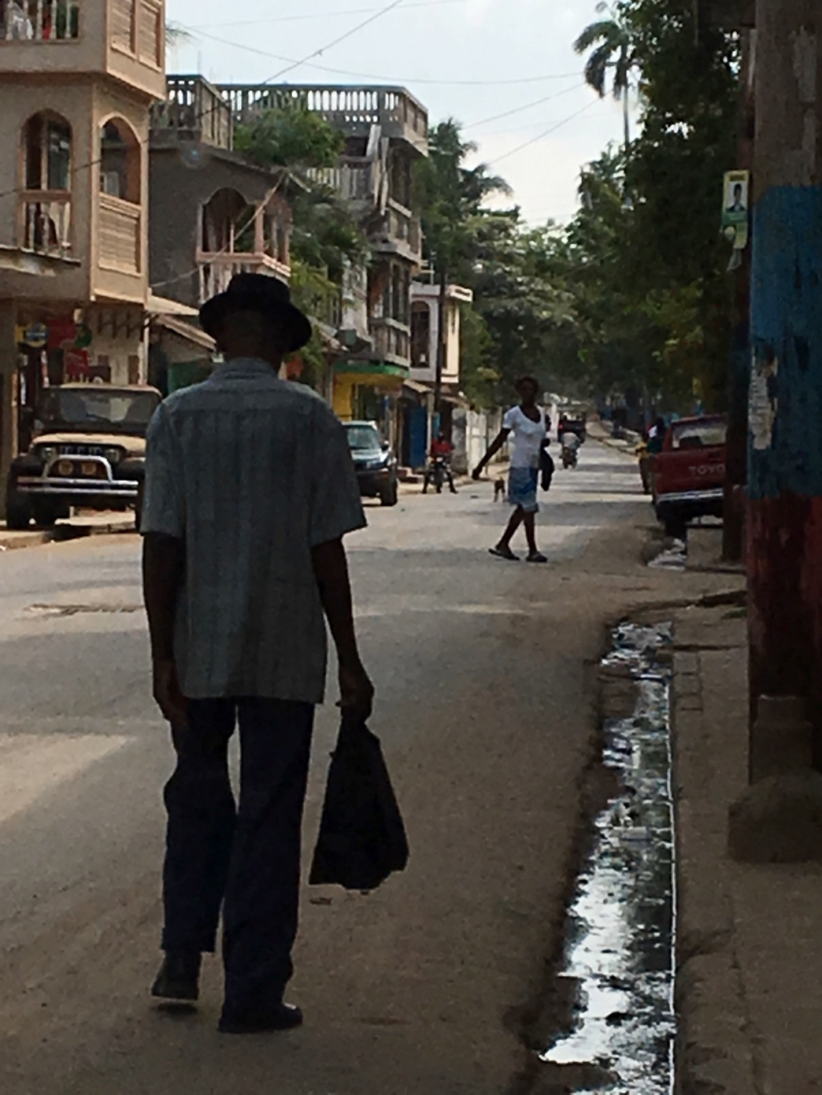
THANK YOU!
MERCI!
Photo: A. Eddy, 2017

