Slide 1
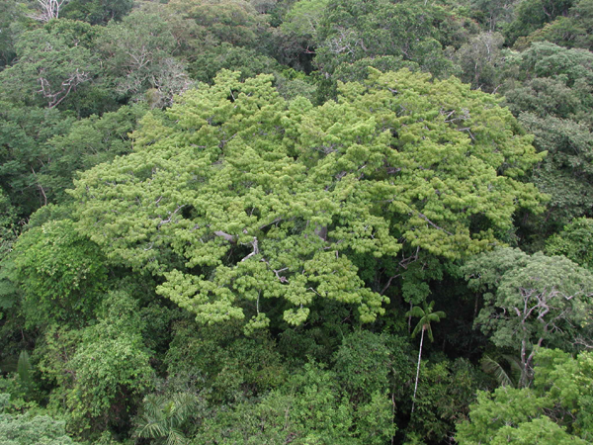
INPE’s Data Cube: results and perspectives
Lubia Vinhas and
e-sensing project team

Slide 2
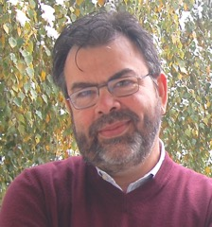
With many thanks to the esensing team…
Adeline
Ieda
Isabel
Karine
Lúbia
Michelle
Alber
Cartaxo
Gilberto Camara
Gilberto Queiroz
Pedro
Rodrigo
Rolf

Slide 3
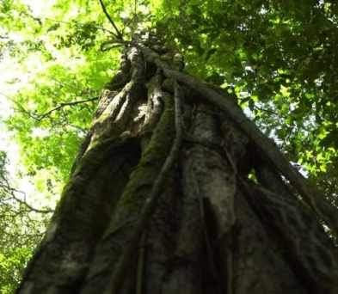
“A few satellites can cover the entire globe, but there needs to be a system in place to ensure their images are readily available to everyone who needs them. Brazil has set an important precedent by making its Earth-observation data available, and the rest of the world should follow suit.”

Slide 4
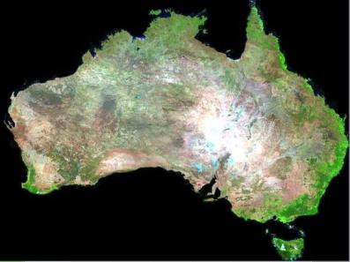
Big data requires new conceptual views
How best to use the information provided by big data sources to support public policies in Brazil?
Image source: Geoscience Australia

Slide 5
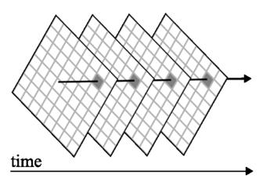
INPE’s data Cube meets user needs
Needs of research community
System architecture choices
New tools for big EO data analysis
Analytical scaling: algorithms developed at the desktop run on big databases
Cloud computing
Collaborative work: share results with the scientific community.
Replication: research teams can build their own infrastructure.
Data cubes optimized for time series

Slide 6
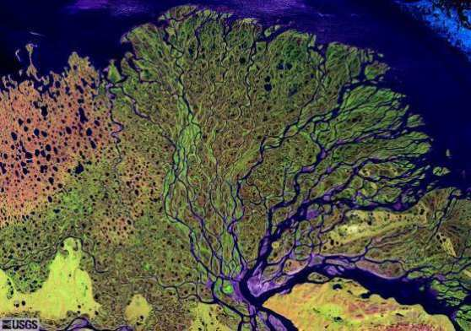
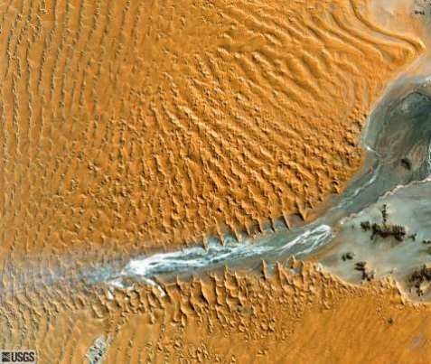
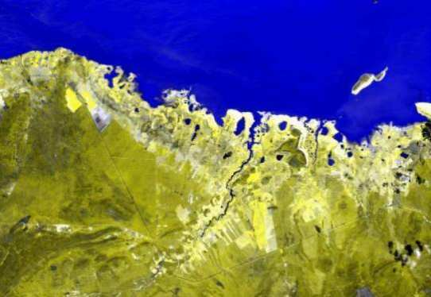
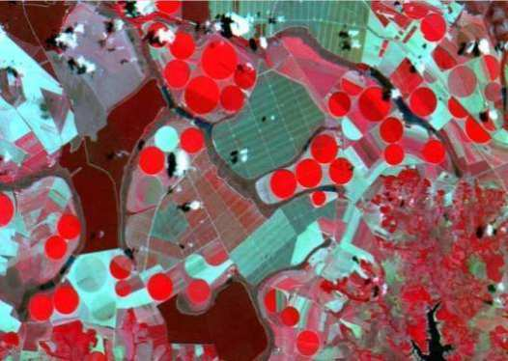
What are we looking for in big EO data?

Slide 7
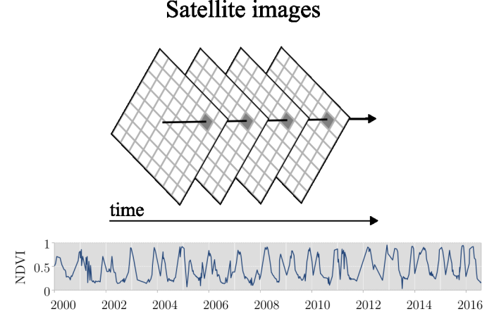
Motivation: image time series
Satellite Image Time Series
Notes:
7

Slide 8
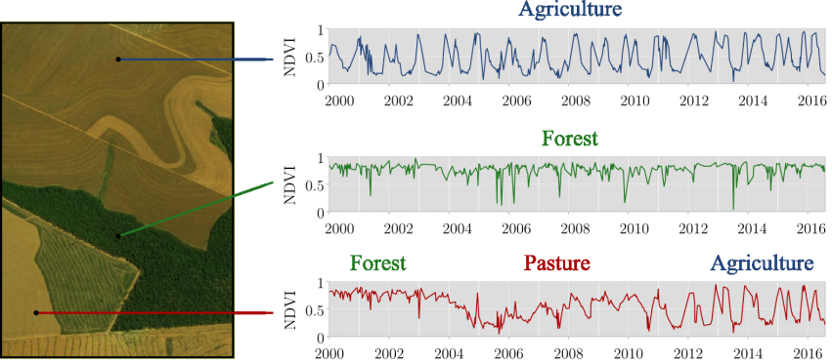
Land system trajectories derived from time series
“The transformations of land cover due to actions of land use”
graphics: Rolf Simoes

Slide 9
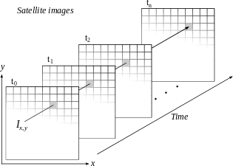
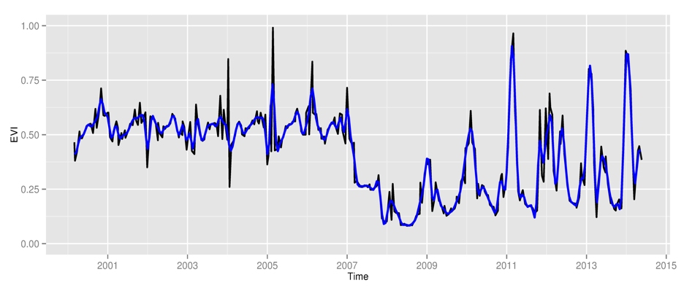
Space first, time later or time first, space later?
Space first: classify
images separately
Compare results in time
Time first: classify
time series separately
Join results to get maps

Slide 10
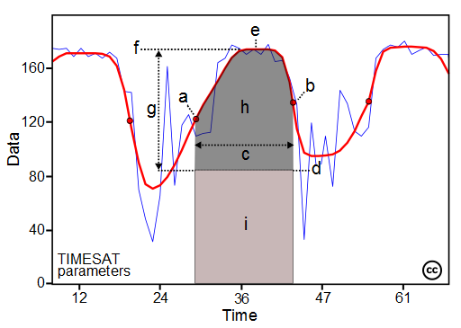
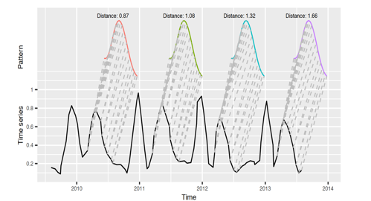
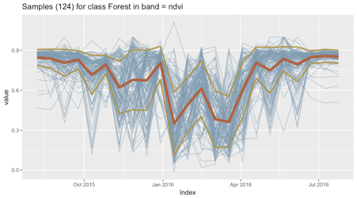
Time series & LULC classification
TIMESAT
TWDTW
Our approach
Machine Learning
Dimension
Reduction
Shape
matching
High-dimensional
input space
Process-based
classifier
Minimum distance
classifier
Machine learning
predictors
Existing applications
Maus et al.(2016)
e-sensing
research
Notes:
10

Slide 11
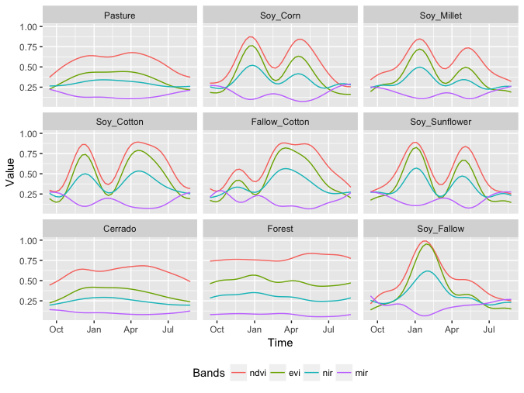
Temporal patterns of different classes

Slide 12
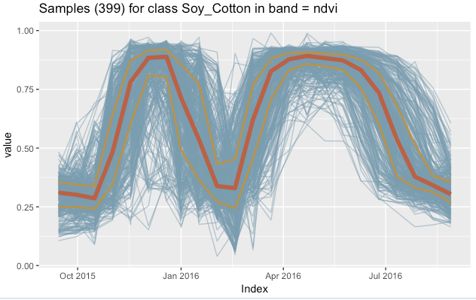
Use all the data: more is better!
Current applications of image time series select ”best pixels”. We use all of the data. Nothing is discarded!

Slide 13
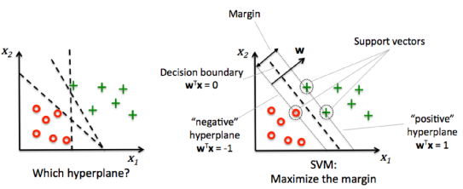
SVM: maximal margin classifier
SVM classifiers are simple to train and robust to outliers
(good samples = good classification results)

Slide 14
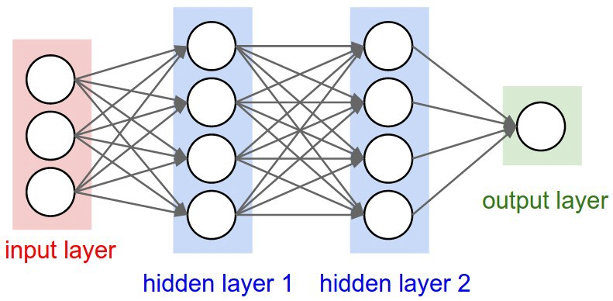
Deep learning
Function estimation by repeated approximation

Slide 15
Deep learning trainning example
Samples for Mato Grosso (2,200): 3 layers of 512 neurons, ”elu” activation, dropouts (40%, 40%, 30%), adam_optimizer

Slide 16
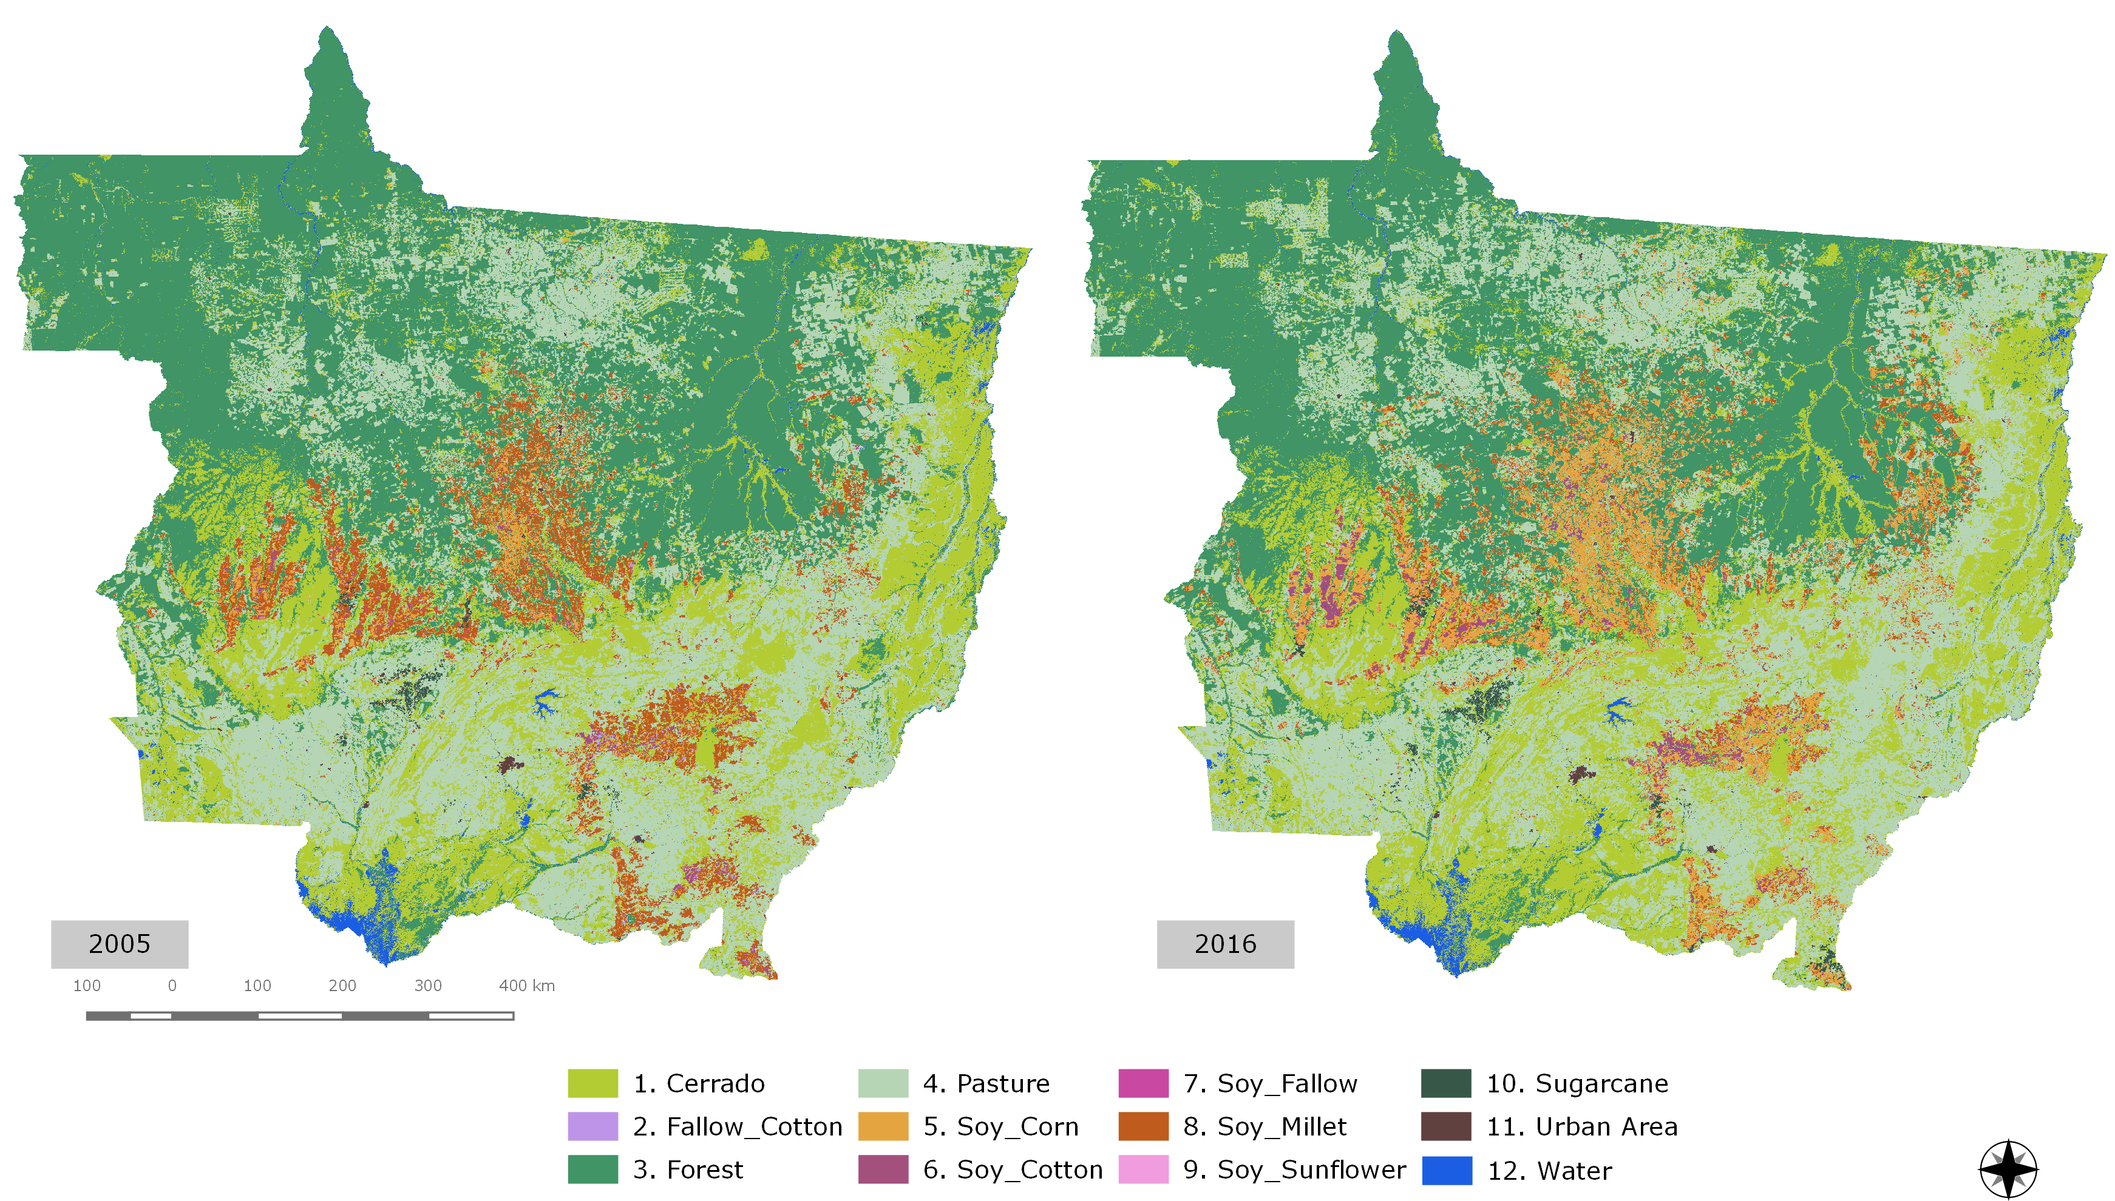
Mato Grosso – Brazil’s agricultural frontier
Land change dynamics (2001-2017)

Slide 17
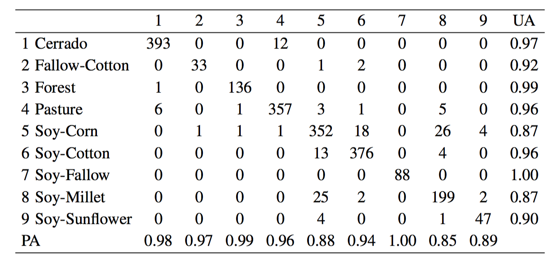
Mapping land use change (5-fold validation)
Overall validation accuracy of 94% (svm)

Slide 18
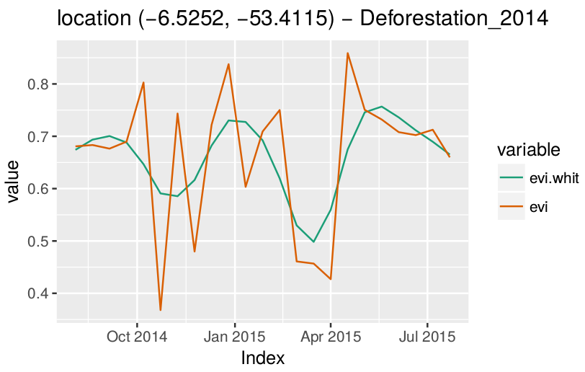
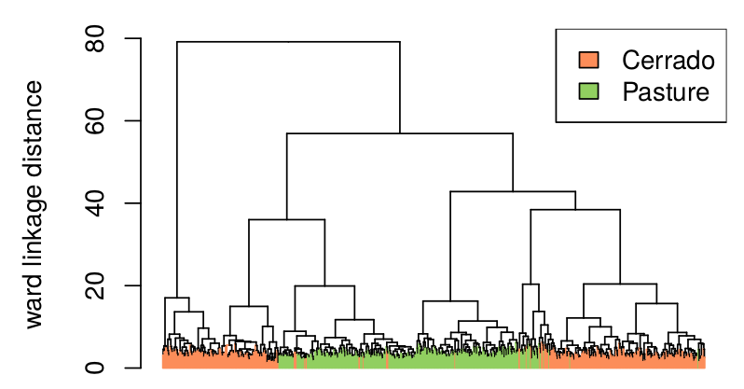
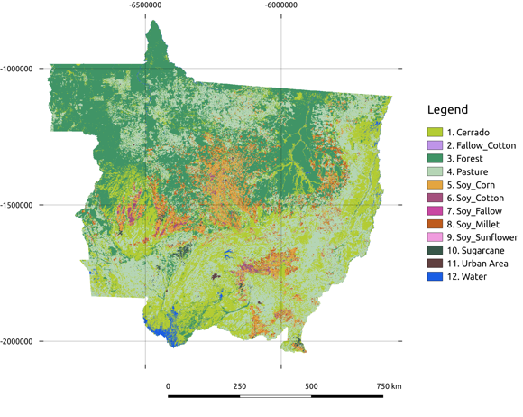
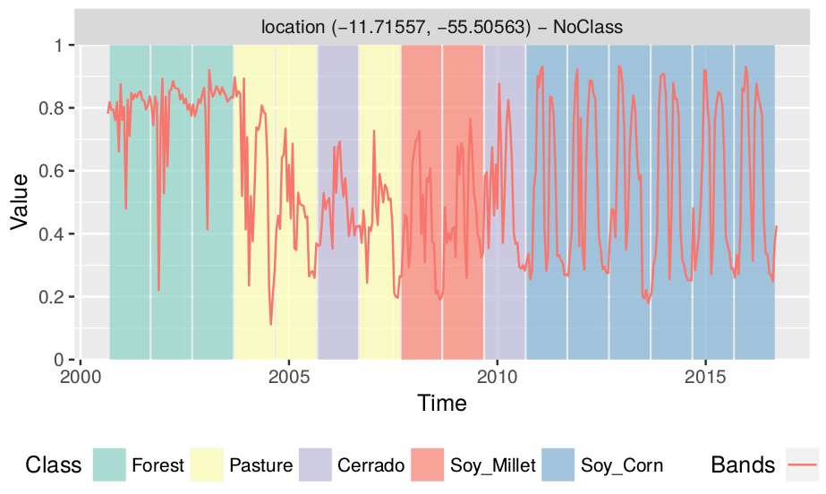
SITS – an R package for image time series
SITS package (R language)
Source: Paper 2
https://github.com/e-sensing/sits
Notes:
Each prototype is a time series that represents a cluster according to a given criterion. It summarises some chosen characteristic of the elements of a cluster. The literature points out that the quality of the clustering process is highly dependent on the prototype
18

Slide 19
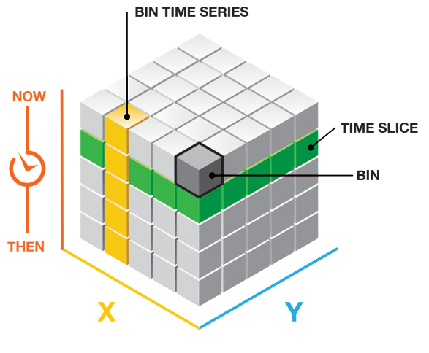
Not all data cubes are alike!
image: ESRI
Google Earth Engine: organized as 2D images over multiple machines (good for space-first, not fit for time-first)
INPE’s Data Cube: currently organized as temporal bricks (good for time-first, not so good for space-first)
Can a Data Cube be organized to meet both space-first and time-first efficient processing?

Slide 20
Mixed LANDSAT8-MODIS bricks for Brazil
1 year, 23 instances, 4 bands: 35.4 GB
1 Scene
65,530 samples (SVM classifier)
13 LULC classes for Cerrado biome
4h40” processing in Amazon EC2/S3
(32 CPU, 244 GB)
95% match with visual interpretation

Slide 21
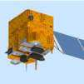
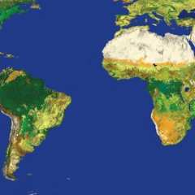
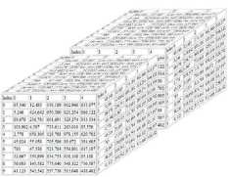
Global Land Observatory: describing change in a connected world
Methods for land change for forestry and agriculture uses
40 years of LANDSAT + 12 years of MODIS + SENTINELs + CBERS
Unique repository of knowledge and data about global land change

