Slide 1
Vietnam Data Cube experience
Vietnam Cube background
Vietnam Cube official release
Vietnam Cube in pictures
Vietnam Cube what’s next
Considerations for CEOS
Vietnam National Space Center
Vietnam Academy of Science and Technology
http://datacube.vn - Publicly accessible
Landsat 5/7/8, ALOS, S-1, ASTER
Collaborative application development with Py Notebooks

Slide 2
Vietnam Data Cube background
Vietnam National Space Center (VNSC)
Began with ODC after CEOS Plenary in Nov 2016
CSIRO, SEO and Symbios working with VNSC to support their capability and capacity build
VNSC is a Unit of Vietnam Academy of Science and Technology
VNSC / VAST - Next CEOS Chair
VNSC Plan 2015 to 2025 (very brief!)
Satellite development with JAXA. LOTUSat-1 launch in 2019
Ground segment
Applications = Vietnam Data Cube
Industry links and co-funding

Slide 3
Vietnam Cube official release - 6 March 2018, Hanoi
CEOS support over past 18 months
International partners
CEOS SEO, CSIRO
USGS
JAXA, RESTEC
CNES
ODC deployment and capacity
Software and training (SEO, CSIRO)
Hardware and maintenance (IMSG)
Strategic support (Symbios)
ARD preparation and transfer to VN
Landsat (USGS, SEO)
ALOS, PALSAR (JAXA, RESTEC)
Sentinel-1 (SEO, CSIRO, CNES)
ASTER DEM (SEO)
Application domains
Forests (GFOI)
Rice (Asia-Rice, JAXA/RESTEC, CNES)
Water extent and quality and mangroves (Mekong, Red River, Coastal, MRC)

Slide 4
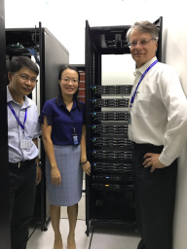
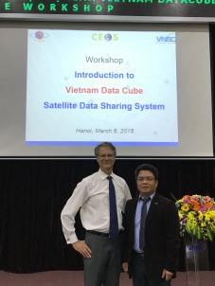
Vietnam Data Cube pictures
and examples

Slide 5
Nga et al,
VDC workshop, Hanoi 6 March 2018

Slide 6
Nga et al,
VDC workshop, Hanoi 6 March 2018

Slide 7
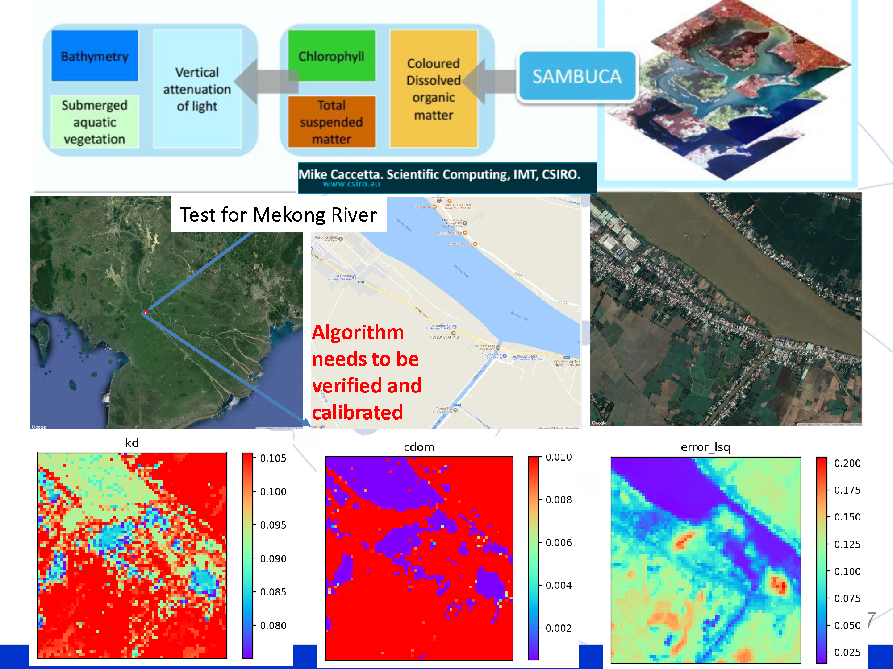
Nga et al,
VDC workshop, Hanoi 6 March 2018

Slide 8
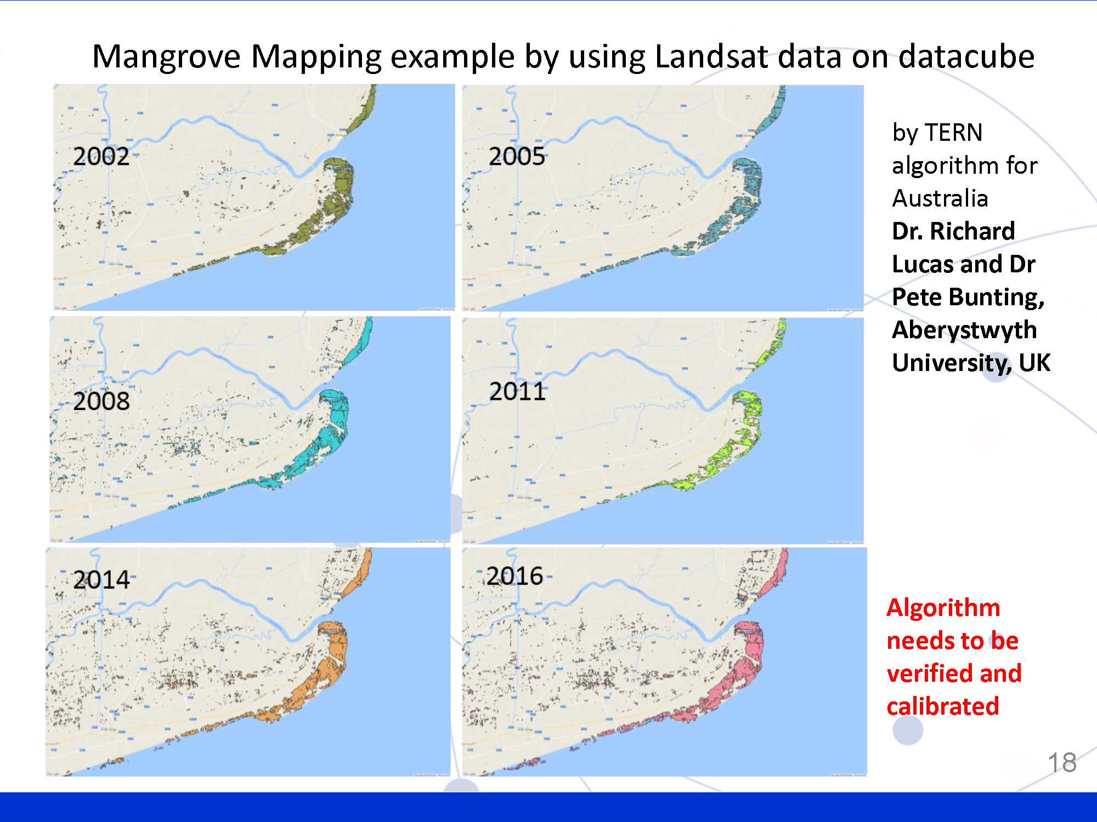
Nga et al,
VDC workshop, Hanoi 6 March 2018

Slide 9
Vietnam Data Cube – What’s next
With the CEOS and ODC communities
Improved data management tools
Full coverage with S-1
UI customisations
Application development
Director Tuan,
VDC workshop, Hanoi 6 March 2018
With domestic and int’l partners
Capacity building
Strategic positioning
Application partnerships

Slide 10
Considerations for CEOS (“user” perspective)
Data access and preparation
VNSC-JAXA MOU for ALOS. USGS has recently provided full coverage Landsat SR
>> Can CEOS present a “one stop shop”
Regional partnerships
Mekong River Commission looking to build on Vietnam’s experience
>> CEOS can support and champion regional capacity building
Open source tools
ODC and SEO UI are a good start
>> Need to improve User guides and Customisation for general uptake
International partners
Many CEOS agencies have projects in Vietnam and the region
>> Opportunity to identify common goals and leverage activities

Slide 11
Thank you
Team VNSC:
Pham Anh Tuan – Director
Vu Anh Tuan – Vice Director
Dr. Nga – Head of Imagery and Informatics
Lam Dao Nguyen – Head of Remote Sensing and GIS
Ms. Linh – International Cooperation
Kien Nguyen – IMSG
… and many others
Credits:
Brian Killough, CEOS SEO, and the AMA team
Alex Held and Matt Paget, CSIRO
Shin-ichi Sobue, JAXA, and colleagues
Steve Labahn, USGS

