Slide 1
Best Practices Learned while Exploring Cloud-Native Architectures for NASA EOSDIS Applications and Systems
Dan Pilone
Chief Technologist, NASA EED2 Contract dan@element84.com
The material is based upon work supported by the National Aeronautics and Space Administration under Raytheon Contract Number NNG15HZ39C. This document does not contain technology or Technical Data controlled under either the U.S. International Traffic in Arms Regulations or the U.S. Export Administration Regulations.

Slide 2
Notes:
EJD 10/20/16 changed dates of SAGE III and LIS to 2017
Fleet - Earth Science Division - Missions (with color key; editable)
Dec. 15, 2015
Credit: NASA/J. Mottar
------------------------------
SLIDE INFO
CORRECTION DENNING PER RIVERA Feb 18, 2016
Changed misspelling of “Sentinal” to “Sentinel”
UPDATE DENNING PER FREILICH DECISIONS FEB 12, 2016
Changed OCO-3 to Formulation color and moved lower in list
Changed RBI to Formulation color
Changed GEDI to Implementation color and moved to line above it
Added TSIS-2 in Formulation color
UPDATE DENNING PER FREILICH DECISIONS FEB 4, 2016
Changed “Altimetry FO (Formulation in FY16) to “Sentinal-6A/B”
On Landsat 9, removed comma and TIRFF
Change I was going to make – “NISTAR, EPIC (NOAA’s DSCOVR) to green primary ops was already corrected
Dec. 15, 2015 – Updated: TEMPO changed to Implementation phase; NISTAR, EPIC changed to Primary Ops phase; ; OCO-3 and ECOSTRESS changed to Implementation phase; Aquarius removed; slide now fully editable. JMottar
May 18, 2015 – Added to SMD Multimedia Library.
May 18, 2015 – Updated the outdated 2014 version: TRMM was removed; NISTAR, EPIC (NOAA's DSCOVR) were added; SMAP icon was updated; moon at top left was removed; color key moved to top left.-JMottar
ID: I-EA-15-0040 (image)
ID: SL-EA-15-0068 (slide)

Slide 3
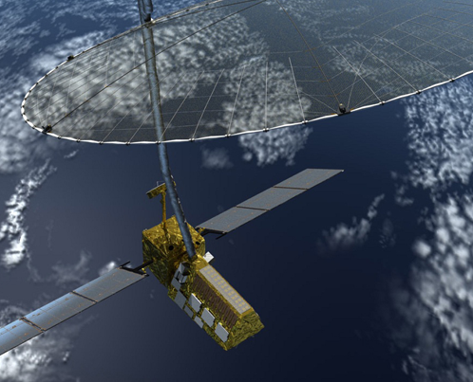
NISAR Facts
80 TBs/day
generation
400 TBs/day
reprocessing
Most networks can’t handle sustained 50 Gbps
Processing times for creating scenes, times to create time-series
150 PBs @ 50 Gbps
processing speed for months
300 GB
Granules
150 PBs @ 50 Gbps
processing speed for months
300 GB
Granules

Slide 4
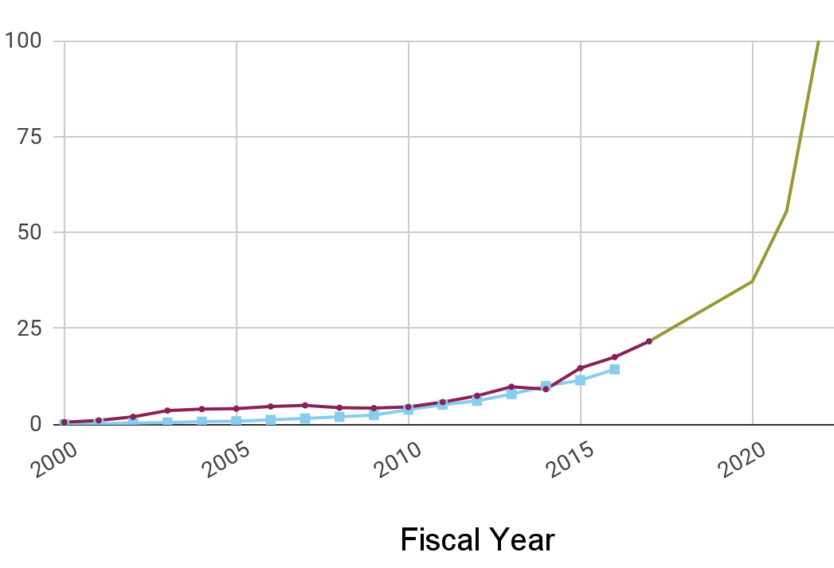


EOSDIS Data System Evolution
EOSDIS is the premier Earth science archive, but we are always looking for ways to improve
The current architecture will not be cost effective as the annual ingest rate increases from 4 to 50PB/year
It will become increasingly difficult and expensive to maintain and improve our current system as data volumes and research demands continue to increase exponentially
EOSDIS is developing open source cloud native software for reuse across the agency and throughout the government
Petabytes
Cloud offers benefits like the ability to analyze data at scale, analyze multiple data sets together easily and avoid lengthy expensive moves of large data sets allowing scientists to work on data “in place”

Slide 5
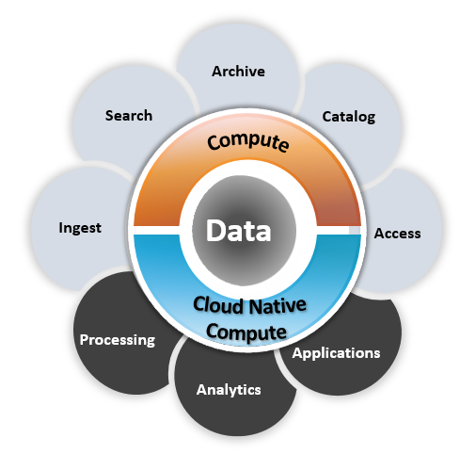
Conceptual ‘data close to compute’
Bring customers to the data
Large volume data storage: Centralized mission observation and model datasets stored in auto graduated AWS object storage (Amazon S3, Amazon S3 IA, Amazon Glacier)
Scalable compute: Provision, access, and terminate dynamically based on need. Cost by use
Cloud Native Compute: Cloud vendor service software stacks and microservices easing deployment of user based applications
EOSDIS applications and services: Application and service layer using AWS compute, storage (Amazon S3, Amazon S3 IA, Amazon Glacier), and cloud native technologies
Non-EOSDIS/public applications and services: Science community brings algorithms to the data. Support for NASA and non-NASA
The operational model of consolidating data—allowing users to compute on the data in place with a platform of common tools—is natural to cloud; it is a cost-effective way to leverage cloud and could be applicable to many businesses and missions

Slide 6
Best Practices
Technical
Cost
Psycho-Social

Slide 7
Enable Cloud native architectures by strongly preferring cloud services
Technical Lesson 1
Notes:
Cloud-native architectures are a fundamentally different way of building applications

Slide 8
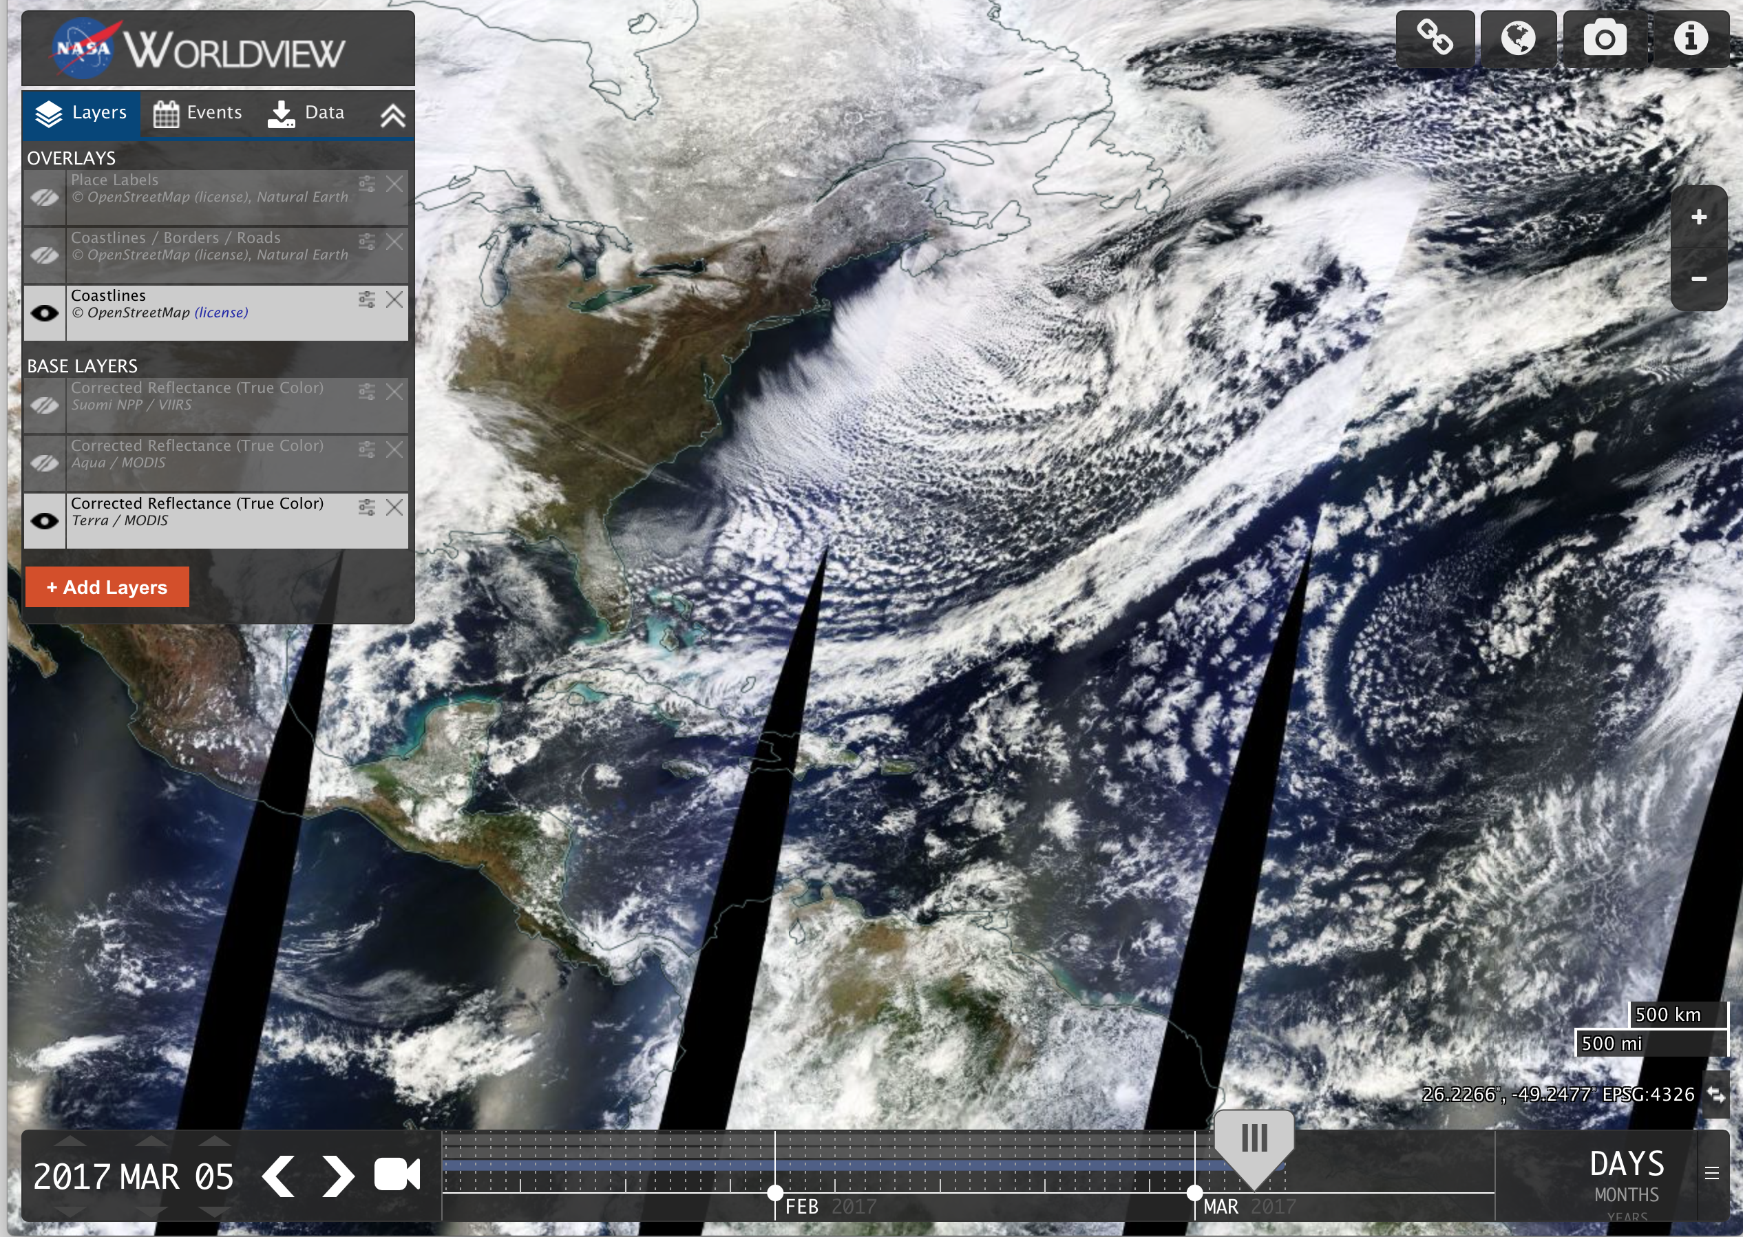

Slide 9
Global Imagery Browse Service (GIBS) in the Cloud Service Swap
Ops Console
Infrastructure
Install
AWS
(Cloud Form.)
Inventory
AWS
(S3)
CM
AWS
(Cloud Form.)
Subscription Service
AWS
(SNS / SQS)
Authentication
AWS / NASA
(IAM / NAMS)
Scheduler / Dispatcher
ZooKeeper
Manager
AWS
(Dynamo / SQS)
SigEvent Server
AWS (CloudWatch)
Product Config
Generation
MRF Gen
Product Configs
Handlers
Custom Software
Cloud Services
External NASA/GIBS Library
Data

Slide 10
GIBS-in-the-Cloud Ingest and Processing
Infrastructure
AWS
Scheduler
(66 LoC)
Dispatcher
(106 LoC)
Product Config
Handlers
Generation
MRF Gen
Notes:
By leveraging AWS services, the initial implementation of GIBS in the cloud ingest and processing was reduced to ~200 LoC.

Slide 11
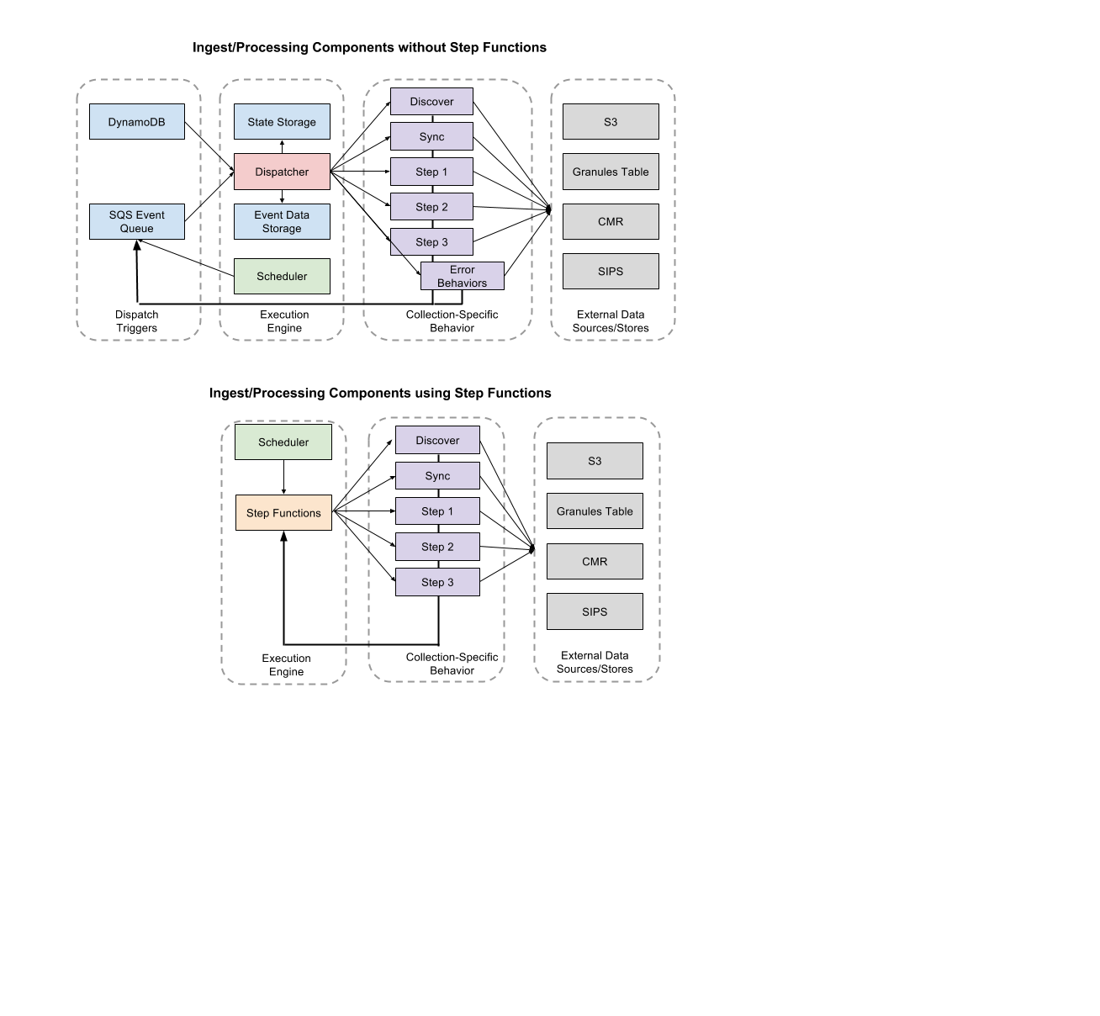

Slide 12
Managed Services Drive Innovation
Instances to Containers
  Greater segregation of functionality
  Movement toward services over monoliths
Software on an Instance to AWS Service
  ElasticSearch to AWS ElasticSearch
  RabbitMQ to AWS SQS
  Etc.
And bigger changes… (more on that later)

Slide 13
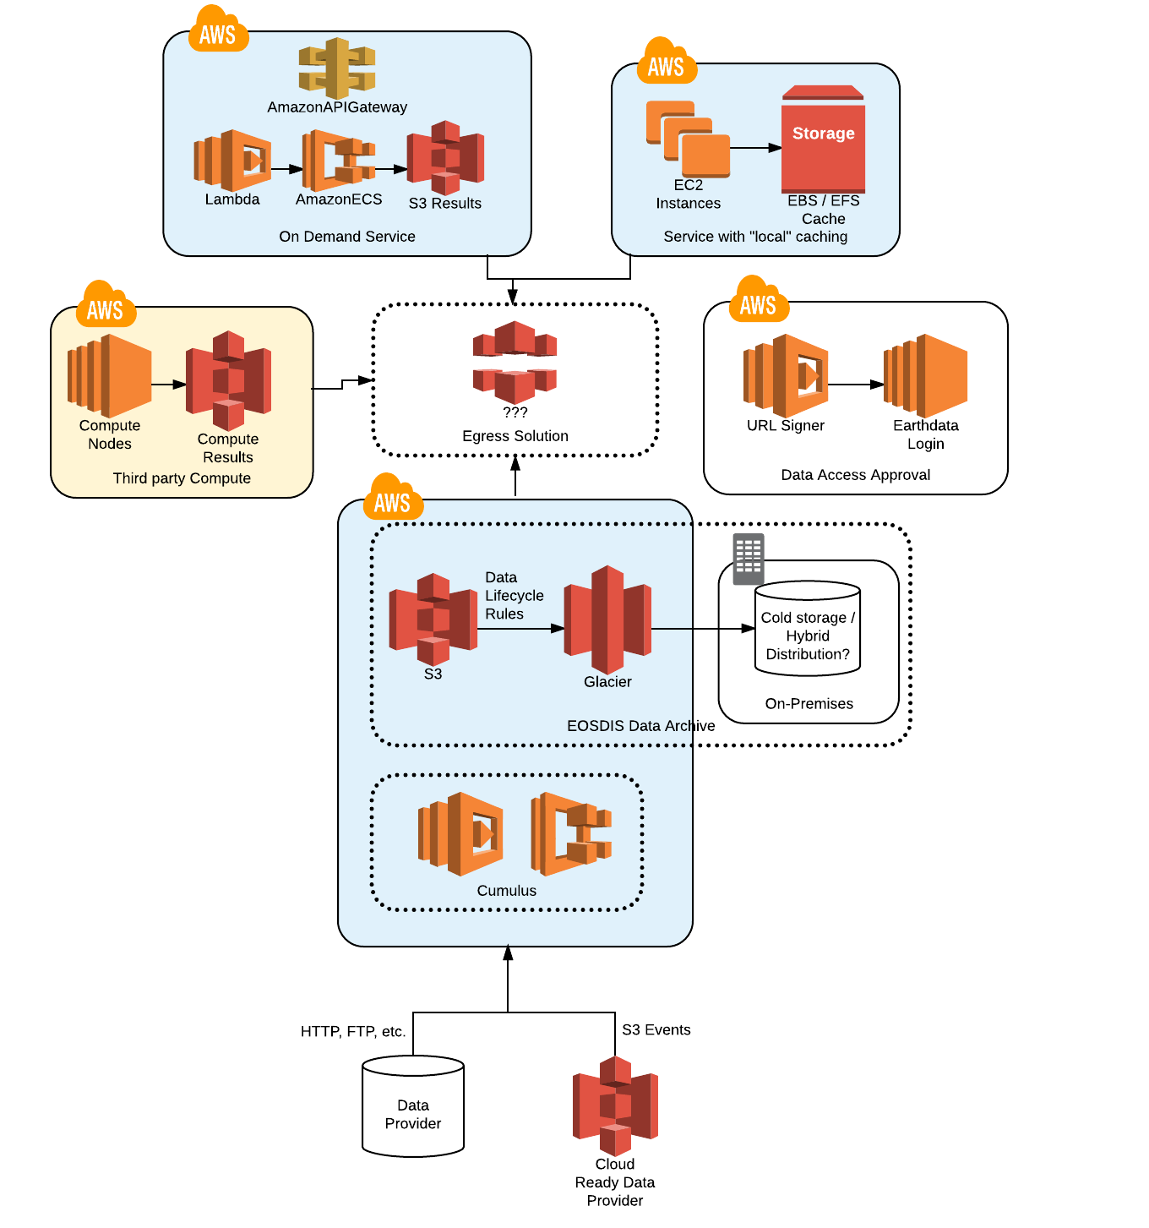
Cloud scale science data
Data can be generated at scale in AWS and placed in accessible buckets, avoiding massive data moves
Ingest, archival, validation, processing, etc. can scale dynamically based on incoming data streams, reprocessing needs, etc.
Entire petabyte scale archive is directly accessible, with no transfer time or costs, to science users in the same region for longtime series or multiproduct use
Data processing, transformation, and analysis services can be spun up, NASA funded or completely independently, leveraging the data with scalable compute and cost and access-managed output targets.
Notes:
Now we have a cloud framework that lets us scale in all directions.

Slide 14
Aws has very low internal latency – but trust nothing.
Technical Lesson 2
Notes:
CMR Example:
During our performance testing many elasticsearch requests were returning in as little as 2 ms. In our current ops environment we have never seen less than 3 ms.
Why does it matter for CMR?
CMR search performance is critical.
The CMR is made up of several (currently 10) microservices which communicate with one another via HTTP requests. A single search request can involve several HTTP calls to other microservices, queries to Oracle, and queries to Elasticsearch.

Slide 15
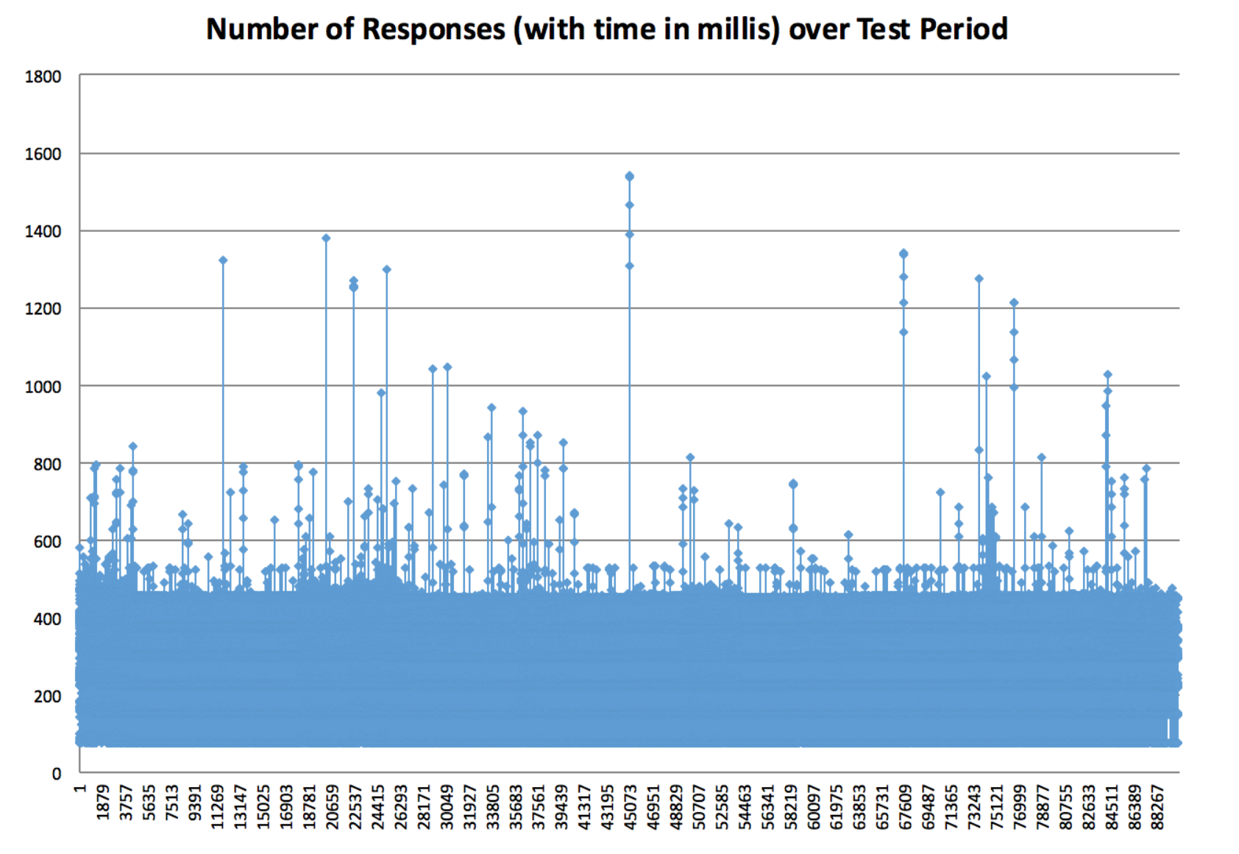
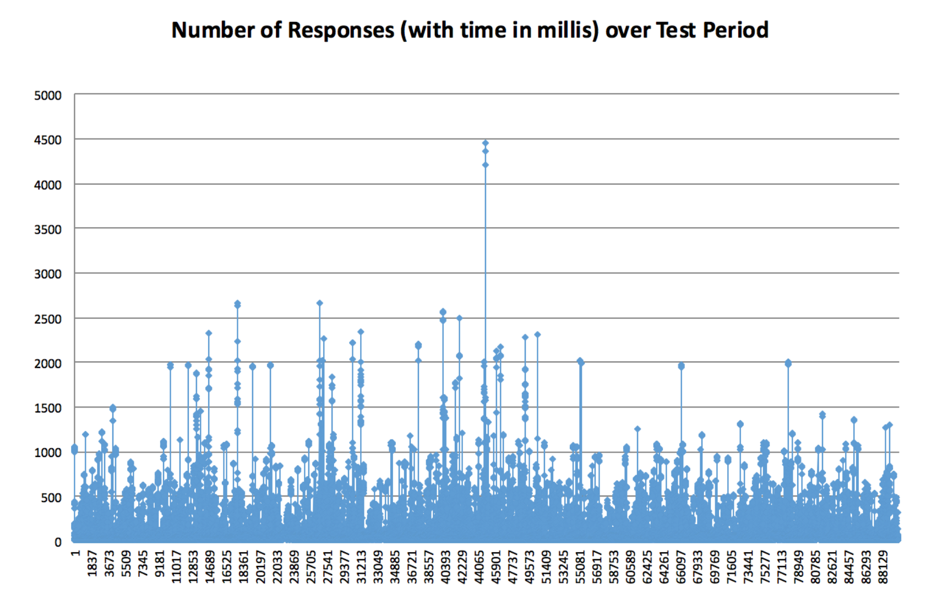
ms
On premises implementation showed consistent performance during load testing vs more sporadic latencies in AWS.
ms

Slide 16
Involve security from the very beginning
Technical Lesson 3
Notes:
Both technically and organizationally

Slide 17
NGAP as a Platform
NGAP Services
(Monitoring, Logging, Security, Autoscaling, Billing, etc.)
NASA’s Office of the Chief Information Officer
(AWS Reseller)

Slide 18


Layer security thoughout the architecture
NGAP Secured Components
- ESDIS “blessed” component
NASA Development Infrastructure
Application Builder
App Source Code
Application
Application
Application
NGAP Services
(Monitoring, Logging, Security, Autoscaling, Billing, etc.)
Usable cloud “platform”
NASA Office of the CIO
(AWS Reseller)

Slide 19
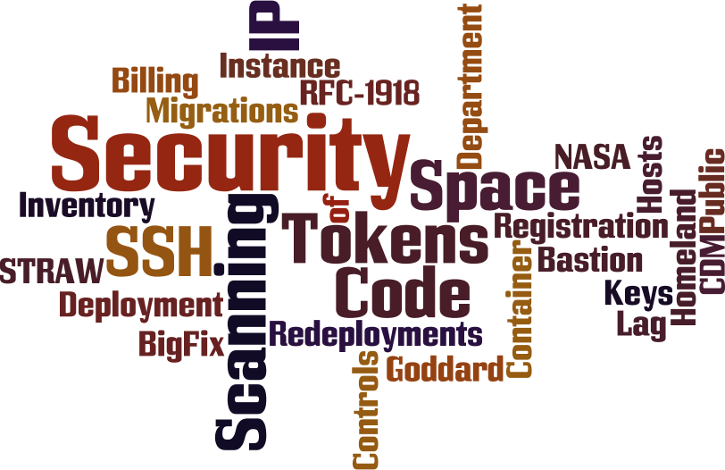
* Generated via http://wordle.net

Slide 20
Modeling total cost of ownership (TCO) is extremely complicated
Cost Lesson 1

Slide 21
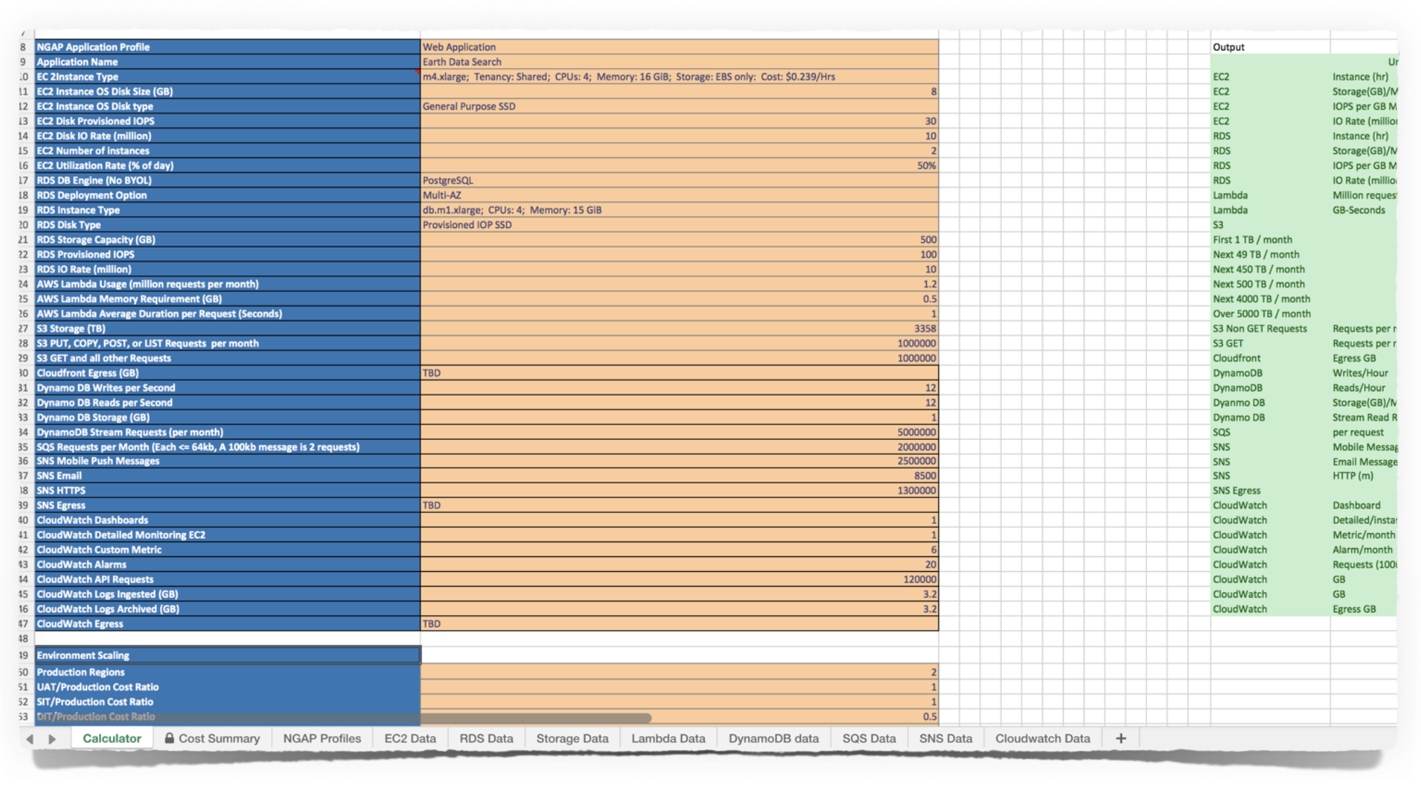

Slide 22

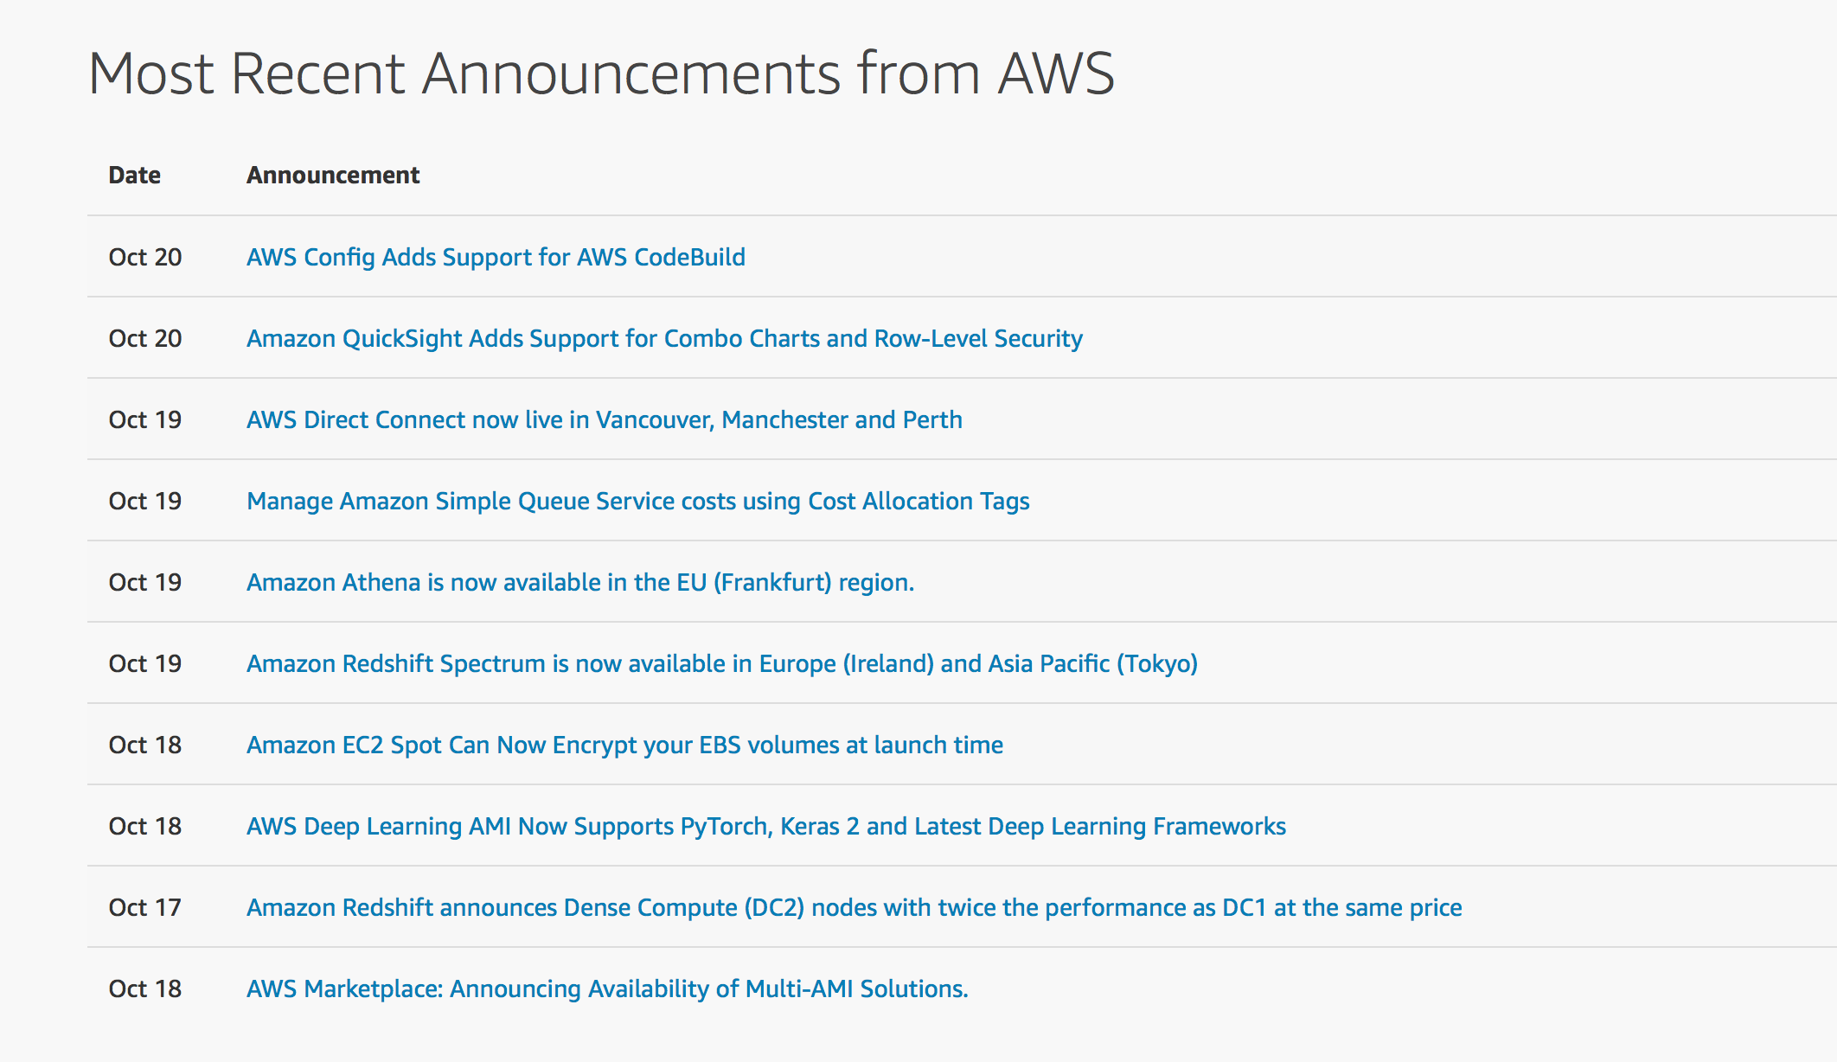
OCTOBER 17-20, 2017 AWS announcements!
Notes:
AWS introduces new / improved / reduced cost services _constantly_. Unofficial count puts it at 719 SO FAR in 2017, or over 70 / month on average.

Slide 23







internet
NASA TIC
NASA TIC
End User AWS Account
EMCC GP_MCE AWS Account
JPL AWS Account
ASF DAAC
Amazon S3
“Landing Zone” bucket
Amazon EC2
ASF DAAC
Amazon EC2
Ingest
Processing
us-west-2 region
JPL
Amazon EC2
SDS Processing
ASF DAAC
Amazon S3
“Serving” buckets
NGAP Platform
NGAP and Trusted Internet Connections (TIC)
us-west-2 region
us-west-2 region

Slide 24
Egress (in particular) is a big deal
When data leaves your application, service, data store, etc. …
  …and goes to another region
  …and goes outside of AWS
Egress is expensive
  Rack Rates: $0.08/GB after first 150TB
  In other words, a significant portion of total monthly cloud-associated costs

Slide 25
This is before considering…
User behavior
Staff cost savings
Development cost savings
Inter-region costs
Data lifecycle modeling
Application migration costs – both in and out
Managing “consumption” based cost model

Slide 26
Amazon provides the information and empowers the user
Amazon wants to inform but not limit
  AWS is happy to email you
  AWS is happy to let you know what you’re spending
  AWS (reasonably) cannot force action, because “the action” is not standard

Slide 27
Explore alternative architectures for possible cost savings
Cost Lesson 2

Slide 28

Basic S3 Egress
S3
Internet

Slide 29

S3 with CloudFront
S3
CloudFront
Internet

Slide 30


S3 through Direct Connect to
On-premises Distribution Pipe
S3
Internet
Direct Connect

Slide 31



Request Limiting using Lambda and API Gateway
S3
Internet
Lambda
API Gateway
DynamoDB

Slide 32
Egress costs range more than 13x across those models.

Slide 33
Favor Re-architecture over
“just getting into the cloud”
Managed Services
Natural Inflection Point
Opportunity for Innovation
Better leverage cloud cost models

Slide 34
Go hands-on quickly
Psycho-Social
Notes:
We talked, we provided training, but ultimately what seems to have best conveyed the potential of leveraging cloud computing as well as changed thinking was…

Slide 35

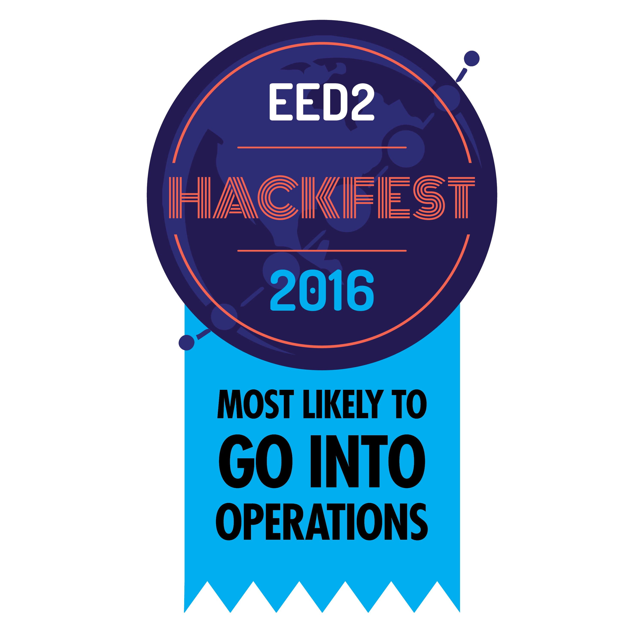
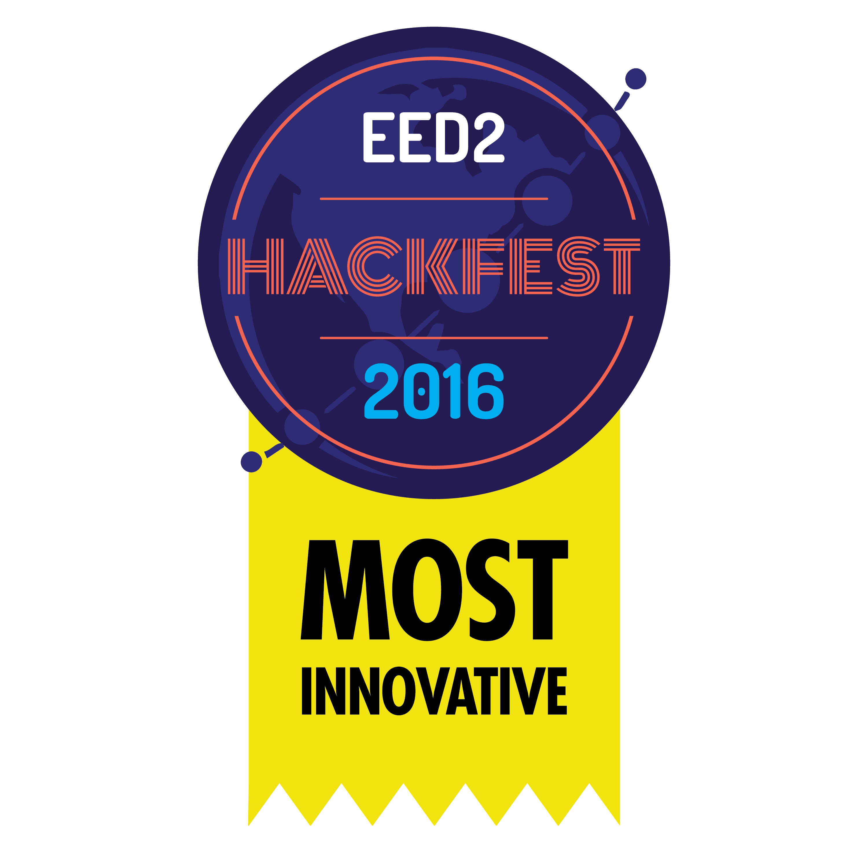
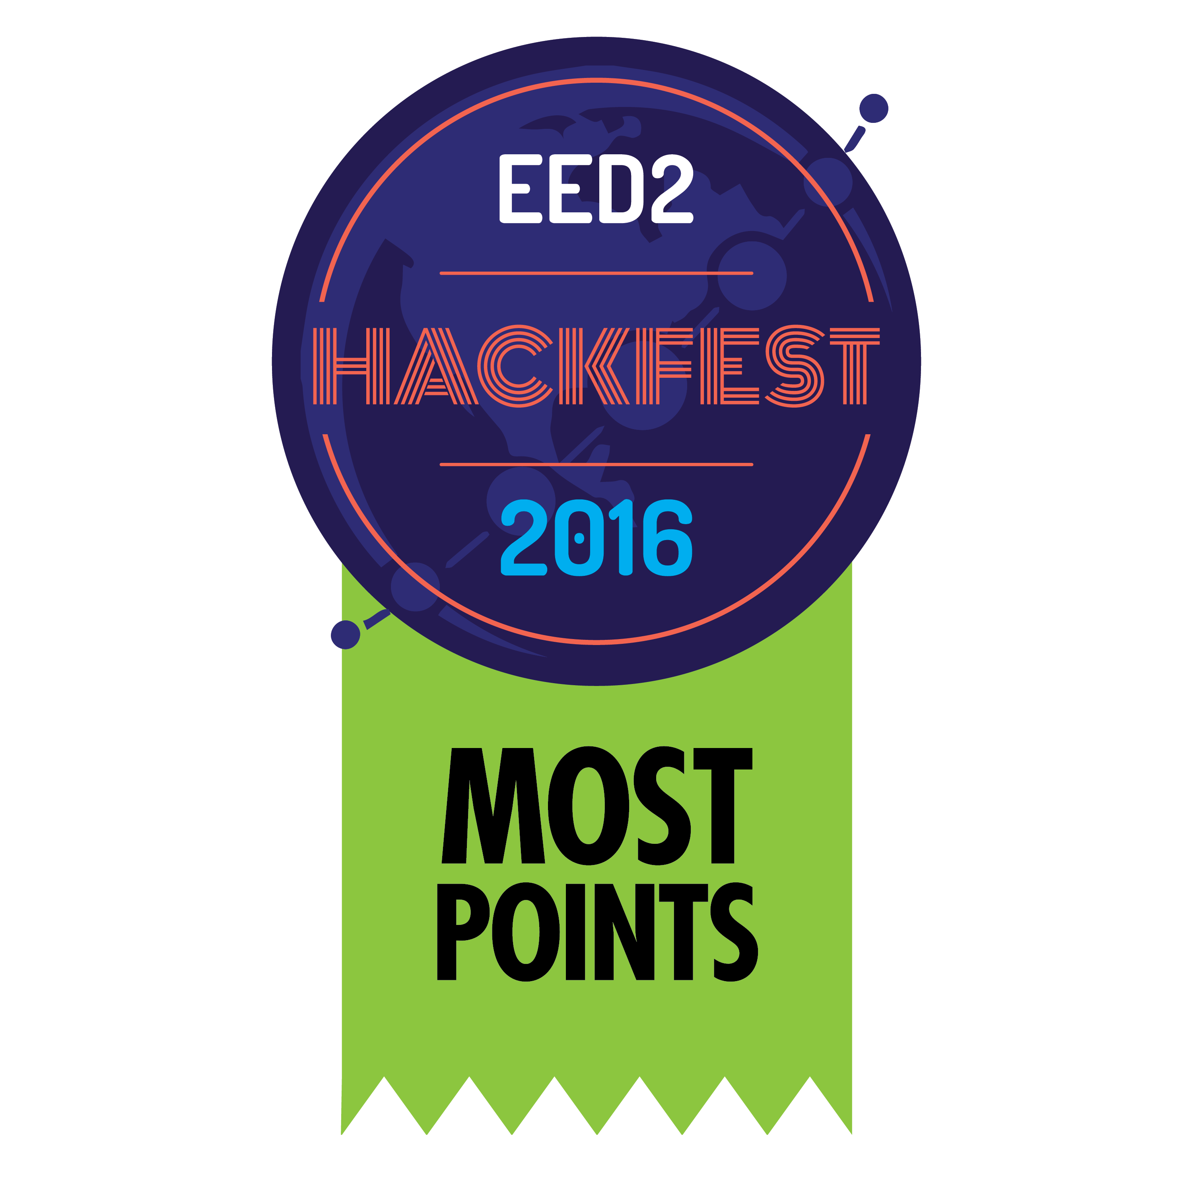

Slide 36
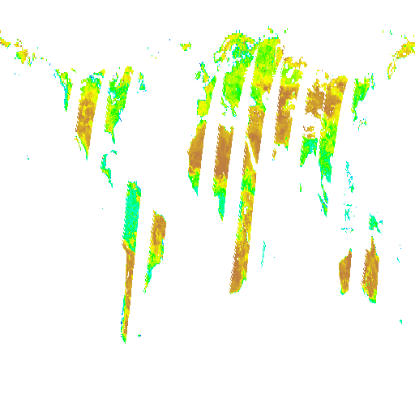
Notes:
Sample of results of HackFest: Serverless SMAP subsetting

Slide 37
understand the operations team’s NEEDS
Psycho-Social
Notes:
We talked, we provided training, but ultimately what seems to have best conveyed the potential of leveraging cloud computing as well as changed thinking was…

Slide 38
Current procedures may not translate directly
Tailing / Grepping logs
SSHing into machines to start / stop /restart services
Monitoring specific hostnames
Existing “operations” scripts
Current dashboards vs AWS Console

Slide 39
Understand WHY they do what they do – you may need to find another way to do it.

Slide 40
Summary
Enable cloud native architectures by strongly preferring cloud services
AWS has very low internal latency, but trust nothing.
Involve security from the very beginning
Modeling TCO is extremely complicated
Explore alternative architectures for possible cost savings
Go hands-on quickly
Incorporate Operations’ Needs

Slide 41
Helpful Resources
AWS Pricing: http://amzn.to/218Jr1G
AWS Cost Optimization: http://amzn.to/2g3813l
Decoding Your AWS Costs: http://bit.ly/1XCIzSk
Minimizing AWS Transfer Costs: http://bit.ly/1njNOtJ
Common Expensive Mistakes: http://bit.ly/1JR1NQb
Serverless Architectures: http://amzn.to/1120t91

Slide 42
Questions?

Slide 43

This material is based upon work supported by the National Aeronautics and Space Administration under Contract Number NNG15HZ39C.

