Slide 1
CODE-DE
Copernicus Data and Exploitation Platform - Deutschland
CEOS WGISS 45
April 11th, 2018
DLR Space Administration
Albrecht von Bargen & Vanessa Keuck

Slide 2







CODE-DE: Copernicus Data and Exploitation Platform – Deutschland
Phases:
  Data Access: March 2017
  Processing 1: Nov 2017 (open/public solution as PaaS)
  Processing 2: May 2018 (dedicated 3rd party solution +
  connection to Open Telekom Cloud)

Slide 3
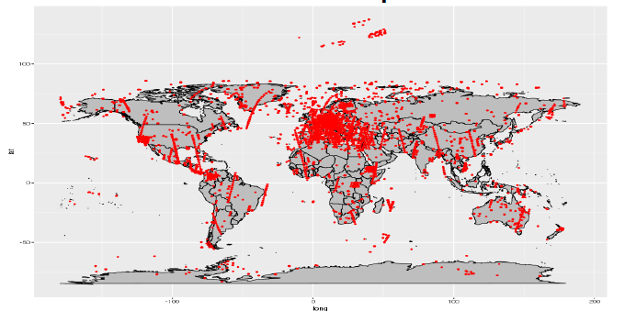

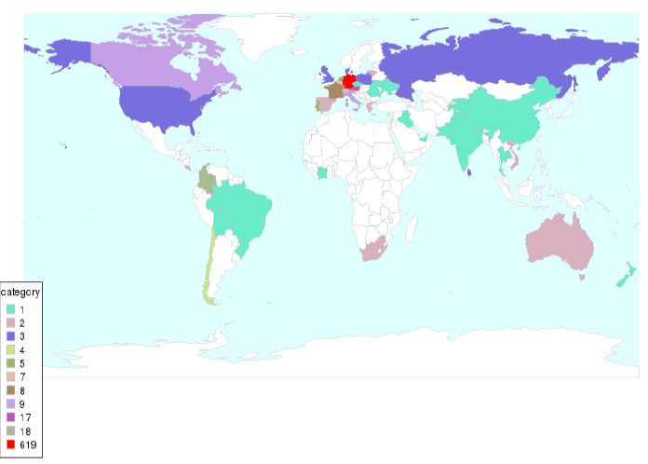
CODE-DE – Access and
distribution
Sentinel Data,
Copernicus Service Products and Tools
Global distribution of downloaded products (03.2017-01-2018)
Operation since March 2017
794.000 GiB data volume
(rolling archive –
focus region Germany)
830 users
65.000 downloaded products
19 open source tools
(as of 28.02.2018)
Origin of users

Slide 4
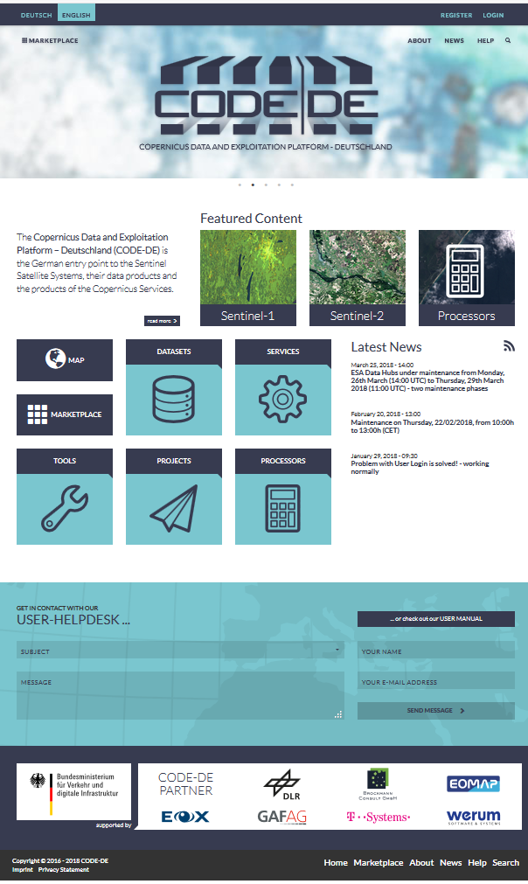
Portal and Internet
code-de.org

Slide 5
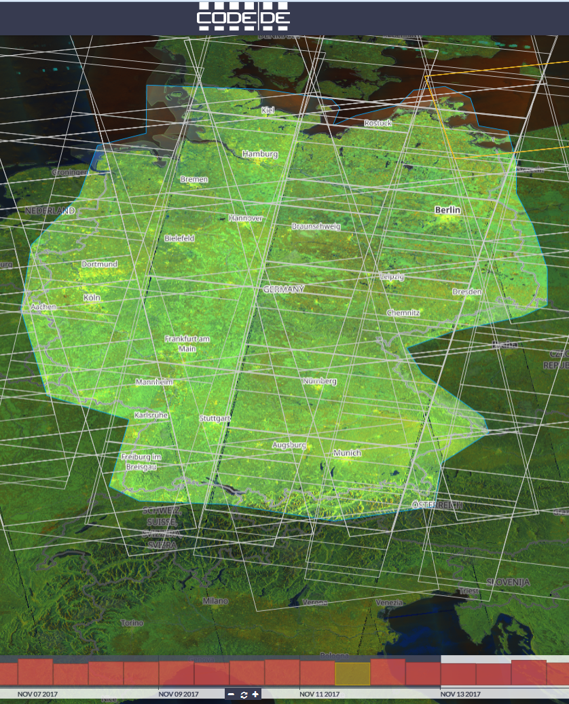
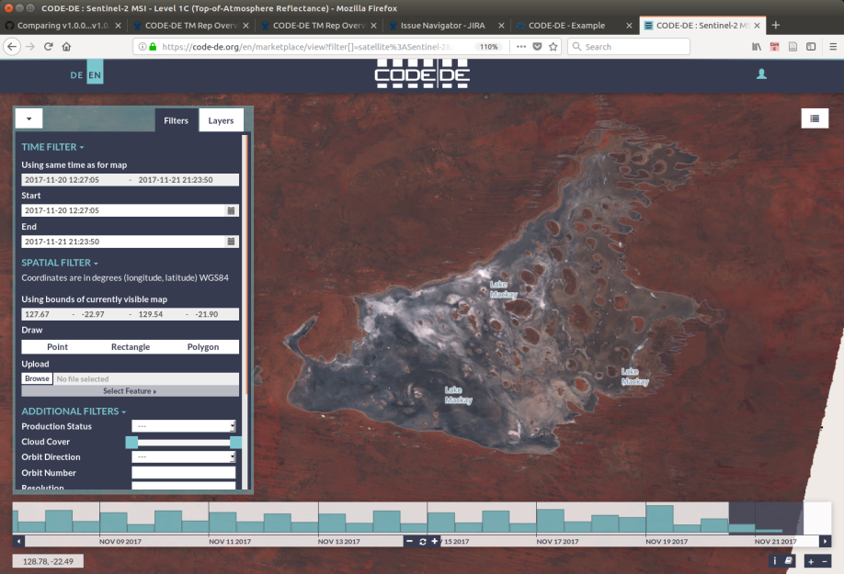
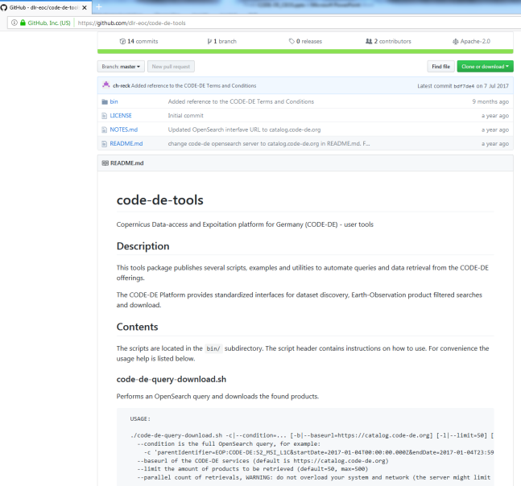
Geo-client and data download

Slide 6
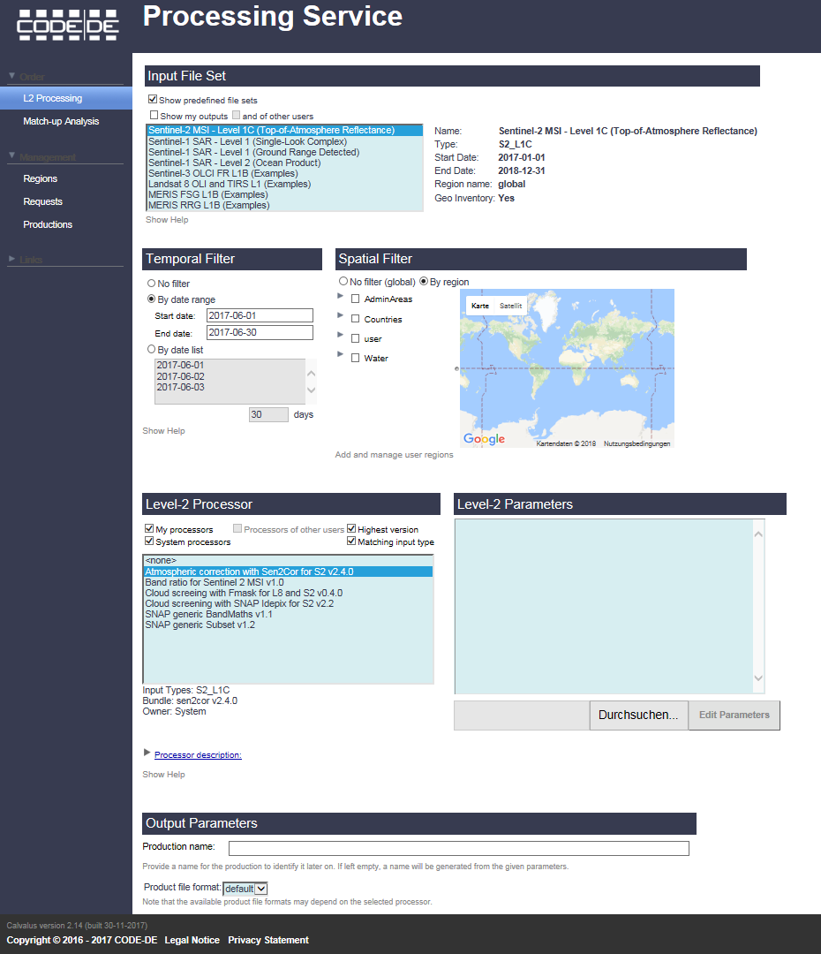
CODE-DE – Open/public processing
Application processing
1.) Open/ public processing
„free and open“
=>
2.) Third party processing
(processing bed)
Notes:
CODE-DE ist für mich derzeit eine Mischung aus Core und Stimulating Element –sollte aber später eher in Richtung stimulating element gehen

Slide 7
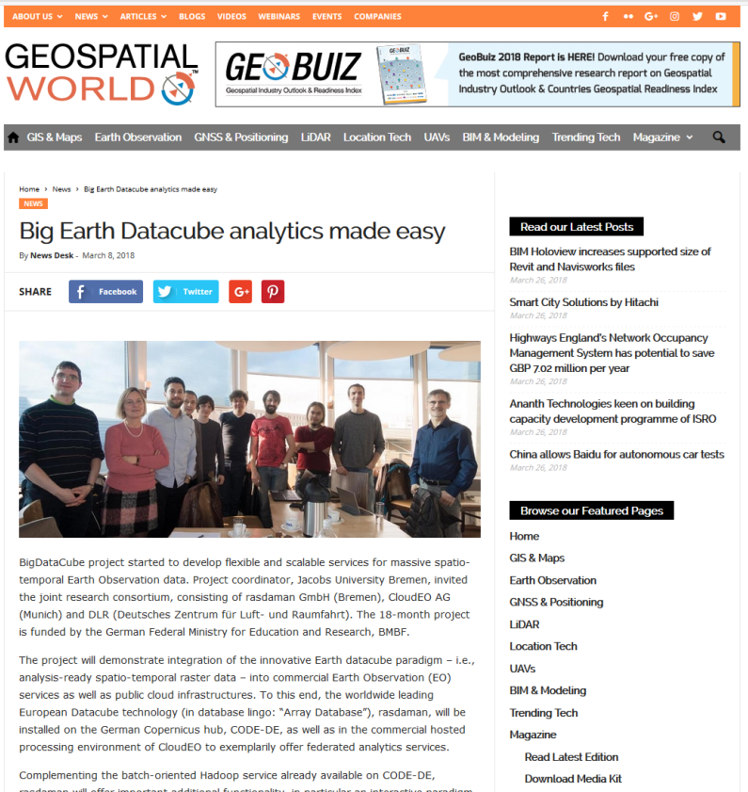
CODE-DE – Dedicated 3rd party processing
Implementation of 3rd party processing applications (Dockers and VMs)
“Announcement of opportunity” in 2017 as 3rd party precursors
16 possible candidates selected,
10 proposals to be implemented
Industry, research and public authorities
Global S1, S2 data requested (sometimes in combination with Landsat 8)
Application domain: mainly land surface and flood mapping
Technology: tests with array database
Notes:
CODE-DE ist für mich derzeit eine Mischung aus Core und Stimulating Element –sollte aber später eher in Richtung stimulating element gehen

Slide 8
Way forward in CODE-DE
Successful installation of further CODE-DE components
  Geo-client improvements (i.e. visualization of different band combinations)
  Implementation of 3rd party processing applications incl. coupling to Open Telekom Cloud (OTC)
  Integration of Sentinel-3, Sentinel-5P and RESA data
  Integration of further tools
  In discussion: usage for specific SAR trainings, including TerraSAR-X
Routine operations

Slide 9
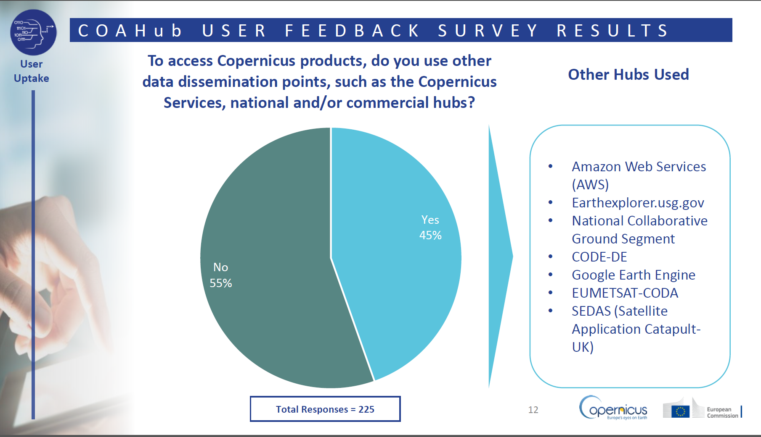
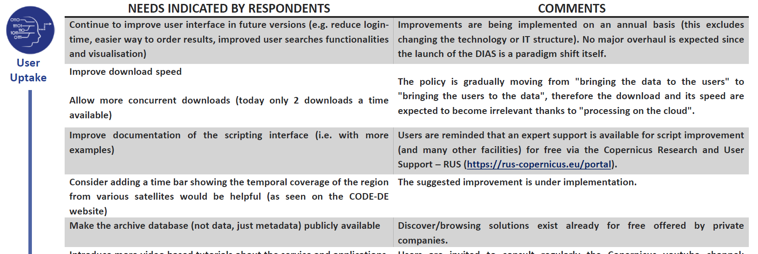
CODE-DE in European context
CODE-DE is a reference
Data availability (temporality)
Ease of use – Geo-client
EU User Forum17
presentation –
COAHub user feedback survey

Slide 10
CODE-DE II - Opportunities / future discussion
The future:
Everything from nothing
– autonomous platform – hybrid platform – full transfer to DIAS ─
Planned:
National User Requirements Workshop with federal agencies
Future use scenarios, data requirements (also in-situ), technical requirements, ease of use
National users as DIAS beta tester (tbd)
Q3-Q4/2018 (planned): EU tender for CODE-DE II operations

