Slide 1
Proba-V Mission Exploitation Platform
CEOS WGISS Meeting #45 11/04/2018
Erwin Goor (VITO),
Philippe Mougnaud (ESA), Andrea Della Vecchia (ESA)

Slide 2
Objectives
The PROBA-V Mission Exploitation Platform (PV-MEP) is an ESA pathfinder project aiming to:
Build and operational Exploitation Platform
Give full access to PROBA-V data repository
Integrate, correlative data and derived products addressing the wider vegetation user community with the final aim to ease and foster the use of PROBA-V data.

Slide 3
Architecture
Three interfaces towards the users are provided:
The Web Portal provides access to the different applications, data and related documentation via a simple Web browser.
Web Services, according to standardised or widely used interfaces, are provided to invoke MEP services directly by 3rd-party applications.
Remote desktop access and Secure Shell (SSH) allow users to access the Virtual Research Environment, where they can develop-test-deploy applications on the platform.
The Product Distribution Facility (http://www.vito-eodata.be) provides the data discovery and access service on the data archive available on the platform.
A Data Manager component manages and caches data on the platform, accessible to the users via NFS or HDFS. The Data Manager component interfaces with the VITO Product Distribution Facility and as well with 3rd-party catalogues via standardised interfaces.
Several applications, provided by both VITO and different users, are deployed on the platform and accessible via the different user interfaces.
The Hortonworks Hadoop distribution and several related tools are used to build a scalable processing and data analytics platform, with access to the complete data archive on the platform.
OpenStack is used as private cloud middleware where the MEP applications will be deployed, as well as pre-configured Virtual Machines allowing users to work on the platform.

Slide 4
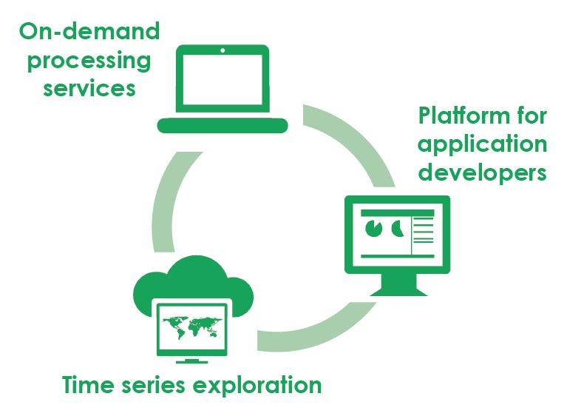
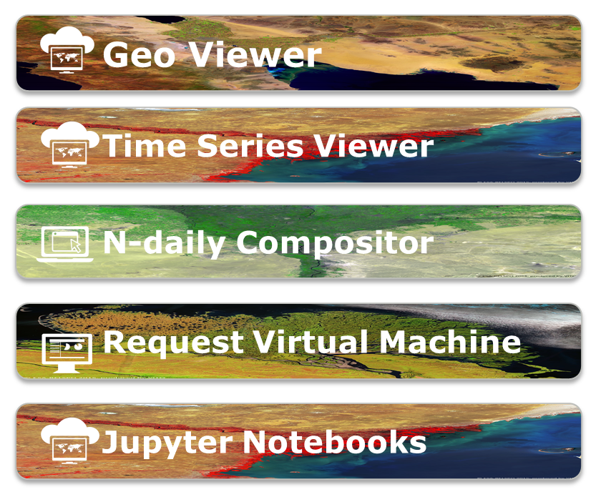
Proba-V MEP – Tools
https://proba-v-mep.esa.int/
(*) only operations & EC funded – limited to viewers
(**) http://viewer.globalland.vgt.vito.be/viewer/
http://viewer.globalland.vgt.vito.be/tsviewer/
Copernicus Global Land (*) (**)
SPOT-VEGETATION
Proba-V

Slide 5
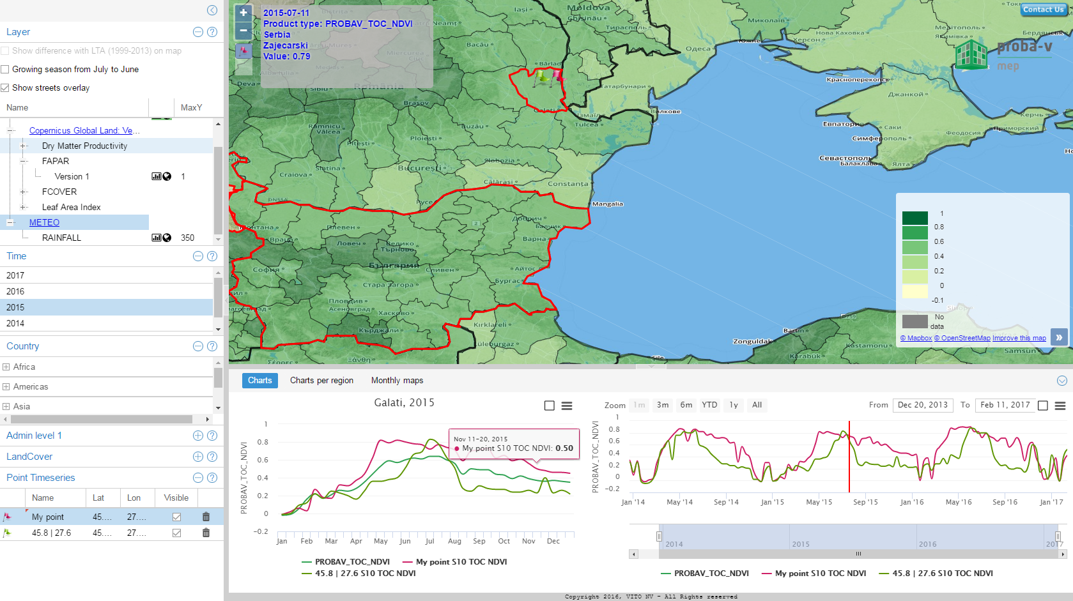
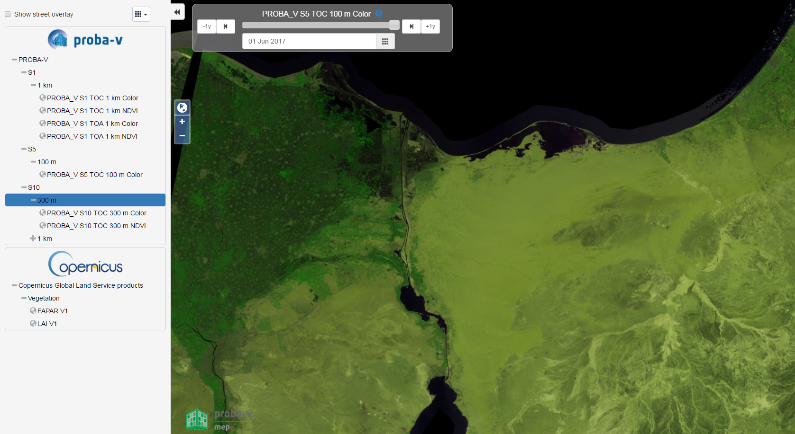
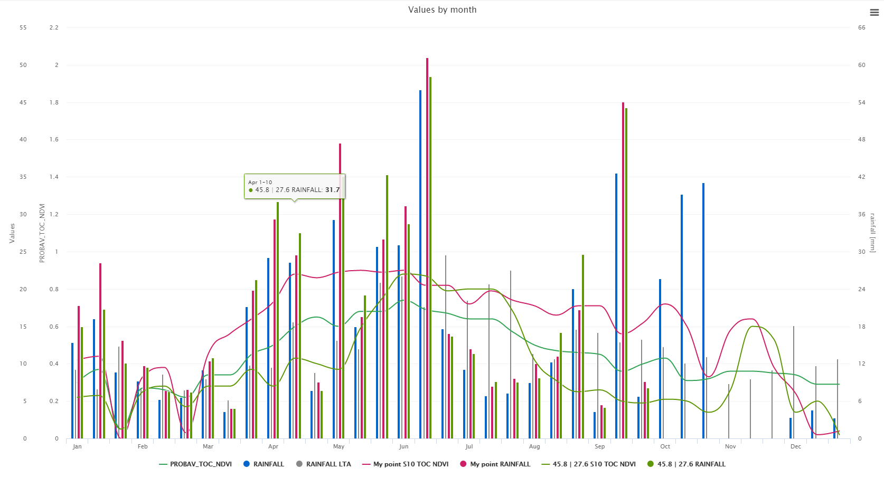
Data Access & Analysis
Full resolution
viewing
Time Series
Viewing
Countries
Regions
Pixels
Polygons
Web Client &
API
https://proba-v-mep.esa.int/api/timeseries/v1.0/ts/PROBAV_L3_S10_TOC_NDVI_333M/point?lat=50&lon=4

Slide 6
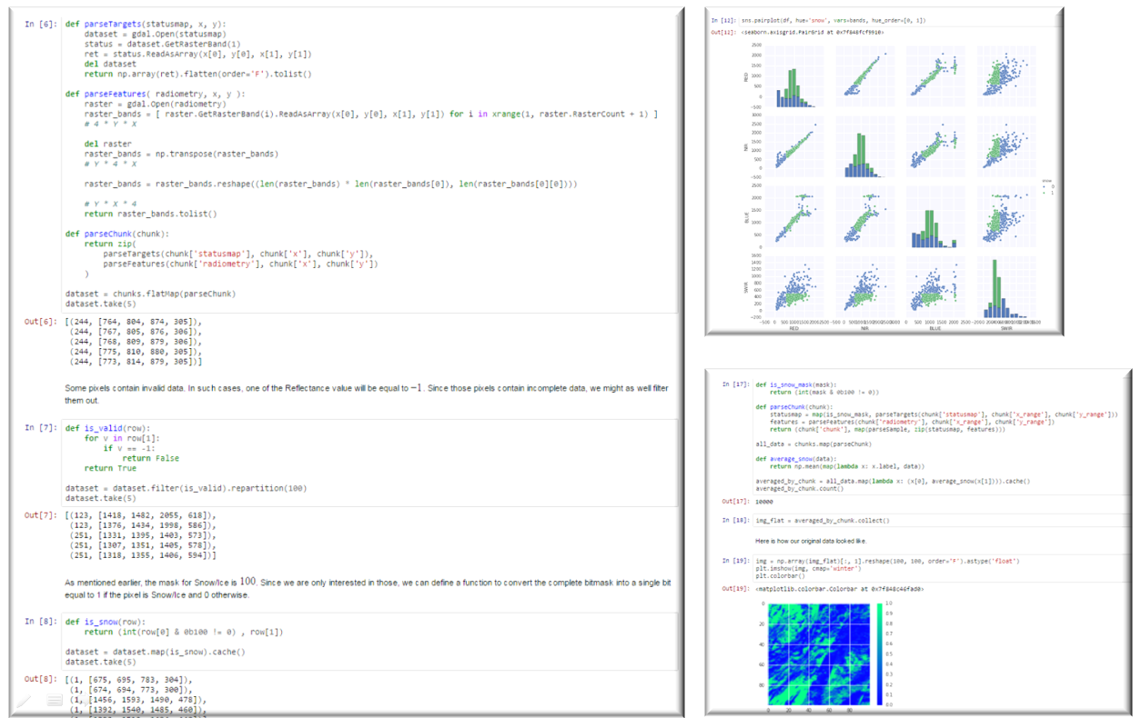
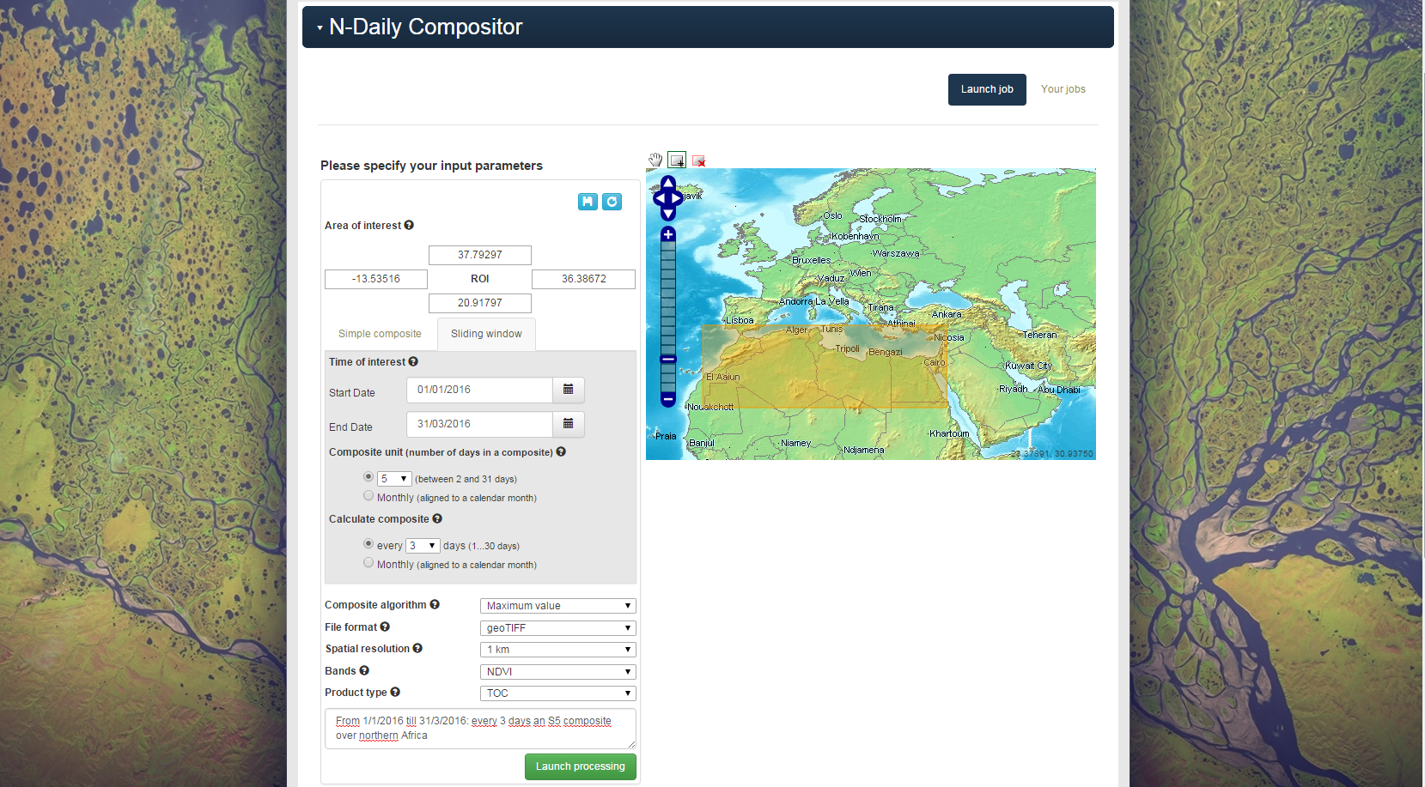
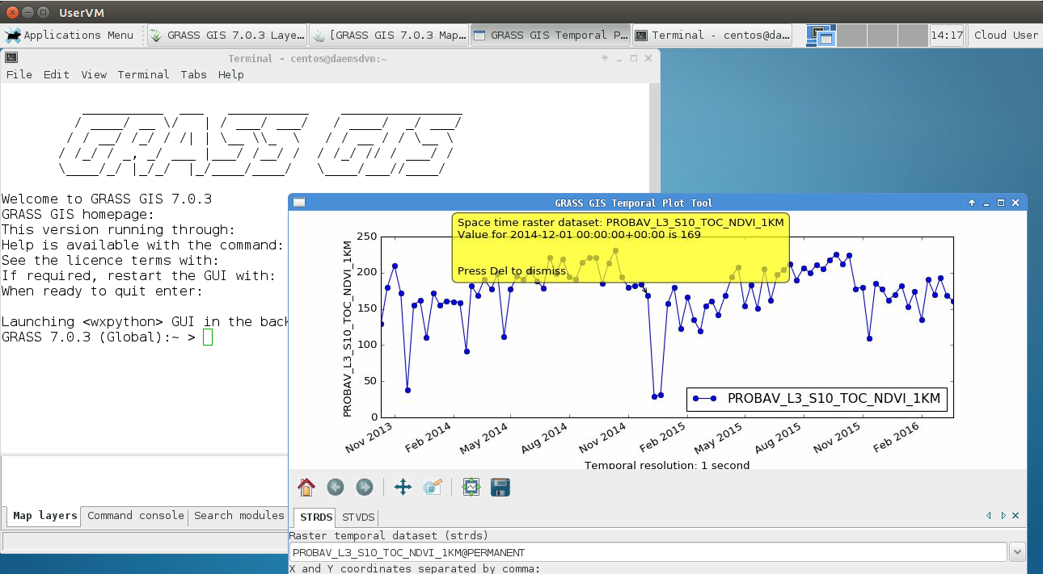
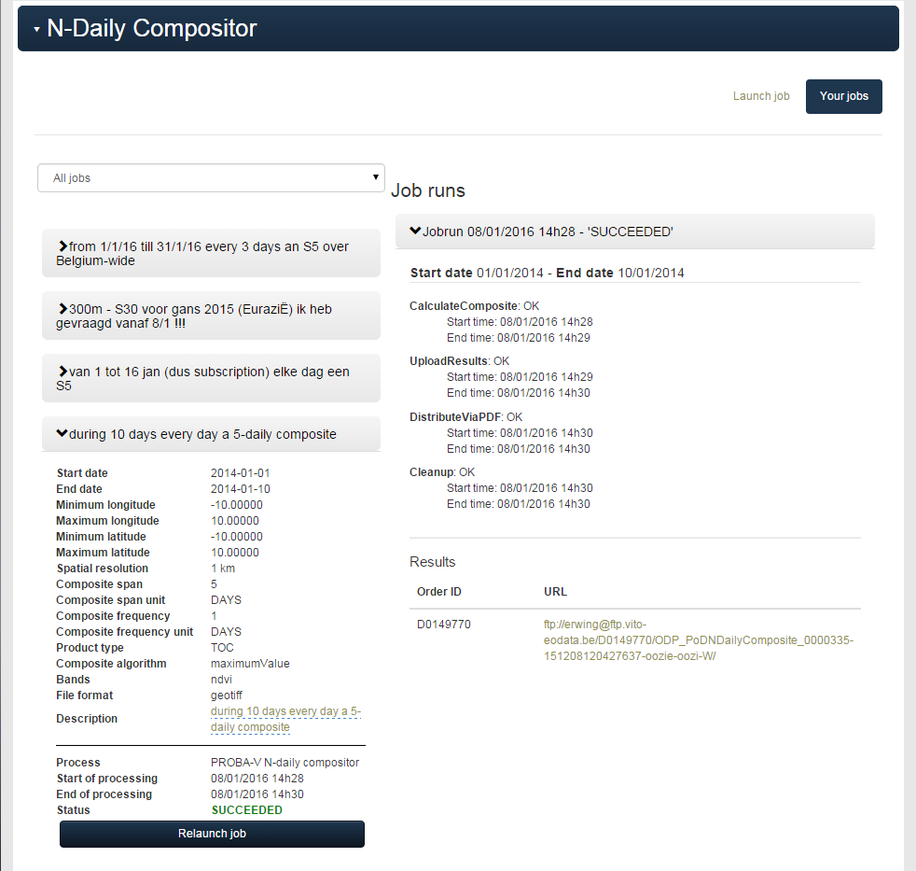
Data Processing
On-demand processing
Virtual Research Environment
Notebooks

Slide 7
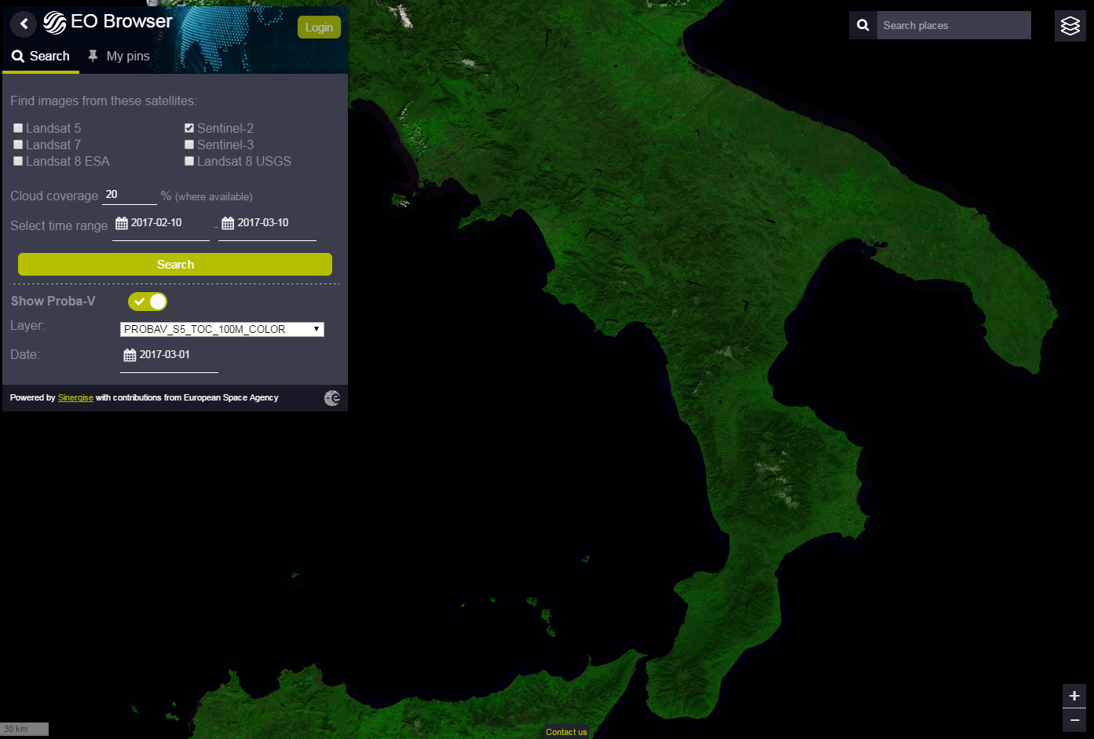
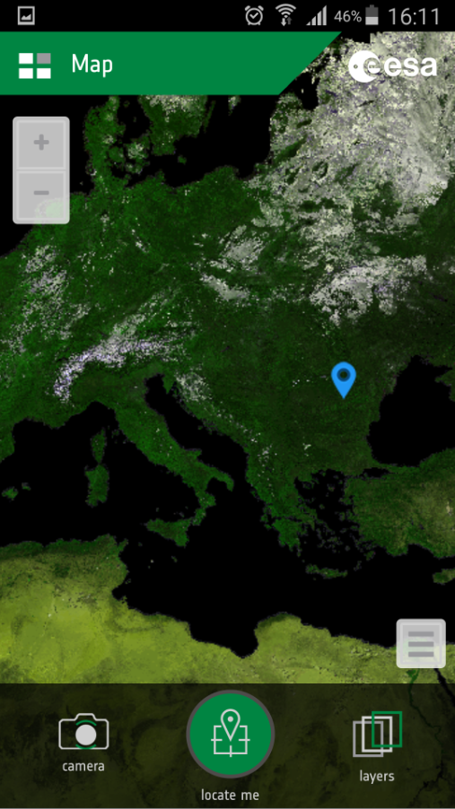
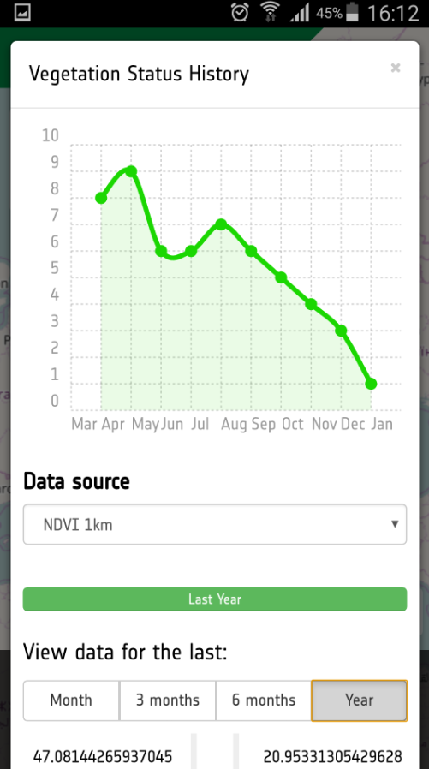
Planning and user uptake
In operations since Nov 2016
Project extension definition ongoing
Regular releases of new features, e.g. polygon support Time Series Viewer
Supporting many researchers and developers:
Virtual Research Environment – Virtual Machines
Notebooks, e.g. for Cal/Val users
Using MEP APIs in users’ applications
…
MEP services are integrated in 3rd-party services & projects
https://proba-v-mep.esa.int/

Slide 8
ESA-NASA multi-Mission Analysis Platform for improving global aboveground terrestrial carbon dynamics
Clément Albinet¹, Amanda S. Whitehurst², Henri Laur¹, Kevin J. Murphy², Bjorn Frommknecht¹, Klaus Scipal³, Andrew E. Mitchell⁴, Benhan Jai⁵, Rahul Ramachandran⁶ and Marco Lavalle⁵
¹ ESA-ESRIN, Frascati, Italy
² NASA-HQ, Washington, USA
³ ESA-ESTEC, Noordwijk, The Netherlands
⁴ NASA-GSFC, Greenbelt, USA
⁵ NASA-JPL, Pasadena, USA
⁶ NASA-MSFC, Huntsville, USA
CEOS WGISS Meeting #45 – 11/04/2018

Slide 9
An ESA-NASA common project

Slide 10
Potential joint Biomass-NISAR-GEDI MAP
→ Why a joint Biomass-NISAR-GEDI platform?
The missions have similar scientific objectives (biosphere study, in particular forests)
The missions target the same (science) communities;
The missions will use the same type of in-situ measurements for algorithm training and Cal/Val.
These missions and the corresponding research leading up to launch will produce multiple petabytes of data per year
Leading to increased data storing, processing and sharing challenges
Address these challenges now so that they don’t impede scientific progress in the future

Slide 11
Potential joint Biomass-NISAR-GEDI MAP
Transparent access to the content of both platforms
ESA NASA MEP
NASA Mission
Data
NASA Mission
Tools&Visu
ESA-NASA
Missions
Community
ESA Mission
Data
ESA Mission
Tools&Visu
NASA Mission
Processing
resources
ESA Mission
Processing
resources
Concept under discussion…
Not yet approved!
Up to date data and algorithms
Cohesive community

Slide 12
How to build this MEP: Joint MEP functionalities
Operational MEP
Testbed
Pilot MEP
Before launch
After launch
Data visualisation
Data storage
Algorithm Edition
Product generation
Information sharing
Existing GIS Software
Prototype of dedicated GUI
Dedicated GUI
ESA P-band campaigns
+ NASA P&L-band campaigns
+ ESA L-band campaigns
+ Biomass, NISAR & GEDI? data
Write your own algorithm or edit shared a one
Access prototype of official algorithm
Access official algorithm
Low processing resources
medium processing resources
High processing resources
Share information with your own tools
Share information with the prototype platform
Share information with the platform

