Slide 1
The Geohazards Exploitation Platform (GEP)
WGISS-45
The 45th Meeting of the Working Group on Information Systems & Services
11/04/2018
Jolanda Patruno

Slide 2
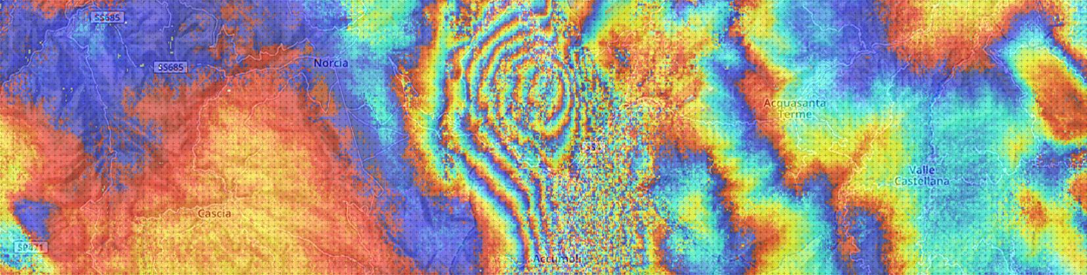
The Geohazards Exploitation Platform (GEP)
A 27+ months contract started on Nov 2015;
Consortium: Terradue (IT), CNR IREA (IT), INGV (IT), DLR (DE), TRE ALTAMIRA (ES), EOST-CNRS (F), ENS-CNRS (F)
Develop an Exploitation Platform based upon virtualisation & federation of satellite EO data and methods
Provide innovative responses to the needs of the geohazards community
As a Platform, GEP:
Provides on-demand processing services for specific user needs
Runs systematic processing services to address “common information” community needs
Connects to massive compute power on multi-tenant Cloud Computing resources, to address the challenges of monitoring tectonic areas, globally
Connects to full Copernicus Sentinels-1/2/3 repositories
Connects to 70+ TB of EO data (ERS and ENVISAT archive), and specific data collections from EO missions, such as JAXA’s ALOS-2, ASI’s Cosmo-Skymed and DLR’s TerraSAR-X, provided under special arrangements in the framework of the CEOS WG Disaster and GSNL.

Slide 3
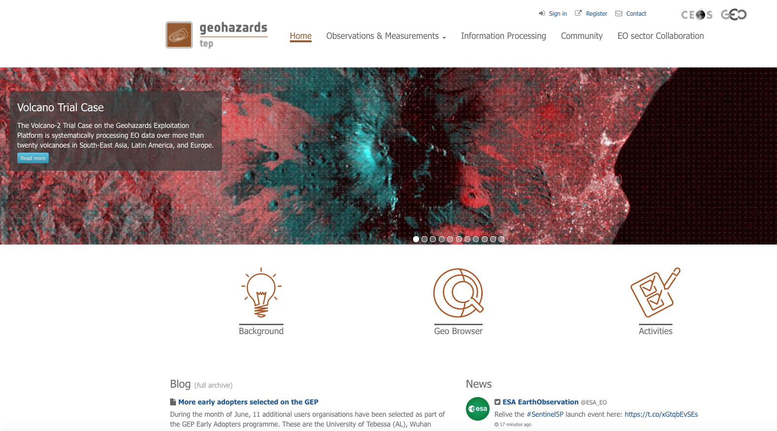
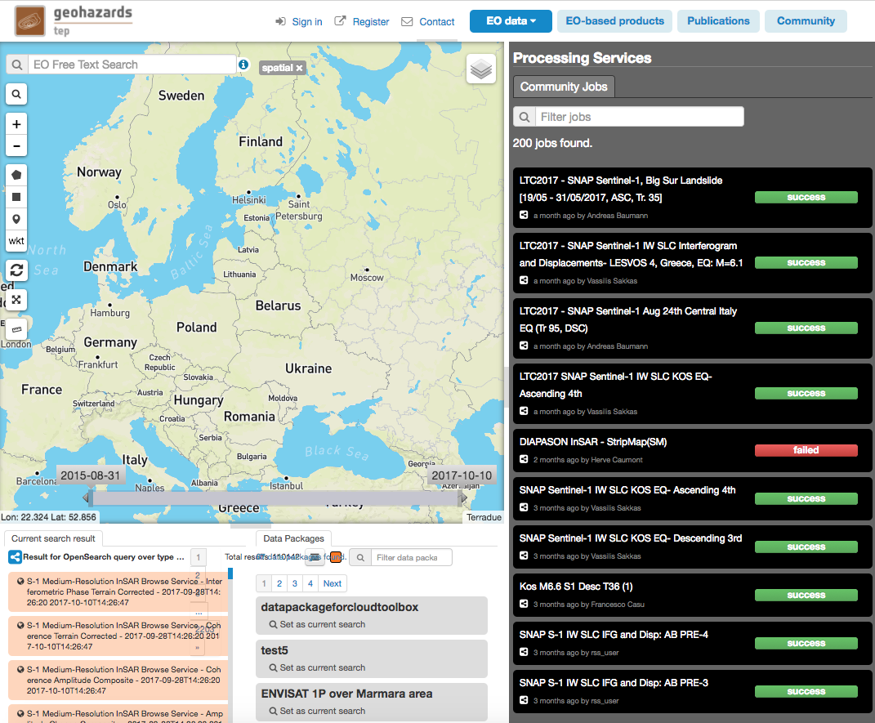
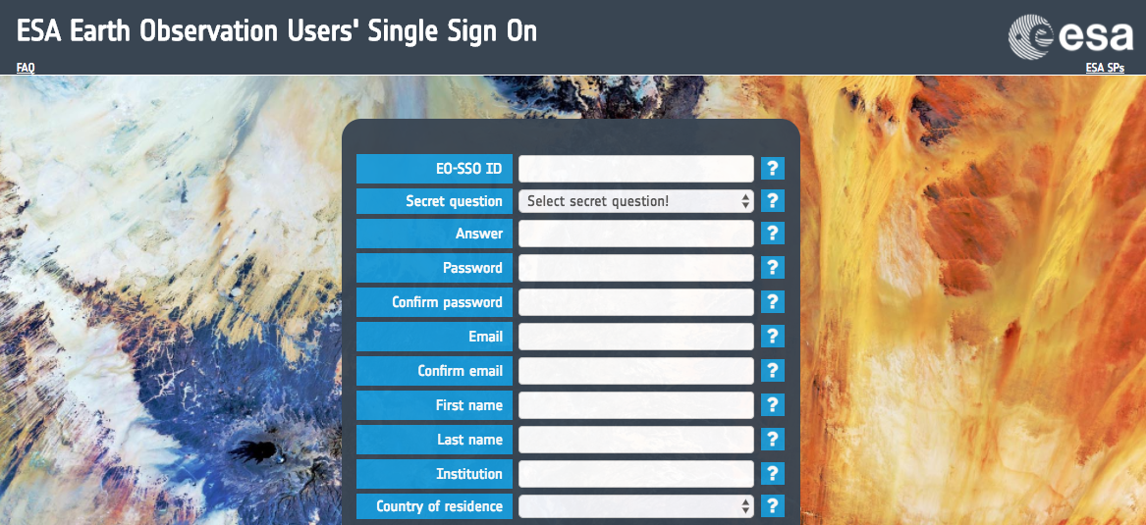
GEP in a Nutshell: Data access integration
4

Slide 4
The Geohazards Exploitation Platform (GEP)
GEP is primarily targeting scientific & operational users from public organisations
  Geo-science community incl. Universities worldwide
  Organisations with a national mandate concerning risk assessment (incl. seismological centres)
  National & regional civil protection agencies and national & local authorities with a risk management mandate (potentially for both prevention/preparedness and response)
GEP has demonstrated capabilities that are also relevant to specialists of geohazard risks in other sectors such as pre-commercial research affecting insurance, civil engineering companies, energy, etc.
Even before start of pre-ops, interest manifested by commercial VA companies (e.g. InSAR/PSI suppliers) and industry users (e.g. California Geological Survey)
This is planned to be supported on a platform with the same functionalities but a different deployment than the GEP

Slide 5
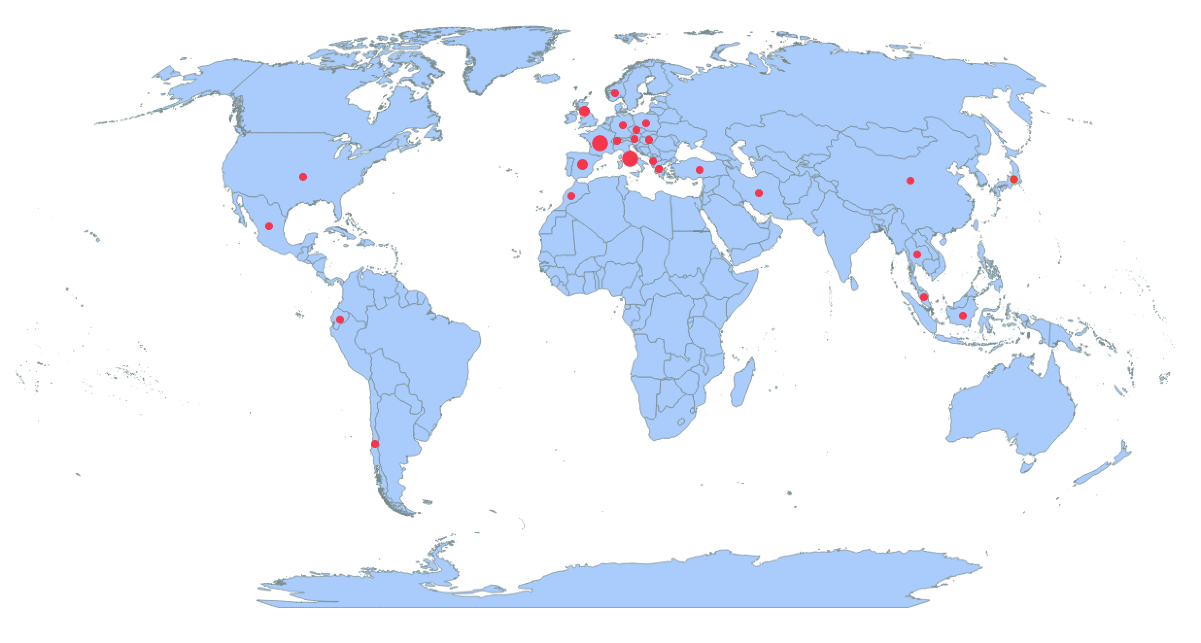
GEP User Uptake
Country | Number of User organisations
FR | 13
IT | 11
ES | 10
UK | 7
GR | 4
DE | 3
CH | 2
TR | 2
US | 2
AT | 1
CL | 1
CN | 1
CZ | 1
DK | 1
DZ | 1
EC | 1
HU | 1
JP | 1
ID | 1
IR | 1
MA | 1
ML | 1
MX | 1
NO | 1
PL | 1
TH | 1
Total | 71
820 registered users
That is 21 users from the GEP Consortium and 50 users from the community via the Early adopters programme in 26 countries
Mainly European users, but also 15 users from the rest of the world: Asia (Turkey, Thailand, Indonesia, China, Malaysia, Japan & Iran), Africa (Morocco, Algeria), Latin America (Ecuador, Mexico and Chile) and North America (USA).

Slide 6
GEP v2 soon available
New features provided by the GEP:
20+ on-demand services using both Optical & SAR data grouped in Thematic Apps according to the user profile
including new advanced services available for both Optical & SAR data:
(SAR based SBAS multi-baseline processing chain (CNR IREA, InSAR measurements),
DSM OPT and MPIC OPT chains (CNRS EOST, Optical measurement using Sentinel-2 & VHR data)
New basic services providing full resolution Geotiff imagery (RASTER on-demand service) and change detection imagery (SNAP based COIN & SNAC tools) for rapid on-line visualization
8 systematic services including the large scale production of Sentinel-1 InSAR browse images at both 100m and 50m resolution over tectonic regions
GEP V2 brings enhanced platform capabilities:
improved processing time and system scalability allowing parallel massive data processing
multisourcing to optimise data access
integration with new Cloud based processing environments (such as the DIAS)
visualize many large images and products on the geobrowser with a low latency
display dynamic histograms of a query result over selected time span and area of interest for any data collection
directly publish the results of a processing chain for community sharing
The GEP Early Adopter programme is able to on board additional users
geohazards-tep@esa.int
Notes:
Left – Danube Delta (Romania)
Middle – Mount Etna (Sicily, Italy)
Right – South-East Greenland (glaciers)

Slide 7
Data available globally:
Copernicus Sentinel-1, Sentinel-2, Sentinel-3 and Landsat-8
Via the GEP Data Agency Catalogue, the Platform currently makes available for processing the global coverage of the following data collections:
Sentinel-1A/B: (RAW, SLC, GRD and OCN) synchronized* with the Copernicus Open Access Hub
Sentinel-2A/B: (MSI L1C, L2A) synchronized* with the Copernicus Open Access Hub
Sentinel-3: (OLCI, SLSTR) synchronized* with the Copernicus Pre-Operations Data Hub
Landsat-8: (OLI and TIRS) synchronized* with the USGS EarthExplorer
*:
about metadata: complete catalogues published in NRT.
about data: different solutions according to use case incl. colocated data & processing, on-demand data fetching, data caching, etc.
Notes:
A

Slide 8
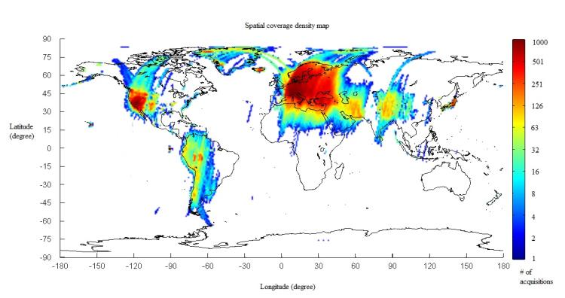
Available ERS, Envisat & TPM data
GEP has taken commitments about data access
The GEP provides on line access to ESA heritage EO missions data:
  ERS (SAR IM Level-0)
  ENVISAT (ASAR IM Level-0)
global coverage synchronized with the ESA VA4 (70+ terabytes)
Through agreements with CEOS partners and project partners (CEOS Pilots and Geohazards Supersites), limited private collections of the following missions are made available for processing & download:
ALOS-2
TerraSAR-X
COSMO SkyMed
RADARSAT-2
ERS & ENVISAT Level-0 data available as of February 2016
Notes:
A platform for EO processing rather than data distribution or dissemination. Agreement with CEOS partners for access and accounting of specific data collections (CEOS Pilots and Geohazard Supersites).

Slide 9
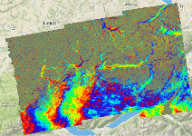

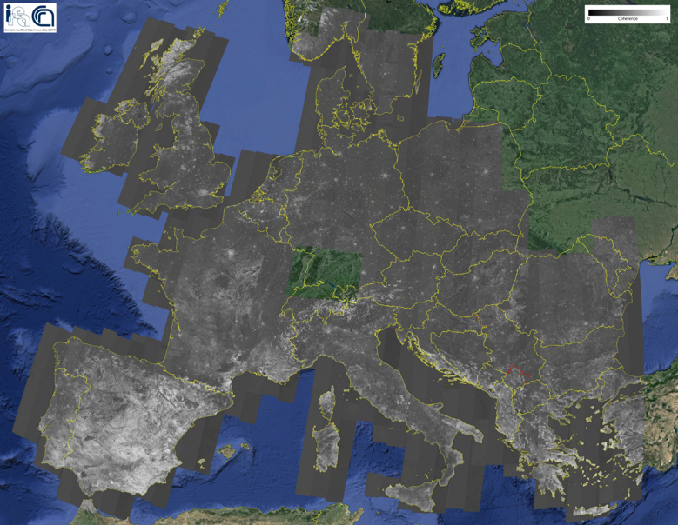
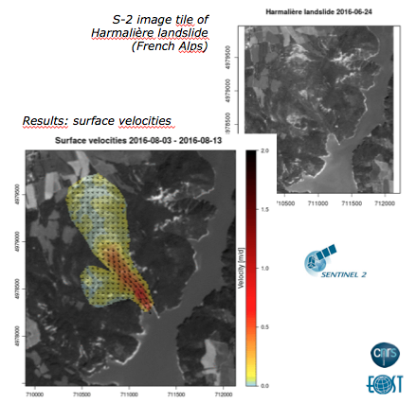
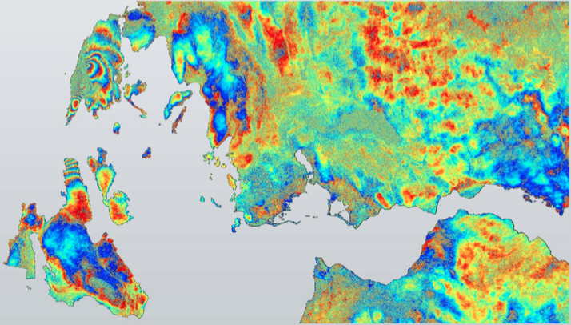
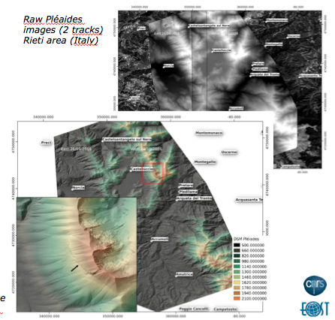
GEP Pilot projects (1/2)
CNR IREA
CNRS/EOST
CRL (ENS,NOA,HUA)
Terrain motion surveillance
Data provisioning: S-1 SLC
Results visualisation: displacement time-series, mean velocity maps
Designated users
  EPOS Community & Italian Department of Civil Protection
Validation goal
  On-demand generation of Earth deformation time series and mean velocity maps
  Automatic “Sentinel-1 Surveillance Service” over Mt Etna & Napoli Bay volcanic area
Processing chains for optical images
  Data provisioning: HR (S-2 & L7/8), VHR (Spot6/7, Pléiades)
  Results visualisation: digital surface models
Designated users
  CEOS Pilot on Seismic Hazards
Validation goal
  DSM-OPT: Automation of satellite-photogrammetry pipeline for rapid processing of multi-views images (Pléiades, Spot6/7)
  MPIC-OPT: Monitoring of surface deformation from optical image time-series, based on Multiple-pairwise image correlation
Corinth Rift Laboratory
  Data provisioning: S-1 SLC
  Results visualisation: all possible interferograms from archive over CRL, e.g. ~5000 S1 asc. and ~5000 S1 desc. then all pairs after each new acquisition
Designated users
  Workshops & Summer Schools involving MSc, PhDs
Validation goal
  Deliver methods & data products as part of the Near fault observatory of EPOS

Slide 10
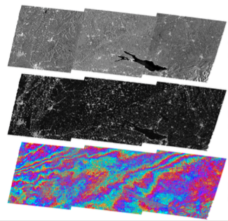
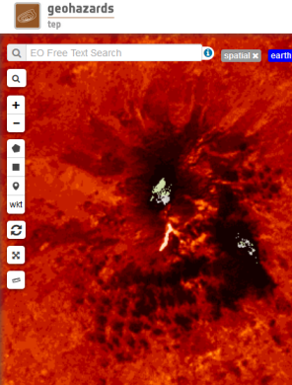
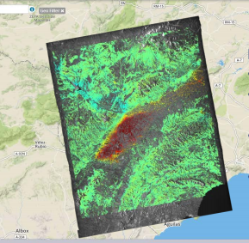
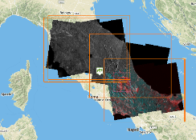
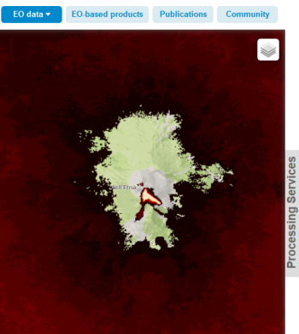
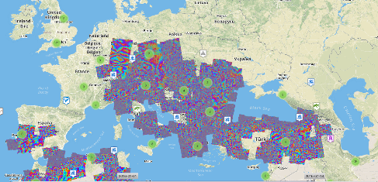
GEP Pilot projects (1/2)
DLR
INGV
TRE-ALTAMIRA
Systematic InSAR QuickLook service
  Data provisioning: S-1 SLC
  Results visualisation: geocoded quicklooks of Amplitude, Coherence, Diff. interferograms
Designated users
  CEOS Pilot on Seismic Hazards
Validation goal
  Monitoring service of the CEOS Seismic & Volcanoes areas
Volcanic hazard monitoring
  Data provisioning: L8 (L1B), S-2 (L1C), S-3 (SLSTR, L1B/L1C)
  Results visualisation: Surface temperature maps/hotspot detection
Designated users
  Italian Civil Protection
Validation goal
  Generation of time series relevant for the CEOS Pilot on volcanoes, for Mount Etna and Phlegrean field
PSinSAR for precise terrain motion mapping
  Data provisioning: S-1 SLC
  Results visualisation: ground motion velocity map, corrected
  topography map
Designated users
  Commercial sector (pay-per-use via TRE-ALTAMIRA Sales Dept.)
Validation goal
  Define a SaaS business model for GEP hosted InSAR services

Slide 11
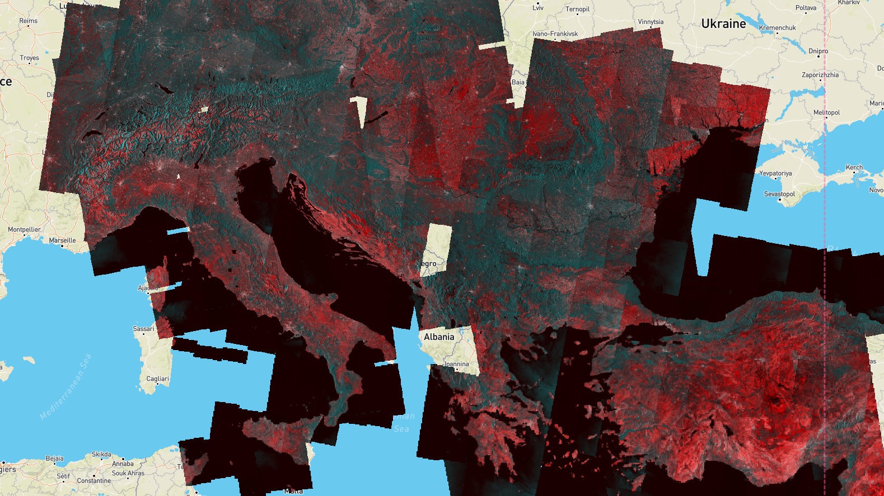
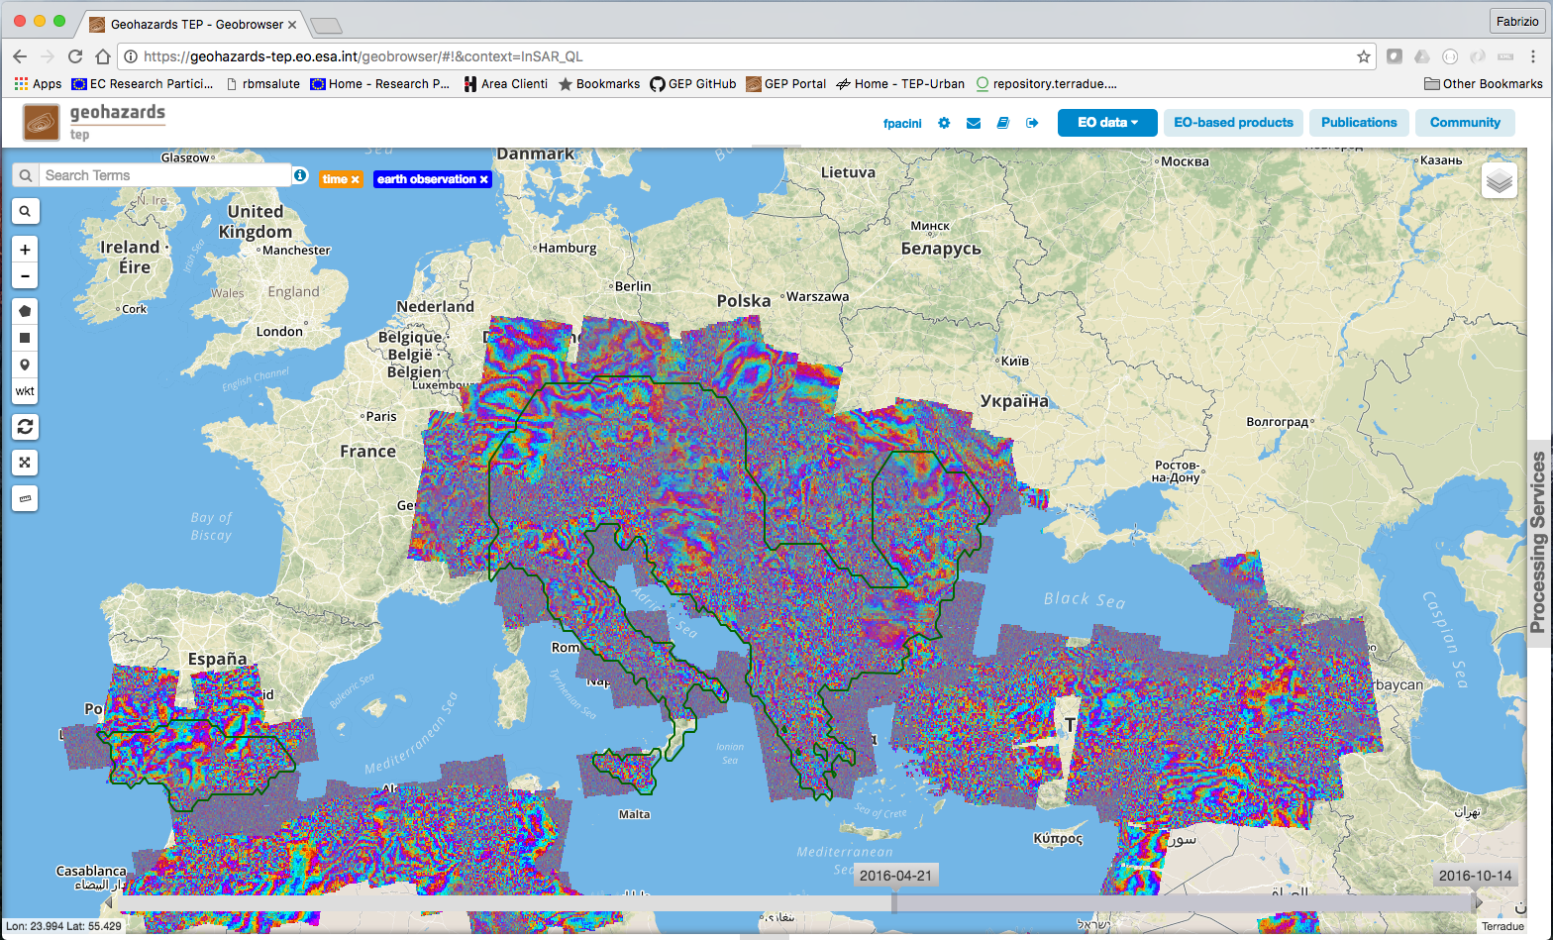
Systematic SAR data processing
Systematic production of S-1 InSAR pairs
A service developed by DLR
Systematic processing using the InSAR Browse of DLR. Each tile has the extent of an S-1 footprint.
Providing amplitude (cyan) and coherence (red) of all consecutive S-1 pairs over the world tectonic mask.
Current production rate: 150 pairs per day
About 1TB data cached and processed daily
Published results available freely to any user

Slide 12
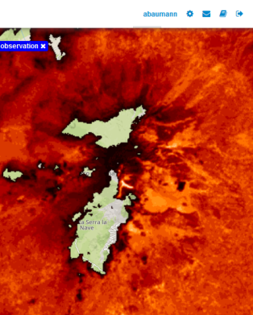

Systematic optical data processing
2017 Eruption of the Volcano Etna (Italy): Surface Temperature Map processed with the systematic processing service «STEMP L8 – Surface Temperature Map» integrated by INGV. Landsat-8 acquisition of 27th March (left), 12th April (middle) and 19th April 2017 (right).
STEMP L8 – Surface Temperature Map developed and integrated by INGV, processes systematically Landsat-8 data to measure the temperature for areas identified as «thermally active» in the volcanic areas (22 volcanoes worldwide)

Slide 13
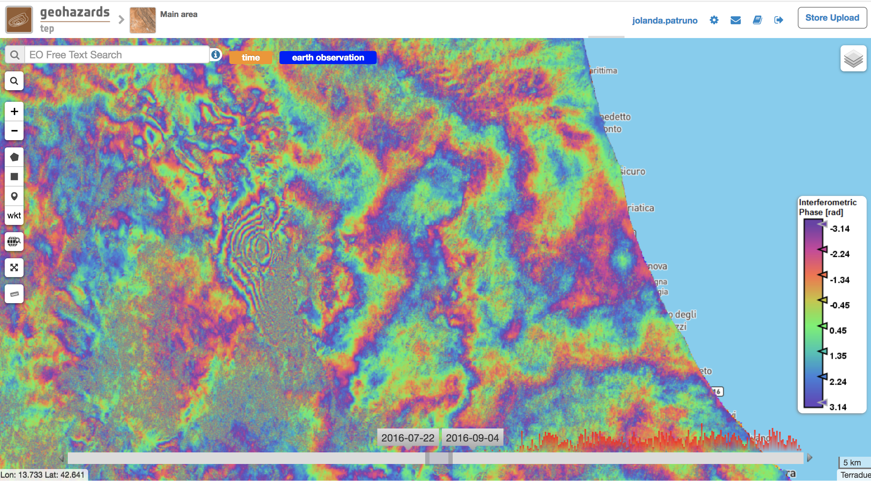
Conventional InSAR Processing Chain:
ESA SNAP
August 2016 Central Italy Earthquake: S-1 Interferogram, 21st August to 2nd September 2016, descending, processed on GEP with the on-demand processing service «SNAP Sentinel-1 IW SLC Interferogram and Displacements» integrated by RSS. Contains modified Copernicus Sentinel data (2016), Processed by Jolanda Patruno, ESA
ESRIN RSS integrated two S-1 chains based on the ESA SNAP tool for on-demand processing.

Slide 14
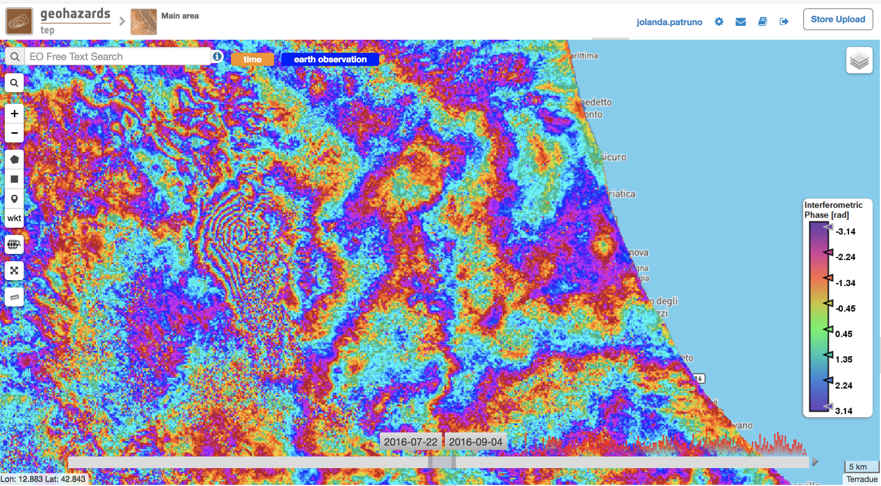
Conventional InSAR Processing Chain:
DLR S-1 InSAR Browse
August 2016 Central Italy Earthquake: S-1 Interferogram, 21st August to 2nd September 2016, descending, processed on GEP with the systematic processing service «Sentinel-1 Medium Resolution InSAR Browse» integrated by DLR. Contains modified Copernicus Sentinel data (2017)
DLR integrated two systematic S-1 InSAR services:
The S-1 Medium-Resolution (100m with 50m spacing, open to public, 50% CEOS world seismic mask by end of 2017) and
the S-1 High-Resolution InSAR Browse (50m with 25m spacing, restricted, volcanoes of the VO-2 Trial Case)

Slide 15

The GEP Charter Platform Prototype
Following the discussion at the «International Charter Major and Space Disasters» Board meeting in Oxford (April 2017) and Frascati (October 2018), prototype processing platform have been implemented for testing to support the Project Manager and Value Adding partners of Charter activations.
Main goals:
support Charter PM in operations:
  Faster access to data
  Help PM rapidly screen data (even before downloading the data) about whether data selected are useful for the activation by using online co-registration functions, change detection functions and possibly some GIS capability
support Charter VA partner in operations:
  Faster access to data and ancillary datasets (e.g. DEM, OSV, etc.)
  Perform part of the EO processing with online functions even before downloading the data and remotely from any place:
    On-line pre-processing of images (co-registering multi-sensor collections)
    On-line image analysis (e.g. change detection, a classifier to generalize some processing)
    Access to common tools (to be exploited offline) and some GIS capability (option)
        ESA started two limited processing platform prototypes to test the contribution of TEPs to disaster response. One prototype based on the GEP (disaster risk management for geohazards themes) and for information, one prototype based on the Coastal TEP (coastal zone monitoring).

Slide 16
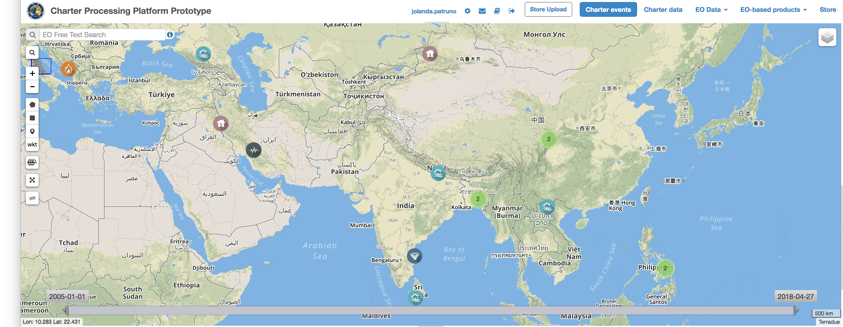
The GEP Charter Platform Prototype
The Charter
composed of 16 Space Agencies
delivers data from 30+ active EO missions
The current Charter processing platform prototype is able to support 16 of them

Slide 17
The GEP Charter Platform Prototype
EO data sources
Missions | Rasterization | Band combination Co-registrator
SENTINEL-1/2 | YES | YES
LANDSAT 8 | YES | YES
UK DMC II | YES | YES
KOMPSAT-2 | YES* | In preparation
KOMPSAT-3 | YES* | YES
PLEIADES 1A/1B | YES* | In preparation
KANOPUS-V | YES* | In preparation
RESURS-P | YES* | In preparation
SPOT 6&7 | YES* | In preparation
RAPIDEYE | YES* | In preparation
VRRS1- ABAE | YES* | In preparation
DEIMOS-1 | Planned | Planned
GF-2 | YES* | In preparation
TERRASAR-X | YES* | In preparation
ALOS, ALOS 2 | YES | In preparation
KOMPSAT-5 | YES* | In preparation
RADARSAT-2 | YES* | In preparation
Any EO source can be included
ESA would welcome the integration of other EO sources from Charter members
* Rasterization not always available

Slide 18
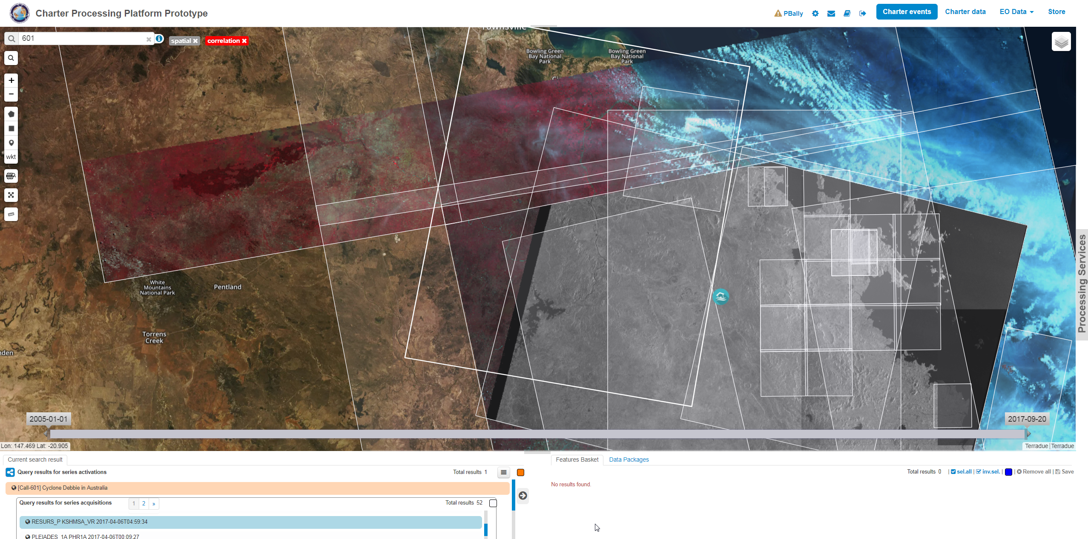
The GEP Charter Platform Prototype
RASTER systematic service
Activation n. 522
Call ID 601
Cyclone in Australia
  Visualize multi-sensor Full Resolution images (footprints, metadata, product)
Illustration: UK DMC (2017-3-29) and Sentinel-1 (2017-4-5); full resolution data opened on-line automatically based on Charter operational flow. The User does not have to download nor open the image files.

Slide 19
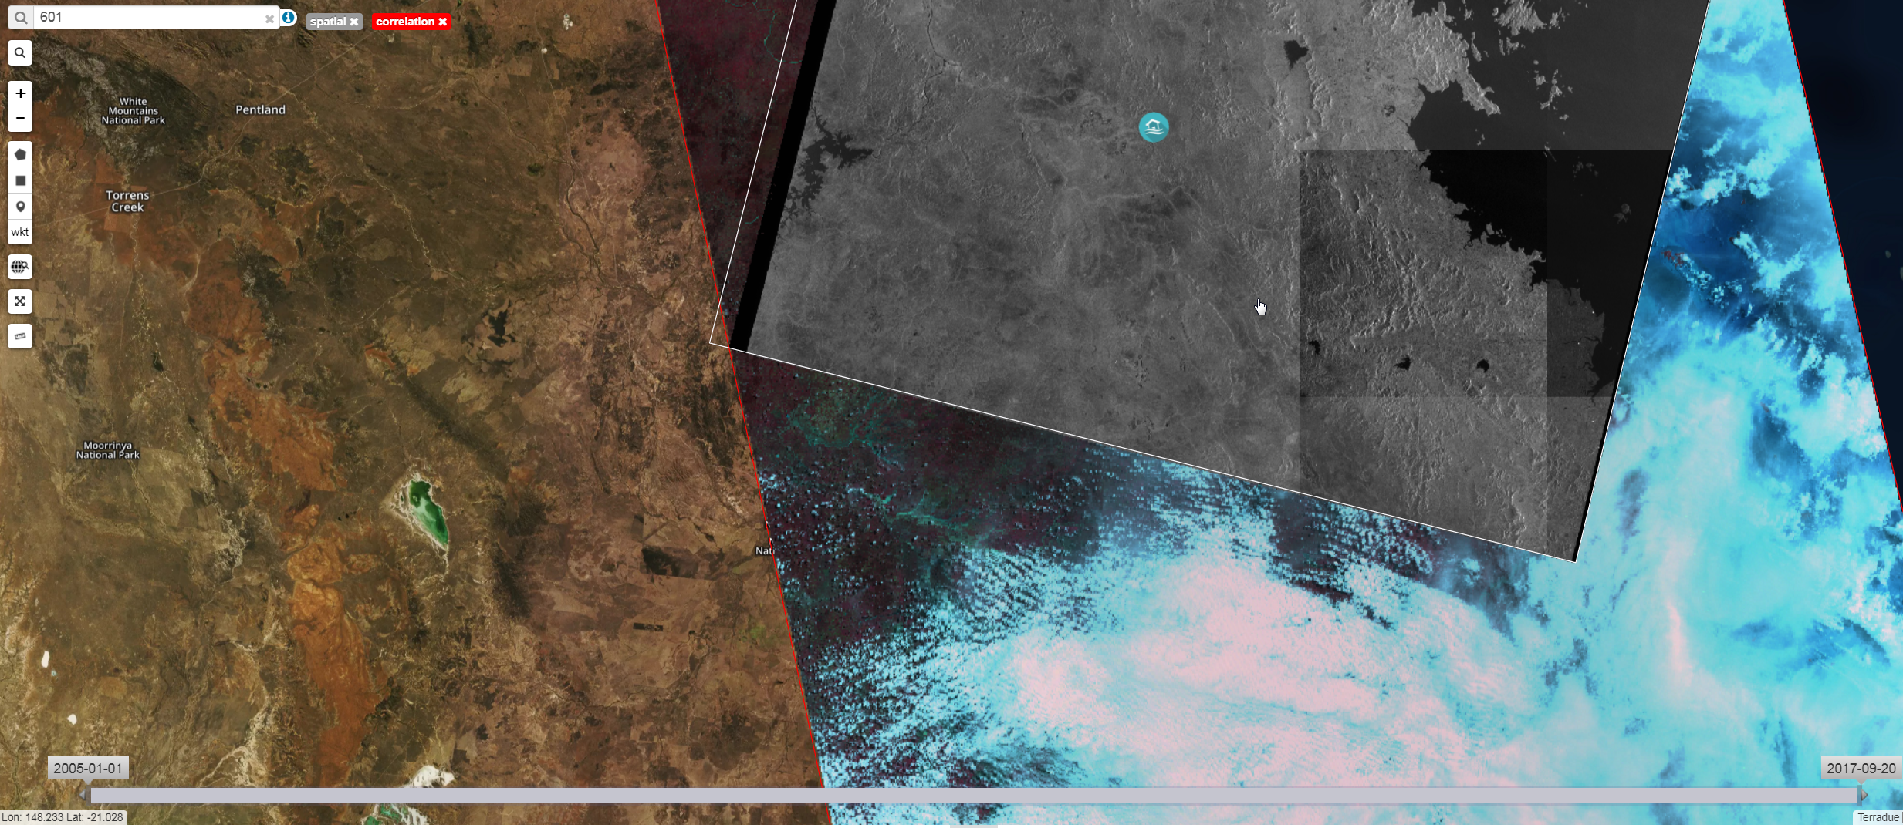

The GEP Charter Platform Prototype
RASTER systematic service
Activation n. 522
Call ID 601
  OVERALL IMPRESSION:
  A simple visualization of images
  TODAY:
  PMs: 16 order desks (16 Agencies contributing to the Charter / 16 emails for active links or ftp to download EO data
  WHAT’S NEW: (USER NEED – RASTER):
  PMs: Faster screening and unified access in ONE PLACE to download EO data.

Slide 20
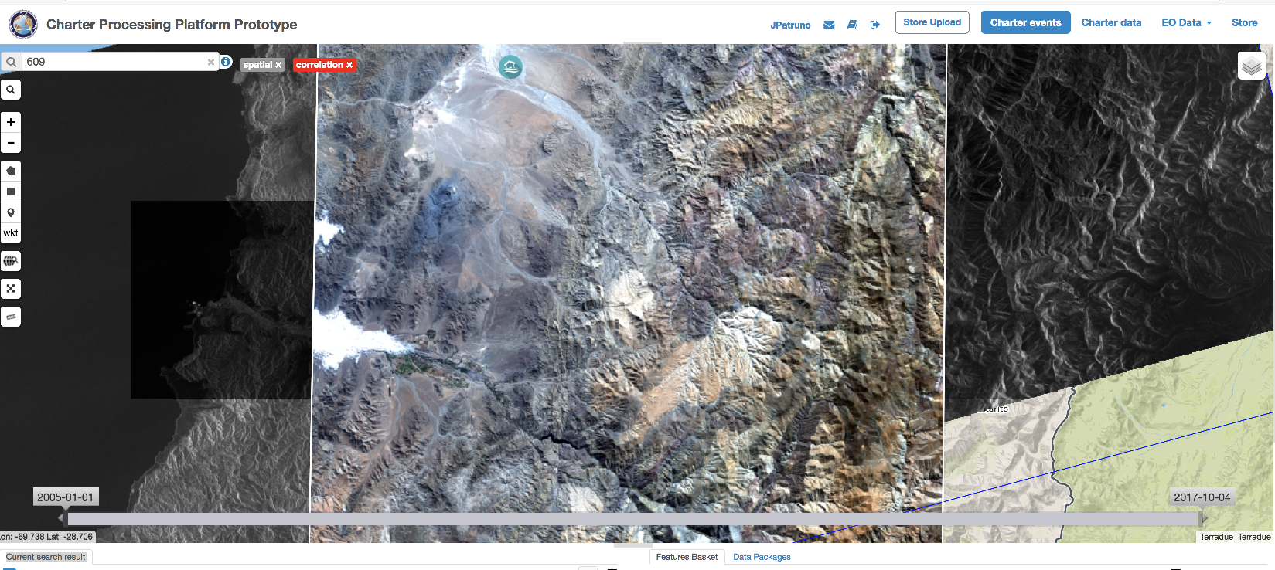
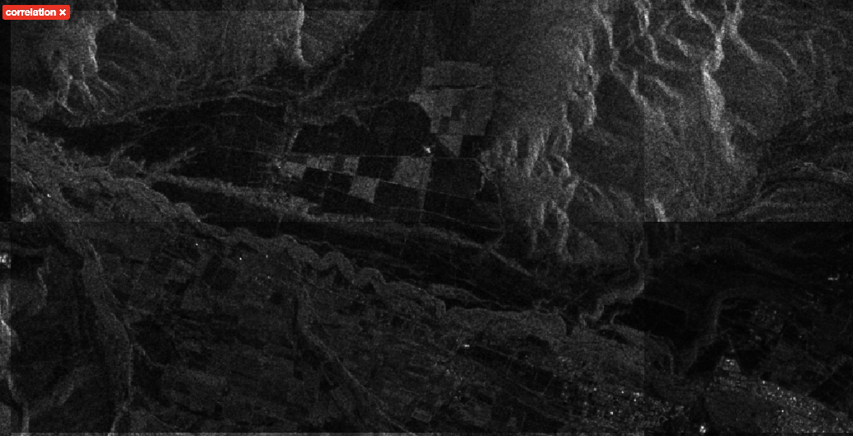
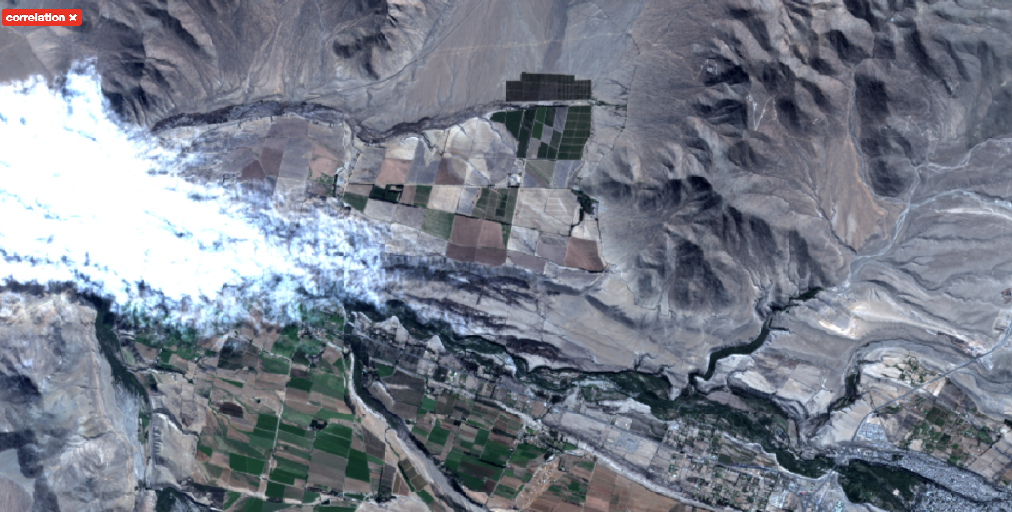
The GEP Charter Platform Prototype
RASTER systematic service
Activation n. 530
Call ID 609
Inspection of geometric accuracy
Sentinel-1 (2017-05-24) and Sentinel-2 (2017-05-19)

Slide 21
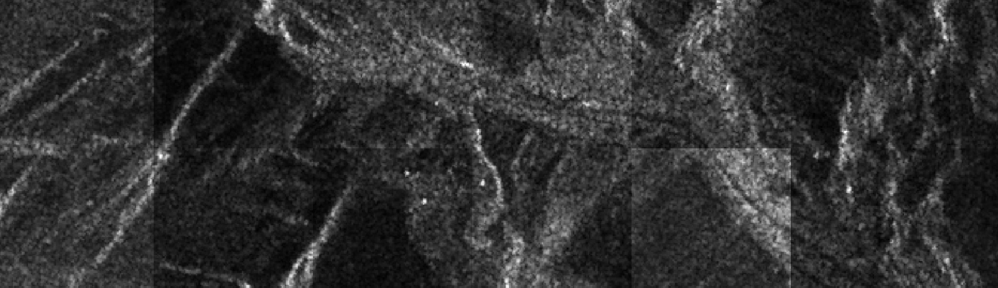
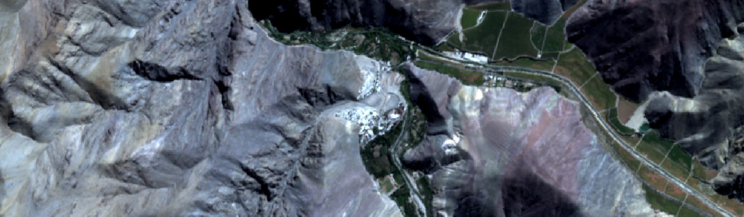
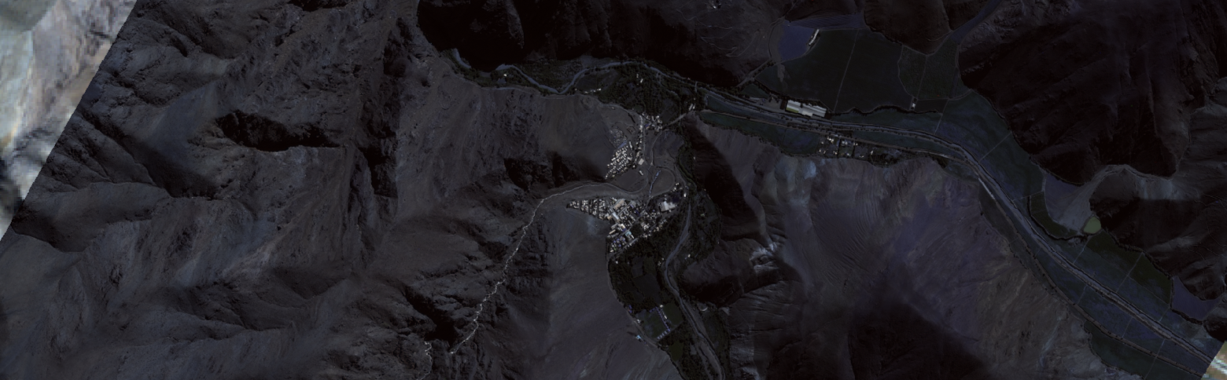
The GEP Charter Platform Prototype
RASTER systematic service
Activation n. 530
Call ID 609
Multi-sensor qualitative analysis
Sentinel-1
Sentinel-2
Pleiades

Slide 22
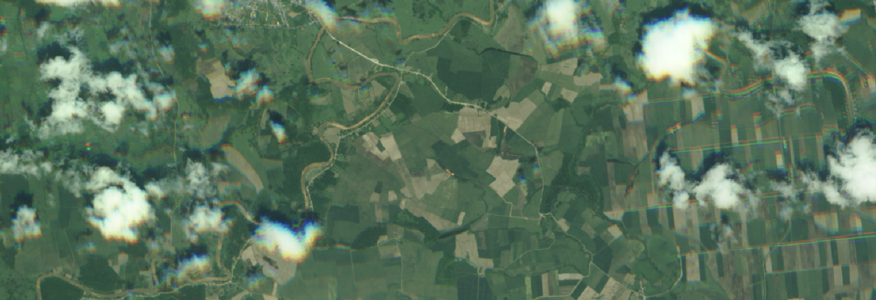
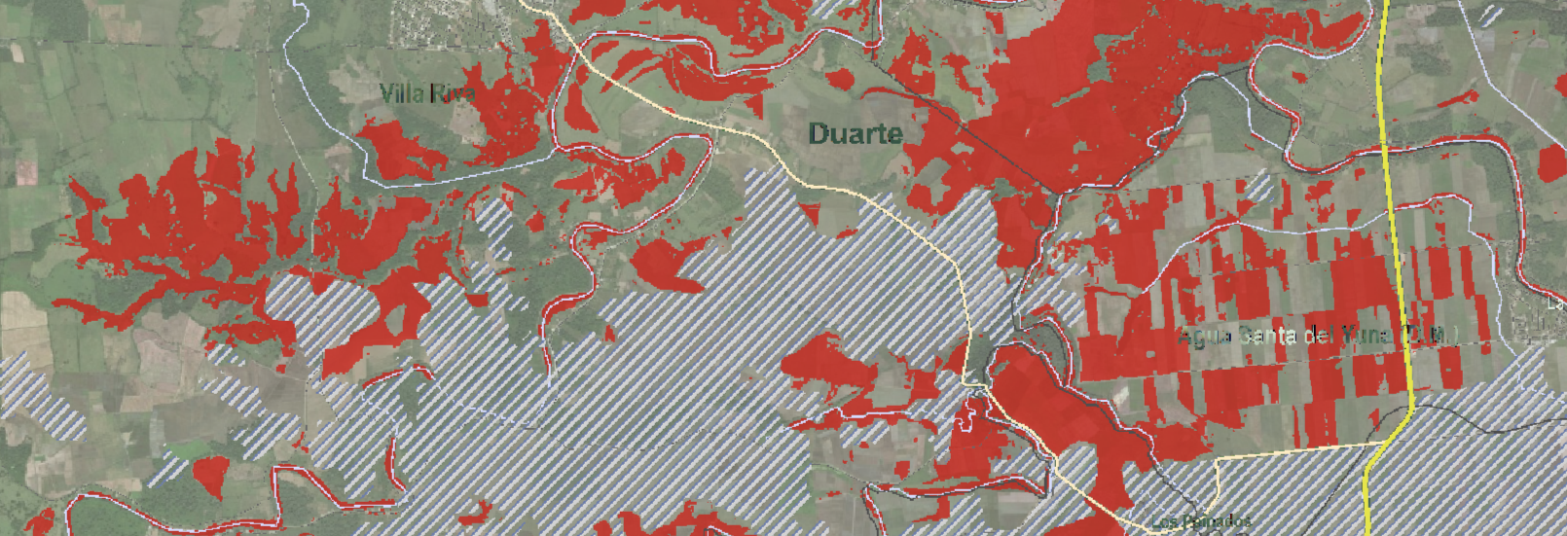
The GEP Charter Platform Prototype
RASTER systematic service
Activation n. 526
Call ID 605
Multi-sensor qualitative analysis – VA product
Kanopus-V (2017-05-24), SPOT-6 based map (UNOSAT)

Slide 23
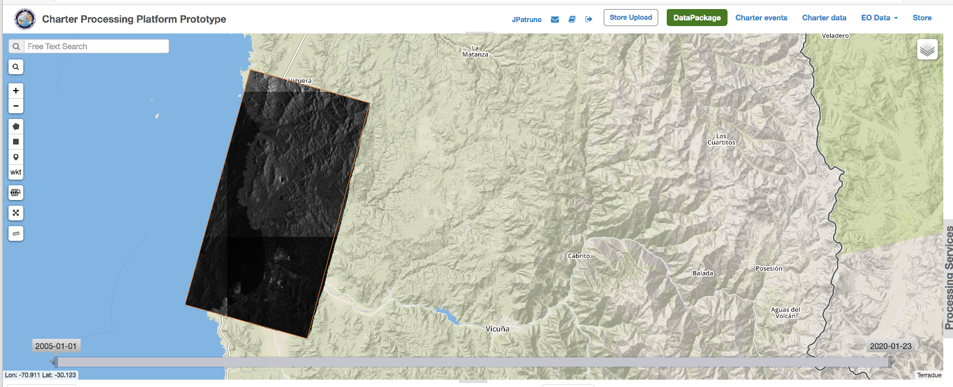
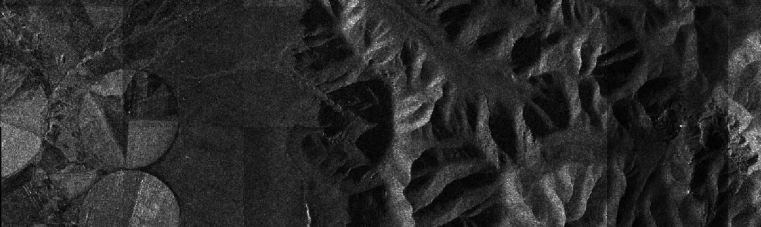
The GEP Charter Platform Prototype
Upload of external data sources
External data can be uploaded (damage maps, vector/shapefile, etc.)
EO data not delivered on line (eg. permission issues)
Basic security requirements are met (authentication, management of permissions, etc)
TANDEM-X (2017-05-14)

Slide 24
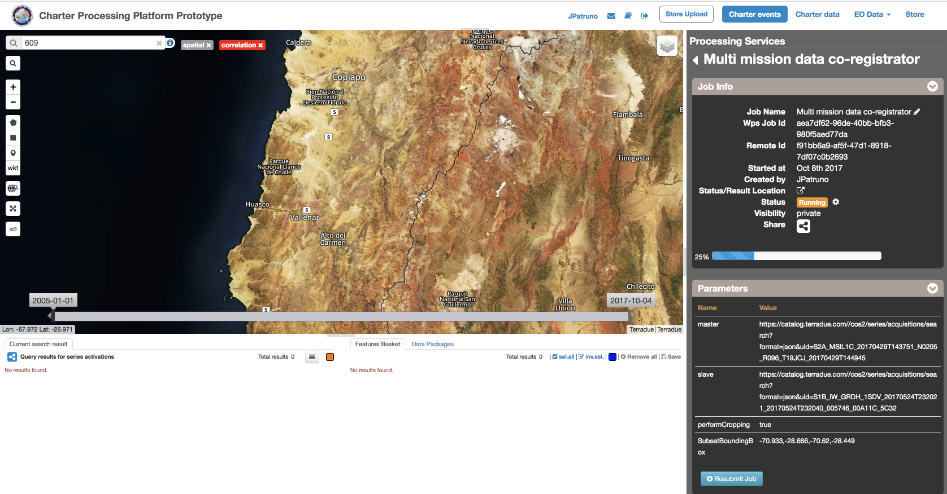
The GEP Charter Platform Prototype
COREG - Multi mission data co-registrator on-demand service
- Selection of the area
- Parameters setting (the User customizes the processing chain)
- Download of the output result

Slide 25
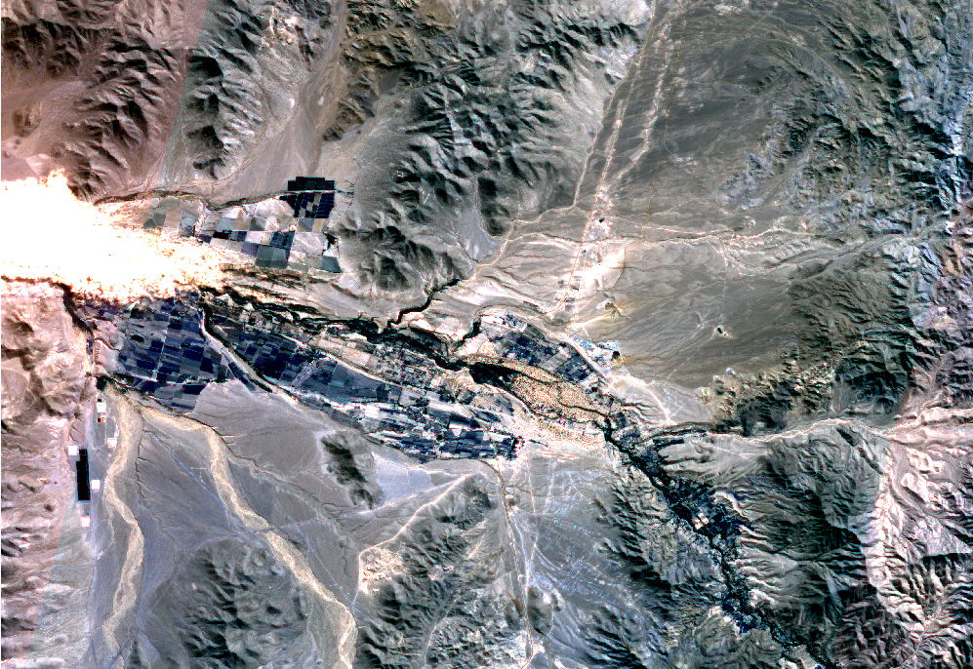
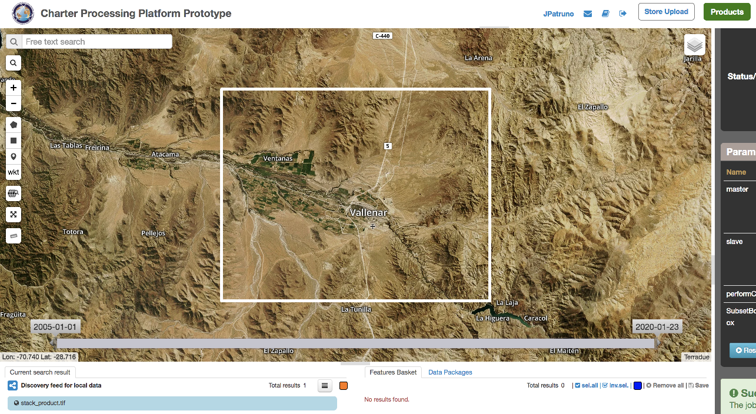
Charter Platform Prototype:
Use Case B overview (in progress)
The GEP Charter Platform Prototype
COREG - Multi mission data co-registrator on-demand service
Activation n. 530
Call ID 609
Sentinel-1 (2017-05-24) and Sentinel-2 (2017-05-19) Stuck product
  WHAT’S NEW (USER NEED – COREG):
  Possibility to perform Multi mission stack co-registered images within the Geobrowser (customizing the processing chain).
  Quick identification of useful EO data
  Multi sensor combination RGB results (GIS environment)

Slide 26
Thank you

