Slide 1

Copernicus DIAS
Committee on Earth Observation Satellites
European Commission
CEOS 2018 Chair team
WGISS
11th April 2018

Slide 2
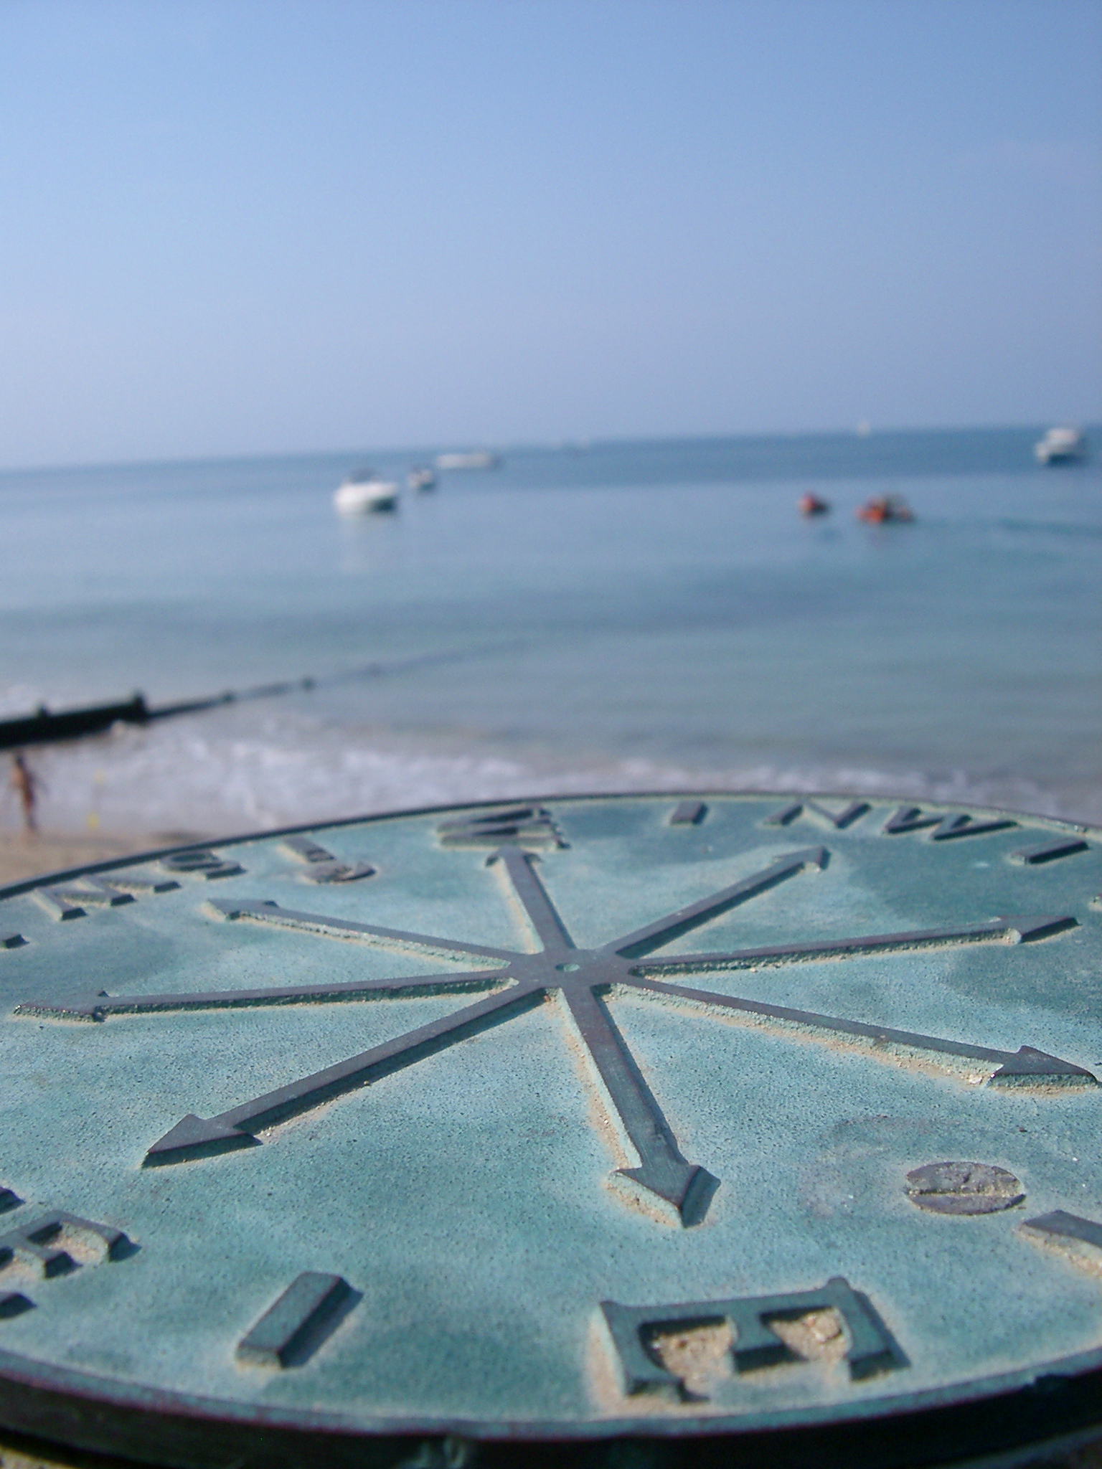
Objectives
Provide visibility on the implementation of the Copernicus Data and Information Access Services
Invite WGISS contribution to the CEOS FDA Big Data Workshop

Slide 3
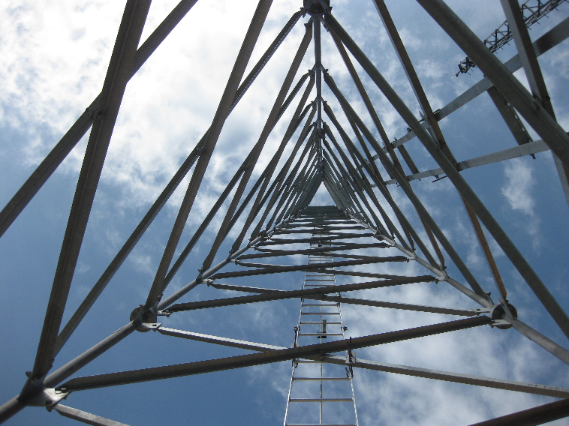
Structure
Challenge & DIAS concept – a reminder
Status of DIAS implementation
DIAS within the EO ecosystem
Use-cases targeted
Other use cases under consideration
FDA Big Data Workshop

Slide 4

Copernicus - Challenge
Massive amounts of data
Full, open and free-of-charge
Ease of access and use
Different types of dissemination infrastructures
Member States Collaborative GS
New technology developments
ICT and EO cross-fertilisation
Interoperability with non-EO datasets
Public programmes as enablers
Growth and jobs in downstream sector
Over 10 Petabyte/year of new data
with just Sentinels-1, -2 and -3 fully operational
(data are downloaded many times over)

Slide 5

DIAS Objectives
Easy and user-­friendly; access to all Copernicus data and information
Maximise uptake and exploitation of Copernicus/ EO data in an efficient environment
DIAS as an enabler: stimulate the emergence of an ecosystem that facilitates activities by 3rd parties
Bring together research & operational, supply & demand, different data sources and know-how
Commission bears large part of common costs, defragmentation, increased efficiency and cross-fertilisation
Notes:
Easy and user-­friendly; access to all Copernicus data and information
Maximise uptake and exploitation of Copernicus/ EO data in an efficient environment
DIAS as an enabler: stimulate the emergence of an ecosystem that facilitates activities by 3rd parties
Bring together research&operational, supply&demand, different data sources (both EO and non­‐EO) and know-how (EO, ICT, thematic)
Commission bears large part of common costs, defragmentation, increased efficiency and cross-­fertilisation

Slide 6
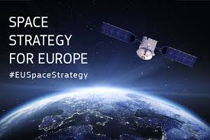
DIAS Core Principles
Access must be open and non-discriminatory
Operation must be fair and obey competition rules including for institutional demand
Transparency of governance and reporting
Must promote Copernicus brand
Intellectual property must be protected

Slide 7

Functional Requirements & More
Find the link to functional requirements here
Functional Requirements state the Copernicus - defined mandatory services
  Copernicus Distribution Services
  Copernicus Data and Information Access Services (DIAS)
And more … this focuses on DIAS-based, additional services in response to user demand
  Responds to bespoke user needs
  E.g. added data, tools, compute …
More
User
DIAS Mandatory Functions

Slide 8

DIAS Mandatory (public) Functions
Data holdings*
Sentinel data (-1, -2, -3, -5p)
Copernicus Services Information
Selection of Third party data
Services
Discovery and View services, Basic downloads
Basic Programming / application environment
Free/open source tools
Basic user support services
* Temporal and geographic coverage may differ from one DIAS provider to another

Slide 9

DIAS Other Functions
Commercial Offers
Data
  Hosting of Third Party data (e.g. Commercial, Institutional data)
Services
  Advanced development and application environment
  ICT resources (Storage & processing power)
  Advanced/commercial tools
  Third Party business hosting
Market place for Third Party value- adding services
* Temporal and geographic coverage may differ from one DIAS provider to another

Slide 10










DIAS - Functional Context
End user: customer to third-party services
Funded by
third-parties
Copernicus Services & user uptake
Copernicus Data & Information Access Services
Open Science Cloud & GEOSS Common Research and Innovation Projects (H2020)
Infrastructure (GCI)
Front
office service
Front
office service
Front
office service
Front
office service
Front
office service
Front
office service
Front
office service
Front
office service
Front
office service
Front
office service
Front
office service
Heritage Data (LTDP+), Earthnet
EOEP-5 EO Science for Society
EarthWatch CCI, InCubed
Copernicus DIAS interfaces
DIAS
funded
EU MS & participating countries
National/commercial missions data access
Sentinel Collaborative Ground Segment
Copernicus Data & Information
Other EO and non-EO data
User data integrated into DIAS
Third-party
Users
&

Slide 11

DIAS Rollout Schedule
Five DIAS are being set up
DIAS providers pursue different approaches, based upon their own technology choices and sustainability strategies
All comply to mandatory requirements
DIAS are currently in the set-up phase
Operational launch will be in June with a defined level of initial services – Baveno event 21 June
Further incremental addition of data/service offers by the DIAS for December 2018

Slide 12



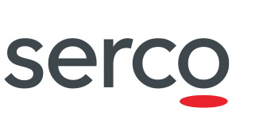
DIAS Providers – contact@ramp-up
Alek Cesarz
alek.cesarz@creotech.pl
Anne Chanié
anne.chanie@airbus.com
Contact for EUMETSAT DIAS
will be published once
commercial provider is selected
Jean-Baptiste Lavedrine
jean-baptiste.lavedrine@atos.net
Guido Vingione
guido.vingione@serco.com

Slide 13
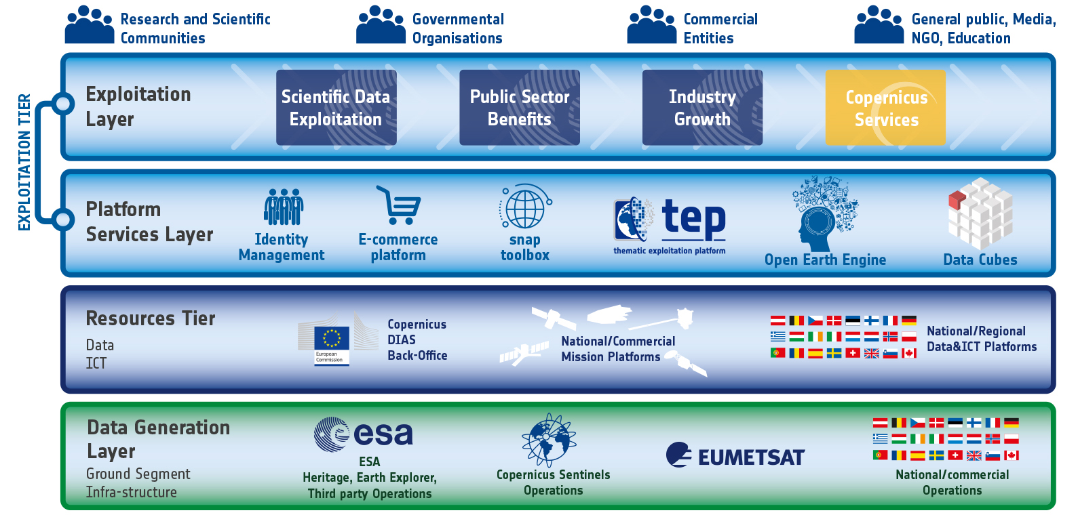
DIAS within the EO Ecosystem

Slide 14
Use-Cases: to maximise …
… return on investment – Institutional
Progressive integration of DIAS into national Collaborative Ground Segments, Operational and research infrastructures, cross-sectorial development of big-data applications
Support to on-boarding of national, industrial and in-situ data
Support to development of (open source) tools , standards and best practice for interoperability
… return on investment – Industry
Creation of a market place for EO data and services
Integration of industry data and services into the DIAS ecosystem

Slide 15

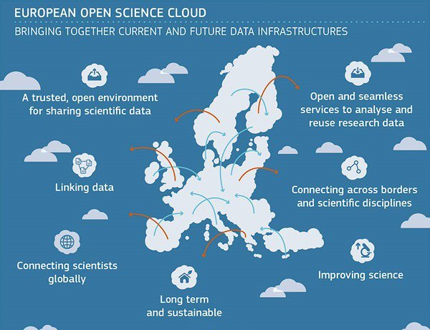

Other Use-Cases in Discussion
Copernicus in support to the EU Common Agricultural Policy implementation
Copernicus data and information as part of the European Open Science Cloud – through integration of DIAS-based offers
Use of DIAS within EU Research Programme Horizon 2020
Connecting Copernicus to Artifical Intelligence research through DIAS

Slide 16

FDA Big Data Workshop - Boulder
A detailed look at ongoing FDA work from FDA co-chairs
Presentations by identified CEOS agencies of their Big Data projects from an operational and implementation standpoint
A return on experience from the SEO regarding cooperation with AWS
Status of related WGISS work – what challenges are identified and what solutions exist or are under development
One key challenge relates to obtaining and understanding user and usage information
26 April
Prepare today

