Slide 1
COLOMBIAN DATA CUBE
Horizontal Scalability for the Colombian Data Cube
Institute of Hydrology Meteorology and Environmental Studies IDEAM
Sub-direction of Ecosystems
Los Andes University – System Engineering Department

Slide 2
CONTENT
Introduction
Advances (Web Portal and algorithms)
Current implementation
Results
Conclusions

Slide 3
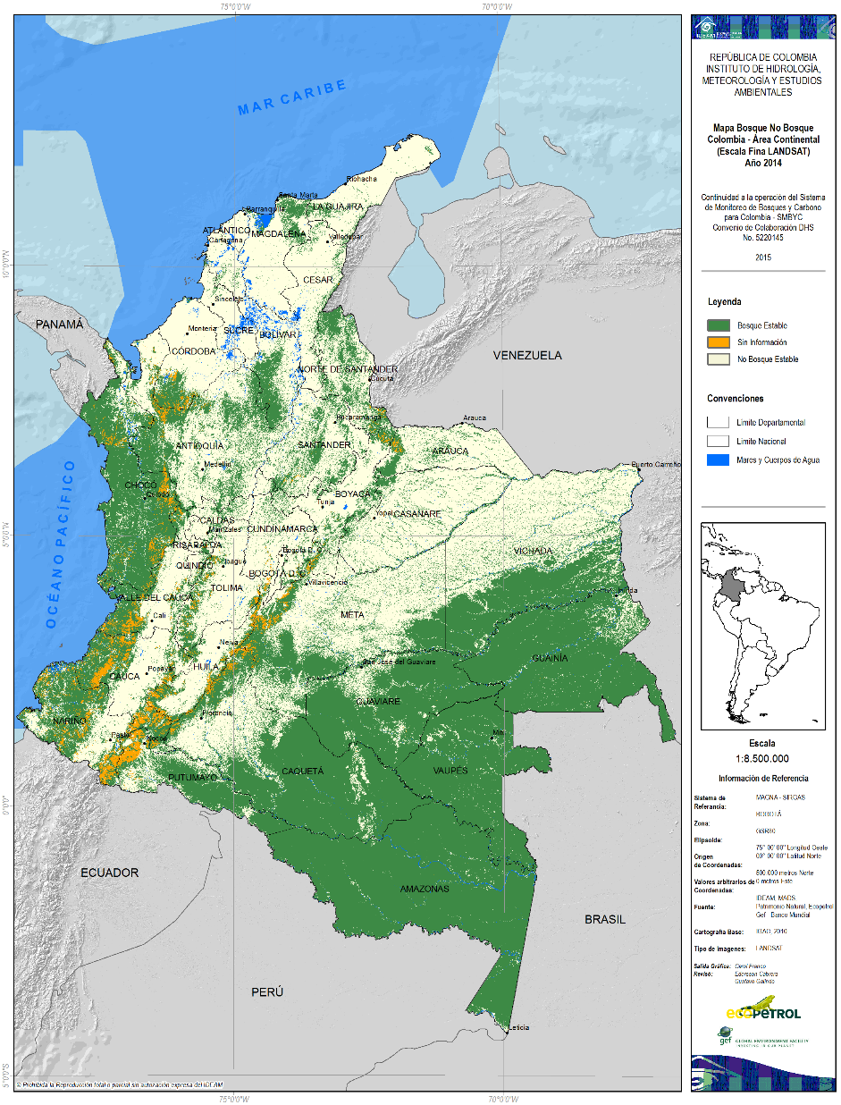


Forest & Carbon Monitoring System
Semestral
2016
Colombian Data Cube
R&D component of the SMBYC

Slide 4
CDCol Time Line
2015
2016
2017
2018
Version 1.5
Mini- Data Cube
Ingestion: 1500 scenes
Algorithms
Horizontal Scalability
New algorithms
Sentinel 1 Testing
Capacity building
Version 2.0
Bank of algorithms
WUI
Bulk ingestion
Massive ingestion: 18000 scenes
Capacity building
Data Cube Strategy (Copernicus)
Workflow module
Classification Algorithms
Sentinel 1/2

Slide 5
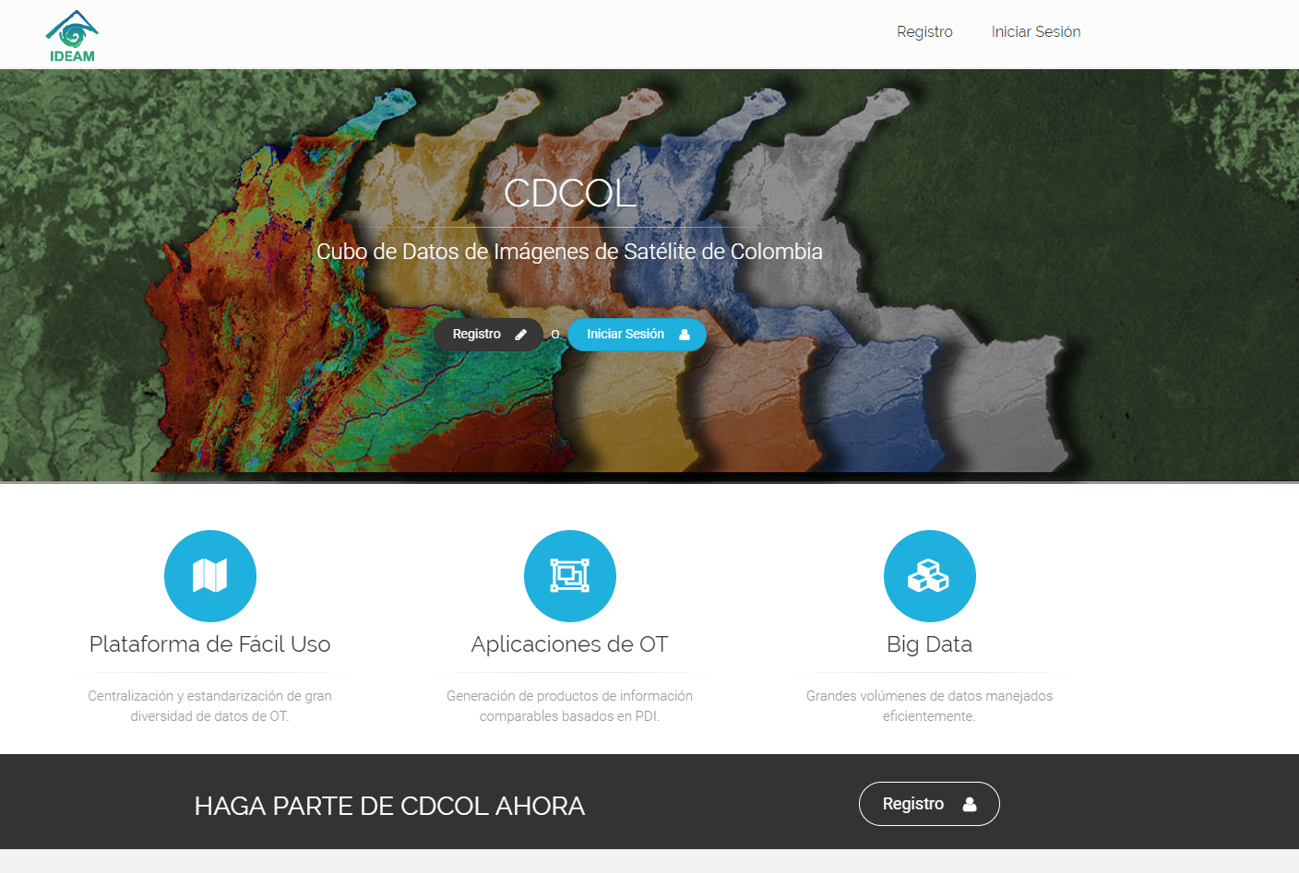
Advances
18years
2000-2018
30meters
PIXEL RESOLUTION
3sensors
LANDSAT 5/7/8 + MEDIAN COMPOUNDS
18.809scenes ingested
LANDSAT 7/8/5
5.6TB
CUBO STORAGE
1WUI
BANK OF ALGORITHMS
3 Types of users
ANALYST, DEVELOPER, ADMINISTRATOR

Slide 6
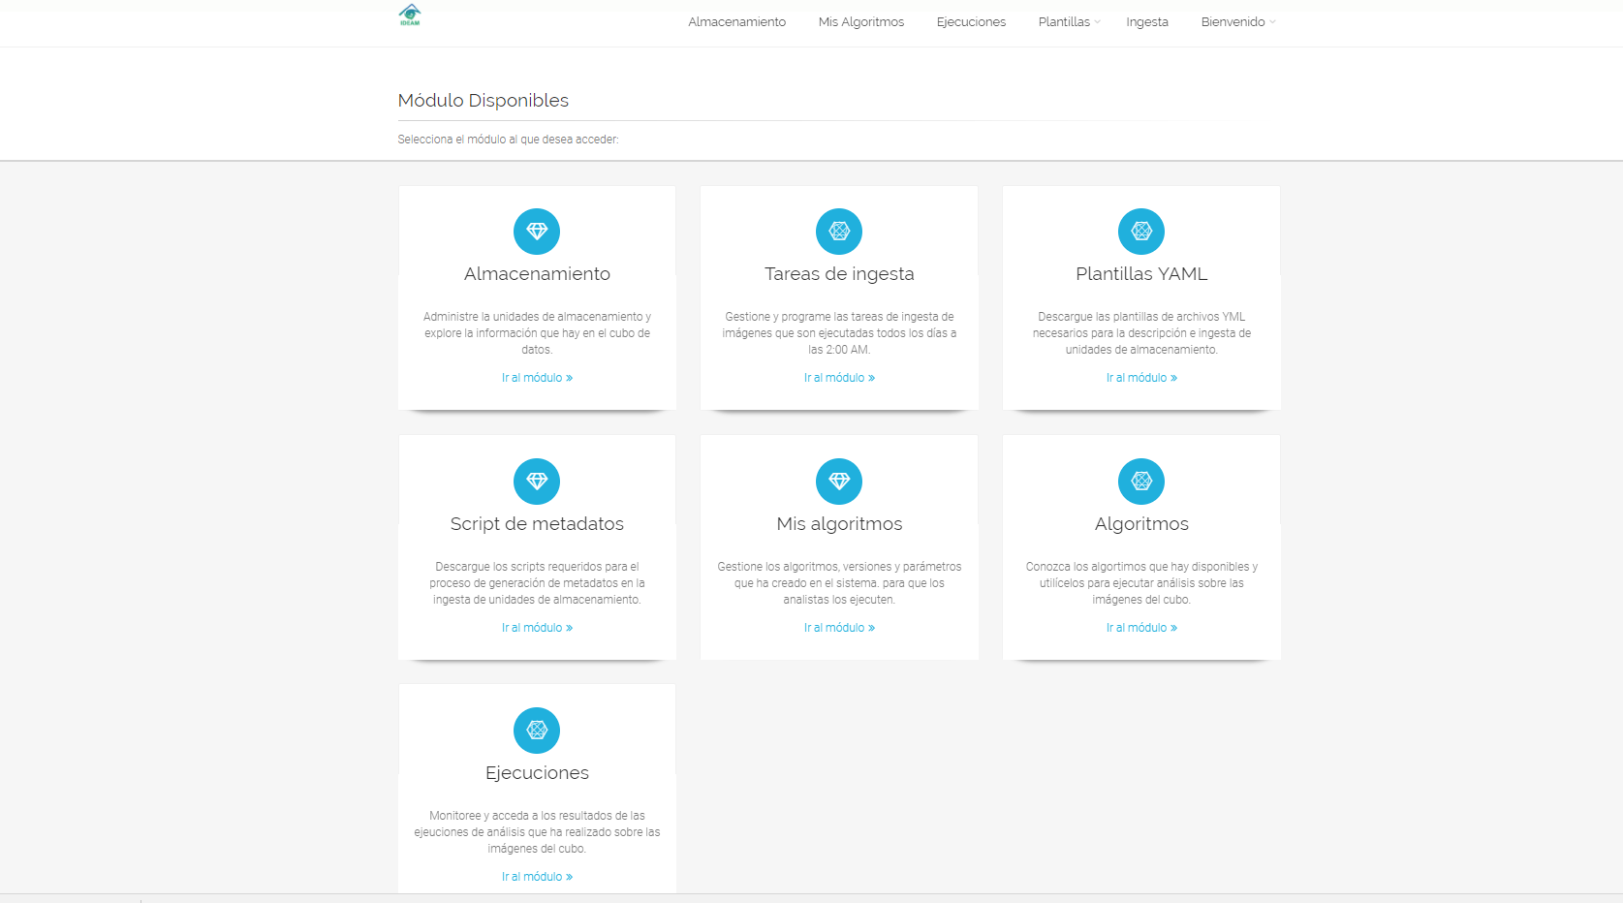

Slide 7
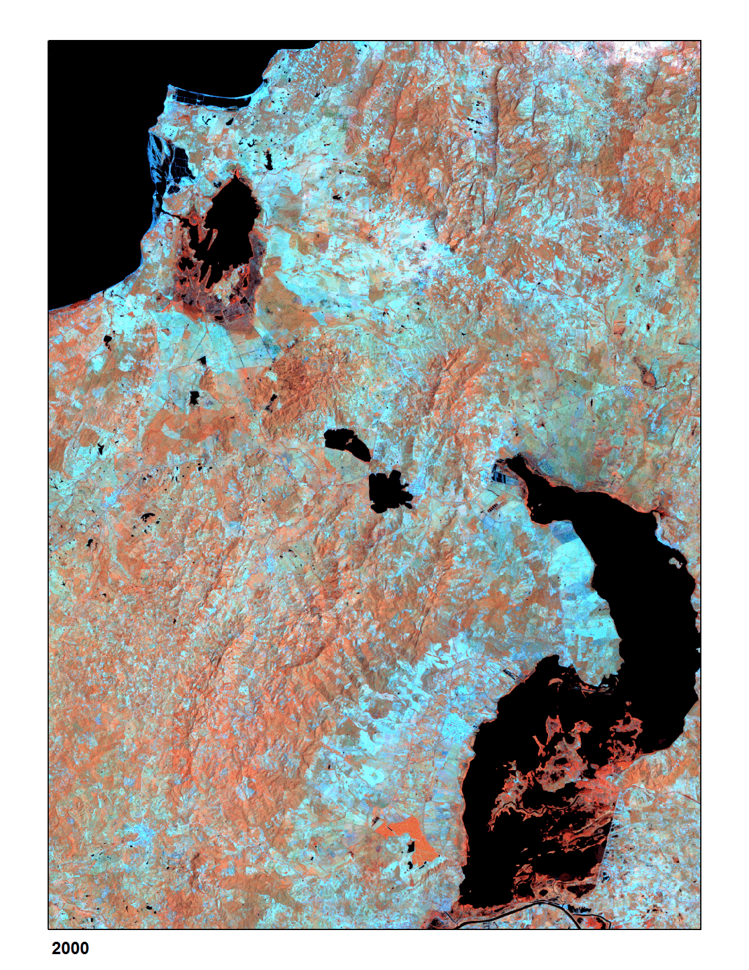
Results – Temporal median compound
18 years
FROM 2000 TO 2017
30meters
PIXEL RESOLUTION
357 scenes
LANDSAT 7/8
2min
PROCESSING

Slide 8
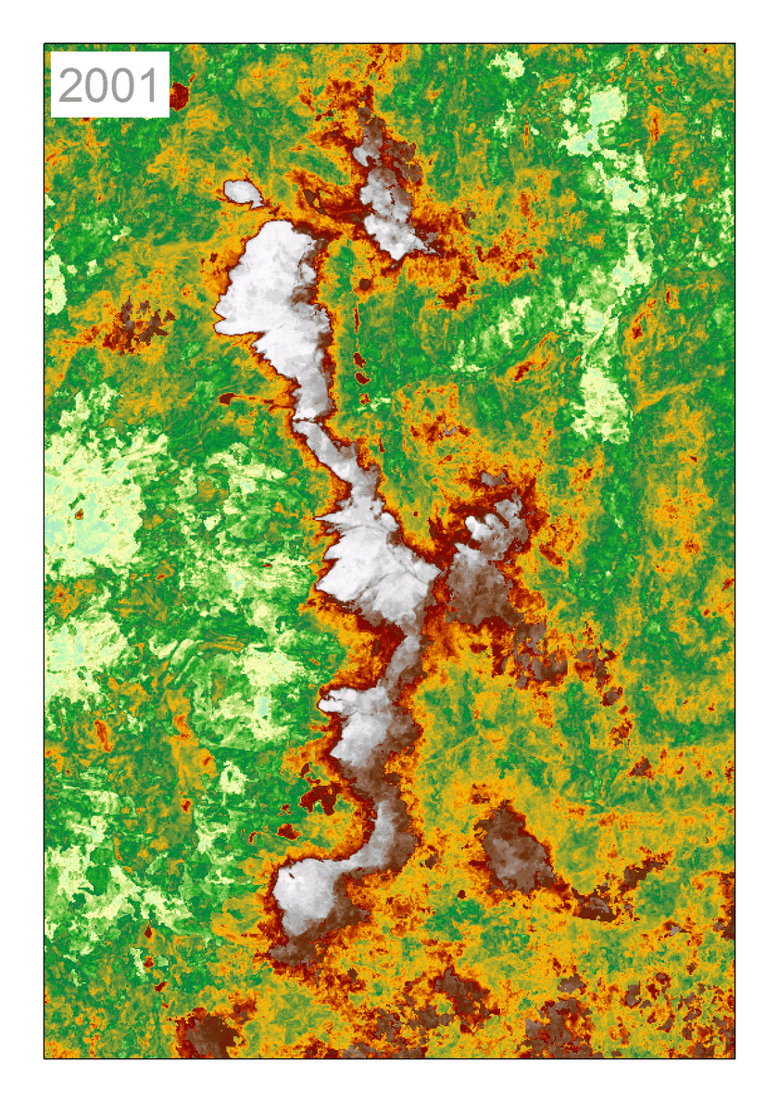
Results - NDSI
16years
FROM 2000-2016
30meters
PIXEL RESOLUTION
342 scenes
LANDSAT 7/8
22min
PROCESSING

Slide 9
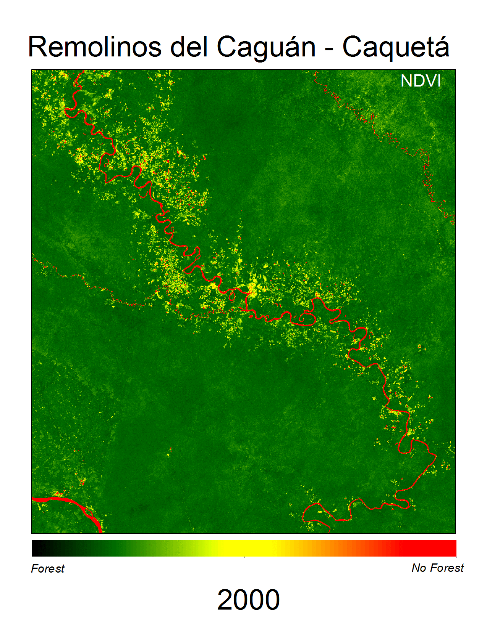
Results - NDVI
18 years
DATOS DE 2000-2015
30meters
PIXEL RESOLUTION
462 scenes
LANDSAT 7/8
26 min
PROCESSING
Notes:
Normalized Difference Vegetation Index

Slide 10
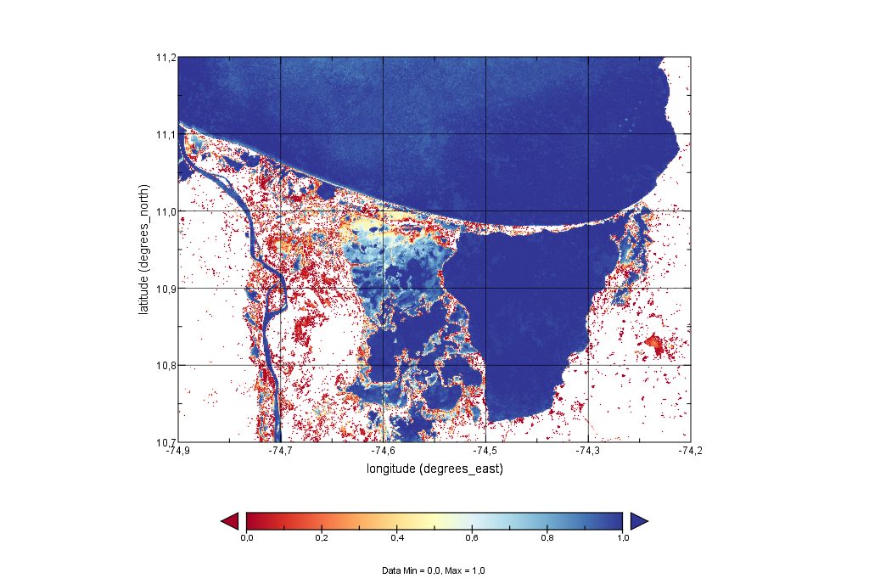
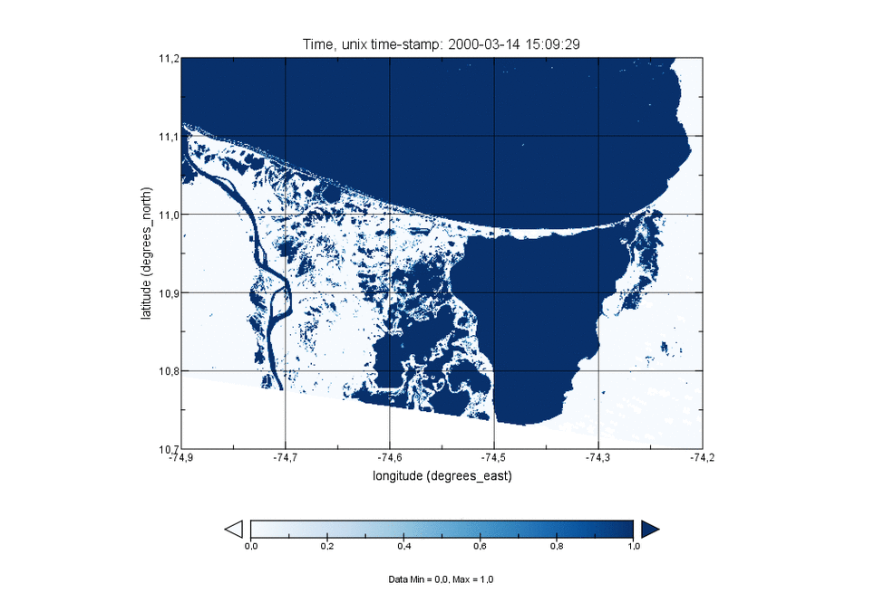
Results - WOFS
15years
FROM 2000 TO 2014
30meters
PIXEL RESOLUTION
294 scenes
LANDSAT 7/8
8h
PROCESSING

Slide 11
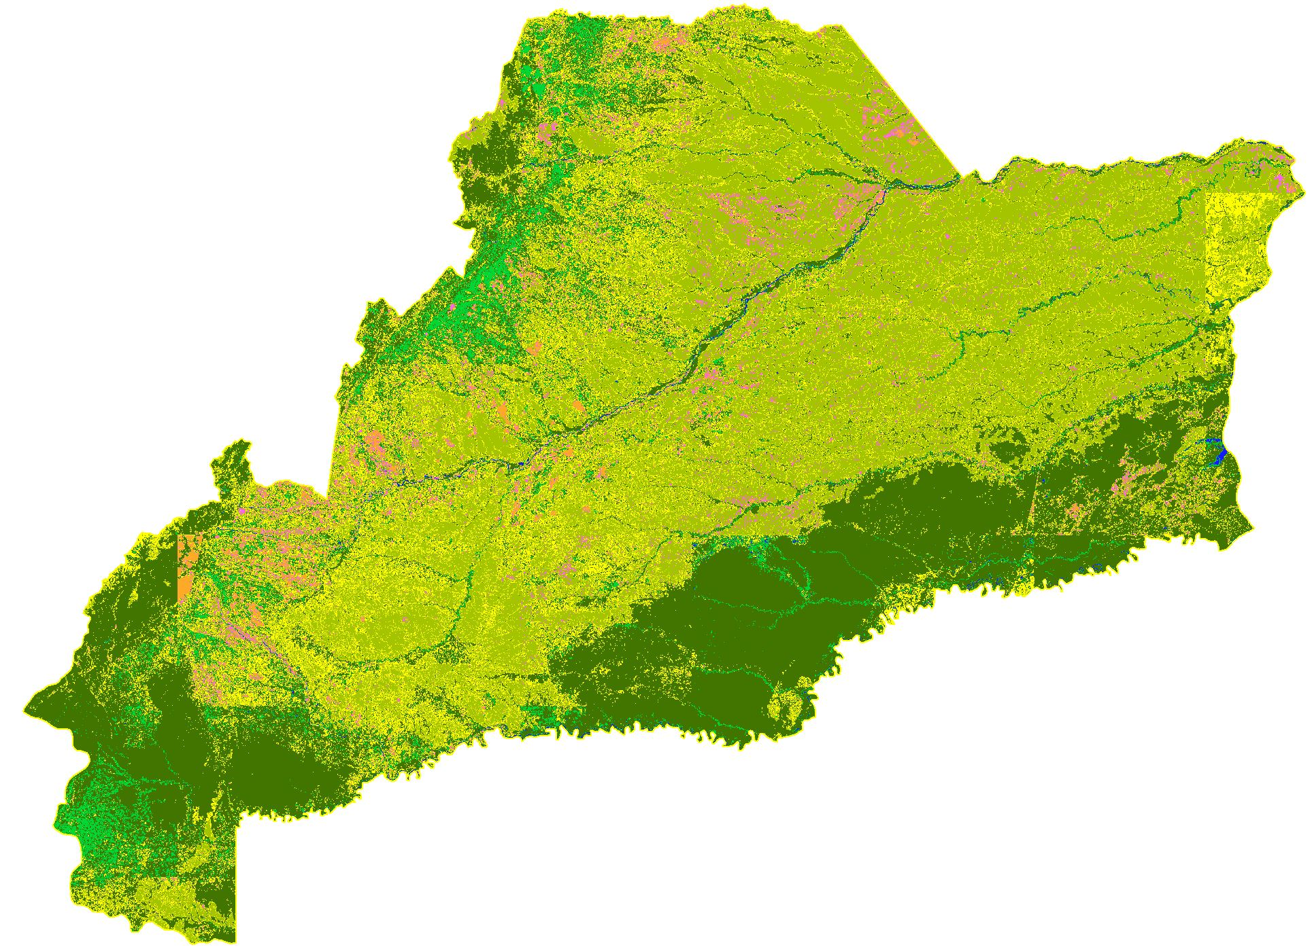
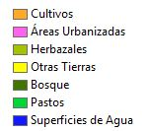
Results – Generic Classifier
1year
2016
30meters
PIXEL RESOLUTION
14 scenes
LANDSAT 8
1,1h
PROCESSING
1python library
RANDOM FOREST

Slide 12





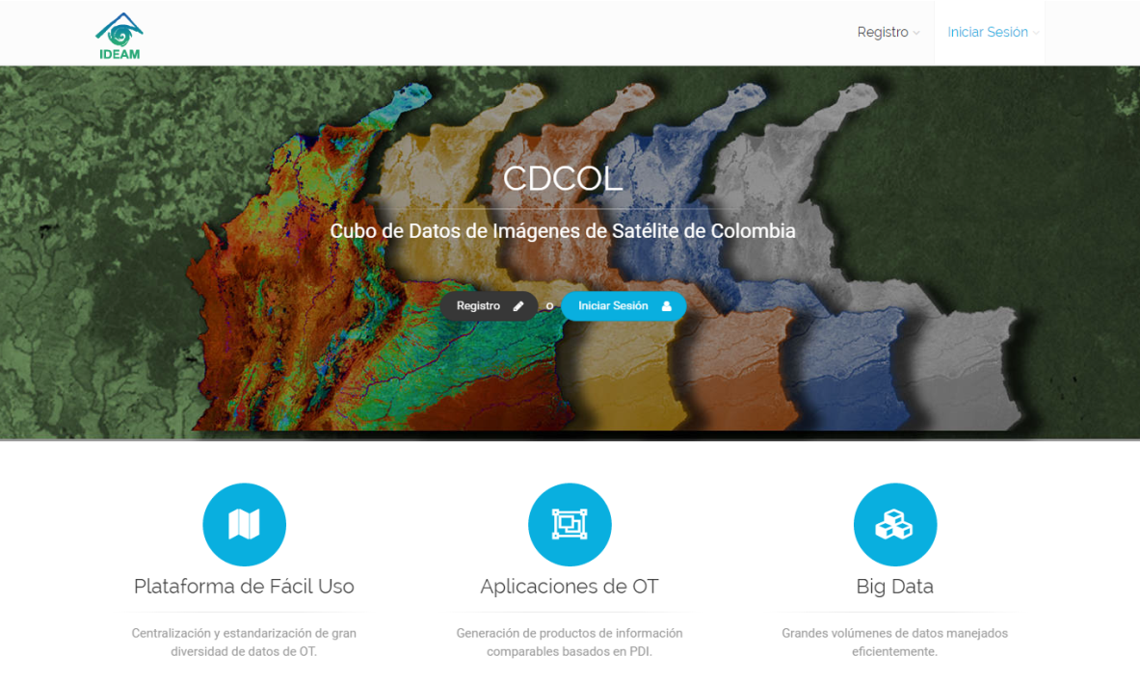





Current Implementation
Data Manager
Developer
Analyst
System Admin
Portal Web CDCOL

Slide 13
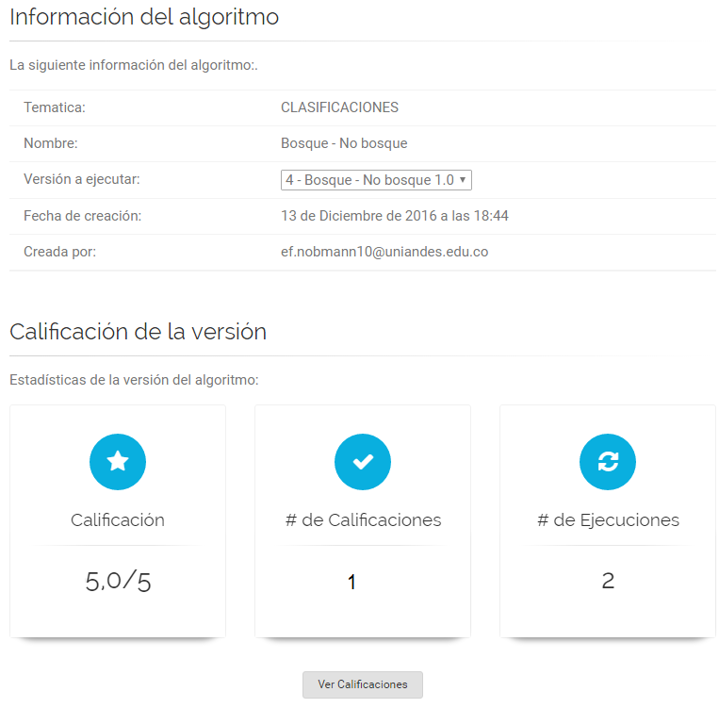
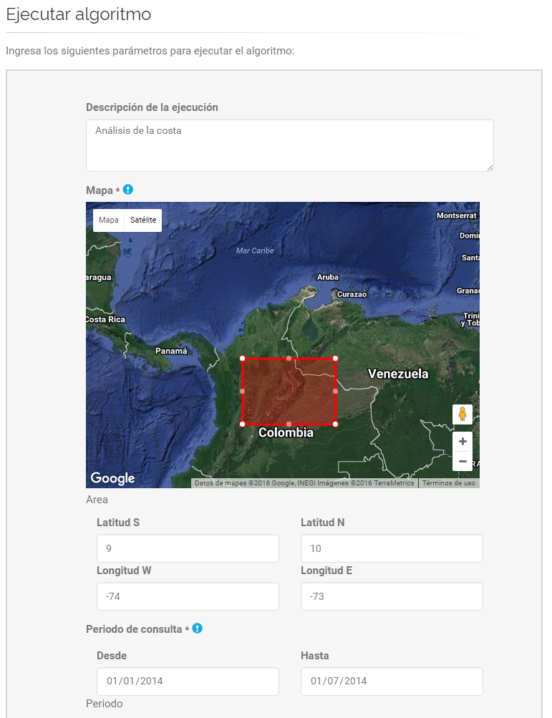
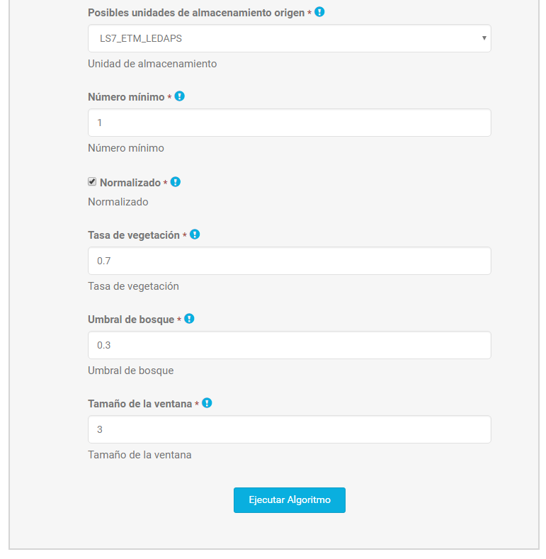
Current Implementation

Slide 14
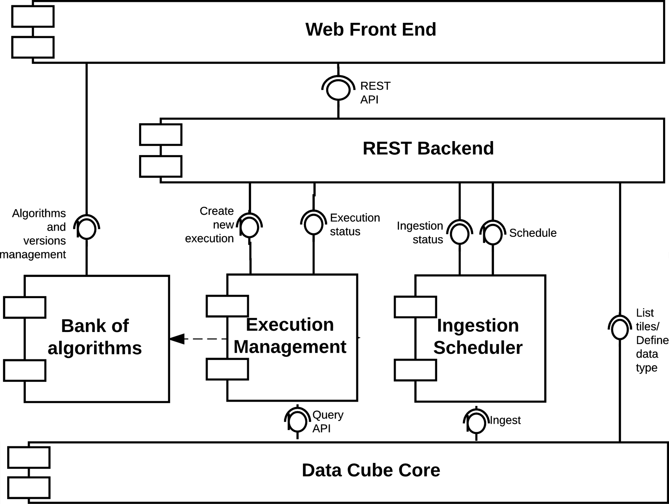
CDCol Components

Slide 15
CDCol Components
OpenDatacube/
datacube-core

Slide 16
CDCol Components

Slide 17
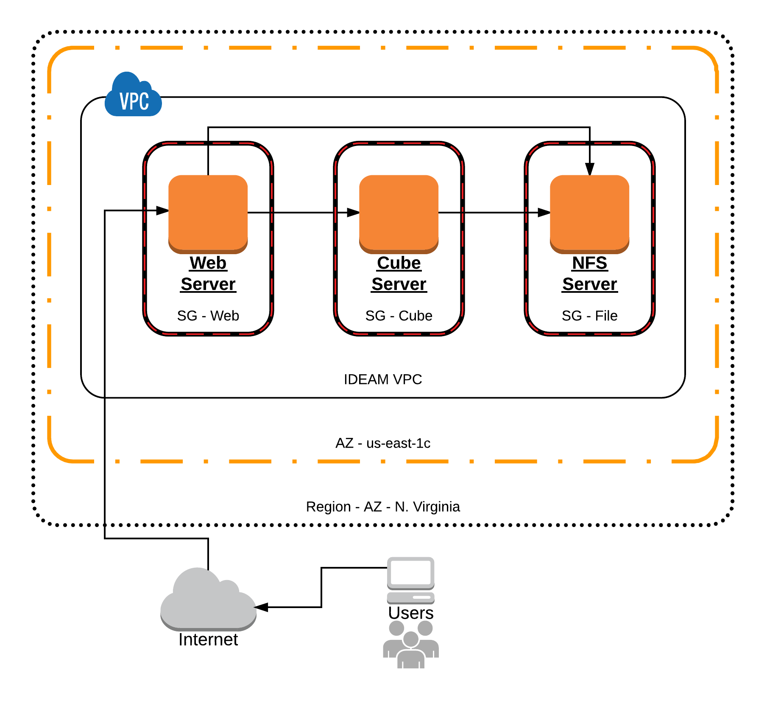
CDCol Old Architecture
Three instances are required to run the old architecture.
We executed performance tests for this architecture on Amazon Web Services (AWS).

Slide 18
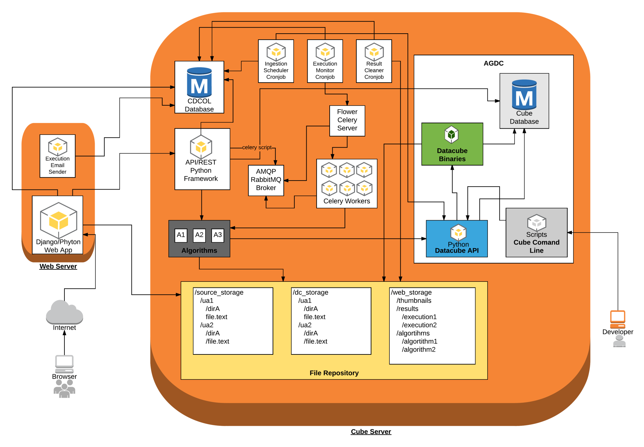
CDCol Old Architecture

Slide 19
CDCol Old Architecture
A single machine to run bulk ingestions and algorithms tasks.
  Bulk ingestions and algorithm executions can not be executed concurrently.
  It is not possible to increase the number of algorithm tasks than can be executed concurrently in the Cube Server due to hardware restrictions. This restriction limits the throughput of the datacube and impact the time to get results in large analysis.

Slide 20
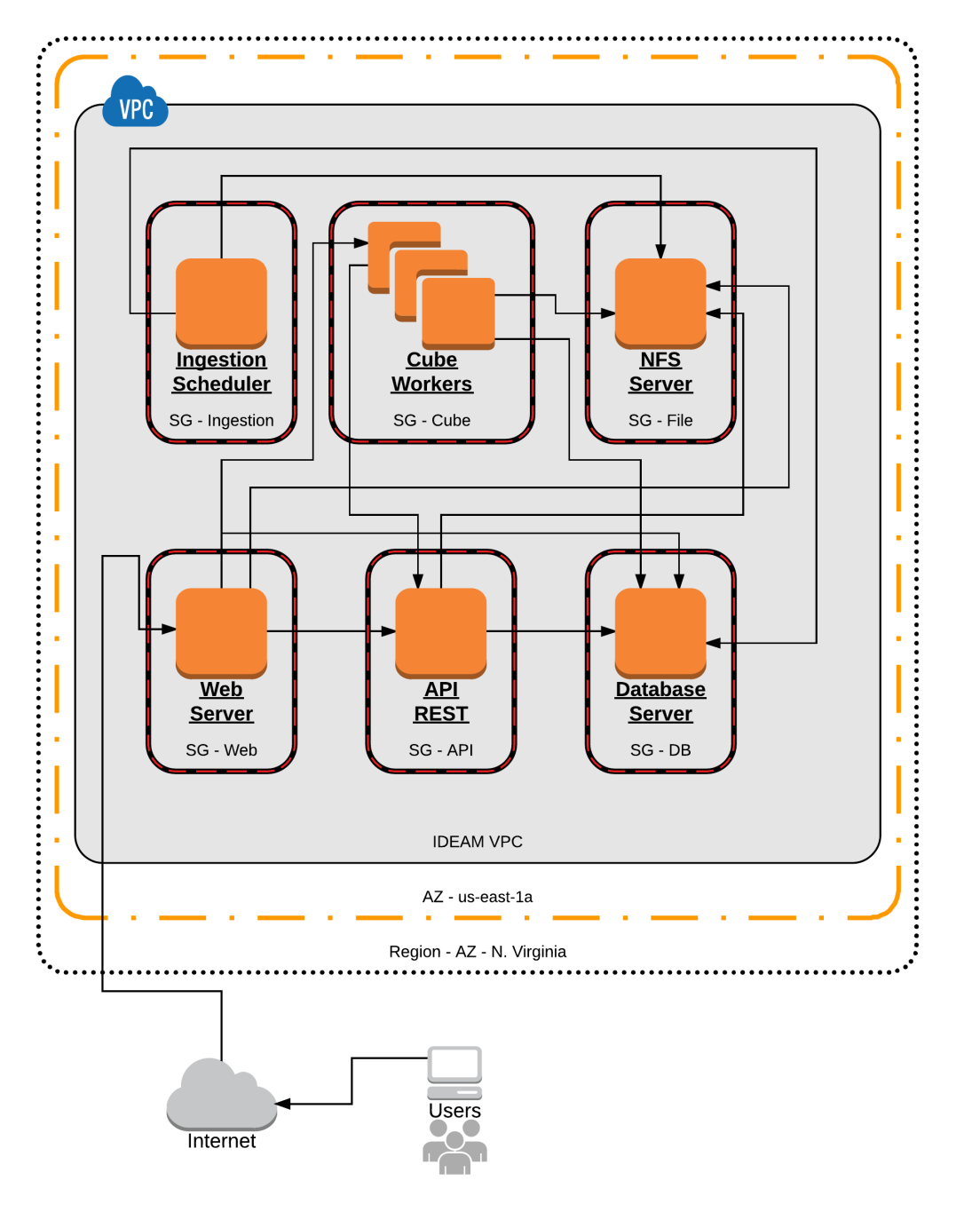
CDCol New Architecture
At least six instances are required to run the new architecture.
We executed performance tests for this architecture on Amazon Web Services (AWS).

Slide 21
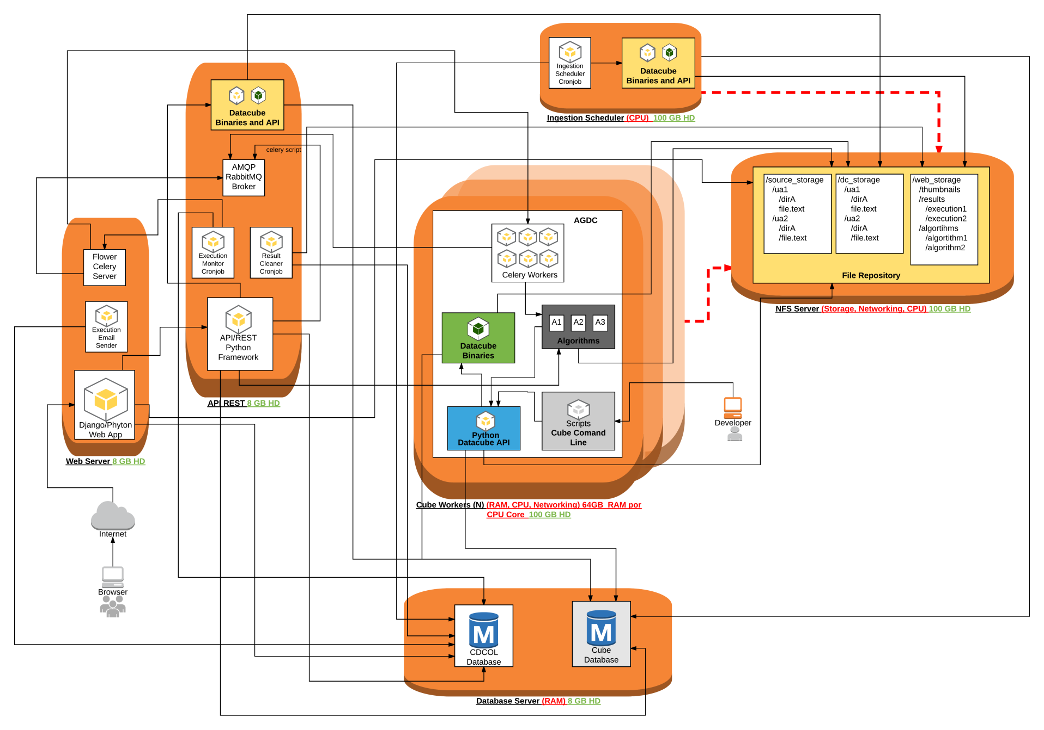
CDCol New Architecture

Slide 22
CDCol New Architecture
A single machine dedicated to run bulk ingestions.

Slide 23
CDCol New Architecture
A single machine dedicated to run bulk ingestions.
Several machines to run algorithm tasks. These machines can scale horizontally to increase the number of tasks than can be executed concurrently.

Slide 24
IDEAM Infrastructure
Virtual Machine | Quantity | RAM (GB) | CPU (Cores) | Storage | Shared Storage
Web Server | 1 | 16 | 4 Cores | 50 GB | 8 TB
API REST | 1 | 16 | 4 Cores | 50 GB | 8 TB
Database Server | 1 | 16 | 4 Cores | 100 GB | 2 TB
Ingestion Scheduler | 1 | 128 | 16 Cores | 100 GB | 8 TB
Cube Workers | 1, 2 | 256 | 16 Cores | 150 GB | 8 TB

Slide 25
AWS Infrastructure
Virtual Machine | Quantity | Instance Type | RAM (GB) | CPU (Cores) | Disk (EBS)
Web Server | 1 | t2.medium | 4 | 2 Cores (Variable) | 100 GB
API REST | 1 | t2.medium | 4 | 2 Cores (Variable) | 100 GB
Database Server | 1 | t2.medium | 4 | 2 Cores (Variable) | 100 GB
Ingestion Scheduler | 1 | m4.2xlarge | 32 | 8 Cores (26 ECUs) | 1500 GB
Cube Workers | 1, 2, 3, 4, 5 | r4.8xlarge | 244 | 32 Cores (99 ECUs) | 200 GB
NFS Server | 1 | m4.2xlarge | 32 | 8 Cores (26 ECUs) | 2000 GB

Slide 26
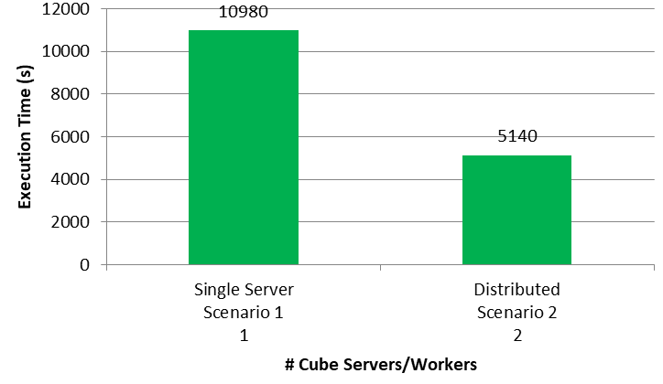
IDEAM Results - Temporal Medians Composite
Storage Unit | LandSat 8
Bands | blue, green, red, nir, swir1 & swir2
Latitude Range | 0 to 9 degrees
Longitude Range | -78 to -68 degrees
Date Range | January 1, 2013 to Decembrer 31, 2013
Tiles | 90
Tasks | 90
Classes (K-means) | 6

Slide 27
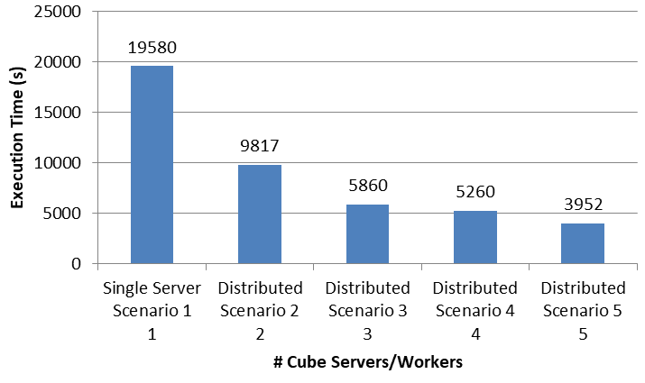
AWS Results - Temporal Medians Composite
Storage Unit | LandSat 8
Bands | blue, green, red, nir, swir1 & swir2
Latitude Range | 0 to 9 degrees
Longitude Range | -78 to -68 degrees
Date Range | January 1, 2013 to Decembrer 31, 2013
Tiles | 90
Tasks | 90
Classes (K-means) | 6

Slide 28
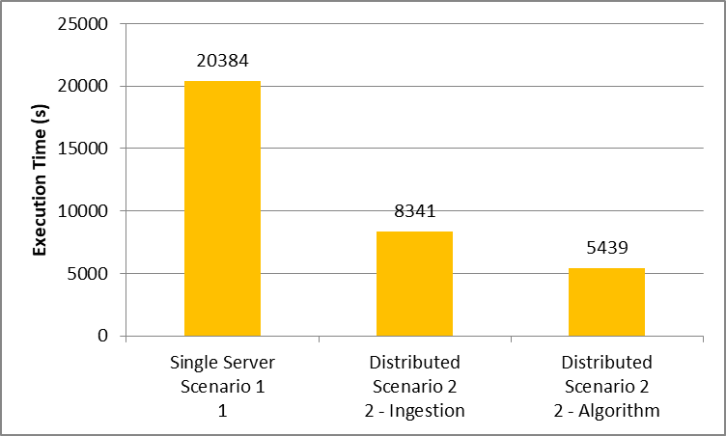
AWS Results – Ingestion Performance
Storage Unit | LandSat 8
Year | 2013
Scenes | 75
Algorithm | Temporal Medians Composite
Storage Unit | LandSat 8
Bands | blue, green, red, nir, swir1 & swir2
Latitude Range | 3 to 8 degrees
Longitude Range | -78 to -73 degrees
Date Range | January 1, 2013 to Decembrer 31, 2013
Tiles | 25
Tasks | 25

Slide 29
Conclusions
This architecture may be used as reference architecture for other institutions and research groups deploying customized version of the ODC.
The distributed architecture defined allows to scale horizontally the datacube using a cluster of Cube Servers/Workers, avoiding the vertical scaling restrictions of single server cube installations.
The installation process of the distributed architecture required a considerable effort

Slide 30
Conclusions
Performance tests with a larger number of Cube Servers/Workers are required to identify possible architecture bottlenecks as more Cube Servers/Workers are added.
Tests with other types of algorithms are also required to evaluate the behavior of the architecture with other algorithms.
Tests to evaluate the scalability of other components of the systems may be also of interest, in particular the ability to scale the bulk ingestion process.

Slide 31
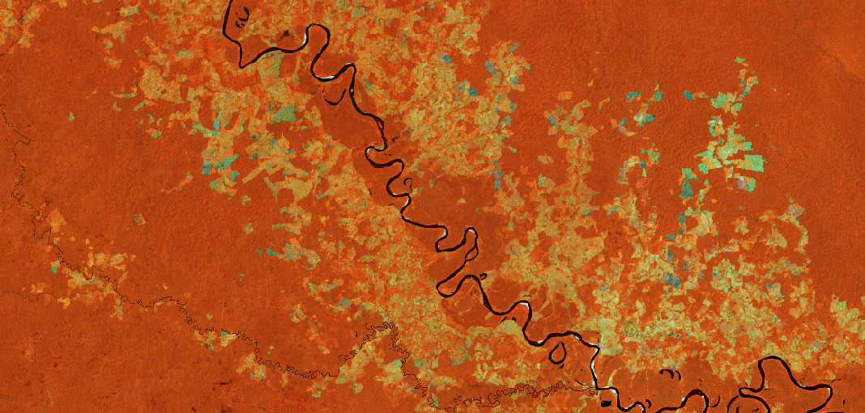
Thanks for your attention
Pilar Lozano-Rivera (plozano@ideam.gov.co)
María Teresa Becerra (mtbecerra@ideam.gov.co)
Harold Castro (hcastro@uniandes.edu.co)

