Slide 1
ESA Perspective on Datacubes
CEOS WGISS Meeting #45 - 11/04/2018
R. Leone (ESA), A. Della Vecchia (ESA)

Slide 3
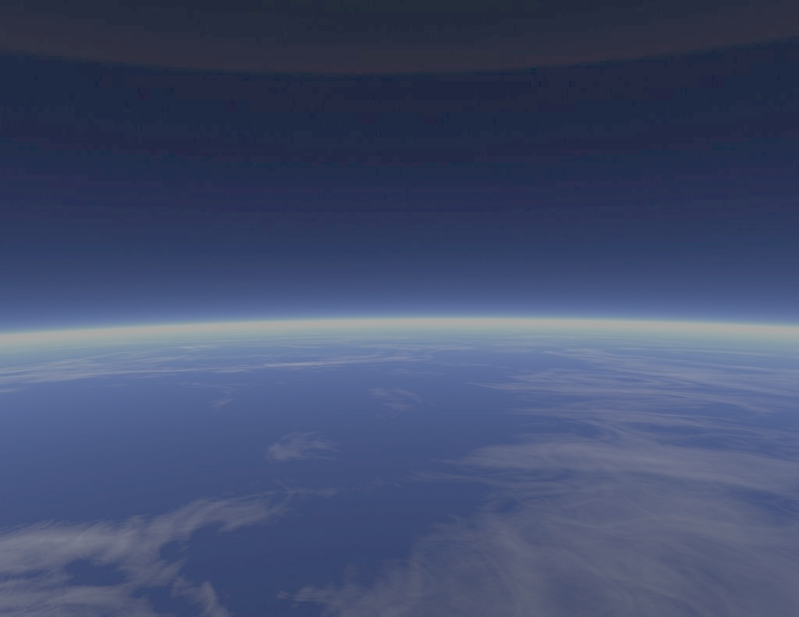
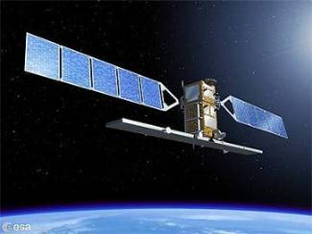
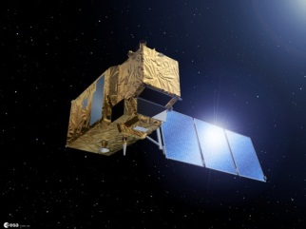
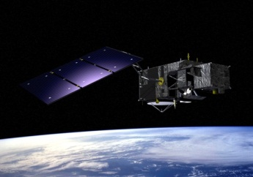
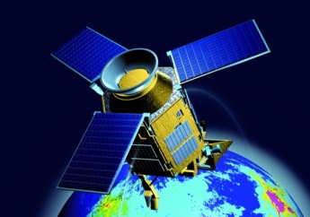
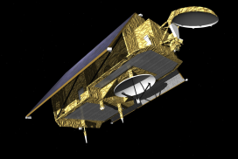
Sentinels: A New Generation of Data Source
Sent-1A/B
Sent-2A/B
Sent-3A/B
Sent-4A/B
Sent-5/5P
Sent-6A/B
Copernicus - European space flagship programme, led by the EU
ESA is responsible for space component, Sentinel development, operation of some Sentinels, data buy from other partners, system evolution
Sentinels – designed to monitor various elements of the Earth System in a fully operational manner
Free, full and open data policy

Slide 4
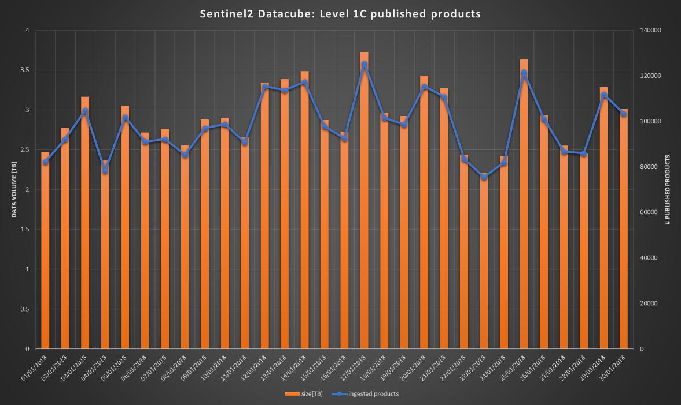
Earth observation data volume
Sentinel 2A Level 1C daily figures
Products: ~ 100.000 per day
Volume: ~ 3 TB/day
Coverage: global
Example: Copernicus sentinels constellation:
Sentinel 1 (SAR) (4 sats, 2 already flying)
Sentinel 2 (Land) (4 sats, 2 already flying)
Sentinel 3 (Ocean) (4 sats, 1 already flying)
Sentinel 5P (Atmosphere) (1 sat, already flying)
Sentinel 5 (Atmosphere) (4 sats, from 2021)
Sentinel 4 (Atmosphere)(4 sats, planned for 2021)
Sentinel 6 (OCEAN) (2 sats, from 2022 (TBC))
→ Overall more than 1pb per day generated by eo satellites

Slide 5
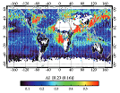
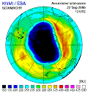
Enabling a more holistic approach
An ever-growing number of remote-sensing satellites provides the scientific community with an unprecedented wealth of long-term monitoring data.
Combined analysis of these data streams creates a huge potential to better understand the trajectories of land and marine ecosystems, atmospheric components, and the interactions of these spheres.
Can datacubes support the scientific community to adopt a more holistic approach in understanding land-marine-atmosphere interactions and the role of humans?

Slide 6
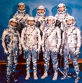
Enlarging the User Base
Standard products made available by space agencies
have a space-specific format
require space-specific tools to extract the data
and space-specific knowledge to extract the information.
Can Datacubes provide an innovative data access mechanism to ease the life for users from outside the space community?
WCS access interface starts to be well known to GIS community
Possible integration with GIS tools already operated by enlarged user community

Slide 7
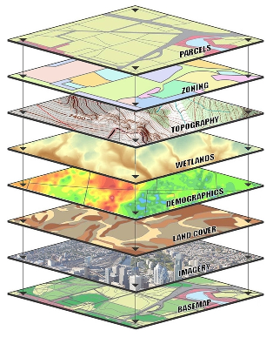
Cross-domain/-mission access
Science and applications need interaction across space missions and merge data with non-space information.
Can Datacubes support the drilling through long time series of different satellite series more efficiently?
Can Datacubes support the merging of different information sources (space, airborne, in-situ, GIS) more efficiently?

Slide 8
A Bridge from Space to Applications
ESA has experimented datacubes with 2 different levels of data:
“signal measurements” (e.g. spectral radiance, backscatter):
The ESA TPM/HM Data Cube is populated with Landsat - ERS-1/2 – ASAR - historical archive over Europe (https://eodataservice.org/): → remote sensing knowledge is required to extract information
“parameters” (e.g. land surface temperature, soil moisture, biomass, …..)
The Earth System Data Cube provides higher-level information layers readily consumable by a thematic community (http://earthsystemdatacube.net/)
→ can be directly ingested into thematic information systems without specific remote sensing knowledge
Today, parameter layers are generated periodically
by one “agreed” algorithm
Bridging between these 2 worlds is essential to get space data adopted into operational processes

Slide 9
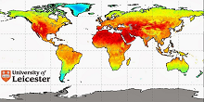
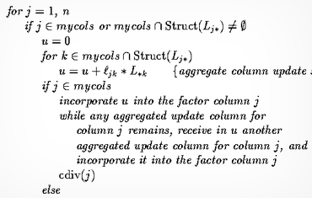
Dynamic Generation of Parameter Layers
A step change in the use of space data:
an interactive environment for the “recipe” coding & tuning ?
Can we generate information layers datacubes help to derive parameters more dynamically from “signal measurement data”?
Can we have many different “virtual” parameter layers based on the same measurement data, applying a “recipe” on-the-fly?

Slide 10
Dynamic Gridding
Agreement on a standard grid will significantly ease use and performance of data cubes.
… but it is a very ambitious task across data providers and application communities.
Investigation on a complementary approach to address:
Application communities complain about “loss of information” and about the method used for aggregation/ subsampling
Data duplication for use by datacube is prohibitive for space data (Processing cost is going to zero, storage cost doesn’t !!!)
Can we keep space data in original format and generate the gridding/ projection on-the-fly?
With the user selecting the grid and the projection/aggregation/subsampling method?

Slide 11
Use Case
The Mission Owner
A free and open data owner wishes to boost usage of his data via the data cube.
Needs:
get statistics on who accessed the data
get acknowledgement when data are used
ESA
Target: create value for public funding

Slide 12
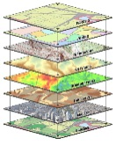
Use Case
Commercial Data/Information Owner
A commercial data owner wishes to boost
his data/information business via the data cube.
Needs:
guaranteed payment for data use
possibility to provide a “taster” subset with free access
Target: create value on private investment

Slide 13
Why Hosting a Data Cube Workshop by ESA?
Data Cubes are a cornerstones of the
“Future Data Architecture”
1st CEOS Open Data Cube Workshop at IGARSS 2017
Data Cubes for Big Earth Data
Workshop organised by
the Earthserver EU project
ESRIN, 19-20 October 2017
What are the reasons to believe that this technology can significantly contribute to the paradigm shift and pave the way for increased use of space data in our society ?

Slide 14
Data Cubes: Past & Upcoming Events
ESA Open Science Worksop 9/2017, ESRIN:
dedicated datacube session
Data Cube for Big Earth Data Workshop 10/2017, ESRIN
hosted at ESRIN, organised by EC “EarthServer” project
BIDS 2017, Toulouse, organised by CNES
Various data cube related presentations
Ф-event planned for 10/2018
Session on data cube foreseen

Slide 15
ESA TPM Heritage Mission Datacube Pilot
MEA (https://eodataservice.org) is a proof of concept activity to investigate about how a datacube can help the data dissemination, access and exploitation of TPM and HM missions.
Available Collections
Sentinel2 Level 1C and fetaure layers (e.g. NDVI, True color, cloud mask), Landsat8 L1GT and fetaure layers (e.g. NDVI, True color, cloud mask), MODIS Level 2 and Level 3 Atmosphere products, ESA SMOS Soil Moisture and Ocean Salinity, etc…
Forthcoming Heritage Missions Collections
Radar → ERS-1/2 SAR, ENVISAT ASAR
Optical → MERIS, (A)ATSR, MODIS L1

Slide 16
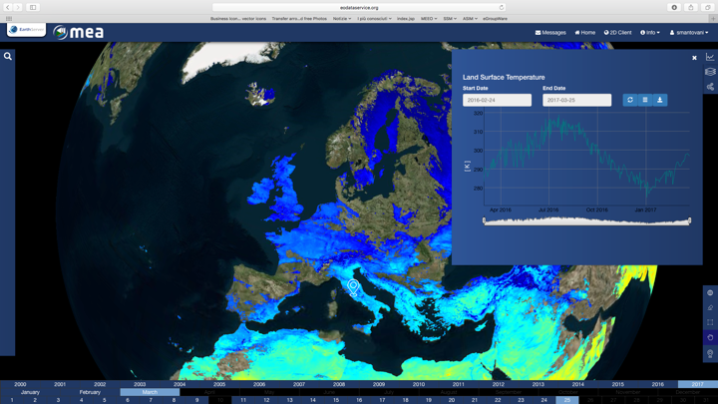
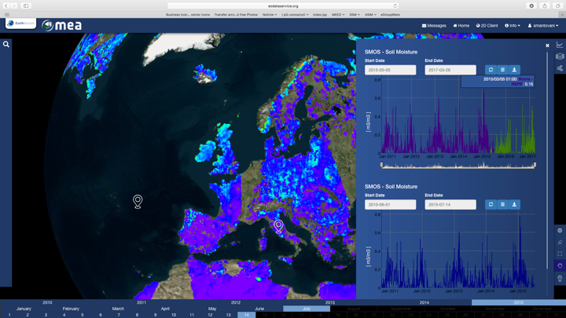
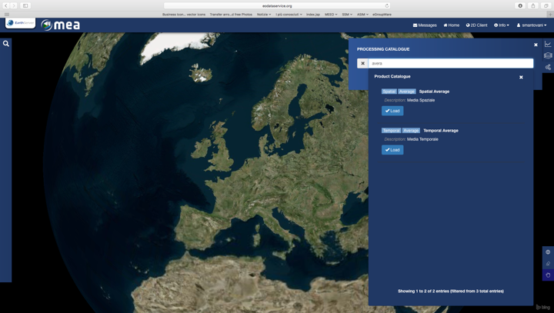
MEA GUI
Processing
Versioning Comparisons
Time series
Jupyter Notebook

Slide 17
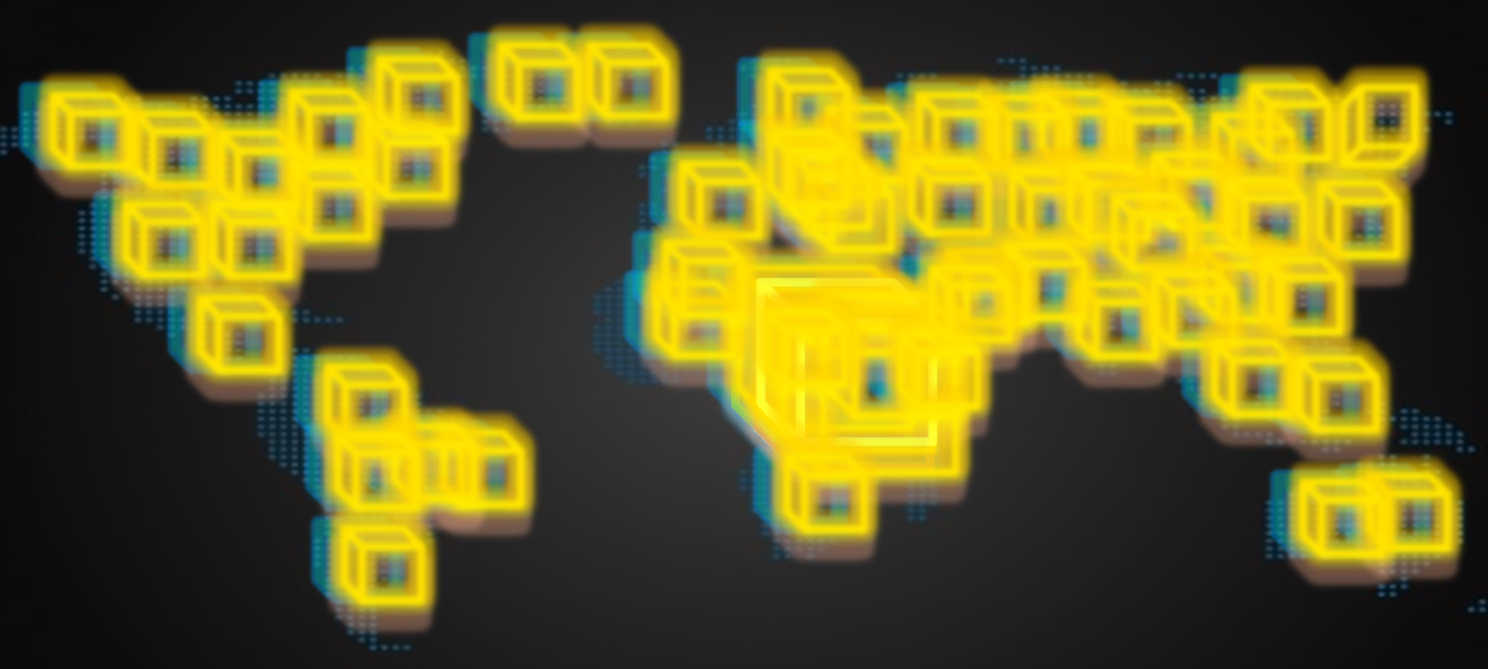
Effective Data Subsetting
Let’s assume we want to study drought in Eastern Africa in the last 17 years.
We want to use time series of Vegetation Index (NDVI), Precipitation (P) and Soil Moisture (SM).
Full collection (NDVI + P + SM) > 5 TB
Soil Moisture
17 years, one point
(NDVI + P + SM) < 1MB
Vegetation
Identification of anomalies
Cross-fields correlation
Identification of similar areas
Precipitation
In real time
Notes:
Message #1: effective subsetting

Slide 18
Federated Exploitation Infrastructure
Data & Services Discovery
Collection Catalogue / Product Catalogue / Service Catalogue (e.g., visualisation, data access, processing, etc..)
Data Visualisation
(e.g., WMS, WMTS, APIs, etc…)
Enhanced EO Products Access & Exploitation
(Data Cube via WCS, WCPS, APIs, etc..)
Data Processing
Processing Environment (e.g., WPS, WMTS, APIs, Jupiter, VMs…)
MAPS
MAPS
MAPS
Coverage
Coverage
Coverage
Data Products Access
(FTP, HTTP, Ordering, Subscription, fast download protocol, VMs)
EO
XX
YY
Long Term data preservation
RO-1
RO-2
RO-3

Slide 19
Federated Exploitation Infrastructure
Machine to Machine Interface
GUI - Client
Data & Services Discovery
Collection Catalogue
Product Catalogue
Service Catalogue
EO Products Visualisation
Browse Server (e.g., WMS, WMTS, APIs, …)
Data Processing
Processing Environment (e.g., WPS, WMTS, APIs, Jupiter, VMs…)
Data Access, Exploitation and Storage
Data Products Access
FTP HTTP
Ordering Subscription
Fast Download protocol
Etc… ….
Enhanced EO Products Access & Exploitation
Data Cube (e.g., WCS, WCPS, etc..)
Long Term data preservation (e.g., RO)

