Slide 1
Exploitation Platforms and Common Reference Architecture
Cristiano Lopes
11/04/2018

Slide 2
What’s in a title…
    Exploitation Platforms
      an EO exploitation platform is a collaborative, virtual work environment providing access to EO data, algorithms, tools and ICT resources required to their use
      Based on “Ground Segment Evolution Strategy”, ESA/PB-EO(2015)34
      Federation of EO Exploitation Platforms (as a whole) or of (individual) Platform Services (inc. ICT Infrastructure) is referred as the “Network of EO Resources”,
    Common Architecture
      Open, consensus based architecture for Exploitation Platform, Network of EO Resources
      Open and standard Interfaces
      Aims at becoming a Reference Architecture

Slide 3
“Bringing the User to the Data”
Sustainable exploitation environments (data + tools + processing)
Industrial basis to handle future data volumes and diversity
Connectivity and interoperability of exploitation environments
Coordination and standardisation
Continued availability of high quality data
Availability of information, tools, training and tutorials
→ Integrated EO data exploitation approach !

Slide 4
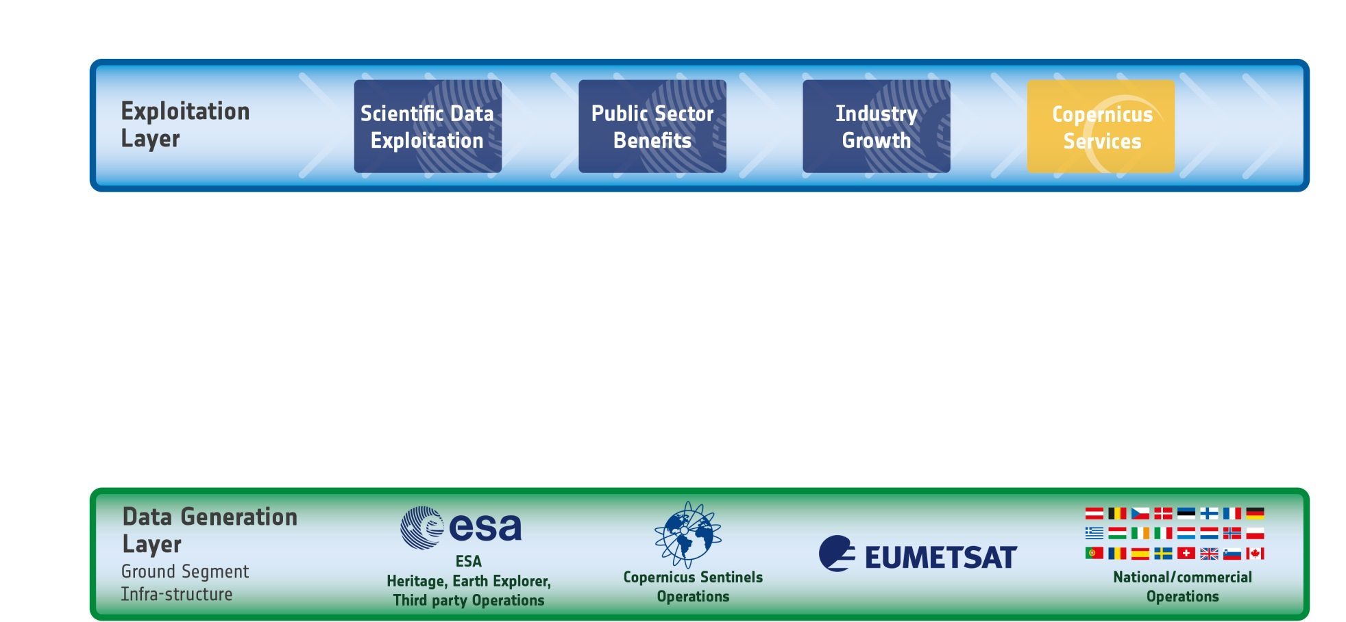
The EO Value Chain: the past
… Mission Ground Segments make data available for download
… Users discover and download the data to their own infrastructures
… Users process the data on their own…
Notes:
… traditional approach, that cannot cope with huge data volumes as produced by Sentinels anymore:
Most problems with Sentinel data download are linked to insufficient internet bandwidth from the download hubs to the end-users
Users that do not have massive storage and processing capabilities are “cut out”

Slide 5
Space 4.0i
Space 4.0 is adapted to an ESA-specific derivative, ‘Space 4.0i’, which describes the way ESA will play its role as a space agency for Europe.
Space 4.0 combines the described global situation of space developments with the ‘i’ standing for an ESA-specific interpretation of the tasks:
ESA innovates – through more disruptive and risk-taking technologies;
ESA informs – through the reinforcement of the link with large public and user communities;
ESA inspires – through the launch of new initiatives and programmes, both current and future generations;
ESA interacts – through enhanced partnerships with Member States, European institutions, international players and industrial partners.

Slide 6
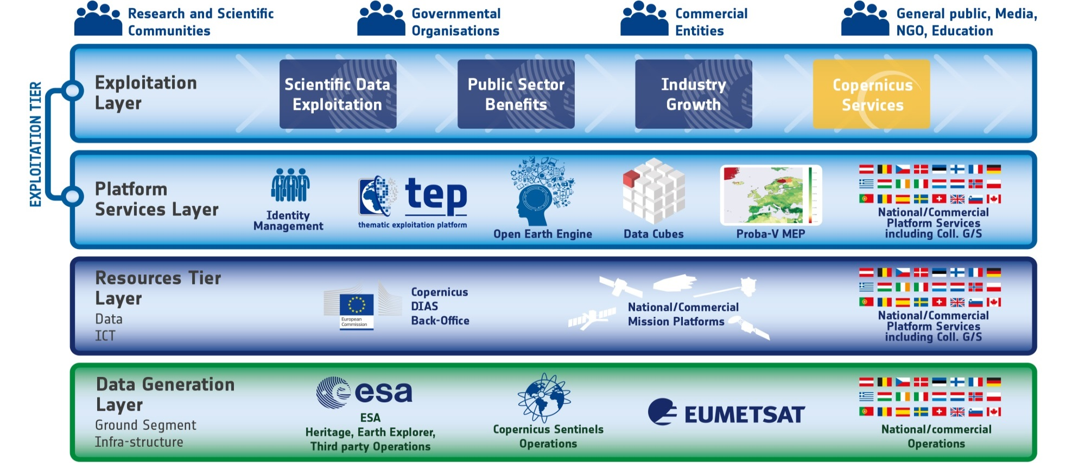
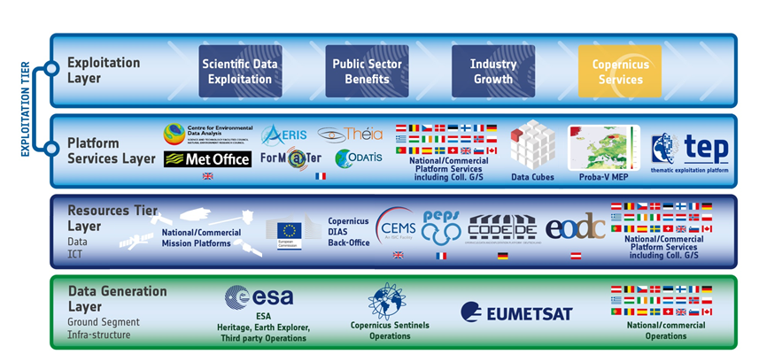
The EO Value Chain: Space 4.0

Slide 7


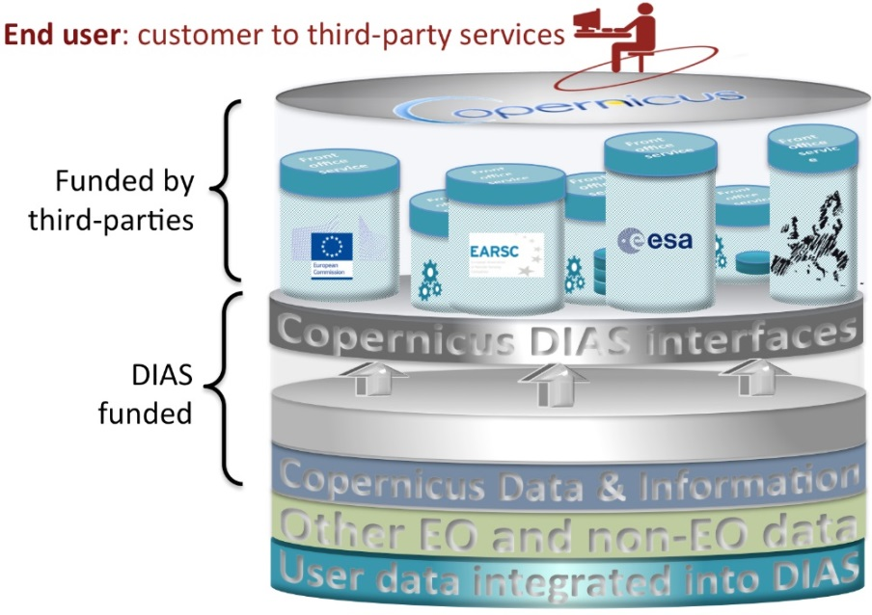
Resource Tier Layer
Implementation => DIAS
Closes the European “gap” between Data Generation and Exploitation layer
4 DIAS are being established through ESA / 1 through EUM
Building on the principles and mechanisms identified in G/S evolution strategy
European access to Copernicus
data and information
Progressive integration of DIAS with national:
Collaborative Ground Segments
Operational and research infrastructures
  Cross-sectoral development of big-data applications
→ national, industrial and in-situ data
→ tools (open) and standards for interoperability
Third-party
Users
Notes:
Many user-uptake initiatives will make use of DIAS. (e.g. Copernicus info sessions, Copernicus start-up programme…)

Slide 8
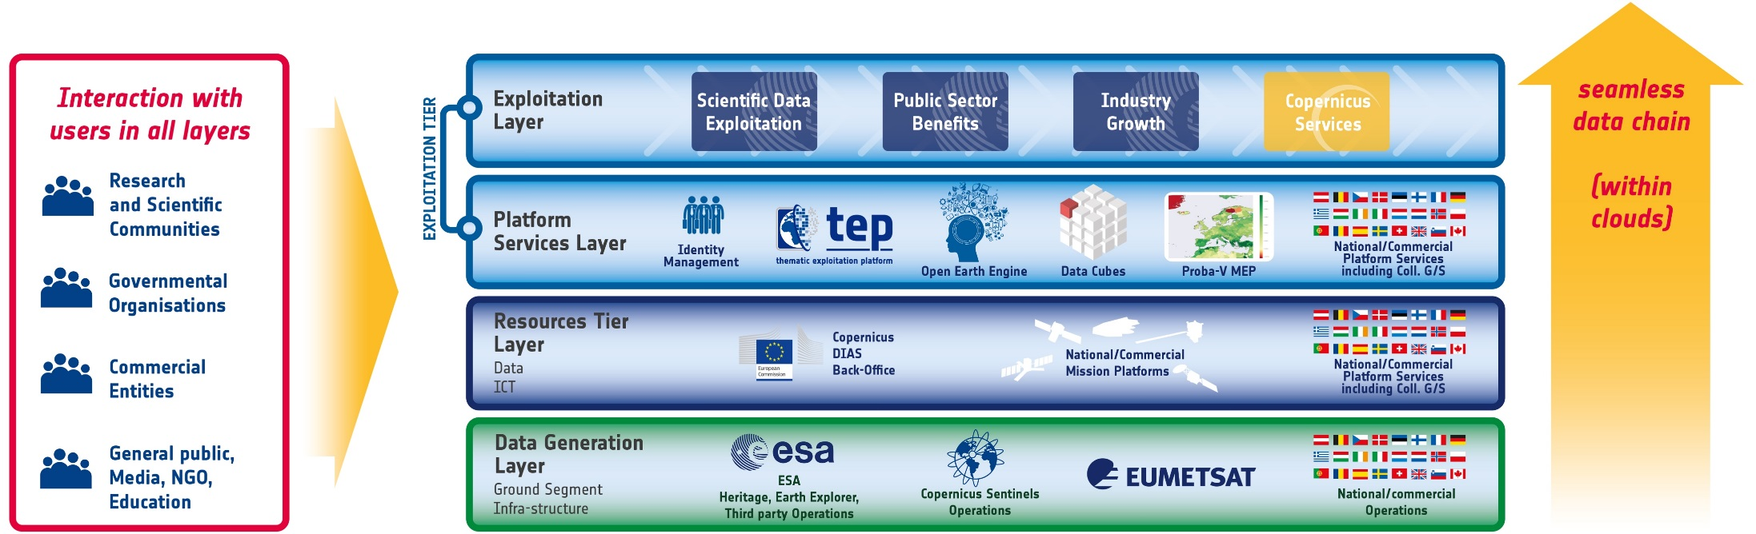
Ground segment, data management and data exploitation “infrastructure”:
→ in virtual environments (“Cloud”):
seamless data chain through layers from data acquisition to exploitation also with non-EO data
ensuring interaction with users in all steps of this data chain.

Slide 9
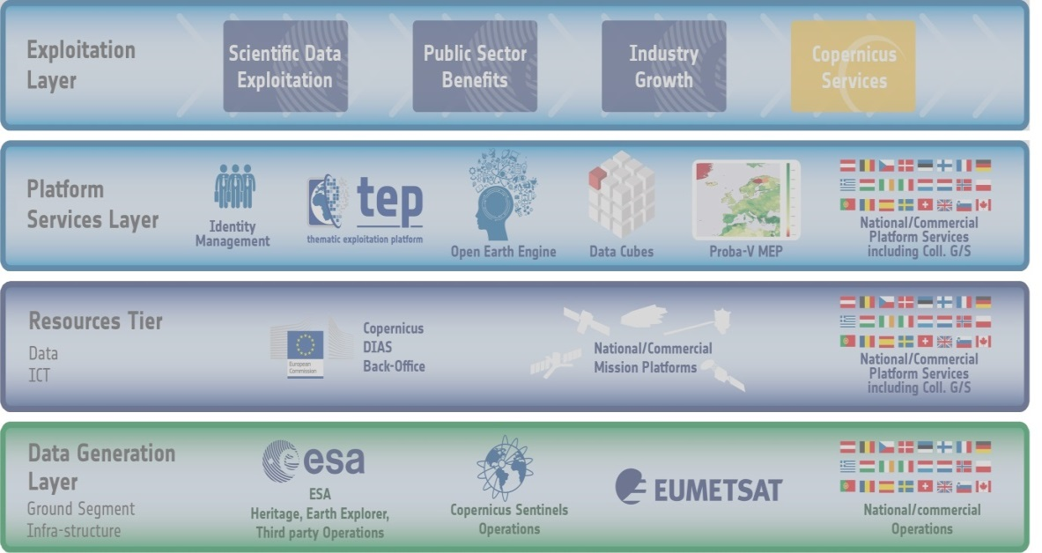
The EO Value Chain : Interfaces
Users may still download the data to process them on their own infrastructure
Expert users can install their algorithms directly on the cloud
Users use data analytics environments to view data or plug-in algorithm
Science or value adding activities retrieve generated information
inspect
algo
… and/or re-ingest user-generated products into the eco-system
data
algorithm
Platform Services are hosted on the Resource Tier cloud environment, gaining local access to data
Resource Tier provides processing power & hosted data
G/S provides mission data products for storage and sharing on the cloud

Slide 10

The EO Ecosystem: the past
The EO Ecosystem: IT industry starts investing
The EO Ecosystem: Industrial actors react
The EO Ecosystem: European National Activities
The EO Ecosystem: past ESA Activities
Network of EO Resources
Network of Resources
Creation of a portfolio of pre-qualified National and European Platform Service providers for subsequent use in scientific and value adding activities.
Within the two layers there are various European Stakeholders providing services
National/Commercial Mission owners;
Owners of Collaborative Ground Segments investing in exploitation platforms;
Institutional service providers offering relevant services;
Commercial actors offering relevant services.

Slide 11
Generic Platform
Architecture
within
Network of EO Resources
Common Architecture / Common Interfaces
Technical Domains:
Identity Management
Data Provision
Data Processing

Slide 12
Common Architecture - Process
Use Case
Implementation
Assessment
Operations
Define
Update
Market Assessment
Standards / Best Practices
FOSS
Reusable
Validation
User Experience
Against Use Case
User responses
Standards definition
Analysis
Testbed / Prototype

Slide 13
Common Architecture – Exploitation Platform
    Generic functional view
  High-level grouping
  Logical Functions
“Collaboration & Support” not presented – low priority.

Slide 14
Common Architecture – EP Discovery
    Discovery Functions
  User
  Other Platforms
    Service = Processing Algorithms
      or tools.

Slide 15
Common Architecture – EP Processing
    Processing Functions
  User
  Other Platforms
  Focus on User provided/developed Processing Algorithms (or Workflows)

Slide 16
Common Architecture – EP Support Functions
    Support Functions
  User (administrator, operators)
  Other Platforms
  Local, centralised
  Relying on base infrastructure services
Resources = data, tools, etc.

Slide 17
Implementation status
    “Network of EO Resources”, Tender open for Prime managing administration.
  TEPs (x7) pre-demonstration on-going; most havre achieved AR; transition to operations on DIAS planned.
    “Common architecture”, Tender open for Prime managing administration and high-level architecture.
  Preliminary activities performed via OGC processes (Testbed-13, forest use case), plus number of smaller specific focus pathfinders (FIM, small scale platforms)
    “Evolving Shared Technical Platform Capabilities”, part of an “Open Call” Tender
  Special case “Data Cube Service”, Tender issue upcoming;
    For science missions, gradual introduction of virtual research environments for flexible interaction between users and data => PROBA-V, SMOS, Biomass Exploitation Platform
    Copernicus Research and User Support (RUS): “Expert service for Sentinel users” aiming to support the scaling up of R&D activities to promote uptake of Sentinel data.
Notes:
Consultation process started with:
TEP Request for Interest: 2012
Enlarged GSCB workshop September 2015, open to industrial actors from all MS
Implementation guideline process:
“Exploitation Platform study” executed in Q2/2016 to collect stakeholder input on shared approach on Exploitation Platform” architecture and “Network of EO resources”.
Industry Day June 2016: Draft approach and possible alternatives presented and RFI-based feedback mechanism introduced
80 Entities responded to RFI. Attendance to consolidation workshop in ESRIN funded for 40 SMEs
Consolidation Workshop October 2016: attended by 153 external participants
BDVA summit November 2016: Consolidated guidelines presented recommending approach for Common Architecture, Network of EO Resources, TEPs

Slide 18

Cristiano Lopes
Ground Segment System Engineer
Earth Observation Programmes
Phone: +39 06 941 80735
Email: cristiano.lopes@esa.int

