Slide 1

FDA context
Steven Hosford
On behalf of FDA Co-chairs
Committee on Earth Observation Satellites

Slide 2
Summary
Context
FDA status at plenary 2017
Progress made and focus in 2018
  Analysis Ready Data and interoperable products
  EO “use environments” (including datacubes)
  Mapping and monitoring the EO ecosystem

Slide 3
Background
Spurred by ambitious operational programmes, open data policies, and a growing digital sector, Earth Observation is in TRANSITION
New paradigms of access to and use of EO data are being developed by new actors across the globe
Positioning publicly funded space agencies to reinforce this new complementary activity and ensure EO becomes part of everyday life is a critical objective of many space agencies
The FDA AHT addresses this theme to:
  raise awareness among space agencies of this phenomenon and the associated challenges
  gather and share lessons learned
  identify key areas where CEOS agencies need to act together, and identify CEOS entities best equipped to act

Slide 4
Background
Future Data Architectures Ad-Hoc team created at plenary 2015 by CEOS Chair CSIRO/GA
  Lead co-chair Alex Held (CSIRO)
FDA AHT renewed at plenary 2016 by incoming CEOS Chair USGS
  Lead co-chair Steve Labahn (USGS)
FDA AHT again renewed at CEOS Plenary 2017 – in line with COM “Data” priority.
  Lead co-chair Nick Hanowski (ESA)

Slide 5
FDA Status at Plenary 2017
CEOS Analysis Ready Data (ARD)
  Develop and provision CARD4L-compliant optical and/or SAR products
  Examine ARD for ocean and atmosphere domains
Interoperable Free and Open Tools
  Continue supporting the CEOS Data Cube (CDC) initiative
  Demonstrate new technologies through ongoing support of ‘pilot projects’ and consideration of alternate candidate architectures
Data, Processing, and Architecture Interface Standards
  Develop standards for pixel-level data discovery, access, and common analytical processing requests (e.g., cloud free mosaics of ARD) exploiting EO satellite data among various CEOS exploitation platforms
Analytical Processing Capabilities
  Prototype portable web-based analytical processing APIs/Web Services that work across CEOS exploitation platforms in full computing environments for time series and other analysis
User Metrics
  Develop a data use metrics framework through which agencies can contribute to how EO data is being used, rather than just downloaded data quantities
Analysis Ready Data, CARD4L and interoperable products
EO “use environments”
Mapping and monitoring the EO ecosystem

Slide 6
Analysis Ready Data (ARD), CARD4L and Interoperable products
Committee on Earth Observation Satellites

Slide 7
Analysis Ready Data (ARD) and Interoperable products
Why ARD? Why now?
Definition of Harmonisation
The act of …
making consistent or compatible
bringing into agreement
making systems or laws the same or similar in different companies, countries, etc. so that they can work together more easily
What? CEOS works on harmonisation at many levels, but in this case we concentrate on product harmonisation/interoperability
Why? The primary objective is simplification
Why now? To limit a potential increasing disconnect between
users and EO data.

Slide 8






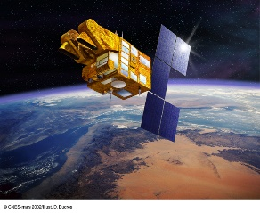

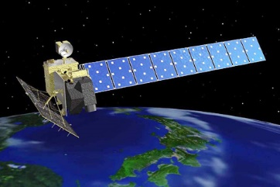

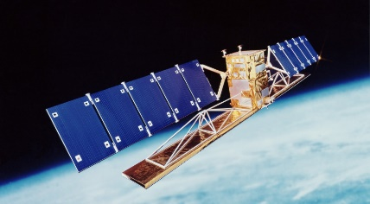
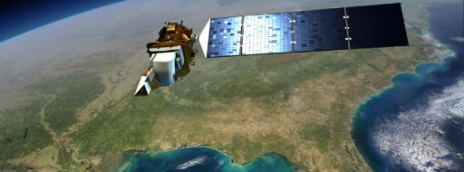
Land imaging … in 2006?
Exploitation Layer
Science
projects
Data
Data Generation Layer
Ground Segment Infrastructure
SPOT
Envisat
ALOS
Terra,
Acqua
……
Landsat
Radarsat

Slide 9

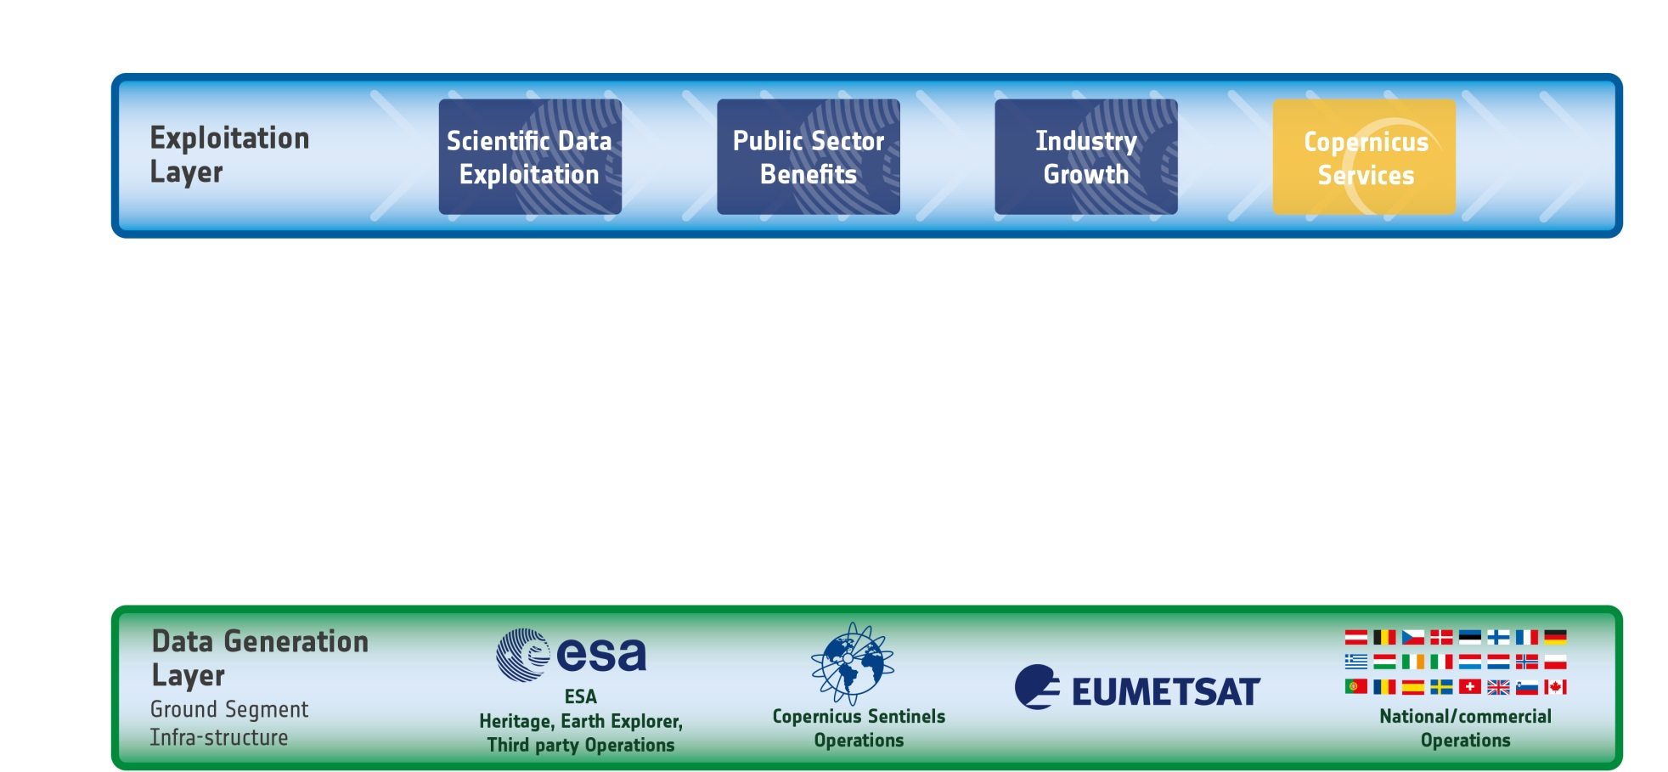











The evolving EO Ecosystem
Many “general
public” users
Complexity
++ less “sophisticated users”
Few sophisticated users
++ missions and ++++ data
“Small” data Big data

Slide 10
Definition: CEOS ARD for Land
CEOS Analysis Ready Data for Land (CARD4L) definition:
  CARD4L are satellite data that have been processed to a minimum set of requirements and organized into a form that allows immediate analysis with a minimum of additional user effort, and, interoperability both through time and with other datasets
CARD4L is a framework for establishing ‘minimum requirements’ for products that:
  Are ready for ‘immediate analysis’
  Require minimal additional user effort to prepare
  Interoperable with other CARD4L datasets

Slide 11
Medium Resolution Sensor Interoperability
MRI
Products
S2 Level 1b product
RI
ARD
S2 Level 2 SR product
CARD4L
S2 Level 2 SR product with general and pixel level metadata aligned with CARD4L PFS
Product
Family
Harmonised
Product
S2 CARD4L SR product using harmonised geo/ atmospheric algorithms and references (e.g. HLS)

Slide 12
Medium Resolution Sensor Interoperability
MRI
Products
RI
ARD
++ constraints
CARD4L
-- barriers to interoperability
between products
Product
Family
Harmonised
Product

Slide 13
ARD, CARD4L, Interoperable products
FDA-7: Product Specifications in accordance with LSI-VC
the CARD4L Framework
VC-30: Interoperability case study for Landsat and LSI-VC
Sentinel-2
VC-31: Evaluate CARD4L among target user LSI-VC
communities
VC-32: CARD4L Product Assessment Framework LSI-VC
VC-33: Maintain the CARD4L Product Family LSI-VC
Specifications (PFS)
VC-34: CARD4L Engagement Strategy LSI-VC

Slide 14
EO use environments
Committee on Earth Observation Satellites

Slide 15
EO “use environments”
FDA-8: Establish a common description of Future FDA-AHT/
Data Architecture functional blocks WGISS
FDA-10: Finalise inventory of Software and Tools WGISS
FDA-11: Organise several sessions/workshops to FDA-AHT/
share lessons learned WGISS
FDA-12: Inventory of space data product formats WGCV

Slide 16
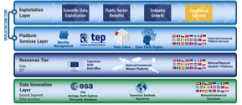

Future Data Architecture functional blocks
ICT/Data Resources Layer
This layer includes the data hosting infrastructures, i.e. the resources to enable scientific, public or commercial value-adding on the data.
Advantages:
Large quantities of data hosted in one place – available for processing
Mutualise storage, avoiding strain on local storage and transfer bandwidth
Data
Processing power
ICT/Data Resources Layer
Data Generation Layer
Data Generation Layer
This layer includes the “traditional” Mission Ground Segment that delivers quality assured and traceable Mission data products. It also includes EO data management activities.

Slide 17
Future Data Architecture functional blocks
Exploitation Layer
This is the knowledge layer including the domain and application specific knowledge and experience that value-adders use to define the processing chains and algorithms required to extract actable information.
Exploitation Layer
Platform Services
Platform Services Layer
This layer includes higher-level data analytics platform services such as Thematic Platforms, Data Cube, Open Earth Engine. These EO specific and domain specific data manipulation environments provide tools to prototype information extraction processing chains and can then deploy them operationally against the data holdings in the lower tiers

Slide 18
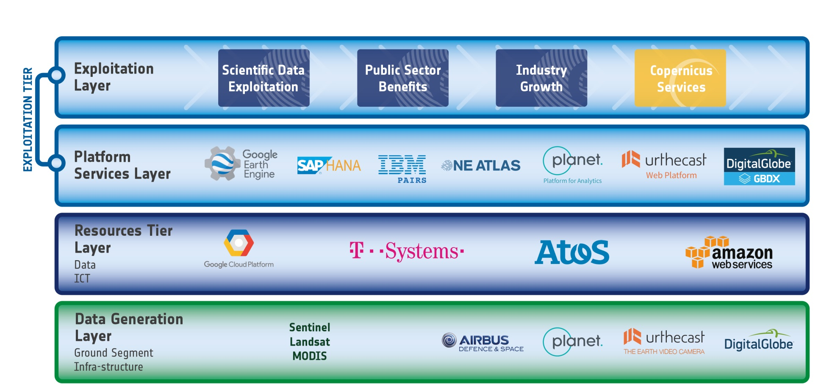




Future Data Architecture functional blocks

Slide 19
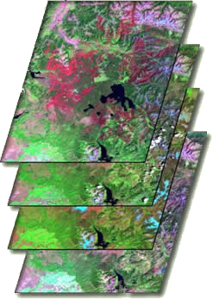

What are Data Cubes?
Data Cube = Time-series multi-dimensional (space, time, data type) stack of spatially aligned pixels ready for analysis
Proven concept by Geoscience Australia (GA) and the Australian Space Agency (CSIRO) and planned for the future USGS Landsat archive.
Analysis Ready Data (ARD) ... Dependent on processed products to reduce processing burden on users
Open source software approach allows free access, promotes expanded capabilities, and increases data usage.
Unique features: exploits time series, increases data interoperability, and supports many new applications.
TIME
Data Cubes are one example of a Future Data Architecture

Slide 20
The “Road to 20” Operational Data Cubes by 2020
Colombia has an operational Data Cube since Dec 2016 with over 25,000 historic Landsat images. They continue to expand the user base, applications and datasets. The Colombia Data Cube won the National Environmental Award of Colombian Society of Engineers in May 2017 and has been approved by the Colombia Government into 2018.
Switzerland has an operational Data Cube since July 2017 with over 4,000 historic Landsat images. They have received Swiss government approval and developed a new website (swissdatacube.org). Their future plans include expanded datasets (Sentinel) and increased applications with both government and university involvement. They are also planning capacity building in Georgia and Moldova.
Vietnam is slowly making progress by establishing pilot cubes in several regions using a new high performance computing system. Their focus is on forests, rice, and water applications. VNSC is hosting an internal Data Cube Workshop on Sept 17.
Operational
Under Development
Under Review or Expressed Interest
3 operational, 4 under development, 22 under review = 29 total

Slide 21
Monitoring and mapping the EO ecosystem
Committee on Earth Observation Satellites

Slide 22
Monitoring and Mapping EO Ecosystem
FDA-9: Inventory and characterise existing FDAs WGISS
FDA-13: Develop a User Metrics Best Practice WGISS

Slide 23
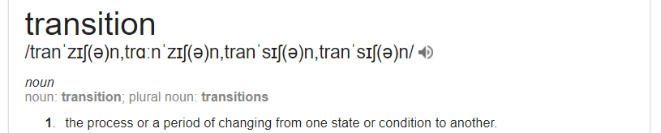
FDA Block B
Earth Observation Resources analysis and User Metrics
Earth Observation in transition
... the process of changing from one state or condition to another …
++ new entrants
++ private investment
++ EO “use environments”
Evolving role for space agencies (public funding)
Where does public funding need to be invested?
Which enabling activities to ensure EO becomes part of people’s everyday life?
These questions are faced by all CEOS members …

Slide 24

















FDA Block B
Earth Observation Resources analysis and User Metrics
Earth Observation in transition
To position space agencies appropriately there is a need to characterise and monitor this explosion of activity

Slide 25
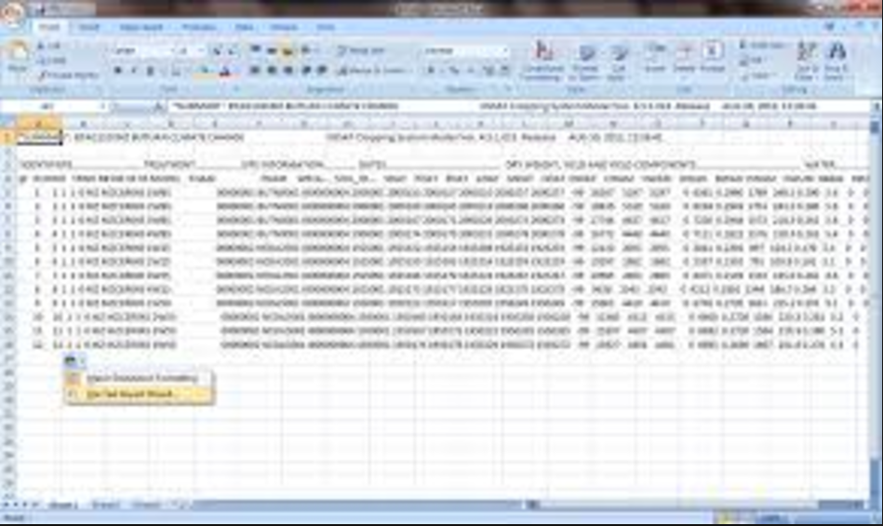
FDA Block B
Earth Observation Resources analysis and User Metrics
Two FDA deliverables in CEOS WP 2018-2020
FDA-9: Inventory and characterise existing FDAs operated by both public and private entities …
FDA-13: Develop a User Metrics Best Practice
EO resource inventory describing
Position in 4-layer model
Platform metrics (storage, compute, services, data collections)
User metrics (Nb active users, Data consumed/newly generated)
Financing/Governance model

Slide 26





An example of a type of analysis
Need to update frequently figures obtained to monitor the evolution in time
Nb of
active
users
Cloud
Computing
capacity
Traditional
data access
portals
EO specific
EO use
environments
Compute available to users

