Slide 1

WGISS-WGCV Joint Session
Committee on Earth Observation Satellites
Mirko Albani (WGISS), Kurtis Thome (WGCV)
WGISS#45 / WGCV#43
INPE, São José dos Campos (SP), Brazil
09 April 2018

Slide 2
Joint Session - Scope
Discuss common areas and topics in the ongoing/planned WGs activities which could benefit from cooperation between the two groups:
Describe and share available facilities, expertise, resources, technical information and documentation
Discuss topics of common interest and identify synergies focused on common tasks
Define way forward, actions/owners/contributors
Progress monitoring through periodic joint calls

Slide 3
Joint Session - Identified Topics to be discussed
Data Formats and Interoperability in the framework of FDA
  Robert Woodcock (WGISS), Medhavy Thankappan (WGCV)
Quality Indicators in Discovery Metadata
  Michael Morahan (WGISS), Nigel Fox (WGCV)
CEOS Data Cubes and CEOS Test Sites Data Access in support of WGCV Activities
  Robert Woodcock (WGISS), Greg Stensaas (WGCV)
Standardization and Best Practices (e.g. ISO 19159-3)
  Richard Moreno (WGISS), Cindy Ong (WGCV)

Slide 4
Data Formats and Interoperability in the frame of FDA
  Objective: Ensure users a seamless access and usability of data from multiple sensors including tools to fuse/use data from multiple sensors
    Data/Sensor formats interoperability: e.g. CEOS Format update
    Joint contribution on ARD definition
    Determining uncertainties for Analysis Ready Data (and methods for communicating those uncertainties)
  (Notes: Data Discovery and metadata addressed in topic 2)

Slide 5

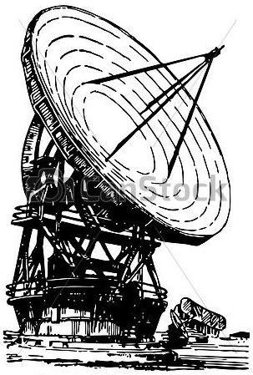


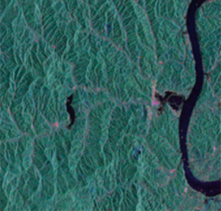

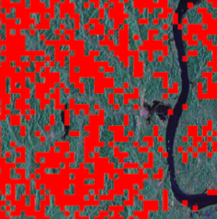
Data Formats and Interoperability in the frame of FDA - Discussion
  Data and Sensors Interoperability:
        Different data formats: e.g CEOS, netCDFx, HDFx, ENVISAT, GEOTiff, MPH/SPH/DSR, HRPT→ alignment of data format allows data interoperability in terms of data comparison (visualization, geolocation, etc.).
        Different data Content: e.g ARD → alignment of content allows data interoperability in terms of data comparison and data management for time series etc.
  Full Interoperability Process:
  ARD specification available for all sensors/areas of interest???
    Joint contribution for ARD definition
    Determining uncertainties for Analysis Ready Data (and methods for communicating those uncertainties)
  Cost/Benefit Analysis:
    Consider Product owners costs
    Consider Final Users needs
    Consider simple converter or Processor improvement and Reprocessing
?
ARD Specifications
CAL/VAL & Experts Team
Products
Reprocessing
ARD Products
Format Converter

Slide 6
Quality Indicators in Discovery Metadata
Objective: Ensure quality and uncertainty information availability (discovery and access) for users
Definition and implementation of Quality Indicator
  QI at collection level (quality, fitness of purpose) or at the granule level (for end users)?
  Higher level product should have an indicator for the user, derived from the instrument and the processes it has gone through, and an estimate of uncertainty being introduced?
Definition of Quality fields in discovery Metadata for the key sensors and products following the QA4EO guidelines
  Include validation metrics (possibly calibration metrics and sensor performance indicator). Make the reference to validation guidelines into the metadata information.
  A Survey on Sensors Quality Indicators could help?
Define cross-validation projects across ARD products, reach out to commercial providers to encourage their participation in ARD, and promote and enable discoverability of ARD datasets. (WGISS-44)

Slide 7
Quality Indicators in Discovery Metadata - Discussion
  Quality Indicators (QI) Definition:
    QI defined in QA4EO guidelines are still fit for purpose (new users and scientists requirements, new quality needs, etc.)?
    QI for key sensors and products, including spatial and spectral
    Validation and calibration metrics: how they are defined and what is the terminology at the various stages of processing?
    Reprocessing information?
    Sensor performance information?
  Quality Indicators Implementation:
    Quality fields in Discovery Metadata or in the Data Collection Landing page?
    QI at collection level (quality, fitness of purpose) or at the granule level?
    Higher level products should have an indicator for the user derived from the instrument and the processes it has gone through and an estimate of uncertainty?
    Make reference to validation guidelines in the metadata information?
How to define cross-validation projects across ARD products, reach out to commercial providers to encourage their participation in ARD, and promote and enable discoverability of ARD datasets?

Slide 8
CEOS Data Cubes and CEOS Test Sites Data Access in support to WGCV Activities
  Objective: Data Cubes (or similar stacking of data over time for specific locations) test cases
  Support data access of CEOS Test Site information (CEOS IVOS sites, LPV sites, SAR, DEM and others). (WGISS-41)
  WGCV can provide necessary information to WGISS(IDN/CWIC/FedEO).
  WGCV has previously provided WGISS with several records (< 50) to be cataloged in the IDN. CWIC provides access to several of these records. Continue to update these records → We need to know the status
Support to Data Cube: Vietnam Data Cube - Evaluation of Root Mean Square (RMS) geo-location error after resampling. (WGISS-43)

Slide 9
CEOS Data Cubes and CEOS Test Sites Data Access in support to WGCV Activities - Discussion
  Support data access of CEOS Test Site information (CEOS IVOS sites, LPV sites, SAR, DEM and others). WGCV has previously provided WGISS with several records (< 50) to be cataloged in the IDN. CWIC provides access to several of these records.
  Provide the status of all catalogued records.
  WGCV provide necessary information to WGISS (IDN/CWIC/FedEO) in order to update these records and/or for new records to be catalogued.
Support to Data Cube projects:
  Vietnam Data Cube - Evaluation of Root Mean Square (RMS) geo-location error after resampling.
  On-demand Data Cube support???

Slide 10
Standardization and Best Practices
Objective: Contribution on CEOS Best Practice/White Paper
Support and collaboration on ISO 19159-3 “Geographic information -- Calibration and validation of remote sensing imagery sensors and data – Part 3: SAR and InSAR.” (WGISS-43)
Develop a White Paper on Recommendations for improving Data Quality in Metadata (WGISS-41)
Support WGISS to provide guidelines for the metadata for ARD to ensure the information needed to describe a measurement is available. (WGISS-41)
Develop Best Practices on Data Reprocessing – including current and future practices (i.e. on-demand ARD Processing) (WGISS-41)
Support evolution of Data Management principles (Quality principles) (WGISS-41)

Slide 11
Standardization and Best Practices - Discussion
Support evolution of CEOS Best Practices and relevant standards:
  Review of Data Management and Stewardship Maturity Matrix for the Quality area. The result will be provided as input for GEOSS-DMP Implementation Guidelines improvement (Quality principles: DMP-6).
  Support and collaboration on ISO 19159-3 “Geographic information -- Calibration and validation of remote sensing imagery sensors and data – Part 3: SAR and InSAR”.
Support WGISS to provide guidelines for:
  ARD metadata definition for identified areas of interest and/or key sensors.
  Data Reprocessing Best Practices development – including current and future practices (i.e. on-demand ARD Processing).
  Data Quality in Metadata white paper and recommendations definition.

Slide 12


