Slide 1

WGISS-WGCV Joint Session
Standardization and Best Practices
Committee on Earth Observation Satellites
Cindy Ong (CSIRO), Richard Moreno (WGISS)
WGISS#45 / WGCV#43
INPE, São José dos Campos (SP), Brazil
09 April 2018

Slide 2
Standardization and Best Practices
Objective: Contribution on CEOS Best Practice/White Paper
Support and collaboration on ISO 19159-3 “Geographic information -- Calibration and validation of remote sensing imagery sensors and data – Part 3: SAR and InSAR.” (WGISS-43)
ISO 19159-3: Geographic information -- Calibration and validation of remote sensing imagery sensors -- Part: 3: SAR/InSAR passed DIS vote in April 2017. It will automatically become ISO Technical Specification in this year.

Slide 3
Standardization and Best Practices
Objective: Contribution on CEOS Best Practice/White Paper
Develop a White Paper on Recommendations for improving Data Quality in Metadata (WGISS-41)
Support Metadata Requirements for Quality (Quality fields): Review and comment on GEOSS Data Quality Requirements (DDQ -Documentation on Data Quality). Include validation metrics (possibly calibration metrics and sensor performance indicator) Make the reference to validation guidelines into the metadata information. Develop a White Paper on Recommendations for improving Data Quality in Metadata.

Slide 4
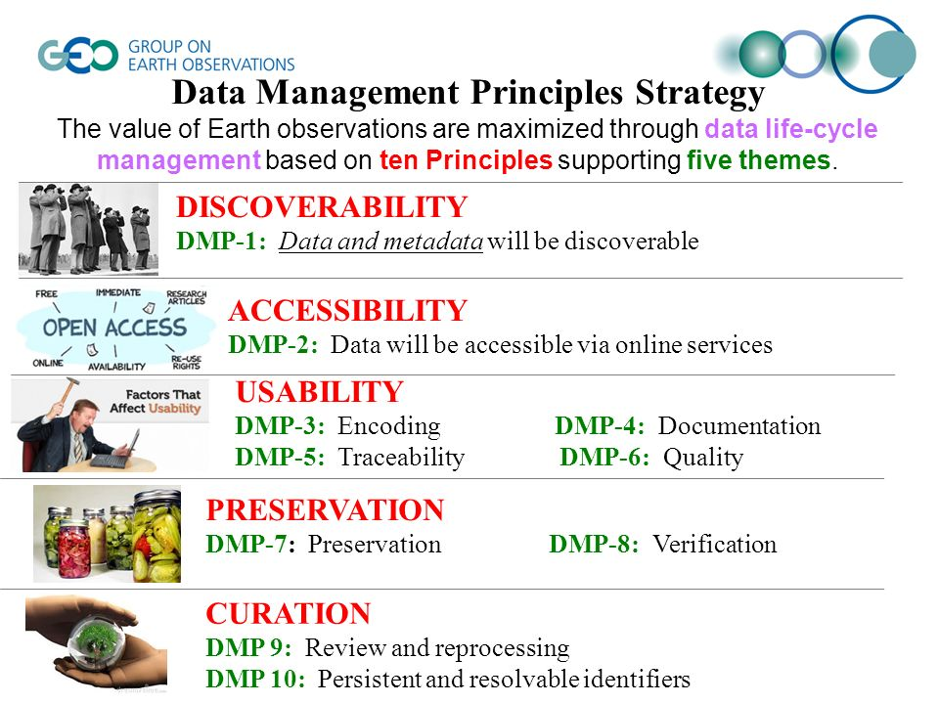
Standardization and Best Practices
Objective: Contribution on CEOS Best Practice/White Paper
Support evolution of Data Management principles (Quality principles) (WGISS-41)

Slide 5
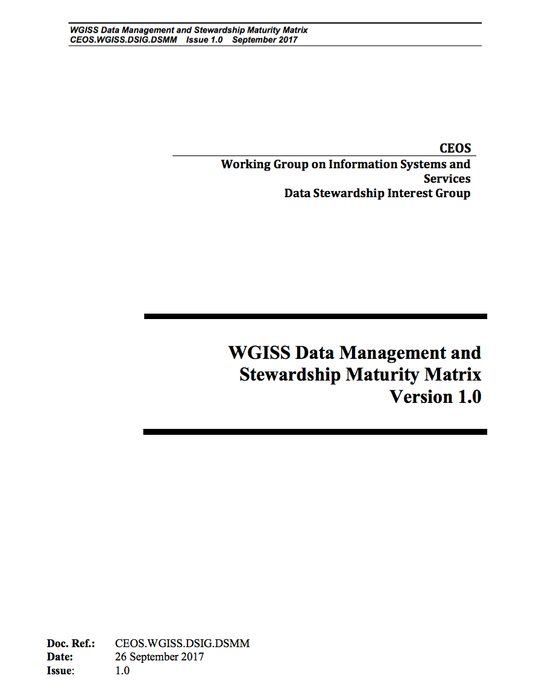
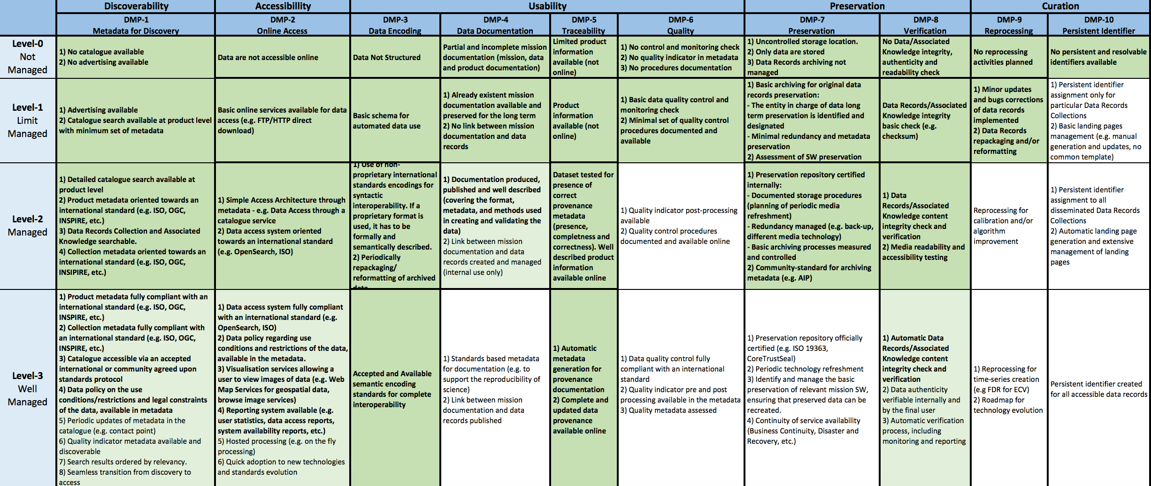
Standardization and Best Practices
WGISS Data Management and Stewardship Maturity Matrix

Slide 6
Standardization and Best Practices
Objective: Contribution on CEOS Best Practice/White Paper
Support WGISS to provide guidelines for the metadata for ARD to ensure the information needed to describe a measurement is available. (WGISS-41)
Develop Best Practices on Data Reprocessing – including current and future practices (i.e. on-demand ARD Processing) (WGISS-41)
See presentation « Data format and interoperability in the frame of FDA

Slide 7
Standardization and Best Practices - Discussion
Support evolution of CEOS Best Practices and relevant standards:
  Review of Data Management and Stewardship Maturity Matrix for the Quality area. The result will be provided as input for GEOSS-DMP Implementation Guidelines improvement (Quality principles: DMP-6).
  Support and collaboration on ISO 19159-3 “Geographic information -- Calibration and validation of remote sensing imagery sensors and data – Part 3: SAR and InSAR”.
Support WGISS to provide guidelines for:
  ARD metadata definition for identified areas of interest and/or key sensors.
  Data Reprocessing Best Practices development – including current and future practices (i.e. on-demand ARD Processing).
  Data Quality in Metadata white paper and recommendations definition.

Slide 8
Preliminary List of needed parameters/categories
platform_name, sensor_name, sensor_type, image_id, processing_facility, product_type
acquisition_datetime, processing_datetime, processing_software_version, in ISO
Orbit, image georeferencing , band_names PLATFORM/SENSOR
calibration_state, calib ration_eqn, calibration_constant, calibration_constant_applied, calibration_noise; CALIBRATION
polarizations, center_freq, pulse_repitition_frequency_hz, pulse_repitition_frequency_perpixel_hz;
pulse_bandwidth_hz, pulse_length_sec, adc_sampling_rate_hz;
antenna_pointing, slant_range_resolution_m, azimuth_resolution_m; antenna pattern(s)
look_angle_near_range_deg, look_angle_far_range_deg, near_slant_range_m,
time_early_azimuth_sec, time_late_azimuth_sec; DATATAKE
elevation_pattern_correction, range_spreading_loss_correction, range_spreading_ref_range_m; PROCESSING
pulse_dependent_gain_correction, divided_by_sine_theta_in, reference_inc_angle_deg;
number_of_range_looks, range_look_bandwidth_hz, number_of_azimuth_looks, azimuth_look_bandwidth_hz;
range_window_type, range_window_parameters, azimuth_window_type, azimuth_window_parameters;
platform_radius_scene_center_m;
platform_altitude_m, terrain_height_m, doppler_centroid(), doppler_rate(), doppler_processing_state;
azimuth_spacing_m, range_spacing_m, range_direction, azimuth_direction, geometry
number_of_pixels (# in range), number_of_lines (# in azimuth)

Slide 9
Major Gaps Remaining
Need to devise a list of standard processing algorithms
Then include a list of standard processing parameters for each.
For example:
convert raw data to slant range uncalibrated image:
calibrate slant range image: single channel, polarimetric, …
orthorectification
Include whether algo has been applied or not:
if applied: answers question: what data do I have?
if not applied: answers question: what algo(s) do I need to apply and how?

Slide 10
Major Parameters being added
datatype: (for each channel) int/float/complex, #bytes, byte-order
doppler rate for each pixel
Calibration params: equation, parameters, applied?, name and units of result
Processing params: numRangeLooks, numAzimuthLooks, antennaElevationPattern- CorrectionApplied (t/f), rangeSpreadingLossCorrection (true or false or reference-range-in-meters), pulseDependentGainCorrectionApplied (t/f), dividedBySinTheta (t, f, or theta_reference), platform_radius_at_scene_center_meters, platform_altitude_meters, terrain_height_meters, product_type
Datatake params: pulseRepetitionFrequency_perpixel_hz, pulse_length_sec, slant_range_resolution_m, azimuth_range_resolution_m, antenna_elevation_pattern, look_angle_near_range_degrees, look_angle_far_range_degrees
As-provided Image Data params:
azimuth_spacing_m, azimuth_direction (+x, +y, -x, -y, N/A)
range_spacing_m, range_direction (+x, +y, -x, -y, N/A)

Slide 11


