Slide 1

CEOS Data Cubes and CEOS Test Sites Data Access in support of WGCV Activities
Committee on Earth Observation Satellites
Greg Stensaas, Robert Woodcock
Joint WGCV/WGISS Meeting
April 2018
INPE, São José dos Campos, SP, Brazil

Slide 2
History of WGCV process
WGCV received approval from SIT and Plenary for all CEOS satellite owning members to collect over recommended cal/val test sites on a regular basis
  Open data for CEOS cal/val and comparison efforts
  Commercial industry/ agency partnerships without open data policy would provided based on Government partner
  Benefit to Government and commercial industry
Each WGCV subgroup provided recommended sites and processes
QA4EO was approved across CEOS/GEOSS/GSICS

Slide 3
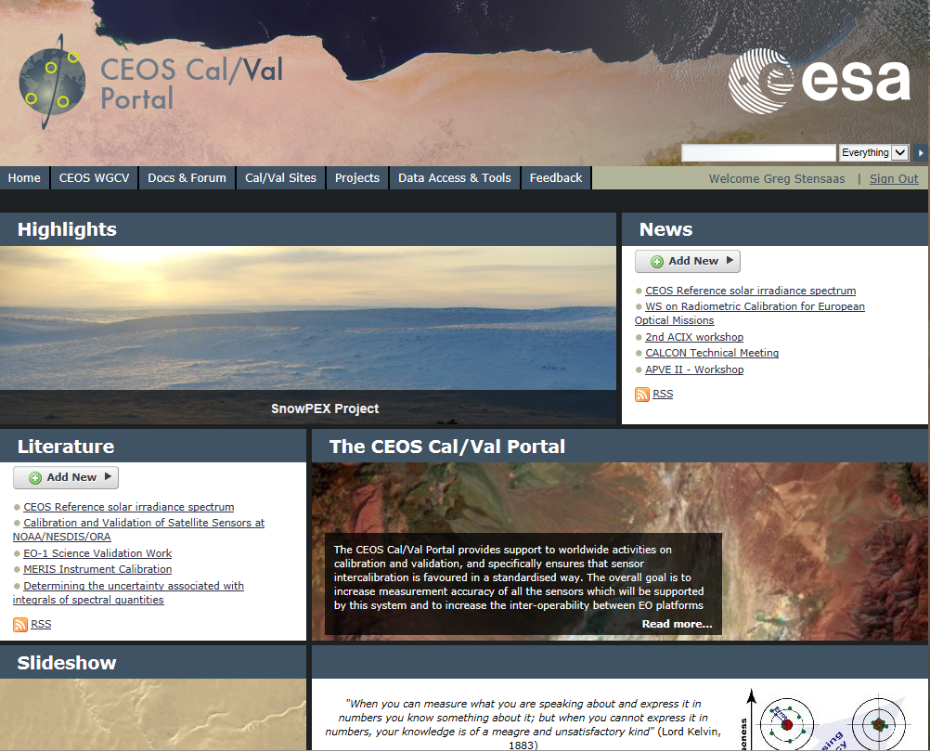
http://calvalportal.ceos.org/web/guest/home

Slide 4
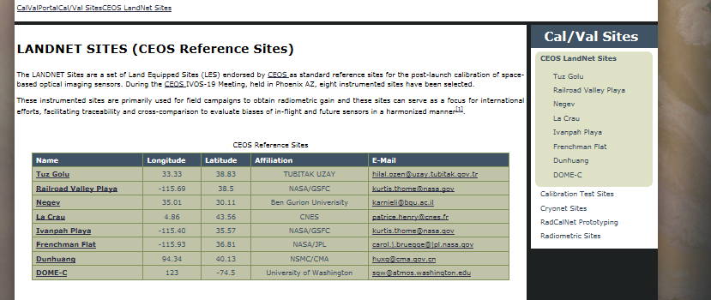
CEOS LANDNET Sites

Slide 5
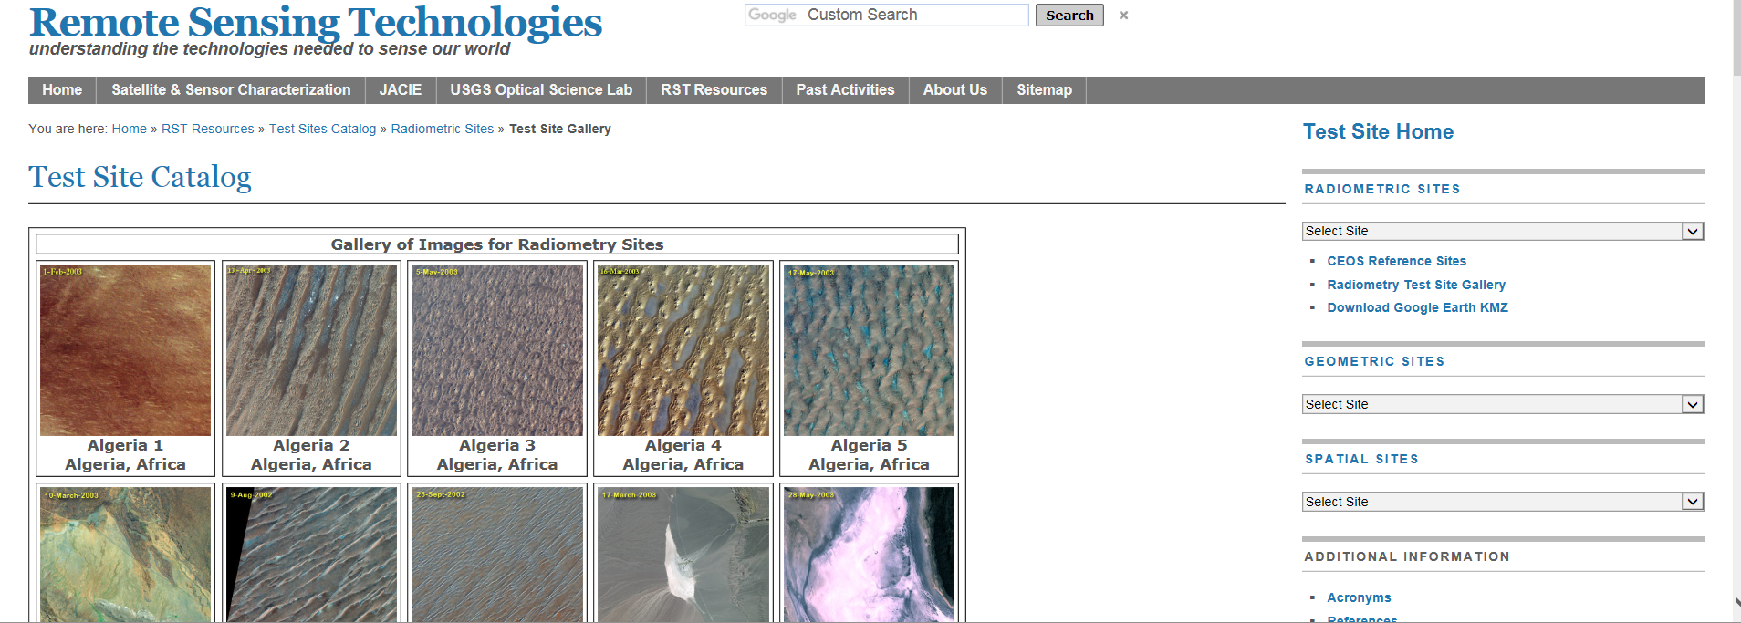
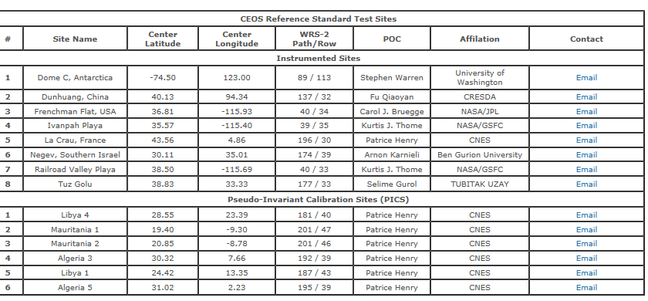
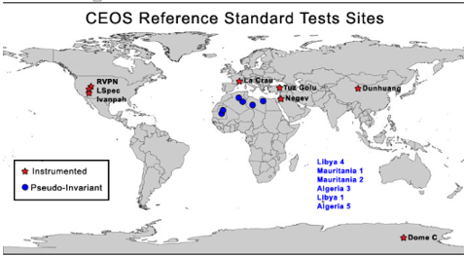
USGS Test Site Catalog

Slide 6
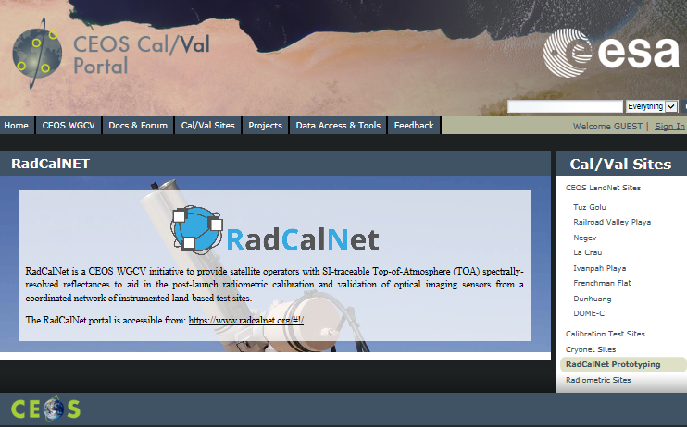
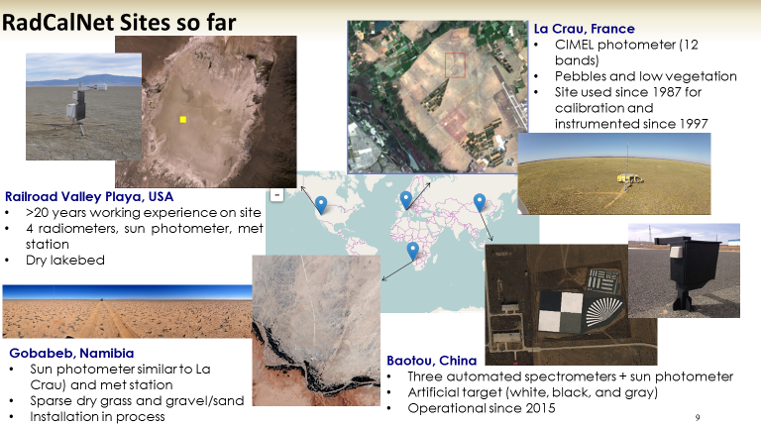
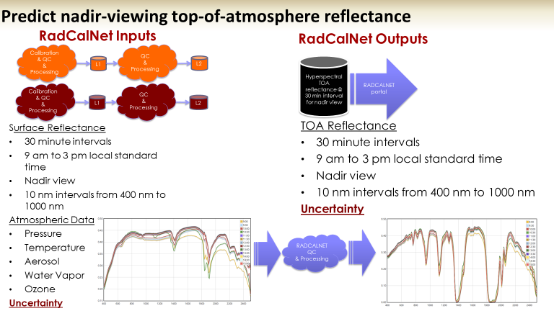
RadCalNet
More Sites coming

Slide 7
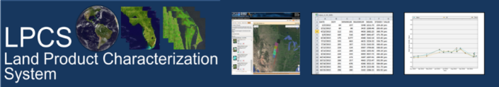
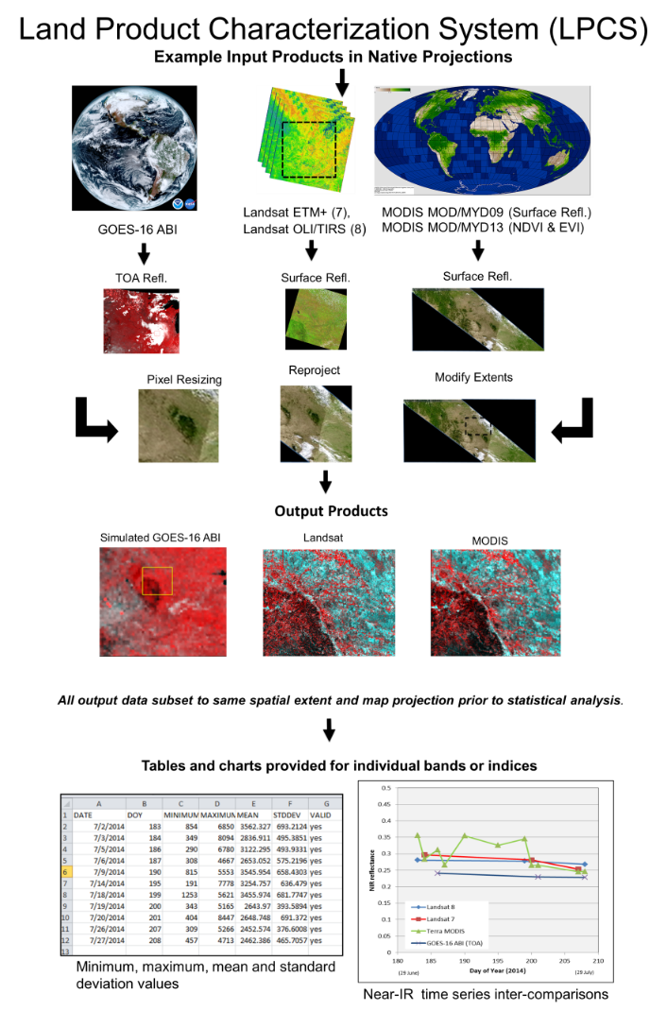
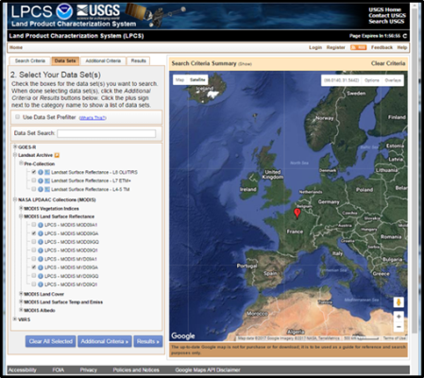
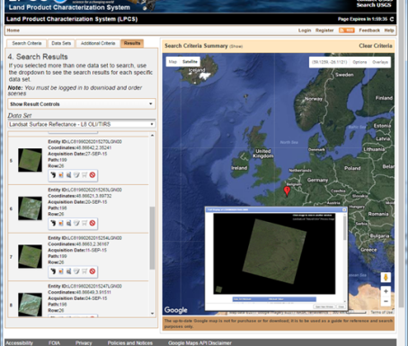
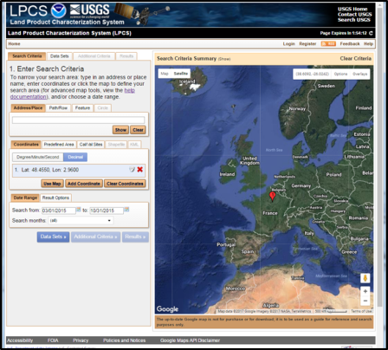
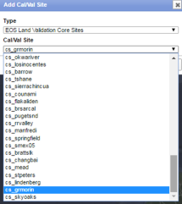
LPCS joint effort – NOAA, USGS, NASA https://landsat.cr.usgs.gov/lpcs
The Land Product Characterization System (LPCS) is a web-based system designed to facilitate characterization and validation of higher-level scientific data products including land products from ASTER, VIIRS, MODIS, Landsat, and in the future, Sentinel-2 and-3, GOES-16 ABI, and comparable in situ products.
The LPCS includes:
data inventory,
access, processing options, and
analysis functions,
that will permit selection of data to be easily identified, retrieved, co-registered, and compared statistically through a single interface. Data inventory and selection includes numerous pre-defined cal/val locations as well as options for user-defined selection of locations.

Slide 8
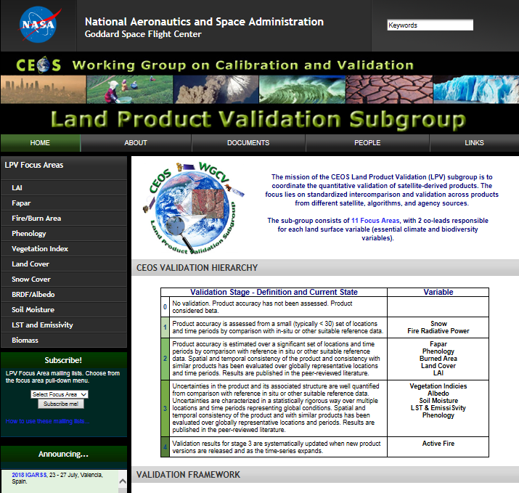
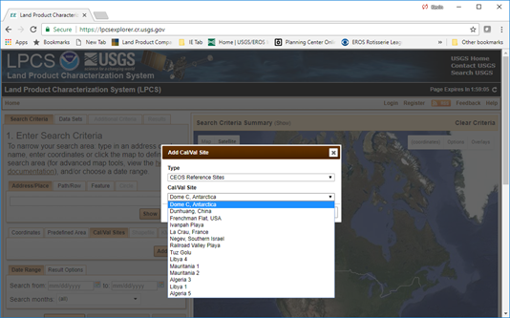
Cal/Val sites in LPSC

Slide 9
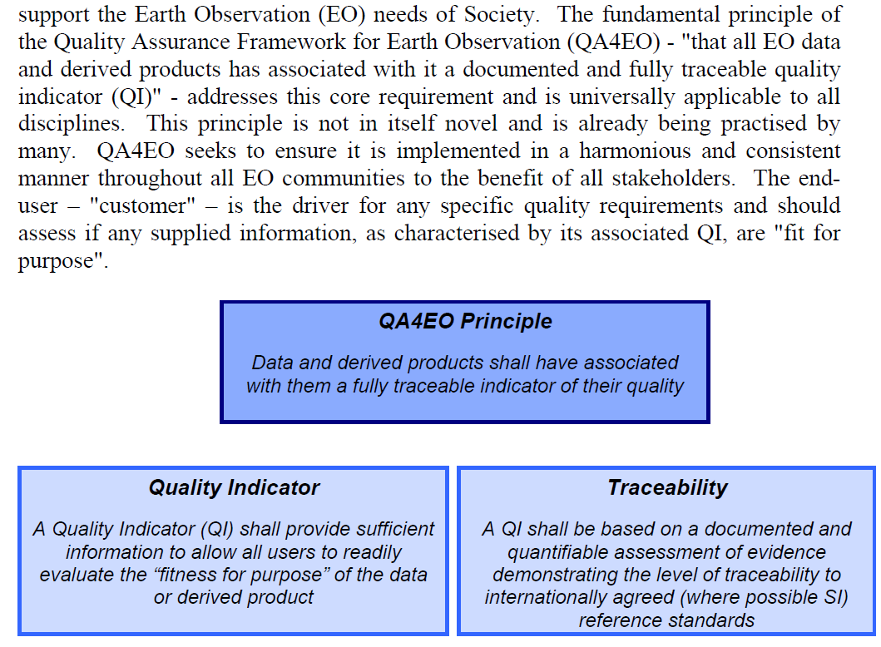
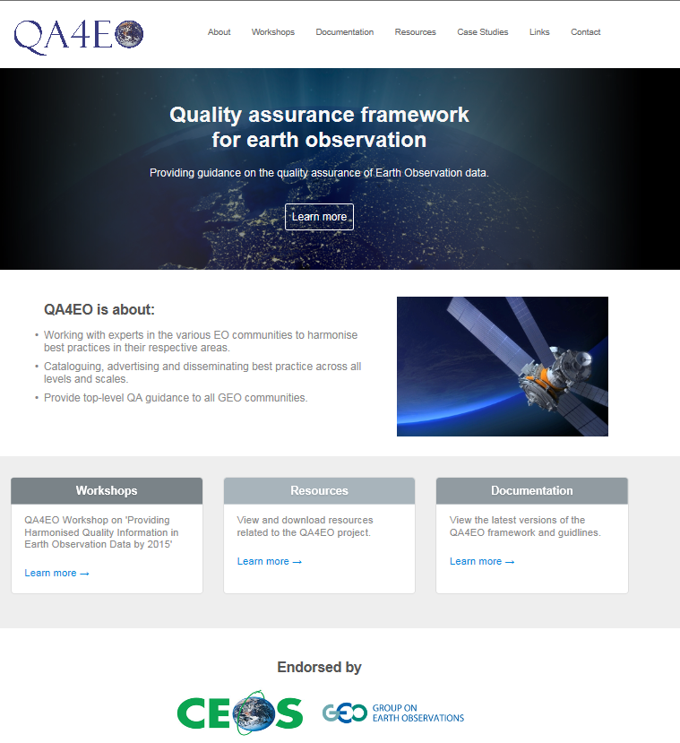
http://qa4eo.org/
JACIE - “Establishing Methodology and Best Practices for Quality Assurance of Remote Sensing Data”
- JACIE Civil Commercial Imagery Evaluation Workshop and ECCOE Workshop (Focused on cross calibration) Sept 21-24
GSICS - Working L1 Uncertainty
Many ongoing processes

Slide 10
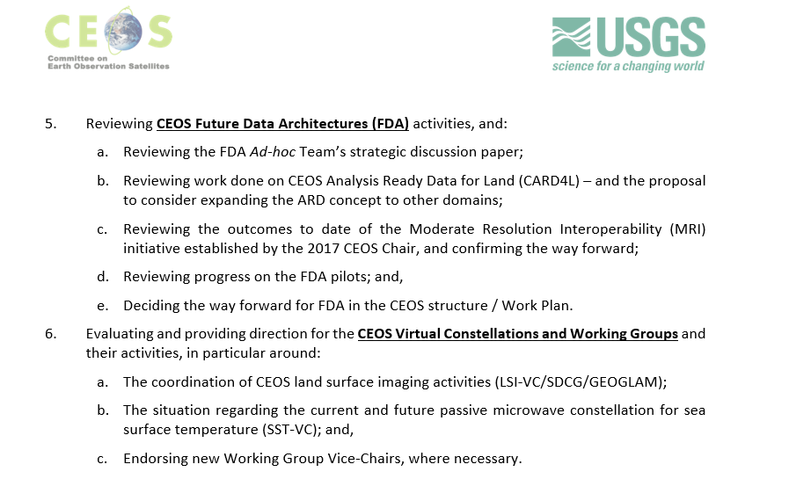


USGS 2017 CEOS Chair
Focus Areas
CEOS Chair Focus Areas define at 2017 Plenary
Future Data Access & Analysis Architectures (FDA)
  CEOS Analysis Ready Data (ARD)
  Interoperable Free and Open Tools
  Data, Processing, and Architecture Interface Standards
  Analytical Processing Capabilities
  User Metrics
Land Surface Imaging Virtual Constellation (LSI-VC)
  CEOS Analysis Ready Data (CARD4L) Definition, Specifications, and Implementation
Moderate Resolution Sensor Interoperability (MRI)
  MRI Framework
  Landsat/Sentinel-2 Interoperability Case Study

Slide 11
Future Data Access &
Analysis Architectures (FDA)
  FDA Driving Themes:
  Satellite data volumes and variety are increasing
  Satellite data demand and expectations of EO value are increasing
  Users want data systems and analysis tools that allow easy access and use of satellite data
  Many users desire ARD to minimize data preparation time and knowledge requirements
  Substantial growth expectation in the EO based digital economy across Industry and Government
  Step change in EO satellite capability leading to new applications
Freely available data and Cloud computing combine to create new industries
New applications from new capabilities in EO
Increased awareness leads to more (non-EO expert) users
Users expect near real-time, locally relevant EO derived information
Higher spatial resolution
Greater diagnostic capability through increased spectral resolution (hyperspectral) and new modalities (active and passive radar)
New capabilities in monitoring through increased acquisition rate and through new payloads (e.g. altimetry, atmosphere)
Data, Processing, and Architecture Interface Standards
  Develop standards for pixel-level data discovery, access, and common analytical processing requests (e.g., cloud free mosaics of ARD) exploiting EO satellite data among various CEOS exploitation platforms
Analytical Processing Capabilities
  Prototype portable web-based analytical processing APIs/Web Services that work across CEOS exploitation platforms in full computing environments for time series and other analysis
User Metrics
  Develop a data use metrics framework through which agencies can contribute to how EO data is being used, rather than just downloaded data quantities
FDA Themes and Outcomes
CEOS Analysis Ready Data (ARD)
  Implement and provision CEOS Analysis Ready Data for Land (CARD4L)-compliant products
  Examine ARD for marine and atmosphere domains
Interoperable Free and Open Tools
  Continue supporting the CEOS Data Cube (CDC) initiative utilizing the Open Data Cube (ODC)
  Demonstrate new technologies through ongoing support of ‘pilot projects’ and consideration of alternate candidate architectures

Slide 12
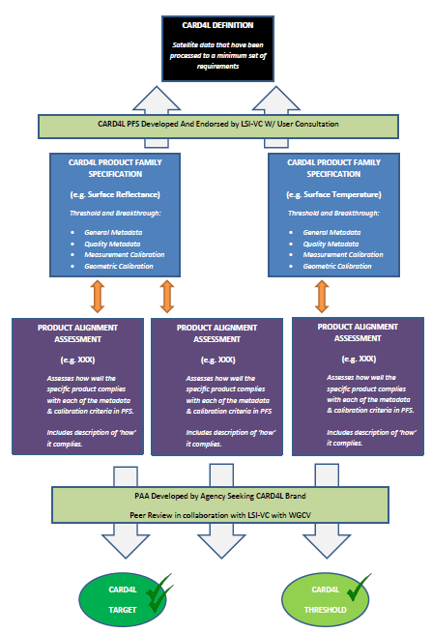
CARD4L Definition/Framework
CEOS Analysis Ready Data for Land (CARD4L), are satellite data that have been processed to a minimum set of requirements and organized into a form that allows immediate analysis with a minimum of additional user effort, and interoperability both through time and with other datasets
CARD4L Definition
Product families with
specifications
Providers self-assess
how well their products
meet the specifications
Peer review
CARD4L stamp!

Slide 13
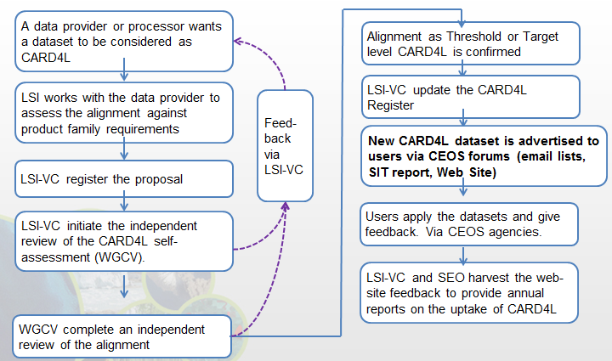
CARD4L Implementation
LSI-VC now moving into an implementation phase with several objectives:
  Develop the process for datasets to be assessed as CARD4L-compliant
  Identify data products that are on-track to become CARD4L-compliant
  Monitor and communicate progress of individual products toward CARD4L
  ‘Road-test’ the Product Family Specifications (PFSs)
    PFSs to be evaluated, and if necessary updated, on an annual cycle based on the implementation experience
Implementation processes are under discussion

Slide 14
MRI Framework
An Application-Specific, Conceptual Evaluation Tool
Framework organized into four components:
  General Metadata
  Per-pixel Metadata
  Data Measurements
  Geolocation
Within each components are a set of interoperability items for which application-specific Threshold and Target requirements (with uncertainties) are identified
  Threshold = agreed-upon, acceptable minimum value or characteristic
  Target = the goal (ideal characteristic or measure) for which producers and users are striving
Verifications are conducted on each item (actual measurements compared to pre-determined Thresholds/Targets), results documented
Next Steps are proposed to increase product interoperability where gaps exist

Slide 15
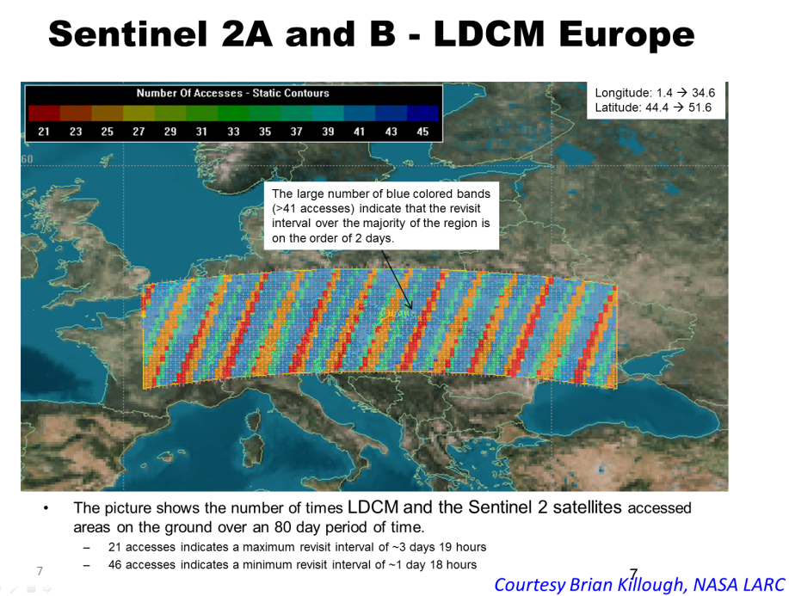
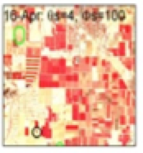
Harmonized Landsat/Sentinel-2
(HLS) Project
Landsat/Sentinel-2 Interoperability Case Study
Served as an example of the use of the MRI Framework for attaining multi-sensor interoperability
NASA Harmonized Landsat/Sentinel-2 (HLS) Project objective is to generate a radiometrically and geometrically (seamless and interchangeable) surface reflectance dataset from L8 and Sentinel-2
Each observation manipulated to look like it came from a single sensing system with consistent statistical properties, and the origin of each observation is transparent to end users
HLS performs a series of consistent radiometric and geometric corrections to minimize sensor differences, including a common atmospheric correction, solar/view angle corrections, spectral bandpass adjustments, and gridding to a common UTM projection and tiling system
Project:
Merging Landsat 8 and Sentinel-2 data streams can provide 2-3 day global coverage
Goal is “seamless” near-daily 30m surface reflectance record
Resampled to 30m Sentinel-2 reference and gridded to common projection (tiles)
atmospheric corrections,
Spectral band pass, Solar angle, and BRDF adjustments
Machine readable metadata
Cloud masks

Slide 16
FDA, CARD4L, and MRI Synergy
Full exploitation of EO data requires critical user feedback informing current implementations and future directions
Future Data Architectures
CARD4L-compliant data feed FDAs
MRI identifies good practices for implementation of multi-sensor data sets
Moderate Resolution Interoperability
- Addresses how to combine data / scientific methods to maximize interoperability
    CARD4L is the first step
    - MRI provides feedback to CARD4L
CEOS Analysis Ready Data for Land
Product family specifications facilitate uptake of EO data by the user community

Slide 17

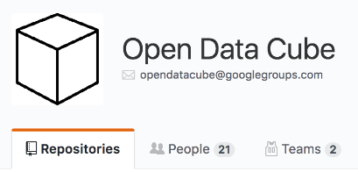
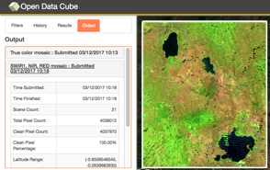
Open Data Cube (ODC)
Based on an open source operational system: Australian Geoscience Data Cube (AGDC)
Open Data Cube (ODC) is a comprehensive solution that builds the capacity of global users to apply CEOS satellite data
Based on Analysis Ready Data (ARD) products that contribute to the increased uptake and impact of growing data volumes
Coordination between GA, CSIRO, NASA, USGS to manage an open source software repository: https://www.opendatacube.org/
Scalable solution targeting 20 countries by 2022 with the support of key global stakeholders (e.g., GEO, World Bank)
Current prototype testing in Colombia, Switzerland, and Vietnam with more planned
Free/Open demo available on Amazon AWS with 14 sample data cubes and 7 applications: http://www.tinyurl.com/datacubeui
Robert Woodcock discuss GeoCube/DataCube

Slide 18
Recommended Plan
Focusing on WGCV Land subgroups (IVOS and LPV) and related key GEO applications
  Potential for SAR subgroup scenario later
Obtain data over key test site areas (WGCV)
  Push process via CEOS SIT/ LSI VC/ WGCV/WGISS
  Define and list primary sites and secondary sites
    Super sites
    Pseudo Invariant sites
    Landnet/RadCalNet sites
    LPV defined key sites
Make data easy accessible (WGISS)

Slide 19
Recommended Plan (cont.)
Make data easy accessible (WGISS)
Utilize Moderate Resolution Interoperability as test platform in the data cube (WGISS/LSI VC – development)
Test example use case(s) with WGCV as user
  Define key process events
Test example use case(s) with key application users
  Define key application user test scenario (GLAM/
Compare data via visualization and trending/monitoring tools (GEOCube and WGISS - development) (User - WGCV IVOS/LPV)
Data Cube definition and plan (WGISS)
DC TEst site analytics environments with ready to run Jupyter notebooks available on, say, AWS so people can spin them up on demand. (WGISS)
Detailed documentation related to interoperability WGISS/WGCV/others?
>Interoperability >Harmonization >Homogenization >QA4EO/ Uncertainty

Slide 20
Thoughts, Questions, Backup
“CEOS Data Cubes and CEOS Test Sites Data Access in support to WGCV Activities “
  WGCV/WGISS Goal
    specific test case(s) of WGCV-type data
    Using Cal/val Test sites
    Use as example(s) to show how future data cube efforts could be standardized.
      Involve standardization of Landnet, MRI, and ARD interactions

Slide 21
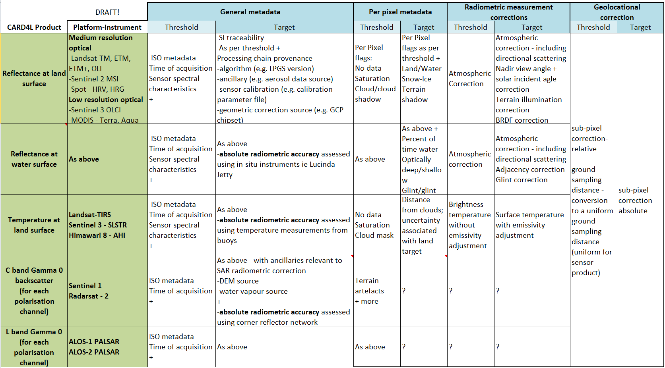
CARD4L Specifications

