Slide 1
Ensuring ARD Interoperability
Medhavy Thankappan

Slide 2
Project overview
Outcomes:
ARD correction parameter sensitivity: Determine the key set of common parameters between correction approaches to minimise artefacts in reflectance and downstream processes
Temporal stability: comparison of measurements from corrections through time (GA NBAR method vs LEDAPS/LaSRC )
Field validation: comparison with in situ measurements (historical and current)

Slide 3
Project timeframe
Q3-Q4 2018
Outputs:
Summary report + peer reviewed article
Intercomparison tools for characterising multisource ARD

Slide 4
Approach
Use NBAR / NBART / with WoFS as control
Quantify impact on reflectance
Relative to control:
per scene differencing
target feature comparison (invariant within scene stack)
Quantify impact on downstream product
Water (WoFS) classification results

Slide 5
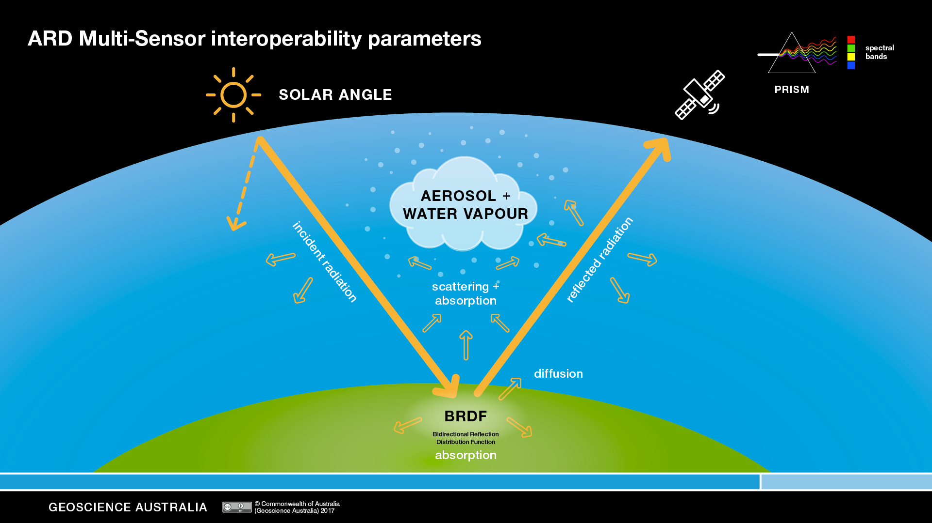

Slide 6
ARD correction parameters
Compare cross matrix of parameters, specifically look:
MODIS BRDF
Average BRDF
Aerosol - actual, [ fixed values ]
Water vapour - actual [ fixed values ]
Nadir solar angle
Landsat Surface Reflectance processor as a surrogate for multiple sensors

Slide 7
Test sites
Low vegetation cover areas (low BRDF): Lake Lefroy path/row 109/082 and adjacent paths 108/082 and 110/082
Medium vegetation cover: Wagga Wagga area, path/row 92/84 and adjacent path (91/84 and 93/84). The region has agricultural areas (MDB). Adjacent areas could be used to validate BRDF correction.
High BRDF areas: East coast forested area.Path/row 092/086) with adjacent path (091/086) and (093/086).
Supplemental area: North Queensland path/row 095/074 and its adjacent paths 094/074 and 096/074.
Notes:
Tools will be developed to enable execution of

Slide 8
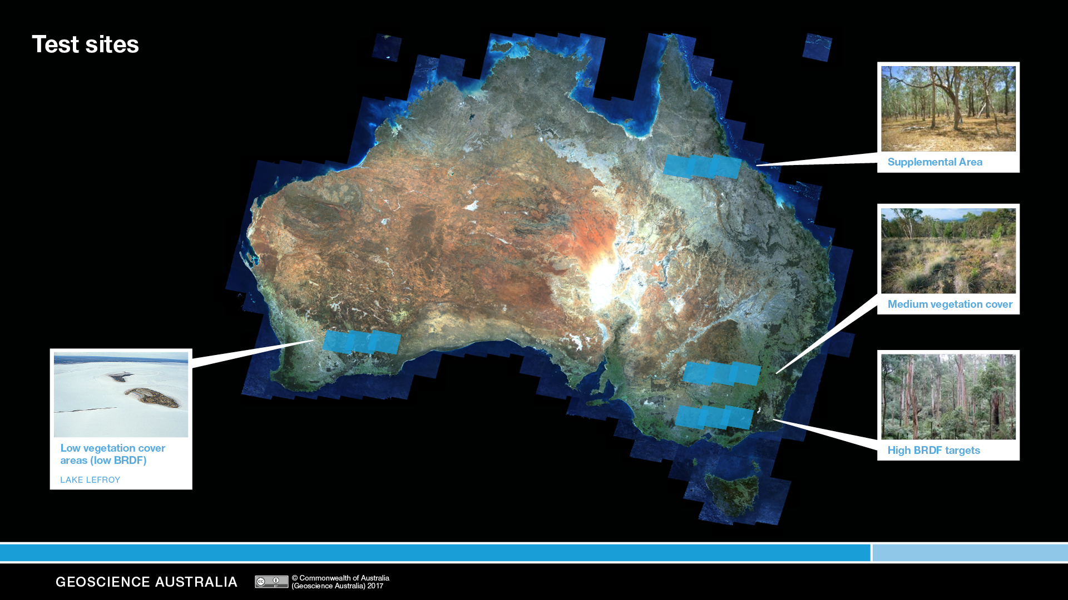
Test sites

Slide 9
Sensitivity analysis
Solar angle: BRDF normalized to 25, 45 (control) and 70 degree.
Aerosol change: aerosol optical depth 0.05, 0.15, 0.25. 0.05 (control is best observed)
Water vapour: 0.5, 2, 3.5 (control is NCEP global modelled/observed)
BRDF: temporal average (control is MCD43 modelled/observed)

Slide 10
Temporal stability
GA NBAR/NBAR T and LEDAPS/LaSRC
Report including statistical summaries:
Invariant targets within scene
Points coincident with field spectra
Polygonal statistics over homogenous targets
Tools for expanded intercomparison studies eg. GA NBAR vs sen2cor

Slide 11
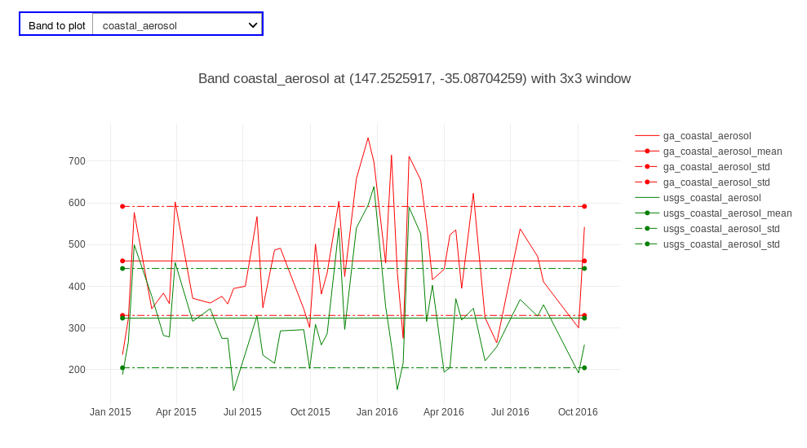
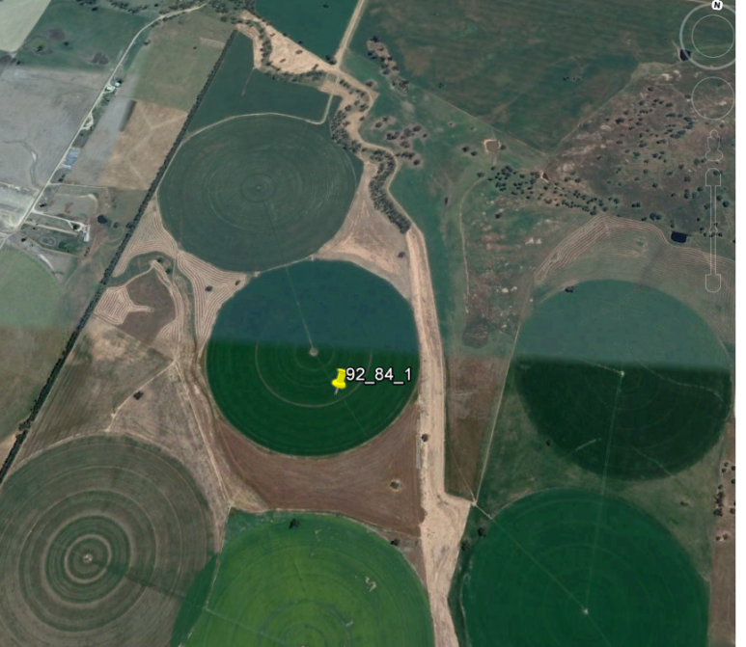
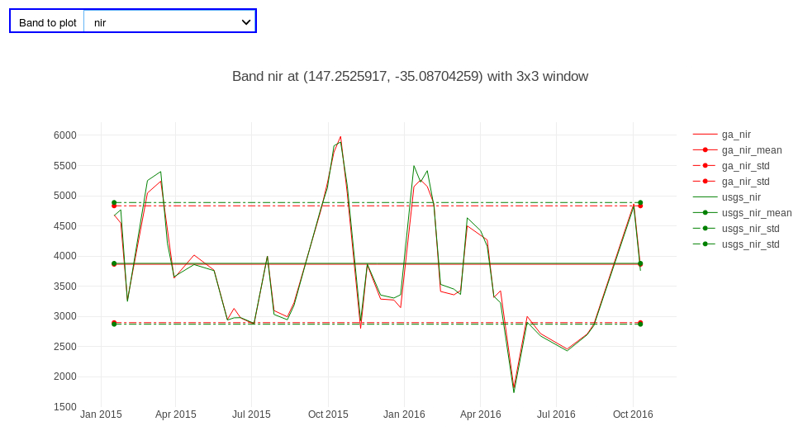
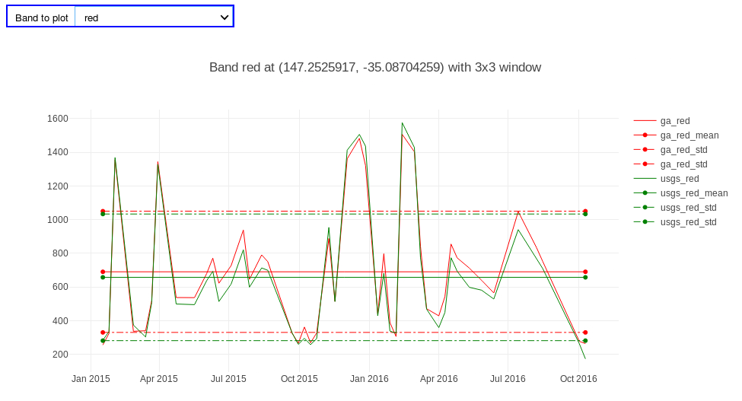
Comparison tool - agricultural site

Slide 12
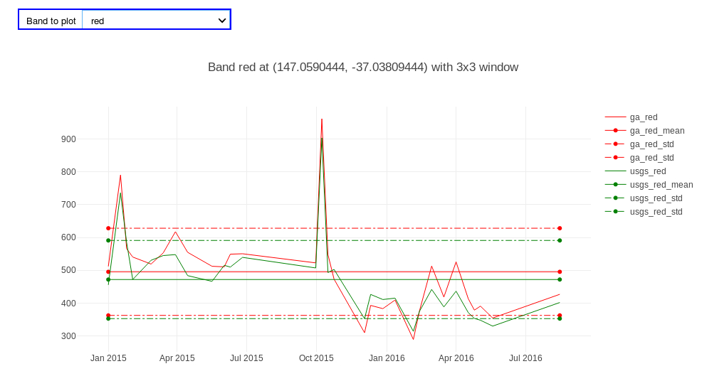
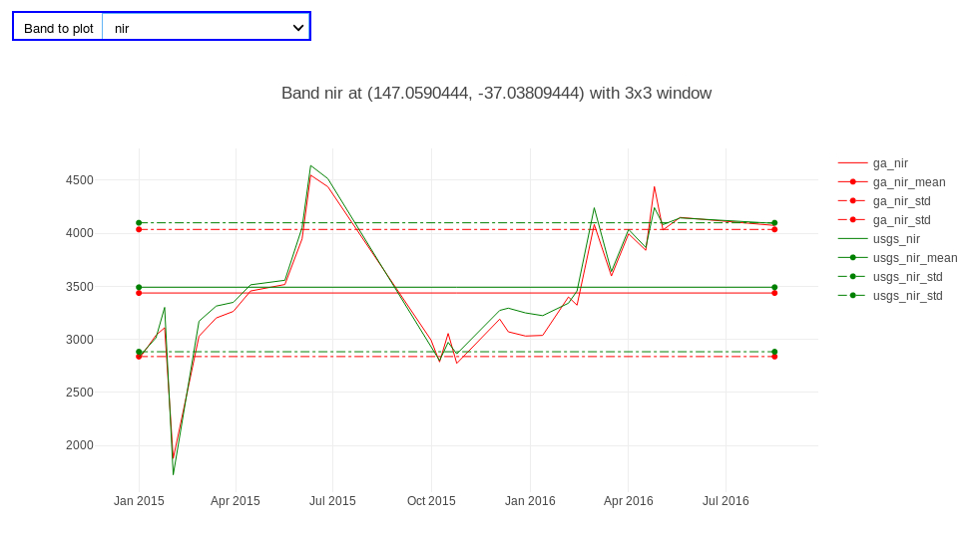
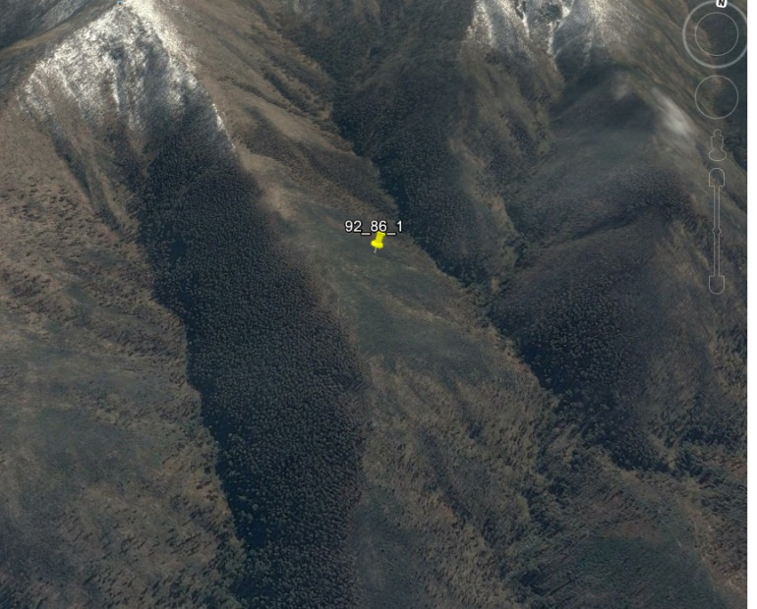
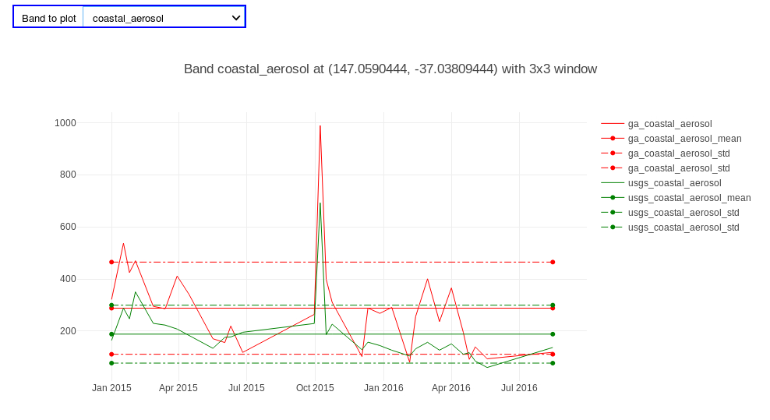
Comparison tool - NE facing hill slope

Slide 13
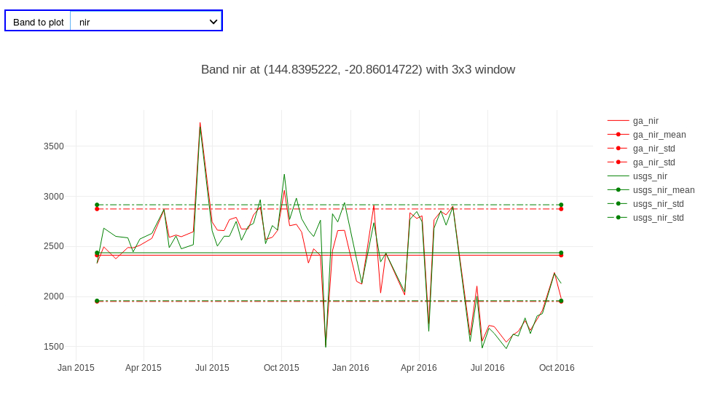
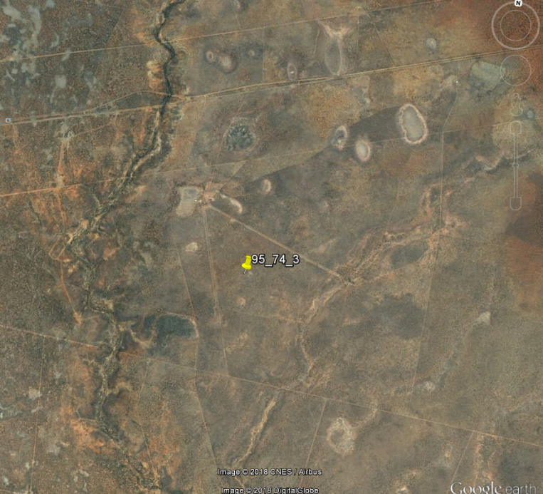
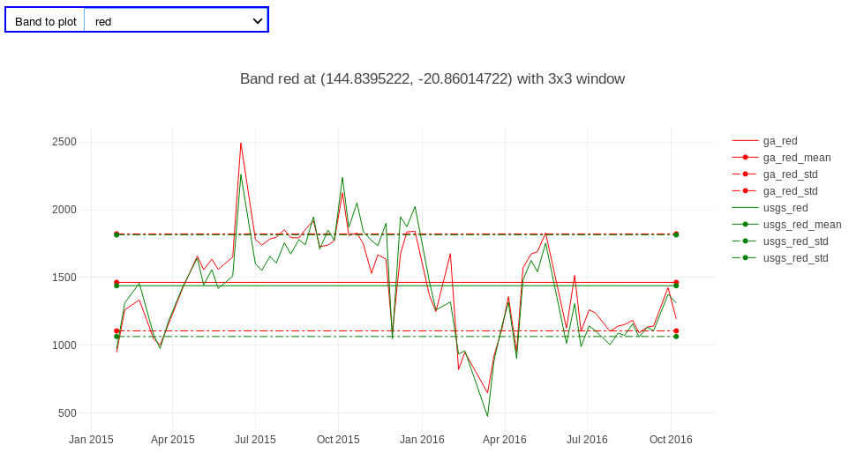
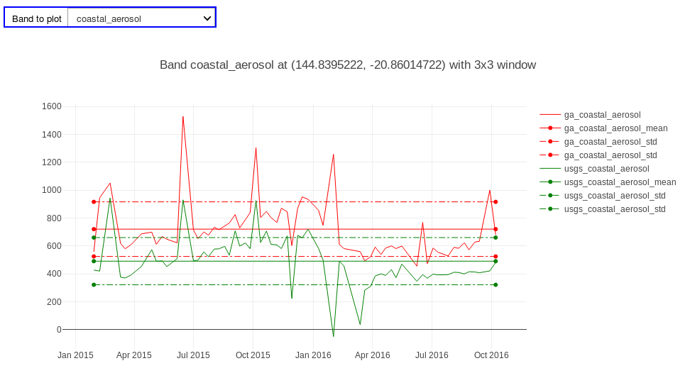
Comparison tool - grassland site

Slide 14
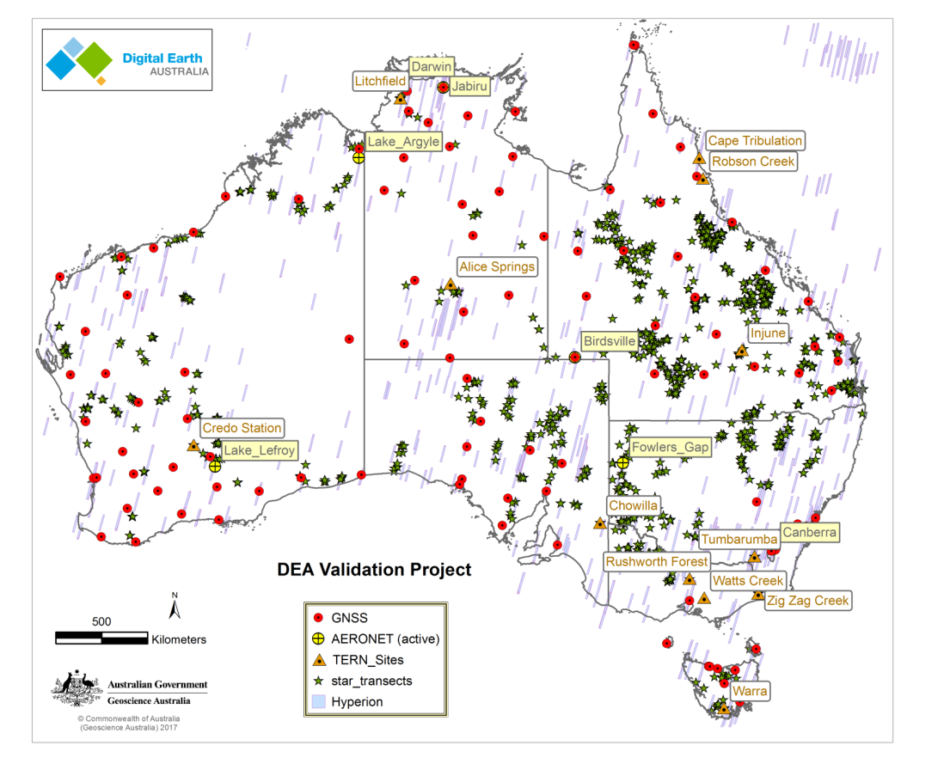
Field validation

Slide 15
Key elements of validation
Validation protocols (QA4EO, CEOS-LPV etc)
Field sites for product validation at national scale
Effective sampling design for validation across product classes
Nationally coordinated campaigns for field data collection
Supported by UAVs and automated field instrumentation
Field data collection management at national level
Automated systems to cross validate EO and field based data

Slide 16
Ensuring ARD Interopability

