Slide 1

WGCV Overview
K. Thome
WGISS#45 / WGCV#43
INPE, São José dos Campos (SP), Brazil
09 April 2018

Slide 2
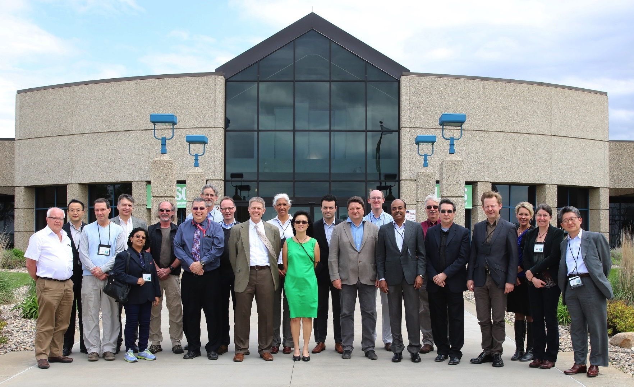
WGCV membership
WGCV includes members from CEOS agencies as well as the Chairs of six subgroups
Subgroups allow inclusion of a wider range of researchers
  Atmospheric Composition
  Land Product Validation
  Infrared and Visible Optical Sensors
  Microwave
  SAR
  Terrain Mapping
Task groups address cross-cutting topics covered by multiple sub-groups
General topics include
  Validation metrics
  Protocols
  Traceability
  Prelaunch and post-launch characterization
WGCV-42 meeting hosted by
USGS in Sioux Falls, United
States

Slide 3
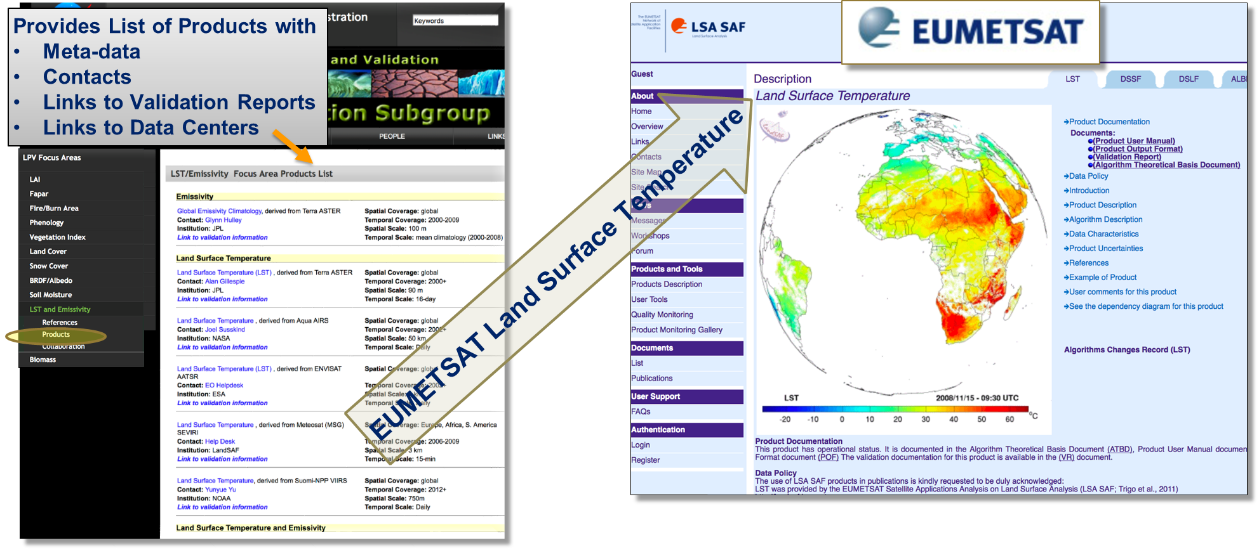
LPV Validation Reports
Documenting validation framework and protocols
One example - Land Surface Temperature & Emissivity Focus Area

Slide 4
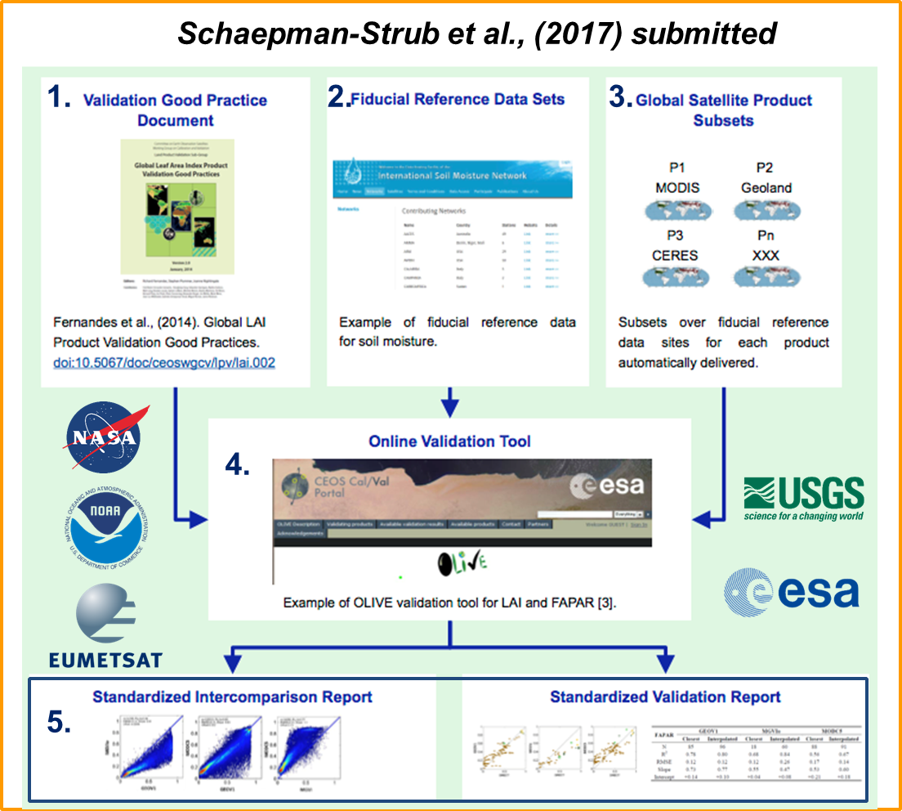
LPV Validation Framework
CEOS WGCV LPV has established a framework with the aim of independent validation and consistent uncertainty reporting across products as main output

Slide 5
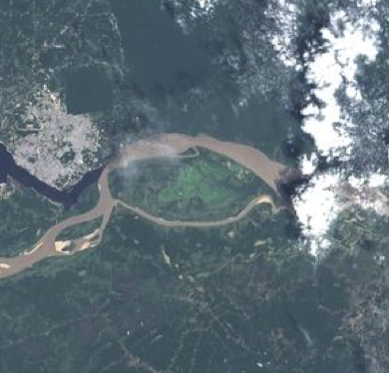
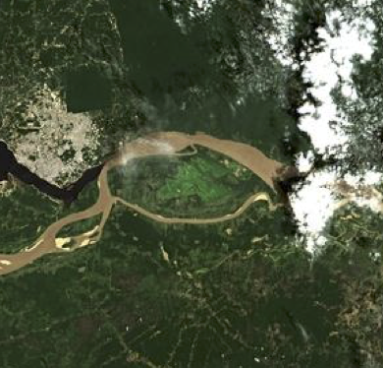
Atmospheric Correction task group
Sensors Processors
1 | ACOLITE [Belgium]
2 | ATCOR [Germany]
3 | Brockmann [Germany]
4 | FORCE [Germany]
5 | GA-PABT [Australia]
6 | LaSRC [USA]
7 | LAC [France]
8 | MACCS [France]
9 | OPERA [Belgium]
10 | SCAPE-M [Germany]
11 | SeaDAS [USA]
12 | Sen2Cor [France&Germany]
Atmospheric Correction Intercomparison Experiment - ACIX
Better understanding of the different uncertainty contributors and help in improving the AC processors
Definition of the inter-comparison protocol - discussed at first workshop
Application of the AC processors - Participants applied their AC schemes for test sites keeping processing parameters constant
Analysis of the results - ACIX coordinators processed the results submitted by all participants in early 2017 leading to a peer-reviewed publication earlier this year

Slide 6
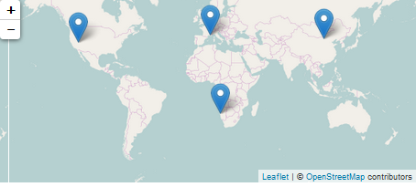
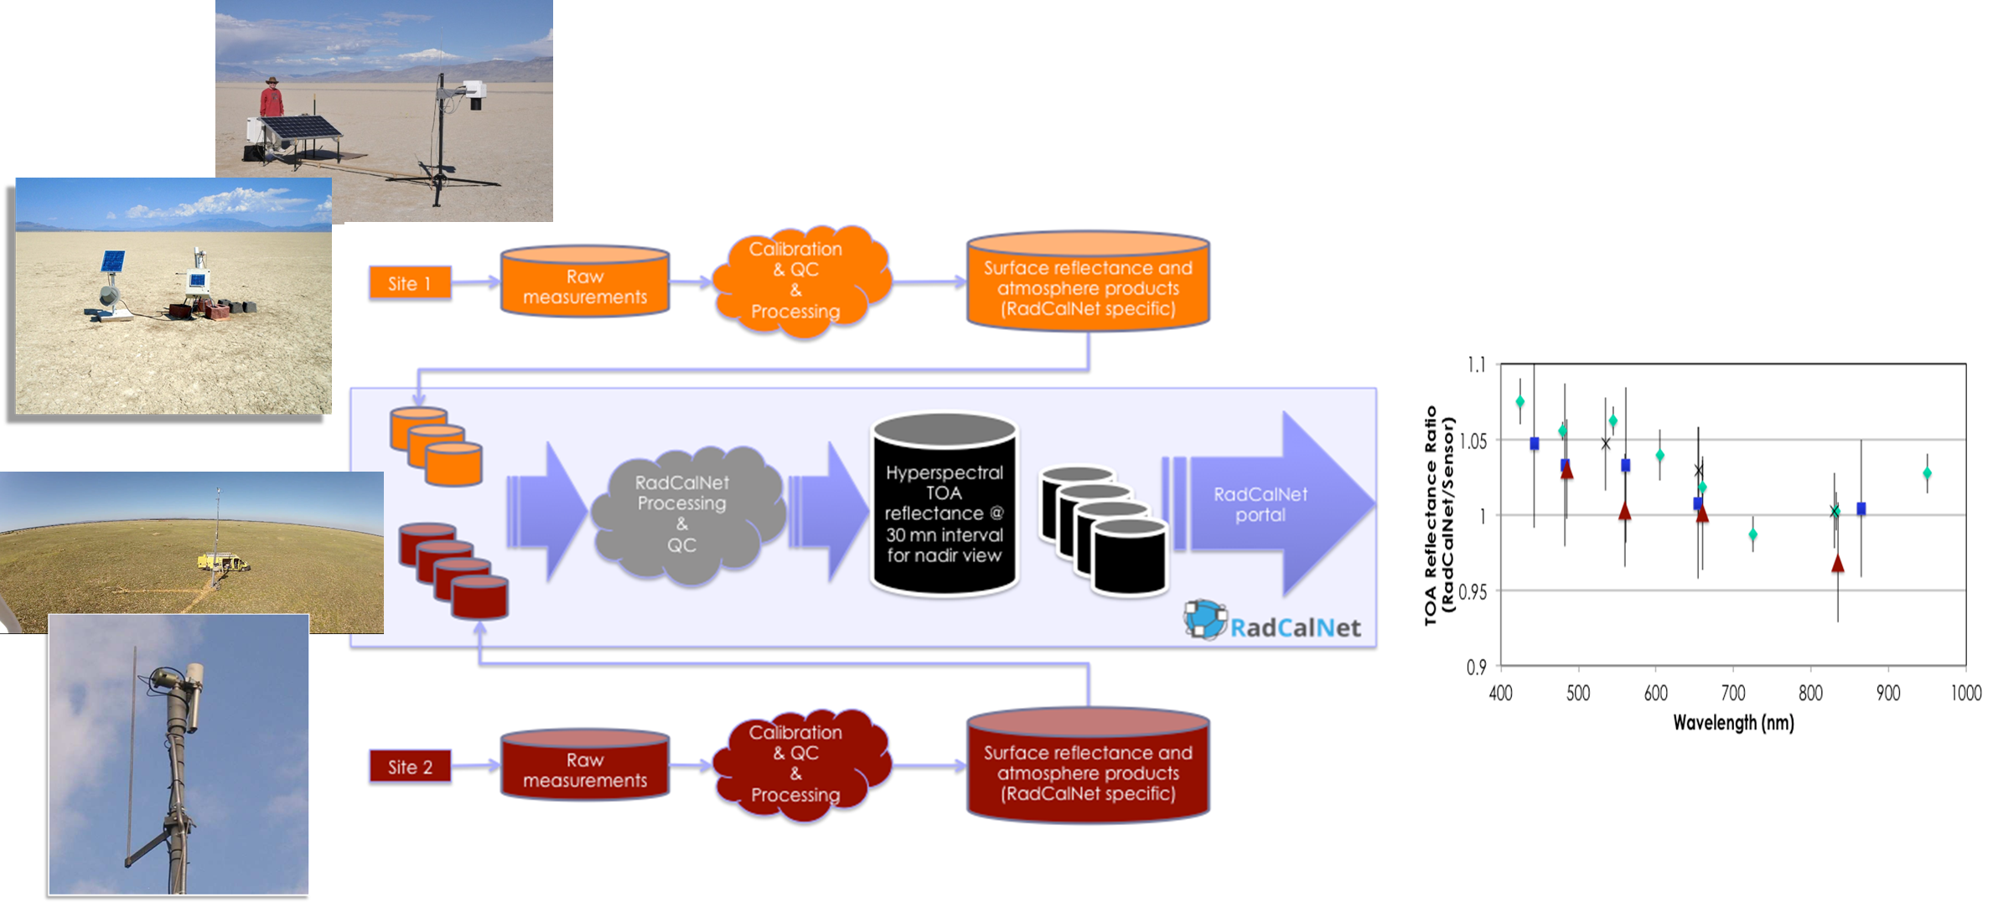
RadCalNet - Radiometric Calibration Network
Network of instrumented sites dedicated to the Radiometric Calibration of EO optical sensors developed in IVOS Subgroup
Automated processing including quality control
Traceability vs. SI standard

Slide 7
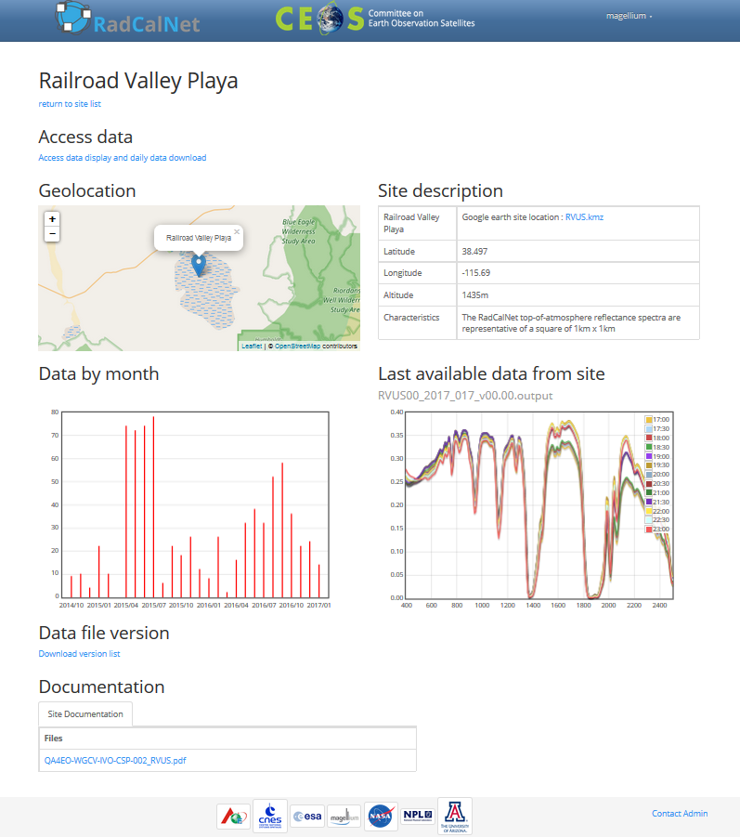
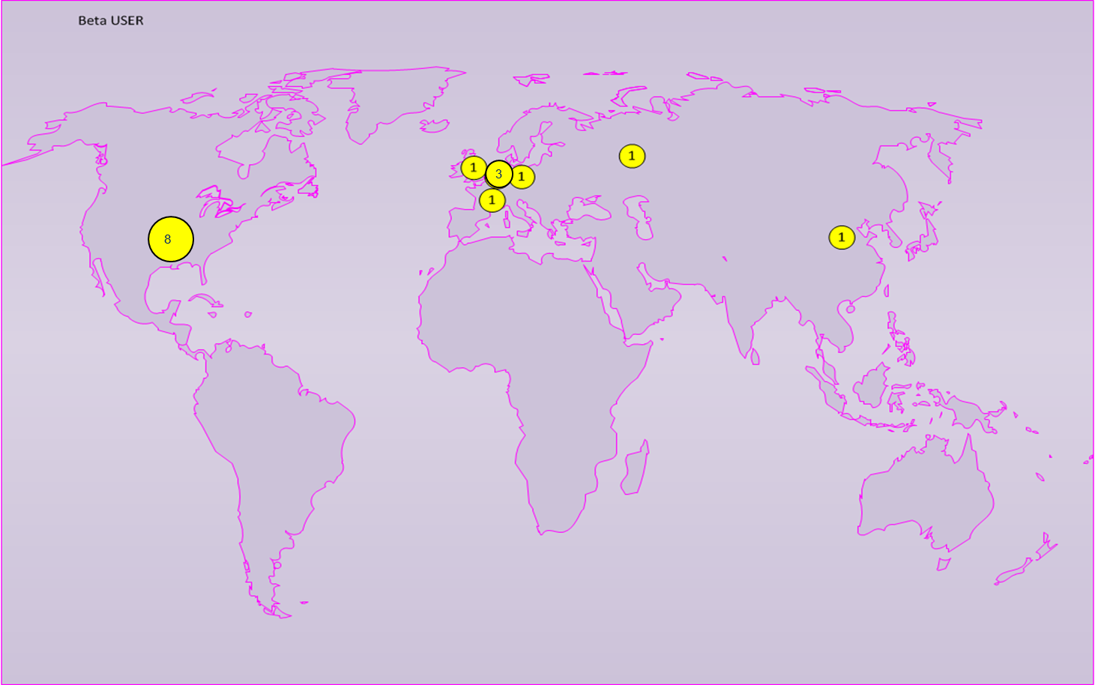
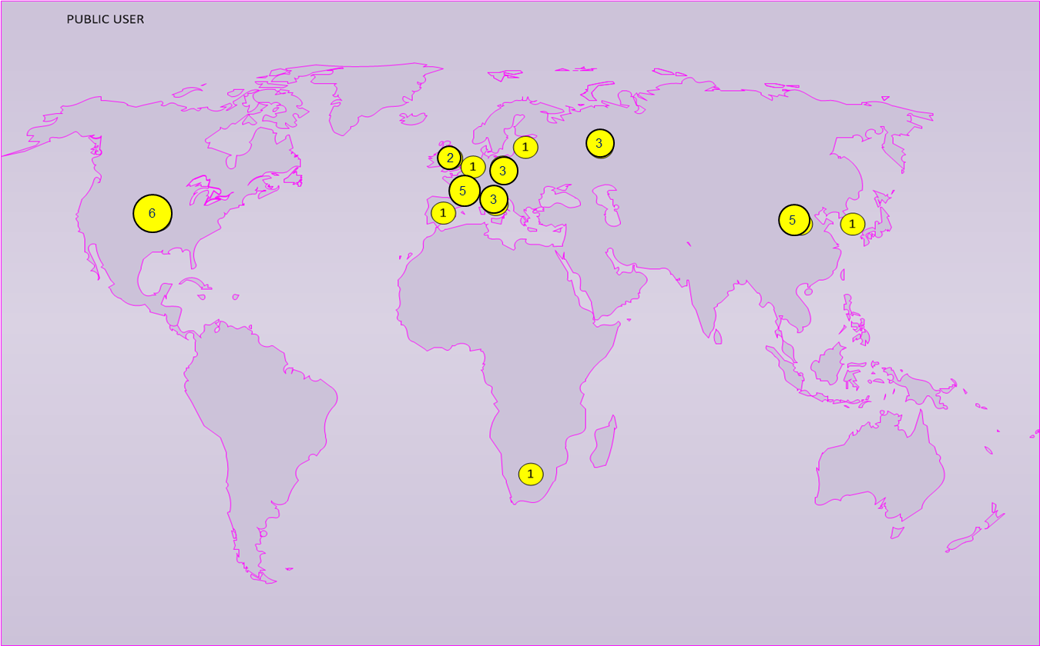
RadCalNet - Radiometric Calibration Network
Approval of firs four sites and opening of website to the public is being discussed at WGCV-43
The portal
16 Beta Users
32 Registered Users

Slide 8
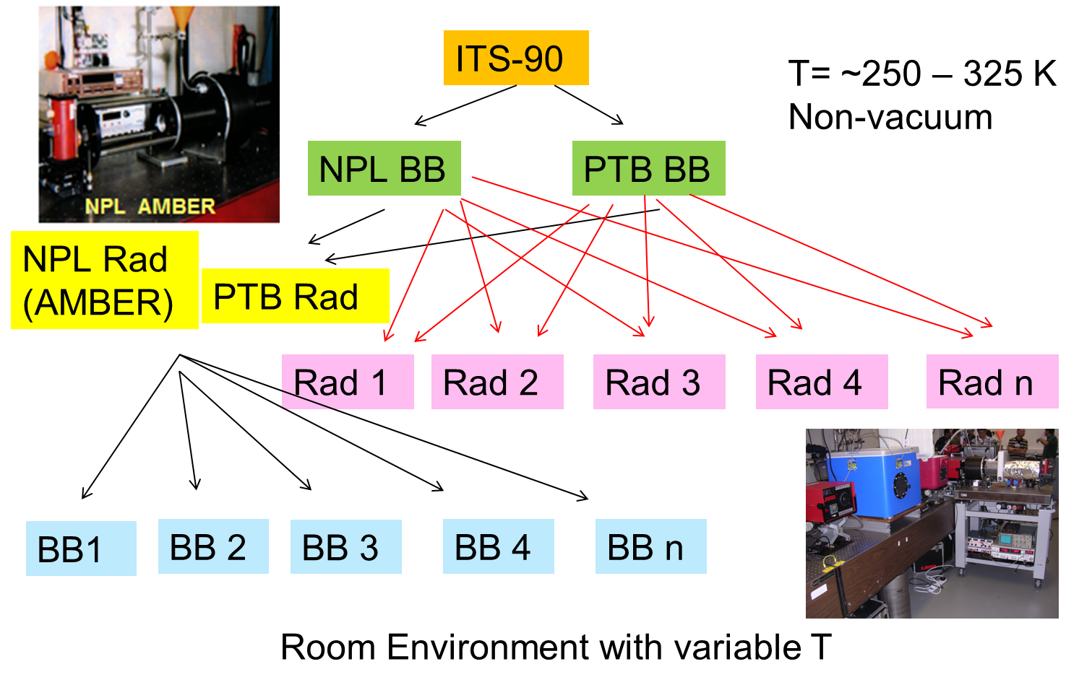
Importance of SI-traceability
Work within all subgroups (AC, IVOS, LPV, Microwave, and SAR) developing good practice approaches to ensure laboratory and field measurements are interoperable
Lead towards Level 1 and higher product agreement

Slide 9
Solar Irradiance Spectrum
Description of proposed GSICS/WGCV IVOS solar irradiance spectrum is being evaluated by WGCV membership for approval
  Solar spectrum choice can lead to differences in comparisons between sensors
  WGCV accepted solar irradiance spectrum will be distributed on the CEOS Cal/Val Portal
CV-16 - Report on outcomes from GSICS/CEOS reference Solar Spectrum evaluation

Slide 10
Level 1 Interoperatibility
Develop an initial recommendation of a community reference in collaboration with GSICS
  Introduced at WGCV-42 as a means to provide input to the MRI team
  Develop an initial recommendation of a community reference in collaboration with GSICS
Makes use of ongoing and newly instituted activities
  RadCalNet
  Solar irradiance spectrum
  SI-traceability and good practices
  Fiducial reference measurements

Slide 11
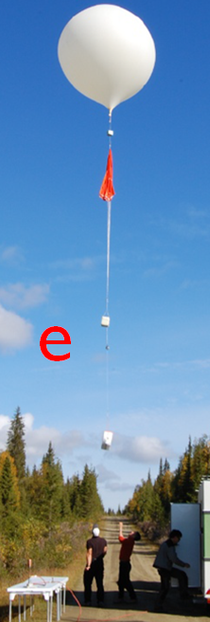
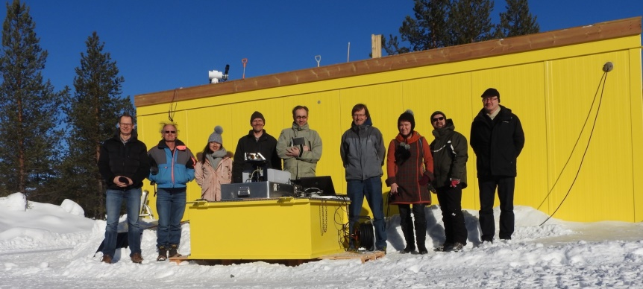
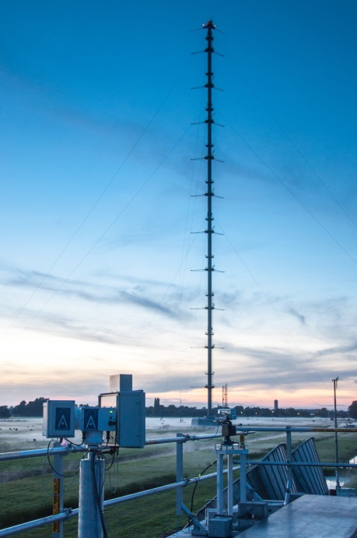

Fiducial Reference Measurements
Examples here from the Atmospheric Composition Subgroup
FRM4GHG Campaign
  CO2, CH4, CO + other GHGs
  S-5p, GOSAT, OCO-2
  Test of new low-cost instruments
  ESA, national agencies
CINDI-II Campaign
  OMI, GOME-2A/B
  Validation of NO2, HCHO, SO2…
  NSO, ESA FRM4DOAS, EU QA4ECV

Slide 12
Summary
WGCV has seen an increase in cross-cutting activities amongst its subgroups
Similarly, CEOS is seeing an increase in cross-cutting activities amongst its Working Groups and Virtual Constellations
Limited resources points to the benefits of cooperative efforts amongst the various WGs and VCs
Joint meeting such as this allows for discussion of common areas and topics in the ongoing/planned WGs activities that would benefit from cooperation between the two groups:
  Describe and share available facilities, expertise, resources, technical information and documentation
  Discuss topics of common interest and identify synergies focused on common tasks
Next set of talks will hopefully lead to clear paths forward to produce measurable benefits to CEOS

