Slide 1

CEOS Status/Overview
Committee on Earth Observation Satellites
Steven Hosford
WGCV-43/WGISS-45
10th April 2018

Slide 2

Bonjour from Philippe!
Philippe Brunet, CEOS Chair 2018
European Commission

Slide 3
Summary
Introduction to CEOS
CEOS annual cycle
Relationships
Organisational structure
Focus areas in 2018
WGCV & WGISS within CEOS
SIT-33

Slide 4
Introduction to CEOS
Viewing Earth, serving society
The Committee on Earth Observation Satellites (CEOS) ensures international coordination of civil space-based Earth observation programmes
60 members and associate members
151 missions currently operating
177 missions under development

Slide 5
Introduction to CEOS
Three primary objectives:
Optimise benefits of EO through cooperation between CEOS Agencies in mission planning and the development of compatible mission outputs
Provide a focal point for international coordination of space-based Earth observation
Serve as a forum for exchange for technical and policy information to encourage complementarity and compatibility among space-based Earth Observation systems

Slide 6
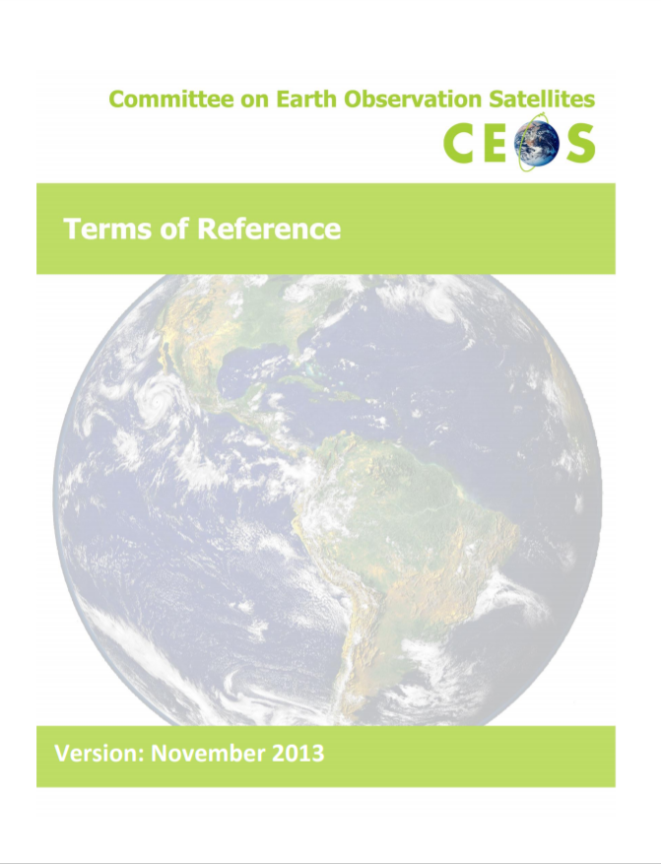
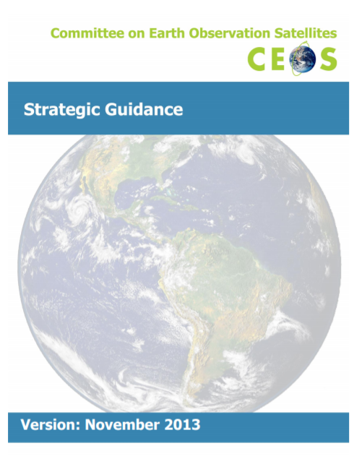
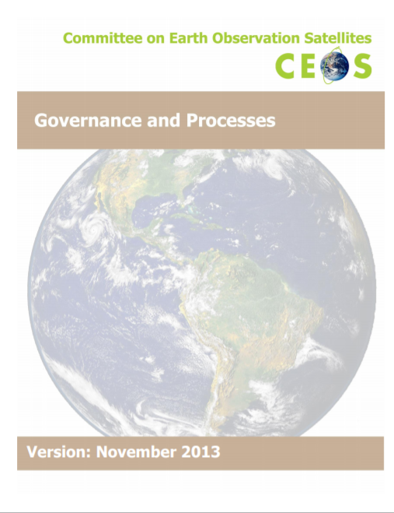

Introduction to CEOS
Governing documents

Slide 7


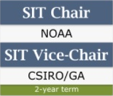
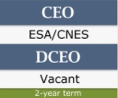
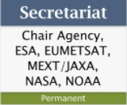
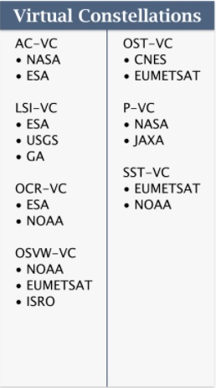
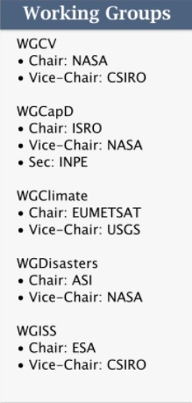
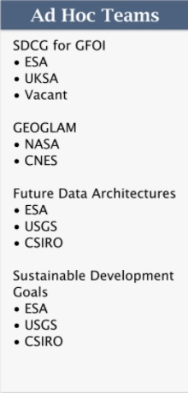
Organisational structure
CEOS Leadership
Support roles
Working Groups
Virtual Constellations
Ad-hoc Teams

Slide 8
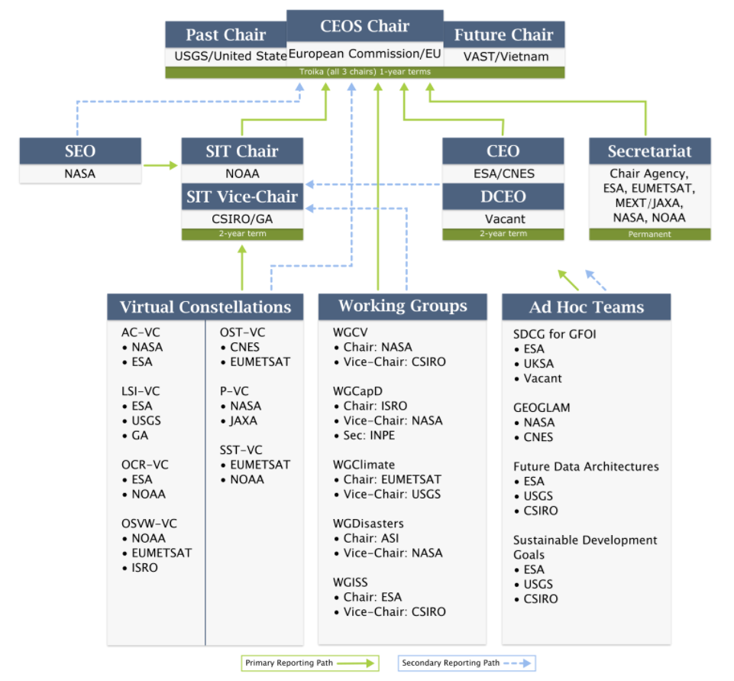
Organisational structure

Slide 9
CEOS annual cycle
July
June
August
May
SIT Technical Workshop
April
SIT meeting
September
WG/ADT meetings
WG/ADT meetings
March
October
Plenary meeting
Update CEOS Work plan
November
February
GEO Plenary
December
January
CEOS/GEO bilateral

Slide 10






Institutional relationships
CEOS is GEO’s “space arm” coordinating the provision of space data to the Global Earth Observation System of Systems
CEOS seeks to benefit from GEO’s “convening power”
Strong institutional relationship on all levels
Annual bilateral meeting arranged with GEO Secretariat to align work
CEOS Climate work feeds into the UN Framework Convention on Climate Change through the Subsidiary Body for Scientific and Technical Advice (SBSTA)
SBSTA is one of two SBs which supports the work of the COP

Slide 11


Institutional relationships
UN International Strategy for
Disaster Reduction – Sendai framework
CEOS contribution through activities from the WG on Disasters, since 2011 in order to promote & enhance the use of EO data in all phases of Disaster Risk Management, with focus on Disaster Risk Reduction.
  Use of EO satellite data is recognized as key for DRR in “Sendai Framework for Disaster Risk Reduction 2015-2030”
Several activities with strong involvement of user communities and major non-space stakeholders e.g. World Bank GFDRR.
UN Sustainable Development Goals
EO can support several of the 17 SDG goals (2, 6, 11, 14 and 15) and associated targets and indicators.
  On indicators, cooperation with UN agencies
  and National Statistical Agencies
Dedicated CEOS Ad Hoc Team on SDG

Slide 12

CEOS Priority areas in 2018
CEOS Chair priorities for 2018
Priority ‘A’: Laying the foundation for an international CO2 and GHG emission monitoring system through
  Completion of the AC-VC whitepaper on defining an optimum constellation for GHG emission monitoring with the CEOS Carbon Strategy
  Place the space segment in the broader context of a sustained system for GHG emission monitoring
  Advance the relationship with CGMS to ensure a ssustained observation capability

Slide 13
CEOS Priority areas in 2018
CEOS Chair priorities for 2018
Priority ‘B’: Continue and progress work within CEOS on Data access and use including
  developing a common understanding of Future Data access and analysis Architectures (FDAs), identifying current examples and the needs for interoperability between them
  developing User metrics that enable a deeper understanding of trends in data usage and thus guide the development of FDAs
  progress definition and production of Analysis Ready Data including identifying and developing ARD specifications for priority data streams

Slide 14
WGCV and WGISS within CEOS
5 Working Groups of which
  3 WGs focused on space agency “Core Business”
    CalVal: Data quality and suitability for use
    WGISS: Data stewardship, publication and access
    WGCapD: Promoting use through training and education
  2 thematic WGs
    Climate
    Disasters

Slide 15
WGCV and WGISS within CEOS
CEOS primary objectives:
Optimise benefits of EO through cooperation between CEOS Agencies in mission planning and the development of compatible mission outputs
Provide a focal point for international coordination of space-based Earth observation
Serve as a forum for exchange for technical and policy information to encourage complementarity and compatibility among space-based Earth Observation systems
As a minimum, CEOS must ensure that EO data acquired must be
Correctly calibrated and validated
Readily Accessible (discoverable and downloadable)

Slide 16
Organisation of SIT-33
New SIT Chair since CEOS plenary 2017: NOAA
  Each SIT Chair brings a different point of view and focus
  NOAA has solicited feedback from all WGs and VCs in February through questionnaire and conference calls
  Much food for thought generated, the SIT Chair team will digest and reformulate for SIT
SIT-33
  Venue: Boulder, CO
  Date: 24th – 25th April
  Side meetings Mon, 23rd April
  FDA Big Data workshop organised on Thurs, 26th April

Slide 17
Organisation of SIT-33
SIT33 structure
  DAY1 - Opportunity at SIT for all CEOS entities to
    share information on status of CEOS objectives/deliverables
    build a common understanding of implementation across CEOS
  Session 4: Working Groups
  DAY2 – Broad strategic discussions, cross-cutting links across CEOS activities and toward other partners
    Ad-hoc teams, partnerships
http://ceos.org/meetings/sit-33
http://ceos.org/meetings/fda-big-data-workshop-2018/

Slide 18

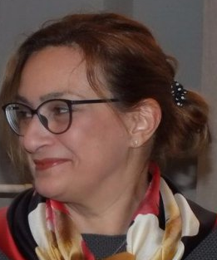

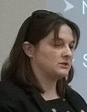
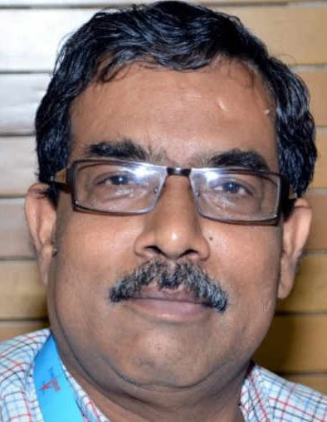






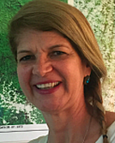
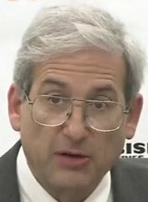
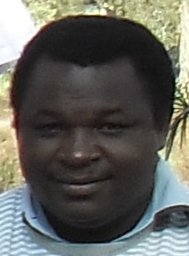

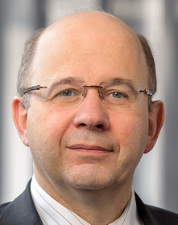

CEOS’s expectations of WGCV / WGISS
… as this famous CEOS Principal once said
“ … ask not what CEOS can do for you, but what you can do for CEOS ….
… in making the planet’s EO programmes greater than the sum of their individual parts ….”

