Slide 1

Data Asset Enhancement
Synergies with FDA
A proposal for a WGISS coordinated FDA technology demonstrator
Dr Robert Woodcock
Fun fact:
A group of Wombats is called a Wisdom

Slide 2
Situation
Review of:
  CEOS FDA report 2017
  Geoscience Australia – Digital Earth Australia
  CSIRO Earth Analytics Industry Innovation Hub
  UK Catapult
  Colombia Data Cube
  Vietnam Data Cube
  Digital Globe
  USGS
  WGISS 44 FDA workshop common architectural themes
What do you learn?
  User requirements fairly well known
    Routine discovery, download, processing and ARD (or similar)
    Need to hit multiple CEOS agency collections using machine to machine APIs
  User experience is quite variable
    You can get the job done, even at continental scale
    But it’s awkward…
Notes:
WGISS4 common themes: Discovery, Index/Ingest and data duplication in different formats (compute ready data)
Yes, the list on the left does look like part of a WGISS FDA-9 action

Slide 3
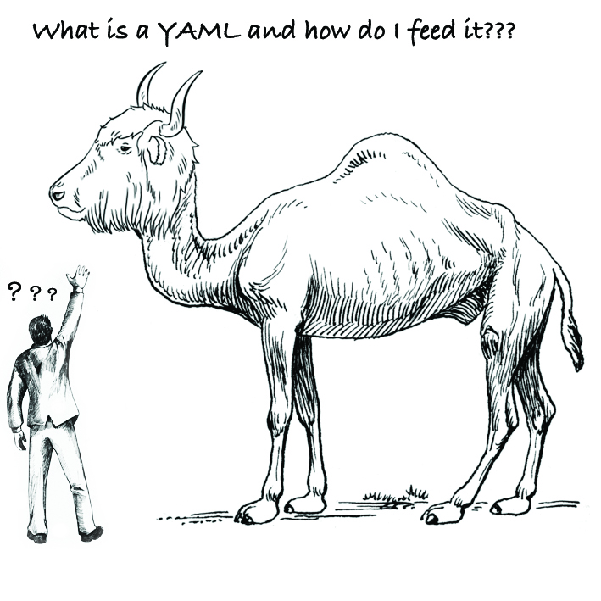
F1 Data Ingest
(and a bit of M2 Data cube on demand)
Ride?
Belle 2018
Notes:
Sample user sentiment from ODC workshop

Slide 4
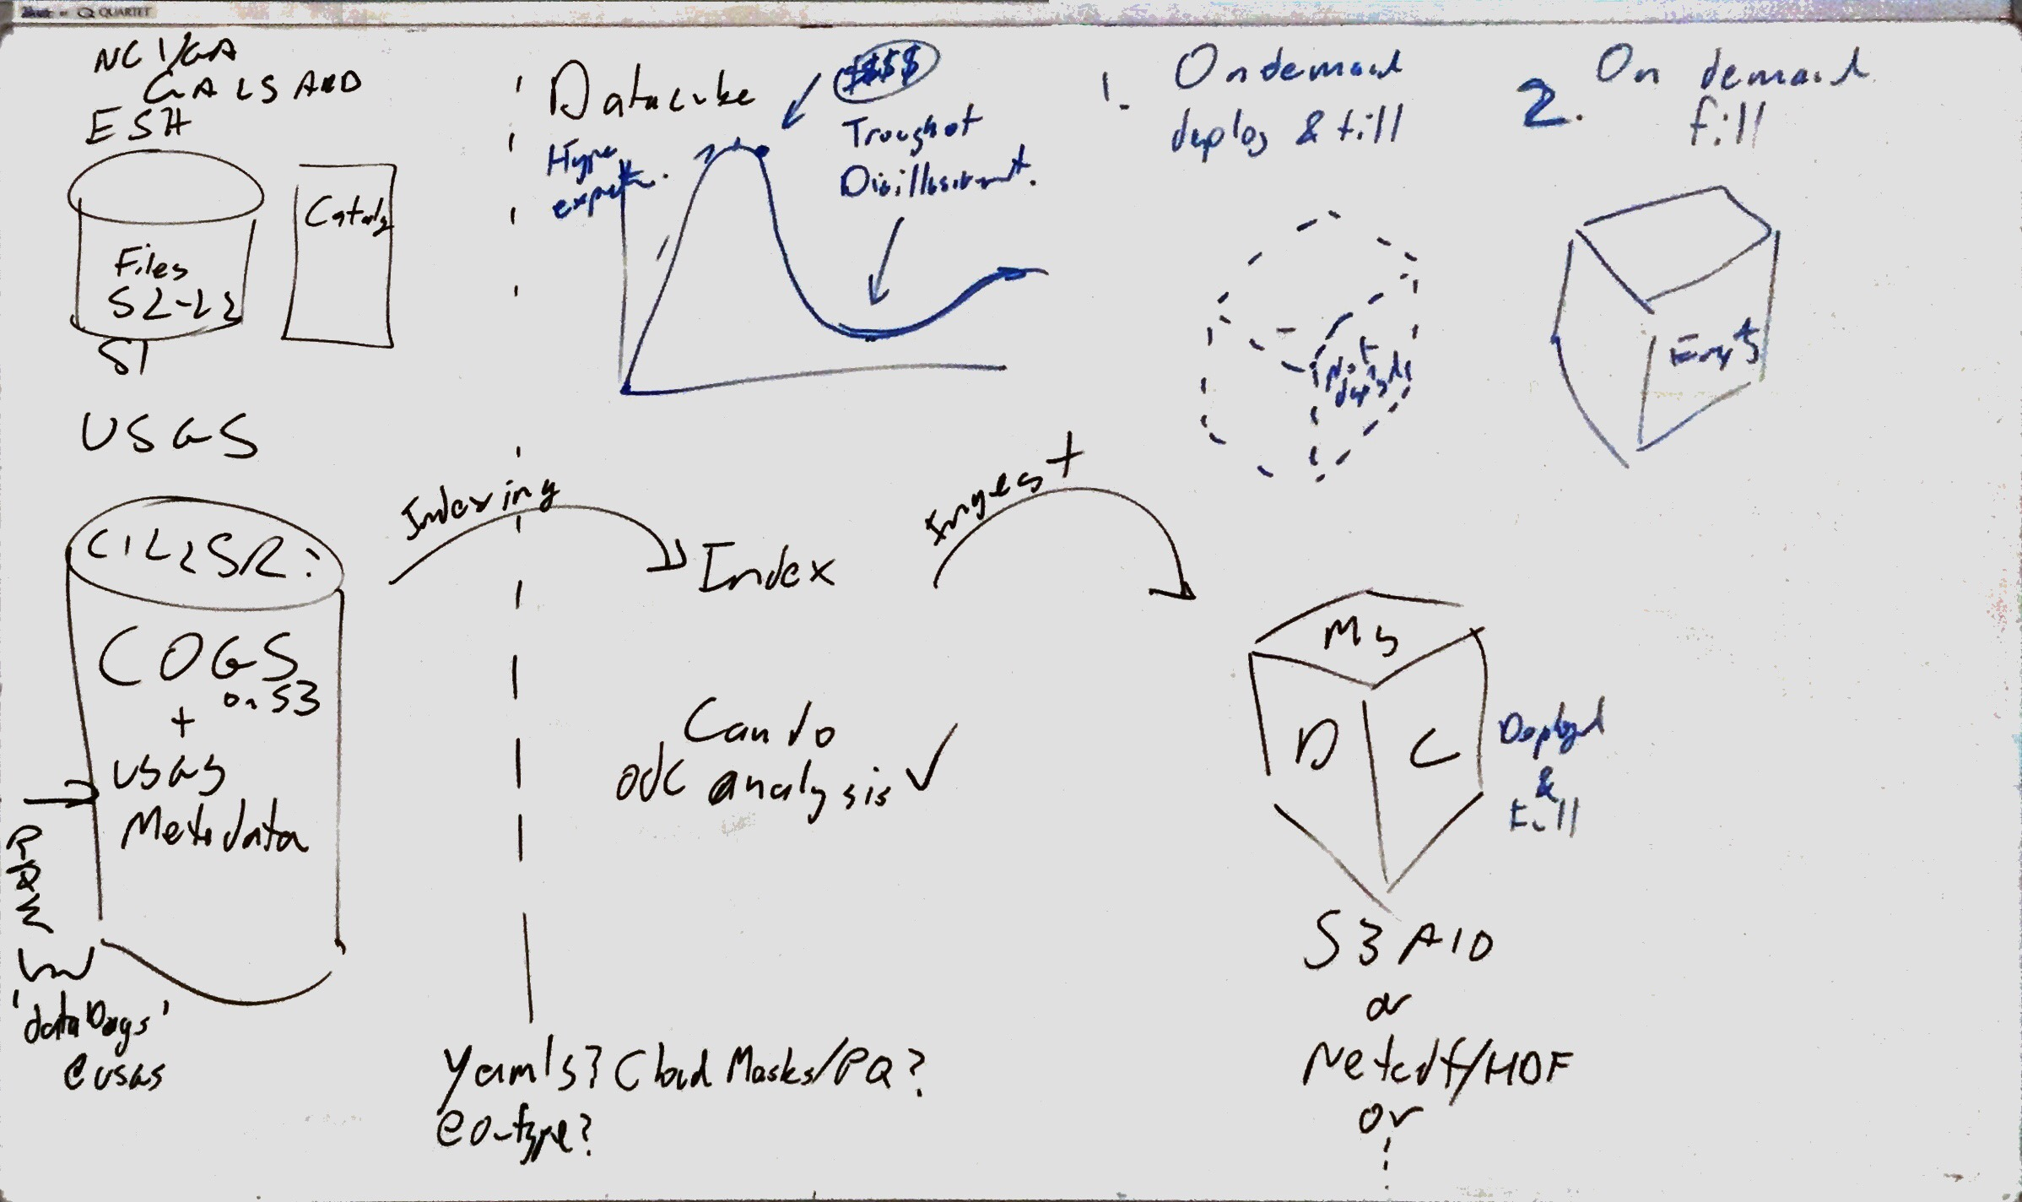
Open Data Cube Workshop
Consistent terminology for the Ingest Pipeline (and DC on Demand)
Tooling, Streamlining, improve docs
Tony’s dataDogs + Harshu’s prepare script’ walkthrough
Clarify required metadata:
  Archive/Custodial/ARD ingest, vs.
  Science project/Compute Ready Data (CRD) ingest (minimum req.)
  → update docs?

Slide 5












CEOS Sub-Cube On-Demand
AWS
USGS
5
2
6
1
7
4
3
LaRC
AMA
Vietnam
Notes:
CEOS sub cube on demand – copy, copy, copy, copy….a lot of this is manual (doesn’t scale)

Slide 6
CEOS WGISS Open Search Best Practice
There are 3 or 4 different versions of this document on the WGISS website?
Does a user go for CWIC, IDN, FedEO, or one of Open Search docs?
Swiss DC experience shows there are overlaps and differences depending choice of catalogue

Slide 7
USGS Landsat Surface Reflectance (SR) Product retrieval for ingestion to ODC
ESPA Bulk Ordering – Landsat SR Product https://espa.cr.usgs.gov/)
  Scene list must be < 5000 scenes
  Not all scenes identified by EE can be processed by ESPA, these will be flagged on submission of list.
  Option for reprojection and variety of output formats (NetCDF, GeoTiff etc) – question on who pays when in Cloud?
  Downloading of processed scenes, required to be done one at a time
  Also provides a machine to machine interface:
    (https://github.com/USGS-EROS/espa-api#user-api )
Notes:
Using USGS at CSIRO
Notice that you can achieve the goal (requirements met)
But
The items flagged can be prohibitive to some endeavours, and you can’t necessarily know this upfront.

Slide 8
Death by a thousand cuts
User requirements are demonstrably met
But the niggles in the EO supply chain are multiplied in FDA environments
Death by a million cuts

Slide 9
Opportunity:
WGISS FDA Demonstrator Proposal
Characterise the user experience in accessing CEOS agency data for new analysis architectures
  Share experience on point FDA solutions and use
  Identify the niggles (the annoying little things)
Tidy terminology – as is done in Open Search Best Practice document
Gap analysis
  How do we get the agency data to the user analysis environments or algorithms to the data env
  Can we feed large scale compute environments to execute science functions at continental scale and/or with 1000’s of users
  Data formats on Clouds
  Business model changes

Slide 10
Opportunity:
WGISS FDA Demonstrator Proposal
Develop WGISS revised notional architecture (FDA-8, part of FDA-9)
Develop Recommendations for CEOS
  WGISS removes the undifferentiated heavy lifting – CEOS on demand services
Some outstanding thoughts/issues:
  FDA -10 Inventory of tools – would this be better as Service Discovery mechanism? GitHub and friends already index the open source tools
  FDA-12 Inventory of data product formats used – why? Better to have a CEOS Format conversion service (user pays?)

Slide 11
Recommendation
WGISS draft a Call for Participation in a FDA Demonstrator Proposal
  Focussed terms of reference to gather missing information
  Supplements the existing Workshops which report on FDA activities
WGISS committed core team to provide collation of Information and deliverables
  Convert the information into coordinated actionable outcomes
  WGISS already has this, just been difficult to convert FDA goals into actionable steps

