Slide 1
CEOS OpenSearch Project II
CEOS WGISS Meeting #45
A. Della Vecchia, O. Barois, M. Albani (ESA)
Yves Coene (Spacebel)
09/04/2018

Slide 2
Agenda
CEOS WGISS Working Groups (WGs) & Objectives
Achievements
Pending Activities
Synergy with OGC initiatives
Conclusions & next steps

Slide 3
Agenda
CEOS WGISS Working Groups (WGs) & Objectives
Achievements
Pending Activities
Synergy with OGC initiatives
Conclusions & next steps

Slide 4
Working Groups (WGs)
CEOS WGISS OpenSearch II Project, started with WGISS#40, led by:
ESA Andrea Della Vecchia
ESA Olivier Barois, since Dec’17 Damiano Guerrucci
Spacebel Yves Coene
On the basis of the WGISS-40 meeting conclusions (WGISS-40 MoM), the following targets have been defined:
Consolidation and finalization of CEOS OpenSearch Best Practice document
Updating of the CEOS Developer Guide document in accordance with the BP finalisation
Start discussion about CEOS OpenSearch Conformance Tests document
CEOS WGISS Connected Data Assets System Level Team, led by Yonsook Enloe, was created after the WGISS#42 in September 2016 (Action WGISS-42-09). It aims to analyse the CEOS Data Assets, identify interoperability issues, propose solutions and feed CEOS standardisation initiatives in synergies with OGC activities. Monthly telco performed since 24 October 2016.

Slide 5
Objectives
To set up and make available a fully standardised and interoperable CEOS (but not limited to) connected data assets, following items need to be addressed:
Make available CEOS OpenSearch endpoints: IDN, CWIC and FedEO
IDN https://cmr.earthdata.nasa.gov/opensearch/collections/descriptor_document_facets.xml?clientId=cswOpenSearchDoc
CWIC http://cwic.wgiss.ceos.org/opensearch/datasets/osdd.xml?clientId=cwicClient
FeDEO http://fedeo.esa.int/opensearch/description.xml
Agree and define CEOS OpenSearch Guidelines, including:
CEOS OpenSearch Best Practice, version 1.2, issued on 13/06/2017
CEOS OpenSearch Developer Guide, version 2.0D3, issued on 14/11/2016
CEOS OpenSearch Conformance Test
Deliver CEOS conformance Test SW to quantify:
CEOS OpenSearch endpoints compliancy with CEOS Guideline
Interoperability among CEOS OpenSearch endpoints
Points II and III could be reiterated considering new CEOS WGISS requirements and taking care of OGC standardization initiatives

Slide 6
Agenda
CEOS WGISS Working Groups (WGs) & Objectives
Achievements
Pending Activities
Synergy with OGC initiatives
Conclusions & next steps

Slide 7
CEOS OS / SLT Working Group Objectives
To set up and make available a fully standardised and interoperable CEOS (but not limited to) connected data assets, following items need to be addressed:
Make available CEOS OpenSearch endpoints: IDN, CWIC and FedEO
IDN https://cmr.earthdata.nasa.gov/opensearch/collections/descriptor_document_facets.xml?clientId=cswOpenSearchDoc
CWIC http://cwic.wgiss.ceos.org/opensearch/datasets/osdd.xml?clientId=cwicClient
FeDEO http://fedeo.esa.int/opensearch/description.xml
Agree and define CEOS OpenSearch Guidelines, including:
CEOS OpenSearch Best Practice, version 1.2, issued on 13/06/2017
CEOS OpenSearch Developer Guide, version 2.0D3, issued on 14/11/2016
CEOS OpenSearch Conformance Test Plan, version 1.0D1, by April 2018
Deliver CEOS conformance Test SW to quantify:
CEOS OpenSearch endpoints compliancy with CEOS Guideline
Interoperability among CEOS OpenSearch endpoints
Points II and III could be reiterated considering new CEOS WGISS requirements and taking care of OGC standardization initiatives

Slide 8
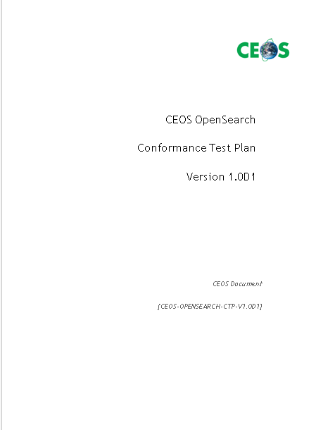
Approach
CEOS Conformance Test Plan Document
Organised as European Cooperation for Space Standardization (ECSS) Software Validation Specification (SVS)
Test Designs
Test Cases

Slide 9
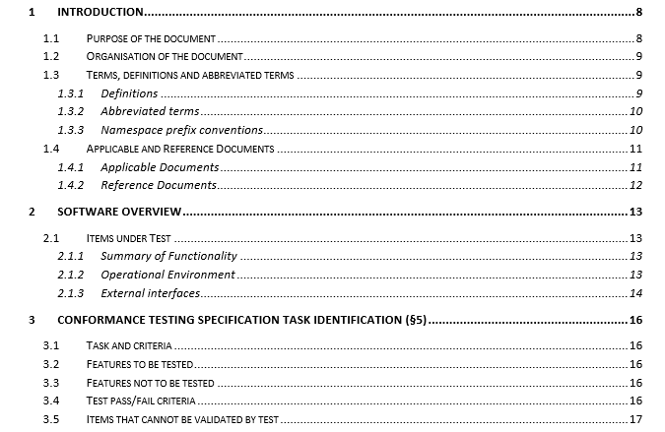
Proposed ToC

Slide 10
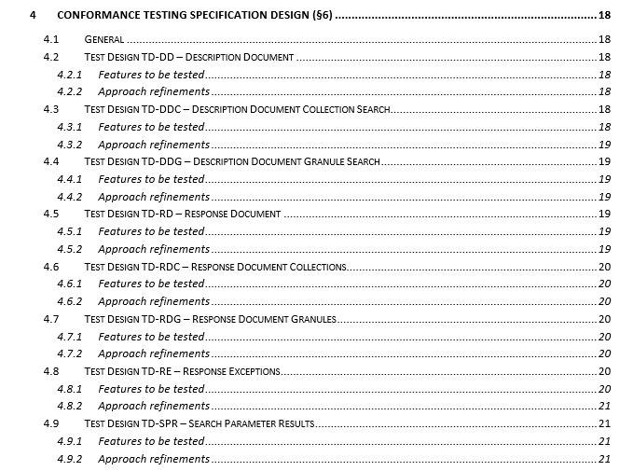
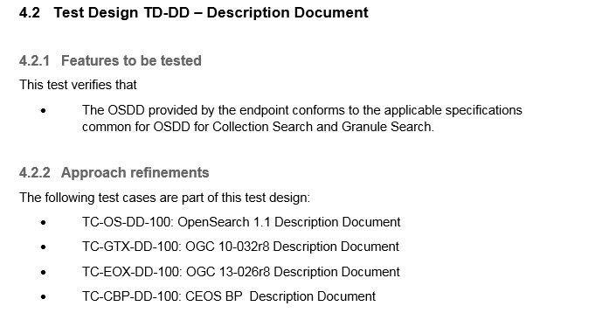
Test Design

Slide 11
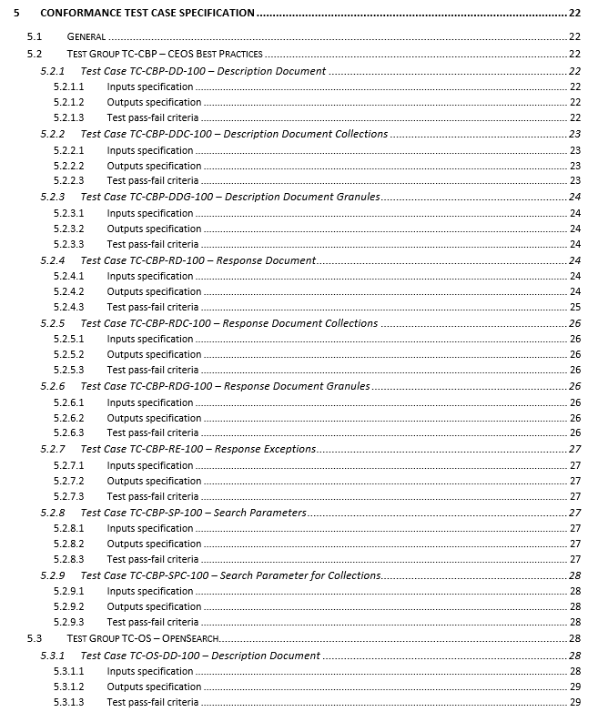
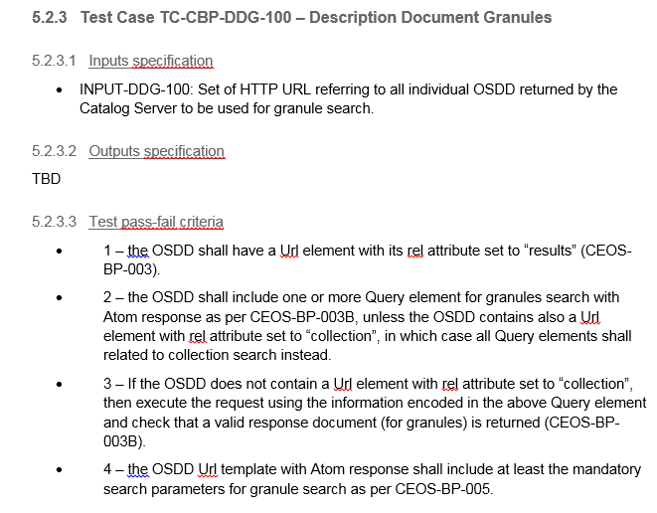
Test Cases

Slide 12
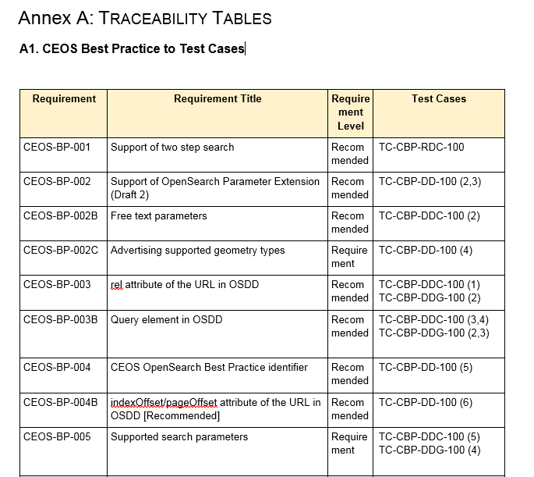
Traceability

Slide 13
Agenda
CEOS WGISS Working Groups (WGs) & Objectives
Achievements
Pending Activities
Synergy with OGC initiatives
Conclusions & next steps

Slide 14
CEOS OS / SLT Working Group Objectives
To set up and make available a fully standardised and interoperable CEOS (but not limited to) connected data assets, following items need to be addressed:
Make available CEOS OpenSearch endpoints: IDN, CWIC and FedEO
IDN https://cmr.earthdata.nasa.gov/opensearch/collections/descriptor_document_facets.xml?clientId=cswOpenSearchDoc
CWIC http://cwic.wgiss.ceos.org/opensearch/datasets/osdd.xml?clientId=cwicClient
FeDEO http://fedeo.esa.int/opensearch/description.xml
Agree and define CEOS OpenSearch Guidelines, including:
CEOS OpenSearch Best Practice, version 1.2, issued on 13/06/2017
CEOS OpenSearch Developer Guide, version 2.0D3, issued on 14/11/2016
CEOS OpenSearch Conformance Test – SLT review and consolidation
Deliver CEOS conformance Test SW to quantify:
CEOS OpenSearch endpoints compliancy with CEOS Guideline
Interoperability among CEOS OpenSearch endpoints
Points II and III could be reiterated considering new CEOS WGISS requirements and taking care of OGC standardization initiatives

Slide 15
Conformance Procedures - Open Issues
CEOS OpenSearch Conformance Test Document
Complete first draft – by April 2018
WGISS SLT Working Group review – by May 2018
Consolidation – by Mid June 2018
Deliver CEOS Conformance Test SW – (TBD)
CEOS Conformance Test Software will permit to validate and score external OpenSearch endpoints vs CEOS guideline. This CEOS tool will be completely based on CEOS OpenSearch Conformance Test guidelines.
Within WGISS SLT working group the following as been discussed and preliminary agreed:
NASA to keep the CWIC-Smart Validation/Test page updated with future CEOS OS BP changes (SLT MoM 01/03/2017)
NASA does have plans to make all their software, including CWIC-Smart client, open source. Until that happens, the CWIC-Smart client is a publically accessible service (SLT MoM 01/03/2017)
ESA available to support NASA to enhance and test CWIC-Smart Validation software, to produce a CEOS tool usable by all agencies (SLT MoM 01/03/2017). This also implies the application of an open source license for this Conformance Test Software (Sec. 4.2 WGISS#42 MoM)

Slide 16
Agenda
CEOS WGISS Working Groups (WGs) & Objectives
Achievements
Pending Activities
Synergy with OGC initiatives
Conclusions & next steps

Slide 17
Synergy with OGC initiatives
At last OGC Technical and Planning Committee Meeting in Orleans, France, 19-23 March ‘18, the EO Product Metadata and OpenSearch Standardization Working Group (SWG) achieved the following major milestone:
Introduced the “final" version of the new EO OpenSearch standard evolution document package, including:
OGC 13-026r9 – OGC OpenSearch Extension for Earth Observation, this is a major consolidation of the spec (from OGC-13-026r8 to OGC-13-026r9) that addresses many issues (CEOS OpenSearch Best Practice is applicable)
OGC 17-047 - OGC OpenSearch-EO GeoJSON(-LD) Response Encoding Standard, this defines how an opensearch response should be encoded in geoJson, as a OWS Context. It describes the “envelope” of a search response. The result items can be either EO products or EO Collections. These are described in separate specs which are reference documents to OGC-17-047
OGC 17-003 - OGC EO Dataset Metadata GeoJSON(-LD) Encoding Standard, this is the spec for the EO product metadata in geoJson. It is based on a simplified metadata model and attribute vocabulary which was discussed/reviewed at CEOS/WGISS level (in particular with NASA).
Requested to OGC to approve that the related document package enters the so-called “public review” phase (3 weeks).
After this phase, final steps will be to address eventual comments and to obtain the adoption as a standard.

Slide 18
Agenda
CEOS WGISS Working Groups (WGs) & Objectives
Achievements
Pending Activities
Synergy with OGC initiatives
Conclusions & next steps

Slide 19
Conclusion & Next Steps
… NEXT STEPS to be Discussed…
Short terms
CEOS Open Search Conformance Test document consolidation
CEOS Conformance Test SW
Longer Terms
A further review cycle of CEOS Best Practice, considering OGC 13-026r9 and OGC 17-047, would significantly simplify the document

