Slide 1
WGISS-45 International Directory Network (IDN) Report
Michael Morahan (Senior Discipline Engineer)
EED2 Team, NASA’s Global Change Master Directory (GCMD)
CEOS WGISS-45 Meeting
Session: Data DISCOVERY and ACCESS
Location: National Institute for Space Research (INPE)
São Jose dos Campos, Brazil
April 9, 2018
This work was supported by NASA/GSFC under Raytheon Co. contract number NNG15HZ39C

Slide 2
International Directory Network (IDN) Topics
Transition of DIF-9 to DIF-10 Metadata Records
GCMD Keyword Update
DIF-10 and UMM-C Schema Changes
Metadata Validation
docBUILDER for Submitting IDN Metadata (i.e. Registration)
Mapping WGClimate Essential Climate Variable (ECV) Inventory to IDN Records

Slide 3
Transition DIF-9 to dif-10

Slide 4
Why Transition From DIF-9 to DIF-10?
DIF-10 offers improvements to the DIF including:
New fields (Ex: Product_Level_ID)
Renamed fields (Ex: Parameters changed to Science_Keywords)
Restructured fields (Ex: Hierarchical representation of Platforms/Instrument).
These changes serve to bring the DIF in compliance with NASA’s Unified Metadata Model (UMM) and integrate features requested by the IDN community.

Slide 5
DIF-9 Fields Mapped to Required DIF-10 Fields
DIF-9 Fields | DIF-10 Fields
Data Center/Organization | Organization
Data Set Progress | Data Set Progress
Entry_ID | Entry_ID (Shortname)
Data_Set_Citation/Version | Entry_ID (Version)
Entry_Title | Entry_Title
ISO Topic Category | ISO Topic Category
Source/Sensor | Platform/Instrument
Project | Project
Related URL | Related URL
Science Keywords | Science Keywords
Spatial Coverage | Spatial Coverage
Summary | Summary
Temporal Coverage | Temporal Coverage
None | Product Level ID
RED fields indicate changes between DIF-9 and DIF-10

Slide 6
DIF-9 to DIF-10 Transition Schedule
(2017-2018)
Sent Provider DIF-9 to DIF-10 QA/Triage Reports.
May 1, 2018
Start migrating existing non-NASA EOSDIS DIF-9 records to DIF-10.
2019 (First quarter)
Plan to have all metadata records transition.
Providers need to submit new metadata in DIF-10 or any format compatible with NASA’s Common Metadata Repository (CMR).
Compatible formats: DIF-10, NASA ISO (MENDs), and UMM-JSON.
docBUILDER supports DIF-10 format.

Slide 7
Provider QA/Triage Reports
The reports are a list of DIF-9 records that are missing required DIF-10 field values needed for ingest.
The reports consist of 2 sections:
An Overview page
Listing of the missing fields
Total number of effected fields
Number of records effected.
Summary of the process and additional information
Record by Record of issues
List of the individual records
Identified by CMR unique ID and Entry_ID
Effected field xPath
Type of issue

Slide 8
QA/Triage Reports: Overview

Slide 9
QA/Triage Reports: Record By Record

Slide 10
Population of DIF-10 Required Fields
Providers have 3 options:
Update the DIF-9 records with the corresponding DIF-10 required fields.
Provide the GCMD/IDN staff with the required fields values.
Or, GCMD/IDN staff will transition records directly to DIF-10 using default values for the required fields. (Example default value: “Not provided”)
If you have any questions or your agency has not received a Provider QA/Triage report, please contact the GCMD/IDN User Support Office at GSFC-GCMDUSO@mail.nasa.gov or myself at Michael.P.Morahan@nasa.gov.

Slide 11
GCMD Keyword Update

Slide 12
Keyword Version 8.6 Release (Spring 2018)
Related URL
Added: 25
Deleted: 18
Water Quality/Water Chemistry
Added: 42
Modified: 31
Modified: 22
Deleted: 0
If you are interested in becoming a keyword reviewer,
please contact the ESO at eso-staff@lists.nasa.gov.
Notes:
Related URL:
* Changes are based on the UMM URL type reconciliation effort with the CMR and the ARC Team.
* Impact is 683 EOSDIS provider records (GES DISC and PO DAAC) and 583 IDN records.
Water Quality/Water Chemistry:
* Changes are based on review of the keywords and to align more closely with the EPA water quality criteria and user search behavior.
* Impact is 83 EOSDIS provider records (GHRC, ORNL, PO DAAC, SEDAC) and 2,404 SCIOPS/IDN records.
* This set of keywords have not been updated since 2002.

Slide 13
Keyword Version 8.7 Proposed Topics (2019)
Cryosphere
Earth Science Services/
Web Services
Notes:
Related URL:
* Changes are based on the UMM URL type reconciliation effort with the CMR and the ARC Team.
* Impact is 683 EOSDIS provider records (GES DISC and PO DAAC) and 583 IDN records.
Water Quality/Water Chemistry:
* Changes are based on review of the keywords and to align more closely with the EPA water quality criteria and user search behavior.
* Impact is 83 EOSDIS provider records (GHRC, ORNL, PO DAAC, SEDAC) and 2,404 SCIOPS/IDN records.
* This set of keywords have not been updated since 2002.

Slide 14
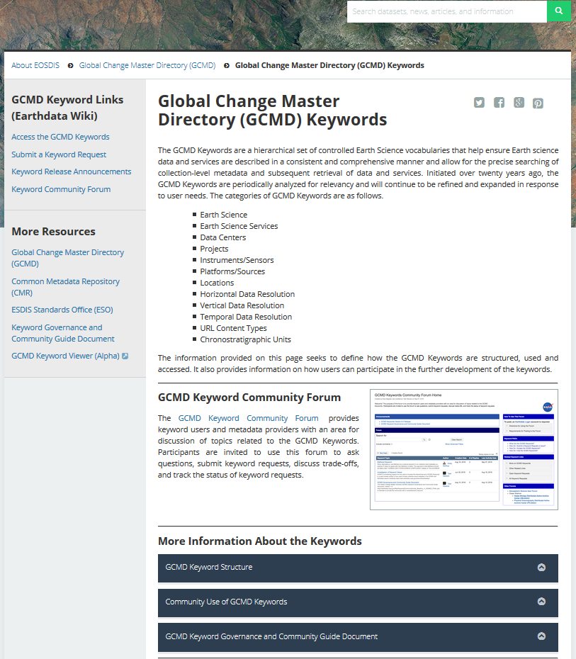
Keyword Landing Page
Access the GCMD Keywords
Submit a Keyword Request
See the Keyword Release Announcements
Review the Keyword Governance Document
https://earthdata.nasa.gov/about/gcmd/global-change-master-directory-gcmd-keywords

Slide 15
DIF-10 and UMM-C and Schema Changes

Slide 16
DIF-10.3 Updates
Existing fields now required:
Data_Set_Progress and Product_Level_ID
Add new sub-fields for :
Distribution: Average_Granule_Size and Total_Collection_Size
Access_Contraints and Use_Contraints: Type
Related_URL/Related_URL Type: URLContentType
Made optional:
Data_Creation and Data_Last_Revision
Allow:
“not applicable” to be specify for Dataset_Citation/Persistent_Identifier.

Slide 17
UMM-C 1.10 Updates
Add:
New UseConstraints sub-fields:
LicenseUrl
Linkage
Protocol
ApplicationProfile
Name
Description
Function
MimeType
LicenseText
Controlled vocabulary:
Tiling System Identification names
Collection Progress
Allow:
“not applicable” to be specify for Dataset_Citation/Persistent_Identifier.

Slide 18
Validation of Metadata Records

Slide 19
Methods for Validating IDN Metadata
CMR Ingest API
CMR Ingest API Validation documentation: https://cmr.earthdata.nasa.gov/ingest/site/docs/ingest/api.html#validate-collection
Recommended for bulk record validation against the UMM-C metadata model
QAViewer API
Metadata Quality Assurance Tool Viewer documentation: https://gcmd.nasa.gov/qaviewer/help/help.html
Recommended for single record validation against the DIF-10 schema

Slide 20
Using CMR Ingest API Validation
Validating a metadata record
curl -i -X POST -H "Content-type: application/dif10+xml" --data-binary @EOP-ESA-SENTINEL_1_L1.xml https://cmr.earthdata.nasa.gov/ingest/providers/ESA/validate/collection/EOP-ESA-SENTINEL_1_L1
Example of the returned validation log:
<?xml version="1.0" encoding="UTF-8"?><result><warnings>After translating item to UMM-C the metadata had the following issue: /AdditionalAttributes/ object has missing required properties (["Description"])</warnings></result>
The errors and warnings are returned with the UMM-C field names.
UMM-C documentation: https://wiki.earthdata.nasa.gov/display/CMR/CMR+Documents
curl -i -X POST -H "Content-type: application/dif10+xml" --data-binary @EOP-ESA-SENTINEL_1_L1.xml https://cmr.earthdata.nasa.gov/ingest/providers/ESA/validate/collection/EOP-ESA-SENTINEL_1_L1
<?xml version="1.0" encoding="UTF-8"?><result><warnings>After translating item to UMM-C the metadata had the following issue: /AdditionalAttributes/ object has missing required properties (["Description"])</warnings></result>
Notes:
Can be used for bulk validation

Slide 21
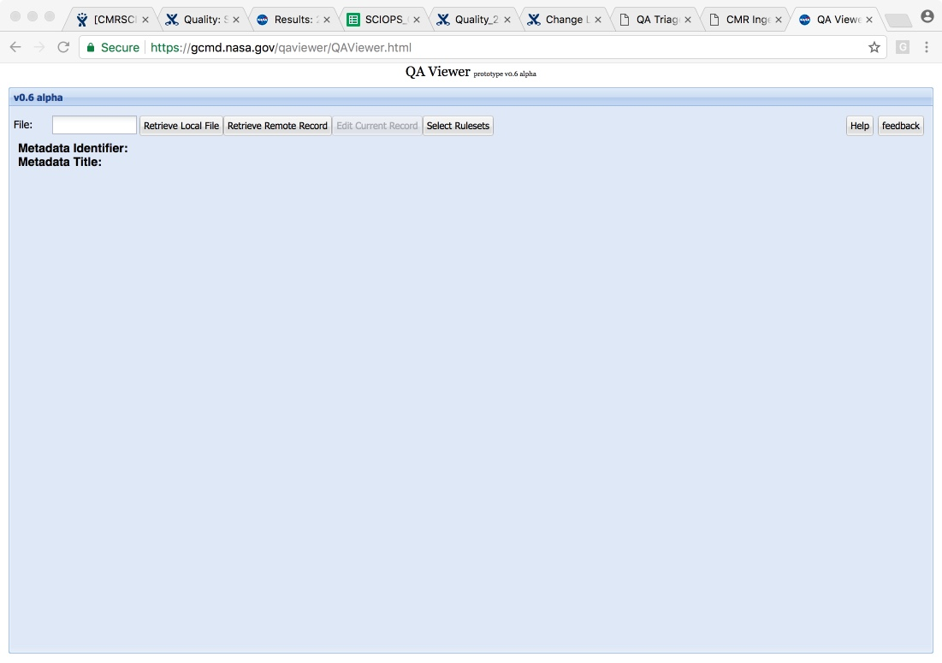
Using QAViewer API for Validation
QAViewer link:
https://gcmd.nasa.gov/qaviewer/QAViewer.html
Click to find metadata file
Notes:
Use: single record validation

Slide 22
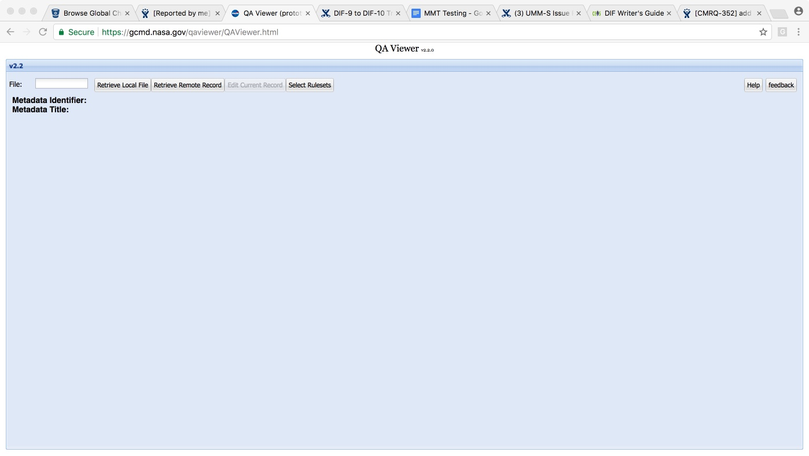
Using QAViewer API for Validation
Select metadata file from your local files

Slide 23
Using QAViewer API for Validation
The API displays metadata record’s errors and warning.

Slide 24
DocBUILDER for Submitting IDN Metadata

Slide 25
docBUILDER for a New DIF-10
Insert collection Short Name (Entry_ID) and Version
Click button

Slide 26
docBUILDER to update a DIF-10
Click button
Click button
Insert collection Short Name (Entry_ID)

Slide 27
DIF-10 docBUILDER Field Layout

Slide 28
DIF-10 docBUILDER Field view

Slide 29
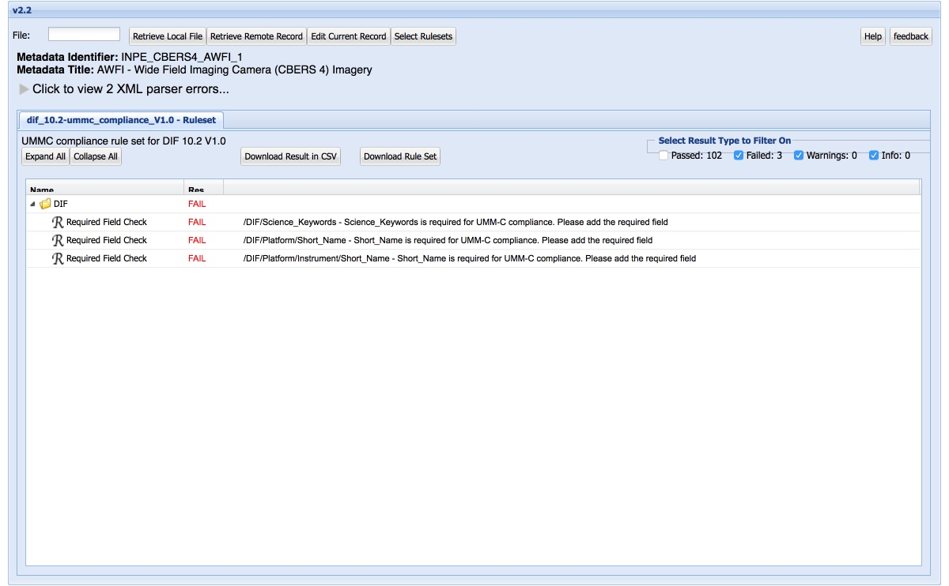
DIF-10 docBUILDER QAViewer

Slide 30
Mapping WGClimate Essential Climate Variable (ECV) Inventory to IDN Records

Slide 31
WGClimate ECV Inventory
http://climatemonitoring.info/ecvinventory

Slide 32
Mapping ECV Inventory to IDN records
Goal: Identify the ECV records within the IDN.
The ECV Inventory spreadsheet has 3 columns to help identify IDN records:
Data record name and version
Data record identifier
Data documentation (link)
The IDN added 3 columns to the inventory:
Provide IDN/FedEO Entry Link
Identify record as CWIC, FedEO, or Not connected
Distinguish, if the IDN records are ”Linked from Collection to Granules”

Slide 33
Preliminary Report
 | Total ECV Entries (out of 913) | In the IDN and Granule/Product accessible via CWIC infrastructure. | In the IDN has granule/product accessible via CNES infrastructure. | ECVs Not in the IDN
ECVs considered for mapping (Current records) | 496 | 288 | 4 | 204
ECVs Not considered for mapping (Future records) | 417 | NA | NA | NA
Notes:
Put in table.

Slide 34
What has been done?
Mapped NASA, NOAA, and some CNES and EUMETSAT ECV records to IDN records.
WGISS Chair Mirko Albani has requested WGClimate members to start adding the missing ECV collection records to the IDN.

Slide 35
Questions?
Please Provide feedback to:
gsfc-gcmduso@mail.nasa.gov
Or
Michael.P.Morahan@nasa.gov

Slide 36
This work was supported by NASA/GSFC under Raytheon Co. contract number NNG15HZ39C

