Slide 1
Data Stewardship Interest Group
WGISS-45 Meeting
Standards Status and Way Forward
INPE, São José dos Campos (SP), Brazil
09–12 April, 2018

Slide 2


CEOS Core Documents STATUS
  Status
    Preservation Workflow
  EO Data Generic Consolidation Process
  EO Data Preservation Guidelines
  EO Preserved Data Set Content
  Purge Alert Procedure
  Purge Alert Procedure White paper
  Glossary of Acronyms and Terms
  Persistent Identifiers Best Practice
  Associated Knowledge Preservation Best Practices
  WGISS EO Data Management and Stewardship Maturity Matrix

Slide 3





CEOS Data Stewardship Best Practices
Document Tree
Policy Documents
Individual organizations'
policies (stewardship, access, ...)
EO Data Stewardship
Cooperative Framework
Applied to
CEOS EO Space Data Sets
Data Purge Alert Procedure & White Paper
High level framework documents
Applied to
Technical Documents
Preservation Workflow
Glossary of Acronyms and Terms
General guidelines and best practices
Support
Guidelines and best practices on specific topics
Persistent Identifiers Best Practice
EO Data Preservation Guidelines
Preserved Data
Set Content
Associated Knowledge Preservation
CEOS Maturity Matrix
Reference Model for Data Stewardship
Technical implementation procedures
EO Data Set
Consolidation Process
…

Slide 4
Document Management Table
Document name | Custodian | Document ID | File name | Current version | Date | Status
Preservation Workflow | ESA | CEOS/WGISS/DSIG/PW | Long Term Preservation of EO Space Data: Preservation Workflow | 1.0 | 03/2015 | APPROVED
EO Data Stewardship Glossary | ESA | CEOS/WGISS/DSIG/GLOS | Long Term Preservation of EO Space Data: Glossary of Acronyms and Terms | 1.2 | 01/2017 | APPROVED
EO Data Preservation Guidelines | ESA | CEOS/WGISS/DSIG/EODPG | EO Data Preservation Guidelines | 1.0 | 09/2015 | APPROVED
EO Data Set Consolidation Process | ESA | CEOS/WGISS/DSIG/GEODSCP | Generic Earth Observation Data Set Consolidation Process | 1.0 | 03/2015 | APPROVED
Preserved Data Set Content | ESA | CEOS/WGISS/DSIG/EOPDSC | EO Preserved Data Set Content | 1.0 | 09/2015 | APPROVED
Persistent Identifiers Best Practice | DLR | CEOS/WGISS/ DSIG/PIDBP | CEOS Persistent Identifier Best Practices | 1.2 | 01/2017 | APPROVED
Data Purge Alert White Paper | ESA | CEOS/WGISS/DSIG/DPA | Data Purge Alert Procedure | 1.0 | 04/2017 | APPROVED
Associated Knowledge Best Practice | ESA | CEOS/WGISS/DSIG/AKPBP | Associated Knowledge Preservation Best Practices | 1.0 | 01/2017 | APPROVED
WGISS Data Management and Stewardship Maturity Matrix White Paper | ESA | CEOS/WGISS/DSIG/DSMM | WGISS WGISS Data Management and Stewardship Maturity Matrix | 1.0 | 09/2017 | APPROVED

Slide 5

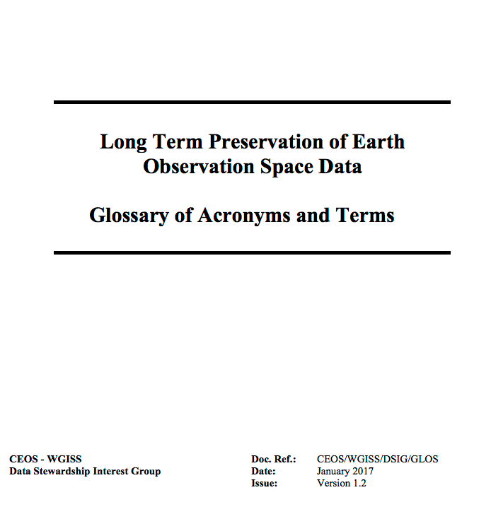
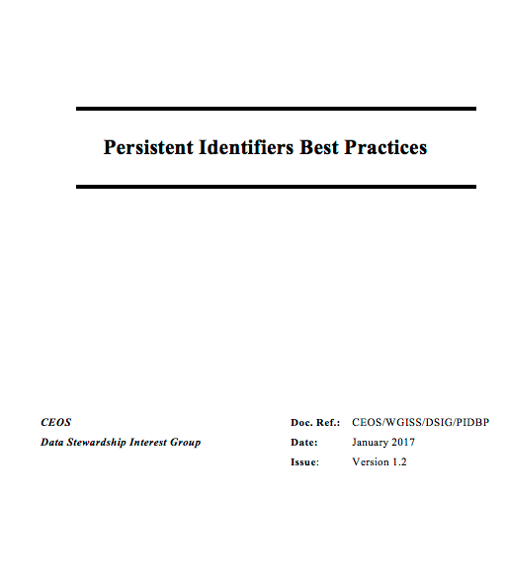
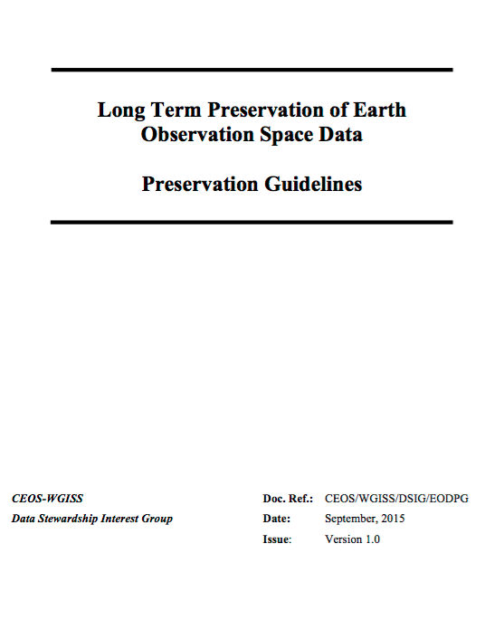
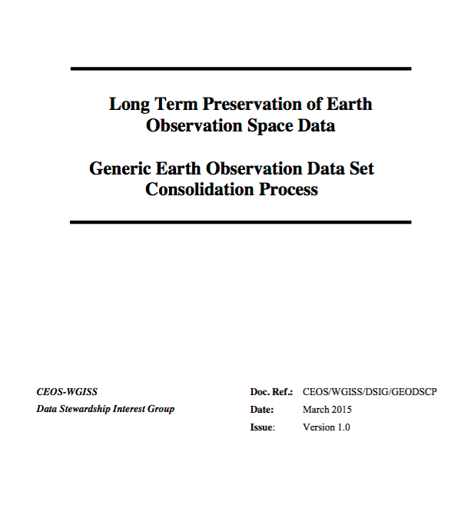
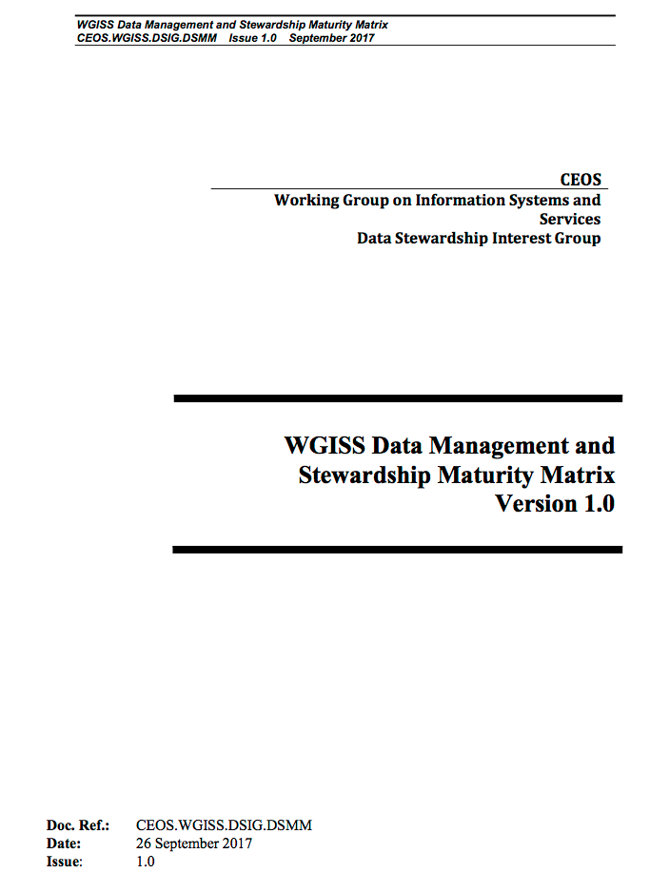
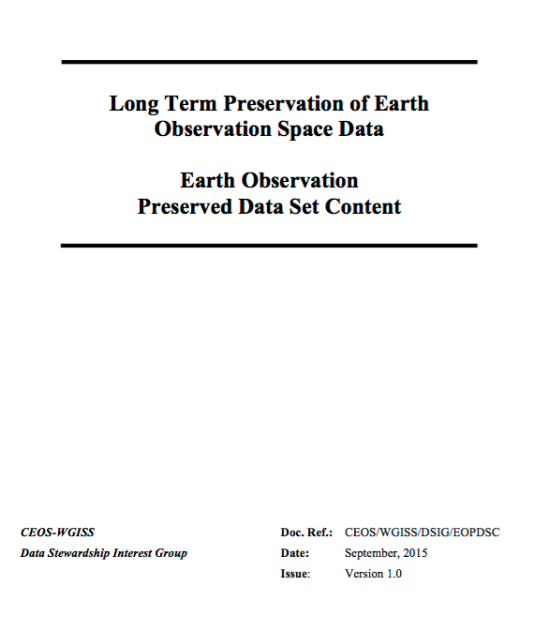
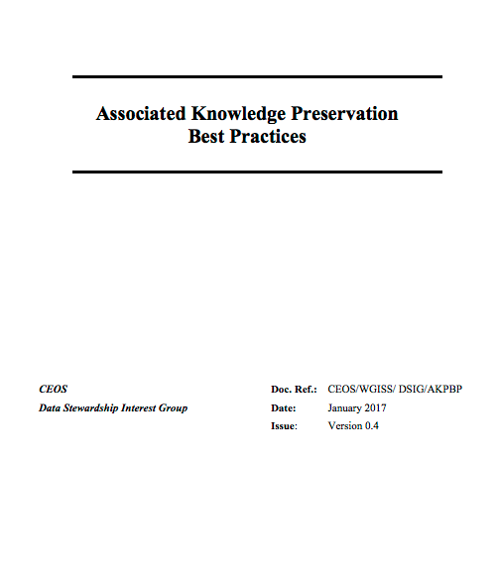
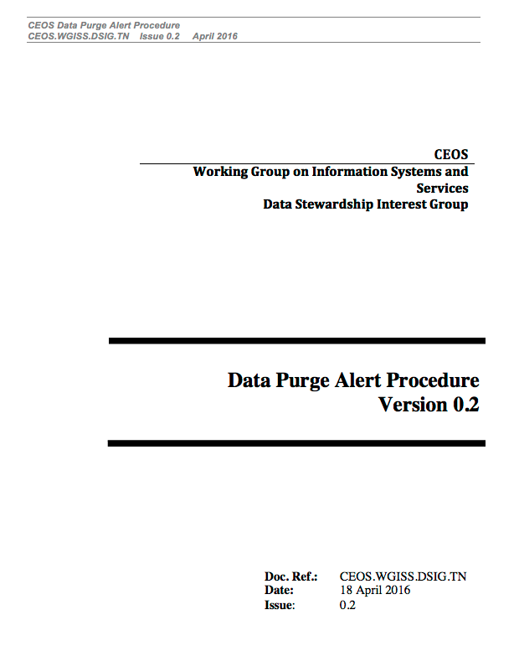
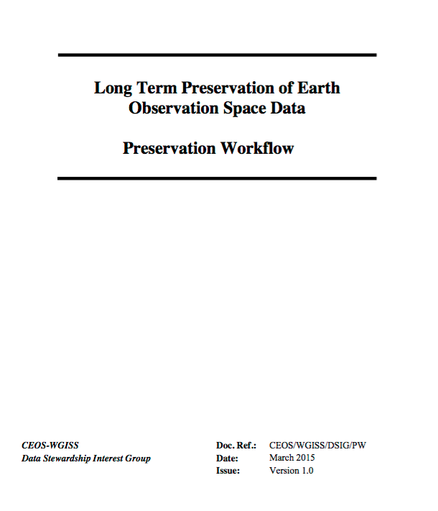
Overview
?

Slide 6


Slide 7
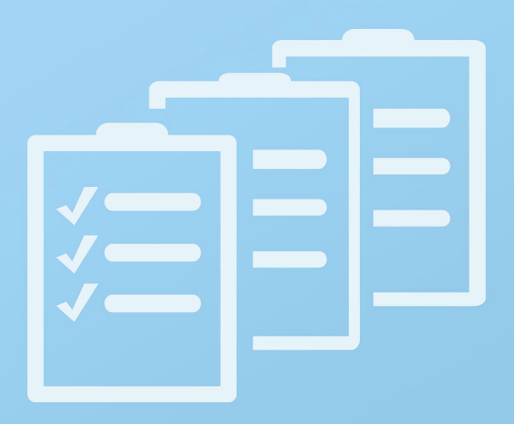
New Opportunities/Tasks
Create a White Paper on Data Stewardship
Reference Model (not more than 2 pages)
Appraisal Procedure: A structured appraisal of a data set considered for long-term preservation helps assess if an Earth Observation data set is valuable enough to be preserved for future generations (e.g. High Level). It also provides an estimate of the cost and effort involved, and of any associated risks.

Slide 8
New Opportunities/Tasks … Continued
Update Data Preservation Guidelines and Preservation Workflow vs DMP, WGISS Data Management and Stewardship Maturity Matrix and Common Framework for Earth-Observation Data

Slide 9

  Brainstorming

Slide 10
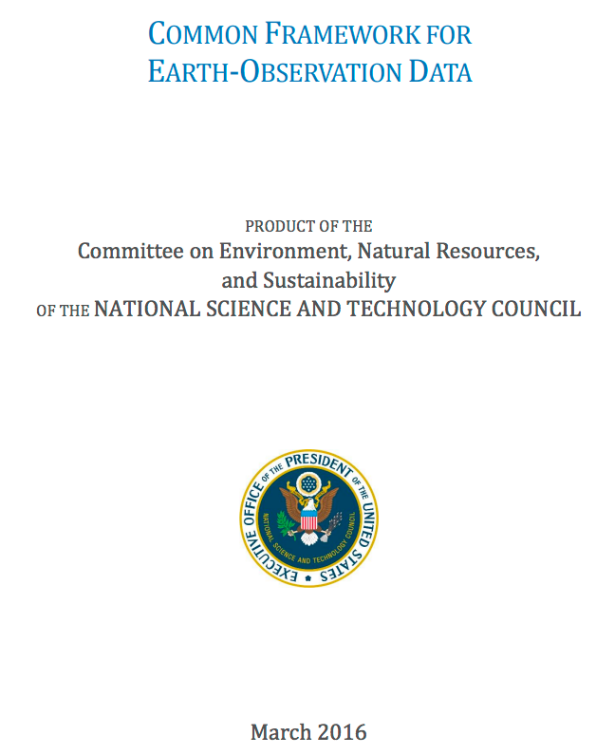
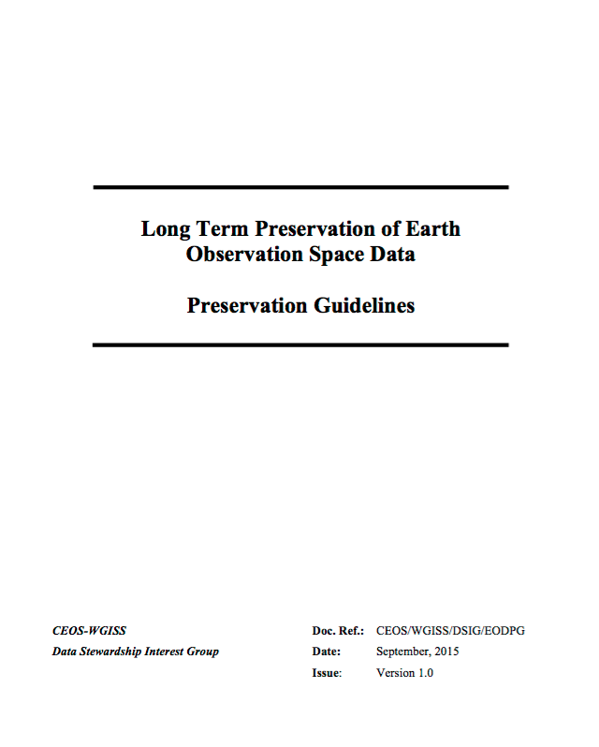
Standards verification
versus

Slide 11
Intended Audience
Data Preservation Guideline:
This document is intended to assist data managers in Earth Observation (EO) data centres in the task of ensuring Earth Observation space data sets long-term preservation, accessibility and usability.
Common Framework for Earth Observation Data:
The primary intent of the Common Framework is to provide guidance to data producers in Federal agencies for improving and standardizing their data-management practices. This document also informs data users, software and tool developers, and information-product producers about which standards are preferred by USGEO agencies. This information can assist them in harmonizing their activities with current Federal data-management practices. These recommendations may also be useful for local, state, international, and commercial data creators whose Earth observations are widely shared.

Slide 12
Documents Structure
Aspects and themes of data management considered in:
Data Preservation Guidelines:
THEME 1: PRESERVED DATA SET CONTENT DEFINITION AND APPRAISAL
THEME 2: ARCHIVE OPERATIONS AND ORGANIZATION
THEME 3: INFORMATION SECURITY
THEME 4: DATA INGESTION
THEME 5: ARCHIVE AND DATA MAINTENANCE
THEME 6: DATA ACCESS AND INTEROPERABILITY
THEME 7: DATA EXPLOITATION AND RE-PROCESSING
THEME 8: DATA PURGE PREVENTION
Common Framework of Earth Observation Data:
Data Search and Discovery Services
Data-Access Services
Data Documentation
Compatible Formats and Vocabularies

Slide 13
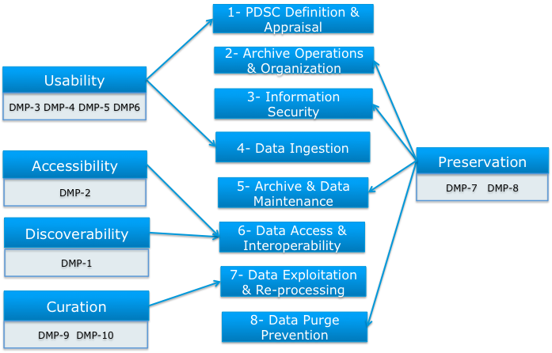
Data Preservation Guidelines Themes vs Data Management Principles

Slide 14
Common Framework for Earth Observation Data aspects vs Data Management Principles
Curation
DMP-9 – DMP-10
Data Search and Discovery Services
Discoverability
DMP-1
Data-Access Services
Accessibility
DMP-2
Data Documentation
Usability
DMP-3 - DMP-4 - DMP-5 - DMP-6
Compatible Formats and Vocabularies
Preservation
DMP-7 – DMP-8

Slide 15
Common framework for Earth Observation data Characteristics & Differences
No focus on Preservation
More technical details:
  Method and Practices
  Implementations
  Applicable Software
  Testing and validation
  Metrics
More details on standards and protocols
Useful to review relevant CEOS Best Practices

Slide 16


