Slide 1
Data Stewardship Interest Group
WGISS-45 Meeting
WGISS EO Data Management and Stewardship Maturity Matrix: AVHRR Reprocessing project
INPE, São José dos Campos (SP), Brazil
09–12 April, 2018

Slide 2

Outline
WGISS EO Data Management and Stewardship Maturity Matrix Updates
Application in AVHRR Reprocessing Project
Way Forward and Achievement

Slide 3
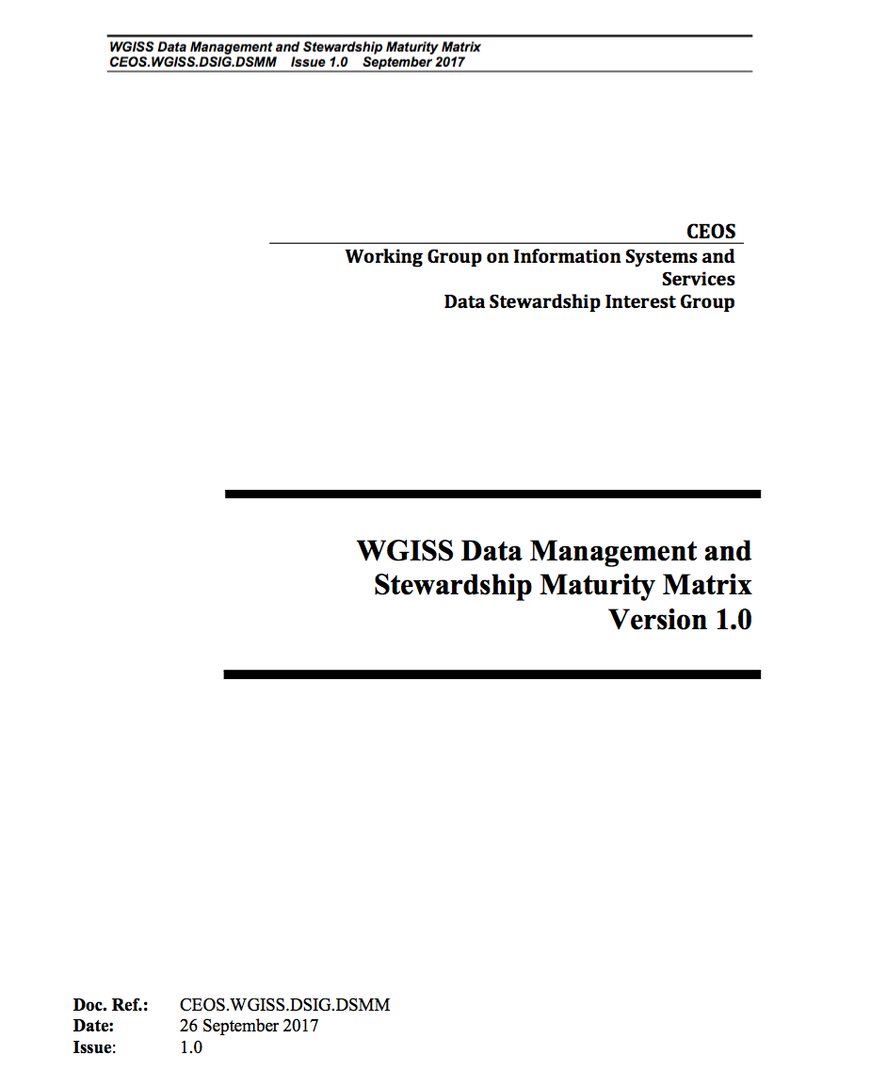

WGISS Data Management and Stewardship Maturity Matrix - White Paper
Data stewardship “encompasses all activities that preserve and improve the information content, accessibility, and usability of data and metadata” (National Research Council 2007).
Data management includes all activities for “planning, execution and oversight of policies, practices and projects that acquire, control, protect, deliver and enhance the value of data and information assets.” (Mosely et al. 2009).
In addition to data preservation, accessibility, and usability, WGISS MM also covers discoverability, use and services capabilities, program budget, data policy, etc.
Cit. Ge Peng

Slide 4
  WGISS Data Management and Stewardship Maturity Matrix
  AVHRR Reprocessing Project Application

Slide 5
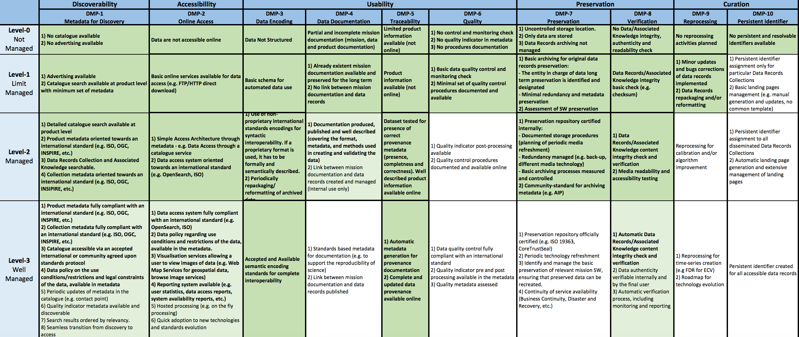
AVHRR Reprocessing Project: SoW Requirements

Slide 6
AVHRR Reprocessing Project: Measurement

Slide 7
AVHRR Reprocessing Project: Gap between SoW and ongoing project Status

Slide 8
AVHRR Reprocessing Project: Work Logic and Strategy

Slide 9
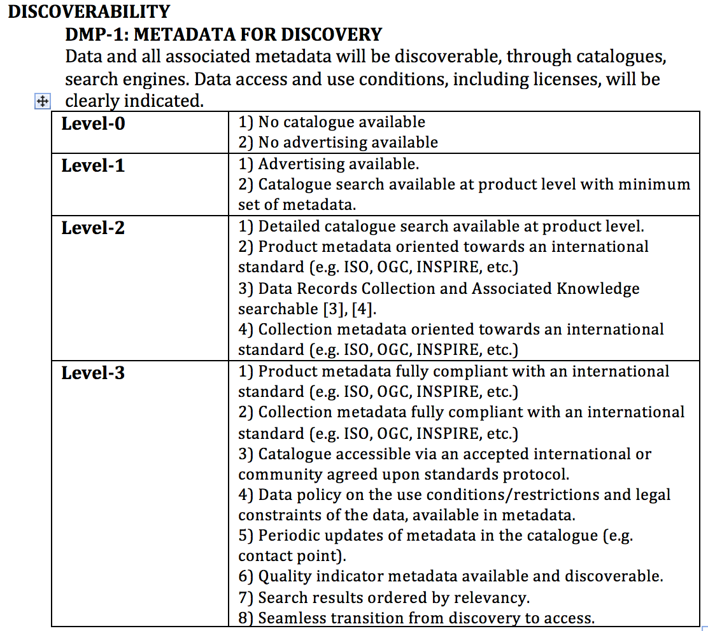
DMP-1: METADATA FOR DISCOVERY
Probably, there is a public available information on ESA webpage on data policy. The link or document should be referenced in a short intro file visible at the first search activity of an user.

Slide 10
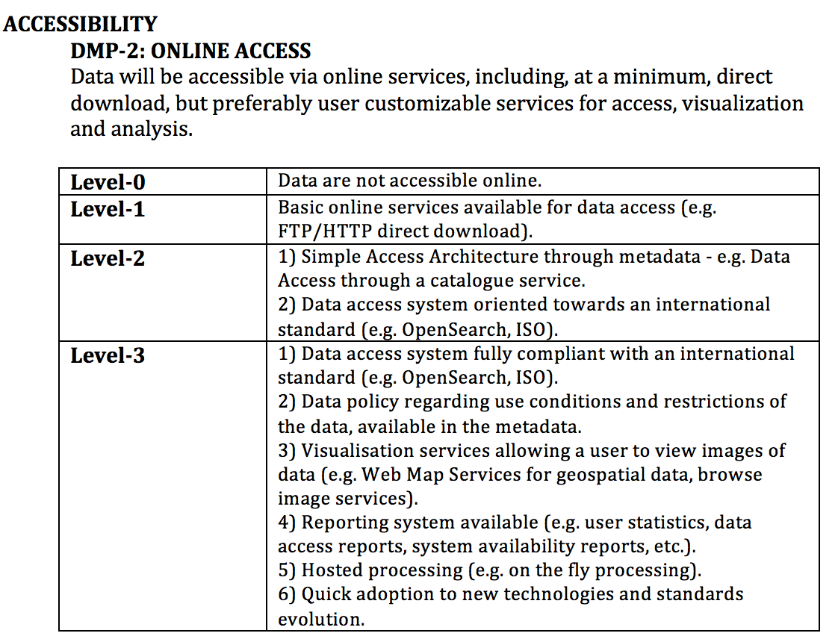
DMP-2: ONLINE ACCESS
I do not know if ESA is generating this information - I think so ... then the green highlighted bar may be shifted to 4)

Slide 11
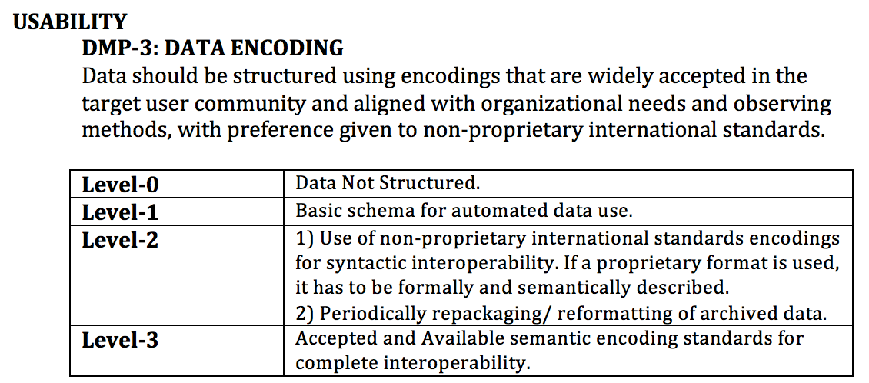
DMP-3: DATA ENCODING
With the decision to use standard NOAA format (1A, 1B) we fulfill these requirements.

Slide 12
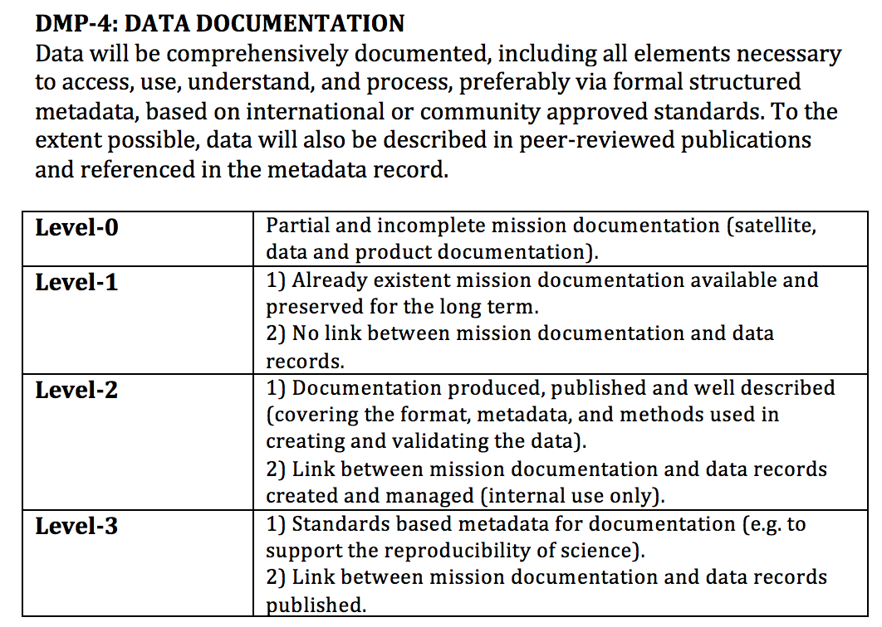
DMP-4: DATA DOCUMENTATION
We rely on mission documentation stored at NOAA and EUMETSAT. NOAA- and MetOp-satellites, sensor description, calibration, etc.
But the external links may change over time. Is there a need to copy all (which one?) information from external sites to ESA. If so - who will maintain and update this information? I would recommend to keep it simple and reference to NOAA- and EUMETSAT pages.

Slide 13
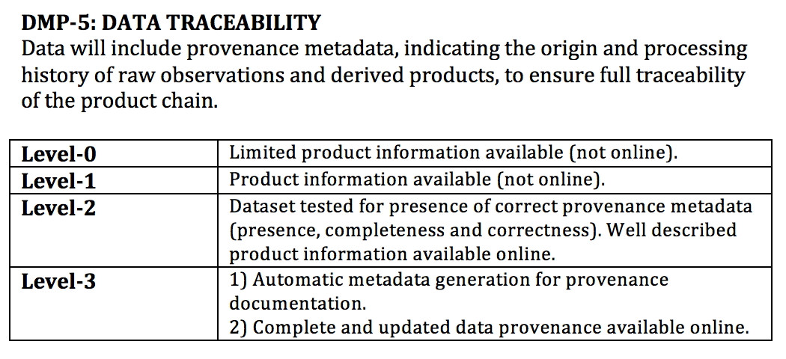
DMP-5: TRACEABILITY
Receiving station and owner is available in the meta-file.
Should we have to exchange the order of these two requirements?

Slide 14
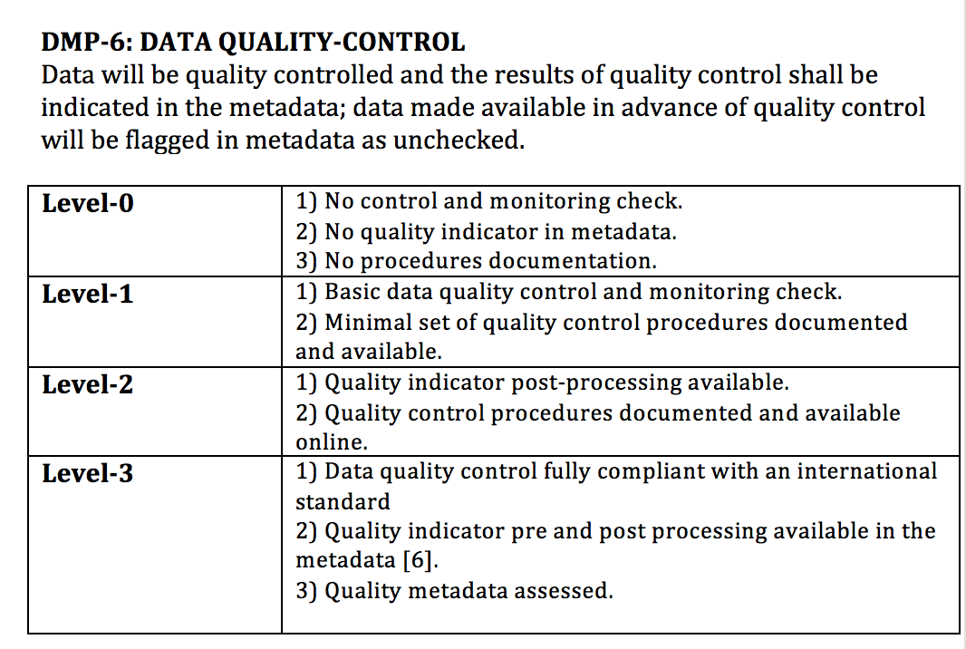
DMP-6: QUALITY
Working with AVHRR data, we distinguish between the following procedures (wording):
- re-formatting, harmonization
- pre-processing (includes calibration and geocoding; needed before a product can be retrieved)
- product generation
- post-processing (check for errors in the products; e.g. spikes in temperature etc.)
"1) quality indicator post-processing available" has to be clearly defined to avoid any confusion by scientists involved in satellite data processing.
?
We should clarify it in the white paper?

Slide 15
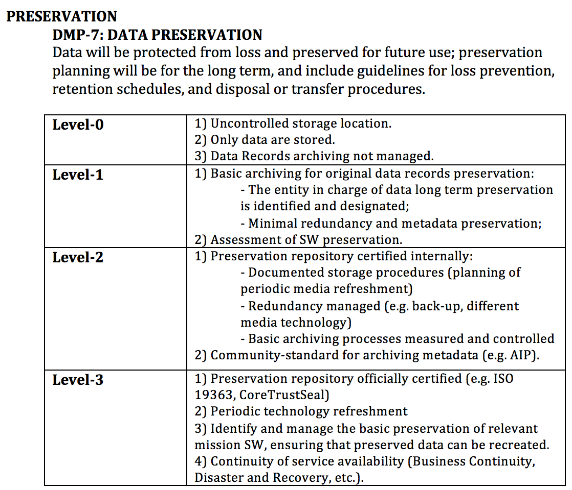
DMP-7: PRESERVATION

Slide 16
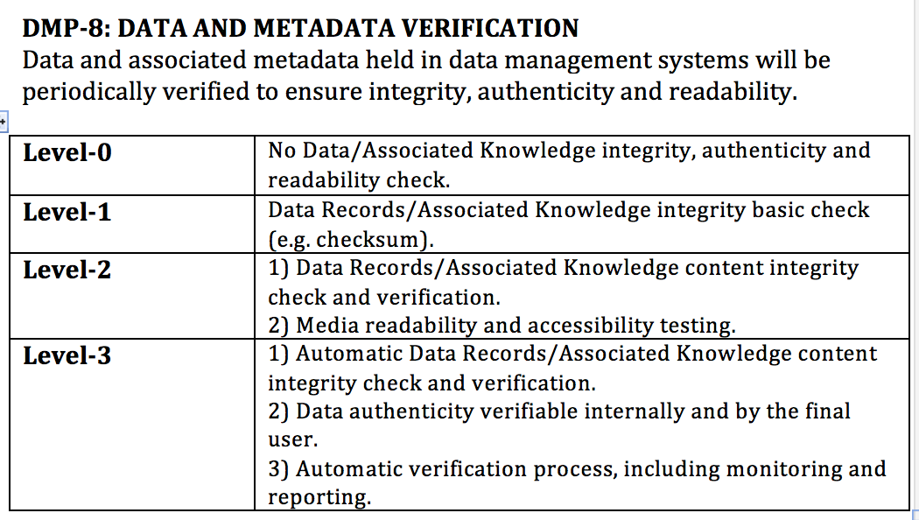
DMP-8: VERIFICATION

Slide 17
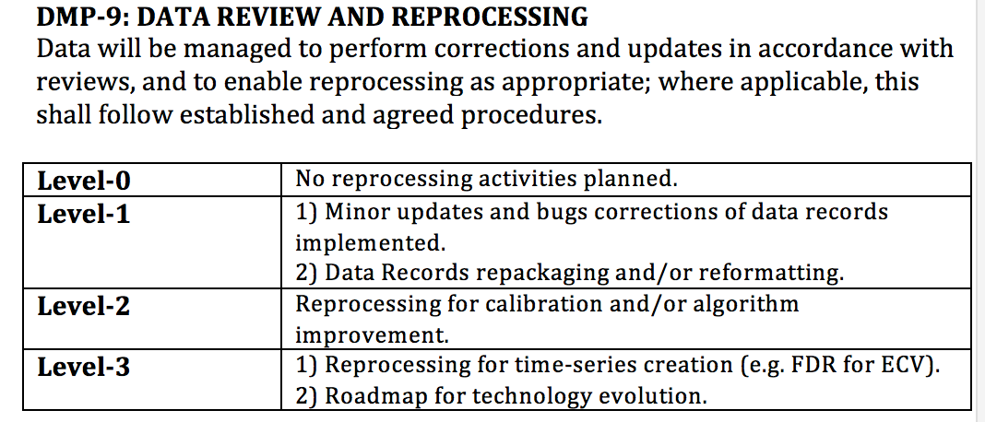
DMP-9: REPROCESSING
Reprocessing for calibration is a good point but it's a new data level. Due to missing on-board calibration of VIS-NIR channels of AVHRR and some noise in TIR, the whole procedure is work in progress with updates from different teams, which may be tested and included in the re-processing DMP-9. Before starting calibration of AVHRR a roundrobin should be organized with specialists of University of Wisconsin (Heidinger), UniBern (Neuhaus) and UnReading (Mittaz) to define the best procedure and test the different methods and approaches.
?

Slide 18
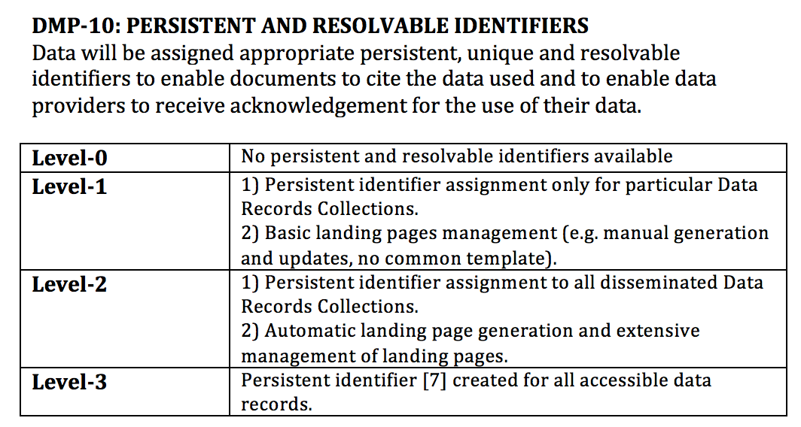
DMP-10: PERSISTENT IDENTIFIER
DOI can help to acknowledge the receiving and archiving teams. If possible should be included in meta data file.

Slide 19

Scope of the Data Management and Stewardship Maturity Matrix
A way to measure the Data Stewardship processes
A way to plan the goals of your Data Stewardship processes and projects

Slide 20









Interested Organizations
CMMI
Standards for Establishing Trusted Repositories for USGS Digital Assets
A Provenance MM
CDR
Data Stewardship in the Earth Sciences
Data Management Maturity
ISO 16363
Other Organizations
Notes:
The DMM model Editorial Board will recommend strategies for adapting and deploying a DMM model to the Earth and space sciences create guidance documents to assist in its implementation, and provide input on a pilot appraisal process.
The ASF SAR DAAC participates in ESIP to further its goals of supporting national and international Earth science research, field operations, and remote-sensing applications that benefit society. These goals complement ESIP’s focus on “the collection, stewardship and use of Earth science data, information, and knowledge that is responsive to societal needs.”
5.4 Future Work
In the meantime, the ESIP Data Stewardship Committee continues to work towards advancing the state of the art in data stewardship through the establishment of a series of liaisons with other groups working in this area. For example, several of the Research Data Alliance (RDA) Working Groups and Interest Groups have members who act as liaisons between those RDA communities and ESIP. In addition, ESIP has members on the FORCE11 DCIG group, on CODATA groups, and on other groups that are conducting related activities.
ESIP teams also are contributing to the development of standards and best practices within the Earth science community. For example, we have started developing example data citation guidelines for reviewers, editors, and authors to help journals and scientific organizations that are considering updating their guidelines to include data related topics.
To characterize the state of preservation of Earth Science data, we are beginning to test the Data Stewardship Maturity Matrix, originally developed by Ge Peng, of NOAA [46], on data that are external to the NOAA environment. The hope is that the Matrix can be generalized enough to work for Earth Science data more broadly, so that the Matrix can be applied in a uniform fashion by data centers and other data-holding organizations to express the state of any particular data set within their care. In assessing such tools, resources that offer similar utility also will need to be considered.
ESIP community discussions are open to individuals and organizational representatives. Individuals may join discussions by perusing the ESIP wiki and attending any of the listed teleconferences or by adding their names to the posted mailing lists. Organizations are encouraged to join the ESIP Federation by completing a membership application. Organizational membership is free, subject to review of application and approval by the Federation Assembly.

Slide 21

Way Forward and Achievements
Data Management and Stewardship Maturity Matrix Verification:
    Collection of Lessons Learned
    Analysis and Tuning of the White Paper
Collaboration with:
    ESDIS as Joint activities
Waiting possible input from NCEI/CICS-NC Scientific Data Stewardship Maturity Matrix (DSMM) Group managed by Ge Peng.
Publication in the Journal of Global Change Data & Discovery by Liu Chuang (Institute of Geographic Sciences and Natural Resources Research)

Slide 22


