Slide 1
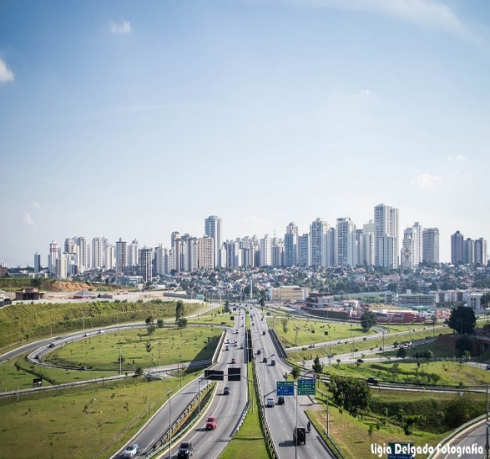
Committee on Earth Observation Satellites
WGISS Infrastructure Project (WISP) Report
Martin Yapur & Anne Kennerley
(Presented by Michelle Piepgrass) WGISS-45
São José dos Campos, SP, Brazil
April 9, 2018

Slide 2
Support Team
Lead
Martin Yapur (martin.yapur@noaa.gov)
Team
Anne Kennerley (anne.kennerley@noaa.gov)
Michelle Piepgrass (mvpiepgrass@gmail.com)
Kim Holloway (kim.e.holloway@nasa.gov)
For any technical CEOS server requests, contact: it@ama-inc.com

Slide 3
Whom do we support?
WGISS
Chair, Mirko Albani, ESA
Vice-Chair, Robert Woodcock, CSIRO
WGISS Secretariat
Michelle Piepgrass, ESA
WGISS Infrastructure Services Project
Martin Yapur, NOAA
Focus Areas:
Preservation and Stewardship
Discovery and Access
Interoperability and Use
Technology Exploration
Data Stewardship Interest Group (Mirko Albani, ESA)
WGISS Connected Assets Systems Level Team
- IDN (Michael Morahan, NASA)
- FedEO (Andrea della Vecchia, ESA; Yves Coene, ESA)
- CWIC (Yonsook Enloe, NASA; Ken McDonald, NOAA)
- OpenSearch II (Andrea della Vecchia, ESA; Olivier Barois, ESA)
Interoperability Interest Group (Robert Woodcock, CSIRO; Richard Moreno, CNES)
- Future Data Architectures (Robert Woodcock, CSIRO; Richard Moreno, CNES; Kristi Kline, USGS)
- Recovery Observatory (Richard Moreno, CNES)
- Carbon Strategy and Portal (Martin Yapur, Ken McDonald, NOAA)
- Open Source SW and Tools (TBD)
Technology Exploration Interest Group (Chris Lynnes, NASA; Yosuke Ikehata, JAXA)

Slide 4
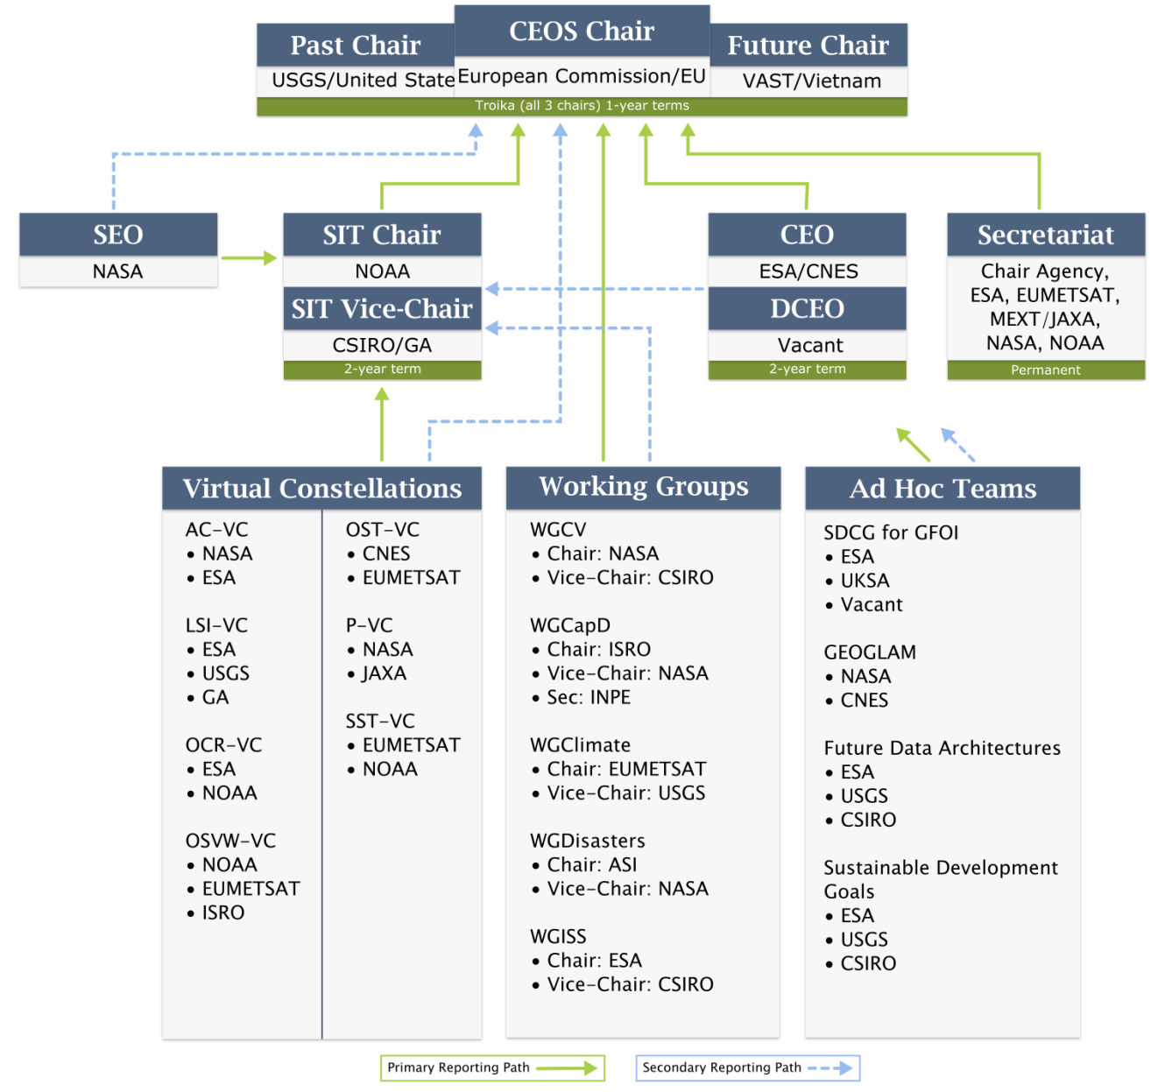
Whom do we support?

Slide 5
WGISS-45 Presentations
Presentation Format:
Date_Time_Title (ie. 2018.04.09_09.20_WISPREPORT)
***Please use two digit format for month, day, hour, and minutes (example: April =04) and use underscores ***
Delivery Method
Send email with presentation to
Michelle at mvpiepgrass@gmail.com
and
Anne at anne.kennerley@noaa.gov

Slide 6
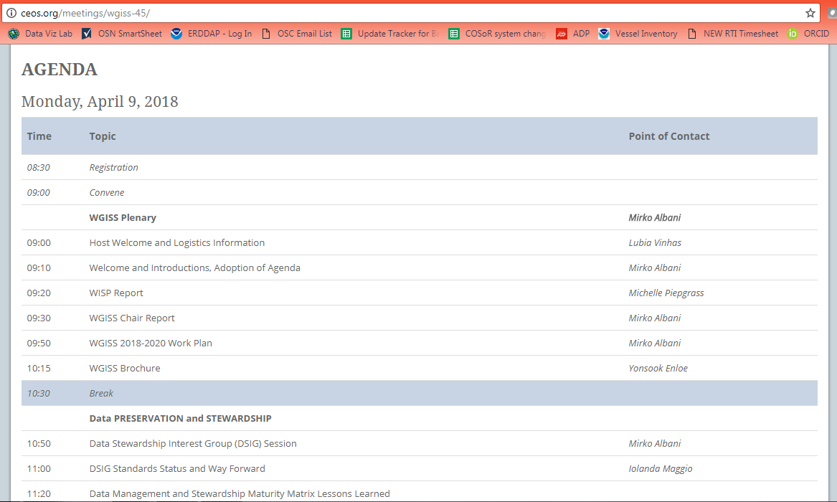
WGISS-45 Presentations
Presentations will be directly linked to the online agenda
Your cooperation is critical to ensure a
smooth time management!!

Slide 7
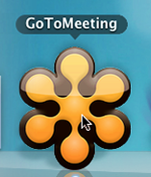
Web Conferencing
WGISS-45 Meeting Remote Participation
1. Please join my meeting.
https://global.gotomeeting.com/join/160468805
2. Use your microphone and speakers (VoIP) - a headset is recommended. Or, call in using your telephone.
United States: +1 (224) 501-3316
Australia: +61 2 8355 1034
France: +33 (0) 170 950 588
Germany: +49 (0) 692 5736 7207
Italy: +39 0 693 38 75 53
New Zealand: +64 4 974 7243
United Kingdom: +44 (0) 330 221 0097
Access Code: 160-468-805
Audio PIN: Shown after joining the meeting
Meeting ID: 160-468-805
WGISS Infrastructure Services (WISP)

Slide 8
WISP Request
The WISP’s success depends on YOU to:
Keep us informed of any new or departing members from your organization so we can keep the mailing lists up-to-date
Let us know of any changes needed to the
WGISS webpages
Support our outreach activities

Slide 9
Thank you!

