Slide 1
NCEI’s Long Term Archive: Infrastructure, Processes, Volume and Trend
Nancy Ritchey Archive Branch Chief, NOAA’s National Centers for Environmental Information
Thursday, September 28, 2017
NOAA Satellite and Information Service | National Centers for Environmental Information

Slide 2
Outline
Who we are
The Numbers
Trusted Archive
Data Management Processes
Infrastructure
Be the Nation’s Trusted Authority for Environmental Information

Slide 3
NOAA’s National Centers for Environmental Information (NCEI)
Responsible for preserving and providing access to one of the most significant archives on Earth, with comprehensive oceanic, atmospheric, and geophysical data
From the depths of the ocean to the surface of the sun and from million-year-old sediment records to near real-time satellite images
Nation’s leading authority for environmental information

Slide 4
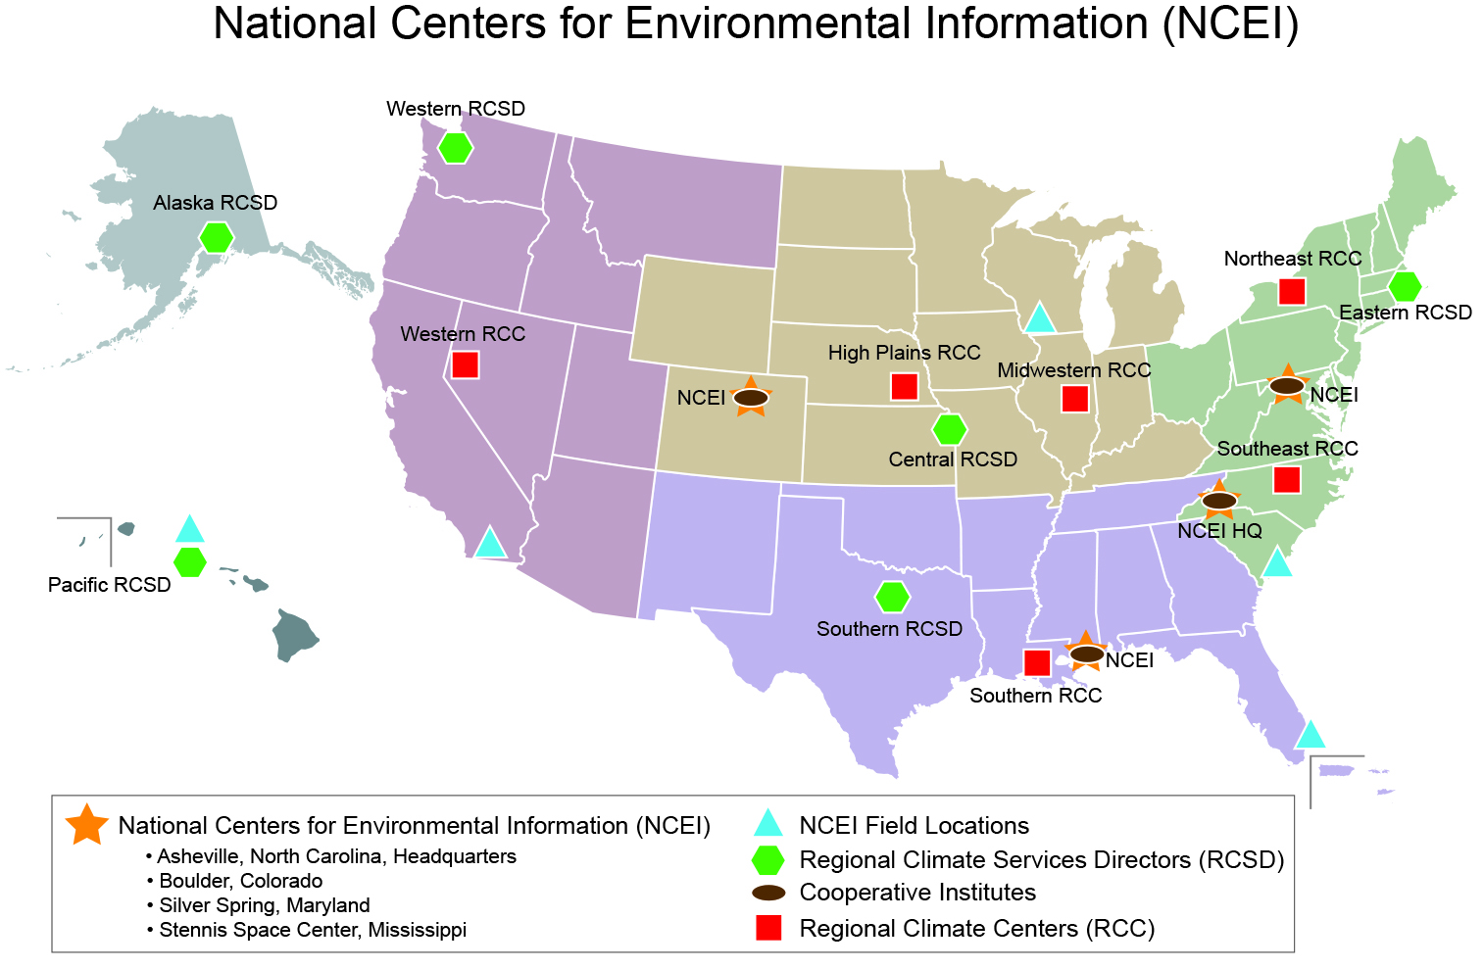
NCEI has a Nationwide Presence

Slide 5
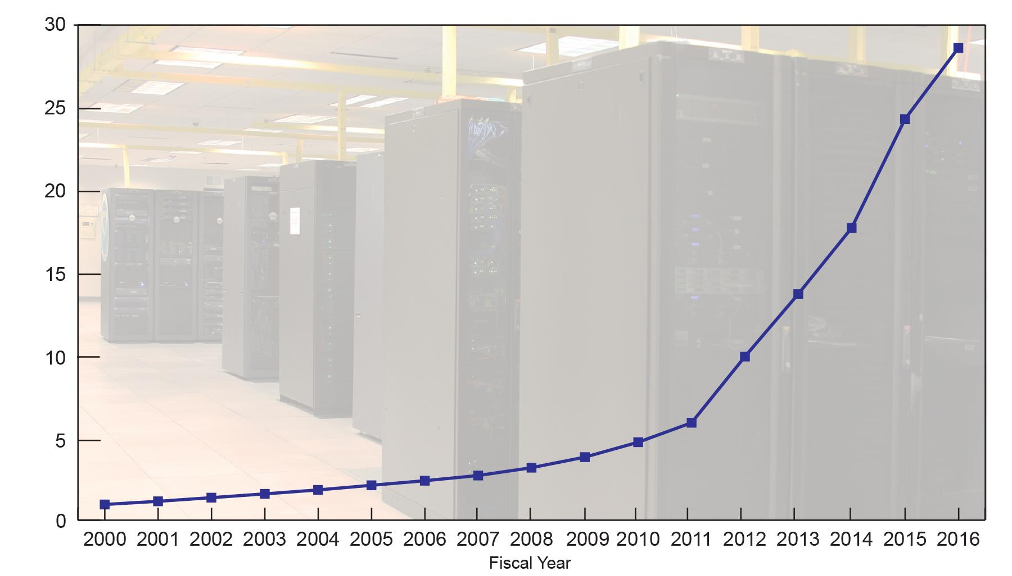
NCEI Environmental Data Archive Volume
Increasing Data Volumes from Station, Model, Radar, and Satellite Sources
2016 Total: 28.6 Petabytes
Aug 2017 32.8PB*
28 PB = Storage in a stack of smart phones 17 Eiffel Towers high (1,063 feet)
Due to increase
in satellite and
model data
Volume (Petabytes)
*Includes primary and secure data

Slide 6
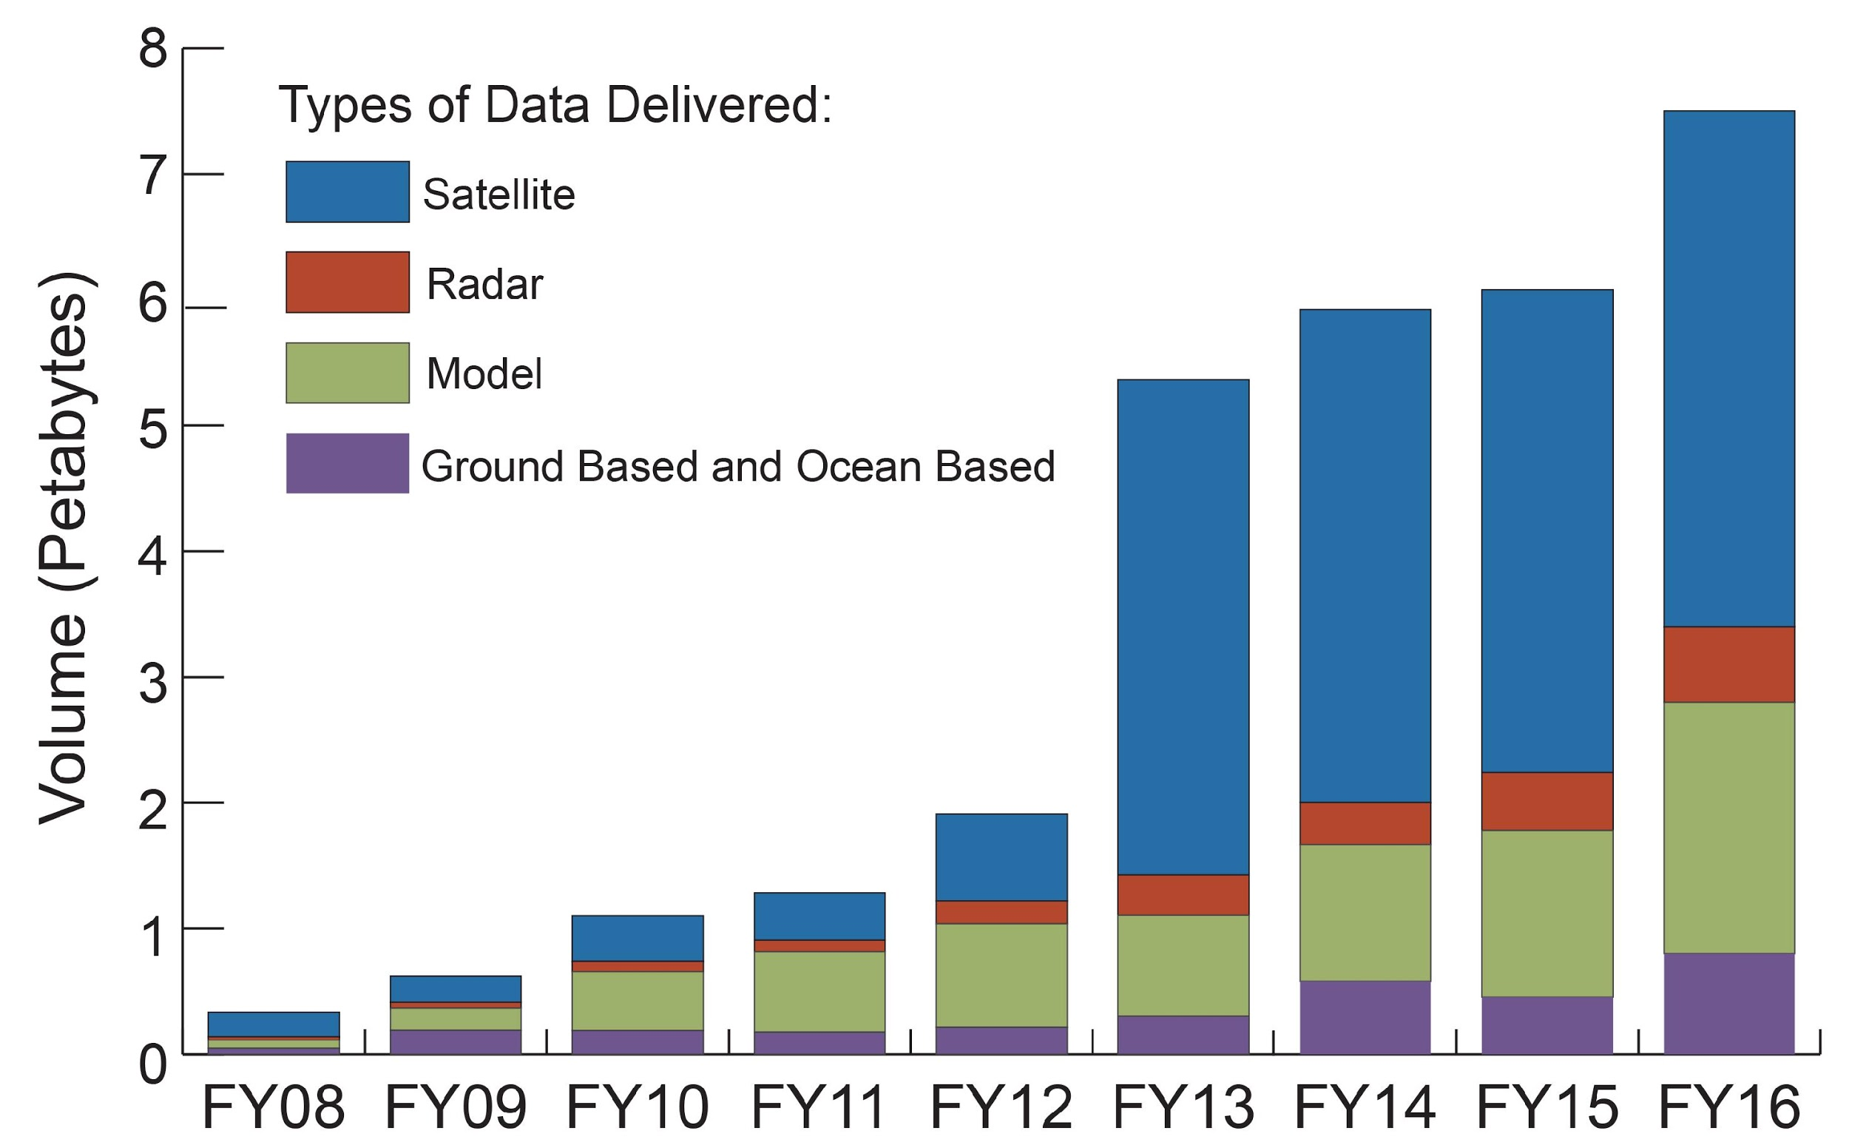
NCEI Environmental Data User-Requested Volume
Increasing Data Requests from Station, Model, Radar, and Satellite Sources
Volume (Petabytes)

Slide 7
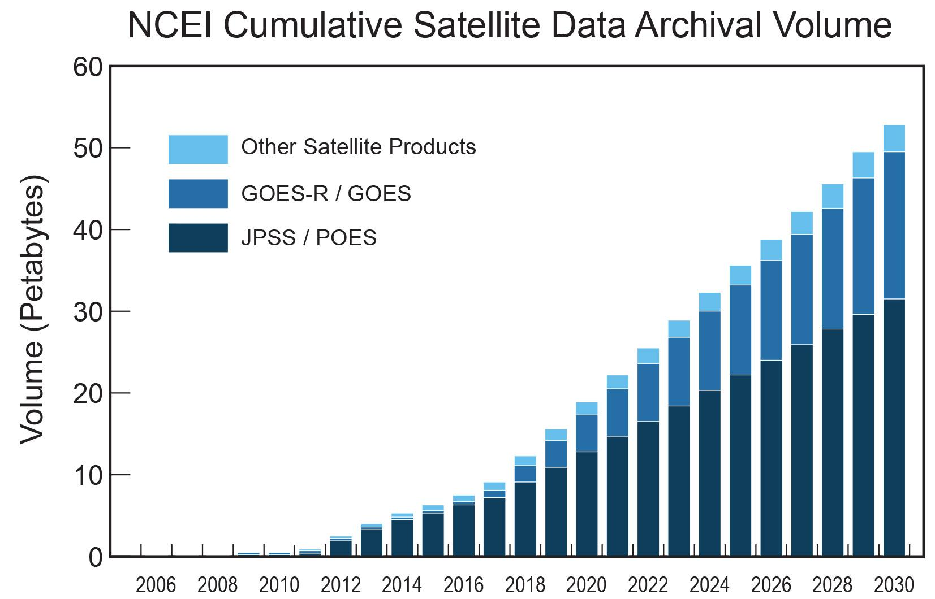
NCEI Cumulative Satellite Data Archival Volume
In Situ adds 10PB by 2025 and 18PB by 2030
Notes:
Notes:
* 2005 - 2016 volumes are based on data archived at NCEI, some of which is compressed.
* 2017-2030 are estimated volumes, based on historical and projected values
* Unless otherwise noted, units are in petabytes
* JPSS includes legacy POES, S-NPP and planned JPS missions.
* JPSS volumes include Retained Intermediate Products, which are used to generate other products. These are roughly equal in volume to combined volume of JPSS Raw Data Record (RDR, L0) and Sensor Data Record (SDR, L1b)
* GOES-R / GOES includes both legacy GOES as well as GOES-R/S/T projections
* "Other Satellite Products" includes a variety of smaller volume satellite data and derived products.

Slide 8
Trusted Archive
Strengthen the trust of user communities, partners and the public by quantifiably demonstrating capabilities for ensuring data integrity and reliability over the long term.
NCEI leads four World Data Systems: Geophysics, Meteorology, Oceanography, and Paleoclimatology
Recommended option is the Core Trustworthy Data Repository.
Notes:
Examine processes and capabilities which will ultimately validate the trustworthiness of the archive.
Core Trustworthy Data Repository, jointly offered by the Data Archiving and Networked Services archive in the Netherlands (creator of the Data Seal of Approval) and the International Council for Science World Data System (WDS).

Slide 9
Data Stewardship Maturity Matrix (DSMM)
A Unified Framework for
Measuring Stewardship Practices Applied to
Individual Digital Earth Sciences Data Products
http://tinyurl.com/DSMMintro
Notes:
NCEI scope policy

Slide 10
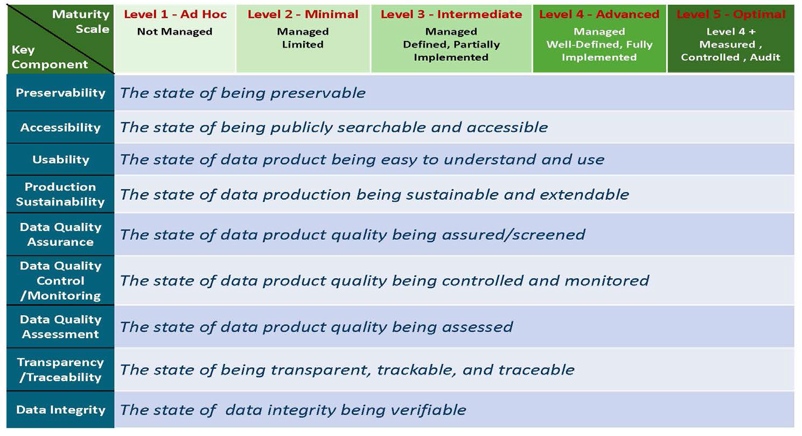
DSMM Defines Measureable, Five-Level Progressive Practices in Nine Quasi-Independent Key Components

Slide 11
Processes: Data Management
Location-based processes
Piloted an End-to-End Data Stewardship process
Initiating Field Teams to support data stewardship throughout the organization
Developing an approach for assigning resources and prioritizing NCEI Product Areas
Notes:
NCEI scope policy

Slide 12
Processes: Data Management
Testing a Cost Estimation Tool for Data Stewardship Tiers 1 and 2
Developing a business approach to using the Cost Model
6
National Services and International Leadership
5
Authoritative Records
4
Derived Products
3
Scientific Improvements
Enhanced Access and Basic Quality Assurance
2
1
Long-Term preservation and Basic Access

Slide 13
Infrastructure: NCEI “Tomorrow”
External Catalogs
Data.gov, Google, WIS, WDS, CEOS, DataONE, etc.
PRODUCERS
Enterprise
Services
CONSUMERS
SIP
Metadata Database + Services
Metadata WAFs
Metadata Docs
OneStop UI
+ data.noaa.gov
One-Off’s
S2N+ATRAC
OneStop API (Geoportal + ElasticSearch services)
Community-
Specific “Thin” Portals
Queries
Results
Automations
Metadata CRUD Tools
Ingest Processes
Common Ingest System
Collection and Granule Metadata
Analytics Engine
DIP
Data
Automations
MSN/OneStop Disk Storage + Public Cloud
CLASS Common Submission
CS
Hyrax
TDS
ERDDAP
FTPS/HTTPS
WxS
LAS
Agg. Tools
AIP
AIP
AIP
AIP
AIP
AIP
CS
* M2M for access in limited cases
Offsite Tape: Disaster Recovery* + System Backups
(provided by NESDIS Ground Enterprise, NGE)
Ingest
AIP
Access
Notes:
Ingest:
Common Ingest is a modular, configurable, scaleable, and extensible system includes GUI-based configuration and management, complete provenance tracking, and integrated security scanning.
Deployed Aug 2017
Initiated migration of data streams across NCEI
Archive:
Currently multiple systems supporting NCEI archival.
Initiating effort to determine a scaleable, extensible enterprise system approach
Access
OneStop: Search and discovery
Common Access: Microservices-based platform will consolidate historical and desperate access systems, enabling order fulfillment and certification

Slide 14
Infrastructure: Ingest
Common Ingest: Architecture
Data Provider
Remote
IO
Aggregate
Submission
Move
Common Ingest
Manager
Rename
Message Oriented Middleware
(Queuing System)
Archive
User Interface
Tracking
DB
Tape
Archive
Notes:
Common Ingest is a modular, configurable, scaleable, and extensible system includes GUI-based configuration and management, complete provenance tracking, and integrated security scanning.
Deployed Aug 2017
Initiated migration of data streams across NCEI

Slide 15
MSN Service Model
Application Services
Data Acquisition
(e.g., Common Ingest)
Product Generation
(e.g., Reprocessing)
Data Discovery
(e.g., OneStop)
Data Dissemination
(e.g., OneStop, THREDDS)
Platform Services
Database Services
(e.g., Postgres, NOSQL)
Web Services
(e.g., Drupal, Apache)
Catalog Services
(e.g., OneStop APIs)
Infrastructure Services
Shared Compute Services
(oVirt, Condor)
Shared Storage Services
(SCDR, Gluster)
Processing Services
(e.g., Cloud/NOAA HPC)
Archive Services
(CLASS Partition/Cloud)
OneStop architecture of tiered services aligns directly within MSN service model
Notes:
NESDIS initiative to develop an enterprise infrastructure to support Satellite Application and Research and NCEI.
Led by NCEI
Leverage existing capabilities (ex. OneStop)
Develop required, non-existent capabilities or replace antiquated technological solutions

Slide 16
Questions?
Nancy.Ritchey@noaa.gov

Slide 17
www.ncei.noaa.gov
www.climate.gov
NCEI Climate Facebook: http://www.facebook.com/NOAANCEIclimate NCEI Ocean & Geophysics Facebook: http://www.facebook.com/NOAANCEIoceangeo NCEI Climate Twitter (@NOAANCEIclimate): http://www.twitter.com/NOAANCEIclimate
NCEI Ocean & Geophysics Twitter (@NOAANCEIocngeo): http://www.twitter.com/NOAANCEIocngeo

