Slide 1
The introduction of Geological Super Computer
Shenyang Geological Survey Center. CGS
2016-12
ZhangNan

Slide 2
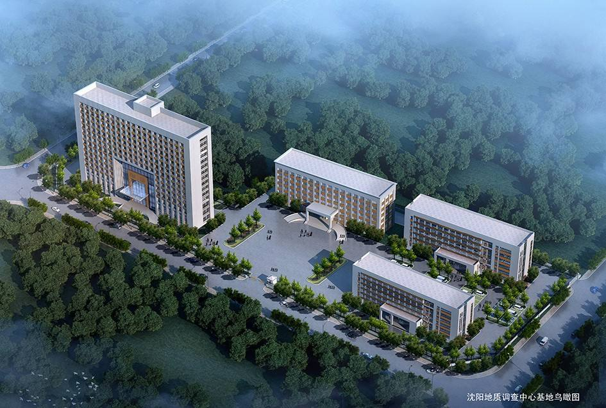
CGS Shenyang Center
China Geological Survey(CGS) is directly managed by Ministry of Land and Resources. And the Shenyang Center(Northeast Center) is part of CGS. The range of our work area include LIAONING, JILIN, HEILONGJIANG and East of Inner Mongolia.
In charge to Conducting geological scientific researches, collecting the geological data , information, develop services, and Project management and supervision in northeast of china.

Slide 3
Outline
Background and goal
Processing ability and professional support
Actual application
Future work

Slide 4
Background and goal
Processing ability and professional support
Actual application
Future work

Slide 5
Super computing
Super computing is MPI process system ,it calculate and process much faster than the traditional high performance computing.
The development of many areas ,from the traditional areas of national security, oil and gas and climate to the new scientific research of biological medicine, micro-structure, depend on the development of high performance computing.

Slide 6
Work background: as the development of geological survey, data processing play a more significant role in this area. The traditional technology can not satisfy the requirment of date process in the front geological research , especially in the areas as follows:
Data in energy ,environmental impact assessment and numerical modeling are huge .The traditional processing technology can not satisfy the requirement of processing work.
The processing step in the whole workflow from data collection to its application is relatively weak. Many excellent algorithm can not be used in the actual work, which delay the generation of the geological survey results.
Short the length of response time for important work, important events and critical disaster to several hours ,and even several minutes.

Slide 7
Technology background: because of the accumulation of research results , huge scale technology become well-known gradually.
For data process, we think it has three key parts.
Data, algorithm and processing ability
If the processing ability can be improved, it is helpful for the generation of new technology, the exiting technology can also be improved easily. At the meanwhile, the utilization
of data can be improved. Therefore , we make the processing ability as the breakthrough, carry out the support work for the research, promote the ability of processing data in the geological survey.

Slide 8
Super Computer
We built a super computer for geological scientific researches. It takes number of CPU and GPU, Support almost all kinds of parallel computing in different ways. You can not only do the complicated work using multiple method in one processor, but also can call the method passing in different multi-core servers, and establish time shorter than 1 millisecond.
2017, our geological super computer Floating point calculations peak will increase to 130TFLOPS. And the storage will be reach to 3000TB. And we got plan to increase these numbers year by year.
Now our super computer using to process the energy area. These's 22 software on it! And we plan to develop remote-sensing applications.

Slide 9
Construction goals
Construct an excellent supporting and innovation platform
Service position
1 satisfy the inner requirement 2 cooperation in areas 3 open to the society
Construct principle: open and sharing, mutual connection and intelligibility
User connect with the platform through internet, and then computing resource, storage resource and software can be used remotely. User’s Data resource and work system can also be connected with platform.
As the first super computing platform , it will lead the development of the high performance computing.

Slide 10
Background and goal
Processing ability and professional support
Actual application
Future work

Slide 11
As the fastest and strongest platform in CGS , it can operate more than 1800 core , 3600 thread and has 1TB memory. It can provide the peak floating point calculations with 120 trillion per second (computational efficiency get to 82%).
The platform has the PB level storage ability, which can also expand to EB level. It can provide support for remote backup. The whole oil and gas data processing software have been installed in the platform, which has 6 categories ,22 soft wares. Compared with traditional data center, computing velocity and process rate are improved dramatically.

Slide 12
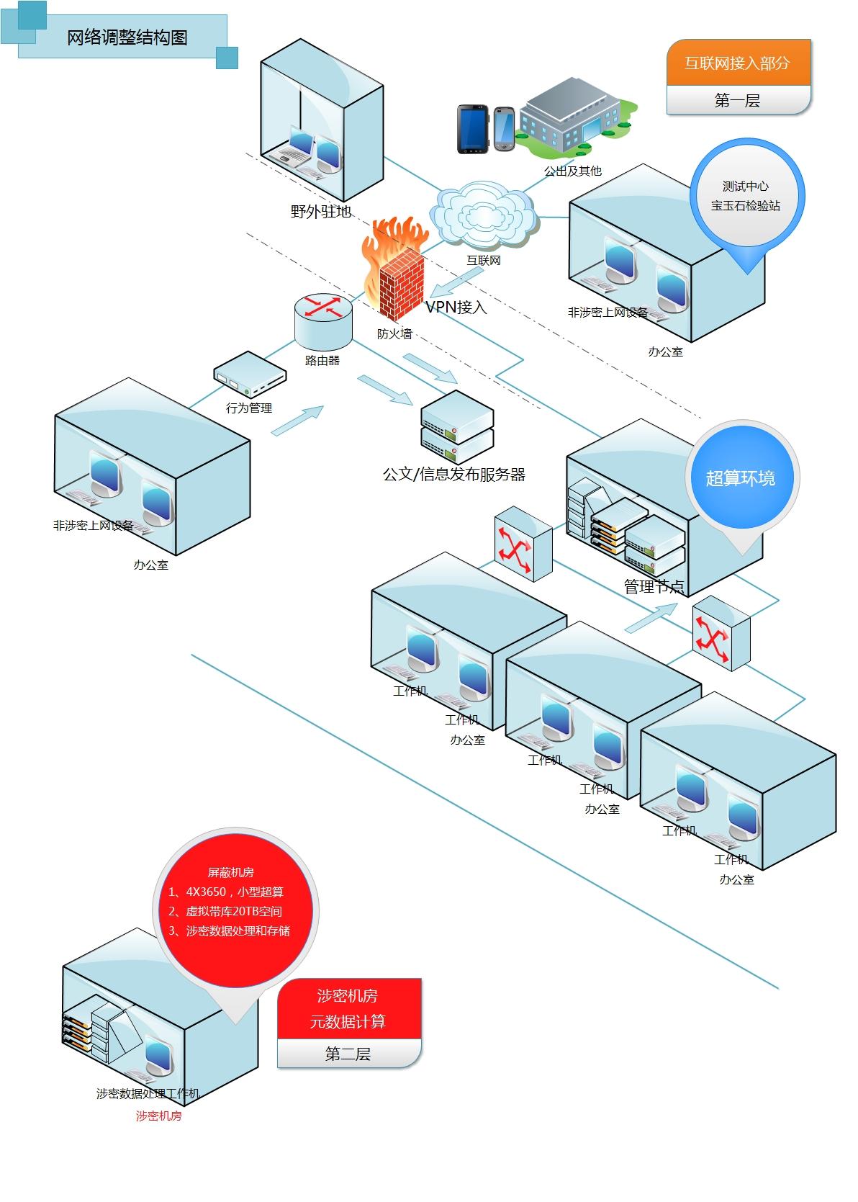
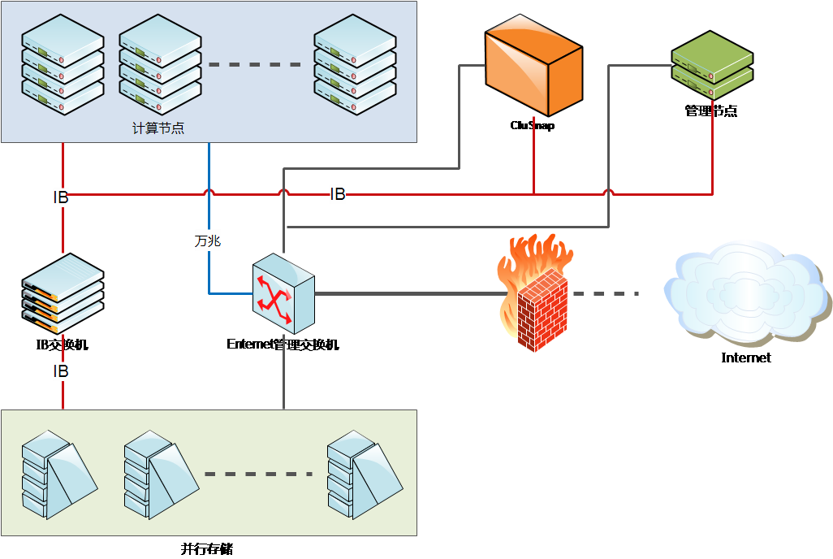
Single 56Gb FDR Infiniband：delay is less than 1μs
GbE，bandwidth get to112MB/s，delay is pretty high，get to47.57μs。
10GbE，TCP/IP bandwidth get to770MB，delay is about12μs，
use RDMA，bandwidth get to 1046MB/s,delay is7.68μs。

Slide 13
Processing workflow for oil and gas data
Seismic data process(LD-SeisFast, LD-DPSeis, LD-SIMO)
Reservoir characterization and oil exploit software(GeoTalk, SeisTalk, image+, EPS+, FRS+, OceanPro, GPA, Landmod, LandFrac)
Oil and gas exploit engine software (ReasPro, ReasPro，GasPro，BeneDes，DevPro，UseDes)
Economy evaluation software(DevelopDes, ExplorDes, PlanDes)

Slide 14
Mathematic calculation : one set
Geophysical data process :one set (support for 3D electronic inversion)
Complier : GNU complier, support for C/C++ Fortran77/90
Intel complier, support for C/C++ Fortran
Math basis: BLAS、LAPACK、ScaLAPACK、FFTW
MPI parallel compute environment: OpenMPI(support for Infiniband and Etherne t MPI environment )
MPICH2(support for GbE MPI environment)

Slide 15
Background and goal
Processing ability and professional support
Actual application
Future work

Slide 16
work in 2017
1、 Seismic data process : 3D seismic data 300km², 2D seismic data 1680km , gravity, magnet ,electronic, seismic joint inversion for 1030 km profile.
2、 Based on the advantage of platform ,we construct the dynamic monitor system for black soil which can process the data model and index system to measure, simulate and predict .

Slide 17
The platform is the first one that hsa the ability of super computing in geology survey in China ,which also supports the large scale MPI computing;
The platform can process the large scale data in time and automatically and has the ability to deal with the emergency events.
International advanced black soil data platform.

Slide 18
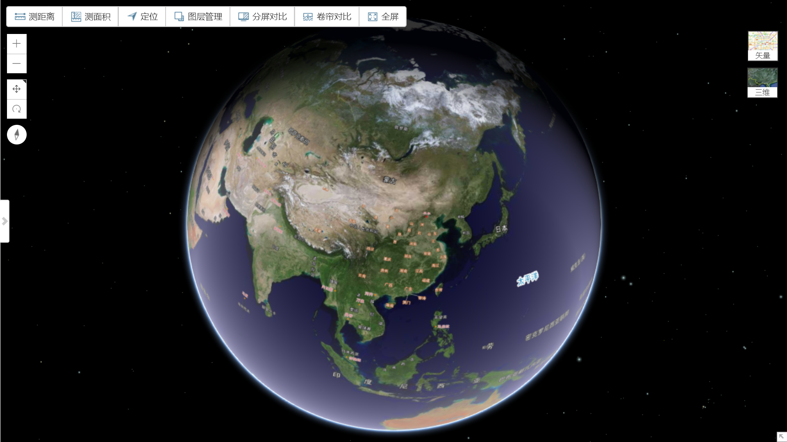
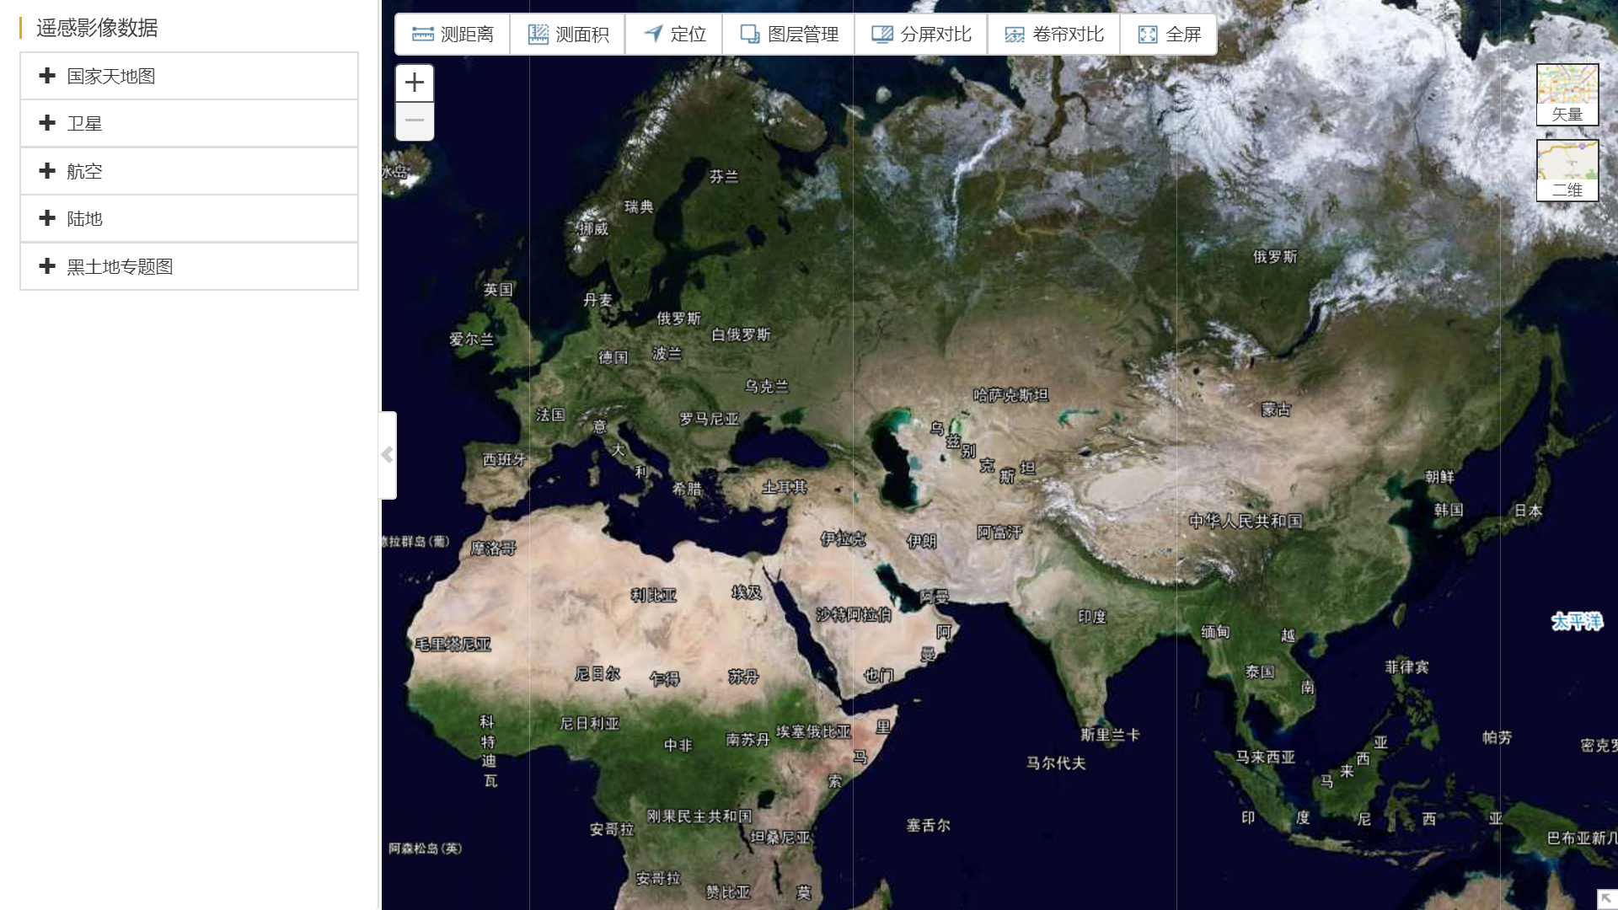
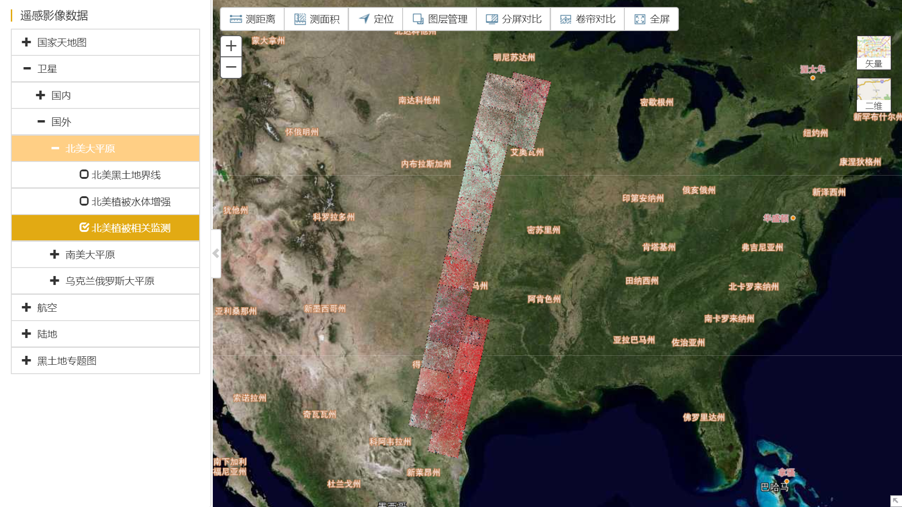
Demo

Slide 19
Background and goal
Processing ability and professional support
Actual application
Future work

Slide 20
Future work
1. Special process for oil and gas data. In 2017, 3D seismic data collected in Gulong area and gravity, magnet ,electronic, seismic data in Binbei area will process and interpret again.
2. Carry out the support work for the research of black soils geological ecology actively ,and then complete the initial dynamic monitor system .

Slide 21
Thank you！

