Slide 1
CNES agency report
CNES
Digital Solutions, Ground Segment & Operations Directorate (DNO)
Earth Observation Department (OT)

Slide 2
CNES objectives : increase the usage of space data
2016 : creation of a new directorate dedicated to Innovation, Application and Science
2017 : creation of a new directorate “Digital solutions, Ground-Segments & operations”
  1 department dedicated to IT infrastructure : big data, HPC, machine learning, architecture
  1 department dedicated to science
  1 department dedicated to Earth Observation
  …

Slide 3
EO department : scope of activities
Our main objective : promote the best possible use of Earth Observation data
Involvement in Space missions :
  Payload Ground Segment Development (Programming, Payload processing, Instrument Expertise Centers, …)
  Operations :
    Mission management (hand-over from “Orbital System directorate” after in-orbit commissionning)
    Payload Ground Segment operations
Value-added products
  CNES contribution to Data and Service hubs
Innovation in Ground segment design
  Benefice of big data/cloud technologies for improved performances

Slide 4




Scientific Data and service hubs
OBSERVATION
      At the end of 2013, CNES and its scientific partners agreed to set up four hubs for Earth Observation data and services (solid earth, ocean, land surfaces and atmosphere), for coordinated management, centralised access to data and derived thematic products from these data, as well as the associated expertise.
      AERIS: The atmosphere pole consists of 4 data and service centres (CDS): Icare (clouds, aerosols, radiation, etc.), ESPRI (chemistry of the atmosphere, etc.), Sedoo (data measurement campaigns), SATMOS (data from geostationary satellites and derived cloud products, etc.)
      ODATIS: Promote and facilitate the use of observations made in the ocean or at its interface with the other environmental compartments. The main contribution of CNES concerns altimetry activities.
      THEIA: Promote and facilitate the use of observations specifically of land surfaces, covering several themes: agriculture, forests, hydrology, health, urban planning, risk assessment, etc.
      FORM@TER: The mission of the solid Earth pole is to facilitate and enhance the use of in situ and satellite data and products related to the different thematic areas concerning the solid Earth (geodesy, magnetism, gravimetry, tectonics, geodynamics, volcanology, etc.) for the needs of different communities working on the Earth system.
      Work on progress: to constitute a unique research infrastructure federating these four data hubs according to the following themes: Earth Scientific Data and service hub

Slide 5
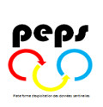
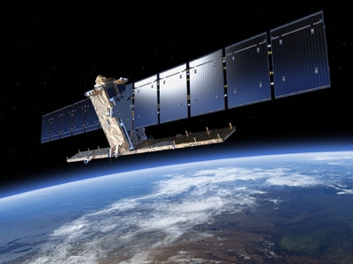
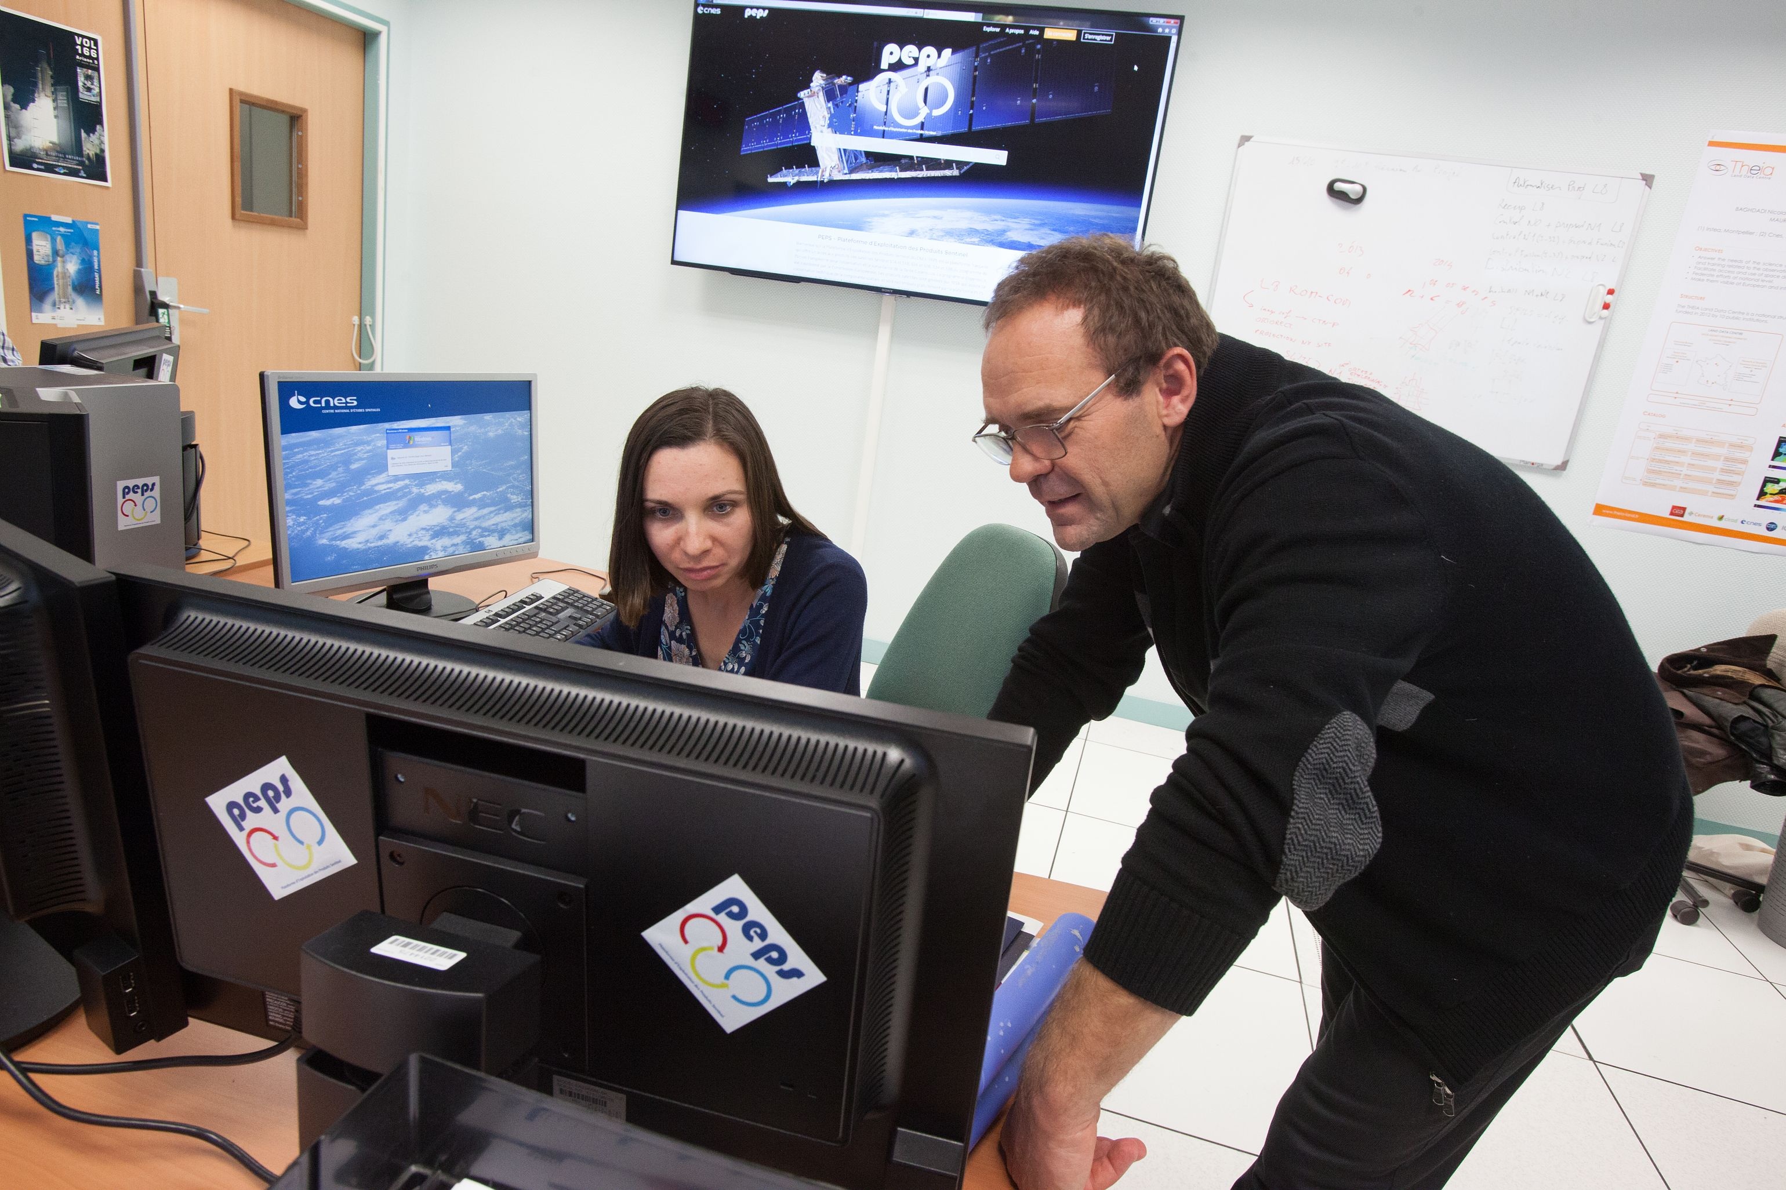
PEPS: Sentinel Products Exploitation Platform, French Copernicus collaborative ground segment
OBSERVATION
      With its unique fleet of 6 families of Sentinel satellites, the European Union’s Copernicus environmental monitoring and security programme is set to generate a wealth of regular, high-quality data. The Sentinel-1, Sentinel-2 and Sentinel-3 pairs of satellites are sending back 10 terabytes of data every day, the equivalent of petabytes by year.
      To meet demand in France, the PEPS platform (Sentinel Products Exploitation Platform), developed at CNES’s Toulouse Space Centre, will evolve in the next years into an integrated Europe-wide system involving key industry players in big data and cloud computing, in line with the development of the DIAS.
© ESA
© CNES/F. Maligne

Slide 6











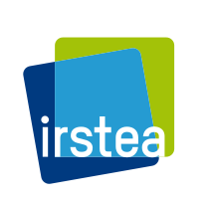

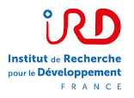



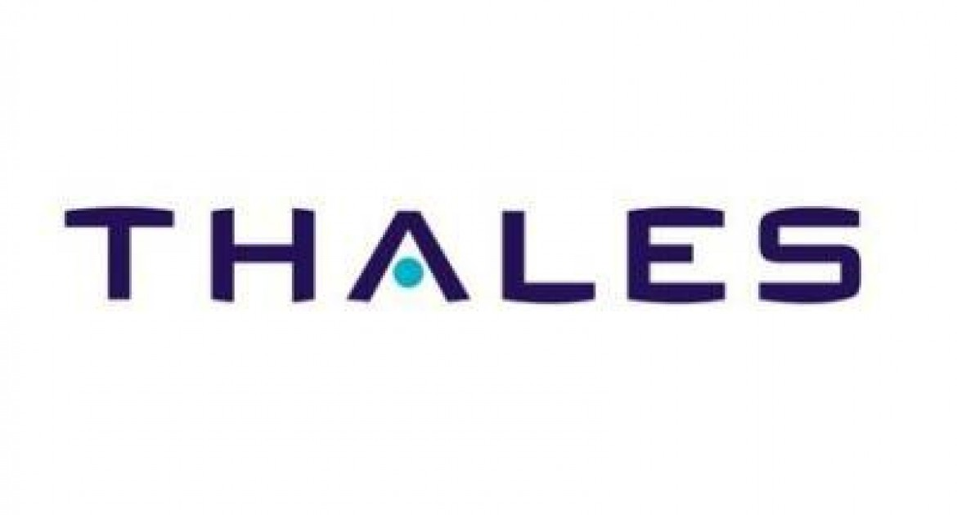


Our main external interfaces
Space agencies
European partners
Meteorological agencies
Defence
DNO/OT
Regional partners
Industry (Space, IT, …)
Scientific labs
…
Subsidaries
…

Slide 7
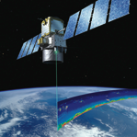
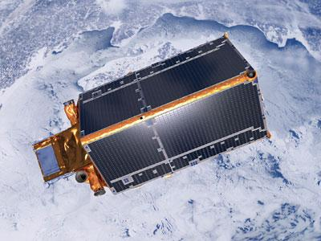
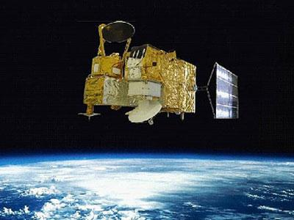
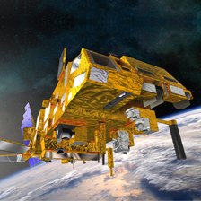
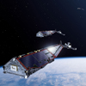
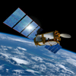
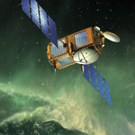
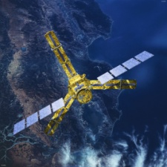
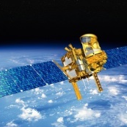
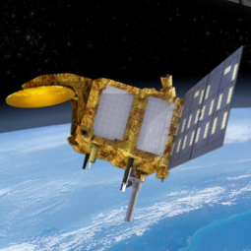
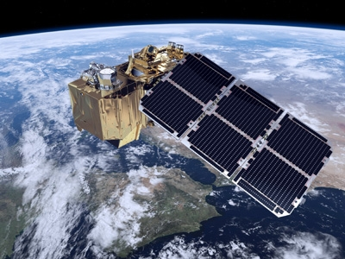
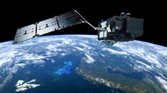
Programmes in operation
OBSERVATION
Calipso
Cryosat-2
Hy-2A
Iasi2/MetopB
Swarm
Jason 3
2005 | 2006 | 2007 | 2008 | 2009 | 2010 | 2011 | 2012 | 2013 | 2014 | 2015 | 2016
Iasi1/MetopA
Jason 2
Smos
Megha-Tropiques
Saral-AltiKa
Sentinel-2A
Sentinel-3A

Slide 8
CNES missions in operations (1/2)
OBSERVATION MISSIONS IN OPERATION
 |  |  |  |  | Version | 04/09/2017 |  |  | Nominal Period |  |  |  |  |  |  |  |  |  |  |  | Mission Extension |  |  |  |  |  |  |  |  |  |  |  |  |  | Mission Extension foreseen |  |  |  |  |  |  |  |  |  |  |  |  |  |  |  |  |  |  | Post-Mission technical experiment
 |  |  |  |  |  |  |  | 2008 |  |  |  | 2009 |  |  |  | 2010 |  |  |  | 2011 |  |  |  | 2012 |  |  |  | 2013 |  |  |  | 2014 |  |  |  | 2015 |  |  |  | 2016 |  |  |  | 2017 |  |  |  | 2018 |  |  |  | 2019 |  |  |  | 2020 |  |  |  | 2021 |  |  |  | 2022 |  |  |  | 2023 |  |  |  | 2024
 | Missions in Operations with Mission Operation Center @ CNES
 |  |  | Current Missions
 |  |  |  |  |  | Helios 2A | 2004-Dec
 |  |  |  |  |  | Calipso | 2006-Apr
 |  |  |  |  |  | Jason 2 | 2008-Jun
 |  |  |  |  |  | SMOS | 2009-Nov
 |  |  |  |  |  | Helios 2B | 2009-Dec
 |  |  |  |  |  | Pléiades 1A | 2011-Dec
 |  |  |  |  |  | Pléiades 1B | 2012-Dec
 |  |  |  |  |  | Jason 3 | 2015
 |  |  | Future Missions
 |  |  |  |  |  | CSO (1) | 2018
 |  |  |  |  |  | CSO (2) | 2019
 |  |  |  |  |  | Merlin | 2021
 |  |  |  |  |  | SWOT | 2021
 |  |  |  |  |  | MicroCarb | 2020
 |  |  |  |  |  | CSO (3) | 2021

Slide 9
CNES missions in operations (2/2)
 |  |  |  |  |  |  |  | 2008 |  |  |  | 2009 |  |  |  | 2010 |  |  |  | 2011 |  |  |  | 2012 |  |  |  | 2013 |  |  |  | 2014 |  |  |  | 2015 |  |  |  | 2016 |  |  |  | 2017 |  |  |  | 2018 |  |  |  | 2019 |  |  |  | 2020 |  |  |  | 2021 |  |  |  | 2022 |  |  |  | 2023 |  |  |  | 2024
 | French Participation (Payload Operation, Calibration, Data Processing, …) in Missions operated by others agencies |  | Current Missions
 |  |  |  |  |  | Grace | 2002-Feb
 |  |  |  |  |  | IASI 1, 2, 3 | 2006-Oct
 |  |  |  |  |  | Cryosat | 2010-Apr
 |  |  |  |  |  | HY2-A | 2011-Aug
 |  |  |  |  |  | Meghatropiques | 2011-Oct
 |  |  |  |  |  | Saral/Altika | 2013-Feb
 |  |  |  |  |  | Swarm | 2013-Nov
 |  |  |  |  |  | Sentinel 2A&2B | 2015-Jun
 |  |  |  |  |  | Sentinel 3A&3B | 2016-Feb
 |  |  |  |  |  | Vénµs | 2017
 |  |  |  |  |  | CFOSAT | 2018
 |  |  |  |  |  | Jason-CS | 2020
 |  |  |  |  |  | IASI NG 1,2,3 | 2021
 |  |  |  |  |  |  |  | 2008 |  |  |  | 2009 |  |  |  | 2010 |  |  |  | 2011 |  |  |  | 2012 |  |  |  | 2013 |  |  |  | 2014 |  |  |  | 2015 |  |  |  | 2016 |  |  |  | 2017 |  |  |  | 2018 |  |  |  | 2019 |  |  |  | 2020 |  |  |  | 2021 |  |  |  | 2022 |  |  |  | 2023 |  |  |  | 2024
 |  |  | (ie : re-processing in progress, ..)
 | Past Missions with still a project @CNES |  |  |  |  | SPOT 4 | 1998-Mar
 |  |  |  |  |  | Jason 1 | 2001-Dec
 |  |  |  |  |  | Parasol | 2004-Dec
 |  |  |  |  |  | Goce | 2009-Mar
 |  |  |  |  |  | SPOT 5 | 2002-Apr

Slide 10
Venµs: France-Israel space cooperation – vegetation-monitoring satellite
Orbited by a Vega launcher from the Guiana Space Centre (CSG) on the night of 1 to 2 August, Venµs is a scientific satellite developed jointly by CNES and the Israel Space Agency (ISA), and supplied by Israel Aerospace Industries (IAI).
With its multispectral camera supplied by CNES, the satellite is now ready to observe more than 100 sites of scientific interest at a resolution of five meters. The selected sites are representative of the Earth’s main natural and crop ecosystems. They will be observed every two days for the next two and a half years in 12 spectral bands, from the blue to the infrared.
Jerusalem and Marseille are both prone to frequent wildfires that are posing an increasing threat as a result of longer periods of heatwaves and drought conditions due to the influence of climate change. Venμs will help scientists to develop new methods for characterizing the Mediterranean’s ecosystems, understanding their underlying mechanisms and devising risk-reduction solutions.

