Slide 1

CEOS Chair 2018 priorities:
Data & Information Access Services within FDA
Committee on Earth Observation Satellites
European Commission CEOS team
WGISS
27th September 2017

Slide 2
CEOS Chair 2018
European Commission - CEOS Chair
As the 2018 CEOS Chair, the European Commission will
Ensure continuity and coherence of CEOS activities by:
  supporting and further developing priorities and themes of current Chair (USGS) are through 2018
  understanding of common priorities and coordination with the incoming SIT Chair (NOAA).
Beyond this, the European Commission will provide leadership on a number of initiatives

Slide 3
Continuation and development
The European Commission will work with USGS, ESA, and the incoming SIT Chair NOAA and the relevant stakeholders to ensure the required continuity of the following activities:
  Implementation of the study of future data access and analysis architectures.
  Supporting the ad-hoc team on Sustainable Development Goals (SDGs) through increased engagement with national statistics agencies and analyzing the mainstreaming of these efforts into policy.
  Moderate Resolution Sensor Interoperability.
  Consideration of future partnerships and priorities for CEOS, notably with GEO, the UN system, development banks, and the big data players.
  Expediting existing CEOS thematic acquisition strategies – in relation to forests, agriculture, disasters, climate, carbon, and water.

Slide 4
CEOS Chair 2018 priorites
Specific Chair Initiative #1: Laying the foundation for an international CO2 and GHG emission monitoring system
Specific Chair Initiative #2: Bring the benefits of Future Data Architectures to the present - identify new targets

Slide 5

Copernicus - our Challenge
Massive amounts of data
Full, open and free-of-charge
Ease of access and use
Different types of dissemination infrastructures
Member States Collaborative GS
New technology developments
ICT and EO cross-fertilisation
Interoperability with non-EO datasets
Public programmes as enablers
Growth and jobs in downstream sector
Over 10 Petabyte/year of new data
with just Sentinels-1, -2 and -3 fully operational
(data are downloaded many times over)
5

Slide 6
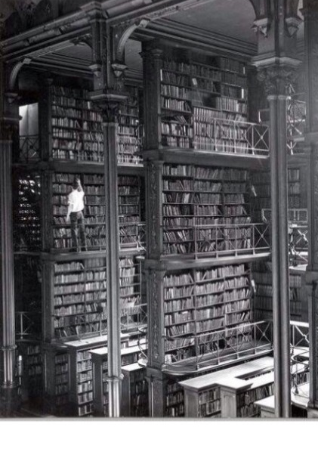
Copernicus response
Dual approach – also for risk management:
Strengthening Copernicus Distribution Services for download
Setting up of Data Access and Information Services (DIAS)
  Access to all Copernicus data and information virtually collocated with computing resources
  Allowing Big Data analytics without the need to download the data and information
  Allowing data fusion with non-EO data and information
6

Slide 7
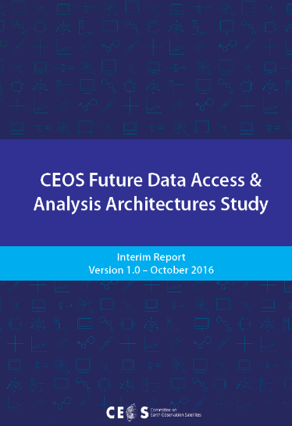
The link to CEOS FDA
Extract from a draft for a future data architecture
strategy proposed by FDA/AHT:
FDA AHT have pointed to a necessity, and indeed a trend to move away from downloading data towards the use of data analyses "platforms"
It is useful to distinguish between:
  a platform in the sense of infrastructure and tool environment and
  Data analyses environments such as data cubes

Slide 8
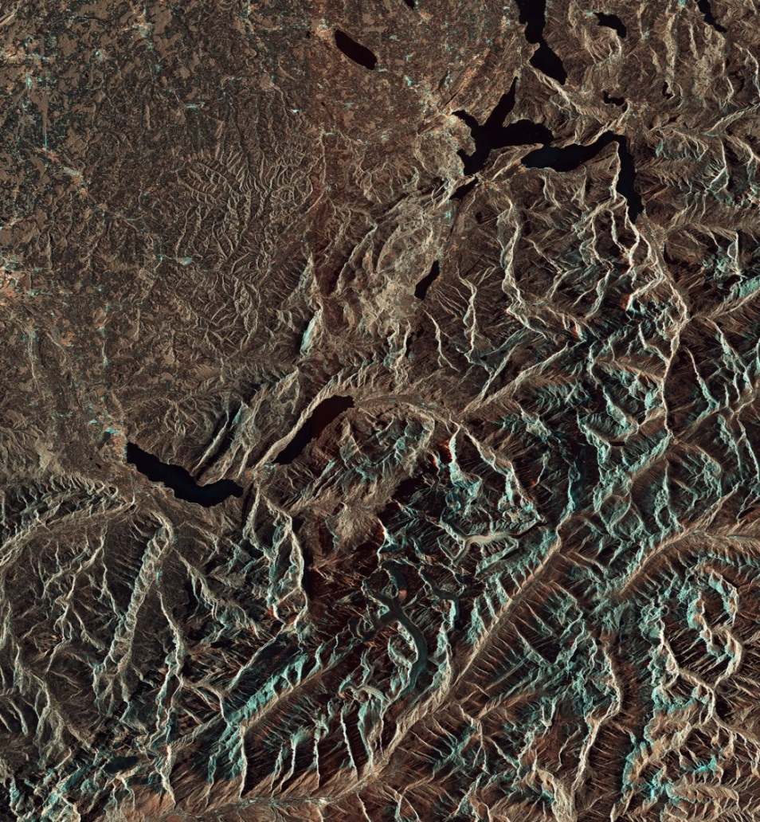
Functional requirements
Functional Requirements are publicly available on copernicus.eu
They address
  Copernicus Distribution Services
    Discovery, view, download provided by Copernicus EEs
  Copernicus Data and Information Access Services (DIAS)
    Bringing the users to the data : embrace big data paradigm , cost mutualisation and improved efficiency - we are downloading the Earth too many times
  Related issues : stakeholder roles, governance and monitoring, visibility…
  Review by 2020

Slide 9
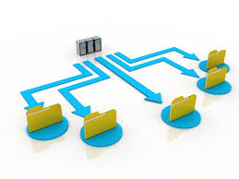
Copernicus distribution element
IGS functional requirements address all distribution services
Main focus is on
  Robustness and availability of services
  Enhanced transparency on usage
  Reinforced user-support
  Homogeneity and interoperability
Implementation efforts towards meeting these requirements are progressing well

Slide 10
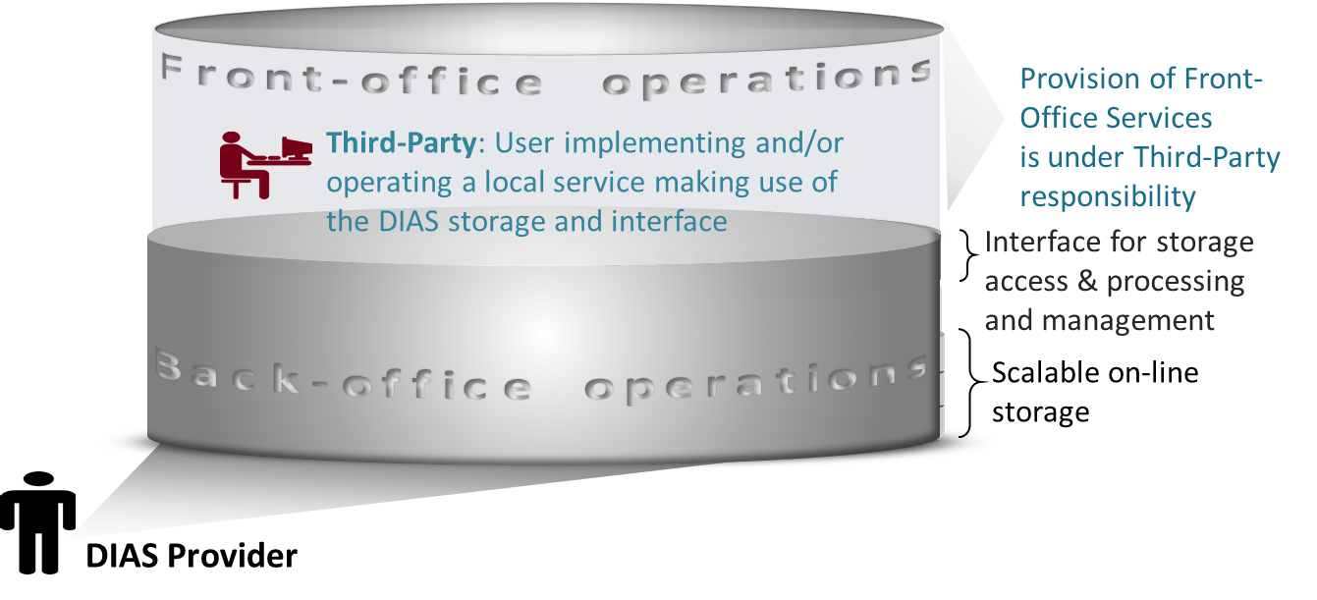
DIAS Principle

Slide 11
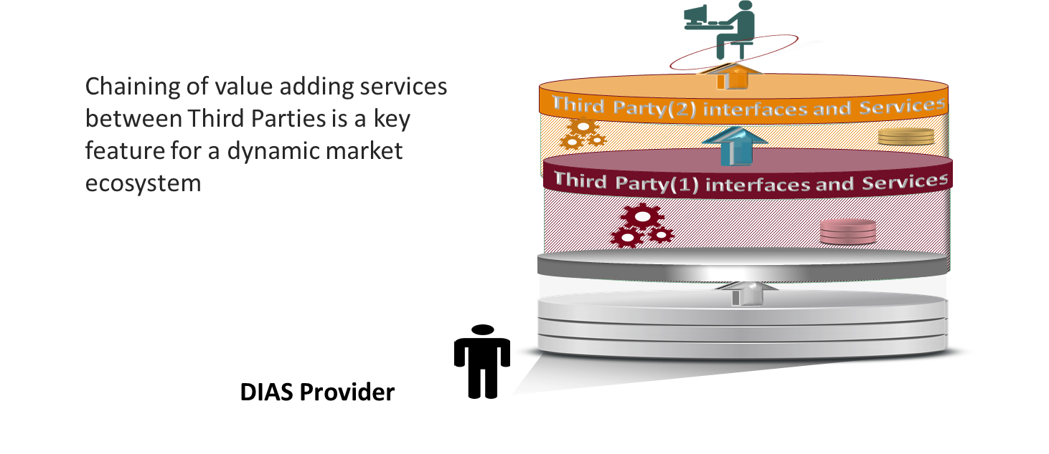
Chaining of services - principle

Slide 12











DIAS used in Europe - principle
End user: User of the third-parties services
Front
office service
Front
office service
Front
office service
Front
office service
Front
office service
Front
office service
Front
office service
Funded by
third-parties
Front
office service
Front
office service
Front
office service
Front
office service
Third Party
Users
Copernicus DIAS interfaces
DIAS
funded
Copernicus DIAS Storage
Third-party
Users
Copernicus Services & user uptake
Commercial or research users or initiatives (e.g. EO Market place,..)
Pathfinder projects
EOEP-5 (“EO Science for Society”)
EU Member States & particpating countries
Copernicus Data & Information Access Services
SAF
Heritage Data (LTDP+), Earthnet
National/commercial missions data access
Research and Innovation Projects (H2020)
EarthWatch CCI, InCubed
Sentinel Collaborative Ground Segment
Open Science Cloud & GEOSS Infrastructure

Slide 13

DIAS Objectives
Easy and user-­friendly; access to all Copernicus data and information
Maximise uptake and exploitation of Copernicus/ EO data in an efficient environment
DIAS as an enabler: stimulate the emergence of an ecosystem that facilitates activities by 3rd parties
Bring together research&operational, supply&demand, different data sources (both EO and non­‐EO) and know-how (EO, ICT, thematic)
Commission bears large part of common costs, defragmentation, increased efficiency and cross-­fertilisation

Slide 14

Success criteria - typical
Technical performance - innovation must be at core of initiative
Ability to interact with and attract third-­party users, different user communities and to mobilise EO industry
Ability to:
  provide EU Member States an effective and efficient service offering
  attract additional data
  support and facilitate third-party value-­added services (e.g. data/ information/applications)

Slide 15
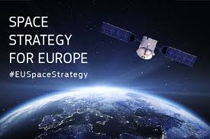
Core principles
Access must be open and non-discriminatory
Operation must be fair and obey competition rules including for institutional demand
Transparency of governance and reporting
Must promote Copernicus brand
Intellectual property must be protected

Slide 16
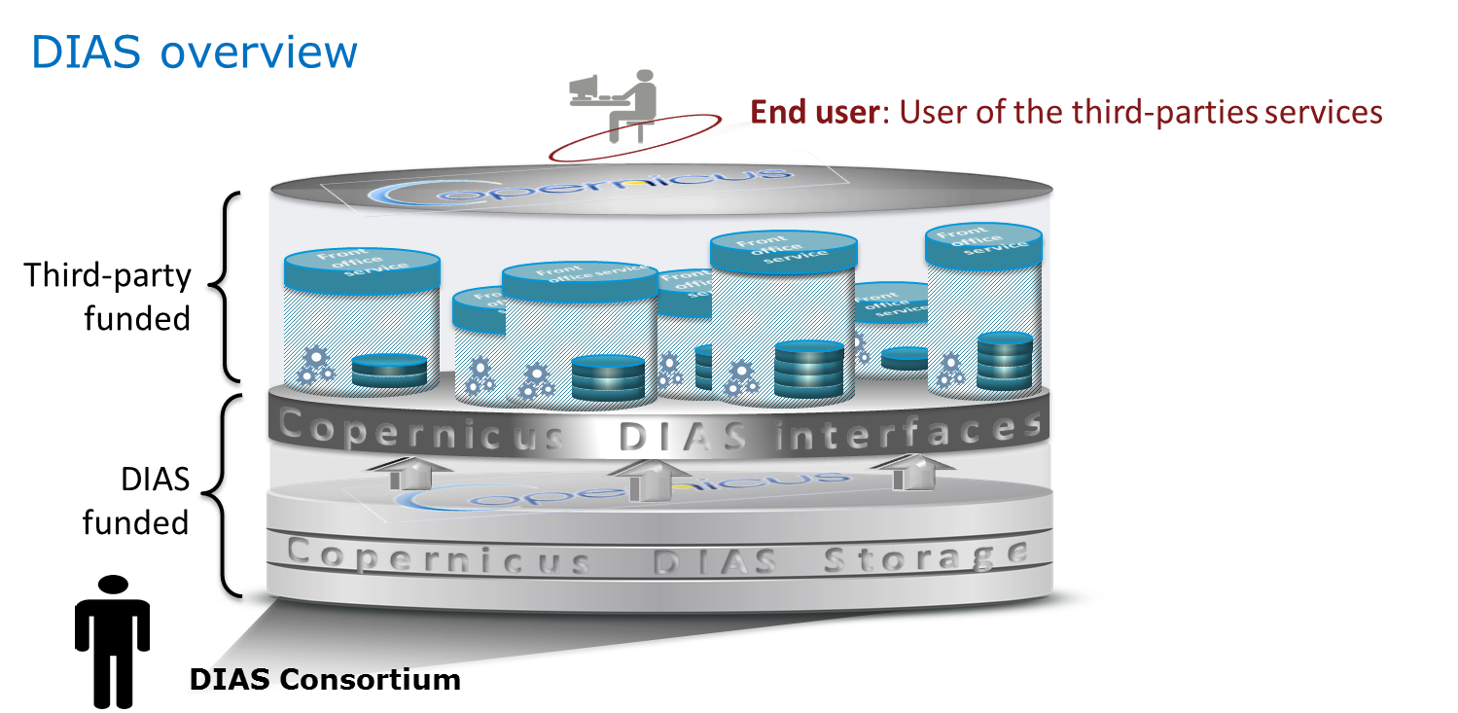
Implementation timeline
ESA
  Industry Information day: December 2016
  Procurement initiated in January 2017
  Offers received in April 2017
  Evaluation for June 2017
  Procurement authorised by COM in July 2017
  Negotiation on-going
  Signature October 2017
  Initial operation January 2018
Announcement event Q2/2018
..up to 4 DIAS Providers (consortia)

Slide 17
Workshop and preparation proposal
Presentation of return on experience and best practices established in the context of a workshop on this topic in Colorado (SIT) – late April:
  Exchange lessons learnt and best practices for cooperation with large IT providers - introduce Copernicus DIAS as an enabling element for operational implementation of services, CEOS pilot projects and other Small-scale demonstrators
Preparation and collection of contributions at WGISS in early April 2018

